Slide 1
Implementing PIPEDA in the Banking Sector
A review of on-line practices

Slide 2
PIPEDA and Canadian Banks
Banking is one of Canada’s largest businesses
Banks deal with sensitive financial information
Historically have had fiduciary duty toward privacy and confidentiality.
Notes:
As per Canadian Banker’s Association: The banking industry includes 19 domestic banks, 29 foreign bank subsidiaries and 22 foreign bank branches operating in Canada. In total, these institutions manage about 1.8 trillion dollars in assets. As major players, banks serve millions of customers including individuals, small and medium-sized businesses, large corporations, governments, institutional investors and non-profit organizations. Such a large number of customers means a large amount of personal information that banks are responsible for collecting, storing, using and disclosing.
Banks deal with personal information that is more sensitive than that used by other industrial sectors. Apart from name, contact information etc, banks also collect more sensitive information like the social insurance number, which makes the issue of consumer privacy and security of information more important in the banking sector
One of the most important services a bank can provide to its customers is the ability to protect his/her privacy. The banking industry developed a comprehensive privacy code of conduct in 1986, which was updated regularly to meet the changing needs of its consumers. Many of the principles in this privacy code are reflected in PIPEDA that went into effect January 1, 2001 for federally regulated industries. CBA states that prior to January 2001, banks conducted a thorough review of their privacy practices to ensure compliance with the act, and appointed senior officer responsible for upholding it’s rules. Therefore, when PIPEDA was enacted, there was little change in the way banks operated, as most of the requirements were the same as the voluntary standards followed by the banks.

Slide 3
Information Privacy Concerns
Improper account access
Use and disclosure
Secondary marketing
Over collection of personal information
Income reporting questions
Security problems
Access problems
Credit reporting
SIN Use
Notes:
Over collection of personal information – PIPEDA Case Summary #46 – Bank accused of inappropriately demanding birthdates from account applicants – Customer complained that bank required inappropriate information – birth date when she tried to open an account over the phone, was told that it was required for revenue reporting purposes, and was later told by the supervisor that the bank required the birth-date to verify identity in future transactions. This birth date was mandatory. Commissioner’s findings stated that bank was in violation of principle 4.3 that states that the bank should only collect information that is required for the stated purposes, and felt that the bank had enough personal information about the customer that could be used for the purposes of identification. Section 5(3) states that an organization may collect, use, or disclose personal information only for purposes that a reasonable person would consider appropriate in the circumstances. The bank was found to be in violation of this also.
Security problems – PIPEDA Case Summary #28 – Bank sends customer’s pay stubs to wrong party – complainants – husband and wife – had provided documentation, including pay stubs in the process of applying for debt reduction under Canada Student Loan Program. A few weeks later, they got a call from an unknown person in another part of the province informing them that the pay stubs had been enclosed with communication he had received from the bank. Bank claimed that the information had been misdirected due to clerical error. In violation of principle 4.3 which states that knowledge and consent is required for the use, disclosure and collection of personal information, in violation of principle 4.7 which states that the personal information must be protected by security safeguards appropriate to the sensitivity of the information. Section 5(3) states that an organization may collect, use, or disclose personal information only for purposes that a reasonable person would consider appropriate in the circumstances. Commissioner deemed that a reasonable person would not have considered the disclosure appropriate in the circumstances.
SIN Use – PIPEDA Case Summary #105 – Customer objects to bank’s using SIN to activate credit cards. Banks collect SIN for the purpose of income reporting in order to comply with the Canada Customs and Revenue Agency’s income reporting requirements. Bank had collected the SIN when customer purchased an interest-bearing produc from the bank. By using this SIN as identification for credit card activation, the bank was using the customer’s information for a purpose not previously identified to the customer, and had not informed the customer of this intended use, prior to the use and had not gained consent – violation of principle 4.2.4 The bank had failed to make a reasonable effort to advise the customer of the customer of how the information would be used – violation of principle 4.3.2 Bank was also in violation of principle 4.5 which states that information will not be used or disclosed for purposes other than those identified to the customer without the customer’s consent or as required by law.

Slide 4
Policy Review
Banks reviewed – Scotiabank, CIBC
Policies reviewed based on
  Accessibility
  Usability
  PIPEDA Compliance
Notes:
Access – How easy is it for the customer to access the bank’s privacy policy on the web-site. Is it intuitively placed, and located prominently when the customer tries to open an account or access the online features
Usability – How usable is the policy? Is the customer able to understand the language used? Can the customer obtain the information he is looking for easily? Is the privacy policy navigable?
PIPEDA Compliance – does the privacy policy comply with PIPEDA’s principles?

Slide 5
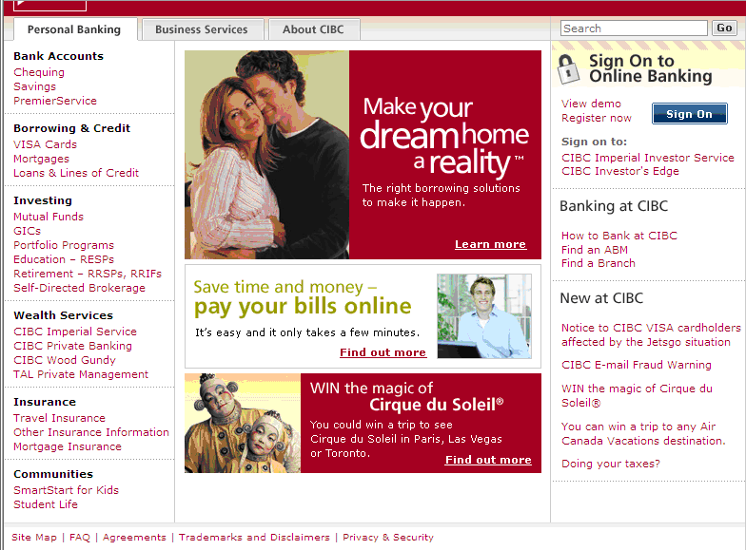
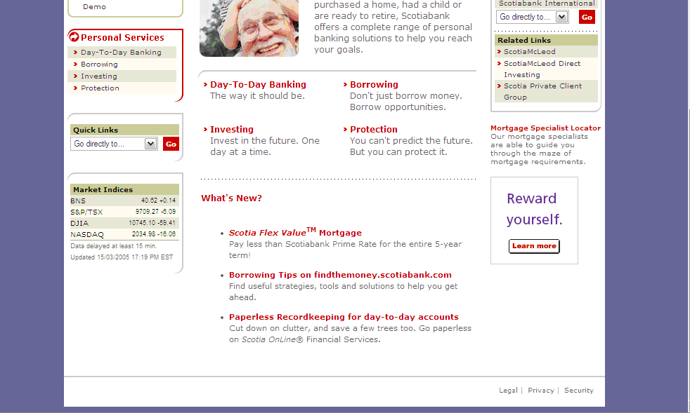
Accessibility
Notes:
Users can access the privacy statement at the footer of the web-site. This seems to be the standard location to have links to “legal” information including trademarks, disclaimers, and security information. Internet users know to instinctively go to the footer of a web-site to access information that could have legal implications

Slide 6
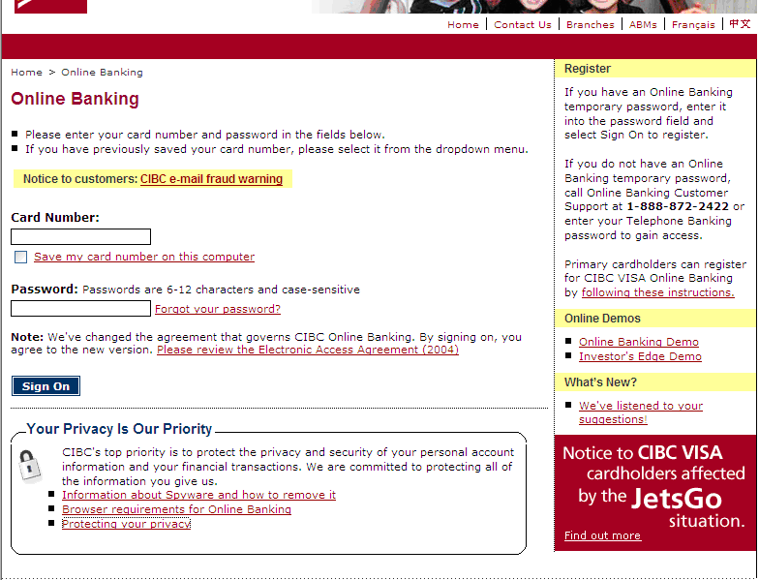
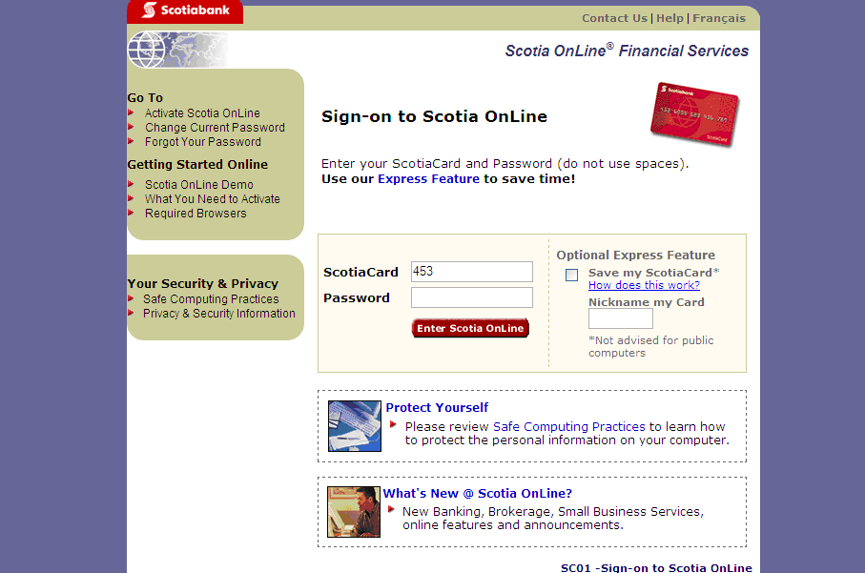
Accessibility
Notes:
Links are also present on the online banking and online banking pages for both banks. This location reinforces trust in the user who may have reservations about conducting financial business online

Slide 7
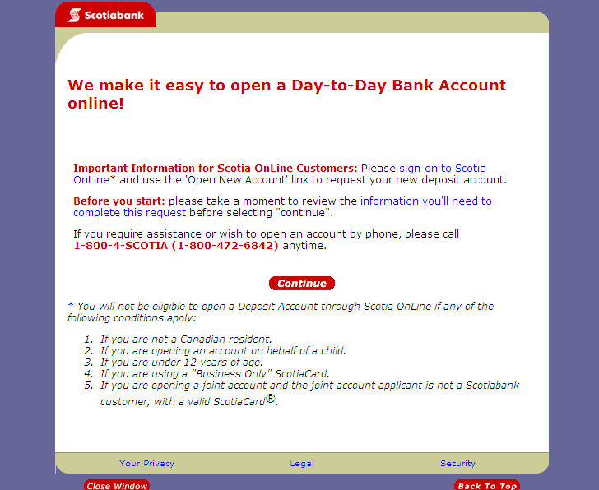
Accessibility
Notes:
When opening an account, the privacy information is also present at the bottom of the page as a link. This is analogous to the privacy information provided to the customer when he opens an account at a branch or over the phone.
The CIBC web-site does not have a provision to open an account online, so this doesn’t count

Slide 8
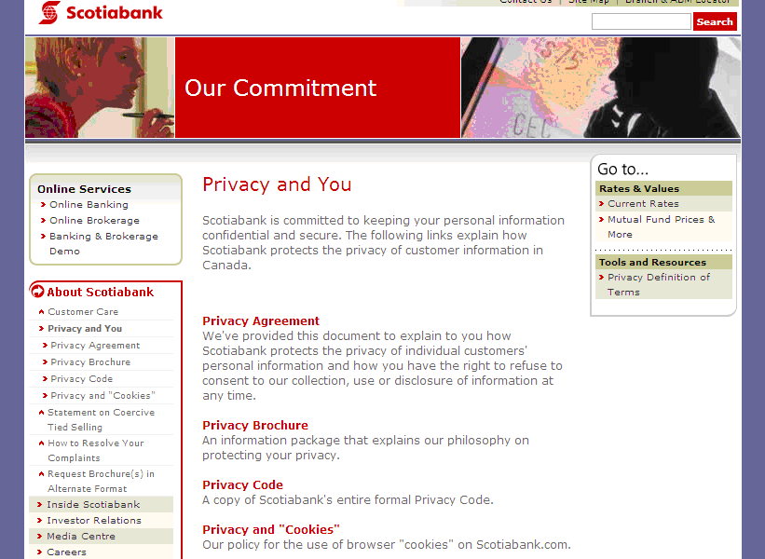
Usability – Scotiabank
Notes:
Scotiabank’s privacy page is called “Privacy and You” and has links to the Privacy Agreement, the online version of the privacy brochure, the Scotiabank privacy code and the bank’s policy on using cookies on the website.
This page states that the privacy agreement is a “document to explain how scotiabank protects the privacy of the individual customers’ personal information and how the customer has a right to refuse cosent to collection, use or disclosure of information at any time. However on clicking the Privacy Agreement, the customer finds that it is a statement of what the customer agrees to in terms of information collection and what the bank might use this information for. So the blurb regarding the privacy agreement on this page is a little misleading…
The Privacy brochure is the online version of the privacy booklet that is available in the branches. It is a simplified version of the Scotiabank Group Privacy Cod which is based on the CSA’s Model Coe for the Protection of Personal Information and PIPEDA. It outlines the uses for which information will be collected, the fact that consent will be asked for and provide the customer with power to refuse consent for collection of information. It also talks about requiring consent to disclose information, except in certain cases. The brochure also states that Scotiabank will endeavour to keep all information correct and updated and the user has the right to challenge the accuracy of any of the information the bank has in it’s posessios

Slide 9
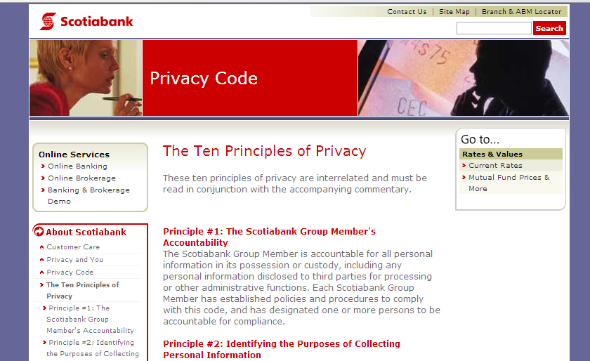
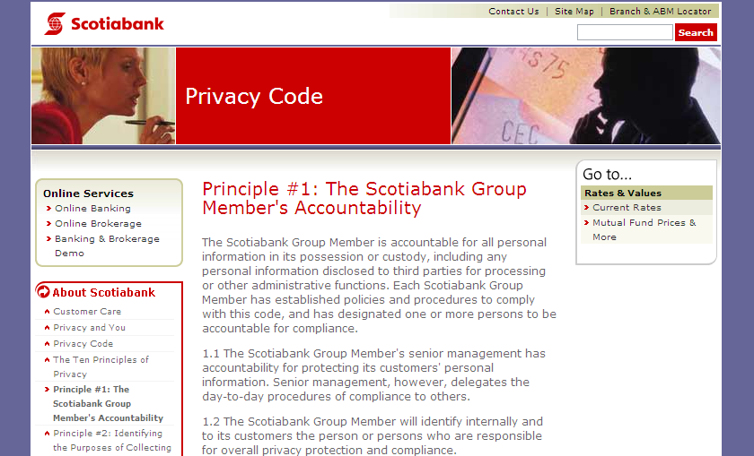
Usability – Scotiabank

Slide 10
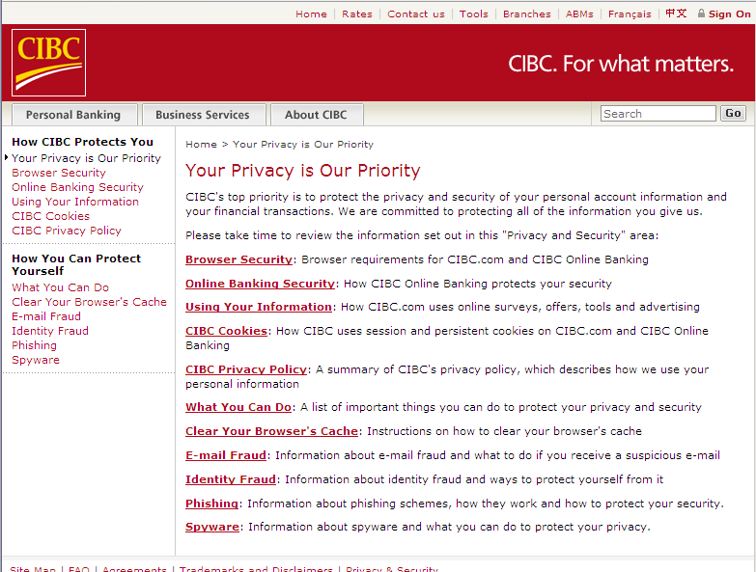
Usability - CIBC

Slide 11
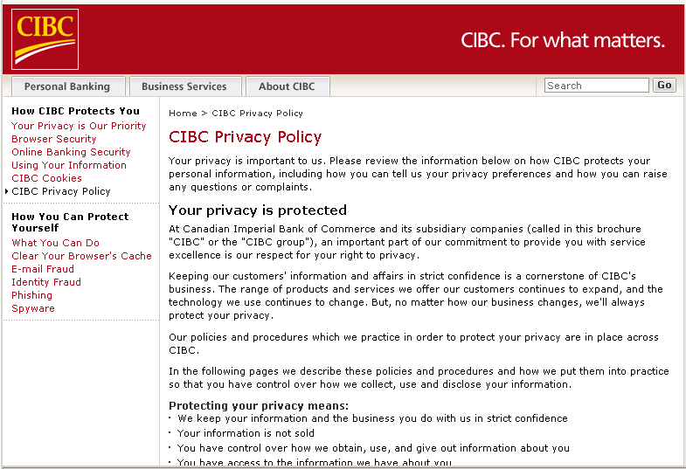
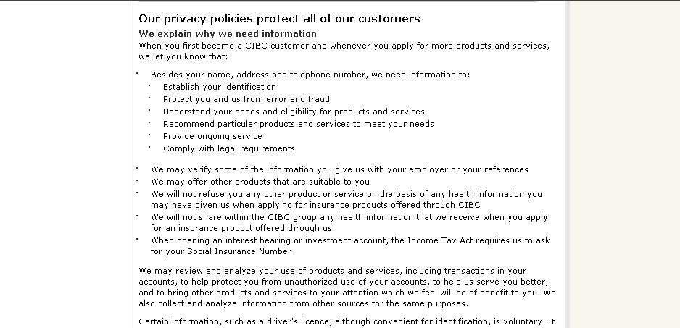
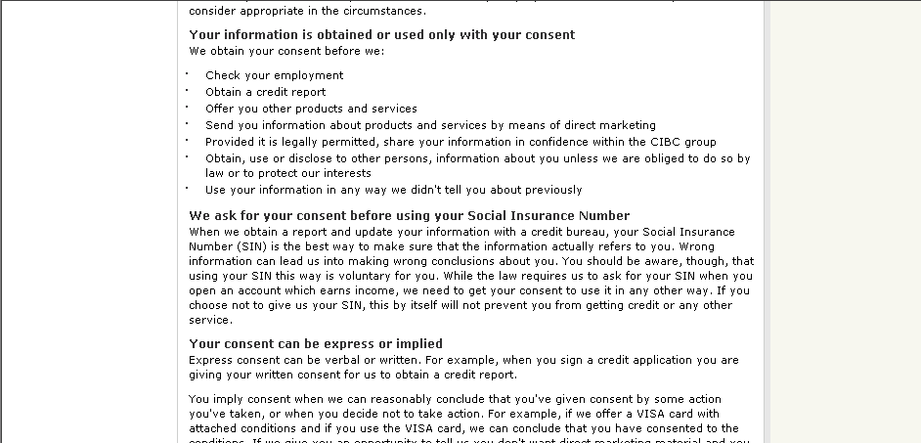
Usability - CIBC

Slide 12
PIPEDA Compliance
Difficult to determine whether the privacy notices are completely PIPEDA compliant - Certain principles of PIPEDA ignored
Consent – Express or implied
Withdrawal of consent couched in negativity
Explicitly mention uses of SIN
Third parties are not specified
Use of the phrase “in Canada”
Notes:
Scotiabank has the Privacy Agreement, the Privacy Brochure and the Privacy Code online. To determine whether their policies are PIPEDA compliant, one needs to go through these different notices. (example of how the different principles are distributed) CIBC makes it simpler by providing only one relevant privacy statement online.

Slide 13
Layered Notices
Information is provided in three tiers – short, condensed and full
User can click from the short notice to the full notice depending on level of interest
Should follow a template
Concise, easy to understand and easy to compare.

Slide 14
Summary
Privacy policy placement is standard
Privacy related information is located in too many different locations
Language can be intimidating
Intricate details of PIPEDA are not discussed
Move toward a use of layered notices

