Slide 1
Implementing PIPEDA:
A review of internet privacy statements and on-line practices
Friday, March 18, 2005
Notes:
My role this afternoon is to provide you with a brief overview of the federal Contributions Program that has made this conference possible.
As well, I would like to tell you a bit about the work our research team has undertaken.

Slide 2
Contributions Program
On June 1, 2004, the Office of the Privacy Commissioner of Canada (OPC) officially launched a $200,000 Contributions Program to support research and promote protection of personal information.
Notes:
On June 1, 2004, the Office of the Privacy Commissioner of Canada launched a $200,000 Contributions Program aimed at supporting research into and promoting the protection of personal information.

Slide 3
Contributions Program
Program Objectives:
  “To encourage the development of a national privacy research capacity,
  To build strong links between researchers and organizations with an interest in privacy,
  To capitalize on existing research capacity in the voluntary, academic and not-for-profit sectors,
  To support the development of expertise in selected areas of privacy, and
  To facilitate the transfer of knowledge and research results to the general public or private sectors”.
Notes:
The program includes five main objectives:
To encourage the development of a national privacy research capacity that will contribute to advances in knowledge and policy development in the areas of privacy and data protection;
To build strong links between researchers and organizations with an interest in privacy and data protection and to contribute to the development of the privacy community;
To capitalize on existing research capacity in the voluntary, academic and not-for-profit sectors in order to generate new knowledge and supplement OPC's expertise;
To support the development of expertise in selected areas of privacy and data protection and to foster an understanding of the social value of privacy; and
To facilitate the transfer of knowledge and research results to the general public or private sectors to help them address emerging issues and opportunities.

Slide 4
Contributions Program
OPC invited research in one of two areas:
  The intersection of technology and privacy;
  or
  Implementation issues related to the Personal Information Protection and Electronic Documents Act (PIPEDA).
Notes:
The OPC invited research proposals in one of two areas:
1.The intersection of technology and privacy - projects that examine the privacy impact of video surveillance, radio frequency identification, location technology, biometrics and other technologies; and
2. Implementation issues related to the Personal Information Protection and Electronic Documents Act.
With the expansion of the scope of PIPEDA as of January 1, 2004, new sectors of the economy have become subject to the Act, raising new and challenging implementation issues that need to be addressed.

Slide 5
Our Project
On January 27, 2005, we were awarded $48,300 to review the effectiveness of Internet privacy statements.
Collaborators:
  Centre for Innovation Law and Policy (CILP),
  Information Policy Research Program (IPRP)
Notes:
On behalf of the Centre for Innovation Law and Policy, Rajen Akalu submitted an application to the Office of the Privacy Commissioner proposing to review the effectiveness of internet privacy statements and online practices and the extent to which they comply with PIPEDA.
The proposal was successful and on January 27, 2005, The Centre for Innovation Law and Policy was awarded $48,300 to conduct research in this area.
The IPRP, based at the Faculty of Information Studies, is an on-going program of research examining key public policy issues, notably access, privacy and governance.

Slide 6
Our Project
Researchers:
  Aniz Alani – Law
  Barbara Bressolles – Law
  Robert Luke – FIS
  Sapna Mahboobani – FIS
  David Ley – FIS
Research Advisors:
  Lisa Austin – LAW
  Andrea Slane – LAW
  Andrew Clement – FIS
  Nadia Caidi – FIS
Notes:
With a balanced representation of researchers and research advisors from both the faculty of law and the faculty of information studies, the project a true collaboration between the Centre for Innovation Law and Policy, and the Information Policy Research Program.
Our Researchers include Aniz Alani and Barbara Bressolles from the Faculty of Law and Robert Luke, Sapna Mahboobani and David Ley from the Faculty of Information Stuides.
This project was also fortunate enough to have on board distinguished research advisors from both faculties: Professors Lisa Austin and Andrea Slane from the Faculty of Law and from the Faculty of Information studies, Professors Nadia Caidi, and Andrew Clement, our lead advisor.
Together we have been able to evaluate the implementation of PIPEDA from both a legal and an information studies perspective.

Slide 7
Privacy Policies
PIPEDA was enacted to establish rules to govern the legitimate collection, use and disclosure of personal information
Privacy policies disclose what information it collects and what it will do with the information after it has been collected
Provide the consumer with an indication of what he or she is entitled to expect
Raise consumer awareness about these issues
Notes:
PIPEDA was enacted to establish rules to govern the legitimate collection use and disclosure of personal information in a manner that recognizes the right of individual privacy.
As a result, organizations, through their privacy policies, are now required to disclose to consumers what information it collects and what it will do with the information after it has been collected.
In support of the Commissioner’s goal to promote the protection of personal information, we felt that reviewing online privacy policies will address some of the objectives of the Contributions Program.
At a minimum, the findings of our research will provide the consumer with an indication of what he or she is entitled to expect.
Hopefully, the our research results will facilitate the transfer of knowledge to both the general public and private sectors and increase their awareness and foster an understanding of the social value of privacy.

Slide 8
Industries Studied
Federally Regulated Industries
  Airline
  Telecommunications
  Banking
  PIPEDA in force since January 1, 2001
Private Industries
  Retail
  PIPEDA in force since January 1, 2004
Notes:
The researchers of this project has been examining how organizations have been communicating their privacy policy and practice in the airline, telecommunications, banking and retail sectors.
The first three are federally regulated industries and PIPEDA has applied to them since its entry into force in January of 2001.
As of January 1st, 2004, PIPEDA applies to the retail sector, and the staggered implementation the Act is now complete.

Slide 9
Methodologies
Online Statement Assessment
Criteria:
  positioning of the privacy statement on the site,
  clarity of language,
  ease of comparability of statement with other statements
  degree of compliance with PIPEDA
OPC Case Summaries
Notes:
One part of the research included a review of organizations online privacy statements. Our researchers assessed the privacy statements on company websites in the four sectors stated above, according to a set of standard criteria related to PIPEDA.
Some criteria included:
The positioning of the privacy statement on the site,
clarity of language,
ease of comparability of statement with other statements
degree of compliance with PIPEDA
In addition, the researchers reviewed case summaries of the Commissioner's findings on complaints made under PIPEDA. The main objective of this was to determine what issues consumers are most concerned with.

Slide 10
Methodologies
Questionnaire
  What an average consumer expect to ask about a company’s privacy policy and practice
  Telephone interview with CPOs
  Information made available on-line
Problems
  Review Ethics Board
  Unwillingness of CPOs to participate
Notes:
A questionnaire was developed as a research tool. The purpose of the survey was to determine what an average consumer is expected to ask about a company’s privacy policy and practice.
It was our original intention to conduct interviews with a large number of privacy officers of companies and then to make those survey results available online.
However, we encountered some problems that we didn’t count on.
Review Ethics Board required us to send potential participants a letter stating that all their answers would not be treated as confidential and would be made available to the public. Not surprisingly, not many privacy officers chose to participate in our research.
Nevertheless, a lot of time and effort was spent devising a sound questionnaire, and we feel it is a useful tool to both consumers and organizations

Slide 11
Website
Privacy Project
  http://pipedaproject.rcat.utoronto.ca/
Notes:
David Ley from the Faculty of Information Studies has created and maintained a website for our project.
http://pipedaproject.rcat.utoronto.ca/

Slide 12
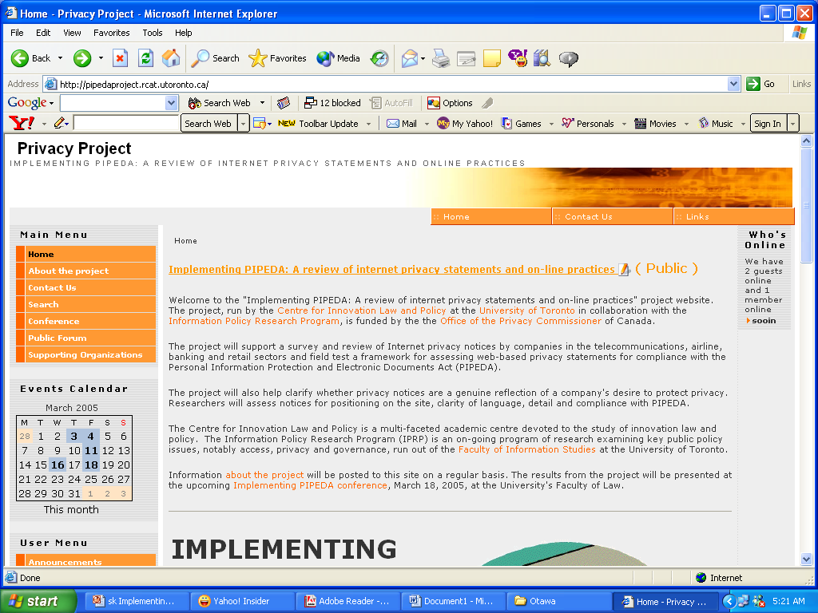
Notes:
The public portion of the website offers information about the project, today’s conference, a public forum and links to resources.
Throughout the project, the team has used the members-only section to communicate with each other, post project documents, minutes of meetings, etc.
At the end of the project, we plan to keep the website going to communicate to the public important emerging issues related to the subject of our project, and to provide an overview of our research findings.

Slide 13
Summary of Findings
In the next segment, the researchers will provide you with a summary of their research.
Final Report to the OPC.
Notes:
In the next segment, our researchers will provide you some highlights what they found in the various industry sectors they studied.
These findings will be compiled and submitted to the Office of the Privacy Commissioner, in the form of a Final Report, marking the end of our research project.

