Slide 1


Slide 2
Web-4-All
What is Web-4-All?
Who is it for?
How does Web-4-All address a user’s needs?
How does it work?
Why is Web-4-All important?
Government On-Line (GOL) Pilot
How will sites be selected?
Host site selection criteria
Where is Web-4-All available?
What does Web-4-All come with?
Web-4-All Contact information
Making Canada the most connected nation in the world

Slide 3
What is Web-4-All?
Web-4-All is an innovative system that combines hardware and software to provide different ways for people to interact with computers and the Internet.
Participants select individual preferences that are saved on a personal access smart card.
Web-4-All technology allows a computer to set up these preferences with the swipe of a card.
A friendly alternative

Slide 4
Who is it for?
In Canada:
The intended beneficiaries of Web-4-All are people with literacy challenges and/or disabilities.
15% of Canadians have disabilities
31% of Aboriginal Peoples have disabilities
50% of seniors have disabilities
47% of adult Canadians have functional literacy challenges
3.3 million Canadians have print disabilities
200,000 “new Canadians” arrive each year
A technology for all

Slide 5
Who is it for?
Web-4-All makes it possible for people with disabilities, people unable to read well, people unfamiliar with the Web, and people intimidated by computer technology to access the Information Highway.
A technology for all

Slide 6
How does Web-4-All address a user’s needs?
People with visual disabilities can have screens magnified or read aloud.
People who have difficulty using a keyboard or a mouse can use settings or displays that handle most dexterity issues.
People with literacy challenges can access information using both sight and sound.
People not familiar with the Web can have Web sites displayed in a simpler and consistent way.
A technology for all

Slide 7
How does it work?
Web-4-All combines 4 assistive technologies:
  Opera - text browser for seniors
  HomePage Reader - speech synthesis for the blind
  eReader - multi-sensory input for learning disabilities, low literacy, and FSL/ESL
  Visual Dynamic Keyboard - alternative keyboard inputs for manual dexterity challenges
Users store their “User Access Preference” on a smart card that can be used at any W4A workstation.
A world leading innovation

Slide 8
OPERA
Text in Opera would appear like this and all graphics would be removed

Slide 9
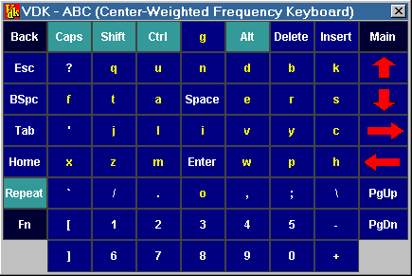
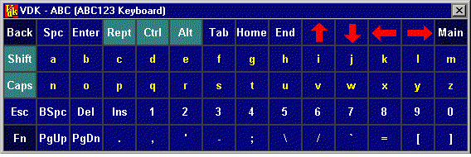
Visual Dynamic Keyboard

Slide 10
Why is Web-4-All Important?
The Government of Canada made a commitment to invest in
“the development of new technologies to assist Canadians with disabilities”.
Speech from the Throne, January 2001
Web-4-All provides much needed affordable access to assistive technologies that address a user’s sight, sound and touch preferences.
Web-4-All is a low-cost solution for public Internet site administrators.
W4A provides a common framework which user’s can depend on for predictable and consistent access.
Providing national standards for universal accessibility

Slide 11
Government On-line (GOL) Pilot
Up to 1,000 Web-4-All systems will be introduced in
selected regions across Canada.
Up to 25,000 smart cards will be distributed to users.
Smart card technology has been provided by Royal Bank, Bell Canada, and Hitachi Canada.
The pilots will be evaluated for user take-up and community sustainability.
Making Canada the most connected nation in the world

Slide 12
How will sites be selected?
Regional “Local Advisory Groups” (LAG) review
applications for participation.
Regional LAGs are made up of experts and organizations servicing/representing people with disabilities and/or literacy challenges.
Regional “Local Champions” assist in establishing and coordinating the activities of LAG.
A “National Advisory Committee” sets application criterion used to establish regional pilot networks.

Slide 13
Host site selection criteria
Individual Web-4-All sites will be selected according to
the following criteria:
Located within one of the pilot regions
open to the public
have a computer running Windows 2000 with large (19”) monitor, speakers and CD_ROM
provide internet access
provide barrier-free access to people with mobility challenges
participate in marketing events and assist in the evaluation process
organize and/or facilitate user training and technical support
Developing a network of accessible resouces

Slide 14
Where is Web-4-All available?
Web-4-All was developed for public Internet access locations, such as the 8,800 Community Access Program (CAP) sites established in partnership with Industry Canada.
Across Canada today:
60% of CAP sites are located in public schools and libraries
there are 3,600 public libraries and 16,400 public schools in Canada.
Helping communities harness the power of the web

Slide 15
What does Web-4-All come with?
1 Kensington Orbit trackball
1 external serial port Hitachi card reader
1 installation CD containing software to the Web-4-All program, Opera, HomePage Reader, eReader and Visual Dynamic Keyboard Program
user training materials in braille, large print, and audio tape
a supply of smart cards.
Bridging the digital divide

Slide 16
Web-4-All contact info:
Internet: http://www.wao-baw.ic.gc.ca
Email: wao-baw@ic.gc.ca
Telephone: 1.800.575.9200
TTY: 1.800.465.7735
Fax: (613) 941-8617
A friendly alternative

Slide 17
Information
We invite you to visit us at:
http://www.wao-baw.ic.gc.ca
A friendly alternative

