Slide 1


Data Science Boot Camp
Spring 2023
Project 1 - New York City Rideshare Analysis
Team Room 1

Slide 2

Project Team
Azriel Tamayo
Chad Richards
Elizabeth Veltre
Kelly L Doyle
Matt Siriani

Slide 3
Project & Dataset Overview
2021 TLC Trip Data
2021 TLC Taxi Zones
2021 Weather Data
The New York City Taxi and Limousine Commission (TLC), created in 1971, is the agency responsible for licensing and regulating New York City's Medallion (Yellow) taxi cabs, for-hire vehicles (FHV), commuter vans, and paratransit vehicles.
Over 200,000 TLC licensees complete approximately 1,000,000 trips each day.
For-hire-vehicle data capture started in 2018 for TLC-licensed FHV businesses that currently dispatch or plan to dispatch more than 10,000 FHV trips in New York City per day under a single brand. 2021 includes Juno, Uber, Via, and Lyft.
All data sourced from Kaggle.com using the Uber NYC for-hire vehicles trip data (2021) by Shuheng_Mo
12 Parquet Files
15,877,481 records
Sample size (.1%) per month
174,595 records Total
14,550 Avg records per month
265 Taxi Zones Across 5 Boroughs & EWR
Daily Weather Conditions

Slide 4
Data Wrangling Process
 | Convert Parquet files to Pandas using PYArrow (1 Dataframe for each Month)
 |  | Reduced Data to a Sample Size of .001 for each Month’s
 |  |  | Concatenated Monthly Sample Data into Single Rideshare Dataframe
 |  |  |  | Column Calculations ( Total Fare, Percent Tip, °C to °F , Day of Week, etc)
 |  |  |  |  | Imported Weather Data into Weather Dataframe and Calculated Precipitation
 |  |  |  |  |  | Merge Weather Dataframe with Rideshare Dataframe
 |  |  |  |  |  |  | Exported Data to CSV for Data Analysis
 |  |  |  |  |  |  |  | Plotted Data, Ran Statistical Analysis, & Documented Results
 |  |  |  |  |  |  |  |  | Presentation

Slide 5
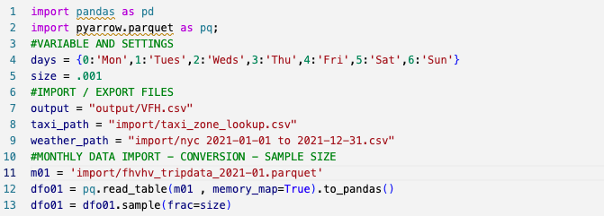
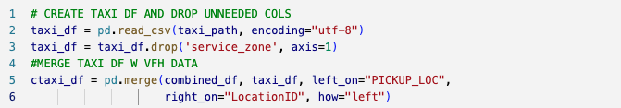
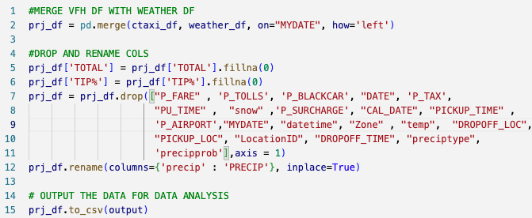
Data Wrangling Code Summary
Libraries & Functions
Screenshots
Panda Library
PyArrow Library
read_table()
to_pandas()
sample()
PD concat()
DF merge()
Tuple
rename()
DF loc
drop()
copy()
fillna()
to_csv()

Slide 6
Analysis Questions
How Does Weather Affect Ride Volume? Does temperature affect number of rides per day? Does precipitation affect number of rides per day?
How Does Weather Affect Rider Fare? Does temperature affect rider fare? Does precipitation affect rider fare?
What Trends Can Be Observed Over Time? Are there trends in ridership that can be identified based on day of the week? Are there trends in ridership that can be identified month-to-month?
Do Temperature or Trip Length Influence Tips? Does temperature affect riders’ decision to tip? Does trip length affect riders’ decision to tip?

Slide 7
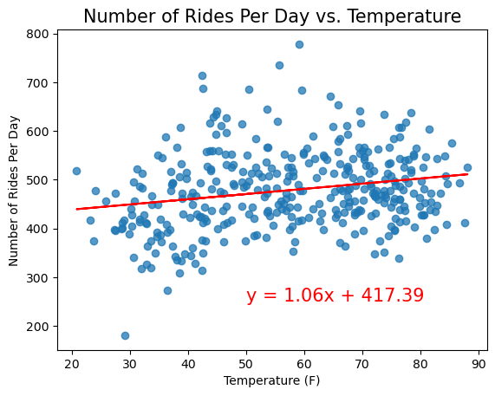
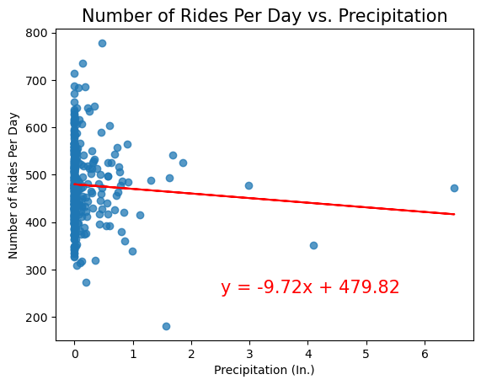
How Does Weather Affect Ride Volume?
r-value: 0.2184750611844878
Weak positive correlation - low r-value; ride count increases slightly with increase in temperature
r-value: -0.06041299690985074
Weak negative correlation - low r-value; ride count decreases slightly with increase in precipitation

Slide 8
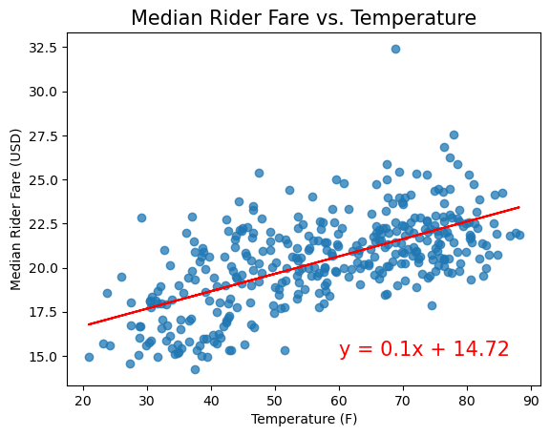
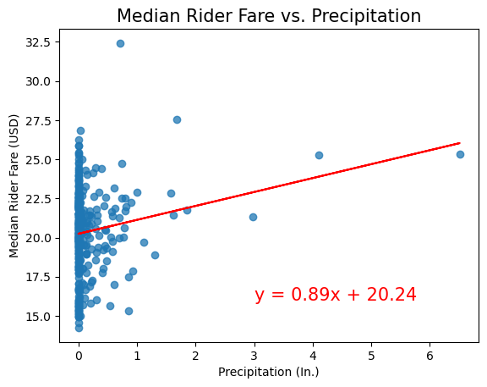
How Does Weather Affect Ride Fare?
r-value: 0.6254556659091998
Moderate positive correlation - ride fare increases with increase in temperature
r-value: 0.17042033527162606
Weak positive correlation - low r-value; ride fare increases with increase in precipitation

Slide 9
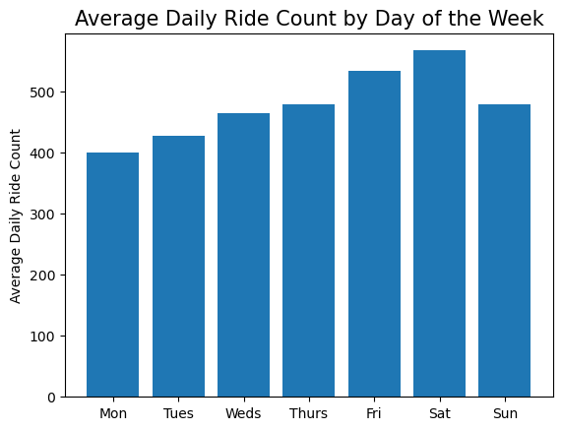
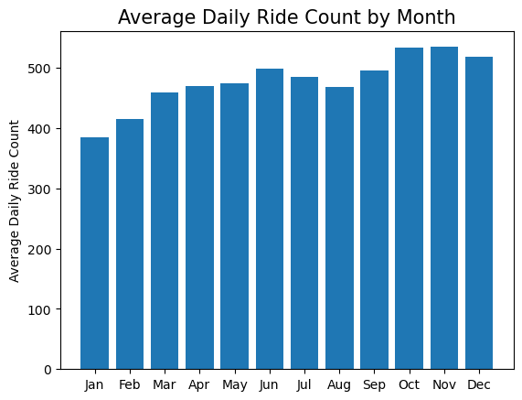
What Trends Can Be Observed Over Time?
Ride count tends to increase over the course of the week, peaking on Saturday, then dropping dramatically on Sunday
Ride count ebbs and flows over the year
Peaks in June and Oct-Nov
Potential impacts from Covid, temperature, and holidays

Slide 10
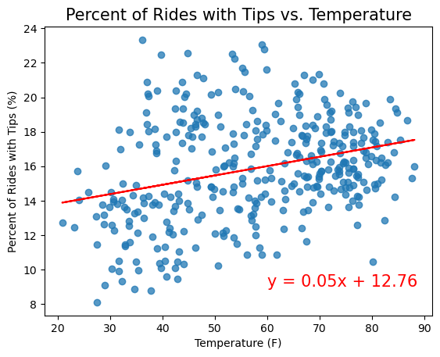
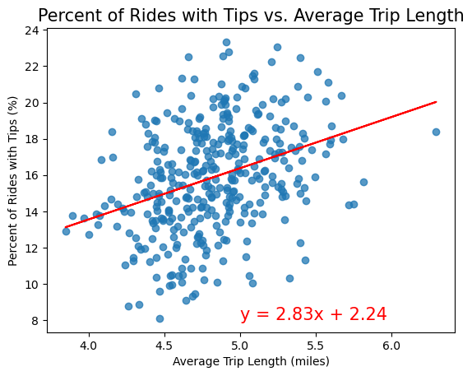
Do Temperature or Trip Length Influence Tips?
r-value: 0.29917711096501626
Weak positive correlation - percentage of riders who tip increases slightly with increase in temperature
r-value: 0.34440626093696786
Weak positive correlation - percentage of riders who tip increases slightly with increase in trip length

Slide 11
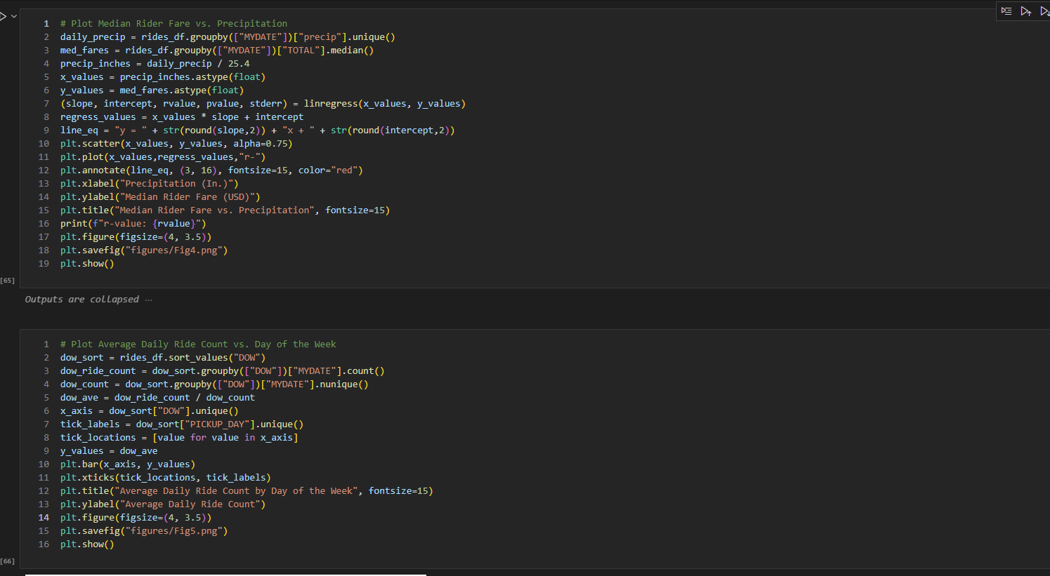
Data Visualization Code Summary
Modules & Functions
Screenshots
pandas
matplotlib
numpy
datetime
scipy.stats
read_csv()
to_datetime()
dt.month
sort_values()
groupby()
loc()
unique()
nunique()
count()
astype()
mean()
median()
linregress()
round()
scatter()
bar()
xlabel()
ylabel()
title()
xticks()
annotate()
figure()
savefig()

Slide 12


Data Visualization Code Summary
Demo

Slide 13
Room 1
Project 1 - New York City Rideshare Analysis
Team Members
Instructors
Azriel Tamayo
Chad Richards
Elizabeth Veltre
Kelly L Doyle
Matt Siriani
Paul Arias
 | Professor
Jonathan Caro
 | Assistant

