Slide 1











InciWatch
The On-Call
Engineer'sSecond Brain
Team: Obsidian
Team Lead: A S S S Koundinya
Theme: Productivity Platforms
Email: assskoundinya.cs24@rvce.edu.in

Slide 2











PROBLEM STATEMENT
Why current systems lack??
●
70% of production incidents recur — engineers repeatedly debug the same root causes with no institutional memory (from PagerDuty State of DevOps Report)
$5,600/min average cost of critical IT downtime for enterprises (from Gartner)
2–4 hrs average MTTR (Mean Time To Resolve) for P1 incidents when runbooks are outdated or
missing (from Atlassian DevOps Trends)
●
Incidenttools likePagerDuty andDatadog manage
escalation and metrics — they don't synthesize historical resolution context
On-call runbooks are manually maintained and go stale within weeks of a system change
Resolution knowledge lives in the heads of senior engineers — when they leave or are unavailable, recovery time spikes No system proactively surfaces "who solved this before and how" at the exact moment of a live incident
●
●
●
●
●

Slide 3




SOLUTION
Persistent Incident Memory
Real-Time Context Surfacing
Expert Routing & Autonomous
●
MonitorsSlack #incidents channel
Intervention
●
When a P1/P2 alert ﬁres, InciWatch instantly queries memory for semantically similar past incidents
Surfaces: last 3 occurrences, resolution summary, who ﬁxed it, how long it took, and the relevant PR/ﬁx link
Posts context directly into the incident thread within seconds — no searching, no wiki-diving
Uses LLM-based semantic matching, not keyword search, so "DB connection pool exhausted" matches "database pool saturation"
continuously as a passive listener
Every resolved incident — root cause, resolution steps, time taken, and resolver — is written into structured Durable Memory (YAML/Markdown)
Memory compounds over time: the more
incidents resolved, the smarter the agent
gets
No manual documentation required — the
agent writes its own runbook from live
conversations
●
Identiﬁes the engineer who last resolved a similar incident from memory
Proactively pings them via Slack/WhatsApp: "Similar to the Nov 14 incident you resolved. Can you assist?" Tracks incident lifecycle: open → in-progress → resolved, and logs resolution automatically
Sends weekly Incident Intelligence
Report: top recurring issues, average MTTR by category, knowledge gaps ﬂagged
●
●
●
●
●
●
●
●
●

Slide 4





How InsiWatch Stands Out?
Aspect
Traditional Incident Tools
InciWatch
Knowledge Retention
Lost when engineers leave or runbooks go stale
Persistent Durable Memory — auto-written, never stale
Context at Alert Time
None — engineer must search manually
Instant: past incidents, resolution, resolver surfaced in thread
Expert Routing
Manual escalation chains
Autonomous — pings the right engineer based on resolution history
Root Cause Matching
Keyword-based log search
LLM semantic similarity — matches intent, not exact strings
Runbook Maintenance
Manual, always outdated
Self-maintaining — agent writes and updates from live resolutions
MTTR Impact
Baseline (2–4 hrs average)
Target: 40–60% reduction via instant context
Proactive Reporting
Dashboards you have to open
Weekly digest pushed to Slack/WhatsApp automatically
Integration
Requires dedicated tools (PagerDuty, Conﬂuence)
Lives inside Slack — zero workﬂow change for engineers

Slide 5

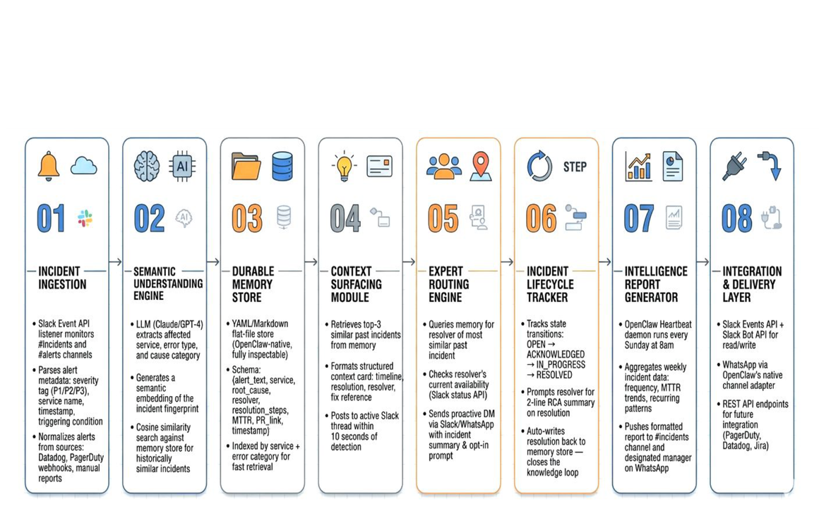
Methodology & Architecture

Slide 6



Technical Speciﬁcations
Platforms & libraries planned
Slack free tier — primary deployment channel; Bot Token + Events API webhook via api.slack.com
Groq API (free, no credit card) — LLM inference via llama-3.3-70b at console.groq.com; fast, generous free
tier sufﬁcient for demo and evaluation scale
Node.js ≥ 22 — mandatory OpenClaw runtime
ngrok free tier — exposes local webhook endpoint for
Slack Events API during development and demo Prometheus Alertmanager (open-source) — planned alert source; manual [P1] Slack messages as fallback during demo
YAML ﬂat ﬁles — OpenClaw's native Durable Memory format for incident history; zero infra, fully inspectable by judges
Planned memory implementation
Durable Memory via incidents.yaml — agent writes a structured entry on every resolved P1 (alert type, resolver, resolution summary, duration); on next matching alert, relevant entries are paged into LLM context window automatically
SOUL.md — deﬁnes agent persona and recall behavior: surface last 3 matching incidents, ping past resolver
by Slack handle, respond within 5 seconds HEARTBEAT.md — proactive weekly digest every Monday 9am: P1 count, avg resolution time, most frequent alert, top resolver; derived entirely from memory, no external DB
●
●
●
● ●
●
●
●
●

Slide 7



Future Scope & Conclusion
Conclusion:
Future Scope:
●
Transforms incident response from reactive and manual to proactive and memory-driven
Eliminates the single biggest MTTR contributor: time spent ﬁnding who knows what
Self-improving — every resolved incident makes the next
resolution faster
Zero workﬂow change for engineers: lives entirely inside Slack
they already use
●
Voice-activated incident assistant for mobile on-call scenarios
Predictive incident detection — ﬂag services showing pre-failure patterns before alert ﬁres
Cross-org anonymized incident benchmarking (how does your MTTR compare to industry?)
Auto-generated post-mortem reports from incident memory with one command
Integration with Jira for automatic ticket creation and linking on P1 open
●
●
●
●
●
●
●

