Slide 1
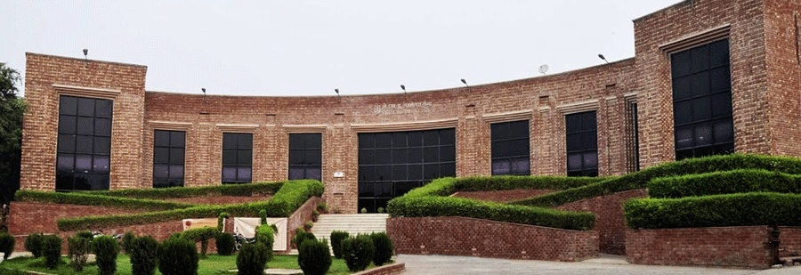


QCAI
NEW DELHI, INDIA
March 12–14, 2027
1st International Conference on Quantum Computing and Artificial Intelligence

