Slide 1



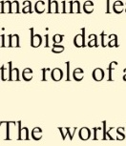
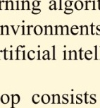
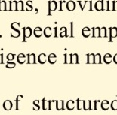
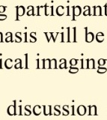
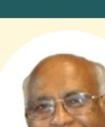

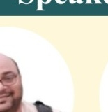
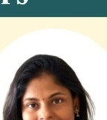



International Conference on Quantum Computing and Artificial Intelligence (QCAI)
12–14
March
2027
Venue
SC&SS
JNU
Jointly Organized by: IIT (ISM) Dhanbad and JNU New Delhi
About the Conference
The conference aims to advance the frontiers of emerging computational technologies by bringing together leading researchers, academicians, industry experts, and students working in the areas of quantum computing, quantum machine learning, artificial intelligence, quantum networking, and quantum-safe security. Through engaging technical sessions, expert talks, and collaborative discussions, participants will explore the transformative potential of quantum technologies and their integration with modern computational and communication paradigms.
Participants will gain a deeper understanding of the fundamentals and advanced concepts of quantum computing, including quantum algorithms, quantum machine learning, and quantum artificial intelligence. The conference will also address critical challenges and emerging opportunities in quantum networking, quantum communication, quantum error correction, and post-quantum cryptography, providing a comprehensive perspective on the development of secure and scalable quantum technologies. Special emphasis will be placed on interdisciplinary applications of quantum computing and AI in next-generation technologies. The conference will provide a platform for researchers and practitioners to present their latest findings, exchange ideas, identify emerging research directions, and establish meaningful academic and industrial collaborations.
The three-day programme consists of keynote addresses, expert talks, technical paper presentations, panel discussions, and collaborative forums designed to foster meaningful knowledge exchange and encourage the development of innovative solutions for the quantum-enabled future.
Speakers
Highlights
◦ Expert Keynote Addresses on emerging quantum technologies
◦ Technical Paper Presentations
◦ Interactive Expert Talks & Panel Discussions
◦ Research, Industry & Academic Networking
◦ Emerging Applications of Quantum Technologies
Biswa Nath Datta
Bhupendra Singh
Vaanathi Sundaresan
M. Tanveer
Important Dates
Research Professor
Northern Illinois
University
Scientist at DRDO
Bengaluru
Assistant Professor
IISc Bangalore
Professor
IIT Indore
Call for Papers:
Last Date for Paper Submission:
Notification of Acceptance:
Early Bird Registration Deadline:
Final Registration Deadline:2027
Conference Date: March 21–22, 2027
Registration Fees
Apoorva D Patel
Alok Mishra
Shayan Srinivasa
Garani
Navin Kashyap
• BTech/MTech/MS/MSc/PhD: INR XYZ + GST
• Post Doc: INR XYZ + GST
• Faculty: INR XYZ + GST
• Industry: INR XYZ + GST
Note: Accommodation (Not included)
Emeritus Professor
IISc Bangalore
Scientist at DRDO
Bengaluru
Professor
IISc Bangalore
Professor
IISc Bangalore
Step-1
Step-2
Organizers:
Webpage
Pay to register
Register here
Convener:
Chairperson:
Committee
Members:
Prof. Abhaya Singh and Dr. Buddha Singh
Prof. Satish Chand
Dr. Pushpendra Singh, Dr. Anuj Sachan
☎ +91 XXXXXXXXXX
✉ XYZ@XYZ.

