Slide 1
Case Study
Juanyi Zhang 2024.5.13
Notes:
Good morning! Today, I'll present my analysis of five datasets of your company's transactions from 2016 to 2018 in Brazil.

Slide 2

Background
Customer dataset
Orders dataset
Order item dataset
Products dataset
Product category name
Identify abnormal data
Extract insights from business data
Know more about Customers
Data-Driven Strategy
Notes:
The goal is to enhance your understanding of your business performance, the market, and customers. （Slide Change)Ultimately, this analysis will facilitate data-driven decision-making, Slide Change)positioning your company as a successful player in the market.

Slide 3
Outlines
Data pre-processing
Missing values
Sales Trend Analysis
Business Performance
Product Contribution
Customer Analysis
Demographics
Behavior Patterns
Customer/ Order Segmentation
RFM analysis
K-mean Cluster analysis
Duplicate items

Slide 4
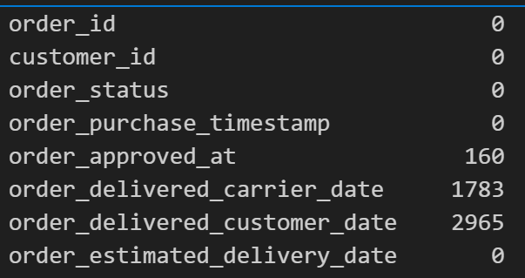
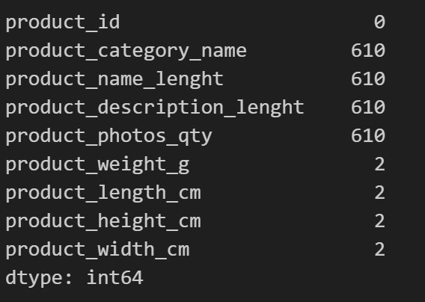
Data Preprocessing
Working with missing values:
Interpretation
Time missing is normal
Action
Drop missing values in orders dataset
orders dataset
Interpretation
Missing values in product ID may be caused by technical problem
Action
Record the ‘product_id’ for the missing values for later QC check
products dataset
Notes:
The first step is data preprocessing, focusing on missing values and duplication. This ensures the accuracy of subsequent analysis and helps identify potential data collection issues. In the orders dataset, missing values are higher in the order delivered date, which is expected as not all orders are successfully delivered. However, 610 products lack names and related features in the products dataset. Upon detailed examination, it's evident that all relevant features are missing for these 610 products. This signals a problem, possibly due to an incomplete recording or an issue from the seller. It's recommended that this be reported to the IT team for further investigation. As a result, I removed all these missing values for later analysis.

Slide 5
Data Preprocessing
Working with duplicated item:
Interpretation
Duplication in Customer dataset is fine
Action
Create a new dataset to see unique customers
Customers dataset
Interpretation
Duplication is confusing
Bring problem with counting
Action
Keep items with the most quantity
Remind IT team to fix it
Orders item dataset
Notes:
Next, regarding duplication, we noticed duplicate customer unique IDs, which is typical as each row corresponds to a product, and customers may purchase multiple items per order. To address this, I created a new file to see unique customers. Additionally, we observed numerous transactions with identical features but varying quantities in the order item dataset, which caused confusion for the number of items purchased. I hypothesized that these duplicates were mistakenly counted, and I retained only the rows with the highest quantity for further analysis. However, reporting this to the IT team for clarification is essential.

Slide 6
Outlines
Data pre-processing
Missing values
Sales Trend Analysis
Business Performance
Product Contribution
Customer Analysis
Demographics
Behavior Patterns
Customer/ Order Segmentation
RFM analysis
K-mean Cluster analysis
Duplicate items
Notes:
With our dataset clean and well-structured, we could move into the analysis phase with confidence in the integrity of our data. The first and one of the most insightful analyses we conducted was on sales trends. Understanding these trends helps us learn more about the product contribution and identify business opportunities.

Slide 7
Sales Trend Overview
Merge datasets
Look at orders that is ‘delivered’
Calculate relevant parameter
Net Value= (Price-freight Price)
Total Value (Cost)= Price * order_item_id
Company have received the payment
Order dataset to know order time and status
Order item to know the price
Notes:
We've augmented our dataset by creating additional features: total Value and net value. We've filtered the dataset to include only orders with the status 'delivery'. Finally, we've presented our analysis using various visualisation tools.

Slide 8
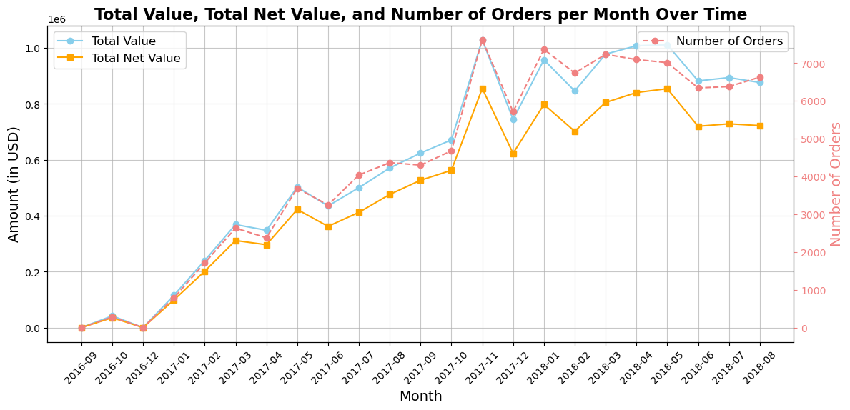
Sale Trend Overview
Interpretation
General upward Trend
Correlation trend between orders and Total Value
Peak reached at 2017-11
Data from 2016-11 is missing
Stagnation starts 2018-05
Significant growth rate at 201711-201712, 201801-201802, 201805-201806 (p<0.05)
Notes:
Overall, both Total Value and Total Net Value exhibit a consistent upward trend, indicating increasing revenue over the observed period. This suggests sustained growth in gross and net sales, with the steady difference between Net Value and Value demonstrating a stable net profit margin. I've identified several months with significant growth rates, which appear non-coincidental from a mathematical perspective. This underscores the need for the marketing team to delve deeper into these data points. For instance, there are discernible seasonal patterns, with peaks typically occurring around November, December, and mid-year, likely tied to Christmas or summer sales. Furthermore, market growth stagnated around May 2018, possibly due to intensified market competition, which aligns with reports of new players entering the market in 2018. Additionally, the absence of data for November 2016 raises concerns about the data collection process, warranting further investigation.

Slide 9
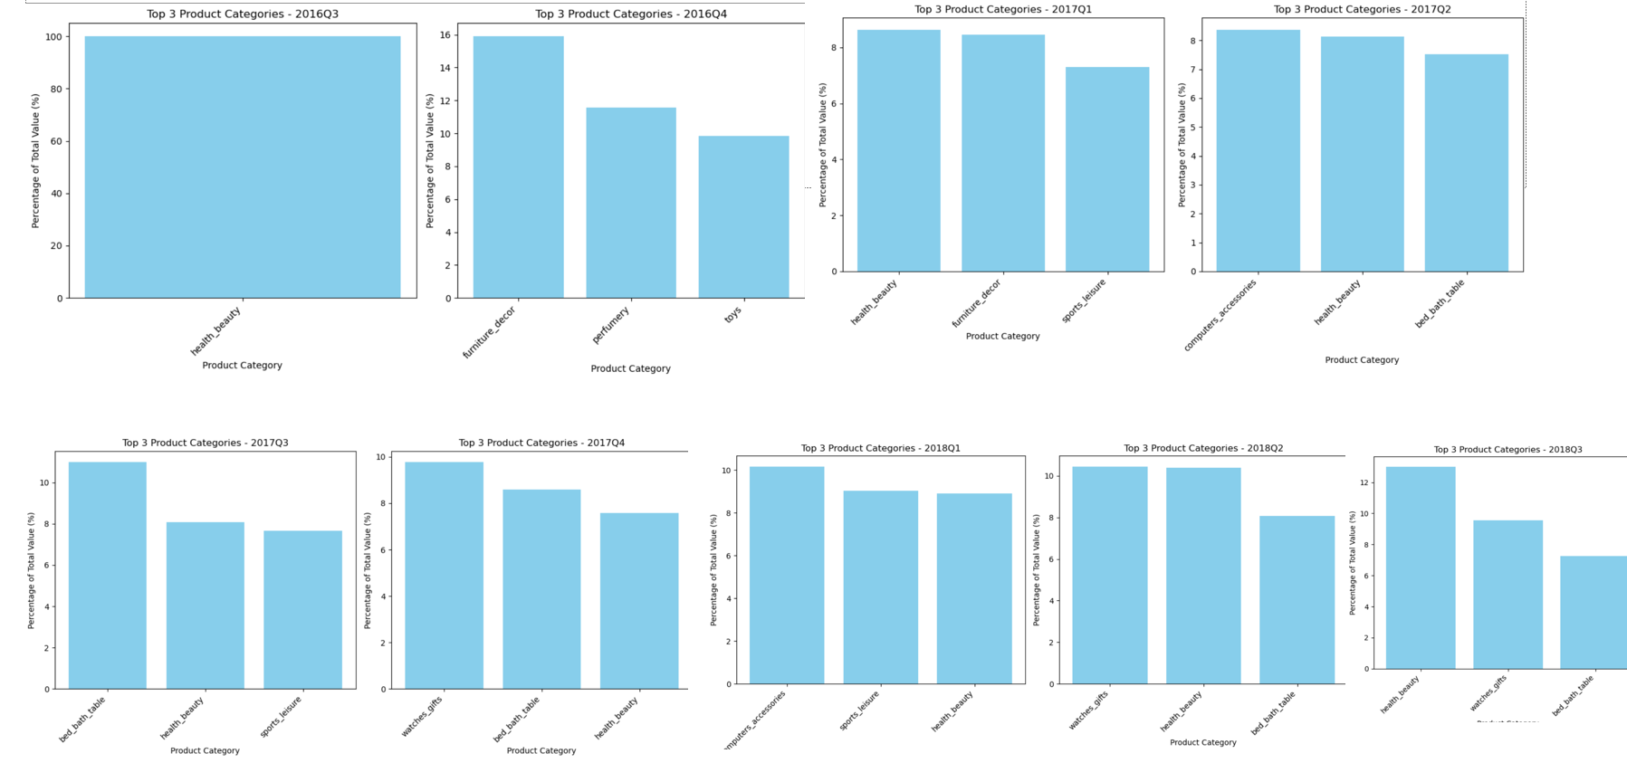
Top 3 Product categories for each quarter
Interpretation
Shift in customer Preferences
Domination performance of Health& Beauty
Watches gift in 2017Q4 bring high sales
Notes:
Then, let’s move to the product categories for each quarter. We can see a shift in consumer preferences. For instance, 'Furniture Decor' and 'Perfumery' were among the top contributors 2016 but were less prominent in later quarters. This might suggest shifts in consumer preferences or changes in available inventory or promotions. In addition, we can see that Health & Beauty consistently has strong performance across multiple quarters, and Watches Gifts' in Q4 2017 peaks, likely due to gift purchases.

Slide 10
Sales Trend Analysis Take away
Growth Trend
Revenue and Product
clear seasonal patterns
Business growing Trend in gross and net sales
Stagnation in 2018 from fierce competition
strong impact of ‘Health &Beauty’ on overall revenue
High margin categories boost net values
Notes:
By integrating product information, we gain deeper insights into trends. For instance, watches, often perceived as high-margin items, notably boost net values. The considerable variability within top categories may explain fluctuations. Evaluating business strategy, such as increasing stock in 'Health & Beauty,' can enhance total revenue. Moreover, seasonal promotions targeting specific categories like 'Watches Gifts' during the holiday season can capitalise on high-revenue quarters, maximising sales potential.

Slide 11
Outlines
Data pre-processing
Missing values
Sales Trend Analysis
Business Performance
Product Contribution
Customer Analysis
Demographics
Behavior Patterns
Customer/ Order Segmentation
RFM analysis
K-mean Cluster analysis
Duplicate items
Notes:
Now that we have a solid understanding of our business's sales trends and product patterns. let’s zoom in and explore the driving force behind these numbers: our customers.

Slide 12
Customer Analysis
Where?
How Much?
When?
How Often?
Notes:
Understanding who they are, where they are from, when they buy, how often and how much they spend is essential for tailoring our strategies effectively. Let’s delve into the customer analysis to uncover these insights.

Slide 13
Customer Analysis Method
Merge datasets
Filtered suitable customer
Visualisation with suitable technology
Log-scale
Exclude customer with delivery status ‘cancel’ or ‘unavailable’
Merge all database and conduct pre-processing
Time convert
Notes:
To analyze this part, I merged all relevant clean datasets, excluded orders with ‘cancel’ or ‘unavailable’, and visualised it with suitable technology.

Slide 14
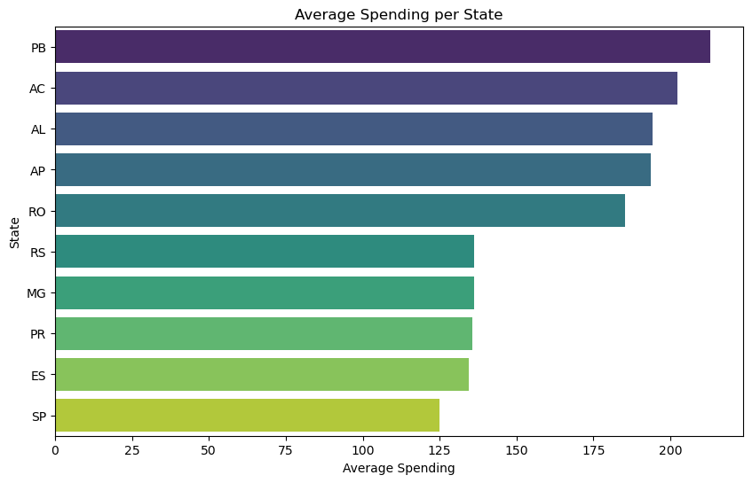
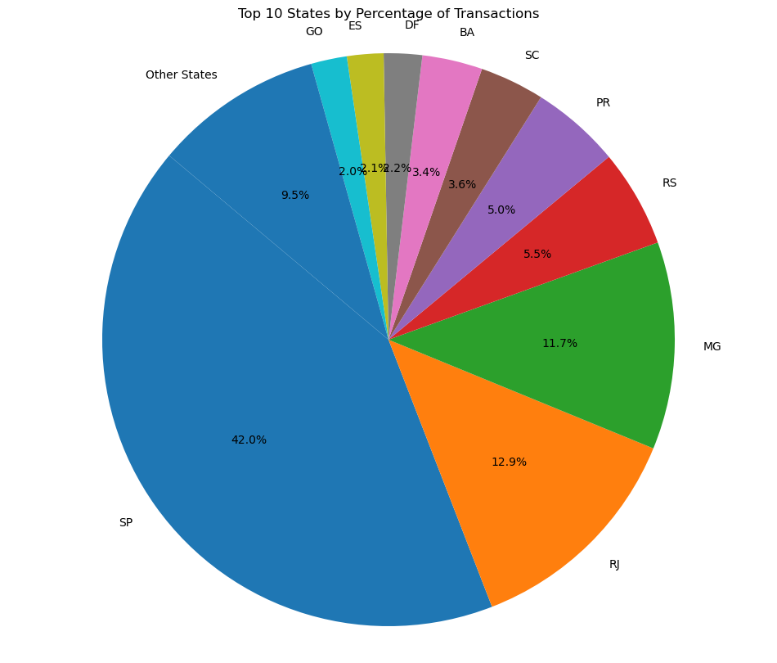
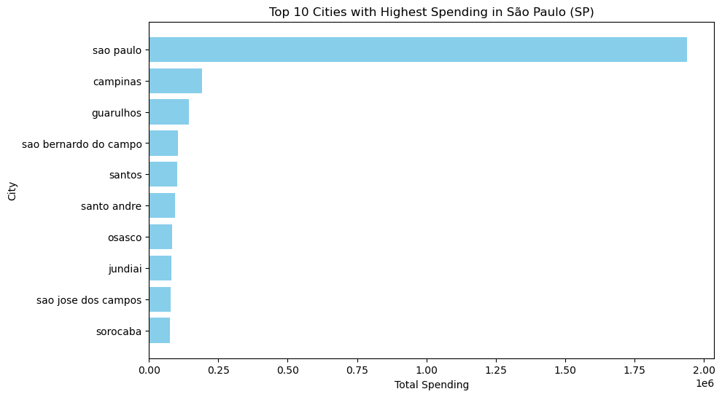
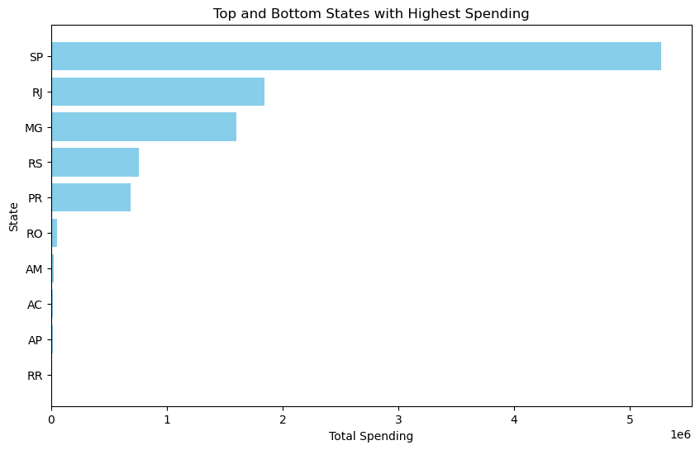
Where are the customers from?
Interpretation
Dominance of SP
RJ & MG is important
concentration of spending in urban and metropolitan areas
Lower Average spending in SP
High Average Spending in Lesser Populated States
Market Suggestion
Heavy focus on SG
Untapped potential in high average spending in less populated states
Better Pricing &logistic Strategy in higher spending state
Notes:
The plot illustrates São Paulo (SP) dominating with 42.0% of transactions, indicating a concentrated market activity in the state. RJ and MG follow with around 10% each, while other states show diverse market penetration. SP also leads in top spending, which is consistent with its high transaction volume. CHANGESLIDE Specifically within SP, the city of Sao Paulo accounts for the majority of spending, aligning with its status as Brazil's financial centre and the world's seventh-largest city by population. CHANGESLIDE, Interestingly, it has a comparatively lower average spending, possibly due to higher frequency or smaller transactions. Conversely, states like PB and AC show higher average spending per transaction despite lower total sales volume. Research suggests that these states aren't considered wealthy, implying the presence of affluent customers. CHANGESLIDE, The market suggestion is to maintain a heavy marketing and sales focus on São Paulo due to its significant transaction volume and total spending, according to the 80-20 rule. Additionally, different product and pricing strategies should be implemented in states with higher average spending, like PB and AC, to maximise revenue potential.

Slide 15
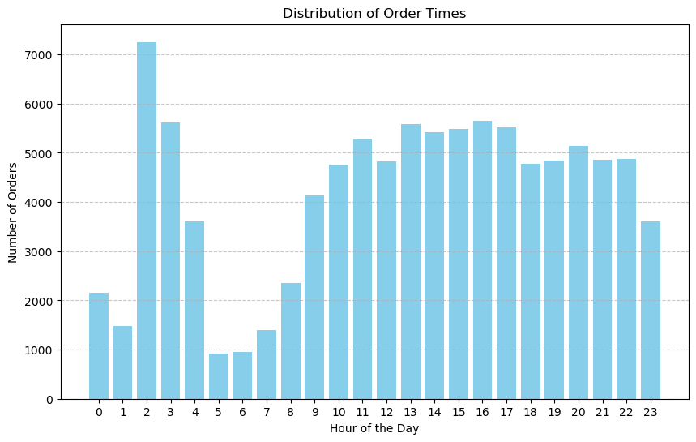
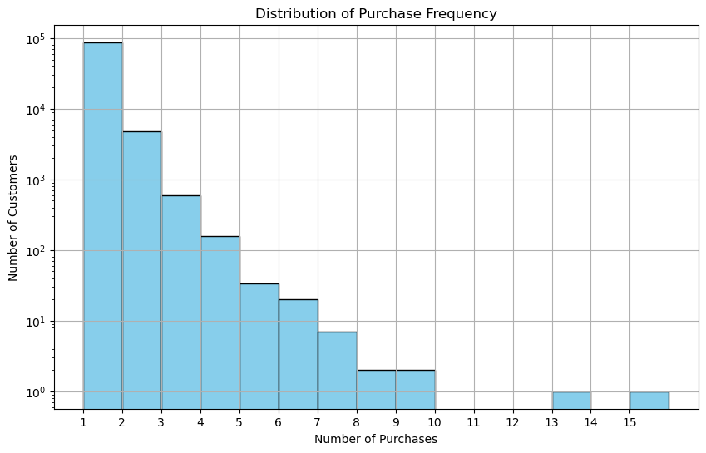
When & How Often do the customer order
Strategic Recommendations
Optimizing Engagement Times
Encourage Repeat Purchase
Repeat Customer Segmentation
Order Times
Peak browsing times during 2 am
Morningtime Drop off
Purchase Frequence
Majority customer make one purchase
small segment of customers make up the long-term, repeat buying base
Notes:
The following two plots shed light on customer behaviour regarding order timing and purchase frequency. Surprisingly, orders peak at 2 am, indicating many customers prefer ordering after midnight, followed by a drop during the daytime, aligning with typical working hours. The distribution of purchases reveals that most customers make only one purchase, which is evident from the first bar towering over the others. The number of customers making two purchases is considerably lower, with a sharp decline in higher purchase frequencies. SLIDECHANGE This suggests scheduling more email campaigns or social media ads during nighttime and implementing loyalty programs to encourage repeat purchases.

Slide 16
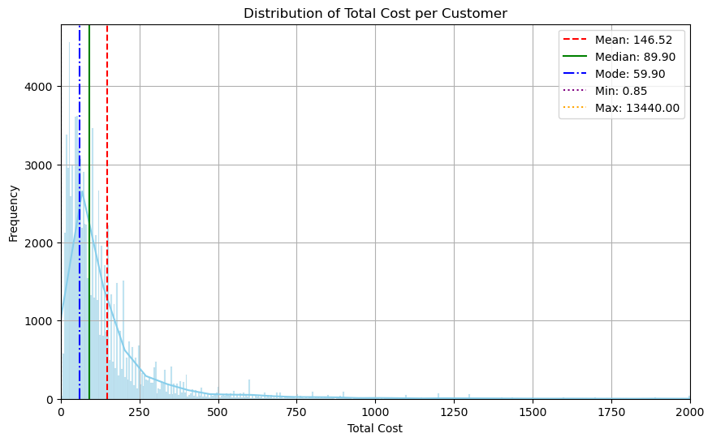
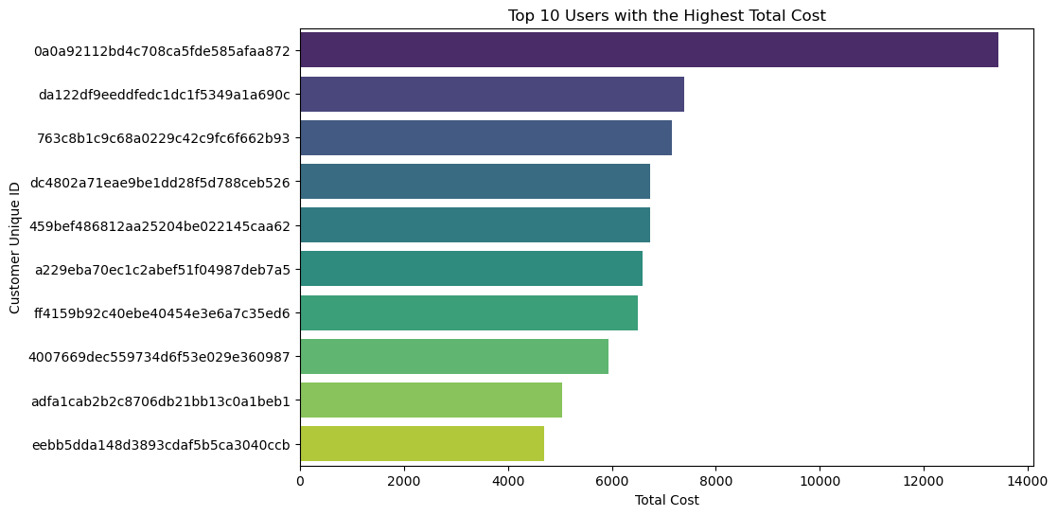
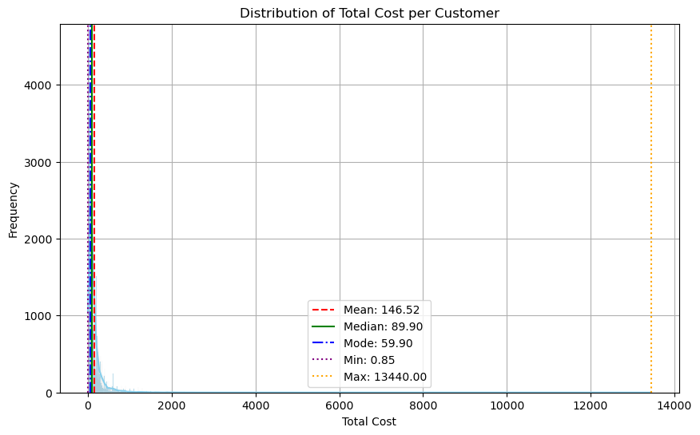
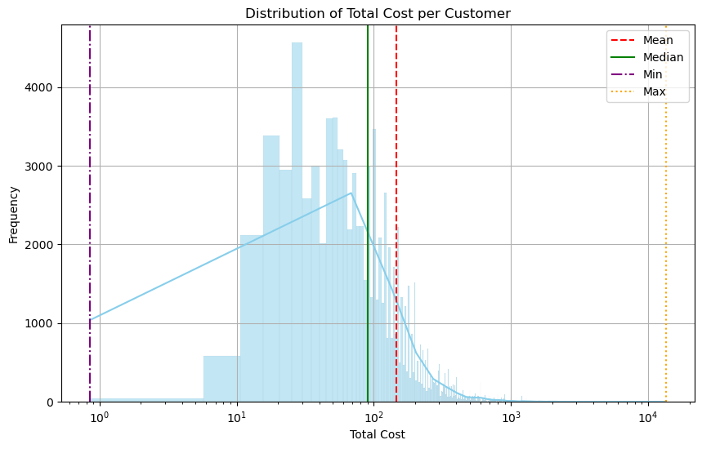
How Much
Interpretation
High Concentration at Lower Cost
Few high spenders purchase from our platform
Some Crazy-rich Customer produces outliers, should be pay attention to
Strategic Recommendations
Customer Segmentation
Targeting and Personalization
Precise marketing
Notes:
Lastly, we utilised a histogram to display the total cost distribution per customer, opting for a log scale due to the distinct range.SLIDECHANGE Most customers spend under $200, with a median of around $90, indicating typical spending. SLIDECHANGEWe identified the top 10 users with the highest spending, notably Mr Outlier, suggesting the need for promotions to compensate for their significant contribution. SLIDECHANGE Thereofore, we can propose that Customer segmentation is crucial. Strategies should focus on promotions and upselling to increase order value for those in lower spending ranges. Conversely, personalised services or loyalty programs may be more effective for high-spending customers in maintaining their interest and spending levels.

Slide 17
Customer Analysis Take away
Behavior Patterns
Demographics
Shopping mode starts at night
One-time Purchase
Small Purchase
Market mainly in SP
Some high value Customer located in small Market
Notes:
Combines with previous analysis, I hope you have a better understanding of your customer, we suggest that special promotion, allocate resources, precise market strateagy and repeat purchase reward program as a result of customer analysis

Slide 18
Key takeaway
One time purchase is the key reason for sales drop and need to solve, but how?

Slide 19
Outlines
Data pre-processing
Missing values
Sales Trend Analysis
Business Performance
Product Contribution
Customer Analysis
Demographics
Behavior Patterns
Customer/ Order Segmentation
RFM analysis
K-mean Cluster analysis
Duplicate items
Notes:
Having dissected our customer data, we now understand who our customers are and how they engage with our platform. However, to extract maximum value from this knowledge, we must segment our customer and order base intelligently.

Slide 20
Segmentation
RFM analysis
Segmented via customer
K-mean Clustering
Segmented via Order

Slide 21
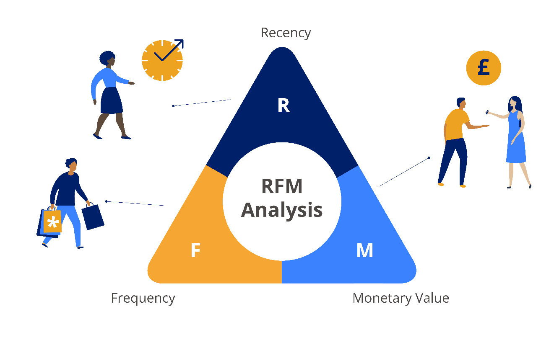
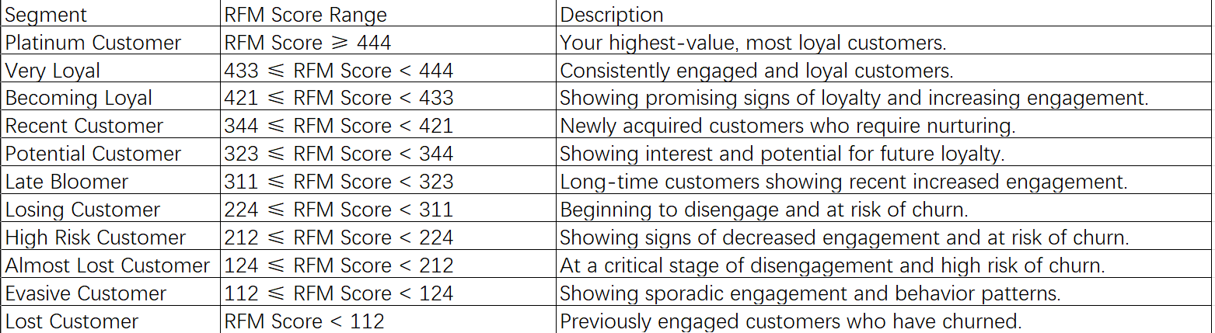
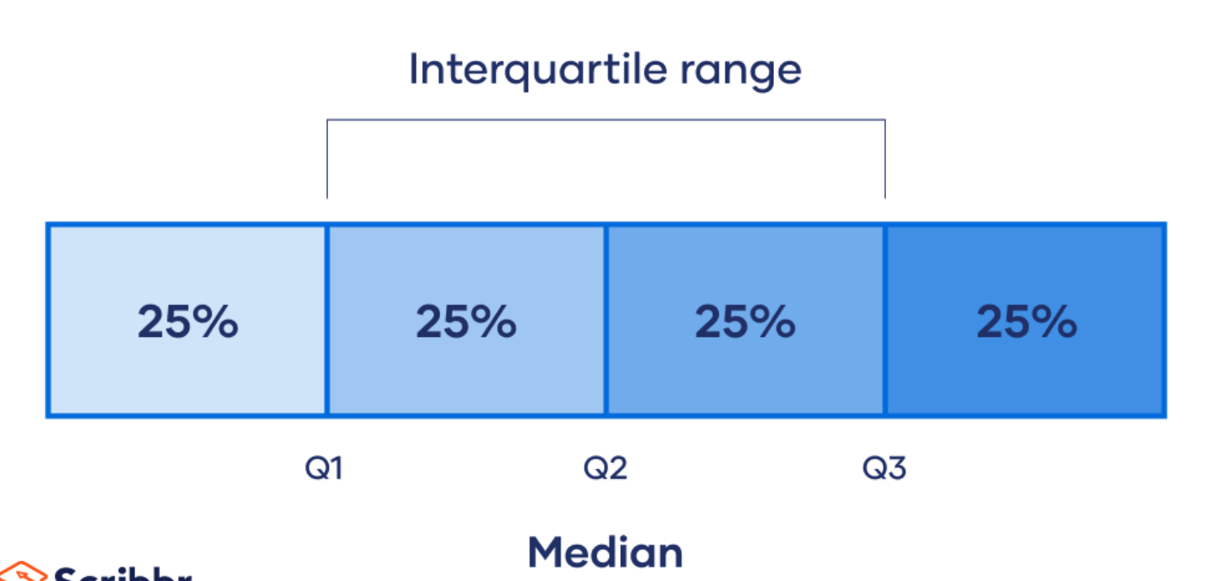
Receny, frequency, monetary analysis (RFM)
Notes:
First of all, RFM analysis is used to segment customers. The acronym RFM stands for Recency, Frequency, and Monetary Value, three critical metrics used to evaluate customer engagement and value. In other words, we will value customers according to these three dimensions. SLIDECHANGE historical transaction data is collected and segmented based on Recency, Frequency, and Monetary Value. Then, we divide each metric (Recency, Frequency, Monetary Value) into quartiles to assign scores. Each customer is assigned a score for each metric on a scale of 1 to 4, with 4 being the highest. These scores are then combined to create an RFM score for each customer. Finally, customers are segmented into groups based on their RFM scores, as shown in the plot, allowing businesses to tailor marketing strategies to each segment's unique characteristics and needs.

Slide 22
RFM Analysis Method
Extract Relevant Data
RFM calculation
Cluster and visualization
Quantile Calculation
Order time, Order Value, Customer ID, order ID
RFM score Assignment
Understand Customer
Relevant strategy
Notes:
As you can see, we have segmented customers according to their RFM score. Still, for better interpretation, I have grouped them into high-risk groups, growth potential groups, Core Customer Groups and low-engagement groups with their segments.

Slide 23
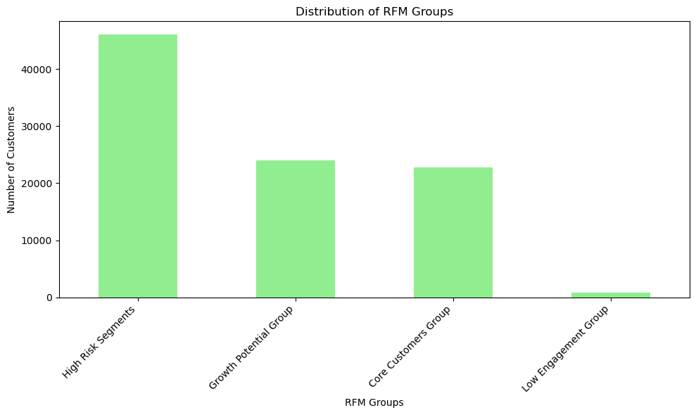
Customer RFM Segments
Interpretation & Strategy
High Risk Segments:
Large Group, Risk of Churning
personalized offers & Communication
Growth Potential Group:
Half Size of HRS
Engagement
Core Customers Group:
Similar size with GPG
Loyalty rewards
Low Engagement Group:
Least segment
remind of Company value, further analysis
Notes:
The analysis reveals that the High-Risk Group constitutes a significant portion compared to others, indicating a churn risk due to infrequent purchases or prolonged time since their last purchase. Aggressive re-engagement tactics such as personalised offers and communication should be implemented to reignite their interest. The Growth Potential Group, comprising customers showing recent engagement but have yet to frequent purchases or high spending, presents an opportunity for growth in engagement and value. Strategies for this group should focus on tailoring onboarding programs and offering first-time buyers incentives to nurture their journey towards becoming loyal customers. The Core Customer Group, consisting of the most valuable customers who frequently engage and spend, is responsible for significant revenue. Market strategies should emphasise premium services and loyalty rewards to strengthen relationships with this group to enhance their lifetime value. Lastly, the Low Engagement Group comprises customers with minimal interaction with the brand, either due to prolonged absence or infrequent engagement. Given their smaller portion of the customer composition, limited periodic engagement efforts and investments should be allocated to this group.

Slide 24
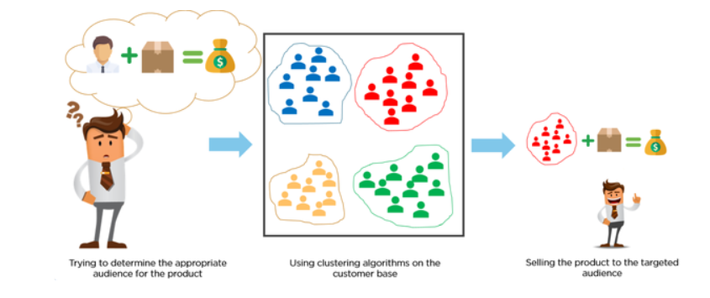
Order K-mean Clustering
Notes:
Although RFM analysis offers valuable insights into customer behaviour, it only considers three dimensions, potentially overlooking the complexity of e-commerce dynamics. We've employed k-means clustering on our order data to understand customer preferences and segmentation better. K-means is an unsupervised machine learning method, meaning it autonomously learns from the data's features and groups orders with similar characteristics. This approach is especially beneficial for uncovering patterns within large, complex datasets like ours.

Slide 25
Order K-means Clustering- Method
Select relevant Features
Conduct PCA
Conduct K-mean Cluster
Capture representative features
Total cost, Product category, State, Volume (object’s length x width x height), Product weight, Time Cost (Arrival day- Order day), RFM analysis
Cluster analysis
Validate result
Notes:
First, I manually selected relevant features for orders, including total cost, product category, state, and weight. Additionally, I created two features: volume (calculated by multiplying the object’s length, width, and height) and time cost (representing the total time customers spend from ordering to receiving their order). Due to the complexity of the order features, I used Principal Component Analysis (PCA). This dimensional reduction technique transforms large features into smaller ones while retaining most information. In simpler terms, PCA reduces the number of features while preserving significant trends or patterns. In our case, PCA helps select appropriate features for more accurate k-means clustering. Following this, we employed k-means machine learning and validated the applicability of the results.

Slide 26
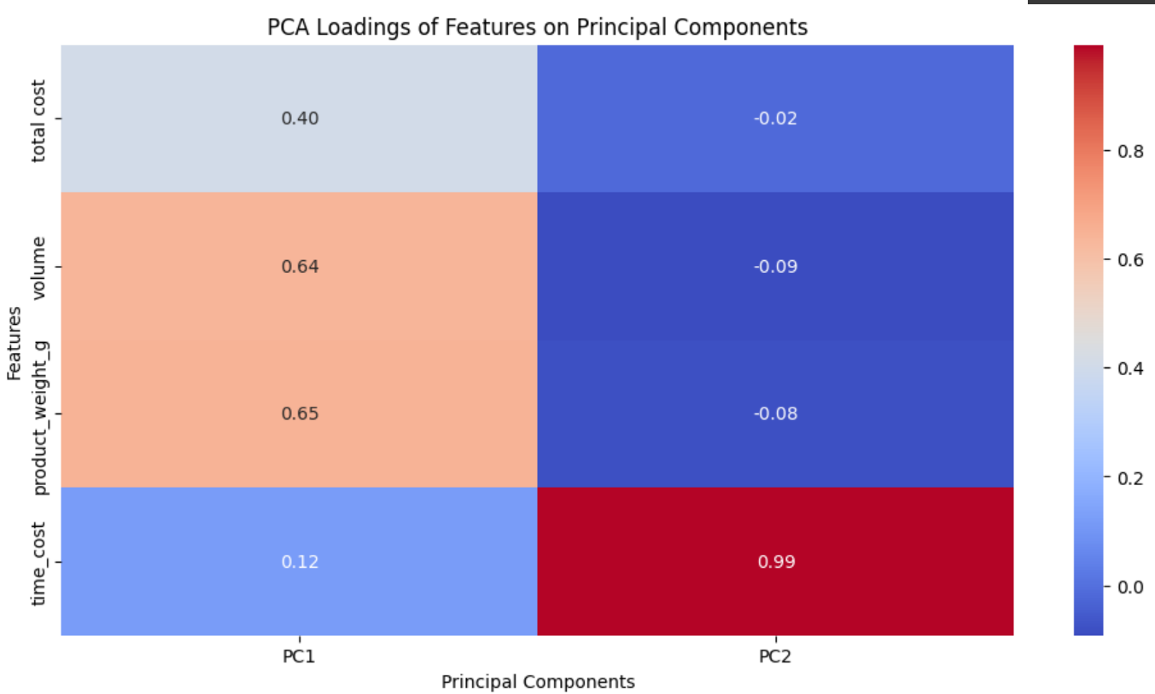
Order K-means Clustering- PCA
Interpretation:
PC1
Product volume & Weight
PC2
Time Cost ( Received time- Order Time)
Notes:
The plots illustrate the features used by PCA to represent the data. The first principal component is primarily influenced by the weight and volume of the order, suggesting that the size of the order significantly impacts the variation between products in this component. This likely corresponds to product size and logistics complexities. On the other hand, the second principal component is dominated by time cost, indicating that this component primarily captures variations in time efficiency.

Slide 27
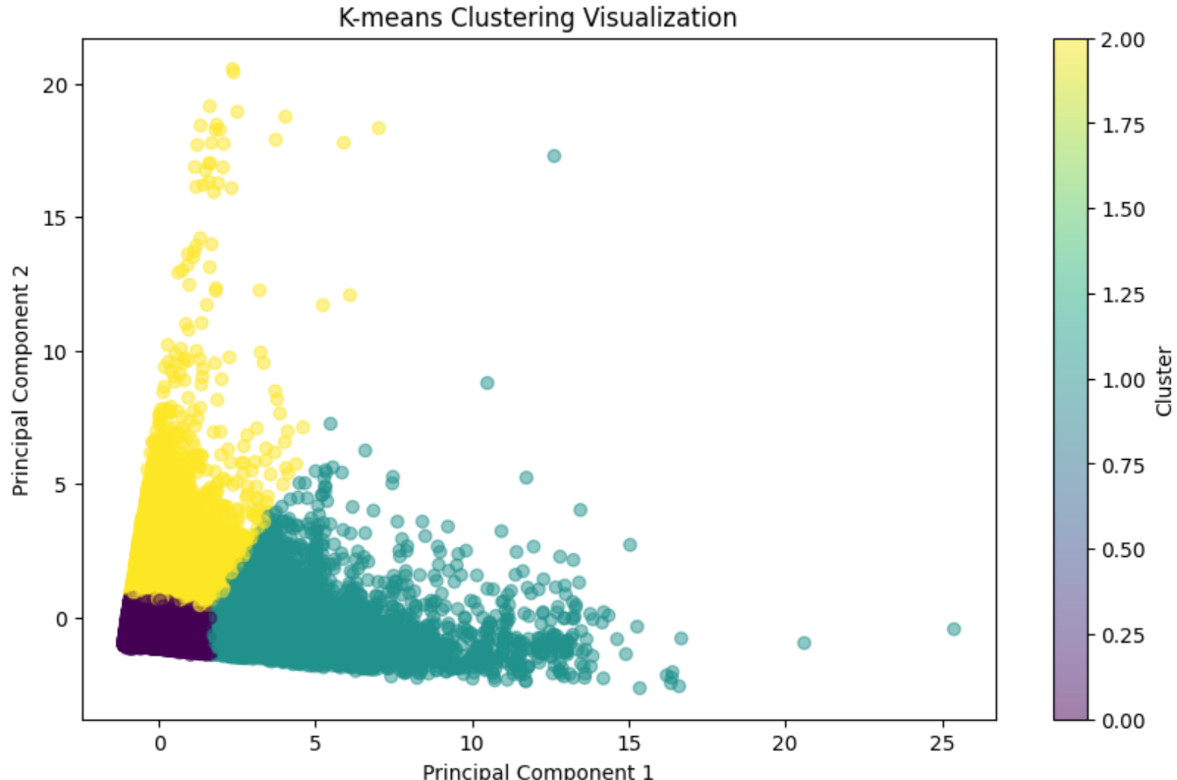
Order K-means Clustering- Cluster analysis
Interpretation:
Cluster 0
Lower total cost & Moderate Size
Everyday Items, moderate shipping requirement
Cluster 1
Higher total Cost & Larger Size
Premium items that need special logistics
Cluster 2
Similar with Cluster 0, slightly bulkier/expensive
Longer shipping day
Sihouette Score
Good clustering (0.512)
Strategy Development:
Cluster 0
Standard Order, minimize profit margin
Cluster 1
Bulky Order, better customer Support & Service
Cluster 2
Enhance product features
Reduce Logistics cost & time with non-dominate states
1
0
2
Cluster | Total Cost | Volume | Product Weight (g) | Time Cost | Product Category | State | RFM
0 | 104.89 | 10044.34 | 1248.61 | 8.79 | bed_bath_table | SP | High Risk Segments
1 | 461.83 | 72976.46 | 11517.89 | 13.56 | office_furniture | SP
2 | 128.55 | 11337.73 | 1542.47 | 27.72 | bed_bath_table | RJ | Growth Potential Group:
Notes:
The visualisation and analysis reveal three closely grouped clusters representing similar features. The first cluster comprises products with moderate volume and weight and lower total cost (average $104.89), primarily categorised under 'bed_bath_table' from São Paulo (SP). These are standard orders with moderate handling and shipping requirements. The second cluster contains items with higher volume and weight and a significantly higher total cost (average $461.83), classified as 'office_furniture' from SP. This suggests bulky or premium items requiring special handling and logistics, contributing to the higher cost. The last cluster resembles the first cluster in category but with a slightly higher average value, time cost, and a different state. This suggests bulkier items and a destination requiring better logistics. SLIDECHANGE To strategise:
Focusing on maximising volume sales and profit margin through competitive pricing would be effective for the first cluster.
For the second cluster, offering premium services, better customer support, and a higher pricing strategy to match the premium nature of the products is recommended.
For the last cluster, enhancing product features to justify the higher price and improving logistics, even in secondary markets like Rio de Janeiro (RJ), would be beneficial.

Slide 28
Conclusion
Upward market trend but see stagnation
One time purchase customer is
One time purchase is related to logistic ability
Logistic ability should be improved according to RFM analysis
Notes:
In summary, our presentation aims to provide valuable analysis for your company across three key areas: anomaly detection, business performance evaluation, and customer segmentation. We've observed a competitive market with a potential stagnation trend, particularly noting the dominance of the health and beauty sector and the presence of seasonal patterns. Our strategies leverage these insights, emphasising targeted campaigns in São Paulo, addressing low-frequency purchases, and implementing personalised offers for high-risk customer segments identified through RFM analysis. Furthermore, K-means segmentation highlights issues related to order time consumption and product size, suggesting logistics and premium product service delivery improvements. SLIDECHANGE By implementing these targeted strategies, we anticipate overcoming current challenges and achieving sustainable growth and customer satisfaction, leading to success in the future.

Slide 29
THANK YOU!
Notes:
That’s all for my presentation. Thank you so much for your time and looking forward for your feedback!

Slide 30
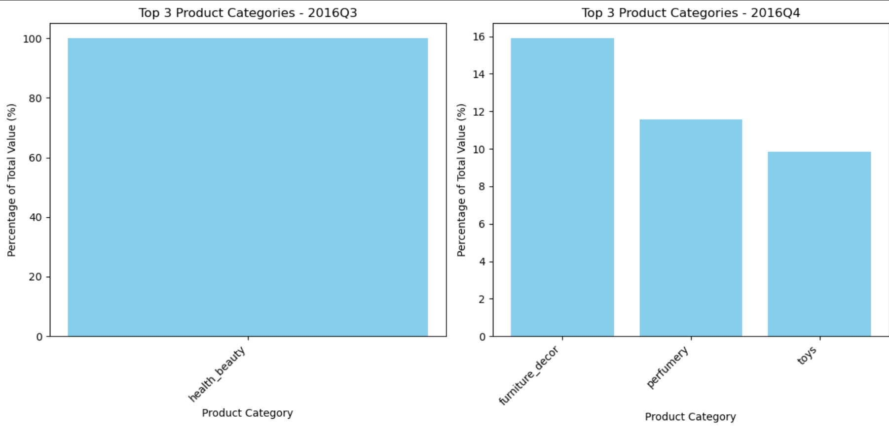
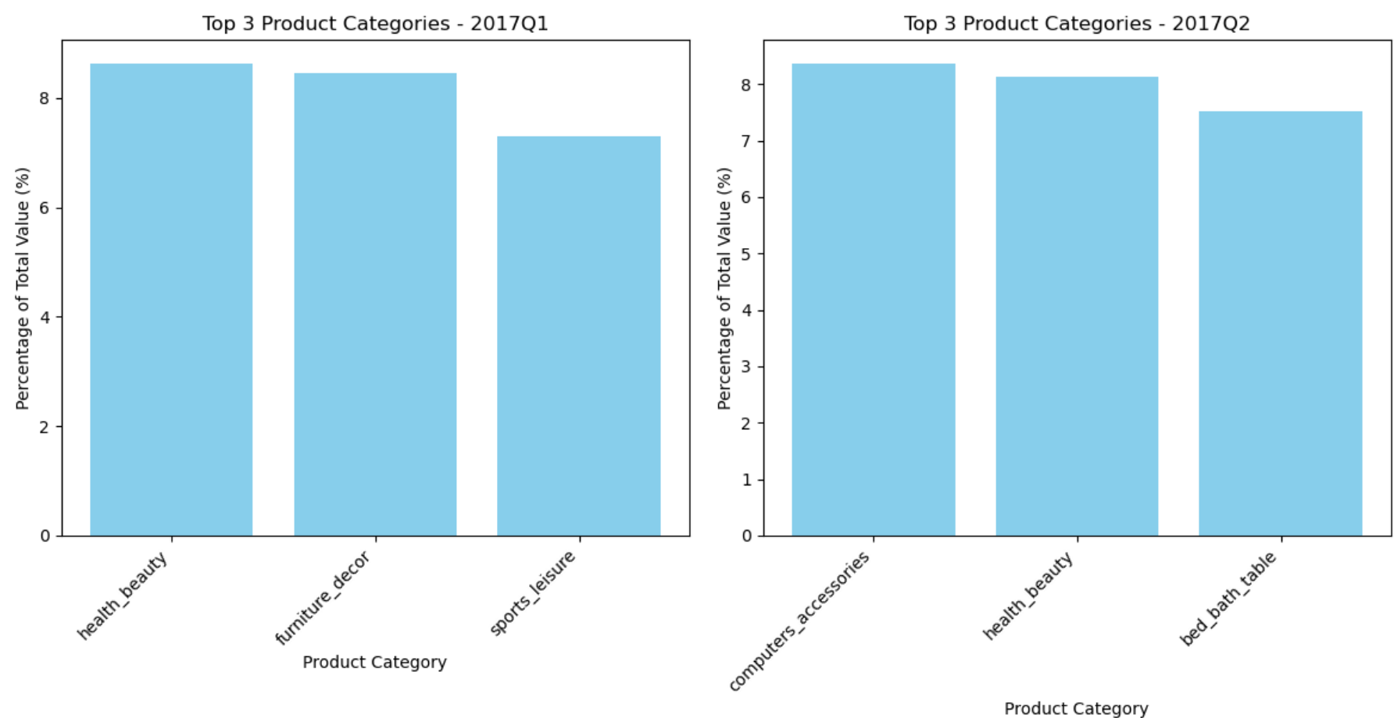
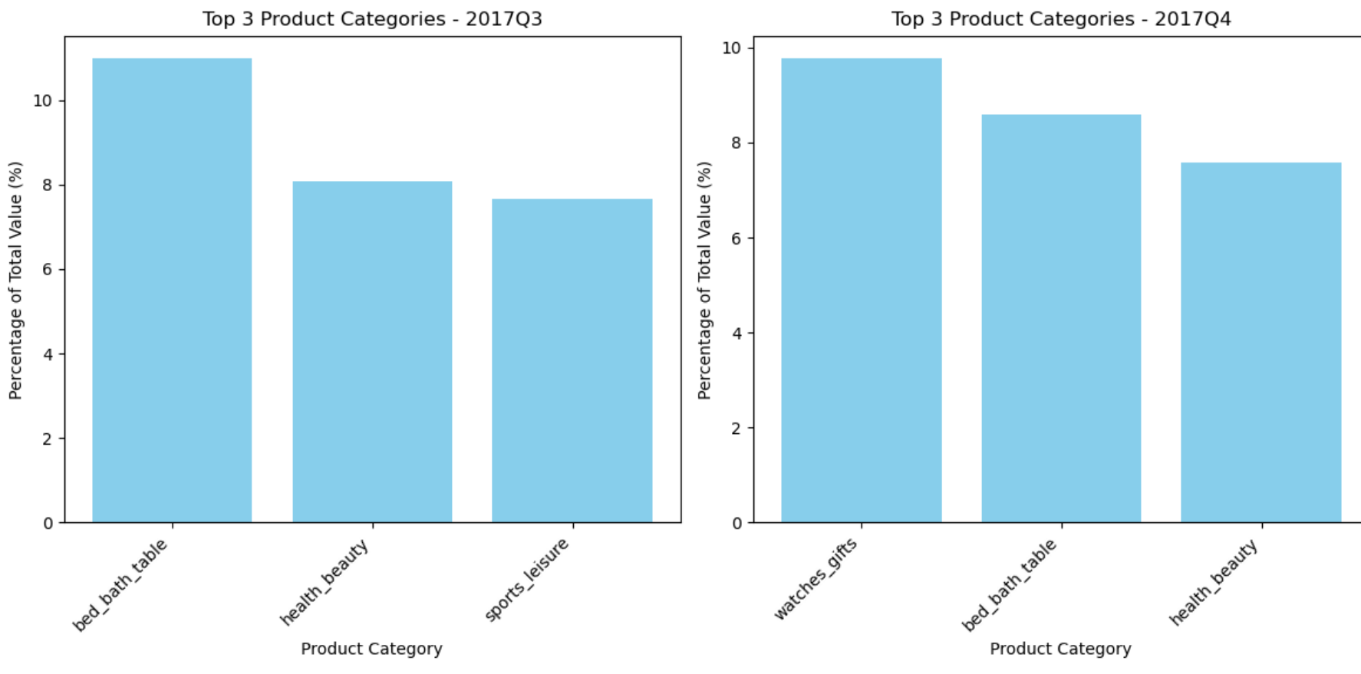
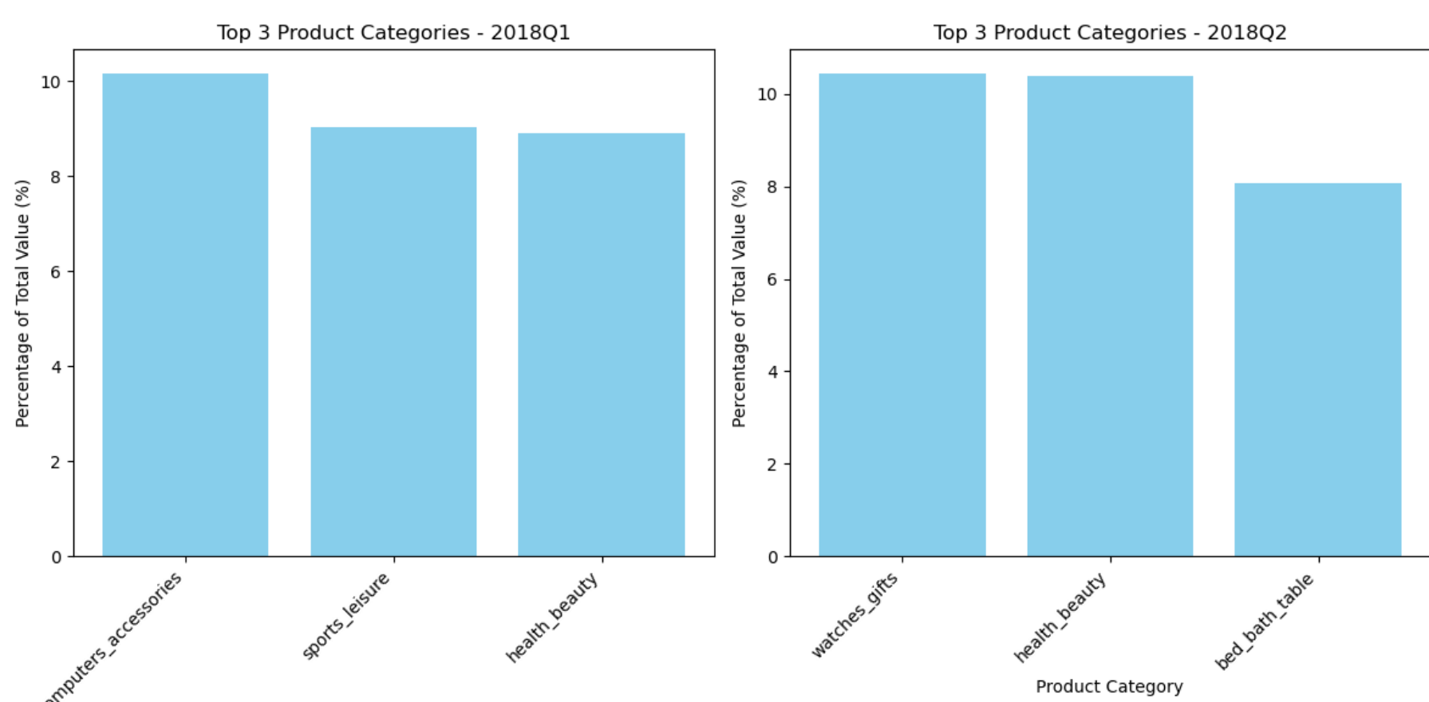
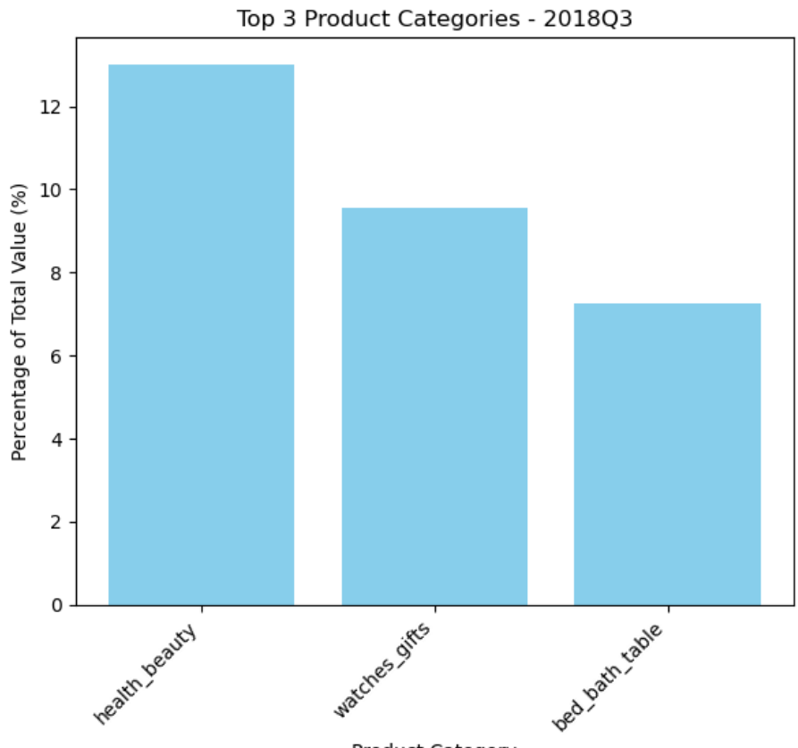
Appendix

