Slide 1


HackFEST
Team WEDNESDAY

Slide 2
team
Mohammed Abdur Rahaman
K.Thoyajaksha Kashyap
K. Jesmitha

Slide 3

Problem Statement
Code Anomaly Detection with Python Logistic Regression

Slide 4
Table of contents
About the project
Logistic regression and its Working
Challenges
Advantages and Disadvantages
Conclusion
result
Future scope

Slide 5
Approach
Anomaly detection using python and its libraries
( Pandas , Sklearn and Matplotlib )
Logistic Regression model is used to classify the anomaly files.

Slide 6
About the project
Code anomaly detection is an essential task in software engineering. It involves identifying and resolving issues in the code that might cause errors or bugs. One of the most popular methods for code anomaly detection is using logistic regression with Python.
Python is a powerful programming language that offers a wide range of libraries and tools for data analysis and machine learning. Logistic regression is a statistical method used to analyze and model relationships between variables.
It is particularly useful for binary classification problems, such as detecting anomalies in code.

Slide 7
Logistic REgression
Logistic regression is a statistical method used for binary classification problems. It predicts the probability of an event occurring based on input variables. In the case of code anomaly detection, the input variables are the features of the code, such as the number of lines, the complexity of the code, and the number of comments. Logistic regression works by fitting a logistic function to the input variables. This function maps the input variables to a probability value between 0 and 1, which can be interpreted as the likelihood of an event occurring. If the probability is greater than a certain threshold, the event is predicted to occur, otherwise, it is predicted not to occur.

Slide 8
Working
Logistic regression works by fitting a logistic function to the data, which maps the input variables to a probability score between 0 and 1. If the probability is above a certain threshold, the model predicts a positive outcome, otherwise it predicts a negative outcome . To train a logistic regression model, we need to first collect a dataset of labeled examples, where each example is labeled as either normal or anomalous. We then use this data to train the model to predict the correct labels for new, unseen examples.

Slide 9
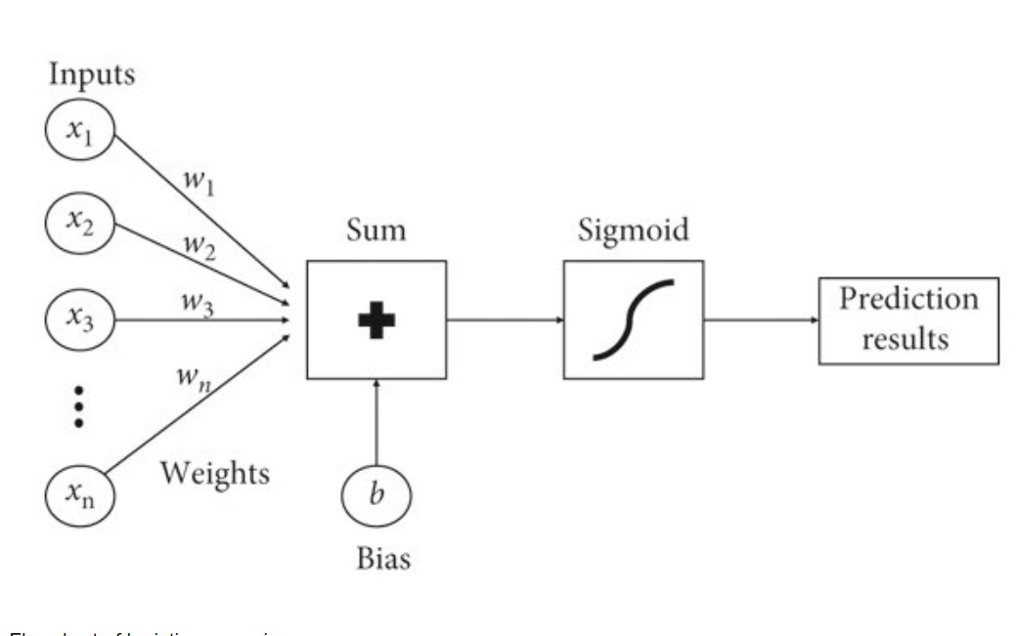
Representation

Slide 10
Implementation
Implementing Logistic Regression in Python. Python is a popular programming language for data science and machine learning, and has many libraries and tools for implementing logistic regression models. One such library is scikit-learn, which provides a simple and intuitive interface for building and training logistic regression models .
To implement logistic regression in Python, we first need to preprocess our data by cleaning and transforming it into a format suitable for modeling. We can then use scikit-learn to split the data into training and testing sets, fit the logistic regression model to the training set, and evaluate its performance on the testing set.

Slide 11
Tips for code anomaly detection
Practical Tips for Code Anomaly Detection While logistic regression is a powerful tool for code anomaly detection, there are some practical considerations to keep in mind when applying it in real-world scenarios. For example, it's important to choose relevant features that capture the essence of the code being analyzed, and to carefully tune the hyperparameters of the model to achieve optimal performance .It's also important to consider the trade-off between false positives and false negatives, and to balance the sensitivity and specificity of the model according to the specific needs of the application. Finally, it's important to continually monitor and update the model as new data becomes available, to ensure that it remains accurate and effective over time.

Slide 12

advantages
Automated KPI
Prevention of security breaches and threats
Discovery of hidden performance opportuninties
Faster results

Slide 13

disadvantage
High false alarm rats .

Slide 14
Conclusion
Code anomaly detection is an essential task in software development, and logistic regression with Python is an effective method for achieving this goal. By using logistic regression, developers can quickly and accurately identify errors and bugs in their code, reducing the time and cost associated with debugging . As software projects continue to grow in size and complexity, the importance of code anomaly detection will only increase. By leveraging the power of logistic regression with Python, developers can stay ahead of the curve and deliver high-quality software that meets the needs of their users.

Slide 15
result
Anomaly detection is done using the python logistic model with the accuracy of the 81.65%.
A web application is developed using the Django to predict the anomaly by taking certain attributes as the input

Slide 16
Thank YOU

