Slide 1


Slide 2
PROBLEM STATEMENT
Software developers often face challenges in identifying potential anomalies in code due to the complexity and size of modern software applicatio ns

Slide 3

SOLUTI ON
•
CREATING A VISUALIZATION TOOL THAT CAN HELP DEVELOPERS TO IDENTIFY POTENTIAL ANOMAL IES IN CODE BY HIGHLIGHTING PATTERNS OF UNUSUAL BEHAVIOR OR CODE CHANGES IN THE FORM OF GRAPHS.

Slide 4
SOLUTI ON
•
CREATING A VISUALIZATION TOOL THAT CAN HELP DEVELOPERS TO IDENTIFY POTENTIAL ANOMAL IES IN CODE BY HIGHLIGHTING PATTERNS OF UNUSUAL BEHAVIOR OR CODE CHANGES IN THE FORM OF GRAPHS.

Slide 5

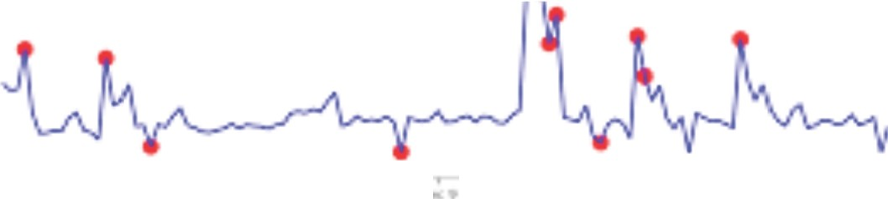
INTRODUCTION
Code visualization tools have become increasingly important in the software development industry. These tools help developers to identify potential anomalies in code by highlighting patterns of unusual behavior or code changes and take corrective action.
.l-.4
•
..."...
f
-. II
.
II

Slide 6

SK LEARN
PANDAS
TENSOR FLOW
NUMPV
MATPLOT LIB
KERAS
06

Slide 7
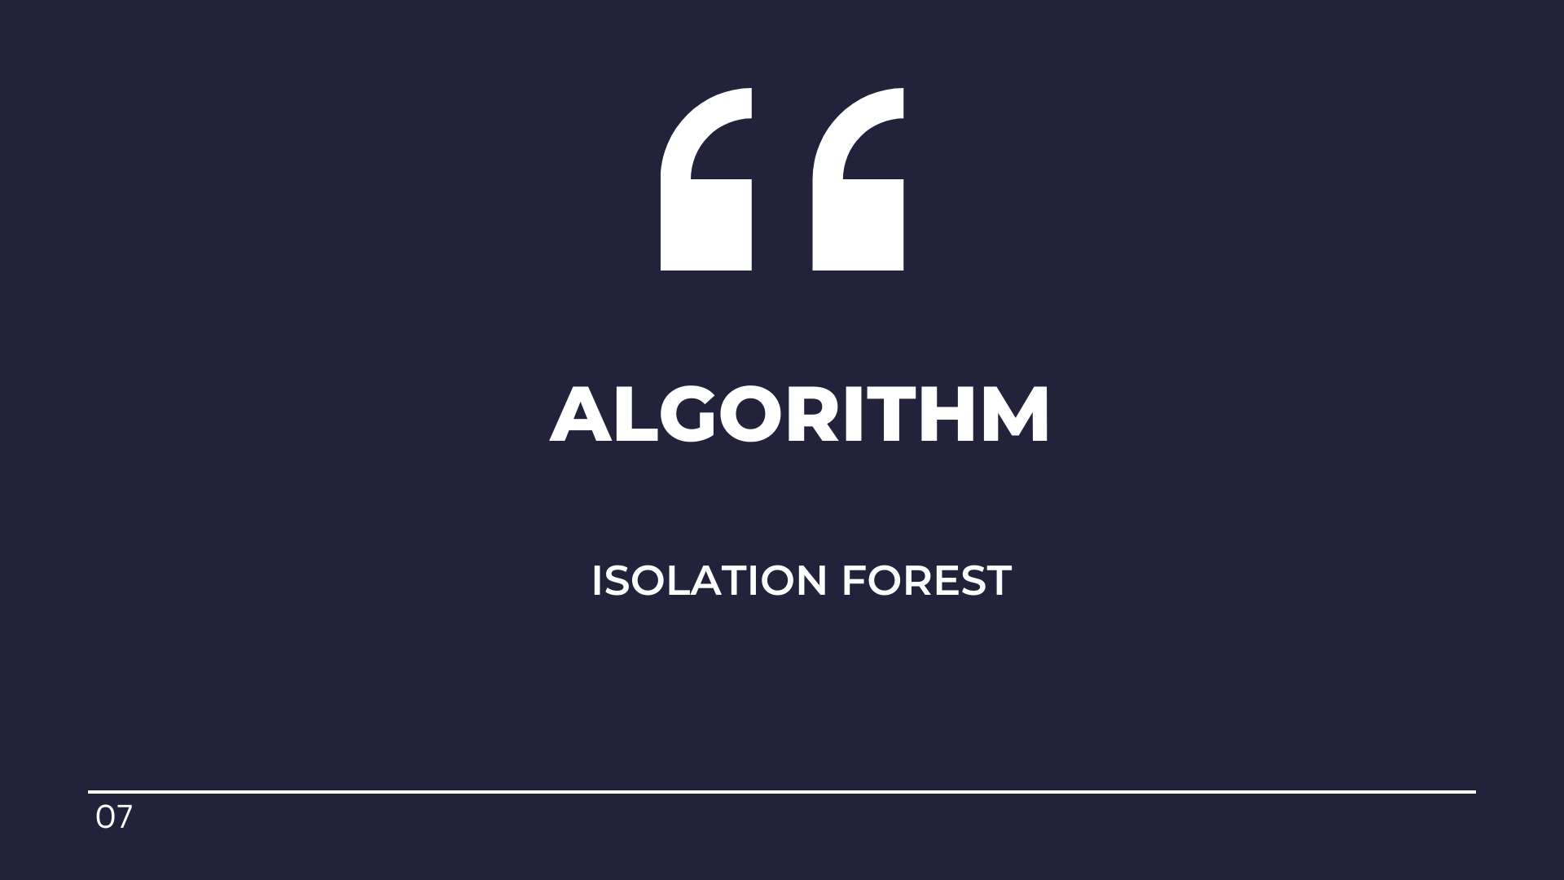

Slide 8
Isolation Forest
Isolation forest is a machine learning algorithm for anomaly detection. It's an unsupervised learning algorithm that identifies anomaly by isoll ating outliers in the data. Isolation Forest is based on the Decision Tree algorithm.

Slide 9
DATA SET
We trained the machine using data set we got from kaggle.
https://www. kaggle.com/datasets/veeralakrishna/python-code-data
We have taken 50 source codes from the kaggle for training the machine

Slide 10
APPROACH
•
Tokenisation:Tokenization in Python is the process of breaking down a text or sentence into smaller units called tokens.These tokens are typically words,phrases,or symbols
that can be used to analyze the text further.
Vectorization: Involves transformingtext into a numerical representation,usually a vector or a matrix,where each element represents a feature of the text,such as the frequency of a word or a character in a document.This process is called feature extraction.

Slide 11
Results
Number of Anomalies Detected 1n Code Files
2 00
Anomaly coun Scatter IP1ot
l.75
l.IXI
• •
L50
1.1:)
Ill
-50
t us
100
IQ
.. .
..
E l.25
⁰c:
-
fi
ct
u
•
0.... l.00
E
² 0.1:;
0..\0
II.I
.D
§ 0.75
z
0.50
........ ............. ...............
Q.7)
0.25
000
0.00
0 10
'20
(Odil t IM
Fig:-Result and visulisation

Slide 12
Team Name
BABA l
MA RAHEEM KHAN
BHARADWAJ KAMTAM
ALTAF BABA

Slide 13
THANK YOU!
10

