Slide 1
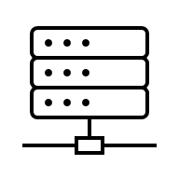



Network Intrusion Detection using Flow-to-Image Conversion and Deep Learning Classifiers
Student: Melinda-Henrietta Incze

Slide 2
Table of Contents
Motivation and Objectives
System Overview
Dataset
Traffic-to-Image Encoding
Training Setup
Experimental Design
Results
Conclusion

Slide 3
Motivation and Objectives
Motivation: IoT networks are widely used, but security is often weak.
Problem: Raw network traffic is difficult to classify because it is complex and variable.
Solution: Transform traffic into a consistent format that can be learned by a classifier.
Idea: Use a visual representation of traffic patterns for multi-class detection.
Objectives: Build the full workflow, run experiments, and report standard performance metrics.

Slide 4
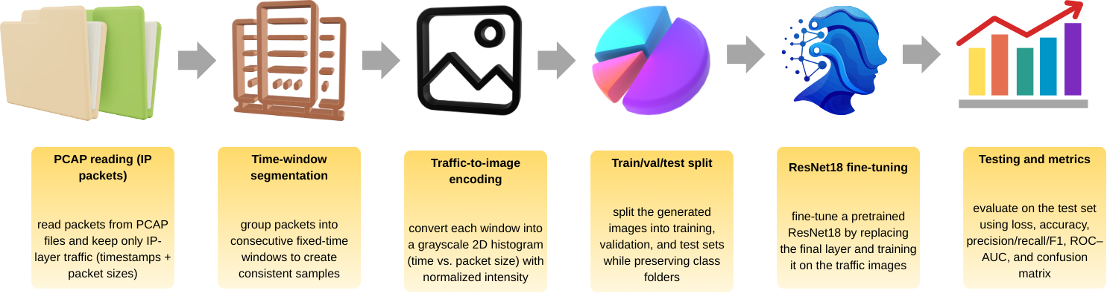
System Overview

Slide 5
Dataset
Source: CICIoT2023 published by the Canadian Institute for Cybersecurity
Content: 33 attacks, grouped into 7 categories: DDoS, DoS, Recon, Web-based, Brute Force, Spoofing, Mirai
Subset used in this project: 5 PCAPs (benign + SYN flood + UDP flood + HTTP flood + DNS spoofing) and 3 merged CSVs
Why this subset: manageable size for a student setup, but still covers different attack behaviors and supports future comparisons with feature-based methods

Slide 6
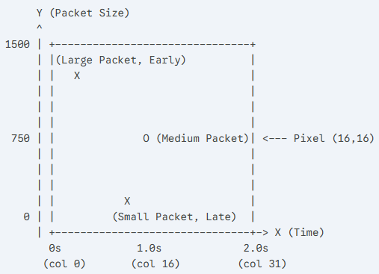
Traffic-to-Image Encoding
Traffic-to-Image Encoding: Split the PCAP traffic into fixed time windows, then convert each window into a grayscale image
How the image is built: The x-axis represents time inside the window, the y-axis represents packet size, and pixel intensity shows how many packets fall into each time–size bin
Why it helps: This creates a consistent input format and highlights patterns such as bursts and repeated packet sizes

Slide 7
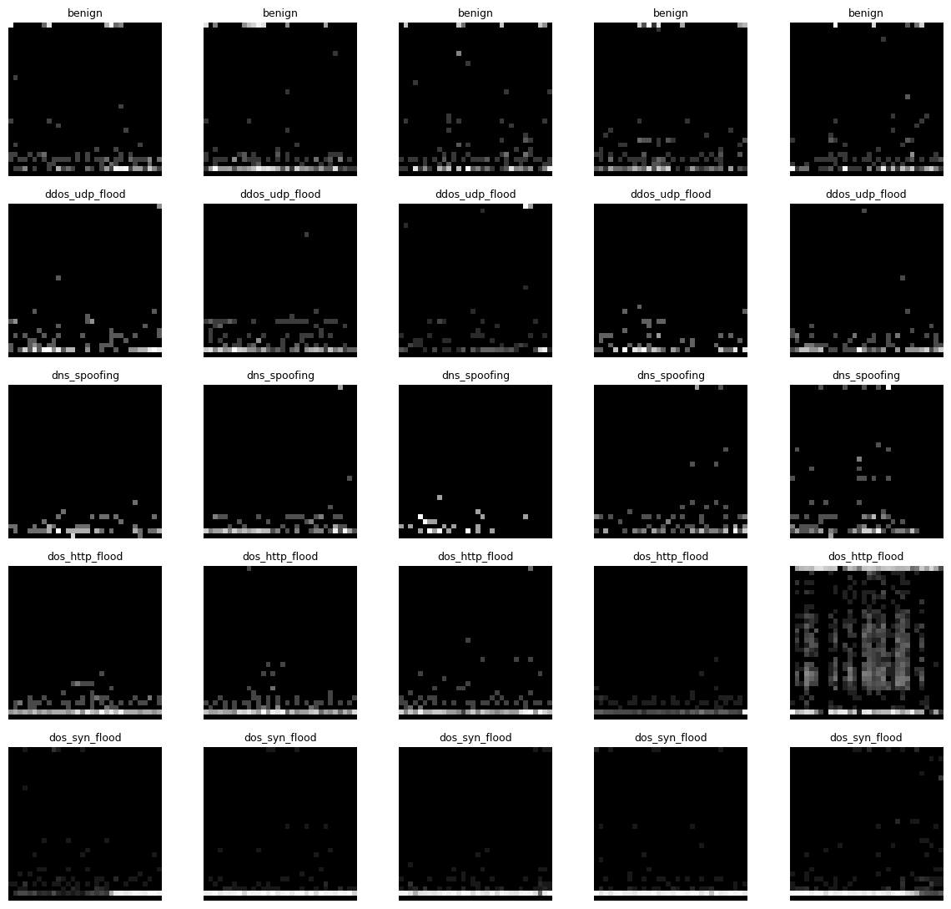
Traffic-to-Image Encoding
Here are representative generated images for each of the five traffic classes

Slide 8
Training Setup
Model: ResNet18 (transfer learning) the final layer is replaced to output 5 traffic classes
Data split: The image dataset is split into 70% train, 15% validation, and 15% test
Input handling: Each traffic image is resized to 224×224 and standardized before training
Training: Multi-class learning with cross-entropy loss and the Adam optimizer
Hyperparameters: batch size, learning rate, and epochs were tuned
Evaluation metrics: loss (cross-entropy), accuracy, precision, recall, F1-score, ROC–AUC, plus confusion matrix

Slide 9
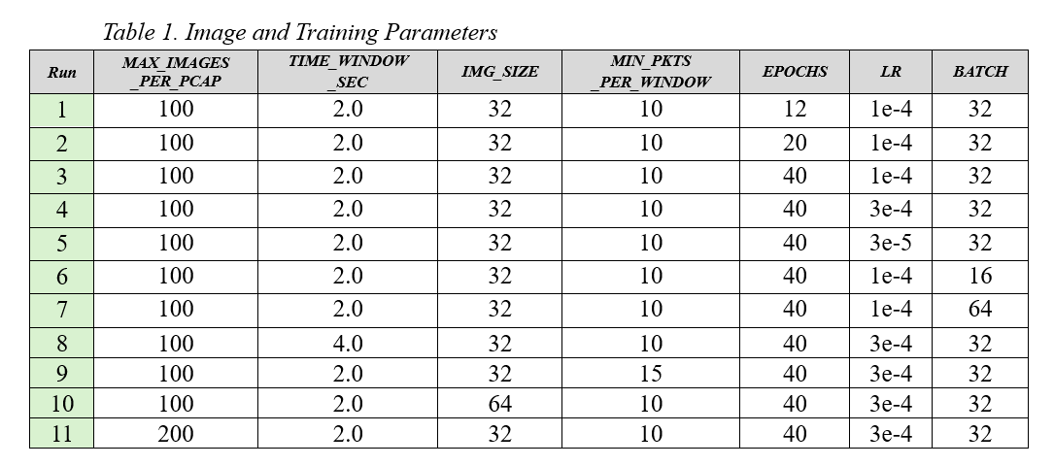
Experimental Design
Here is an overview of the hyperparameter and image-encoding settings evaluated in the experiments

Slide 10
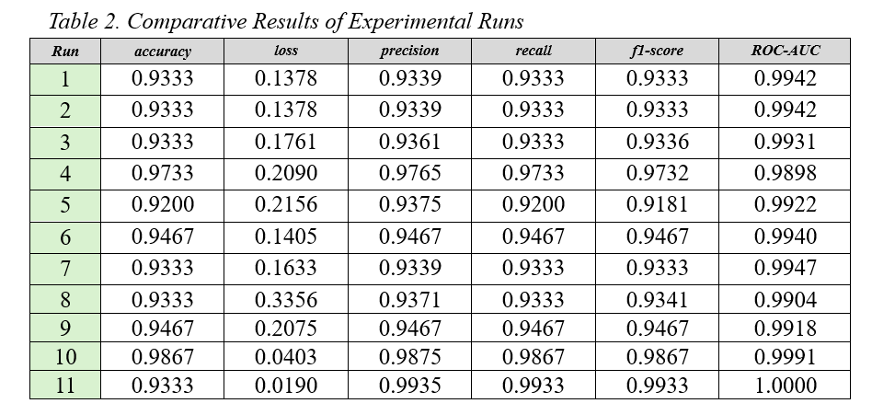
Results
Here we have the test-set results for all runs
Best run: Run 11
Why: it achieves the highest overall F1-score (0.9933) and ROC–AUC (1.0000) while also keeping accuracy high (0.9333) and the lowest loss (0.0190)

Slide 11
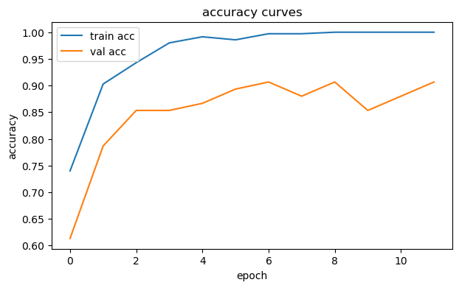
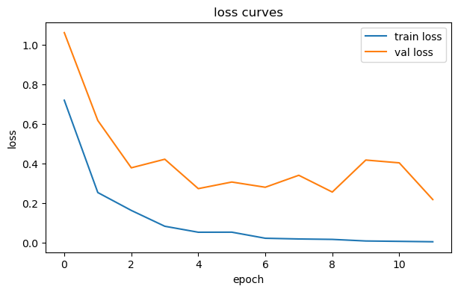
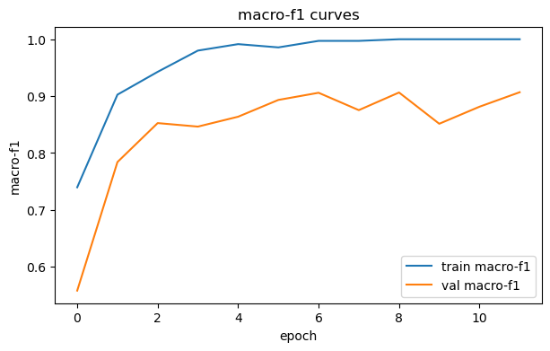
Results
Here we have the learning curves (Run 1)
Train accuracy/F1 increase fast and reach very high values
Validation improves early, then fluctuates below train → overfitting (small date)
Train loss keeps decreasing, while val loss oscillates after the first epochs

Slide 12
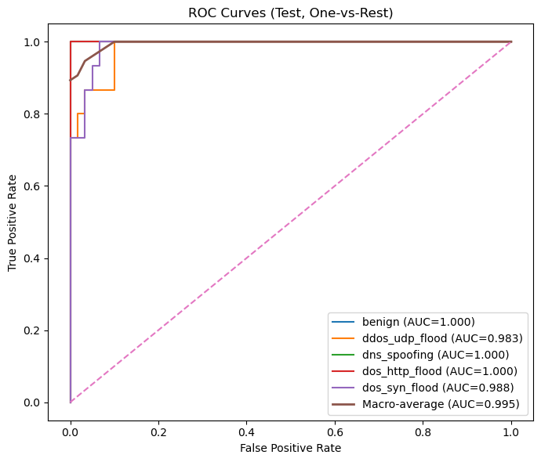
Results
Here we have the ROC curves for all classes on the test set (Run 1)
ROC–AUC measures how well the model separates each class from the others using predicted probabilities
The curves are close to the top-left corner and the macro-average AUC is very high, which indicates strong overall class separability

Slide 13
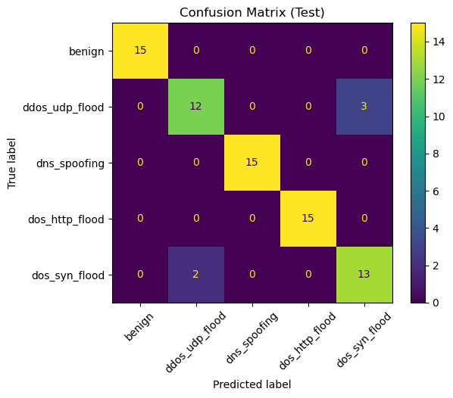
Results
Here we have the confusion matrix on the test set (Run 1)
Most samples are correctly classified (strong diagonal)
The main errors appear between ddos_udp_flood and dos_syn_flood, which suggests these two classes can look similar in the encoded images

Slide 14
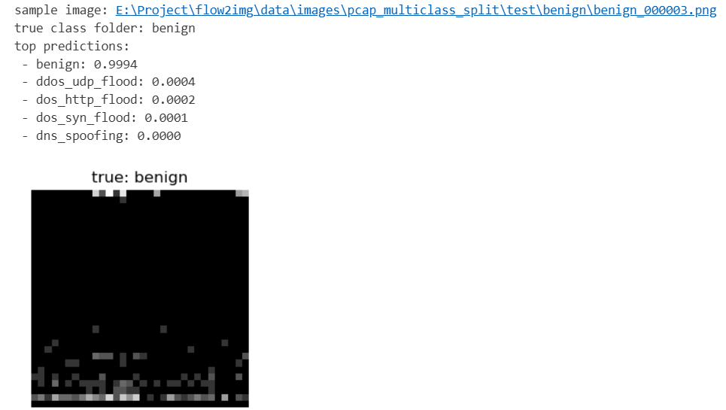
Results
Here we have a single test image with the model’s top predictions (Run 1)
The true class is benign, and the model predicts benign with very high confidence, while all other classes have near-zero probability

Slide 15
Conclusion
Best accuracy: Run 10 (0.9867); best separation: Run 11 (F1=0.9933, AUC=1.0000).
More training helped: 40 epochs + LR=3e-4 improved results vs. baseline.
Encoding mattered: IMG_SIZE=64 improved performance; TIME_WINDOW=4s increased loss
Main errors: confusion mainly between ddos_udp_flood and dos_syn_flood
Future work:
Expand to more PCAPs and attack types
Use stricter splits (by file or time blocks)
Improve the encoding with extra traffic signals

Slide 16
References
[1] E. C. P. Neto, S. Dadkhah, R. Ferreira, A. Zohourian, R. Lu, and A. A. Ghorbani, “CICIoT2023: A Real-Time Dataset and Benchmark for Large-Scale Attacks in IoT Environment,” Sensors, vol. 23, no. 13, Art. 5941, 2023, doi: 10.3390/s23135941.
[2] K. He, X. Zhang, S. Ren, and J. Sun, “Deep Residual Learning for Image Recognition,” in Proc. IEEE CVPR, 2016, pp. 770–778, doi: 10.1109/CVPR.2016.90.
[3] P. García-Teodoro, J. Díaz-Verdejo, G. Maciá-Fernández, and E. Vázquez, “Anomaly-based Network Intrusion Detection: Techniques, Systems and Challenges,” Computers & Security, vol. 28, no. 1–2, pp. 18–28, 2009, doi: 10.1016/j.cose.2008.08.003.
[4] A. L. Buczak and E. Guven, “A Survey of Data Mining and Machine Learning Methods for Cyber Security Intrusion Detection,” IEEE Communications Surveys & Tutorials, vol. 18, no. 2, pp. 1153–1176, 2016, doi: 10.1109/COMST.2015.2494502.
[5] T. Fawcett, “An Introduction to ROC Analysis,” Pattern Recognition Letters, vol. 27, no. 8, pp. 861–874, 2006, doi: 10.1016/j.patrec.2005.10.010.

Slide 17

THANK YOU!
Q&A?

