Slide 1


Copyright©petaniweb
UPLOAD FILE LARAVEL

Slide 2

Upload File Laravel
We plant good web
# UPLOAD FILE
Materi upload file pada laravel tidak terlalu berbeda dengan upload file di framework lain ataupun di php native.
Konsepnya sama, yaitu kita input sebuah file, lalu kita save di sebuah directory public, setelah itu path-nya kita save ke database sebagai text yang berisi path directory, dan yang terakhir kita baca path file dari database tersebut untuk kita tampilkan sebagai image.

Slide 3
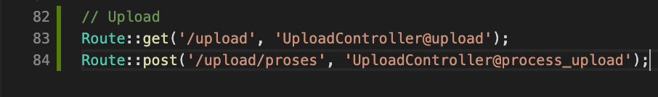
Route & Controller
We plant good web
# UPLOAD FILE
Buat route
Buat controller

Slide 4
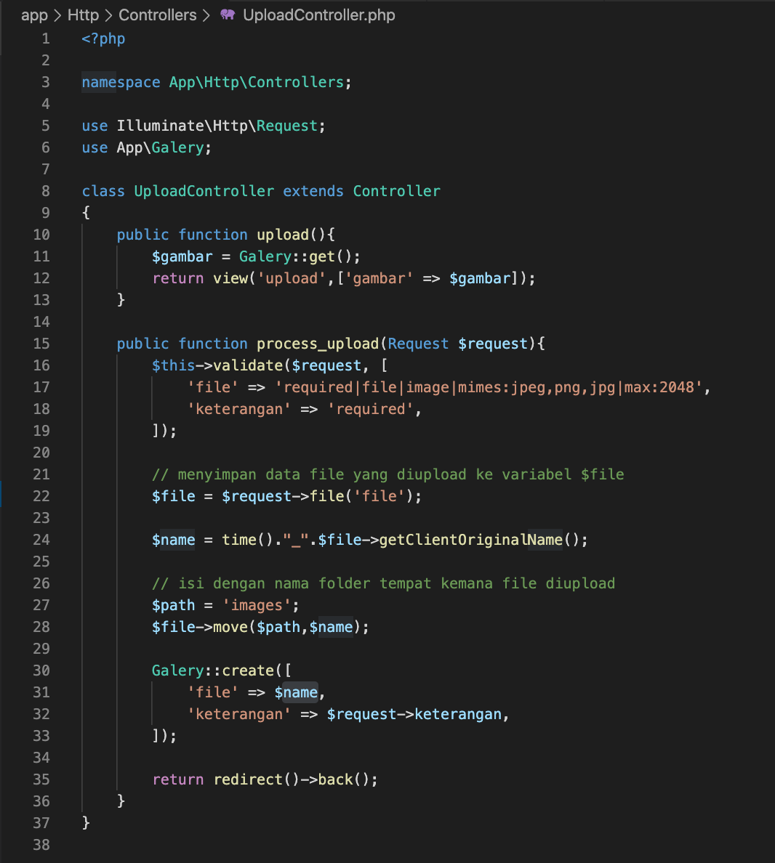
UploadController
We plant good web
# UPLOAD FILE
Edit UploadController.php

Slide 5
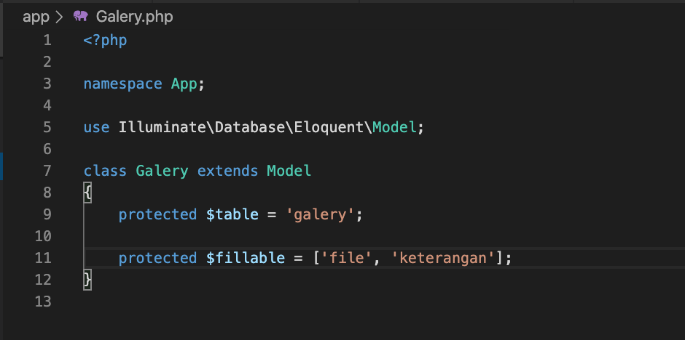
Model Galery
We plant good web
# UPLOAD FILE
Run php artisan make:model Galery --migration
Edit Galery.php

Slide 6
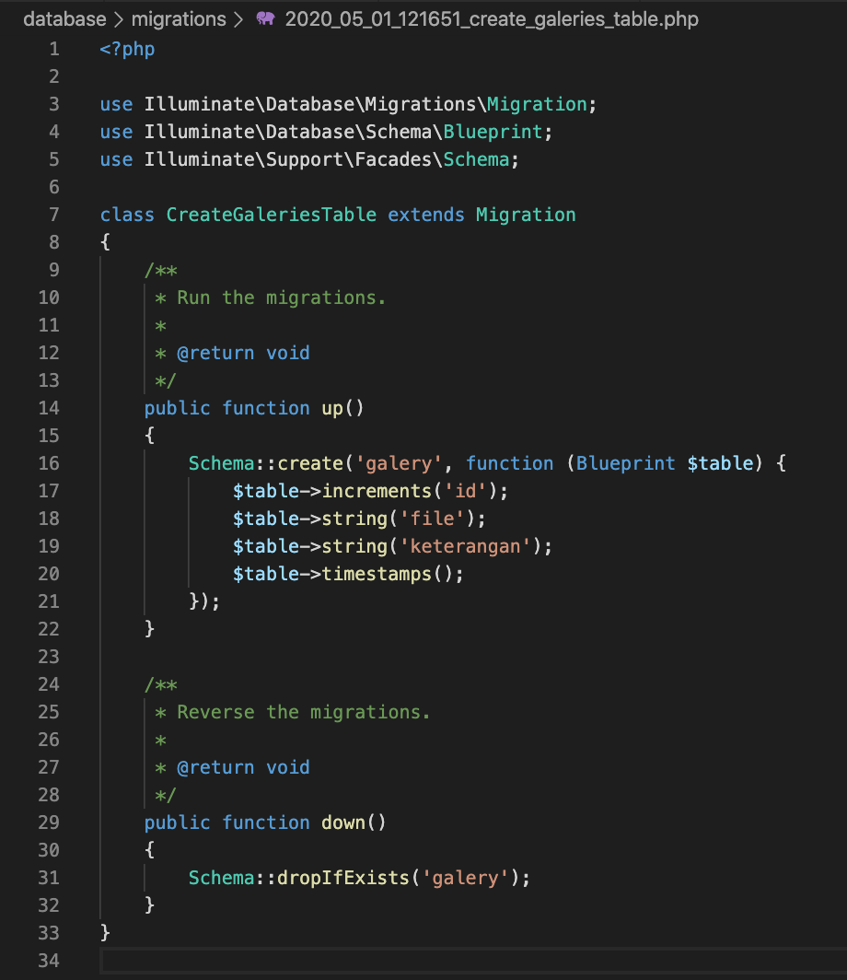
Migrate Galery
We plant good web
# UPLOAD FILE
Edit Galery migration(dabase/migration/create_galeries_table.php

Slide 7
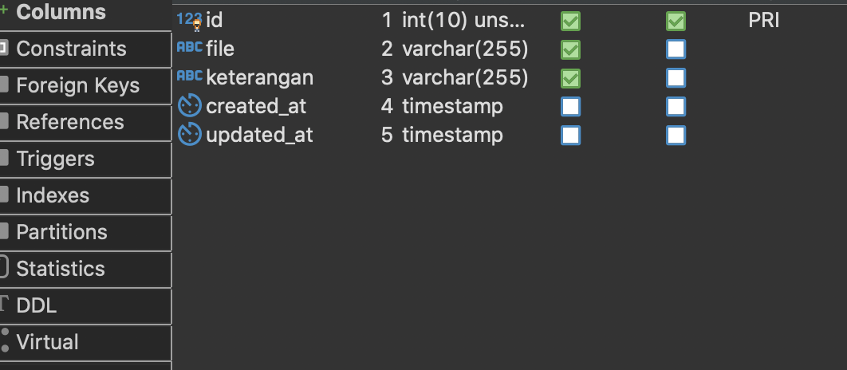
Migrate Galery
We plant good web
# UPLOAD FILE
Run >> php artisan migrate
Check database >> table galery

Slide 8
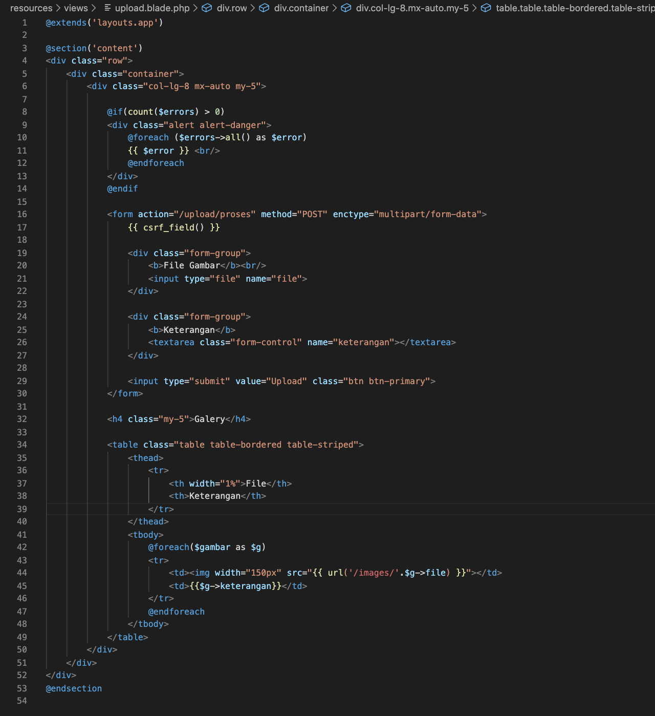
View Upload
We plant good web
# UPLOAD FILE
upload.blade.php

Slide 9
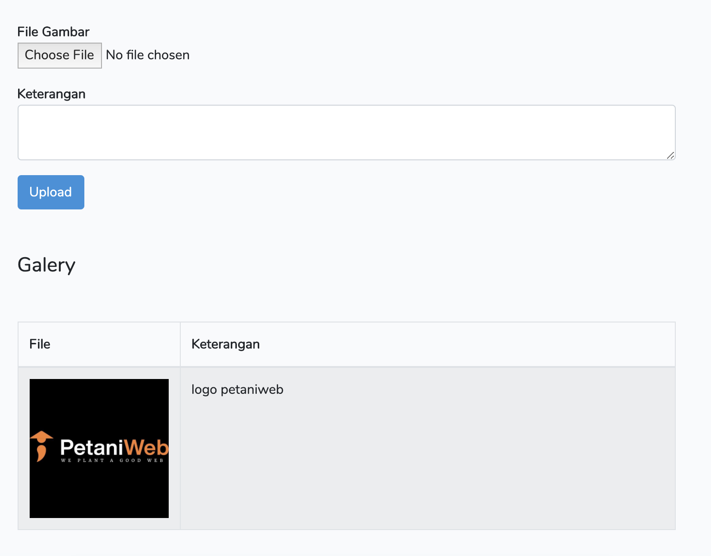
Result Upload
We plant good web
# UPLOAD FILE

