Slide 1

BUDGET TRACKER
A SIMPLE EXPENSE TRACKING PROGRAM CREATED USING PYTHON
spring 2020 Cps 3320
By: Ashley indar

Slide 2

FINANCIAL PRIORITIZING
Many have felt the financial effects caused by the global pandemic, COVID-19.
College students, specifically have either lost their jobs or experienced a significant cut in hours.
This causes stress as we strive to move to a virtual learning environment, in which many do not have access to the technology necessary to succeed in these times.
Financial prioritizing and money management in these times is the key to ensuring that one has enough to afford for the essentials for survival, as well as the necessities to continue to succeed academically and career-wise.

Slide 3



How do I budget?
There are a couple key factors that set the template to efficient budgeting.
Prioritizing
Revision
Accountability
Saving
Identify necessary vs. unnecessary expenses.
Take the necessary action to revise based on priority spending.
Hold yourself accountable by keeping track of your expenses.
Save money based on your new revised budget!

Slide 4

Python budget program
Using Python, I created a budget program for college students, such as myself, that will help the user keep track of their income and expenses on their desired basis (weekly, monthly, annually, etc.)
My program automatically calculates the difference of the users total expenses from their total income to determine whether they have sufficient or insufficient funds.
This program runs on a constant loop until the user indicates they do not want to run it another time.
For simplicity and ease of convenience, it runs directly in the users Command Prompt or Terminal Shell.
It creates an easy and interactive experience to allow the user to check their financial status frequently and assess essential vs. non-essential expenses based on their income.
The ability to see it helps create a level of accountability that will inspire the user to prioritize, revise, and save to ensure efficient budgeting!

Slide 5

How it works
This program was designed as follows:
Import the sys module from the Python Standard Library to utilize it’s System-specific parameters and functions.
Define the Application class to later be called so the program can run.
Define variables to hold and perform key budget functions.
Define functions so the user can:
Add the values and names of multiple incomes and expenses.
Keep track of total incomes and expenses.
Be prompted to add incomes & expenses if they opt not to without having entered any.
Compute and determine wither the user has sufficient or insufficient funds.
Reset and initialize values to 0 again in case the user decides to run the program again.
Exit the program.
Finally, the Application class is called, allowing the program to run.

Slide 6
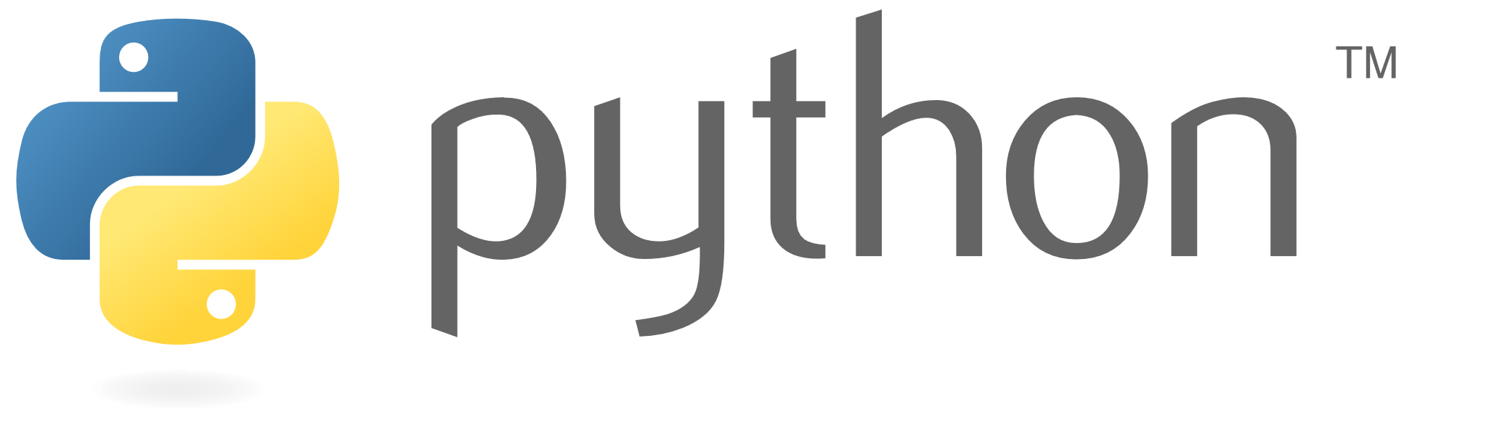
In terms of Python. . .
In technical terms, this program was accomplished through the use of:
import sys
To access system-specific parameters and functions
def functions
To define functions
If/else, nested if/else, while, and for loops
To make all essential functions execute
sys.exit()
To exit the program
if __name__ == '__main__’:
To call on the Application() class

Slide 7
Please see following slides for code sample!
NEXT

Slide 8
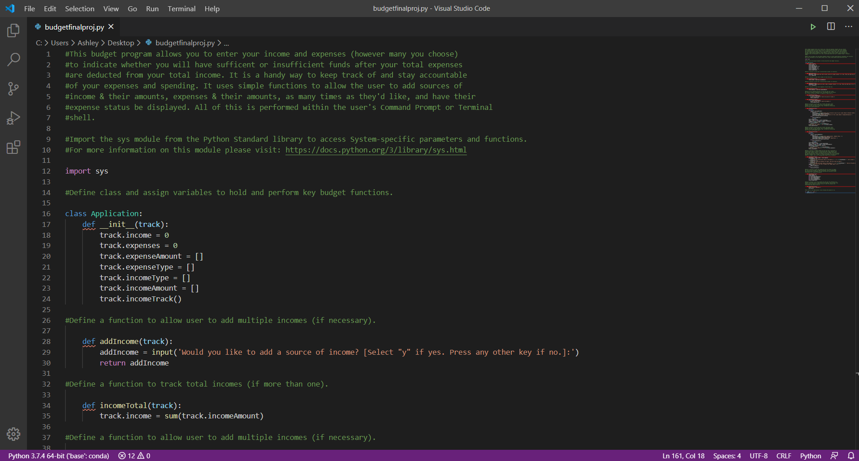

Slide 9
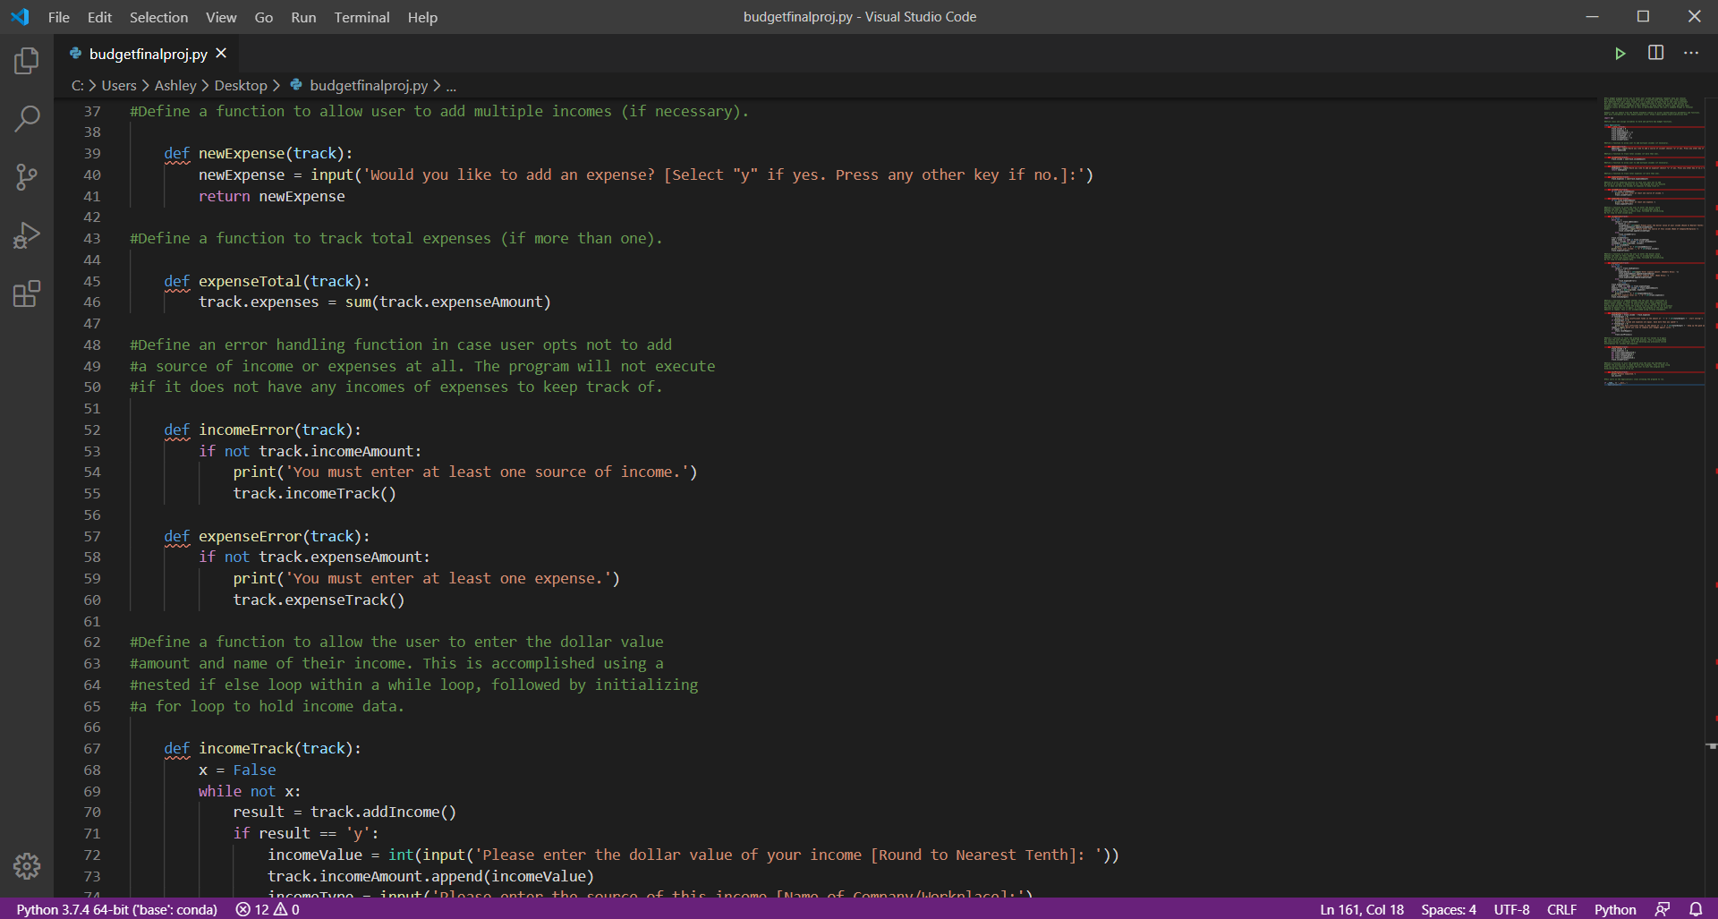

Slide 10
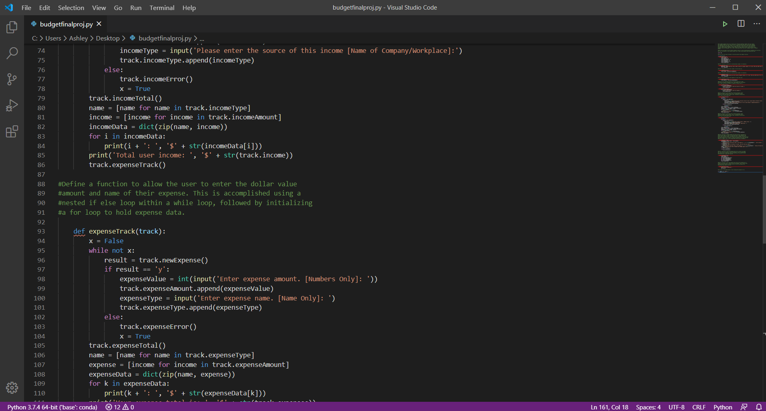

Slide 11
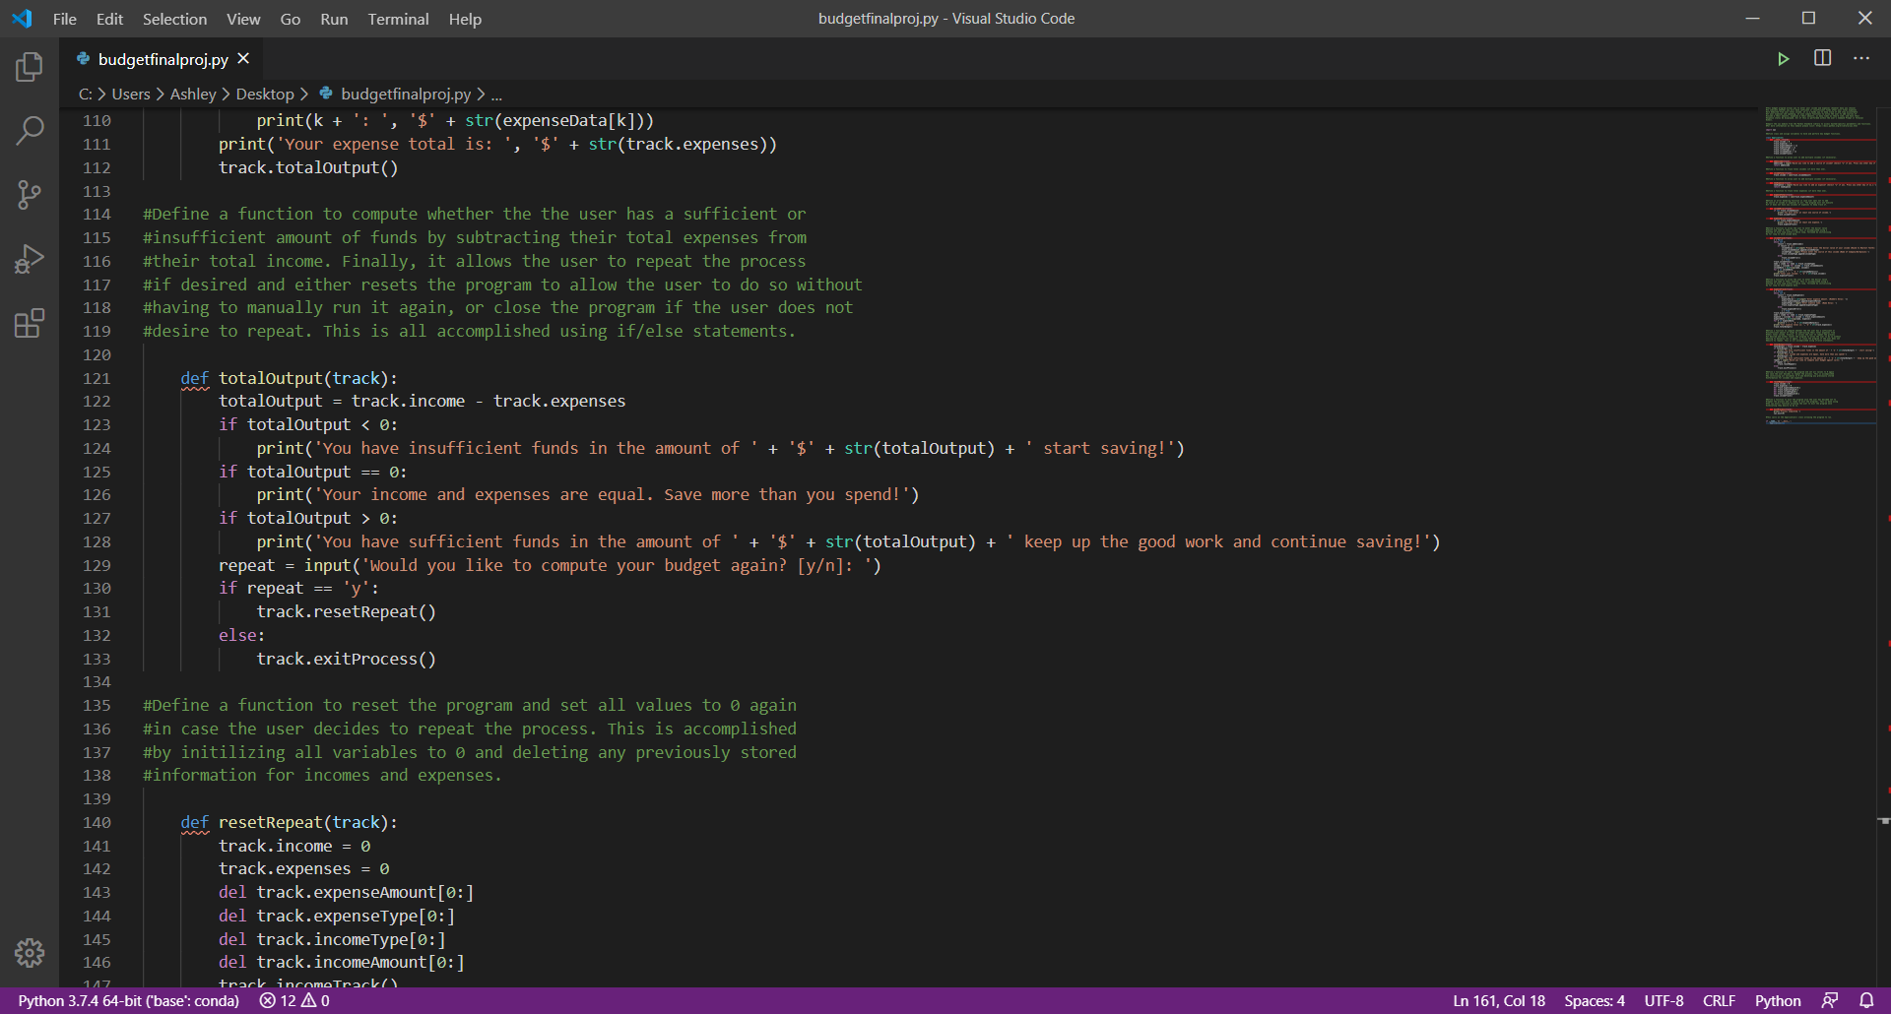

Slide 12
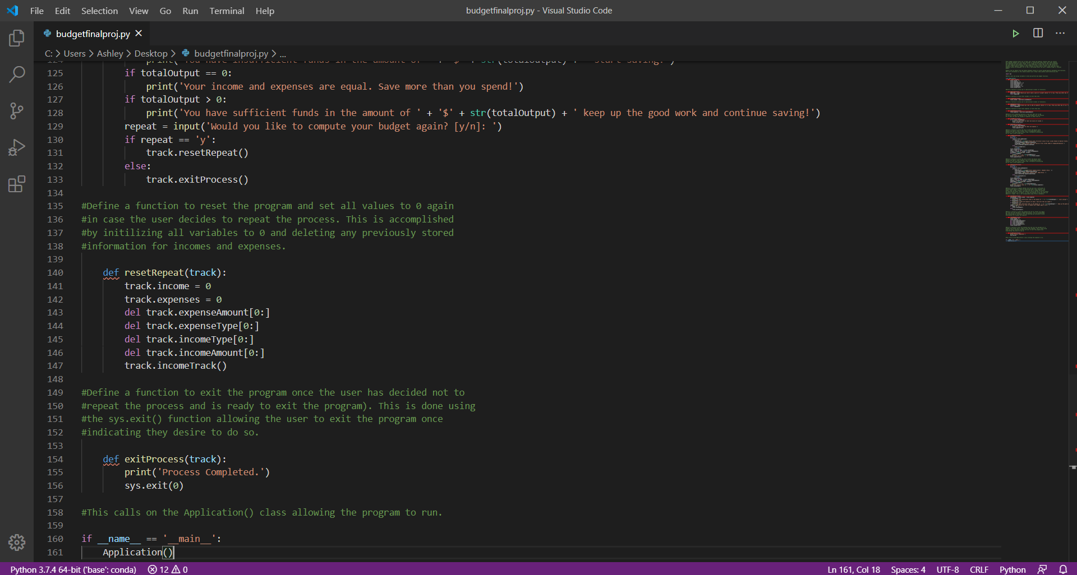

Slide 13
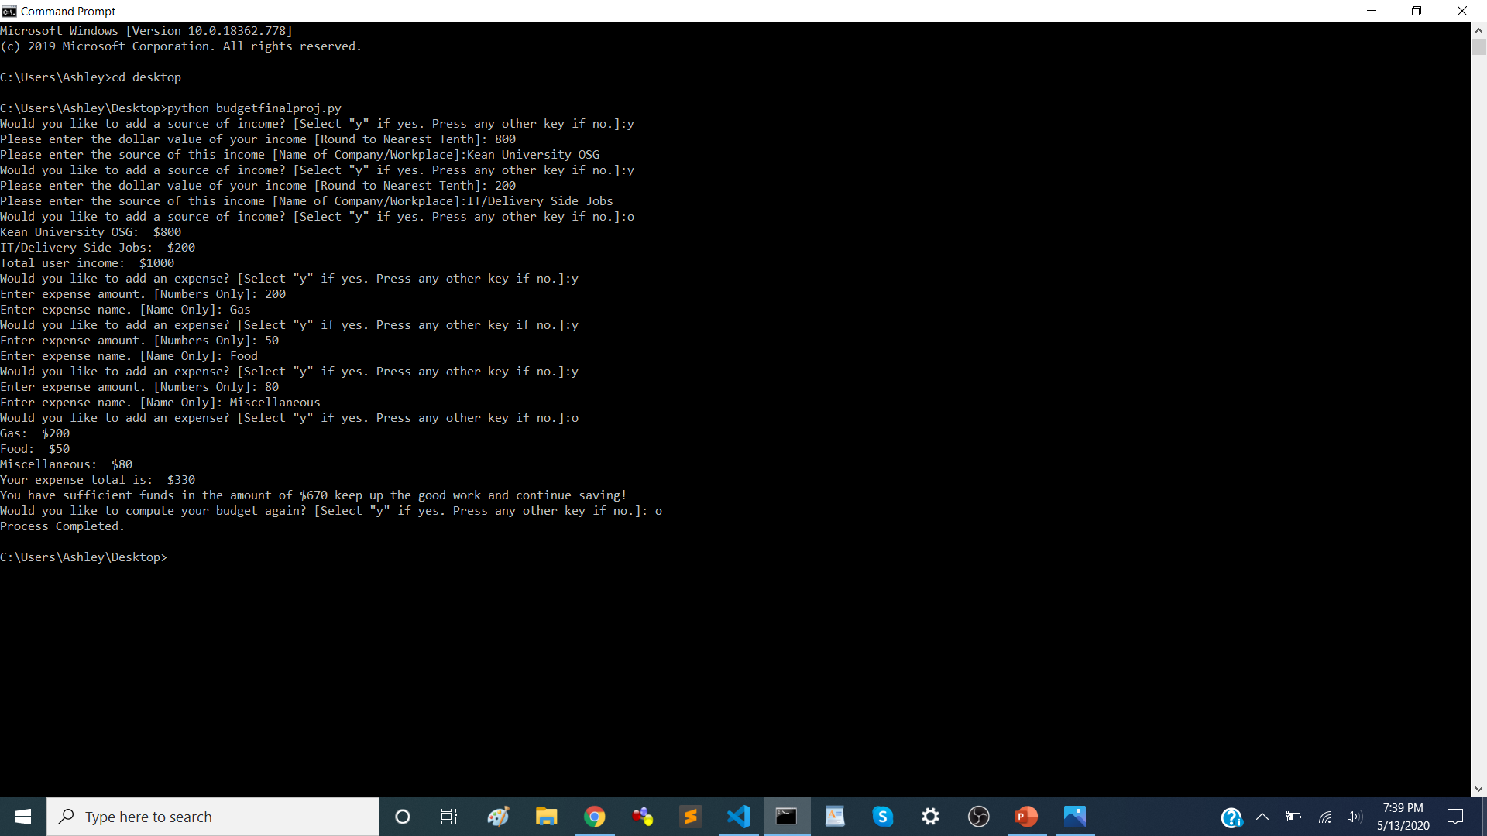
Sample run

Slide 14


Final remarks
I wrote this program in hopes that it can help college students, such as myself, prioritize, stay accountable, revise their expenses, and save based on their new revised budget.
I hope this will help the user implement financial prioritizing and efficient budgeting practices.
My next goal for this project is to implement a Graphical User Interface (GUI) to make it more user friendly and even more fun to work with!

Slide 15

Thank You!
INDARA@KEAN.EDU

