Slide 1



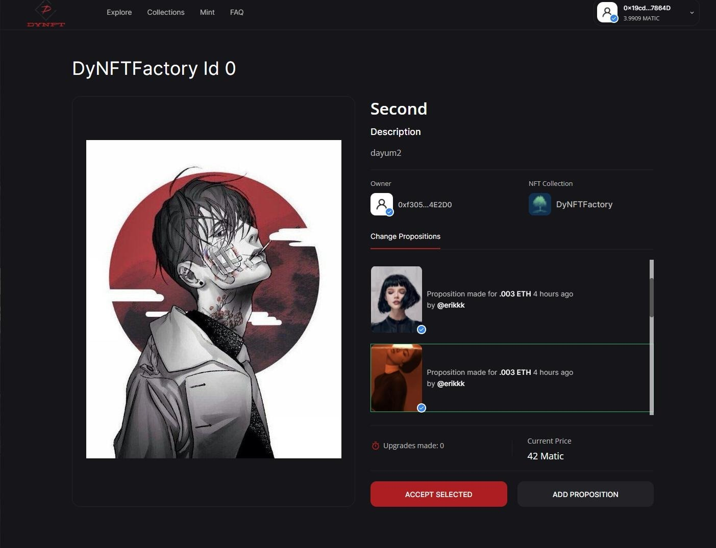

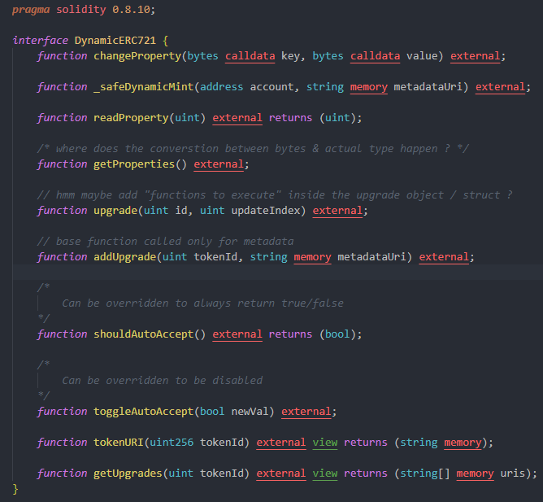

NFTPort
Dynamic NFTs

Slide 2

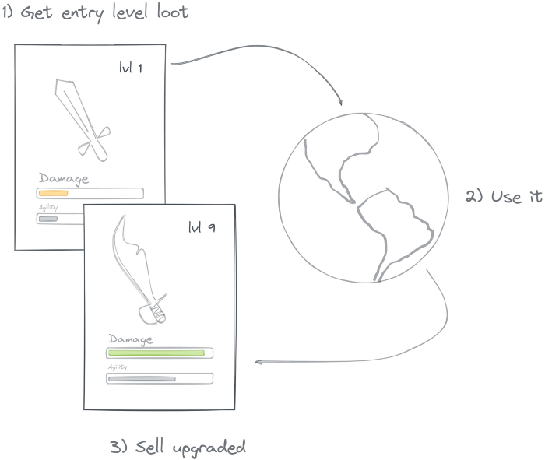
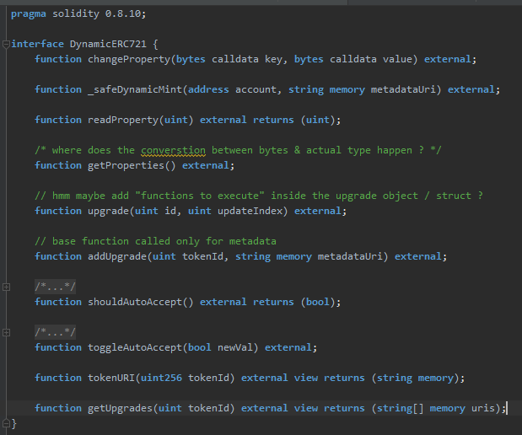
Why?
Why?
Upgradable
IPFS for GameFi assets
Trustless

Slide 3
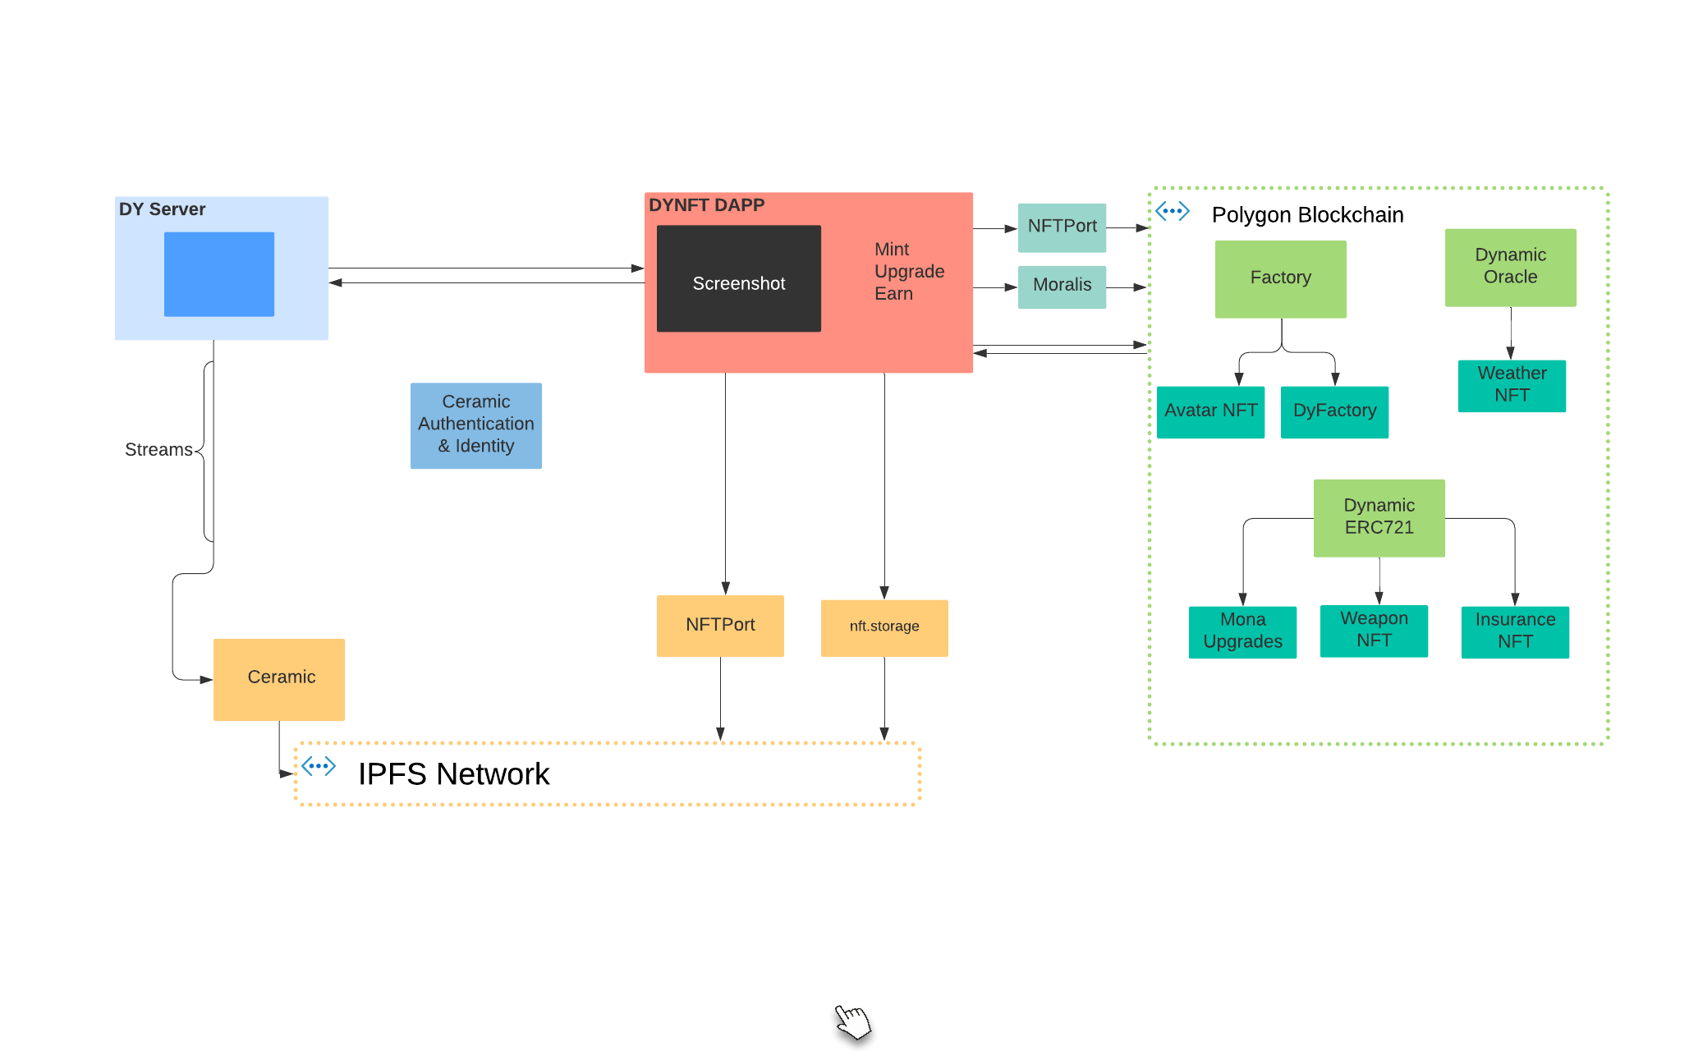

Architecture

Slide 4

DEMO

Slide 5
Next Steps
Step 1
More contracts & examples
Step 2
Add royalty support
Step 3
Extend Dapp
Step 4
Partners & Early Users

Slide 6


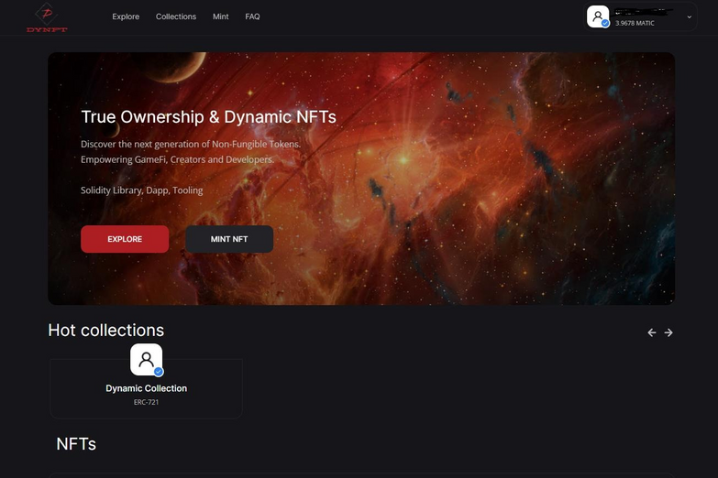
Repo - https://github.com/indeavr/blockchain-developer-bootcamp-final-project
Hosted With Fleek – dynamicnfts.eth
Check it out!

