Slide 1
ChatFolio
Final Presentation
AI-Powered Conversational Investment Advisor
Chris · Indel · Nate · Matt | April 2026
Notes:
Welcome everyone. Today we're presenting ChatFolio, our HAI term project. We set out to solve a specific problem: why do so many people who want to invest never actually start? We'll walk through our design journey, what we built, how we evaluated it, and what we learned.

Slide 2
The Problem
PROJECT OVERVIEW
57%
WHY BEGINNERS DON'T INVEST
→ Information overload — too many products, tickers, and strategies
→ Fear of making a costly mistake with real money
→ Brokerage forms require financial knowledge to complete
→ Existing tools tell you WHAT to buy — not WHY it fits you
→ No clear starting point for someone with $100–$200/month
of US adults don't personally own stocks
38%
of non-owners say they don't understand the market
Source: Philadelphia Fed, Consumer Finance Brief
Notes:
The problem is real and measurable. More than half of American adults have no stock market exposure, and a big driver is a lack of understanding — not a lack of desire. Existing tools like Robinhood and Fidelity are built for people who already know what they want. ChatFolio is built for people who don't.

Slide 3
Our Solution + Target User
PROJECT OVERVIEW
CHATFOLIO
MEET MARCUS — OUR TARGET USER
A conversational investment advisor that replaces brokerage forms with natural dialogue.
Age
26 — recent grad, first full-time job
✦ User describes goals in plain language
✦ GPT-4o-mini extracts profile through conversation
✦ Live sidebar shows what the system has captured
✦ User clicks "Generate My Portfolio" (human-in-the-loop)
✦ Rule-based ETF allocation + AI-written rationale
✦ Growth projections + step-by-step action plan
✦ User can chat to adjust — portfolio regenerates
Budget
~$150/month to invest
Knowledge
Intimidated by financial jargon
Comfort
Comfortable with chat interfaces
Goal
Build wealth without learning finance theory
Problem
Doesn't know where or how to start
Notes:
ChatFolio's core idea: replace the intimidating brokerage form with a conversation. Marcus represents our target user — someone who wants to invest but keeps hitting a wall of jargon and complexity. Every design decision was filtered through the question: would Marcus understand this? Would Marcus trust this?

Slide 4
How It Works
PROJECT OVERVIEW
User Chat
GPT-4o-mini (JSON mode)
Live Profile Sidebar
Generate Button
Portfolio + Rationale + Projections
→
→
→
→
HAI Evaluation Criteria:
Onboarding
User Input
System Output
User Feedback
Explainer panel, disclaimer, post-gen guidance banner
Conversational Q&A, one question at a time, open-ended extras
Live sidebar, portfolio rationale, projections, action plan
Confirmation loops, edit loop, spinner + toast on update
Notes:
Here's the full pipeline. Every user message flows through GPT-4o-mini in JSON mode — the model returns both a conversational reply and structured profile updates in one call. The generate button is deliberate friction: the user confirms their profile before we produce a recommendation. Below, you can see how each part of the system maps to the four HAI evaluation criteria — this wasn't an afterthought, it was the design constraint.

Slide 5
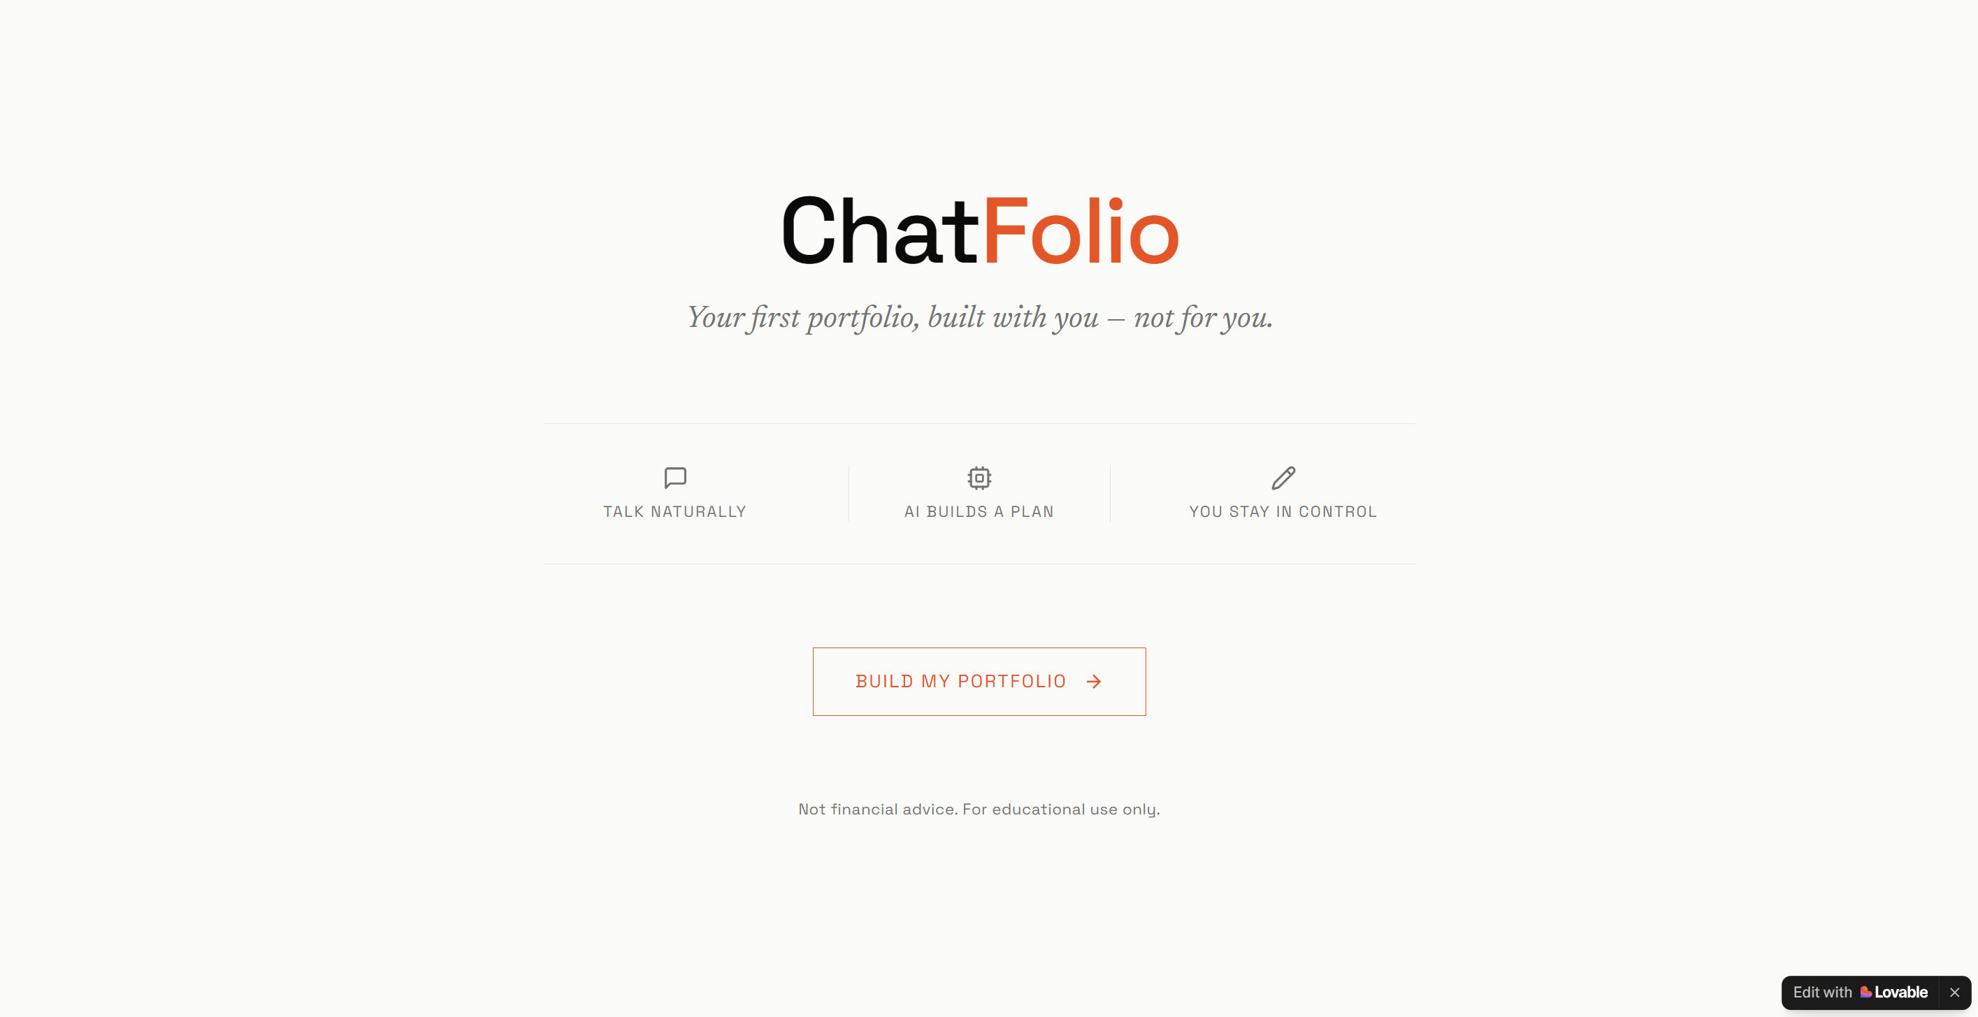
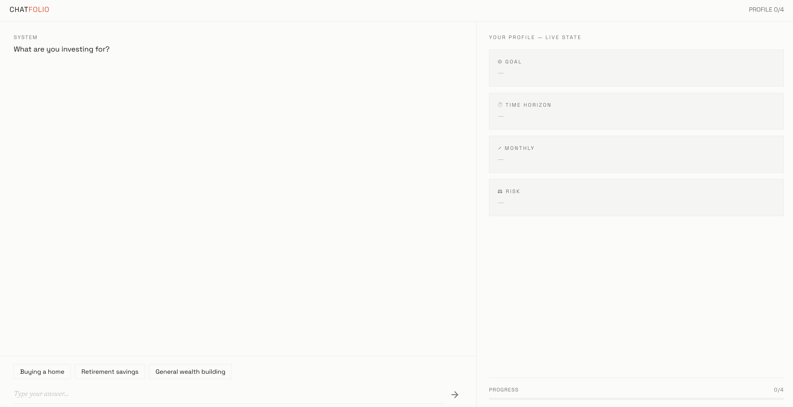
v0.1 — Initial Prototype
PROTOTYPE EVOLUTION | March 2026
Lovable no-code mockup — static UI, no real AI
Landing Page
Chat + Live Profile Sidebar
✓ Established the dual-panel layout concept
✓ Proved conversational framing over forms
✗ Static — no real AI or profile extraction
Notes:
Before writing a single line of Python, we built a static mockup in Lovable. This let the four of us align on the visual concept and interaction model in hours, not days. The dual-panel layout — chat on the left, live profile on the right — came directly from this mockup. The Lovable version even had Accept/Adjust/Explain buttons on the portfolio, which set the aspiration for what the real system should eventually do.

Slide 6
v0.2 / v0.3 — First Functional Prototype
PROTOTYPE EVOLUTION | March 2026
Streamlit + GPT-4o-mini — real AI, real profile extraction
v0.2 — CORE ENGINE
Your Profile
Hi! I'm ChatFolio. What are you investing for?
• GPT-4o-mini live with JSON response mode
• Conversational profile extraction
• Confirmation loops on ambiguous answers
• Live sidebar updates in real time
• "Generate My Portfolio" button (human-in-the-loop)
• Rule-based ETF allocation (VTI/VXUS/BND/BNDX)
Goal
Retirement
Saving for retirement, about 30 years out
Timeline
30 years
Budget
Great! How much can you invest each month?
$150/mo
Risk
Around $150
Moderate
v0.3 — FULL FEATURE SET
Extra
401k noted
• "What is ChatFolio?" onboarding explainer panel
• AI-generated portfolio rationale (plain language)
• Growth projections — 3 scenarios, line chart
• Step-by-step action plan (brokerage, account, ETFs)
• Post-generation edit loop — chat stays active
• Static disclaimer + guardrails in system prompt
Progress 4/4
Generate My Portfolio →
Type your message...
Wireframe — Streamlit dark theme
Notes:
In v0.2 we replaced the static mockup with a real Streamlit app backed by GPT-4o-mini. Users could now have an actual conversation and see their profile fill in live. v0.3 added everything that makes the output meaningful: the rationale that explains WHY the portfolio was built this way, the growth projections that make the numbers concrete, and the action plan that tells the user what to actually do next. The edit loop was also added here — users could keep chatting after generation.

Slide 7
v0.4 / v0.5 — Post-Evaluation Polish
PROTOTYPE EVOLUTION | April 2026
Prompt refinements + UX improvements driven by user testing
PROMPT CHANGES (v0.4)
Chat
ALLOCATION
1
One-field confirmation loop — paraphrase + confirm before saving
Portfolio generated!
VTI
64%
VXUS
2
Edge case handling: variable budget, $0 budget, short timeline
Make it more aggressive
21%
BND
10%
3
Post-gen behavioral split: adjust profile vs. answer questions
Updated to Aggressive. Regenerating...
BNDX
5%
4
Proactive contextual question after 4 required fields
RATIONALE
5
Plain-language risk descriptions required — no numeric confidence
PROJECTIONS
UX CHANGES (v0.5)
ACTION PLAN
• Split view: chat and portfolio scroll independently
• Spinner + success toast on portfolio regeneration
• Prominent follow-up guidance banner after generation
💡 Try: "make it more aggressive" or "what is VTI?"
Wireframe — post-generation split view
Notes:
After running our think-aloud study, we had a concrete list of things to fix. v0.4 was a prompt overhaul: we tightened the confirmation loop, handled edge cases we'd seen break in testing, and required the AI to explain risk in plain English every time. v0.5 was the UX pass: the post-generation layout now uses two independent scroll containers so users can review the portfolio while keeping the conversation in view. The spinner and success toast give clear feedback that a follow-up message triggered a change.

Slide 8
Evaluation: Think-Aloud Study
EVALUATION & REFINEMENT | n = 7
METHODOLOGY
Onboarding & Initial Prompt
Risk Tolerance Confusion
Chat & Conversation Flow
Task: complete full ChatFolio flow
greeting → 4 questions → generate
Method: think-aloud, moderated
Observer noted friction points and
surprises without guiding users
n = 7 college students
Mixed investing experience
CS, Finance, and Economics majors
Synthesis: affinity diagramming → 6 themes
6 / 7 participants
3 / 7 participants
5 / 7 participants
Portfolio Output & Comprehension
UX & Visual Polish
What Worked Well
5 / 7 participants
4 / 7 participants
6 / 7 participants
Notes:
We ran a think-aloud study with 7 participants who used ChatFolio while narrating their thoughts aloud. We observed — we didn't guide or help. After the sessions, we used affinity diagramming to cluster observations into 6 themes. Onboarding and What Worked Well both hit 6 of 7 participants — meaning nearly everyone had something to say about the first impression, and nearly everyone found something they genuinely liked.

Slide 9
Key Findings → What We Changed
EVALUATION & REFINEMENT
PAIN POINTS OBSERVED
WHAT WE CHANGED
1
Onboarding prompt implied only "retirement" or "house" as valid goals
✓
Rewrote opening prompt to accept any goal; removed example anchors
2
Risk tolerance question confused beginners — "35% confident" phrasing broke trust
✓
Required plain-language risk descriptions; banned numeric outputs
3
Users dumped all info in one message, bypassing step-by-step design
✓
Enforced one-question-at-a-time in system prompt; added confirmation loop
4
ETF tickers (VTI, VXUS, BND) were meaningless — literacy gap
✓
Added inline ETF explanations to rationale; defined "index fund" on first use
5
No feedback when a follow-up message triggered portfolio regeneration
✓
Added spinner + success toast on regeneration; clear visual feedback
Notes:
This is the slide that shows why HAI evaluation matters. Each pain point on the left maps directly to a concrete change on the right. The financial literacy gap was the biggest surprise — we assumed users would google an ETF ticker. They didn't. They either guessed or disengaged. The regeneration feedback issue was simpler but just as impactful: users thought nothing happened when they sent a follow-up message.

Slide 10
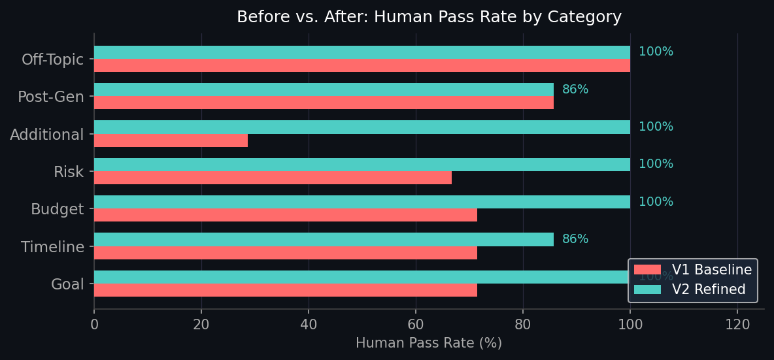
Evaluation Results
EVALUATION & REFINEMENT
Metric
V1
V2
Δ
LLM Avg
3.61
4.80
+1.19
Human Avg
3.96
4.76
+0.80
LLM Pass %
67.3%
91.8%
+24.5pp
Human Pass %
71.4%
95.9%
+24.5pp
+24.5 pp
human pass rate improvement
71.4% → 95.9%
Notes:
The quantitative eval used a 49-sample benchmark dataset across 7 categories. Each response was rated 1-5 by both an LLM judge and a human reviewer — pass threshold was 4 or above. V1 passed 71.4% of human-rated cases. V2 passed 95.9% — a 24.5 percentage point jump. Crucially, the LLM-judge and human ratings stayed within 0.1 of each other on average, which gives us confidence the automated metric is actually measuring what matters.

Slide 11
Walkthrough Demo
DEMO VIDEO | 2-3 minutes
(Video submitted as separate file)
▶
Key moments in the demo:
1. Onboarding panel on first load — what ChatFolio is and isn't
2. Conversational profile building — one question at a time
3. Live sidebar updating in real time as fields are confirmed
4. Clicking "Generate My Portfolio" — the deliberate pause
5. Reading the rationale and growth projections
6. Follow-up adjustment → spinner → portfolio regenerates
Notes:
Play the demo video now — it runs approximately 2 to 3 minutes. Watch for the live sidebar updates, the generate button moment, and the follow-up adjustment at the end. After the video, we'll cover lessons learned.

Slide 12
Lessons Learned
LESSONS LEARNED
1
Mixed-initiative interaction works — but only if users feel in control
Users engaged most when they could steer the conversation freely. The edit loop was used more than we expected — people wanted to iterate, not just accept.
2
Financial literacy is a design problem, not a user problem
Every time a user got confused by a term, that was our failure, not theirs. Inline definitions and plain-language rationale closed the gap more than any other change.
3
Conversation beats forms — but only if it doesn't feel like a form in disguise
The one-question-at-a-time approach worked, but users who tried to answer everything upfront revealed a tension: our sequential design assumed the user would pace with us.
4
The edit loop matters as much as first generation — iteration is the real product
We almost shipped without robust post-generation UX. The think-aloud study made clear that the moment after "Generate" is where users actually engage with the output.
Notes:
Four things we'd tell our past selves. The financial literacy gap was the most actionable insight — it's fixable with copy, not architecture. The mixed-initiative finding is broader: users want to be the driver, not the passenger. And the lesson about the edit loop applies to any generative AI tool — the output is a starting point for dialogue, not a finished deliverable.

Slide 13
ChatFolio
Thank You
Chris · Indel · Nate · Matt
streamlit run app.py
Questions?
Notes:
Open for questions. The walkthrough video was submitted as a separate file. The full source code is in the repo — run 'streamlit run app.py' to try it live.

