Slide 1
ChatFolio
Evaluation Report
Qualitative & Quantitative User Evaluation
Chris · Indel · Nate · Matt | April 2026

Slide 2
Study Overview & Participant Demographics
PART 1 — QUALITATIVE
METHODOLOGY
PARTICIPANTS (n = 7)
Task: complete full ChatFolio flow
greeting → 4 questions → generate portfolio
Method: think-aloud, moderated observation
Observer noted friction points, surprises,
and positive reactions without guiding users
Synthesis: affinity diagramming → 6 themes
All college students
Majors: CS, Finance, Economics
Mixed investing experience:
Some had zero prior knowledge
Some were familiar with stocks / markets
Some were already actively investing

Slide 3
Affinity Diagram Results
PART 1 — QUALITATIVE
Onboarding & Initial Prompt
Risk Tolerance Confusion
Chat & Conversation Flow
6 / 7 participants
3 / 7 participants
5 / 7 participants
Portfolio Output & Comprehension
UX & Visual Polish
What Worked Well
5 / 7 participants
4 / 7 participants
6 / 7 participants

Slide 4
Key Findings by Theme
PART 1 — QUALITATIVE
PAIN POINTS
WHAT WORKED
→ Onboarding: Initial prompt implied only "retirement" or "house"; users felt their goals were being put in a box
→ Risk Tolerance: Beginners don't understand what "risk" means in investing; "35% confident" phrasing was confusing
→ Chat Flow: Users dumped all info in one message, bypassing the conversational step-by-step design
→ Portfolio Output: ETF tickers (VTI, VXUS, BND) and "index fund" were meaningless to beginners — literacy gap
→ UX: No visual indicator when a follow-up message triggers portfolio regeneration; no loading state shown
✓ Real-time sidebar profile updates
✓ Loading screen / onboarding panel
✓ Growth projection chart (clear & intuitive)
✓ Conversational format strongly preferred over traditional forms

Slide 5
UX Takeaways
PART 1 — QUALITATIVE
1
Gather life context before investment goals
Collect age, income, debt, and life stage before asking about specific goals — users need the system to understand them first
2
Close the financial literacy gap
Define ETFs, indexes, and risk tolerance inline. Never assume baseline financial knowledge for a beginner-focused tool
3
Fix the follow-up feedback loop
Users need a clear signal that their follow-up message was received and that the portfolio is regenerating
4
Lean into the conversational format
The conversational design is the core differentiator — invest in making it feel like a real advisor, not a form in disguise

Slide 6
The Critical Prompt
PART 2 — QUANTITATIVE METRICS
Which prompt?
System prompt excerpt (V2)
The conversational profile extraction system prompt in chat_engine.py. This single prompt handles every user message from greeting to portfolio generation.
You are ChatFolio, a friendly investment advisor that helps beginners build a starter portfolio through conversation. Guidelines: 1. Ask ONE question at a time. 2. Paraphrase vague answers and confirm before saving a field. 3. Collect in order: goal → timeline → budget → risk_tolerance → additional_info 4. Handle edge cases: variable budgets, numeric risk scales, short timelines... Respond ONLY in JSON: { "message": "...", "profile_updates": { ... }, "ready_for_portfolio": false, "profile_changed": false }
Why critical?
• Routes 100% of user messages at every stage
• Must handle 5 profile fields and diverse edge cases
• Returns structured JSON — format errors break the entire app
• Failures cascade directly to bad portfolio recommendations

Slide 7
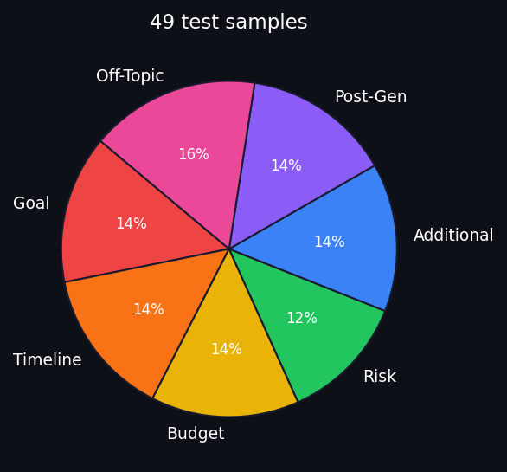
Test Dataset
PART 2 — QUANTITATIVE METRICS
49
7
~60%
~20%
~20%
total samples
categories
typical inputs
edge cases
adversarial
Category breakdown
Goal (7 samples)
Timeline (7 samples)
Budget (7 samples)
Risk (6 samples)
Additional (7 samples)
Post-Gen (7 samples)
Off-Topic (8 samples)

Slide 8
Evaluation Metrics
PART 2 — QUANTITATIVE METRICS
LLM-as-Judge
Human Rating
GPT-4o-mini rates each response against ground truth on a 1–5 scale
Manual 1–5 rating by team member against ground truth
• Same rubric applied consistently across all 49 samples
• Secondary metric — used for consistency check and scale
• Catches systematic failures across many inputs quickly
• Primary metric for pass / fail determination
• Pass threshold: ≥ 4 out of 5
• Catches LLM judge blind spots and context-dependent errors
Rating Rubric
5 — Excellent
4 — Good
3 — Adequate
2 — Poor
1 — Unsat.
Fully matches ground truth
Mostly correct, minor gaps
Partially correct
Mostly fails expectations
Irrelevant or contradicts

Slide 9
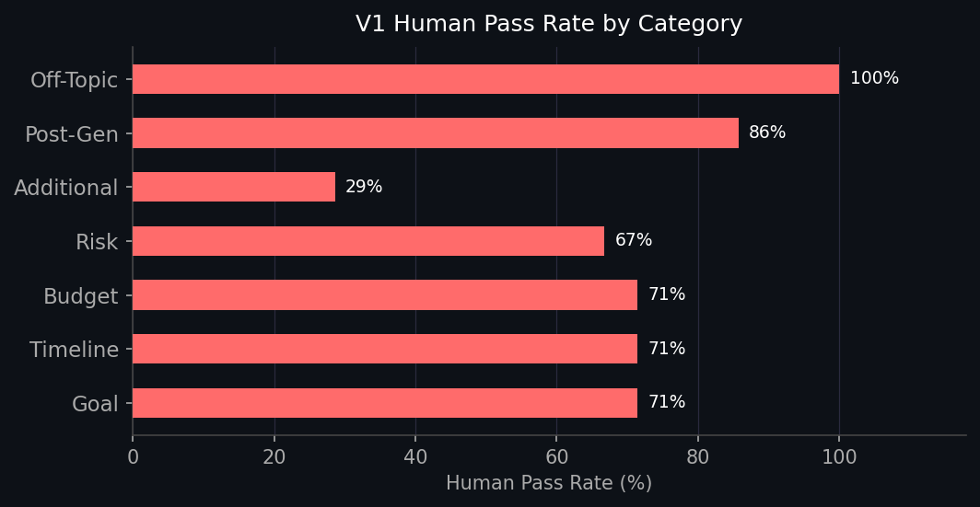
Baseline V1 Performance
PART 2 — QUANTITATIVE METRICS
3.61 / 5
3.96 / 5
67.3%
71.4%
LLM Avg Score
Human Avg Score
LLM Pass Rate
Human Pass Rate
Root Causes
• Variable budgets accepted as-is instead of asking for a steady amount
• Vague timelines (ranges) saved without confirmation
• "YOLO crypto" treated as aggressive instead of redirecting
• "$0, I'm broke" confirmed instead of suggesting $25–50
• Additional Info stage misclassified as off-topic in many cases

Slide 10
Prompt Refinements: V1 → V2
PART 3 — PERFORMANCE COMPARISON
1
One-field confirmation loop
Explicit rule: paraphrase understanding and confirm ONE field before saving. Added required format: "It sounds like X — does that sound right?"
2
Edge case handling
Variable budget → ask for steady amount. Numeric risk scale → map to two nearest categories and let user choose. Short timeline → volatility warning. $0 → empathize + suggest $25–50.
3
Post-generation behavioral split
Profile change requests update fields and set profile_changed=true. Informational questions (e.g. "what is VTI?") answer only — never touch profile.
4
Proactive contextual question
After 4 required fields, ask about existing savings, debt, and life changes instead of generic "anything else?" to surface portfolio-relevant context.
5
Required plain-language risk explanation
Model must describe all three risk levels before asking. Prohibited: numeric confidence outputs like "35% confident."

Slide 11
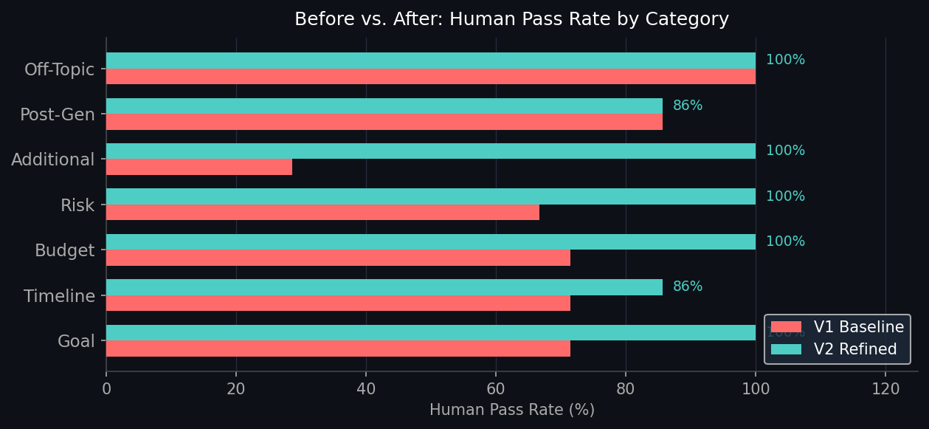
Before vs. After: Performance Comparison
PART 3 — PERFORMANCE COMPARISON
Metric
V1
V2
Δ
LLM Avg
3.61
4.80
+1.19
Human Avg
3.96
4.76
+0.80
LLM Pass %
67.3%
91.8%
+24.5 pp
Human Pass %
71.4%
95.9%
+24.5 pp
+24.5 pp
human pass rate improvement
71.4% → 95.9%

Slide 12
Conclusion
Qualitative
5 UX friction points identified across a 7-participant think-aloud study. Top issues: financial literacy gap, overly narrow initial prompt framing, and missing regeneration feedback after follow-up messages.
Quantitative
Prompt V2 achieves a 95.9% human pass rate (up from 71.4% baseline, +24.5 pp). LLM-as-judge and human ratings aligned closely (avg delta < 0.1 across all samples).
Combined Approach
Qualitative user observations directly informed the quantitative test cases, enabling evidence-driven prompt iteration from observed friction to measurable reliability improvement.

