Slide 1
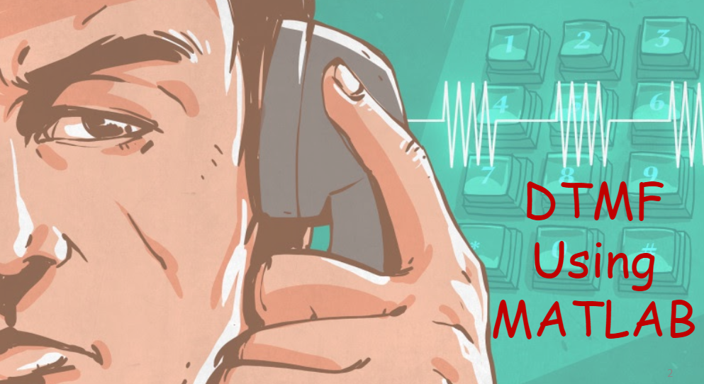
PRESENTED BY: INDER SINGH 191220025 ECE 3RD YEAR

Slide 2
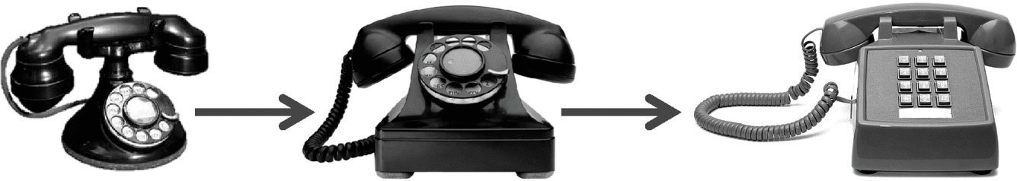
ABSTRACT
In telecommunication, a caller needs to dial the number of the person to which he/she wants to talk with.
The earlier versions of telephones used to have rotary type dials which are now obsolete.
Almost all the landline and mobile phone handsets now use pushbutton keypads as shown in the figure below:

Slide 3
WHAT IS DTMF ?
DTMF stands for Dual-Tone Multi-frequency.
It is a multi frequency tone dialling system used by the push button keypads in telephone and mobile sets to convey the number or key dialled by the caller.
DTMF (Dual tone multi frequency) as the name suggests uses a combination of two Sine wave tones to represent a key.
These tones are called row and column frequencies as they correspond to the layout of a telephone keypad.
FFT is used to detect the DTMF tones.
DTMF has enabled the long-distance signalling of dialled numbers in voice frequency range over telephone lines.

Slide 4
ALGORITHM
Generate a DTMF signal with 8 different combinations of frequency.
DTMF signal is applied to the decoder
FFT is applied to each signal.
Comparing the FFT signal with look up tables.
Get the information of which button is pressed.
Connect the Dialer to the Receiver address obtained through decoder.

Slide 5
WORKING PROCEDURE
When a button is pressed, both the row and column tones are generated by the telephone or touch tone instrument.
These two tones will be distinctive and different from tones of other keys. So there is a low and high frequency associated with a button, it is essentially the sum of two waves is transmitted.
At the receiver the tone frequencies are detected and the number is decoded.
The DFT algorithm can be used to detect the frequencies .

Slide 6
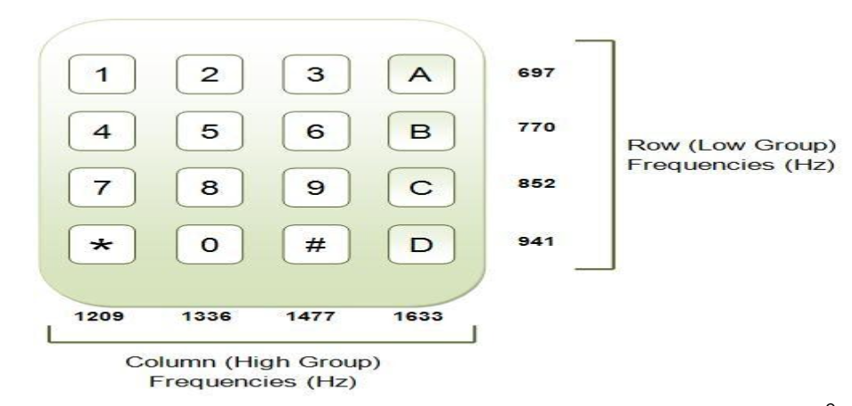
DTMF KEYPAD

Slide 7
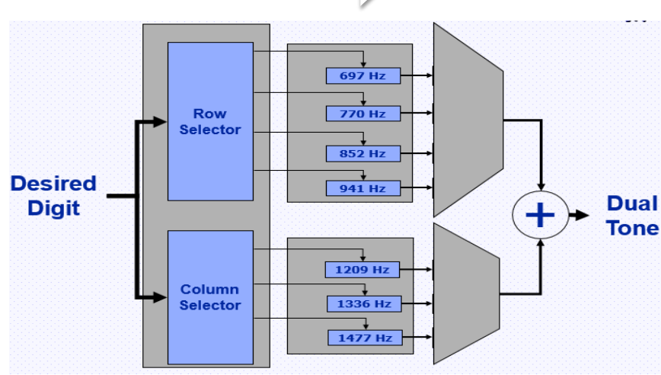
DTMF GENRERATION

Slide 8
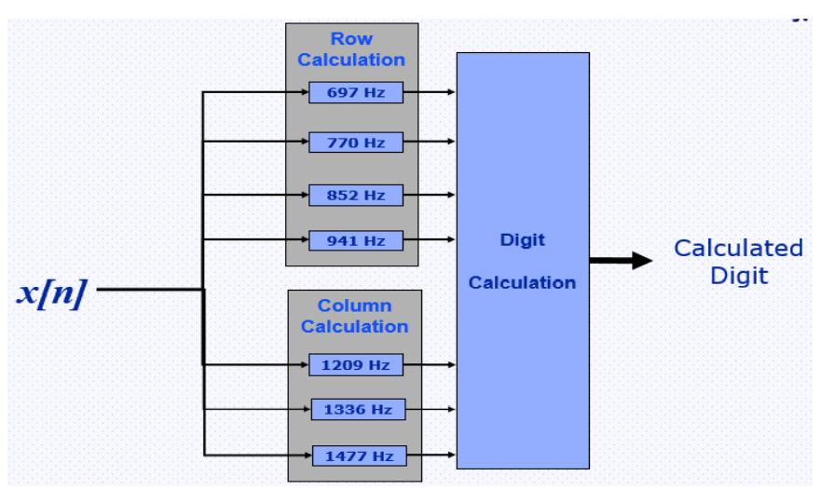
FREQUENCY GENERATION

Slide 9
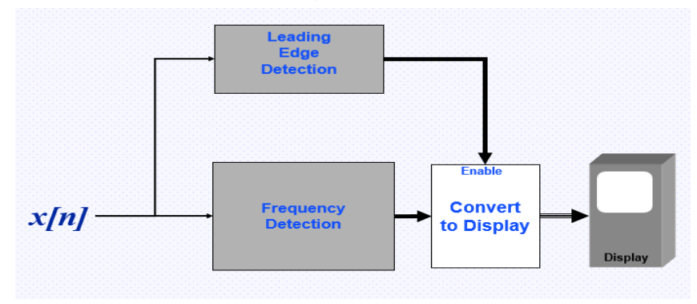
DTMF DETECTION

Slide 10
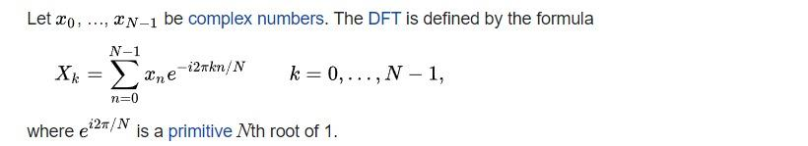
FAST FOURIER TRANSFORM (FFT)
A fast Fourier transform (FFT) is an algorithm that calculates the discrete Fourier transform (DFT) of some sequence
The discrete Fourier transform is a tool to convert specific types of sequences of functions into other types of representations.
The DFT is obtained by decomposing a sequence of values into components of different frequencies
This operation is useful in many fields, but computing it directly from the definition is often too slow to be practical.
An FFT rapidly computes such transformations by factorizing the DFT matrix into a product of sparse (mostly zero) factors. As a result, it manages to reduce the complexity of computing the DFT from O(N*N), which arises if one simply applies the definition of DFT, to O(NLOGN) where N is the data size.

Slide 11
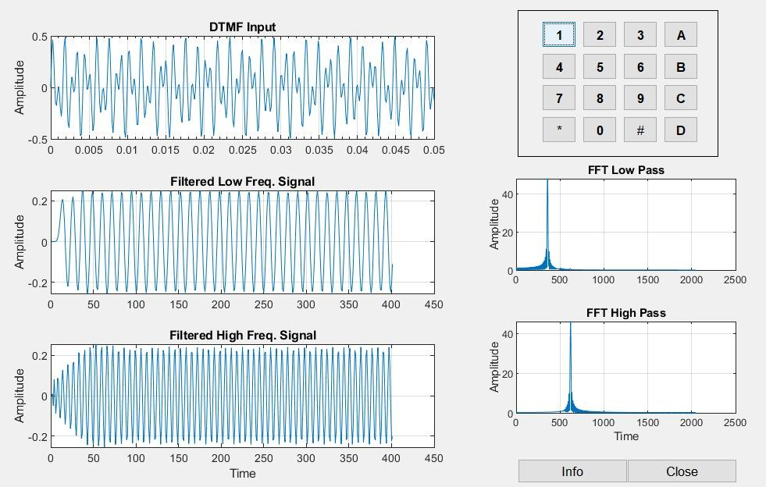
DTMF OUTPUT IN MATLAB

Slide 12
THANK YOU
REFERENCES
"Dual-tone multi-frequency signaling", En.wikipedia.org, 2019. Available: https://en.wikipedia.org/wiki/Dual-tone_multi-frequency_signaling.
"What is Dual-Tone Multifrequency (DTMF) ? - Definition from Techopedia", Techopedia.com, 2019. Available: https://www.techopedia.com/definition/26023/dual-tone-multifrequency-dtmf.
"DTMF: Dual Tone Multi Frequency", Engineersgarage.com, 2019. Available: https://www.engineersgarage.com/tutorials/dtmfdual-tone-multiple-frequency.
“Fast Fourier Transform”, wikipedia.com,
https://en.wikipedia.org/wiki/Fast_Fourier_transform

