Slide 1

QUICK RESPONSE MANUFACTURING SYSTEM
It’s About Time! Singular Focus On Lead Time Reduction
Presentation By:
Inderjeet Singh - 173190001
Saurav Adhikari - 173192001
M.Tech, 1st Year, IEOR

Slide 2
Introduction
QRM-Quick Response Manufacturing Systems is a companywide strategy for reducing lead times throughout an enterprise and its supply chain.
The development of QRM techniques has been targeted particularly at companies making low-volume, high-variety or customized products, which represent the future of manufacturing in advanced nations.
The idea is simple: Shorten the time between when an order is received until the delivery of the product or service.
But it can go even further to include reducing the time required to bring a new product to the market, while still being able to design a product to meet specific customer needs.

Slide 3
History
QRM is rooted in the concept of Time-based competition (TBC) pioneered by Japanese enterprises in the 1980s and first formulated by George Stalk Jr. in his 1988 article entitled “Time – The Next Source of Competitive Advantage”
The concept of Quick Response Manufacturing (QRM) was first developed in the late 1980s by Rajan Suri, at the time professor of Industrial and Systems Engineering at the University of Wisconsin-Madison.
Combining growing academic research in Time-based Competition (TBC) with his own observations from various lead time reduction projects, Suri conceived QRM as a concept espousing a relentless emphasis on lead time reduction that has a long-term impact on every aspect of the company.

Slide 4
Various Lead Times
Order Lead Time - Time from customer order received to customer order delivered.
Order Handling Time - Time from customer order received to sales order created.
Manufacturing Lead Time - Time from sales order created to production finished (ready for delivery).
Production Lead Time - Time from start of physical production of first submodule/part to production finished (ready for delivery).
Delivery Lead Time - Time from production finished to customer order delivered.

Slide 5
Introduction-2
Long lead times add a lot of overhead costs to a manufacturing enterprise--cost for activities like forecasting, planning, scheduling, rescheduling, expediting, work in process, finished goods, warehousing, and so on.
Labor actually only accounts for less than 7 percent of a finished product's selling price, while these overhead activities account for 50 percent, or more.
QRM provides a full set of tools to reduce unnecessary lead time in all areas of your operations - from shop floor, to office operations, accounting, engineering and new product launches. This will, in turn, allow your organization to gain a competitive advantage in the global market, as well as provide you with a better opportunity to compete with low-wage countries..

Slide 6
QRM Cells & Q-ROC
The main building block of the QRM organization is the QRM cell.
QRM cells are designed around a Focused Target Market Segment (FTMS) – a segment of the market in which shorter product lead times provide the company with maximum benefits.
QRM cells complete a sequence of operations ensuring that jobs leave the cell completed and do not need to return.
The work organization in QRM cells is based on team ownership.
Provided with a job and a completion deadline, teams can decide independently on how to complete the job.
To ensure quick response to high-variety demand, workers in QRM cells need to go through cross training.
A Quick Response Office Cell (Q-ROC) is not a random team that can be formed on any individual department.
According to QRM a Q–ROC is a cell which crosses functional structures and where we find multifunctional people gathered together (cross-trained). They form an independent team which is responsible for all the activities of that FTMS.

Slide 7
Manufacturing Critical-Path Time (MCT)
The main performance measure for a QRM cell is lead time as defined by MCT.
QRM introduces Manufacturing Critical-path Time (MCT), a metric designed to calculate waste and highlight opportunities for improvement
It is based on the standard critical path method; defined as the typical amount of calendar time from when a customer creates an order, until the first piece of that order is delivered to the customer.
MCT gives an estimate of the time it takes to fulfill an order, quantifying the longest critical-path duration of order-fulfillment activities.
The critical path method (CPM) is an algorithm for scheduling a set of project activities.

Slide 8
QRM vs. Lean Mfg.
Quick Response Manufacturing
Lean Manufacturing
The driver is reduction of lead time.
The driver is waste reduction.
(7 wastes)
Time-Based
Cost-Based
Principles for other company areas also
Restricted to Shop floor
Low Volume Production
Usually, for high volume production

Slide 9
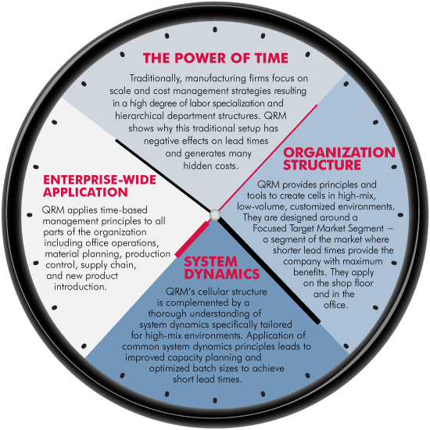
Core Concepts
QRM strategy comprises four core concepts:

Slide 10
Core Concepts - 2
Realizing the Power of Time: Lead time is much more important than most managers realize. Long lead times create many organizational costs -- much more than just WIP and Finished Goods! Such costs are four to five times labor costs. Shrinking these costs is a much bigger opportunity than reducing labor.
Rethinking Organization Structure: QRM transforms traditional functional departments into an organization consisting of "QRM Cells." Although the cell concept has been known for some time, QRM Cells are more flexible, more holistic, and apply outside the shop floor too.

Slide 11
Core Concepts - 3
Exploiting System Dynamics: To understand non linear behavior of complex systems over time using stock, flows, internal feedback roles etc. By getting managers to understand how capacity, batch sizes and other factors impact lead times, QRM enables them to make improved decisions that result in shorter lead times.
Enterprise-wide Unified Strategy : QRM is not just a shop floor approach, it is applied throughout the enterprise. This includes material planning and control, purchasing and supply chain, quoting, order processing and new product development. QRM provides a single, unifying approach for the entire enterprise.

Slide 12
Implementation of QRM
Evaluating the Power of Time:
The many hidden costs of long lead times and the power of short lead times
Pitfalls of traditional methods and how QRM provides a new approach to lead time reduction
Evaluating organization(s) through short QRM quiz
Group workshop on waste due to long lead times
Defining QRM in Production:
Defining product families and implementing cells for low-volume or customized production
How to time-slice shared resources
Group workshop on implementing cells
Group workshop: lead time reduction using rapid modeling tool

Slide 13
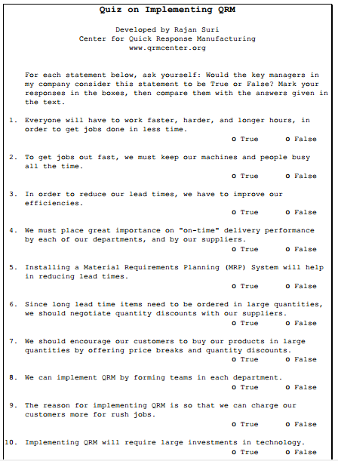
QRM Quiz

Slide 14
Implementation of QRM-2
QRM and Money
QRM impact on bottom line; time-based project justification
Accounting strategies
Material Planning Strategies and Tools for QRM
Capacity planning: key relationships between utilization and lead time
Strategies for developing effective lot sizes
High-level MRP scheduling
Evaluating why other manufacturing systems may not be effective for highly customized or low-volume products

Slide 15
Implementation of QRM-3
Conquering Obstacles to QRM
Rethinking traditional efficiency and utilization measures
Examining case studies and examples to see how it's done
Identifying obstacles to implementing QRM and how to overcome them
Implementing QRM
Management mindset (cost-based versus time-based decisions)
Performance measures to support QRM
Steps to successful implementation
Group workshop: implementation of QRM in your organization

Slide 16
Summary
Laser-like focus on lead time reduction in manufacturing.
Rethinking the manufacturing process and equipment decisions, to put the focus on lead time reduction.
Focusing all aspects of the organization, from the shop floor to the front office, and including vendors in the supply chain, on quick responses and reducing lead times.
Training managers on using time-based strategies.
Linking business strategies to functional strategies.
Measuring performance in “time” units instead of monetary units.
Using the principles of system dynamics to achieve quick response.
Cell-based system of manufacturing.
A focus on implementation and sustaining changes that reduce lead times.
Working Together, Being Flexibles with Customers, Suppliers
Creative Feedback Loops, Root Cause Analysis, Corrective & Preventive Actions.
Using Manufacturing Critical-path Time (MCT) to measure lead times

Slide 17
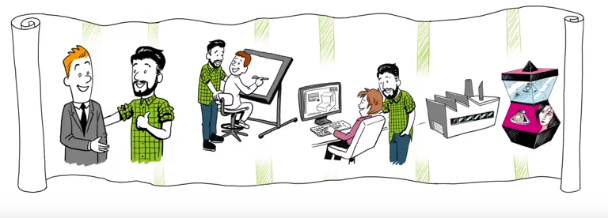
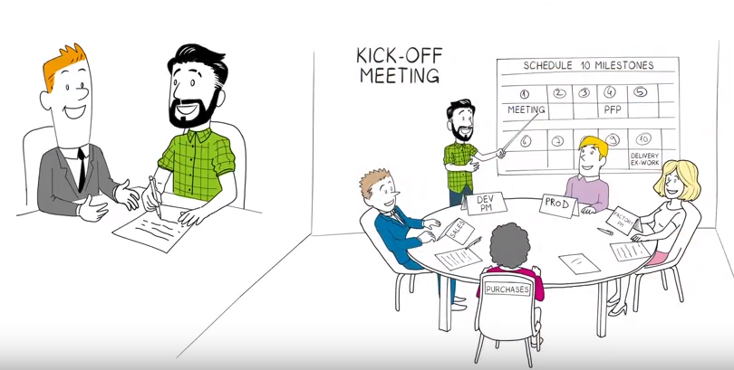
Summary

Slide 18


Slide 19
Traditional Believes
Traditional Belief: Everyone will have to work faster, harder and longer hours, in order to get jobs done in less time. QRM Principle: Find whole new ways of completing a job, with the focus on lead time minimization
Traditional Belief: To get jobs out fast, we must keep our machines and people busy all the time. QRM Principle: Strategically plan for spare capacity – plan to operate at 80% or even 70% capacity on critical resources.
Traditional Belief: In order to reduce our lead times, we have to improve our efficiencies. QRM Principle: Measure the reduction of lead times and make this the main performance measure. Eliminate traditional measures of utilization and efficiency.
Traditional Belief: We must place great importance on “on-time” delivery performance by each of our departments and our suppliers. QRM Principle: Stick to measuring and rewarding reduction of lead times.

Slide 20
Benefits of QRM
Applying QRM in the Office
Defining product families for office operations
How to create office cells to streamline cost estimating, order processing and product engineering
Conquering Obstacles to QRM
Rethinking traditional efficiency and utilization measures
Examining case studies and examples to see how it's done
Identifying obstacles to implementing QRM and how to overcome them
Implementing QRM
Management mindset (cost-based versus time-based decisions)
Performance measures to support QRM
Steps to successful implementation
Group workshop: implementation of QRM in your organization

Slide 21
Disadvantages of QRM
Large variation in demand will cause problems if the manufacturer can't react to the high production of volume quick enough.
Managing the QRM process can be difficult (managing the responsibilities of staff).
A lack of supply will make the manufacturer can problems when trying to meet customer demand.
Highly dependent on suppliers to react to demand.
Customers may have to wait longer for their product to be produced and delivered as one will not be ready made.
May result in decline in the quality among products as manufacturers try to speedily produce.

Slide 22
Case Study-1
Nicolet Plastics, USA:
In 2009, Nicolet realized that customers were increasingly sourcing their high-volume plastic parts offshore to reduce costs.
The company also observed that although the high-volume business was leaving, the low volume business was not. Management began looking for a manufacturing strategy that supported the needs of short-run, complex-part customers, and decided that QRM fit their goals perfectly.
After initiating QRM in 2010, the most impressive impact of QRM has been on Nicolet Plastics’ earnings before interest and taxes (EBIT). The EBIT for 2012 alone was roughly equal to the EBIT for the 10-year period from 2000 through 2009 combined.

Slide 23
Case Study-2
Alexandria Extrusion Company (AEC), USA:
AEC provides custom aluminum extrusions.
In 2002, it decided to implement QRM as AEC’s competitive strategy.
By 2012, AEC had reduced its lead time for extrusions by 83%, from six weeks to five days, and realized a 58% increase in revenue per square foot.
Even during the economic downturn in 2008/09, AEC was able to grow.
Starting at a sales level of around $40 million in 2002, AEC (now called Alexandria Industries) recorded sales of over $100 million in 2012.

Slide 24
Case Study-3
Phoenix Products Company, Milwaukee, USA:
It manufactures industrial lighting for applications that include lighting of mines, shipyards and monuments.
Ten years ago Phoenix was struggling with long lead times, late deliveries, and rising costs, all of which provided opportunities for competitors from low-cost countries.
In 2004, QRM was adopted as the company strategy.
By 2013, lead times across all product lines had been reduced by 50% along with impressive improvements in metrics.
Compared with 2004, by 2013 Phoenix had achieved a 70% increase in revenue per labor hour, and a 30% reduction in overhead.
During the same period Phoenix gained substantial market share: its sales grew at an average annual rate of 12.4%, versus 2% for the industry as a whole

Slide 25
THANK YOU!!

