Slide 1

MRP CALCULATIONS WHEN LEAD TIME IS FUZZY
Presentation By:
Inderjeet Singh - 173190001
Saurav Adhikari - 173192001
M.Tech, 1st Year, IEOR

Slide 2
Introduction
“Material requirements planning (MRP) is a production planning and inventory control system which integrates data from production schedules with that from inventory and the bill of materials (BOM) to calculate purchasing and shipping schedules for the parts or components required to build a product”.
MRP was developed by engineer Joseph Orlicky as a response to the Toyota Production System, the famous model for lean production. The first computerized MRP system was tested successfully by Black & Decker in 1964.

Slide 3
Primary Functions of MRP
To ensure the availability of the raw material for production and availability of the finished products to avoid shortage.
To reduce wastes by maintaining lowest possible materials and product levels in stock.
To help plan manufacturing functions, delivery schedules and purchasing.

Slide 4
Forms of Uncertainties
The forms of uncertainties affecting performance of MRP systems are as follows:
Environmental uncertainties – Includes uncertainty in demand and supply.
System uncertainties – Includes Fuzzy lead times, Quality uncertainty, Production system uncertainty and change of product structure.
When manufacturer wants to begin production, it is important to estimate lead time accurately. Also, estimated planned lead time will effect on the MRP and MPS respectively. After a proper estimation of lead time, the manufacturer is able to improve delivery performance into the customer.
So our objective is to Provide MRP calculations under fuzzy lead time conditions.

Slide 5
Methods Used
Multi-objective integer linear programming approach.
Lead time estimation based on generating fuzzy rules basis and some linguistic rules.
Lead time estimation by Monte Carlo simulation (Less superior).

Slide 6
Multi-objective ILP Approach
Following are some assumptions which have followed during the formulation of given problem by above method:
A multi-level production system.
A multi-product manufacturing environment, Means multiple finished goods, raw material, sub-assemblies structure in bill material etc.
Backlog of the demand is defined as the non-negative difference between the cumulated demand and the volume of available product.
Constraints on production capacity and programmed reception.
Fuzzy lead times for finished goods and raw materials represented by using different values associated with different degree of possibility of each one.
Inventory of the each product is the available volume at the end of a given time period.
Lead time of the product is the number of consecutive and integer periods that are required for their finalization.
Master production schedule (MPS) and MRP are solved jointly.
Multi-period planning horizon
There are some overtime limits.

Slide 7
Multi-objective ILP Approach
We will consider some notations that we will be using throughout our formulation, they are given by-
Pi,t = Production quantity for product ‘i’ at period ‘t’.
Ii,t = Size of inventory for product ‘i’ at time ‘t’.
CPi,t = Production cost.
CIi,t = Inventory holding cost for product ‘i’ at period ‘t’ .
CTOr,t = Overtime cost at facility ‘r’ at time ‘t’.
CTUr,t = Under-time cost of facility ‘r’ at time ‘t’.
TOr,t = Overtime at facility ‘r’ at time ‘t’.
TUr,t = Under-time of facility ‘r’ at time ‘t’.
Bi,t = Backorder quantity of product ‘i’ at time ‘t’.
Pi,t-LT = Production before lead time.
Cr,t = Capacity of resource ‘r’ at time ‘t’

Slide 8
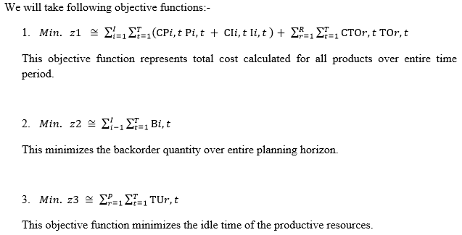
Multi-objective ILP Approach

Slide 9
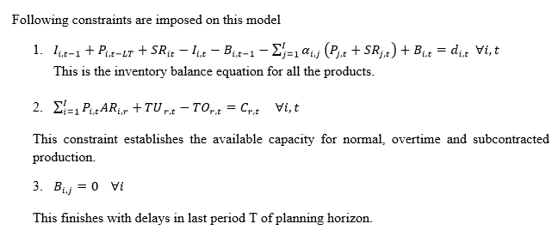
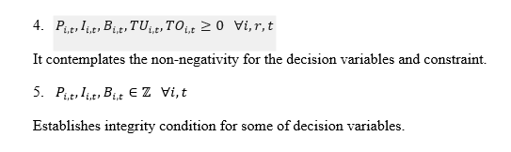
Multi-objective ILP Approach

Slide 10
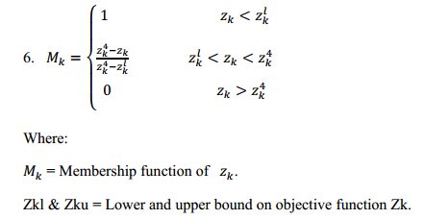
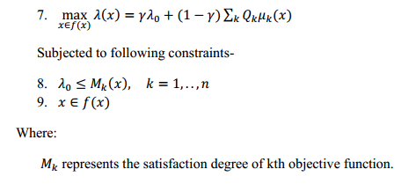
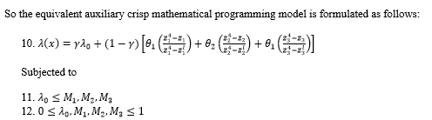
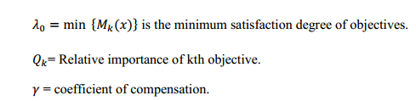
Multi-objective ILP Approach
An approach to transform the fuzzy goal programming (FGP) into an equivalent auxiliary crisp mathematical programming model for MRP problems is provided. This approach considers non increasing linear membership functions for each fuzzy objective function as follows-

Slide 11
Multi-objective ILP Approach
Following solution procedure is thus adopted
Formulate original Fuzzy Goal Programming (FGP) model for the MRP problem.
Specify the corresponding linear membership functions (LMF) for all fuzzy objectives including upper and lower limits.
Determine corresponding relative importance of the objective functions (θk) and the coefficient of compensation (γ).
Transform the original FGP problem into an equivalent single-objective mixed-integer linear programming (MILP) form using the Torabi and Hassini (2008) fuzzy programming method.
Generate problem all possible instances of lead times.
Solve the proposed auxiliary crisp single-objective model by using a MILP solver for each problem instance and obtain a fuzzy set of solutions.
Defuzzify the obtained solution by applying the center of gravity method.
Determine the Manhattan and/or the Euclidean distance of each solution to crisp solution.
Select the solution with minimum distance to the defuzzified crisp solution.

Slide 12
Generating Fuzzy Rules Basis
Fuzzification review:- In this step all meteorological events having ambiguous characteristics and therefore their domain of change are divided into many fuzzy subsets that are complete, normal, and consistent with each other.
Fuzzy Inference System:- This step relates systematically pair wise all the factors taking place in the solution, which depends on the purpose of the problem. This part includes many fuzzy conditional statements to describe a certain situation.
For example if N is dependent on M and ‘A’ and ‘B’ are their two physical sets respectively. Then we can write as:
IF M is A (1) THEN N is B (1)
ALSO
IF M is A (2) THEN N is B (2) etc.

Slide 13
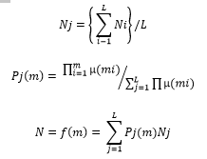
Generating Fuzzy Rules Basis
Defuzzification:- In this method to calculate the deterministic value of linguistic variable N following method must be applied-
Where
P(m) = A Fuzzy basis function.
N = particular value of the linguistic variable.
Nj = Support value, in which the membership function reaches its maximum grade of membership.
Then the center-average method is selected and applied to defuzzify the proposed problem.

Slide 14
Monte Carlo Simulation
Monte Carlo methods are a broad class of computational algorithms that rely on repeated random sampling to obtain numerical results.
Each observation of lead time has obtained through multiple simulation runs, based on obtained data from given values of lead times.
However Results have shown that the results show that the fuzzy lead times are smaller than simulated lead times in all cases.
When the number of orders in the MRP system increases, it seems that the existing difference between simulated and fuzzy lead time becomes bigger.

Slide 15
Conclusion
This PPT addressed that how MRP calculations are done when lead time is fuzzy.
For this we used three method namely,
Multi-objective integer linear programming approach
Lead time estimation based on generating fuzzy rules basis and some linguistic rules
Lead time estimation by Monte Carlo simulation (Less superior).
Every method has its own limitations and assumptions and applicable under specific environment.
The advantages of these methods are related to: The modeling and establishment of the priorities for production objectives that traditionally are measured through costs estimated with difficulty by companies; and considering different values for product lead times associated to different possibility degrees which provide the decision maker with a broad decision spectrum with different risks levels.

Slide 16
THANK YOU!!

