Slide 1
GAMES103: Intro to Physics-Based Animation
Smoothed Particle Hydrodynamics
Huamin Wang
Jan 2022

Slide 2
Topics for the Day
A SPH model
SPH-based fluids

Slide 3
A SPH Model

Slide 4
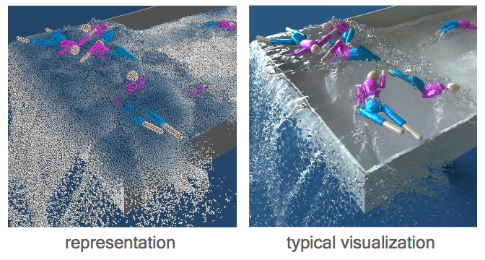
A SPH Model
Consider a (Lagrangian) particle system: each water molecule is a particle with physical quantities attached, such as position $x_{i}$, velocity $v_{i}$, and mass $m_{i}$.

Slide 5




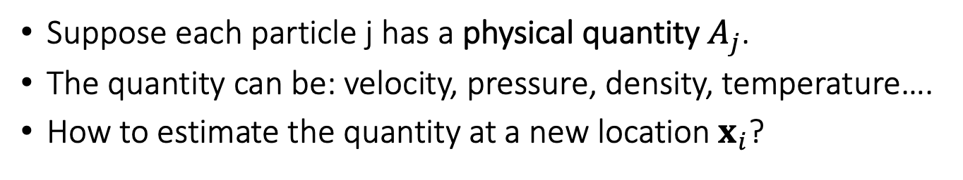
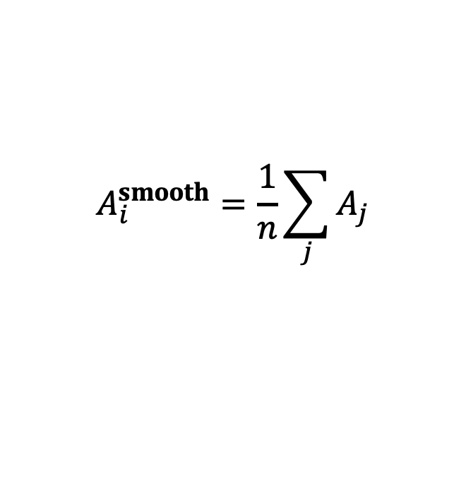

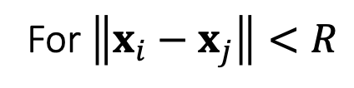



Smoothed Interpolation – A Simple Model
Suppose each particle j has a physical quantity $A_{j}$.
The quantity can be: velocity, pressure, density, temperature….
How to estimate the quantity at a new location $x_{i}$?
$$A_{i}^{smooth}=\frac{1}{n}\sum_{j}{A_{j}}$$
For $\left\|x_{i}−x_{j}\right\|<R$
$$A_{0}$$
$$A_{6}$$
$$A_{1}$$
$$A_{5}$$
$$A_{i}^{smooth}$$
$$A_{2}$$
$$A_{4}$$
$$A_{3}$$

Slide 6

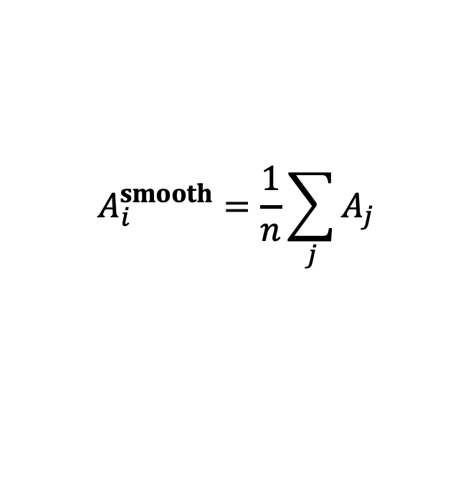

Problem with the Simple Model
$$A_{i}^{smooth}=\frac{1}{n}\sum_{j}{A_{j}}$$
$$A_{i}^{smooth}$$
$$A_{i}^{smooth}$$

Slide 7
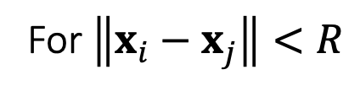
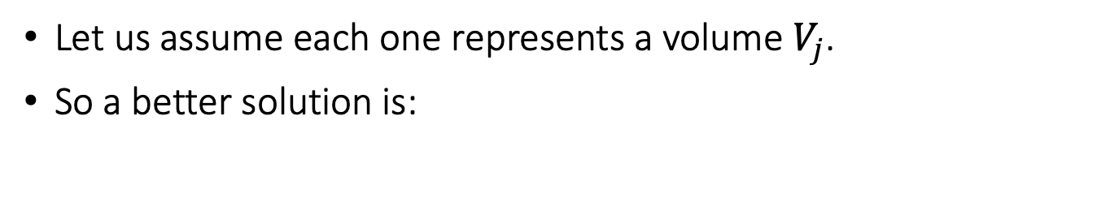
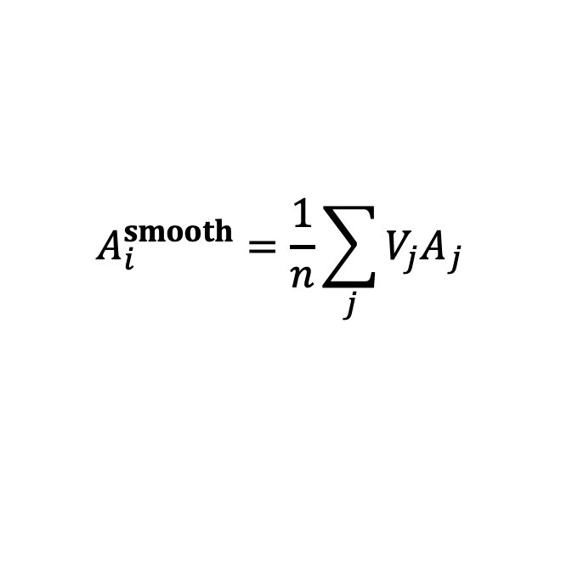
Smoothed Interpolation – A Better Model
Let us assume each one represents a volume $V_{j}$.
So a better solution is:
$$A_{i}^{smooth}=\frac{1}{n}\sum_{j}{{V_{j}A}_{j}}$$
For $\left\|x_{i}−x_{j}\right\|<R$
$$A_{0}$$
$$A_{6}$$
$$A_{1}$$
$$A_{5}$$
$$A_{i}^{smooth}$$
$$A_{2}$$
$$A_{4}$$
$$A_{3}$$

Slide 8
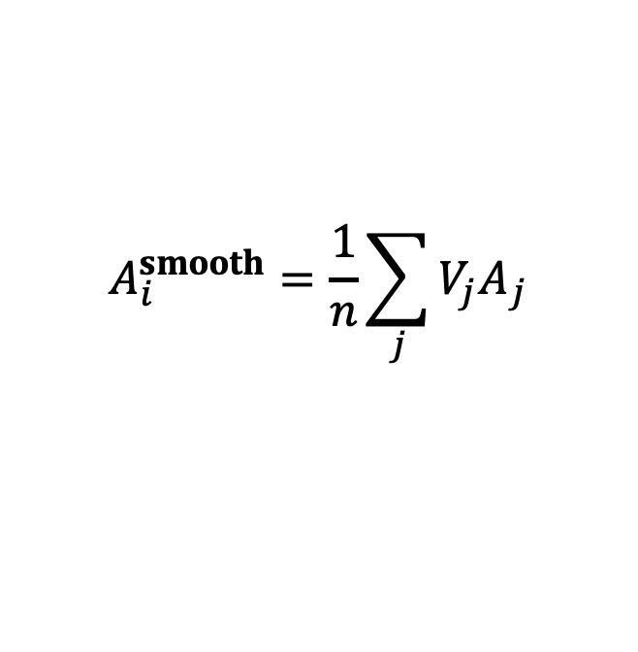
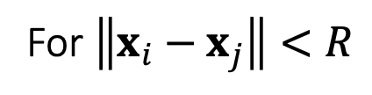
Problem with the Better Model
One problem of this solution:
Not smooth! (7 -> 9!)
$$A_{i}^{smooth}=\frac{1}{n}\sum_{j}{{V_{j}A}_{j}}$$
For $\left\|x_{i}−x_{j}\right\|<R$
i

Slide 9
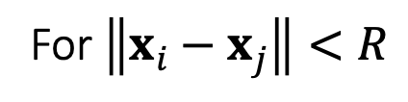
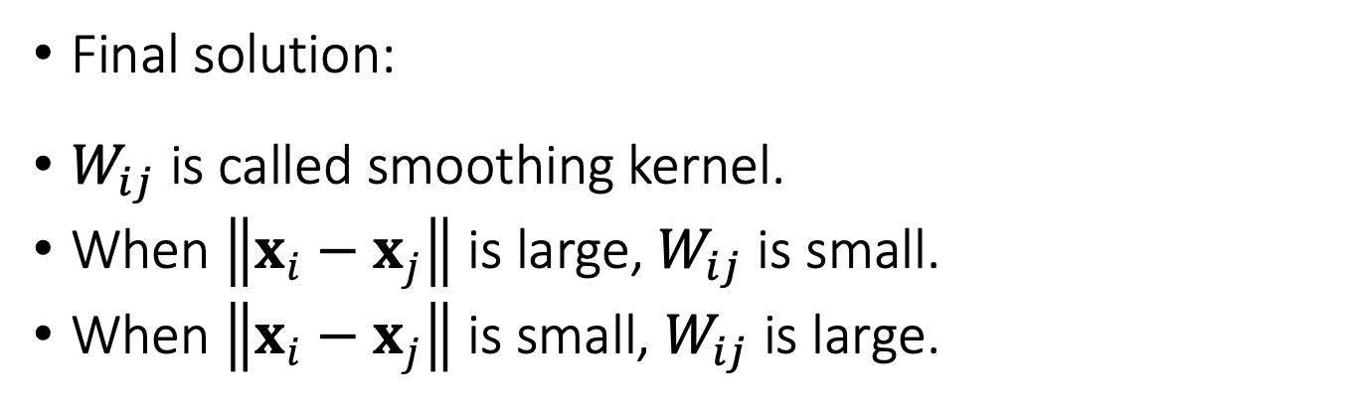
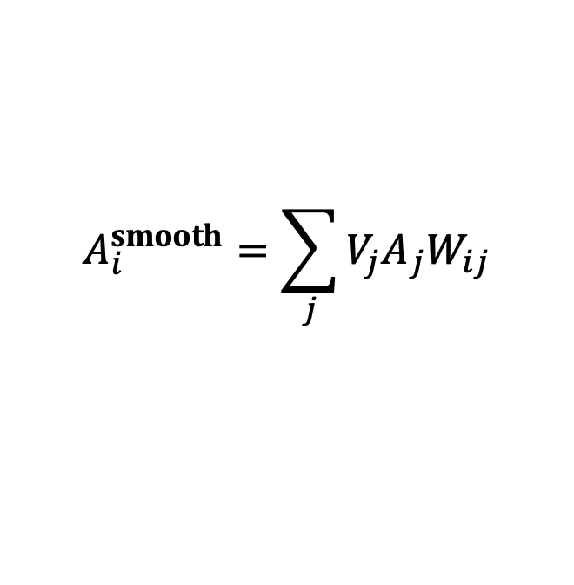
Smoothed Interpolation – Final Solution
$$A_{i}^{smooth}=\sum_{j}{{V_{j}A}_{j}W_{ij}}$$
For $\left\|x_{i}−x_{j}\right\|<R$
Final solution:
$W_{ij}$ is called smoothing kernel.
When $\left\|x_{i}−x_{j}\right\|$ is large, $W_{ij}$ is small.
When $\left\|x_{i}−x_{j}\right\|$ is small, $W_{ij}$ is large.
i

Slide 10
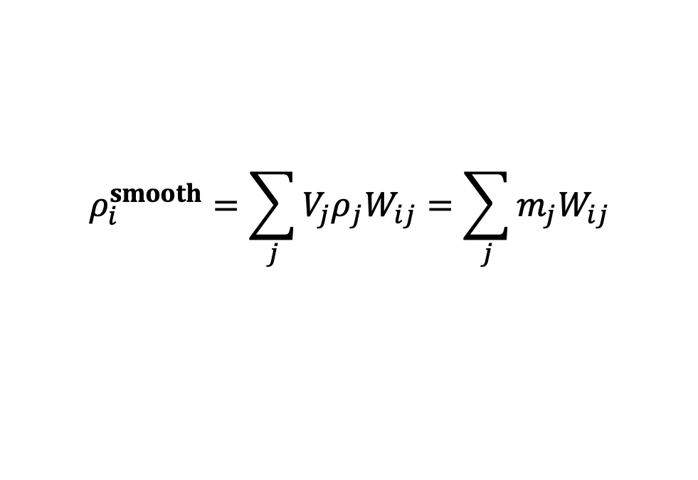
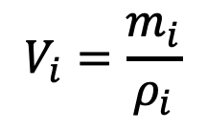
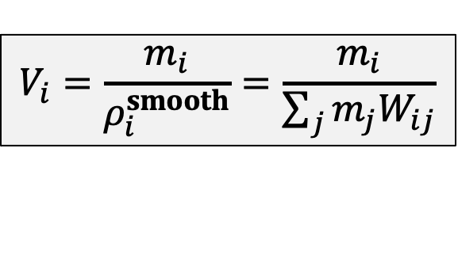
Particle Volume Estimation
But how do we get the volume of particle i?
$$V_{i}=\frac{m_{i}}{ρ_{i}}$$
$$V_{i}=\frac{m_{i}}{ρ_{i}^{smooth}}=\frac{m_{i}}{\sum_{j}{m_{j}W_{ij}}}$$
$$ρ_{i}^{smooth}=\sum_{j}{{V_{j}ρ}_{j}W_{ij}}=\sum_{j}{m_{j}W_{ij}}$$
m₀
m₆
m₁
m₅
m₂
m₄
m₃

Slide 11
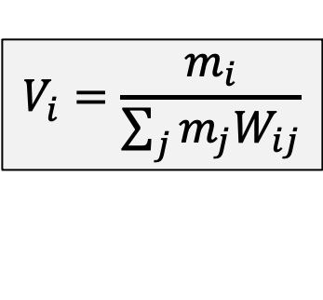
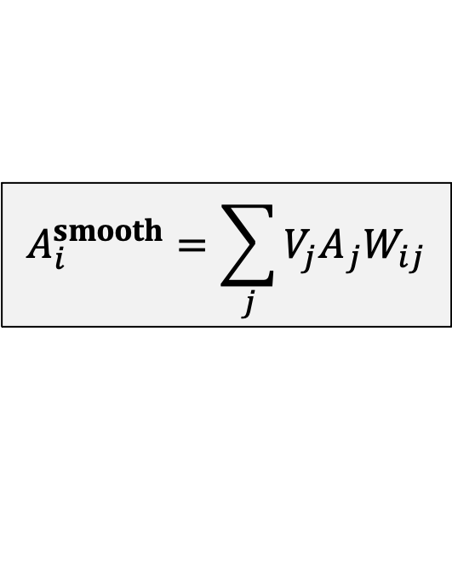
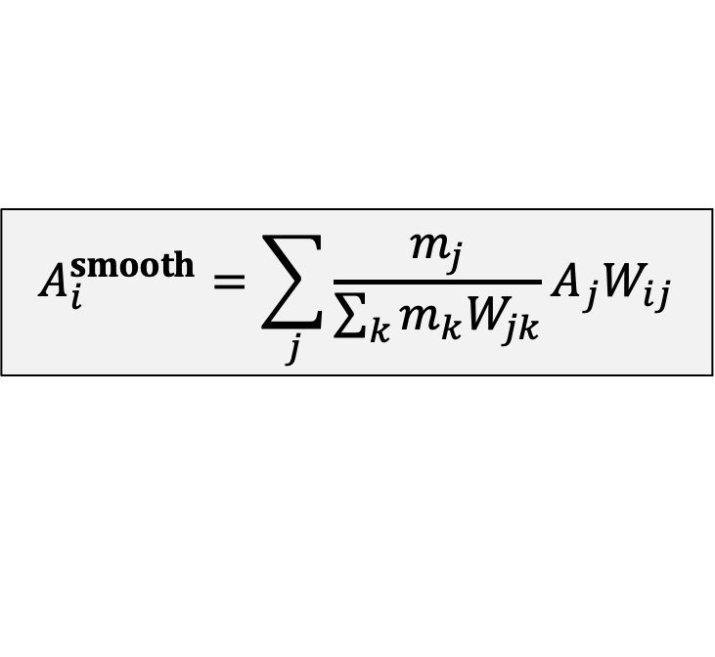
Smoothed Interpolation – Final Solution
So the actual solution is:
$$A_{i}^{smooth}=\sum_{j}{{V_{j}A}_{j}W_{ij}}$$
$$V_{i}=\frac{m_{i}}{\sum_{j}{m_{j}W_{ij}}}$$
$$A_{i}^{smooth}=\sum_{j}{{\frac{m_{j}}{\sum_{k}{m_{k}W_{jk}}}A}_{j}W_{ij}}$$

Slide 12
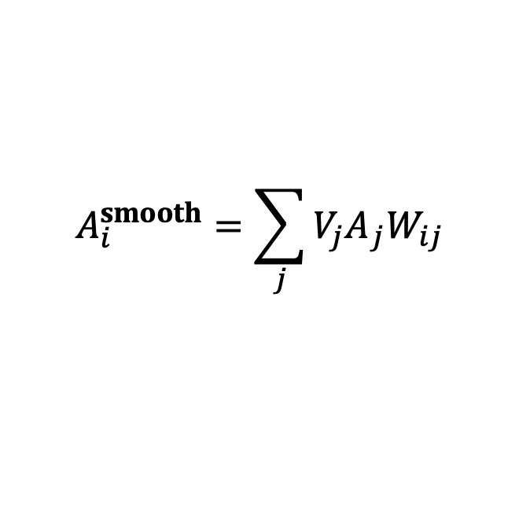
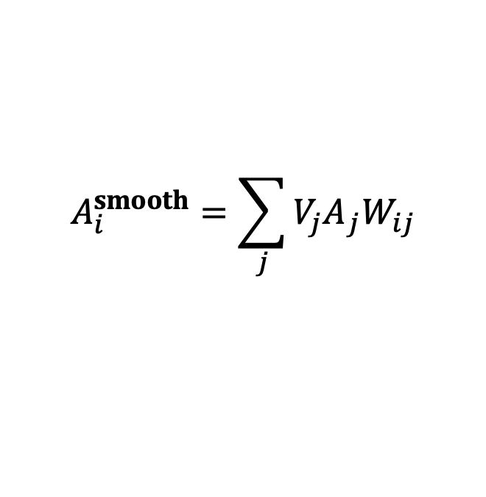
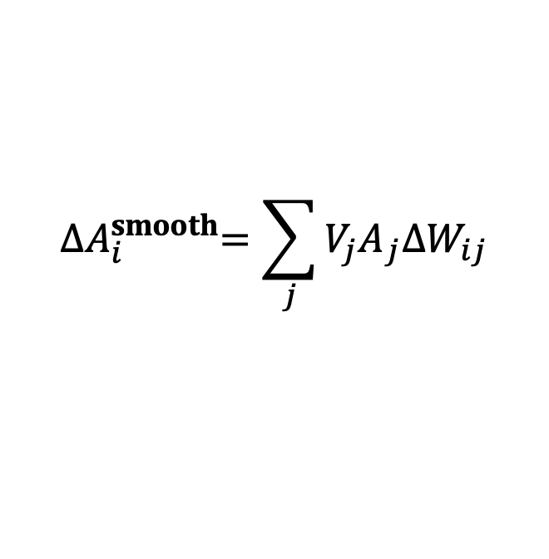
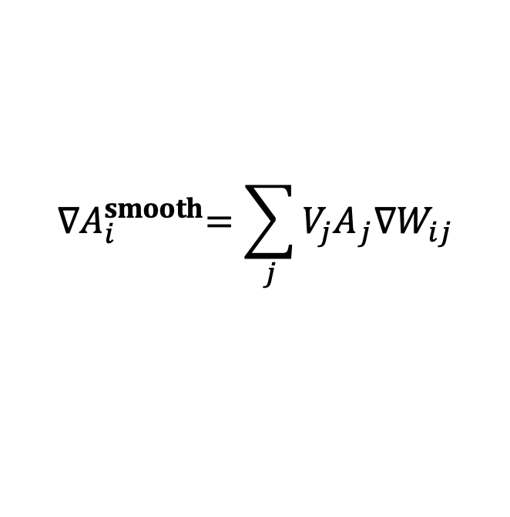
Why Smoothed Interpolation?
We can easily compute its derivatives:
Gradient
Laplacian
$$A_{i}^{smooth}=\sum_{j}{{V_{j}A}_{j}W_{ij}}$$
$${∇A}_{i}^{smooth}=\sum_{j}{{V_{j}A}_{j}{∇W}_{ij}}$$
$$A_{i}^{smooth}=\sum_{j}{{V_{j}A}_{j}W_{ij}}$$
$${∆A}_{i}^{smooth}=\sum_{j}{{V_{j}A}_{j}{∆W}_{ij}}$$

Slide 13
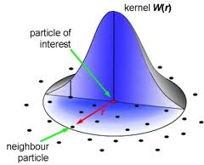
A Smoothing Kernel Example
h is called smoothing length

Slide 14
Kernel Derivatives
Gradient at particle i (a vector)

Slide 15
Kernel Derivatives
Laplacian at particle i (a scalar)

Slide 16
SPH-Based Fluids

Slide 17
Fluid Dynamics
We model fluid dynamics by applying three forces on particle i.
Gravity
Fluid Pressure
Fluid Viscosity
i

Slide 18
Gravity Force
Gravity Force is:
i

Slide 19
Pressure Force
Pressure is related to the density
First compute the density of Particle i:
Convert it into pressure (some empirical function):
High Pressure
Low pressure

Slide 20
Pressure Force
Pressure force depends on the difference of pressure:
High
Pressure
High
Pressure
High
Pressure
High
Pressure
High
Pressure
Low
Pressure
i
i
High
Pressure
High
Pressure
Low
Pressure
High
Pressure
No pressure force!
Pressure force!

Slide 21
Pressure Force
Mathematically, the difference of pressure => Gradient of pressure.
To compute this pressure gradient, we assume that the pressure is also smoothly represented:
So:

Slide 22
Viscosity Force
Viscosity effect means: particles should move together in the same velocity.
In other words, minimize the difference between the particle velocity and the velocities of its neighbors.
Before
After

Slide 23
Viscosity Force
Mathematically, it means:
To compute this Laplacian, we assume that the velocity is also smoothly represented:
So:

Slide 24
Algorithm
For every particle i
Compute its neighborhood set
Using the neighborhood, compute:
Force = 0
Force + = The gravity force
Force + = The pressure force
Force + = The viscosity force
Update v_{i} = v_{i} + t * Force / m_{i};
Update x_{i} = x_{i} + t *v_{i};
What is the bottleneck of the performance here?

Slide 25
Exhaustive Neighborhood Search
Search over every particle pair? O(N²)
10M particles means: 100 Trillion pairs…
i

Slide 26
Solution: Spatial Partition
Separate the space into cells
Each cell stores the particles in it
To find the neighborhood of i, just look at the surrounding cells
i

Slide 27
Spatial Partition
What if particles are not uniformly distributed?
Solution: Octree, Binary Spatial Partitioning tree…
i

Slide 28
Fluid Display
Need to reconstruct the water surface from particles!

Slide 29
Ongoing Research
How to make the simulation more efficient?
How to make fluids incompressible?
When simulating water, only use water particles, no air particles. So particles are sparse on the water-air boundary. How to avoid artifacts there?
Using AI, not physics, to predict particle movement?

