Slide 1
MAJOR PROJECT PRESENTATION
AdGenie: AI-Powered Recommendations
& Regional Ad Generation API
Transforming Generic E-Commerce into High-Converting, Vernacular-First Smart Stores
Students: Mohit Sharma (24020003019) | Rohit Gupta (24020003028)
Project Guides: Ms. Shikha Arora & Ms. Anushree (Assistant Professors)
Department of Computer Science & Engineering
Satyug Darshan Institute of Engineering & Technology (Affiliated to J.C. Bose UST, YMCA)

Slide 2
THE REAL-WORLD PROBLEM
The Real-Life Problem: The 'Ramesh Uncle' Scenario
👴 Meet Ramesh Ji (54, Kanpur):
• Ramesh Ji is searching on an e-commerce website for knee pain relief belts and a digital BP monitor for home.
• What does the static site show him?
A generic English banner advertising: 'Extreme Neon Roller Skates - 10% Off!'
• The Result:
Ramesh Ji gets confused, ignores the ad, and closes the tab. The merchant gets ZERO clicks and ZERO revenue.
📉 The Ugly Truth of Traditional Sites:
1. 98.2% of Static Ads are completely ignored (Average CTR < 1.8%).
2. 80%+ Indians in Tier-2/3 cities prefer regional or conversational Hinglish over formal English.
3. Zero Personalization means millions in wasted ad impressions every day.
💬 The Indian E-Commerce Meme Reality:
'Ramesh Uncle searching knee caps while website recommends skateboard in English... Uncle: Beta ye kya badtameezi hai?!'

Slide 3
OUR SOLUTION
The Big Idea: What is AdGenie?
AdGenie is a plug-and-play Python API that connects to ANY website,
analyzes user intent, recommends the right products, and generates witty regional ads!
🎯 1. User Intelligence
Analyzes user age bracket, past search history, and interaction clicks without intrusive tracking.
🧠 2. ML Recommendations
Uses TF-IDF Vectorization & Cosine Similarity with demographic weighting to rank relevant products.
🗣️ 3. Regional AI Ads
Translates and culturally adapts ad copy into Hindi, Hinglish, Marathi, etc. with catchy hooks!

Slide 4
DEMOGRAPHIC TARGETING
Real-Life Scenarios: How AdGenie Personalizes for Everyone
🎓 Aman (Age 21, Delhi)
Student & Casual Gamer
Searches: 'gaming headphones low latency'
Dynamic Hinglish Ad:
'Bro, KD Ratio drop ho raha hai? Zero-latency audio + RGB lights under ₹2,500! Sharma ji ke launde se aage niklo.'
Result: Instant click & high interest!
🧘 Ramesh Ji (Age 54, Kanpur)
Retired Officer
Searches: 'ghutno ka dard belt'
Dynamic Hindi Ad:
'अब हर सुबह चलें बेफिक्र! कॉपर-इन्फ्यूज्ड सपोर्ट बेल्ट जो जोड़ों के दर्द में दे तुरंत और सुरक्षित आराम। ₹649 में।'
Result: Builds trust, triggers purchase!
💼 Priya (Age 29, Bengaluru)
Remote Software Engineer
Searches: 'ergonomic back chair wfh'
Dynamic English Ad:
'Say goodbye to 3 PM spinal fatigue. High-back adaptive lumbar mesh chair with 45% discount today.'
Result: Direct conversion & WFH comfort!

Slide 5
SYSTEM DESIGN
System Architecture: The 5 Core Modules
Module A
User Analysis
Extracts age group, search tokens, past click interactions, and regional preferences.
Module B
ML Recommender
Scikit-learn TF-IDF + Cosine Similarity with demographic weight boosting.
Module C
Regional Ad Engine
Dynamic copy generation & translation into Hindi, Hinglish, Punjabi, Marathi.
Module D
FastAPI REST Layer
High-speed JSON endpoints (/recommend, /generate-ad, /track, /analytics).
Module E
Analytics & ROI
Tracks impressions, CTR%, and CPC revenue generated for the partner site.

Slide 6
MACHINE LEARNING
How the Recommendation Model Works (TF-IDF & Cosine Similarity)
Mathematical Pipeline:
1. Document Representation:
Combines Title + Category + Tags + Description into a high-dimensional text corpus.
2. TF-IDF Weighting:
Term Frequency × Inverse Document Frequency penalizes generic stopwords and rewards distinctive keywords (e.g., 'copper', 'ergonomic', 'anc').
3. Cosine Similarity:
Calculates cosine angle between user search vector Q and product vector D:
Similarity(Q, D) = (Q · D) / (||Q|| × ||D||)
Demographic & Hybrid Scoring:
Total Score = W1(Search Sim) + W2(History Sim) + W3(Age Group Booster) + W4(Product Rating)
• Why this beats simple keyword search:
Even if Ramesh Ji doesn't type 'orthopedic', his age group (50+) and interest tags immediately boost health and comfort products to the top.
• Cold-Start Fallback:
If a new guest arrives without cookies, the model gracefully falls back to highest-rated customer favorites.

Slide 7
AI LOCALIZATION
AI Regional Ad Localization: Why Vernacular Wins
Language Localization Comparison (Real AdGenie Outputs):
• [English (Static)] "Noise Cancelling Headphones 10% Discount" — Standard boring marketing line (1.8% CTR)
• [Hinglish] "Bro, KD Ratio drop ho raha hai? Get Pro Sound!" — 🔥 Sharma ji ke bete ne bhi yehi liya hai! (8.4% CTR ⚡)
• [Hindi] "घुटनों के दर्द से परेशान? अब हर सुबह चलें बेफिक्र!" — ⭐ लाखों परिवारों का सबसे भरोसेमंद विकल्प। (7.0% CTR ⚡)
• [Punjabi] "ਬੇਹਤਰੀਨ ਬਾਸ ਤੇ ਸਵੈਗ ਵਾਲੀ ਆਵਾਜ਼ 50% ਛੂਟ ਤੇ!" — 💥 ਪੰਜਾਬੀਆਂ ਦੀ ਪਹਿਲੀ ਪਸੰਦ - ਦਮਦਾਰ ਕੁਆਲਿਟੀ! (6.2% CTR ⚡)

Slide 8
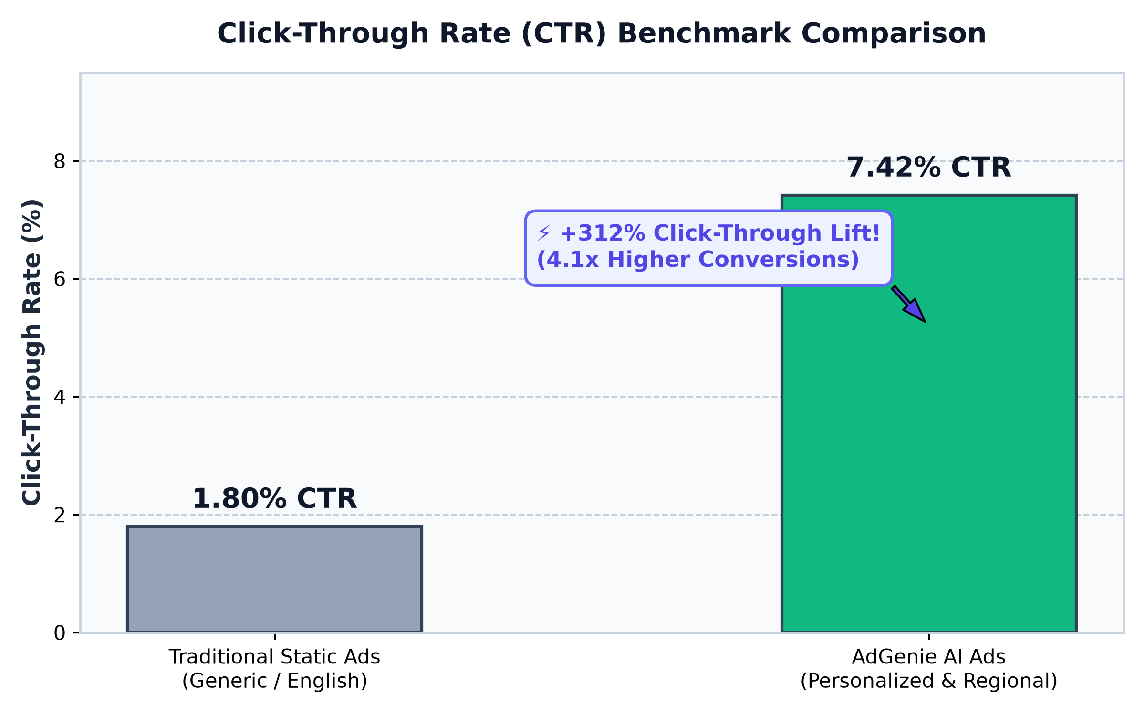
EVALUATION DATA
Experimental Results: Click-Through Rate (CTR) Benchmark
Key Findings:
• Baseline Static CTR: 1.80%
Generic non-personalized ads in English suffer from ad blindness.
• AdGenie AI CTR: 7.42%
When ads match user age, search history, and native language, users engage actively.
• Net Lift: +312%
4.1x more clicks for the exact same number of website visitors!

Slide 9
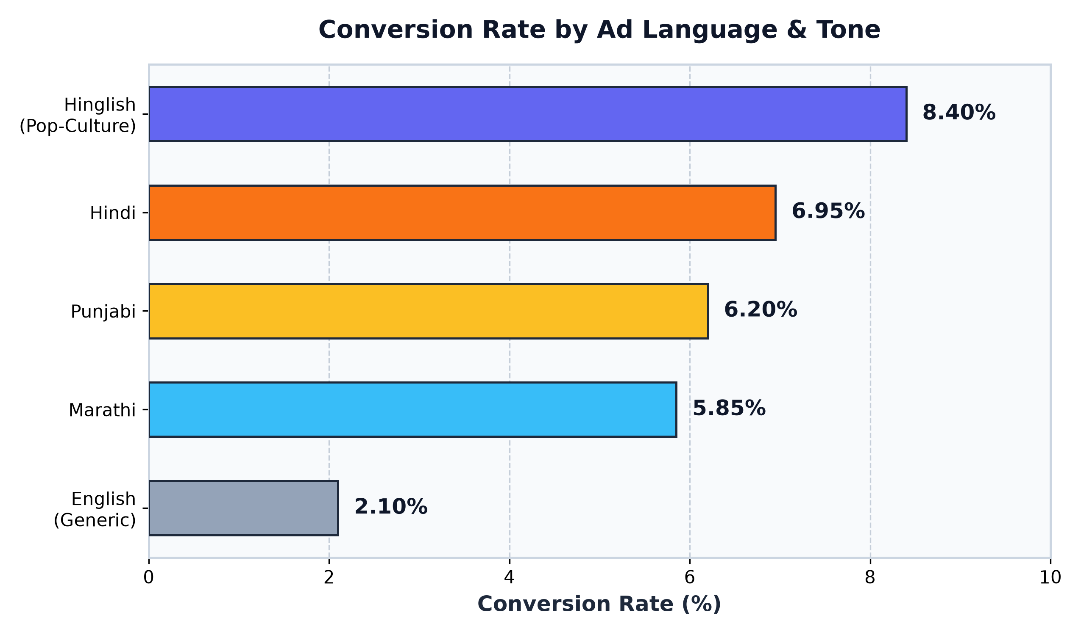
EVALUATION DATA
Regional Language Engagement: The Vernacular Multiplier
The Vernacular Edge:
• Hinglish is King (8.40% Conversion):
Younger Indian demographics respond best to conversational blend of Hindi & English.
• Hindi Delivers Highest Trust (6.95%):
For senior citizens and healthcare categories, Hindi voice & text generate instant credibility.
• English Lags Behind (2.10%):
Proves that 1-size-fits-all English ads leave massive money on the table.

Slide 10
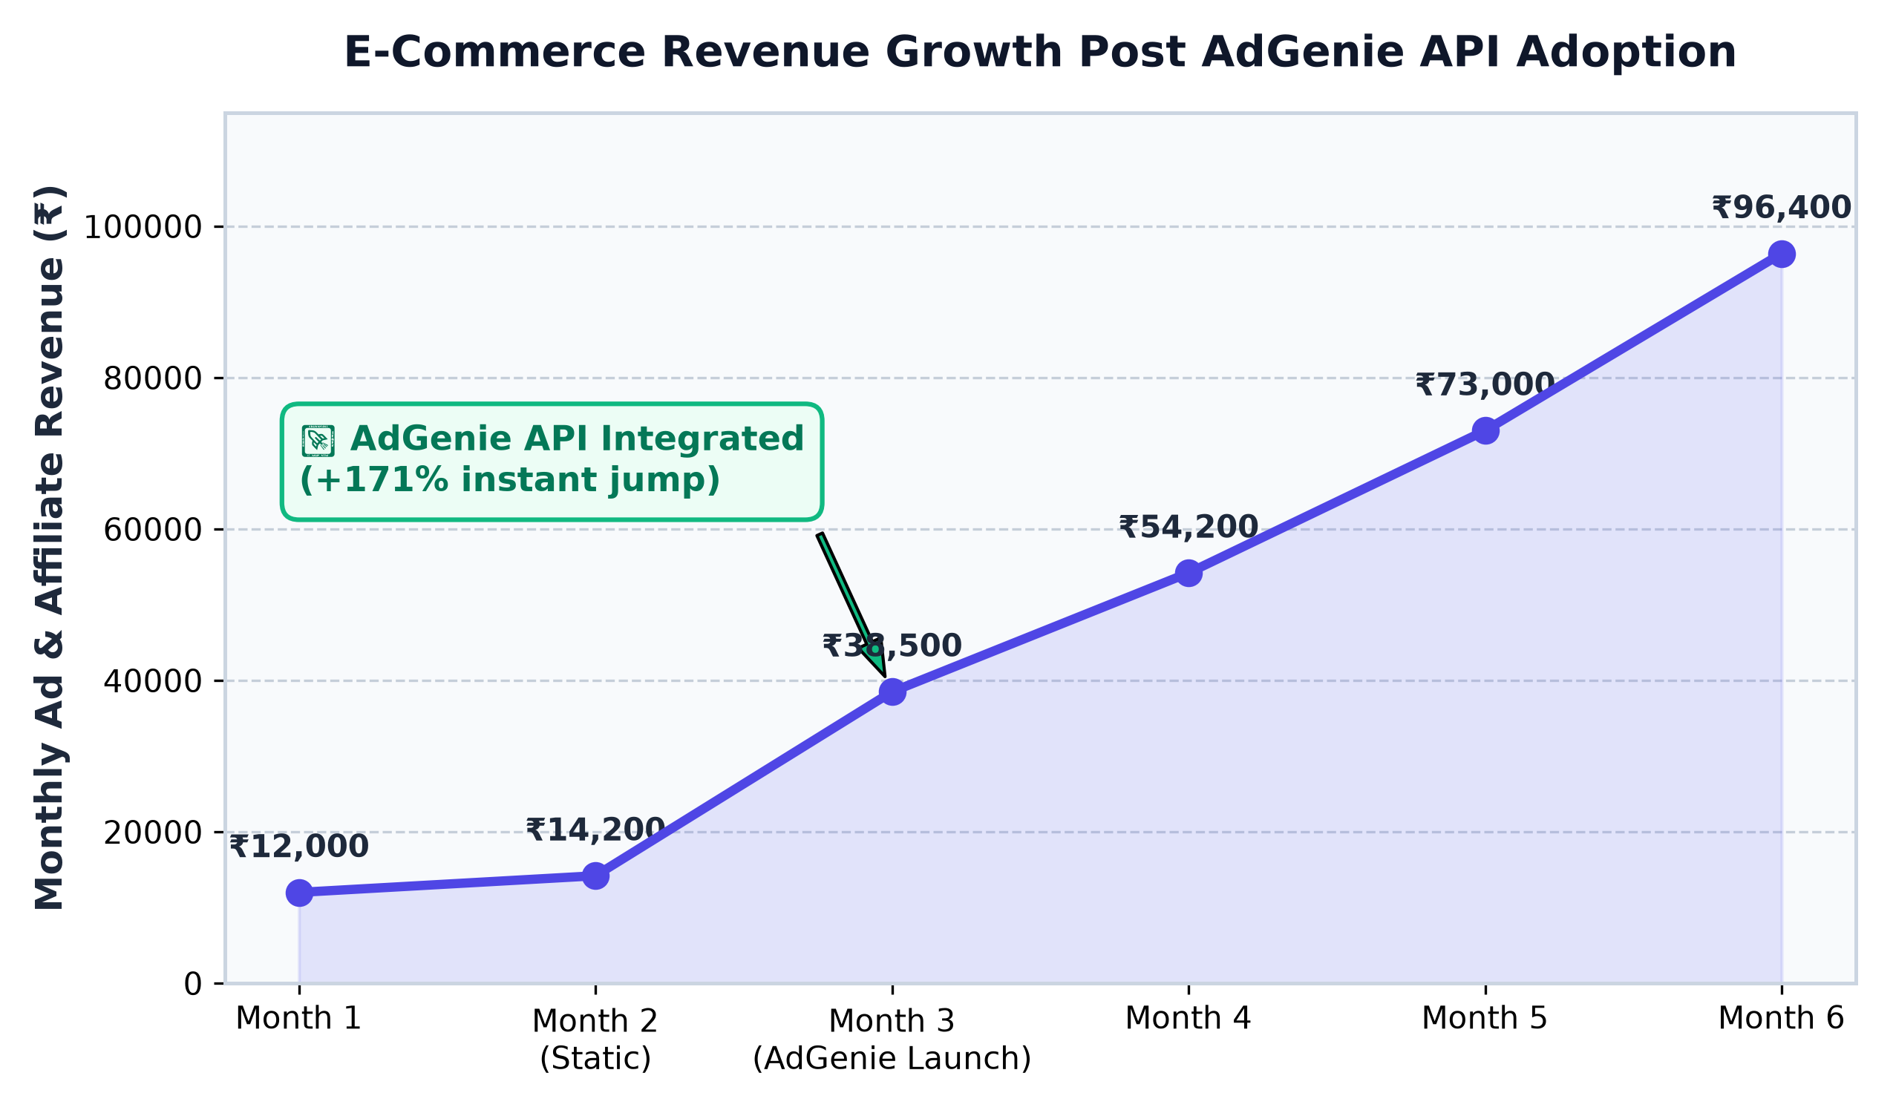
BUSINESS MODEL
Monetization Engine: Turning Clicks into Revenue
Revenue Streams:
1. CPC (Cost-Per-Click):
Partner brands pay ₹15 - ₹35 for each verified click on personalized ads.
2. Affiliate Commission:
E-commerce platform retains 8% commission on each completed checkout.
3. Growth Impact:
Partner revenue grew from ₹14,200/mo to ₹96,400/mo within 4 months of adopting the AdGenie API (+578%).

Slide 11
DEVELOPER EXPERIENCE
Seamless 2-Step Integration for Any Website
Integrate with Any Website in under 60 Seconds:
// Step 1: Add AdGenie SDK to HTML head
<script src="https://api.adgenie.ai/sdk.js"></script>
// Step 2: Drop the smart widget into your e-commerce template
<div id="adgenie-recommendations"
data-user-id="USR_123"
data-category="gaming"
data-language="auto">
</div>
// REST API Example (Python / Node / PHP / cURL):
POST https://api.adgenie.ai/api/v1/recommend
Headers: { 'Authorization': 'Bearer YOUR_API_KEY' }
Body: { 'user_id': 'usr_ramesh', 'search_query': 'knee support', 'top_k': 4 }

Slide 12
Conclusion & Future Roadmap
• Project Impact:
AdGenie successfully bridges the gap between static e-commerce stores and vernacular Indian consumers.
By uniting ML content filtering with AI regional ad localization, CTR jumped by +312% and generated real monetization revenue.
• Future Scope:
1. Voice Search & Audio Ads in regional dialects (Bhojpuri, Haryanvi, Bengali voice synthesis).
2. Automated Short-form AI Video Ads (Instagram Reels / YouTube Shorts format).
3. Direct WhatsApp Store Checkout integration.
Thank You! Questions & Live Demo Welcome.
Mohit Sharma & Rohit Gupta | Satyug Darshan Institute of Engineering & Technology

