Slide 1
CrossLink
ILL Platform
Jakub Skoczen, Lead Architect, Index Data
Wolfcon 2025
Architecture and tech deep dive

Slide 2
Agenda
Benefits of broker-based ILL solution
Challenges of using ISO18626 in a broker-based system
CrossLink Broker design and implementation details
Future development

Slide 3

Benefits of a broker-based ILL system
Company Name
1
2
3
4
Flexible Directory service
Pluggable discovery
Externally configured
Turnkey & standards- based
The discovery mechanism is interchangeable, catalogs can be connected directly via SRU, through adapters like Index Data’s Metaproxy, or OAI-PMH-enabled index such as the Index Data Reservoir.
The broker is built on open protocols such as ISO18626 and NCIP, enabling plug-and-play integration with existing ILS and third-party ILL systems.
Information about peers (requesters and suppliers) are resolved through their ISIL codes, using a JSON/REST Directory API.
The behavior of the system is fully driven by external configuration and policies, making the system adaptable to evolving workflows

Slide 4
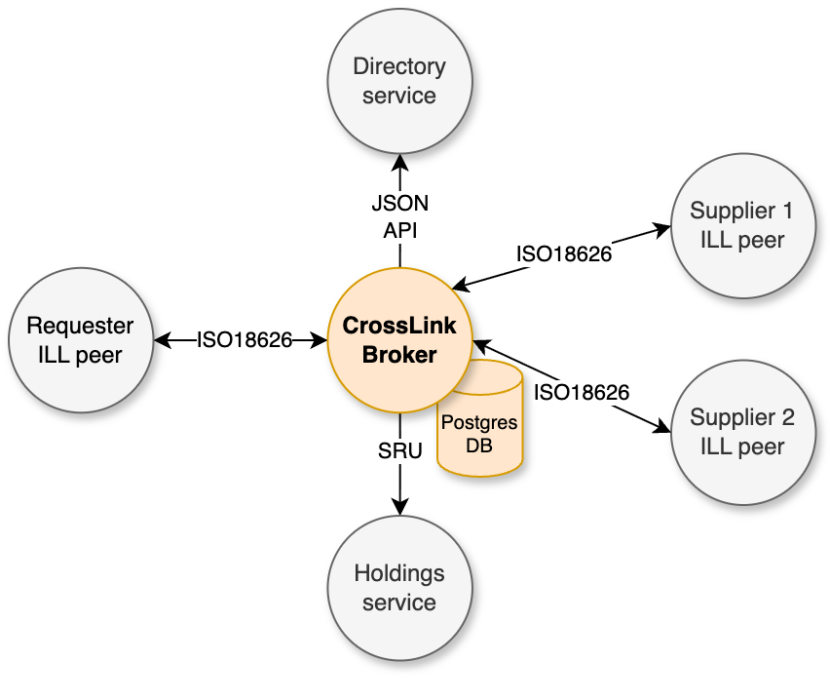
Systems architecture

Slide 5
ISO18626 and broker-based ILL
While ISO18626 is designed for peer-to-peer exchange of standardized messages (requests, shipments, returns, etc.), the broker extends its scope:
Locating holdings and suppliers the broker performs these tasks during the initial borrowing request. Filtering and ordering suppliers relies on policies communicated via the Directory.
Message routing requesters and suppliers address messages to to the broker rather than directly to their peers
Opaque vs. transparent mode:
Opaque mode (e.g., Alma, regular p2p clients): requester remains unaware of the actual supplier.
Transparent mode (e.g., ReShare): supplier identities are revealed, enabling supplier tracking, “local supply” detection, messaging with skipped suppliers, granular cancellation, and condition negotiation.

Slide 6
ISO18626 and broker-based ILL
In certain scenarios, CrossLink Broker employs ISO18626 in innovative ways:
Supplier identification: The broker can notify requesters of supplier selection changes via ExpectToSupply messages. In “local supply” cases, requests never leave the broker.
Embedding of metadata: Requester and supplier details (e.g. addresses) are inserted into forwarded messages, removing the need for synchronizing Directory data across all peers.
Flexible cancellations Supports both full termination and cancellation with continuation to the next supplier in transparent mode. Rejecting conditions is a special form of cancellation with continuation.
Condition negotiation Loan conditions and cost is negotiated via Notification, aka general messaging. Non-standard negotiation (e.g., in ReShare) is translated for compatibility with Alma/Rapido via broker-provided conversion mechanisms

Slide 7
CrossLink Broker design goals
Our objective was to build a service with low-cost hosting on cloud environments:
Lightweight deployment: Written in Go, using minimal dependencies and no external frameworks. Produces compact (~50MB) container images with instant startup and low resource overhead.
Protocol-first design: A custom xsd2go.xsl XML schema mapping library generates internal structures for protocol-compliant ISO18626, SRU, and NCIP handling.
Efficient messaging: Instead of Kafka or other standalone queues, the broker uses a custom-built event bus based on Postgres’ LISTEN/NOTIFY.
Optimized data access: With sqlc, database queries remain high-performing and clean, while fully leveraging PostgreSQL advanced features.

Slide 8
CrossLink Broker implementation
Integration complexity: External testing opportunities with real ILL systems are limited. Despite ~90% synthetic test coverage, successful integration requires a lot of human verification effort.
Custom test tooling: illmock simulates loan/copy workflows, renewals, overdue scenarios, and condition negotiations. Used both for broker testing and validation of third-party systems.
Vendor compatibility: A shim layer ensures interoperability by handling quirks in protocol implementations (e.g., Alma, ReShare).

Slide 9
Future development
CrossLink Broker already powers cross-vendor ILL in Trove (National Library of Australia + partners), connecting Alma and ReShare peers in a unified system. We would like to unlock more opportunities:
Patron Request API: A JSON-based API enabling user/staff interfaces to submit and manage ILL requests directly in the broker. Includes Server-Sent Events for real-time browser updates.
Unified transactions: Broker will combine ISO18626 peer requests with broker-managed requests seamlessly.
NCIP integration: For patron validation, availability checks, and placing requests directly in ILS. Use cases include Direct Consortial Borrowing (DCB) as well as ILS integration in traditional ILL.

Slide 10
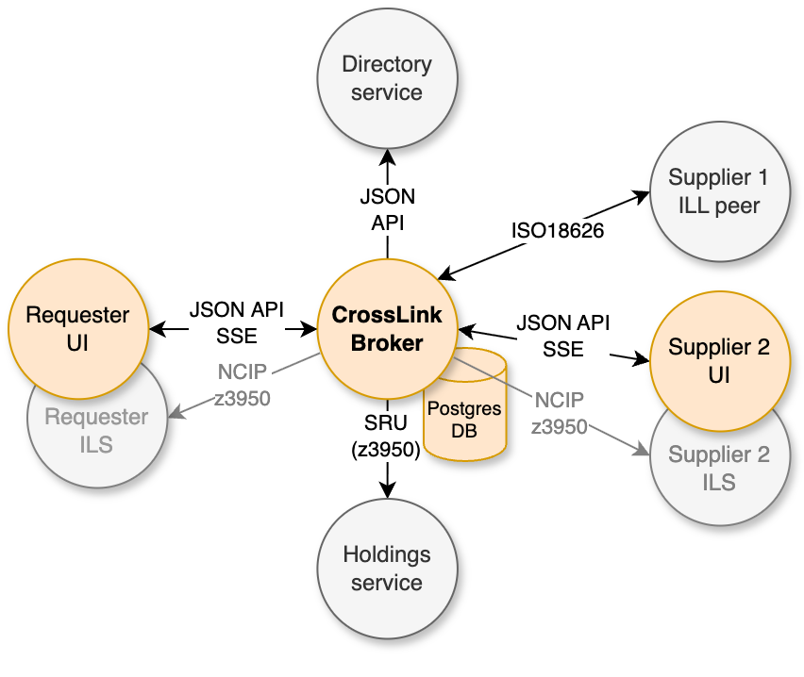
Patron Requests API

