Slide 1
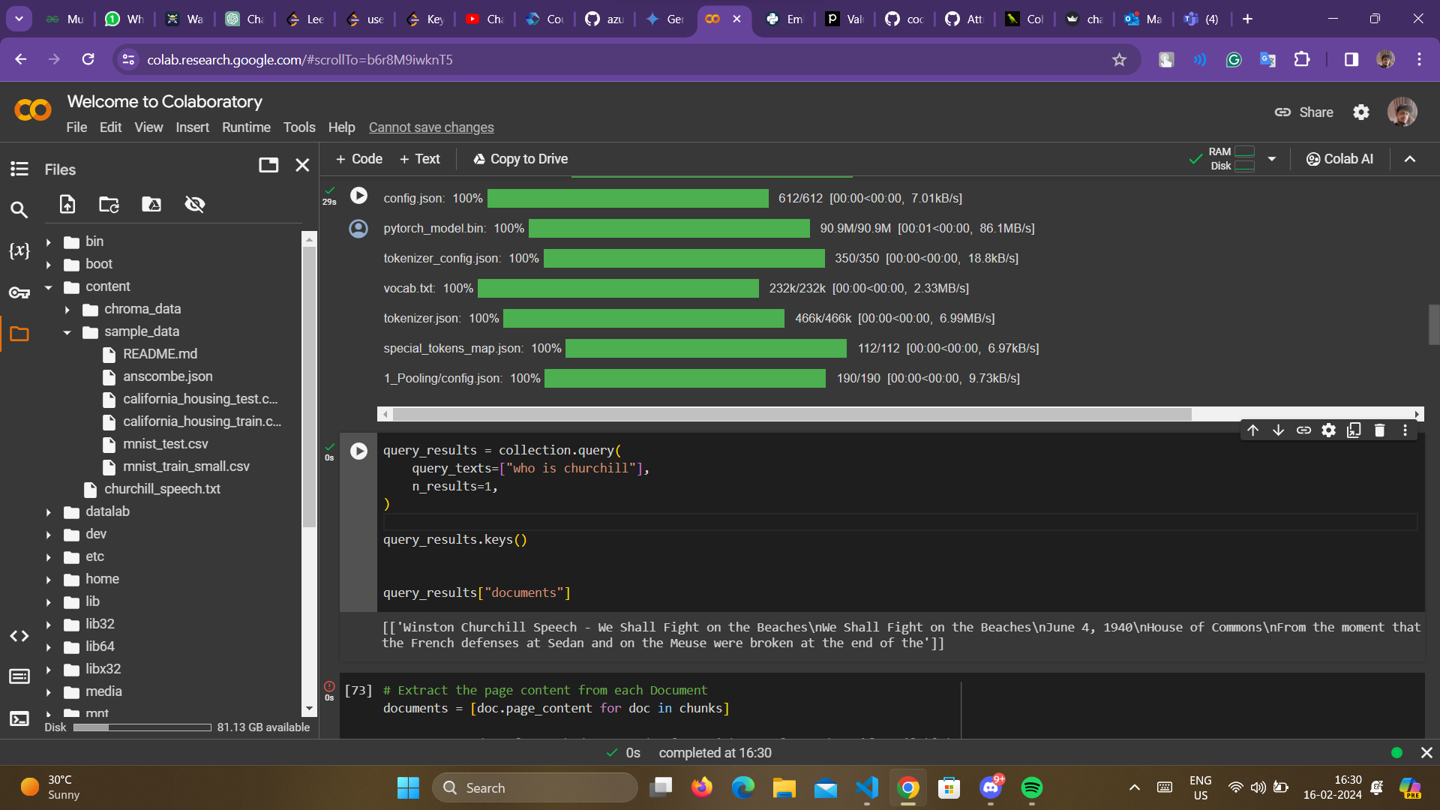

Slide 2
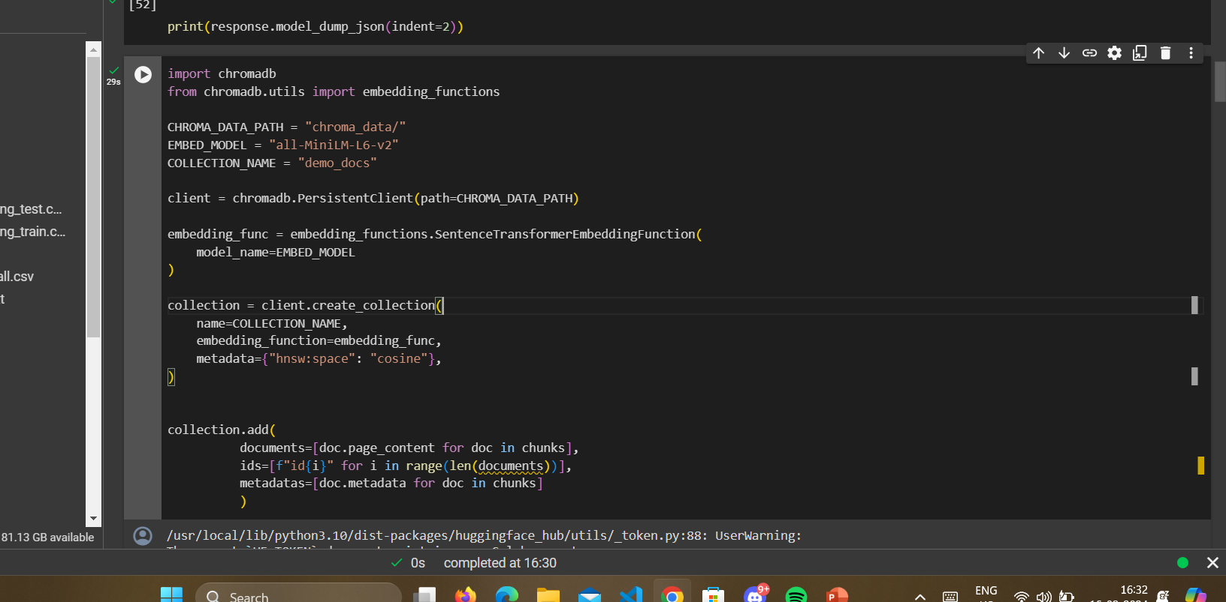
With this set of code, able to create the embeddings and push it to chromadb for persistance

Slide 3
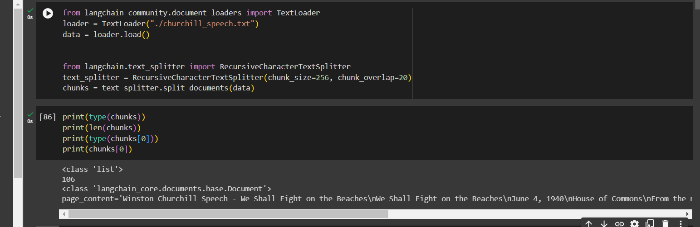
Chunks seems to be list, but inside its langchain document

Slide 4
https://github.com/langchain-ai/langchain/issues/13284 -------- Solution found
from langchain.chat_models import AzureChatOpenAI
from langchain.schema import HumanMessage
BASE_URL = "https://trail-outcome.openai.azure.com/"
API_KEY = "b59f23e204b3426c9dbe1f6741b80acb"
DEPLOYMENT_NAME = "LMM_OPENAI"
model = AzureChatOpenAI(
openai_api_base=BASE_URL,
openai_api_version="2023-03-15-preview",
deployment_name=DEPLOYMENT_NAME,
openai_api_key=API_KEY,
openai_api_type="azure",
)
print(model(
[
HumanMessage(
content="What are you doing"
)
]
))
Code Worked for working with AzureopenAI for ChatGPT model

Slide 5
from langchain_community.document_loaders import TextLoader
loader = TextLoader("./churchill_speech.txt")
data = loader.load()
from langchain.text_splitter import RecursiveCharacterTextSplitter
text_splitter = RecursiveCharacterTextSplitter(chunk_size=256, chunk_overlap=20)
chunks = text_splitter.split_documents(data)
import os
from openai import AzureOpenAI
client = AzureOpenAI(
api_key = "b59f23e204b3426c9dbe1f6741b80acb",
api_version = "2022-12-01",
azure_endpoint = "https://trail-outcome.openai.azure.com/"
)
response = client.embeddings.create(
input = str(chunks),
model= "EMBEDDER"
)
print(response.model_dump_json(indent=2))
from langchain.vectorstores import Chroma
vector_store = Chroma.add_documents(chunks, embeddings)
Code worked for embedding using AzureOpenAI but again storing it in ChromaDB is difficult

Slide 6
import chromadb
from chromadb.utils import embedding_functions
CHROMA_DATA_PATH = "chroma_data/"
EMBED_MODEL = "all-MiniLM-L6-v2"
COLLECTION_NAME = "demo_docs"
client = chromadb.PersistentClient(path=CHROMA_DATA_PATH)
embedding_func = embedding_functions.SentenceTransformerEmbeddingFunction(
model_name=EMBED_MODEL
)
collection = client.create_collection(
name=COLLECTION_NAME,
embedding_function=embedding_func,
metadata={"hnsw:space": "cosine"},
)
documents=[doc.page_content for doc in chunks]
collection.add(
documents=[doc.page_content for doc in chunks],
ids=[f"id{i}" for i in range(len(documents))],
metadatas=[doc.metadata for doc in chunks]
)
How to create embeddings for chromadb, uses it’s own embedding model

Slide 7
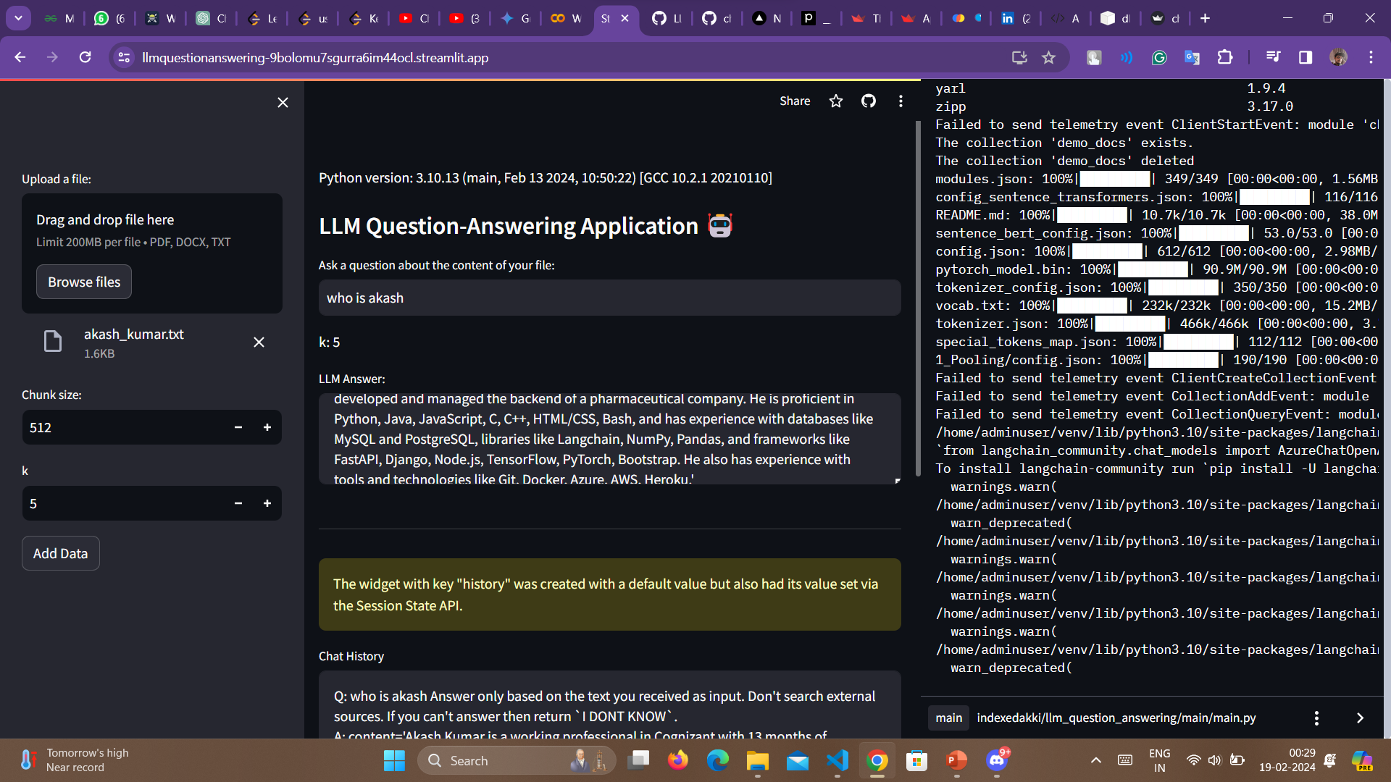
Finally, had a workaround to the problem,

Slide 8
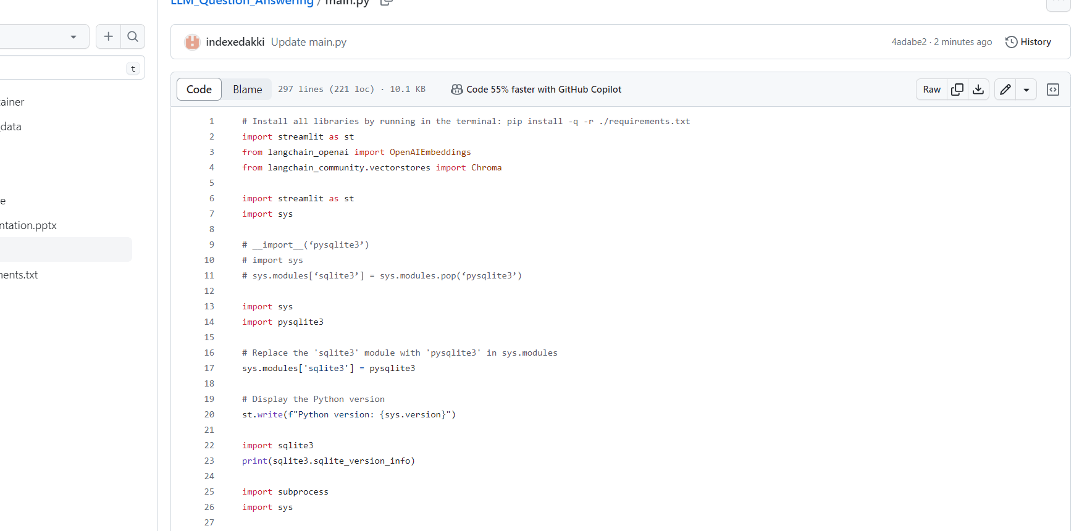
Changed normal sqlite in streamlit which uses 3.34 by default to use pysqlite and now it’s using sqlite 3.45 version
I was facing error in importing chromadb

Slide 9
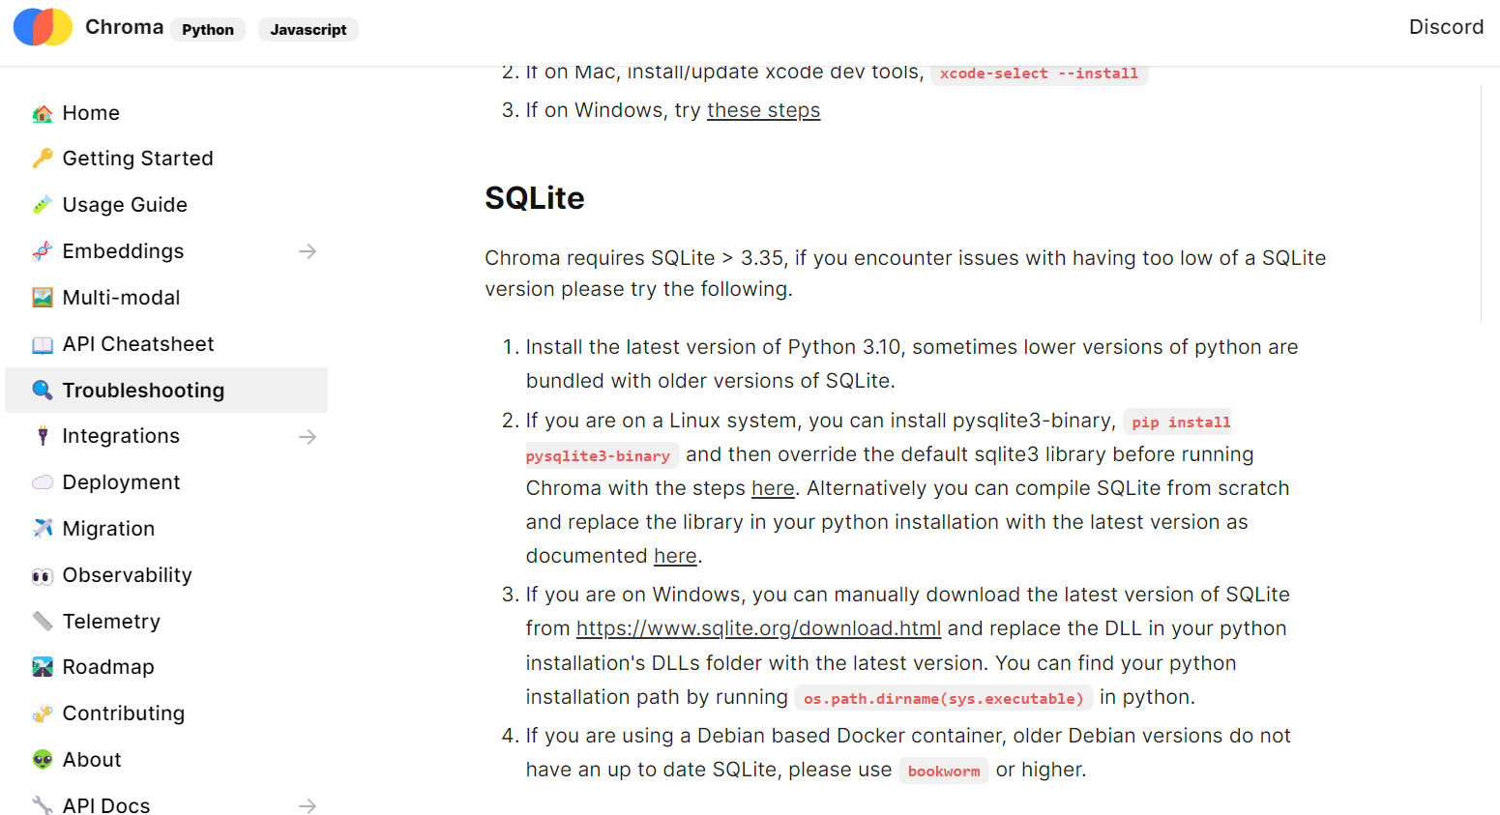

Slide 10
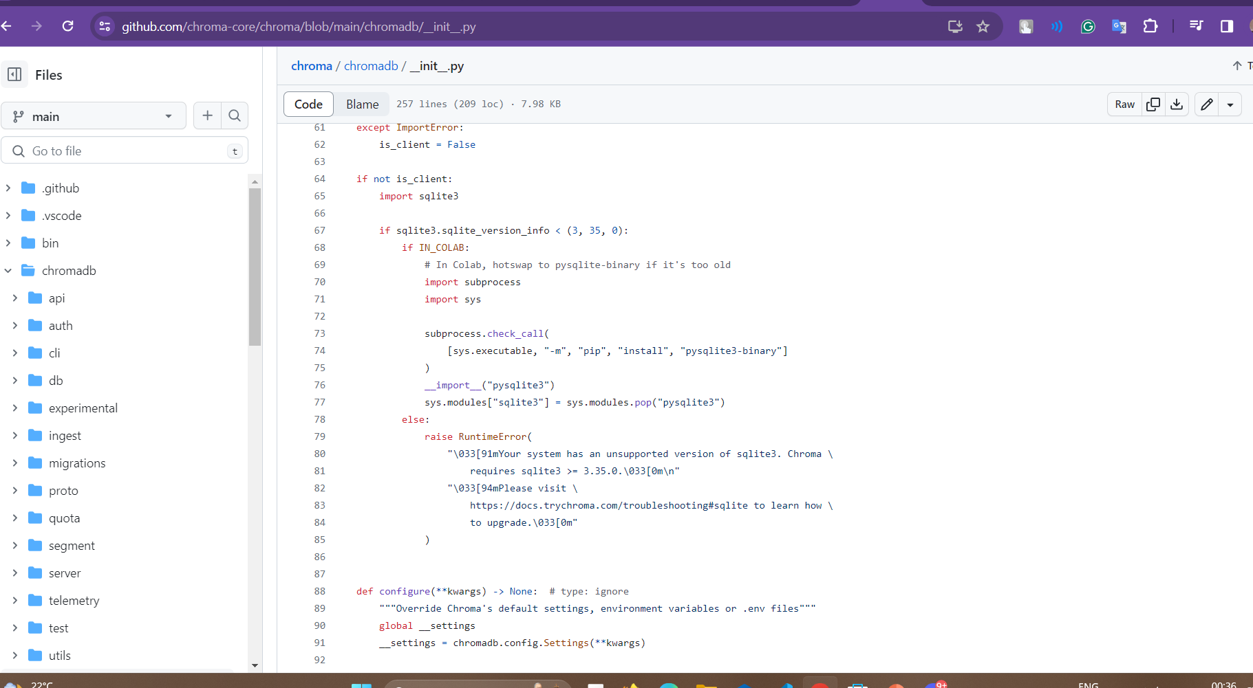
Again github files are helpful

