Slide 1
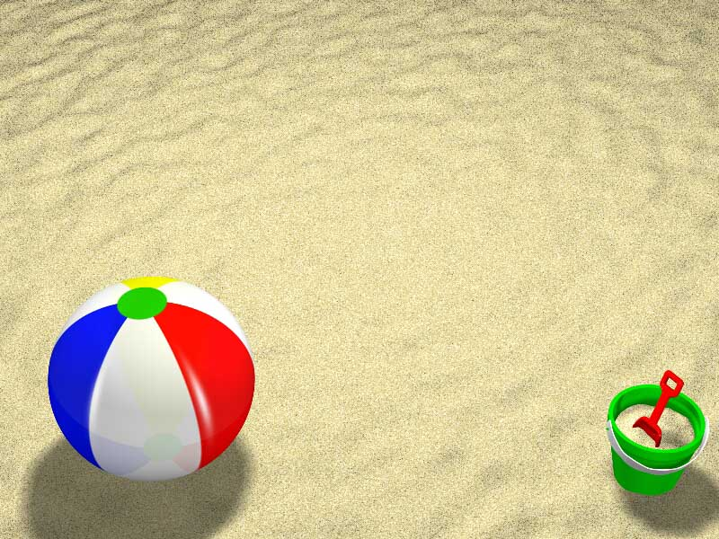
BLAST
Introduction to Bioinformatics
Anthony Nguyen

Slide 2

BLAST - why?
Sequence alignments provide a powerful way to compare novel sequences with previously characterized genes.
Both functional and evolutionary information can be inferred from well designed queries and alignments.

Slide 3
BLAST - what?
Basic Local Alignment Search Tool
BLAST provides a method for rapid searching of nucleotide and protein databases.

Slide 4
BLAST - how?
The BLAST algorithm detects local as well as global alignments and regions of similarity embedded in otherwise unrelated proteins can be detected.
Both types of similarity may provide important clues to the function of uncharacterized proteins.

Slide 5
BLAST - advantages
The BLAST algorithm was written balancing speed and increased sensitivity for distant sequence relationships.
BLAST emphasizes regions of local alignment to detect relationships among sequences which share only isolated regions of similarity.

Slide 6
BLAST - programs
blastp
Compares an amino acid query sequence against a protein sequence database.

Slide 7
BLAST - programs
blastn
Compares a nucleotide query sequence against a nucleotide sequence database.

Slide 8
BLAST - programs
blastx
Compares a nucleotide query sequence translated in all reading frames against a protein sequence database.
This option may be used to find potential translation products of an unknown nucleotide sequence.

Slide 9
BLAST - programs
tblastn
Compares a protein query sequence against a nucleotide sequence database dynamically translated in all reading frames.

Slide 10
BLAST - programs
tblastx
Compares the six-frame translations of a nucleotide query sequence against the six-frame translations of a nucleotide sequence database.

Slide 11
BLAST - objectives
How long is the target sequence?
What is the most likely identity of the sequence?
What is the source organism, where the sequence is found?
Is the sequence is expressed?

Slide 12
BLAST - query
Getting started…
http://www.ncbi.nlm.nih.gov/
Unknown Sequence TCGAAATAACGCGTGTTCTCAACGCGGTCGCGCAGATGCCTTTGCTCATC AGATGCGACCGCAACCACGTCCGCCGCCTTGTTCGCCGTCCCCGTGCCTC AACCACCACCACGGTGTCGTCTTCCCCGAACGCGTCCCGGTCAGCCAGCC TCCACGCGCCGCGCGCGCGGAGTGCCCATTCGGGCCGCAGCTGCGACGGT GCCGCTCAGATTCTGTGTGGCAGGCGCGTGTTGGAGTCTAAA

Slide 13
References
http://www.geospiza.com/outreach/BLAST/
http://www.ncbi.nlm.nih.gov/Education/BLASTinfo/information3.html

