Slide 1


Slide 2
The 5 Standard BLAST Programs
Program | Database | Query | Typical Uses
BLASTN | Nucleotide | Nucleotide | Mapping oligonucleotides, amplimers, ESTs, and repeats to a genome. Identifying related transcripts.
BLASTP | Protein | Protein | Identifying common regions between proteins. Collecting related proteins for phylogenetic analysis.
BLASTX | Protein | Nucleotide | Finding protein-coding genes in genomic DNA.
TBLASTN | Nucleotide | Protein | Identifying transcripts similar to a known protein (finding proteins not yet in GenBank). Mapping a protein to genomic DNA.
TBLASTX | Nucleotide | Nucleotide | Cross-species gene prediction. Searching for genes missed by traditional methods.
Notes:
BLASTP is simplest of all the programs.
BLASTN is very different from the other programs because it compares nucleotides to one another; all the other programs compare proteins or translations. One difference is in the seeding procedure (we'll see this in just a bit). BLASTN is more complicated than BLASTP because matches may reside on either strand of a sequence.
The two most similar programs are BLASTX and TBLASTN. In these, one sequence is protein, and the other is a translation. Since these programs may operate on very large sequences and databases, they can be computationally expensive. Matching proteins to DNA translations is not as straightforward as it sounds. We'll discuss these issues later on.
TBLASTX is the most computationally intensive program because it translates each sequence in 6 frames. It is a difficult program to interpret because much of the time the sequences are anonymous, so you have no idea what a similarity might mean. It is also difficult to run properly because the standard scoring matrices are flawed.

Slide 3
WU-BLAST vs. NCBI-BLAST
faster (except for BLASTN)
word size unlimited
nucleotide matrices
gapped lambda for BLASTN
links, topcomboN, kap
altscore
no additional output formats
no PSI-BLAST, PHI-BLAST, MegaBLAST
Notes:
I generally prefer WU-BLAST to NCBI-BLAST because if gives the user greater control over the search. This is especially true for the protein-based programs where word size is limited to 2 or 3. WU-BLAST also has advantages for more sensitive nucleotide searches where scoring matrices and smaller word sizes are useful (NCBI-BLASTN has a 7 nt minimum). Having gapped statistics is also useful in BLASTN.
Viewing and controlling alignment groups is impossible in NCBI-BLAST. In addition to links, topcoboN, and kap, WU-BLAST has commandline options to control the overlap rules (olf, golf, olmax. golmax) and the distance between HSPs along either sequence (hspsepmaxsmax, hspsepqmax gspsepsmax, gspsepqmax). These features allow advanced users to control alignment groups in subtle yet important ways.
WU-BLAST is better suited for building specialized scripts due to features like dbrecmin and nwstart that can be employed for data splitting and query chopping.
WU-BLAST doesn't have some of the specialized programs like PSI-BLAST and MegaBLAST. It's best to know how to run both NCBI-BLAST and WU-BLAST and use the best tool for a particular job.

Slide 4
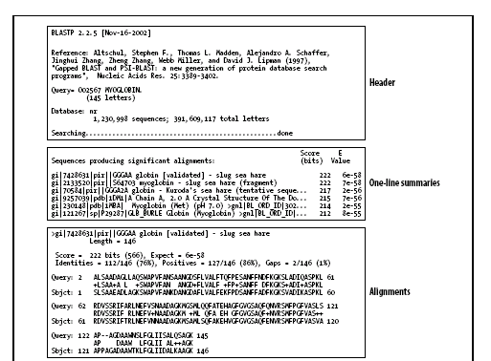
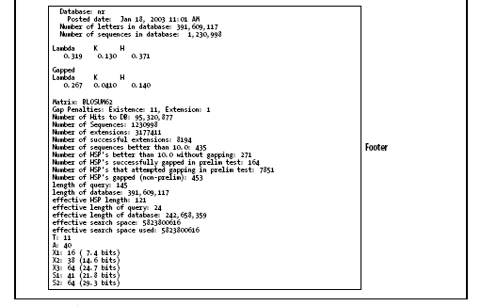

Slide 5
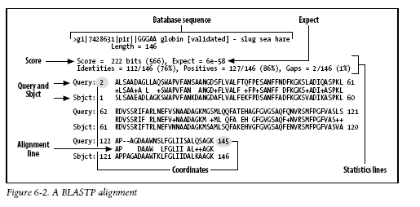

Slide 6
>gi|23098447|ref|NP_691913.1| (NC_004193) 3-oxoacyl-(acyl carrier
protein) reductase [Oceanobacillus iheyensis]
Length = 253
Score = 38.9 bits (89), Expect = 3e-05
Identities = 17/40 (42%), Positives = 26/40 (64%)
Frame = -1
Query: 4146 VTGAGHGLGRAISLELAKKGCHIAVVDINVSGAEDTVKQI 4027
VTGA G+G+AI+ A +G + V D+N GA+ V++I
Sbjct: 10 VTGAASGMGKAIATLYASEGAKVIVADLNEEGAQSVVEEI 49

Slide 7
TWO ASPECTS OF BLAST
BLAST ALGORITHM
BLAST STATISTCS
Word Hit Heuristic
Karlin-Altschul statistics:
a general theory of alignment statistics
Applicability goes well beyond BLAST
Extension Heuristic
BLAST uses Karlin-Altschul Statistics to determine
the statistical significance of the alignments it produces.

Slide 8
TWO ASPECTS OF BLAST
BLAST ALGORITHM
BLAST STATISTCS
Word Hit Heuristic
Karlin-Altschul statistics:
a general theory of alignment statistics
Applicability goes well beyond BLAST
Extension Heuristic
BLAST uses Karlin-Altschul Statistics to determine
the statistical significance of the alignments it produces.

Slide 9
>gi|23098447|ref|NP_691913.1| (NC_004193) 3-oxoacyl-(acyl carrier
protein) reductase [Oceanobacillus iheyensis]
Length = 253
Score = 38.9 bits (89), Expect = 3e-05
Identities = 17/40 (42%), Positives = 26/40 (64%)
Frame = -1
Query: 4146 VTGAGHGLGRAISLELAKKGCHIAVVDINVSGAEDTVKQI 4027
VTGA G+G+AI+ A +G + V D+N GA+ V++I
Sbjct: 10 VTGAASGMGKAIATLYASEGAKVIVADLNEEGAQSVVEEI 49

Slide 10
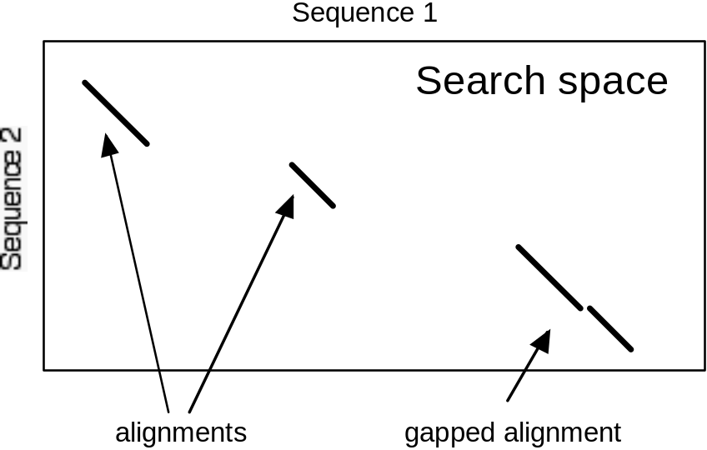
Alignment Overview
Sequence alignment takes place in a 2-dimensional space where diagonal lines represent regions of similarity. Gaps in an alignment appear as broken diagonals. The search space is sometimes considered as 2 sequences and somtimes as query x database.
Global alignment vs. local alignment
  BLAST is local
Maximum scoring pair (MSP) vs. High-scoring pair (HSP)
  BLAST finds HSPs (usually the MSP too)
Gapped vs. ungapped
  BLAST can do both
Notes:
There are fundamentally two types of alignment: (1) global alignment and (2) local alignment. In global alignment, also known as Neeleman-Wunsch, every letter of each sequence appears in the alignment. This can give very strange results for sequences of different lengths. There are some useful variants of global alignment, for example those that align transcripts to a genome. BLAST is a local alignment algorithm.
MSP is an acronym for Maximum Scoring Pair. The Smith-Waterman algorithm is guaranteed to find one MSP and is therefore often considered the gold standard for alignment. This is only a theoretical measure, however, and there may be several alignments worth reporting. For example, it is more useful to report all exons similar to a protein rather than just the highest scoring one. HSP stands for High Scoring Pair. BLAST finds HSPs.
BLAST was originally an ungapped alignment algorithm but produces gapped alignments now (by default). Whether BLAST finds a single gapped alignment or several ungapped alignments can be a matter of parameter choice. Gapped alignment is generally preferred but introduces some hidden problems.

Slide 11
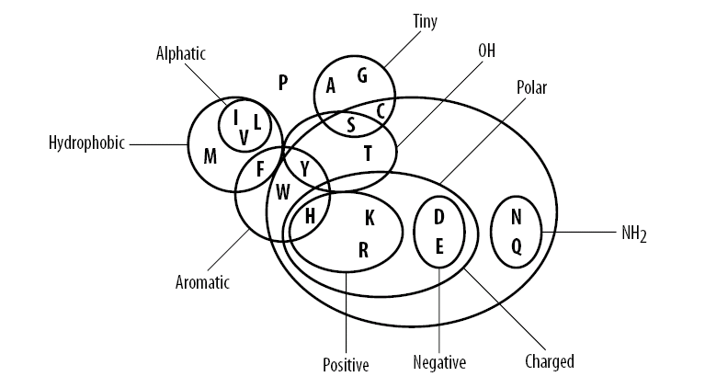
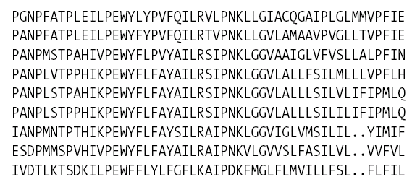

Slide 12
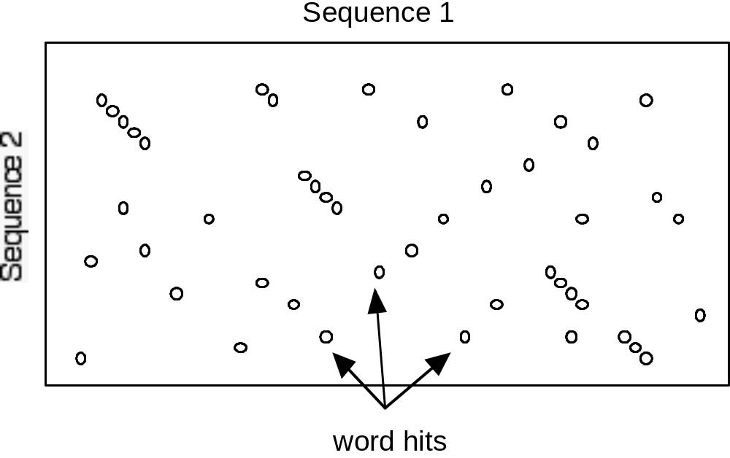
The BLAST Algorithm:
Seeding (W and T)
BLOSUM62 neighborhood of RGD
RGD 17
KGD 14
QGD 13
RGE 13
EGD 12
HGD 12
NGD 12
RGN 12
AGD 11
MGD 11
RAD 11
RGQ 11
RGS 11
RND 11
RSD 11
SGD 11
TGD 11
Speed gained by minimizing search space
Alignments require word hits
Neighborhood words
W and T modulate speed and sensitivity
T=12
Notes:
BLAST is fast because it does not examine the entire search space between two sequences. BLAST only creates alignments where there are word hits. A word hit may be two identical words or two words that meet a threshold value. Note that several diagonals are already apparent in the clusters of word hits.
Let's first consider only matching words for word hits (BLASTN is always run this way). Under these conditions, it is easy to see why increasing word length (W) will reduce the number of word hits. One way to tune the speed/sensitivity of BLAST is through W.
The neighborhood word threshold score (T) modulates sensitivity within a particular word size. For the protein-based BLAST programs (everything except BLASTN), the typical value for W is 3. Varying the value of T changes the number of words that are considered hits. In the example above, RGD can create hits with 7 other combinations of amino acids at T=12. At T=11 there are 16 others.
Altering the values of W and T is the simplest and most effective way to change the sensitivity and speed of any BLAST program.
Note: NCBI-BLAST is limited to word sizes of 7+ in BLASTN and 2 or 3 in others. WU-BLAST is unlimited for all programs.

Slide 13
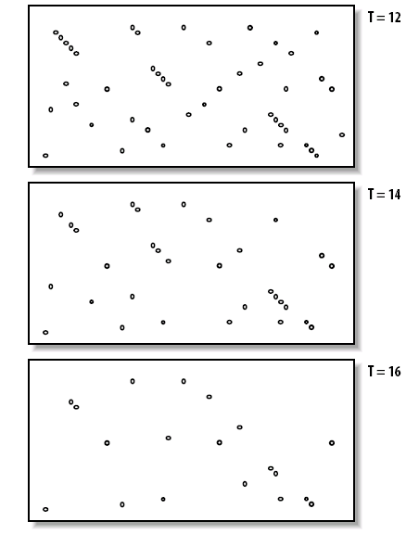

Slide 14
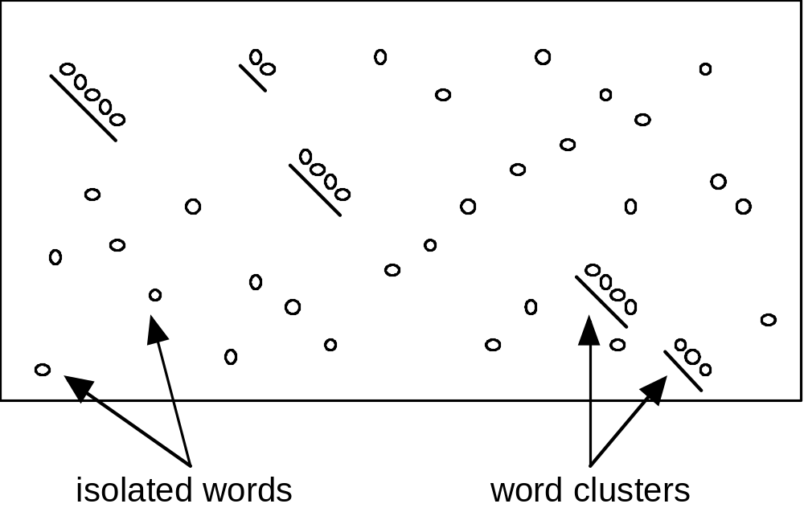
The BLAST Algorithm:
2-hit Seeding
Alignments tend to have multiple word hits.
Isolated word hits are frequently false leads.
Most alignments have large ungapped regions.
Requiring 2 word hits on the same diagonal (of 40 aa for example), greatly increases speed at a slight cost in sensitivity.
Notes:
The 2-hit algorithm is generally not used with BLASTN because the large word sizes typically employed tend to produce few seeds. What follows therefore pertains to the other BLAST programs.
While the 2-hit algorithm is available for both NCBI-BLAST and WU-BLAST, it is not used by default for the WU-BLAST programs. When comparing default parameters (something one should not really do), WU-BLAST will appear slower and more sensitive because it uses single word hits. It may seem a great restriction to require that there be two word hits in an ungapped region to seed an alignment, but in practice it works very well and even relatively dissimilar sequences can be aligned.
The 2-hit algorithm is best employed for "generic" searches. When optimizing for speed, it is more important to raise the word size (this is only available in WU-BLAST). When optimizing for sensitivity, it is better to use 1-hit seeding.
Compared to the default WU-BLASTP seeding parameters (W=3 T=12 1-hit), simply adding the 2-hit algorithm makes the search about 4 times faster. At T=999, the 2-hit is 30 times faster, but one can go much faster with higher word sizes. For example, at W=5 the speed is about 120x even without the 2-hit algorithm.

Slide 15
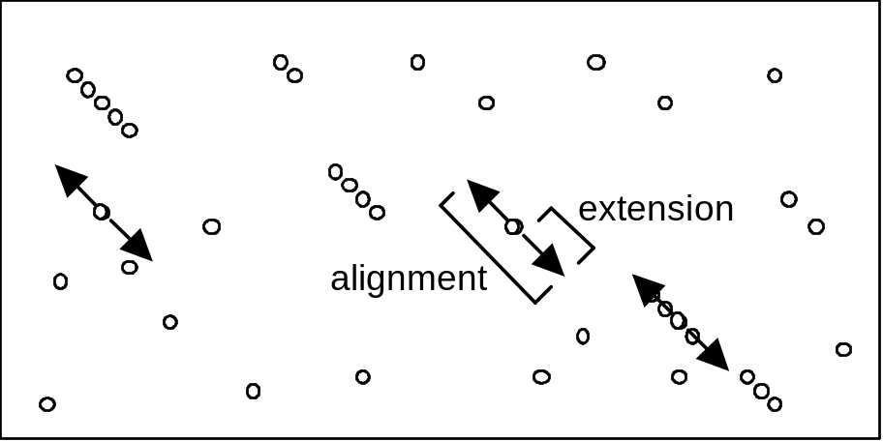
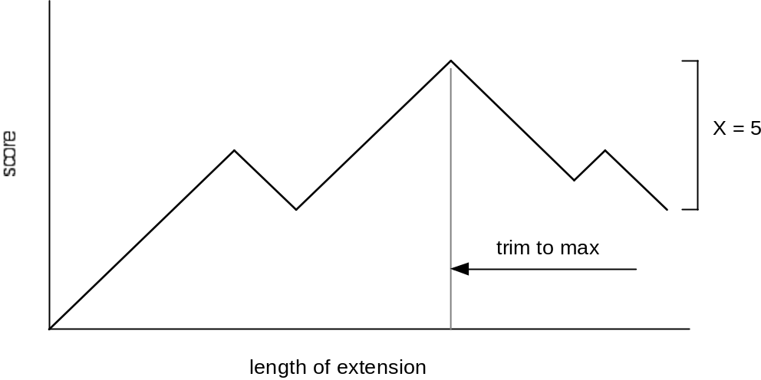
The BLAST Algorithm: Extension
Alignments are extended from seeds in each direction.
Extension is terminated when the maximum score drops below X.
Text example
match +1
mismatch -1
no gaps
The quick brown fox jumps over the lazy dog.
The quiet brown cat purrs when she sees him.
Notes:
Once the search space is seeded, alignments are generated from individual seeds by extending them in both directions. This sounds simple, but when should the extension stop? One could extend to the end of the sequence and then trim the alignment back to the maximum score, but for long sequences this may be a computational burden since there may be many seeds.
BLAST terminates the extensions when the running score drops too far from the last maximum This threshold is called X. In the text example above, one could terminate at the first mismatch (X=1). In this case, the extension would end by aligning the i in quick and quiet. Clearly there are more similar letters farther down. Setting X=5 allows us to get the similarity up to brown, but no farther.
The text example above used ungapped extension. Modern BLASTs use gapped extension, and the algorithm is quite a bit more complicated, but the generalities are the same. Normally one does not need to change the value for X when optimizing BLAST parameters because the default values work well, and it has a relatively minor effect compared with W and T.

Slide 16
>gi|23098447|ref|NP_691913.1| (NC_004193) 3-oxoacyl-(acyl carrier
protein) reductase [Oceanobacillus iheyensis]
Length = 253
Score = 38.9 bits (89), Expect = 3e-05
Identities = 17/40 (42%), Positives = 26/40 (64%)
Frame = -1
Query: 4146 VTGAGHGLGRAISLELAKKGCHIAVVDINVSGAEDTVKQI 4027
VTGA G+G+AI+ A +G + V D+N GA+ V++I
Sbjct: 10 VTGAASGMGKAIATLYASEGAKVIVADLNEEGAQSVVEEI 49

Slide 17
TWO ASPECTS OF BLAST
BLAST ALGORITHM
BLAST STATISTCS
Word Hit Heuristic
Karlin-Altschul statistics:
a general theory of alignment statistics
Applicability goes well beyond BLAST
Extension Heuristic
BLAST uses Karlin-Altschul Statistics to determine
the statistical significance of the alignments it produces.

Slide 18
BLAST STATISTCS
Karlin-Altschul statistics:
a general theory of alignment statistics; applicability goes well beyond BLAST
Notational issues
Information theory: nats & bits
How alignments are scored
Hw scoring schemes are created
λ , E & H

Slide 19
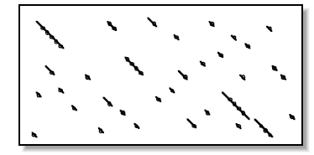
6
5
4
How many runs with a score of X do we expect to find?

Slide 20
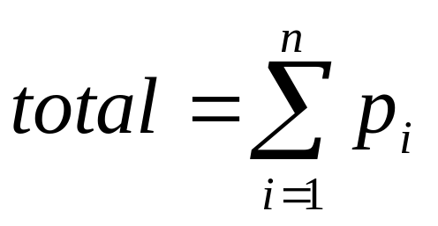
Understanding Gaussian sum notation
my %frequences;
$frequencies{‘A’} = 0.25;
$frequencies{‘T’} = 0.25;
$frequencies{‘G’} = 0.25;
$frequencies{‘C’} = 0.25;
my $total = 0;
foreach my $k (keys %frequencies){
$total += $frequencies{$k};
}

Slide 21


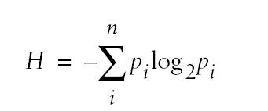


A little information theory

Slide 22
G=A=T=C=0.25
A=T=0.45; G=C=0.05

Slide 23
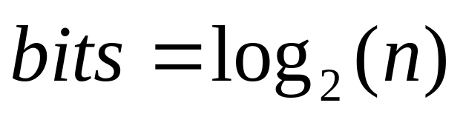
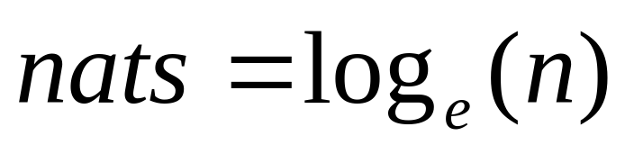
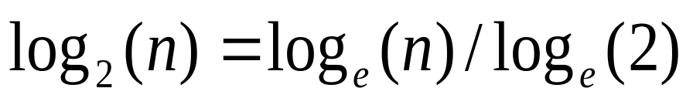
bits vs. nats

Slide 25
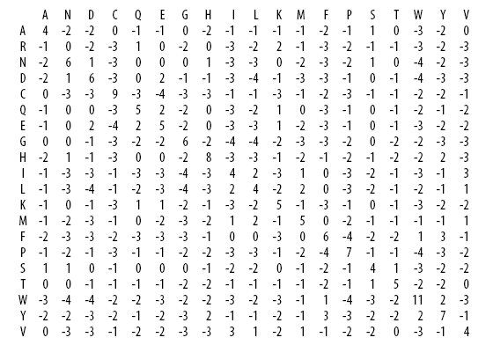

Slide 26
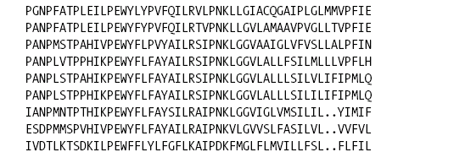
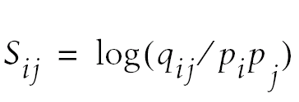
p_{M}=0.01
p_{R}=0.1
p_{I} =0.1
p_{L} =0.1
q_{MI}=0.002
q_{RL}=0.002
S_{MI}=log₂(.002/0.01*0.1) = +1 bits
S_{RL}=log₂(.002/0.1*0.1) = -2.322 bits
S_{MI}=log_{e}(.002/0.01*0.1) = +.693 nats
S_{RL}=log_{e}(.002/0.01*0.1) = -1.609 nats

Slide 27
The BLOSUM MATRICES are int(log₂ *3)
‘munge’ factor

Slide 28
The BLOSUM MATRICES are int(log₂ *3)
‘munge’ factor
Why do this?

Slide 29
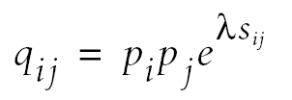
Recall that :
Int(3* )
2
λ is the number that will convert the ‘munged’
S_{ij} back into its ‘original’ q_{ij} for purposes of
further calculation.

Slide 30
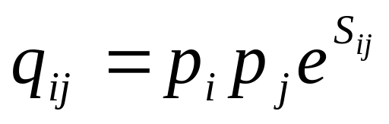
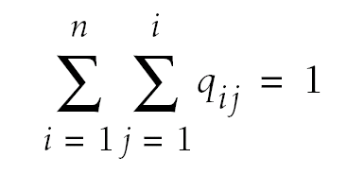

Int(3* )
2
λ allows us to recover that
original q_{ij} for purposes of further
calculation

Slide 31
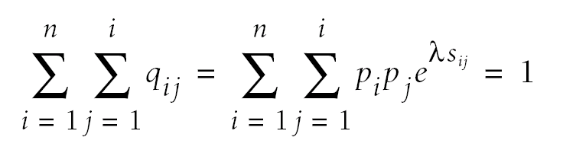
λ is found by successive
approximation using the
Identity below

Slide 32
Further calculations you can do once you know lambda
Expected score
Relative entropy
Target frequencies
Convert a raw score to a nat/bit score

Slide 33
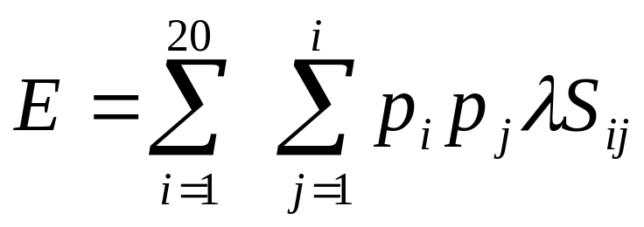
Expected score of the matrix
Note must be negative for K-A stats to apply
What is the expected score of a +1/-3 scoring scheme?

Slide 34
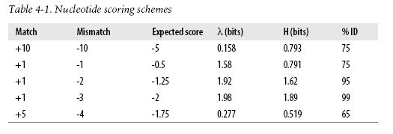

Slide 35
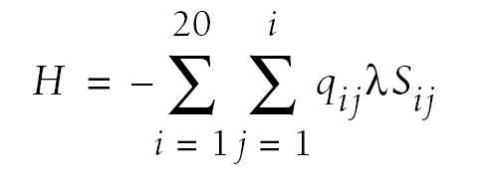
Relative Entropy of the matrix
BLOSUM 42 < BLOSUM 62 < BLOSUM 80
‘Think of Entropy in terms of degeneracy and promiscuity’
H
= far from equilibrium
H = near equilibrium, alignments contain little information

Slide 37
Target Frequencies
Every scoring scheme is implicitly an log-odds scoring scheme.
Every scoring scheme has a set of target frequencies
In other words, even a simple +1/-3 scoring scheme is implictly
a log odds scheme.
What data justify this scheme; what imaginary data
Does the scheme imply?

Slide 38
Further calculations you can do once you know lambda
Every scoring scheme is implicitly a log odds scoring matrix;
Every log odds matrix has an implicit set of target frequencies.
This is quite profound insight.

Slide 39
Commercial break!

Slide 40
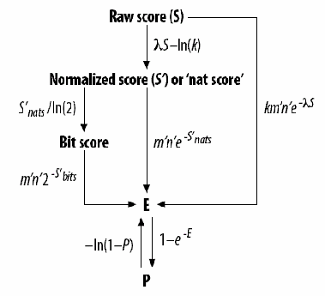
BLAST STATISTCS
The basic operations:
Actual vs. Effective lengths,
Raw scores,
Normalized scores e.g. nat and bit scores
E & P

Slide 41
>gi|23098447|ref|NP_691913.1| (NC_004193) Length = 253
Score = 38.9 bits (89), Expect = 3e-05
Identities = 17/40 (42%), Positives = 26/40 (64%)
Frame = -1
Query: 4146 VTGAGHGLGRAISLELAKKGCHIAVVDINVSGAEDTVKQI 4027
VTGA G+G+AI+ A +G + V D+N GA+ V++I
Sbjct: 10 VTGAASGMGKAIATLYASEGAKVIVADLNEEGAQSVVEEI 49

Slide 42
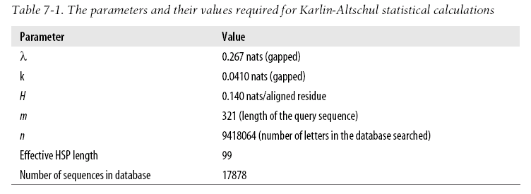

Slide 43

The Karlin-Altschul Equation
A minor constant
Scaling factor
Expected number of alignments
Normalized score
Raw score
Length of query
Length of database
Search space
Notes:
The Karlin-Altschul equation tells us (theoretically) how often we can expect to see an alignment with a given score by chance. This is very useful both for predicting the outcome of a search and for evaluating the results. The equation makes several assumptions that don't quite fit with biological sequences. We'll talk more about this in Advanced BLAST. For now, let's focus on the properties of the equation.
Broadly, E is a function of the search space and the normalized score. If we double the search space (e.g. double the length of the query), the number of alignments will decrease by half. But what if we double the score? Since the score is in the exponent, even small changes in S lead to large changes in E.
Although the K-A equation is very useful, there are certain unavoidable issues in biological sequences. Low complexity sequence is very common. Complexity filters are therefore usually applied to reduce false-positives. Database size is another problem. What is the effective size of a database containing all actins? It must be closer to a single actin than the sum of all sequence lengths. When you see outrageously low E-values, this is a statement of how poorly real searches match from the theoretical model.

Slide 44
The Karlin-Altschul Equation
A minor constant
Scaling factor
Expected number of alignments
Normalized score
Raw score
Length of query
Length of database
Search space
Notes:
The Karlin-Altschul equation tells us (theoretically) how often we can expect to see an alignment with a given score by chance. This is very useful both for predicting the outcome of a search and for evaluating the results. The equation makes several assumptions that don't quite fit with biological sequences. We'll talk more about this in Advanced BLAST. For now, let's focus on the properties of the equation.
Broadly, E is a function of the search space and the normalized score. If we double the search space (e.g. double the length of the query), the number of alignments will decrease by half. But what if we double the score? Since the score is in the exponent, even small changes in S lead to large changes in E.
Although the K-A equation is very useful, there are certain unavoidable issues in biological sequences. Low complexity sequence is very common. Complexity filters are therefore usually applied to reduce false-positives. Database size is another problem. What is the effective size of a database containing all actins? It must be closer to a single actin than the sum of all sequence lengths. When you see outrageously low E-values, this is a statement of how poorly real searches match from the theoretical model.

Slide 45
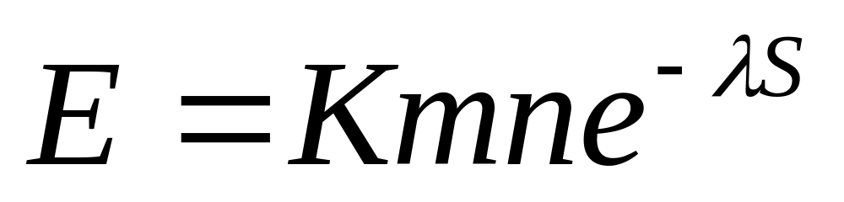
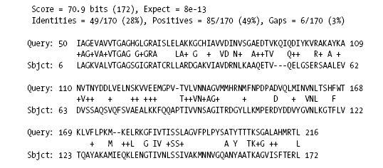
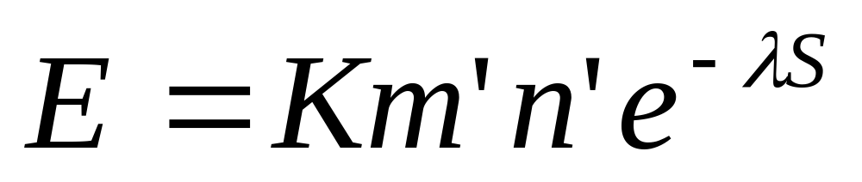
ACTUAL vs. EFFECTIVE LENGTHS

Slide 46

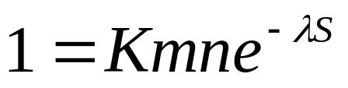
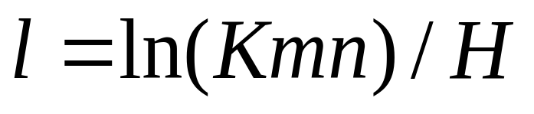


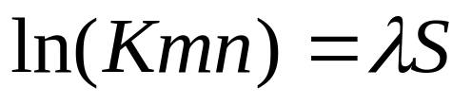
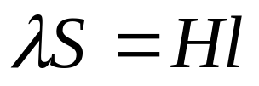

The ‘expected HSP length’
Dependent on search space
Recall that H is nats/aligned residue, thus

Slide 47
ACGTGTGCGCAGTGTCGCGTGTGCACACTATAGCC
Actual length (m)
effective length(m’) = m –l
effectve length (n’) = total length db – num_seqs*l
What happens if m’ < 0 ?

Slide 48
The Karlin-Altschul Equation
A minor constant
Scaling factor
Expected number of alignments
Normalized score
’
’
Raw score
Length of query
Length of database
Search space
Notes:
The Karlin-Altschul equation tells us (theoretically) how often we can expect to see an alignment with a given score by chance. This is very useful both for predicting the outcome of a search and for evaluating the results. The equation makes several assumptions that don't quite fit with biological sequences. We'll talk more about this in Advanced BLAST. For now, let's focus on the properties of the equation.
Broadly, E is a function of the search space and the normalized score. If we double the search space (e.g. double the length of the query), the number of alignments will decrease by half. But what if we double the score? Since the score is in the exponent, even small changes in S lead to large changes in E.
Although the K-A equation is very useful, there are certain unavoidable issues in biological sequences. Low complexity sequence is very common. Complexity filters are therefore usually applied to reduce false-positives. Database size is another problem. What is the effective size of a database containing all actins? It must be closer to a single actin than the sum of all sequence lengths. When you see outrageously low E-values, this is a statement of how poorly real searches match from the theoretical model.

Slide 49
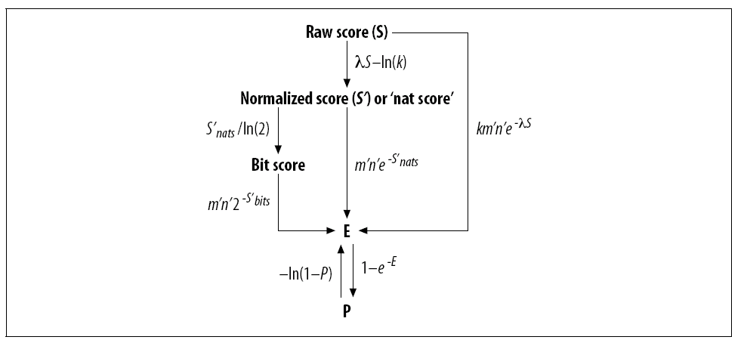
Converting a raw score to a bit score
>gi|23098447|ref|NP_691913.1| (NC_004193) Length = 253
Score = 38.9 bits (89), Expect = 3e-05
Identities = 17/40 (42%), Positives = 26/40 (64%)
Frame = -1
Query: 4146 VTGAGHGLGRAISLELAKKGCHIAVVDINVSGAEDTVKQI 4027
VTGA G+G+AI+ A +G + V D+N GA+ V++I
Sbjct: 10 VTGAASGMGKAIATLYASEGAKVIVADLNEEGAQSVVEEI 49

Slide 50
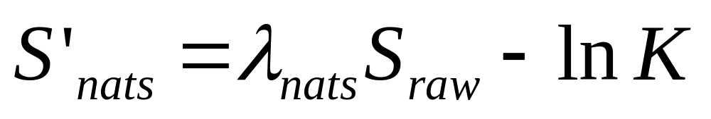
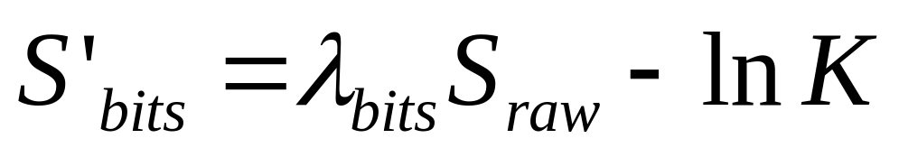
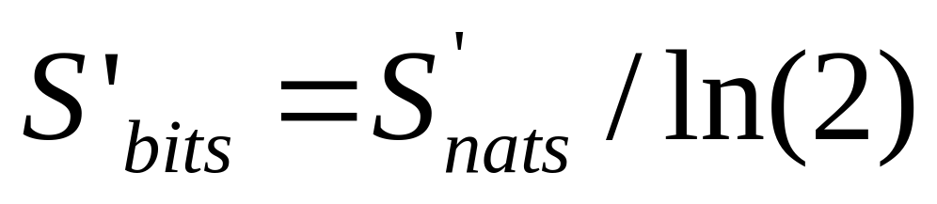
Converting a raw score to a bit score

Slide 51
Converting a raw score or a bit score to an Expect
>gi|23098447|ref|NP_691913.1| (NC_004193) Length = 253
Score = 38.9 bits (89), Expect = 3e-05
Identities = 17/40 (42%), Positives = 26/40 (64%)
Frame = -1
Query: 4146 VTGAGHGLGRAISLELAKKGCHIAVVDINVSGAEDTVKQI 4027
VTGA G+G+AI+ A +G + V D+N GA+ V++I
Sbjct: 10 VTGAASGMGKAIATLYASEGAKVIVADLNEEGAQSVVEEI 49

Slide 52
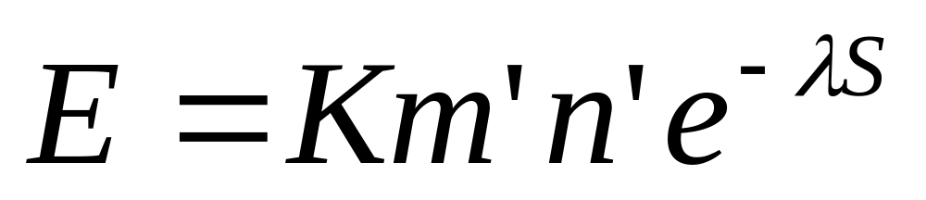
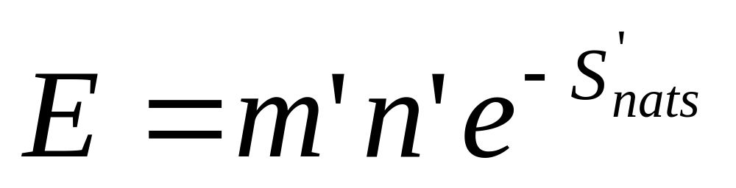
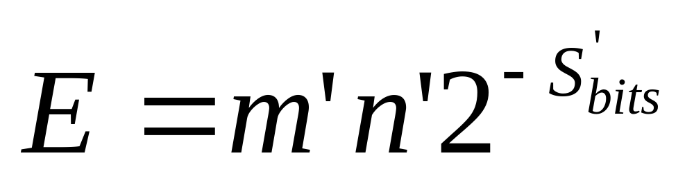
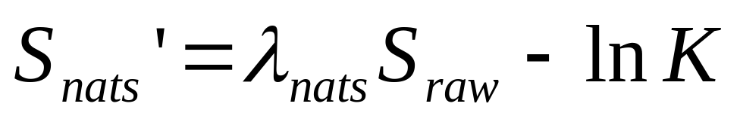
Converting a raw score or a bit score to an Expect

Slide 53
Converting an Expect to a WU-BLAST P value
>gi|23098447|ref|NP_691913.1| (NC_004193) Length = 253
Score = 38.9 bits (89), Expect = 3e-05
Identities = 17/40 (42%), Positives = 26/40 (64%)
Frame = -1
Query: 4146 VTGAGHGLGRAISLELAKKGCHIAVVDINVSGAEDTVKQI 4027
VTGA G+G+AI+ A +G + V D+N GA+ V++I
Sbjct: 10 VTGAASGMGKAIATLYASEGAKVIVADLNEEGAQSVVEEI 49

Slide 54
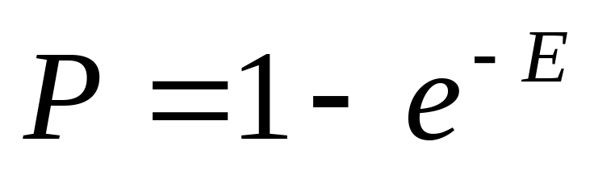
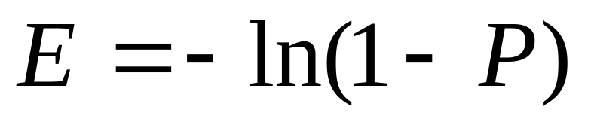
Converting an Expect to a WU-BLAST P value
Note that E ~= P if either value < 1e⁻⁵

Slide 55
Review: where the parts of an HSP come from, and what they mean
>gi|23098447|ref|NP_691913.1| (NC_004193) Length = 253
Score = 38.9 bits (89), Expect = 3e-05
Identities = 17/40 (42%), Positives = 26/40 (64%)
Frame = -1
Query: 4146 VTGAGHGLGRAISLELAKKGCHIAVVDINVSGAEDTVKQI 4027
VTGA G+G+AI+ A +G + V D+N GA+ V++I
Sbjct: 10 VTGAASGMGKAIATLYASEGAKVIVADLNEEGAQSVVEEI 49

Slide 56
Why use Karlin-Altschul statistics?
Why not just stop with the raw score?

Slide 57
Why use Karlin-Altschul statistics?
Why not just stop with the raw score?
Scores is fine, if you are only interested
In the top score… when to stop?
How to compare scores produced using two different
scoring schemes?
Bit score provide a common currency for scores,
i.e. 52 bits is 52 bits is 52 bits.
Scores don’t reflect database size; Expects do.
K-A stats is a bit like stoichiometry: Score ~ weight
λ ~ Avogadro's’ number
E ~ mass

Slide 58


Slide 59
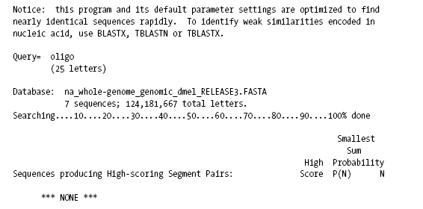
WU-BLASTN

Slide 60
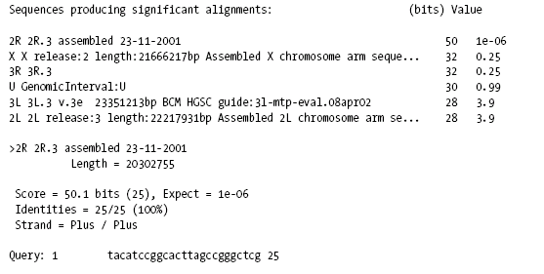

NCBI-BLASTN

Slide 61
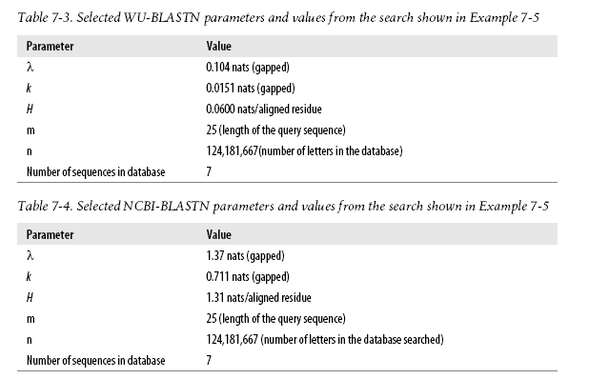

Slide 62
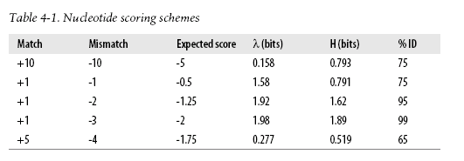

Slide 63





NCBI ~ 15
WU-BLAST ~170
So how long would an oligo have to be to
generate a score of 15 or 170?

Slide 64

l_{ncbi}=16
l_{wu-BLAST=294}

Slide 65


Slide 66

Sum Statistics
Notes:
There are a variety of ways to calculate combined statistical significance. NCBI-BLAST and WU-BLAST do it differently, and even programs within the same family don't use the same formulations. There are equations that require consistent alignments and also those that do not. It's a bit confusing. The book goes into greater detail on the subject, so I'll just describe the generalities here.
The first stage is determining which alignments are consistent with each other. This involves comparing the coordinates of all the alignments. This operation is quadratic in the number of HSPs, and can become a computational burden if there are many alignments. For this reason, it's not a good idea to search long sequences against each other, especially if they have repeats.
The sum score (shown above) is calculated by adding up all the alignment scores from a group and subtracting the expected score [ln(kmn)] from each. The combined E-value is then calculated using a pairwise formulation with adjustments for database size and number of statistical tests (not shown).
A simpler formulation that gives an approximate sum score that can be evaluated by the standard K-A equation is to sum the alignment scores and subtract ln(kmn) for each gap rather than each HSP.

Slide 67
Review: where the parts of an HSP come from, and what they mean
>gi|23098447|ref|NP_691913.1| (NC_004193) Length = 253
Score = 38.9 bits (89), Expect = 3e-05
Identities = 17/40 (42%), Positives = 26/40 (64%)
Frame = -1
Query: 4146 VTGAGHGLGRAISLELAKKGCHIAVVDINVSGAEDTVKQI 4027
VTGA G+G+AI+ A +G + V D+N GA+ V++I
Sbjct: 10 VTGAASGMGKAIATLYASEGAKVIVADLNEEGAQSVVEEI 49

Slide 68


What’s different about this BLAST Hit ?

Slide 69
What’s different about this BLAST Hit ?

Slide 70

What’s different about this BLAST Hit ?
Sum Statistics

Slide 71

BLAST uses two distinct methods to calculate an Expect

Slide 72

Sum Statistics
Sum statistics increases the significance (decreases the E-value) for groups of consistent alignments.
Notes:
There are a variety of ways to calculate combined statistical significance. NCBI-BLAST and WU-BLAST do it differently, and even programs within the same family don't use the same formulations. There are equations that require consistent alignments and also those that do not. It's a bit confusing. The book goes into greater detail on the subject, so I'll just describe the generalities here.
The first stage is determining which alignments are consistent with each other. This involves comparing the coordinates of all the alignments. This operation is quadratic in the number of HSPs, and can become a computational burden if there are many alignments. For this reason, it's not a good idea to search long sequences against each other, especially if they have repeats.
The sum score (shown above) is calculated by adding up all the alignment scores from a group and subtracting the expected score [ln(kmn)] from each. The combined E-value is then calculated using a pairwise formulation with adjustments for database size and number of statistical tests (not shown).
A simpler formulation that gives an approximate sum score that can be evaluated by the standard K-A equation is to sum the alignment scores and subtract ln(kmn) for each gap rather than each HSP.

Slide 74


Slide 75

Sum Stats are ‘pair-wise’ in their focus
In other words, for the purposes of sum stat calculations
n = the length of the sbjct sequence; not the length on the db!
Actual Vs. effective lengths for BLASTX etc

Slide 76
Sum Statistics are based on a ‘sum score’; rather
than the raw score of the alignments
The sum score is not
reported by BLAST!

Slide 77





Calculating a Sum score

Slide 78



Converting a Sum score to an Expect(n)

Slide 79
Sum Statistics take home: buyer beware
Expect = 3.7e⁻¹⁰
Expect = 2.6e⁻⁸
Best to calculate the ‘Expect(1)’ for each hit.
Which –hopefully– you now know how to do!

Slide 80
Enough BLAST for one day!

