Slide 1
Basic Local Alignment Search Tool
BLAST
Why Use BLAST?

Slide 2
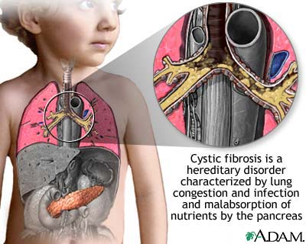
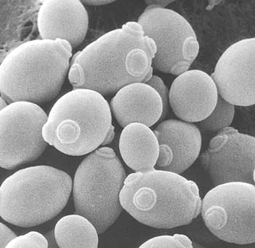
Can yeast be used as a model organism to study cystic fibrosis?
Finding Model Organisms for Study of Disease
David Form - August 15, 2012

Slide 3
Model Organisms
Cystic fibrosis is a genetic disorder that affects humans
  If yeast contain a protein that is related (homologous) to the protein involved in cystic fibrosis
  Then yeast can be used as a model organism to study this disease
    Study of the protein in yeast will tell us about the function of the protein in humans
David Form - August 15, 2012

Slide 4
BLAST helps you to find homologous genes and proteins
Homologous Proteins (or genes)
    Have a common ancestor (they’re related)
    Have similar structures
    Have similar functions
David Form - August 15, 2012

Slide 5
Criteria for considering two sequences to be homologous
Proteins are homologous if
  Their amino acid sequences are at least 25% identical
DNA sequences are homologous if
  they are at least 70% identical
  Note that sequences must be over 100 a.a. (or bp) in length
David Form - August 15, 2012

Slide 6
Whenever possible, it is better to compare proteins than to compare genes

Slide 7
What does BLAST do?

Slide 8
BLAST compares sequences
BLAST takes a query sequence
Compares it with millions of sequences in the Genbank databases
  By constructing local alignments
Lists those that appear to be similar to the query sequence
  The “hit list”
Tells you why it thinks they are homologs
  BLAST makes suggestions
  YOU make the conclusions
David Form - August 15, 2012

Slide 9
How do I input a query into BLAST?

Slide 10
Choose which “flavor” of BLAST to use
BLAST comes in many “flavors”
  Protein BLAST (BLASTp)
    Compares a protein query with sequences in GenBank protein database
  Nucleotide BLAST (BLASTn)
    Compare nucleotide query with sequences in GenBank nucleotide database
David Form - August 15, 2012

Slide 11
Enter your “query” sequence
A sequence can be input as a (an)
  FASTA format sequence
  Accession number
  Protein blast can only accept amino acid sequences
David Form - August 15, 2012

Slide 12
Choose search set
Choose which database to search
  Default is non-redundant protein sequences (nr)
    Searches all databases that contain protein sequences
David Form - August 15, 2012

Slide 13
Choose organism
Default is all organisms represented in databases
Use this to limit your search to one organism (eg. Yeast)
David Form - August 15, 2012

Slide 14
BLAST off!!
Click on the BLAST button at the bottom of the page!
David Form - August 15, 2012

Slide 15
How do I interpret the results of a BLAST search?

Slide 16
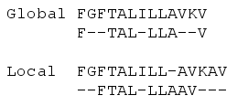
BLAST creates local alignments
What is a local alignment?
  BLAST looks for similarities between regions of two sequences
David Form - August 15, 2012

Slide 17
The BLAST output then describes how these aligned regions are similar
    How long are the aligned segments?
    Did BLAST have to introduce gaps in order to align the segments?
    How similar are the aligned segments?
David Form - August 15, 2012

Slide 18
The BLAST Output

Slide 19
The Graphic Display
1. How good is the match?
    Red = excellent!
    Pink = pretty good
    Green = OK, but look at other factors
    Blue = bad
    Black = really bad!
2. How long are the matched segments?
  Longer = better
David Form - August 15, 2012

Slide 20
The hit list
BLAST lists the best matches (hits)
  For each hit, BLAST provides:
    Accession number – links to Genbank flatfile
    Description
    “G” = genome link
    E-value
      An indicator of how good a match to the query sequence
    Score
      Link to an alignment
David Form - August 15, 2012

Slide 21
What is an E-value?
E-value
  The chance that the match could be random
  The lower the E-value, the more significant the match
    E = 10⁻⁴ is considered the cutoff point
    E = 0 means that the two sequences are statistically identical
David Form - August 15, 2012

Slide 22
Most people use the E- value as their first indication of similarity!

Slide 23
The Alignment
Look for:
  Long regions of alignment
  With few gaps
  % identity should be >25% for proteins
    (>70% for DNA)
David Form - August 15, 2012

Slide 24
BLAST makes suggestions,
You draw the conclusions!
Look at E-value
Look at graphic display
If necessary, look at alignment
Make your best guess!
David Form - August 15, 2012

