Slide 1

BLAST
What it does and what it means
Steven Slater
Adapted from www.pitt.edu/~mcs2/teaching/biocomp/ppt/BLAST_Sp10.ppt
Notes:
www.glbrc.org

Slide 2

Why Search Sequence Databases?
Sequence databases like GenBank contain all public sequences and any annotations of them
Searching these databases permits you to find any genes related to your Gene of Interest (GOI), and to potentially assign it a function
This is a routine, but highly sophisticated, tool used daily by genome scientists

Slide 3
Search programs are sequence alignment programs
They try to find the best alignment between your probe sequence and every target sequence in the database
Finding optimal alignments is computationally a very resource intensive process
It is usually not necessary to find optimal alignments, particularly for large databases
Alignments are ranked and only top scores are reported

Slide 4
Practical database search methods incorporate shortcuts
The fastest sequence database searching programs use heuristic algorithms
Heuristic = “Computing proceeding to a solution by trial and error or by rules that are only loosely defined. ” – Oxford English Dictionary
The basic concept is to break the search and alignment process down into several steps
At each step, only a best scoring subset is retained for further analysis

Slide 5
Heuristic programs find approximate alignments
They are less sensitive than “dynamic programming” algorithms such as Smith-Waterman for detecting weak similarity
In practice, they run much faster and are usually adequate
The BLAST program developed by Stephen Altschul and coworkers at the NCBI is the most widely used heuristic program.
  Altschul SF, Madden TL, Schäffer AA, Zhang J, Zhang Z, Miller W, Lipman DJ. Gapped BLAST and PSI-BLAST: a new generation of protein database search programs. Nucleic Acids Res. 1997 Sep 1;25(17):3389-402.

Slide 6
BLAST is a collection of five programs for different combinations of query and database sequences

Slide 7
Program | Query | Database
BLASTN | DNA | DNA
BLASTP | protein | protein
BLASTX | translated DNA | protein
TBLASTN | protein | translated DNA
TBLASTX | translated DNA | translated DNA

Slide 8
How does BLAST Quantify Alignment Quality?
It uses a scoring matrix to judge the quality of each alignment match.
The most commonly-used matrix is designated BLOSUM62
The BLOSUM matrices are calculated using real gene alignments and estimating the likelihood that a particular alignment will occur randomly
http://www.uky.edu/Classes/BIO/520/BIO520WWW/blosum62.htm
www.glbrc.org

Slide 9
Why BLAST is great
Very fast and can be used to search extremely large databases
Sufficiently sensitive and selective for most purposes
Robust - the default parameters can usually be used

Slide 10
BLAST scores are reported in two columns
Raw values based on the specific scoring matrix employed
As bits, which are matrix independent normalized values (bigger = better)
Significance is represented by E values (smaller = better)

Slide 11
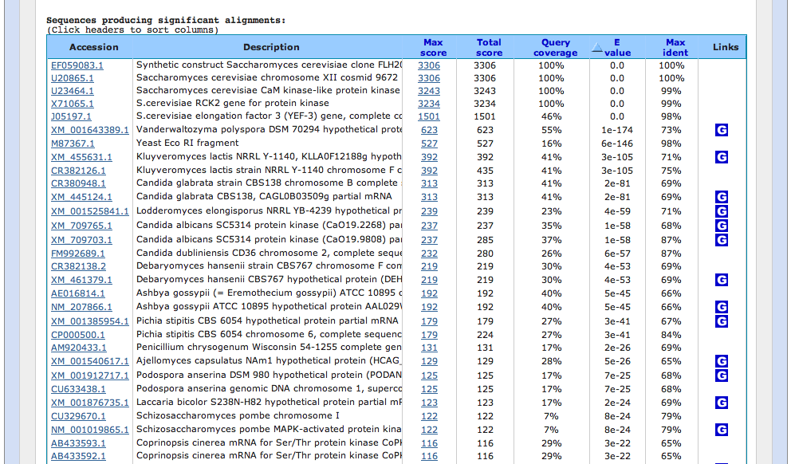
Typical BLAST Output
Sorted by E value

Slide 12
The EXPECT (E) threshold is used to control score reporting
A match will only be reported if its E value falls below the threshold set
The default value for E is 10, which means that 10 matches with scores this high are expected to be found by chance
Lower EXPECT thresholds are more stringent, and report fewer matches

Slide 13
Interpreting BLAST scores
Score interpretation is based on context
  What is the question?
  What else do you know about the sequences?
  Scoring is highly dependent on probe length
Exact matches will usually have the highest scores (and lowest E values)
  Short exact matches may score lower than longer partial matches

Slide 14
Interpreting BLAST scores
Short exact matches are expected to occur at random.
Partial matches over the entire length of a query are stronger evidence for homology than are short exact matches.

Slide 15
Translated BLAST Searches
translations use all 6 frames
computationally intensive
tblastx searches can be very slow with some large databases
must specify genetic code

Slide 16
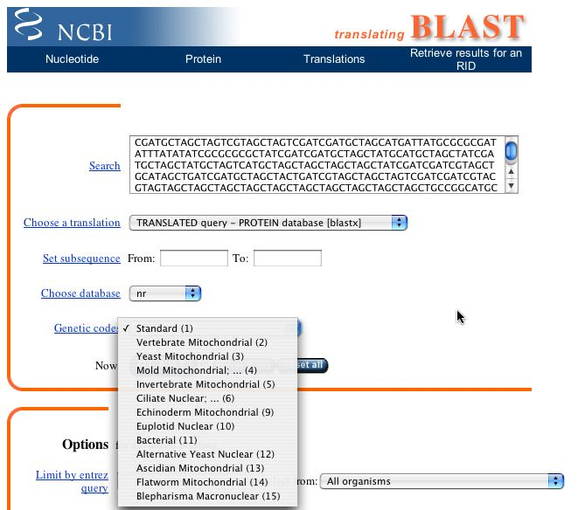
Alternate Genetic Codes

Slide 17
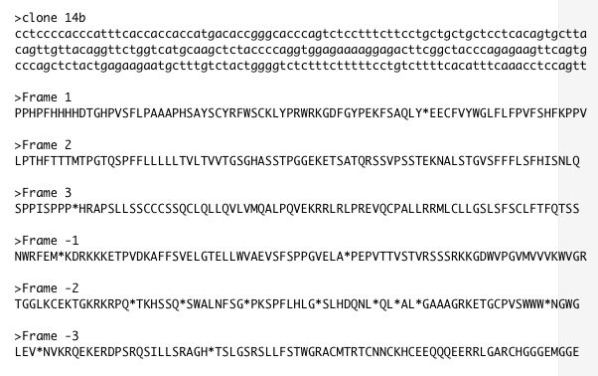
Translated BLAST Searches

Slide 18
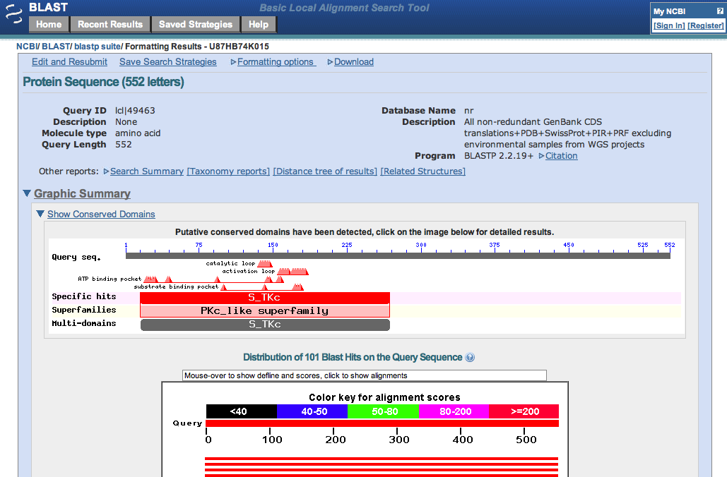
Taxonomy Reports

Slide 19
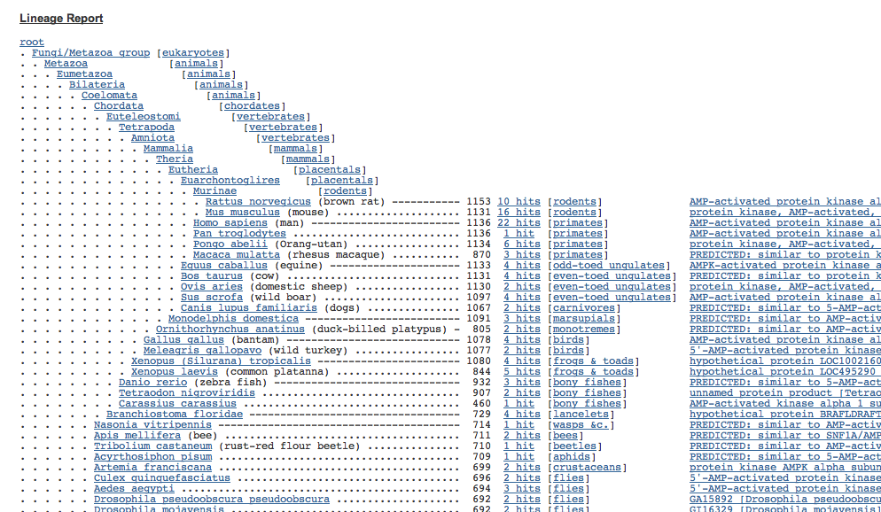
Taxonomy Reports

Slide 20
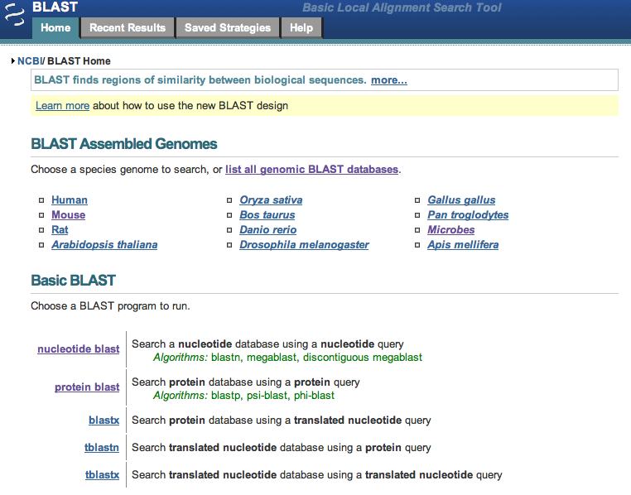
BLAST Genomes

Slide 21
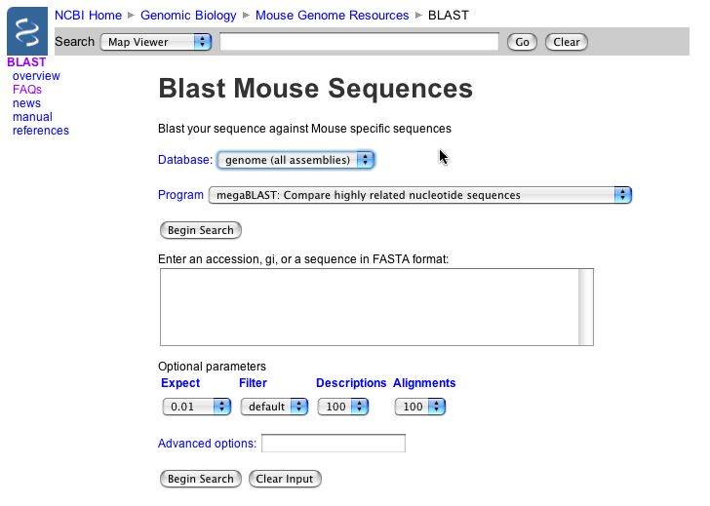

Slide 22
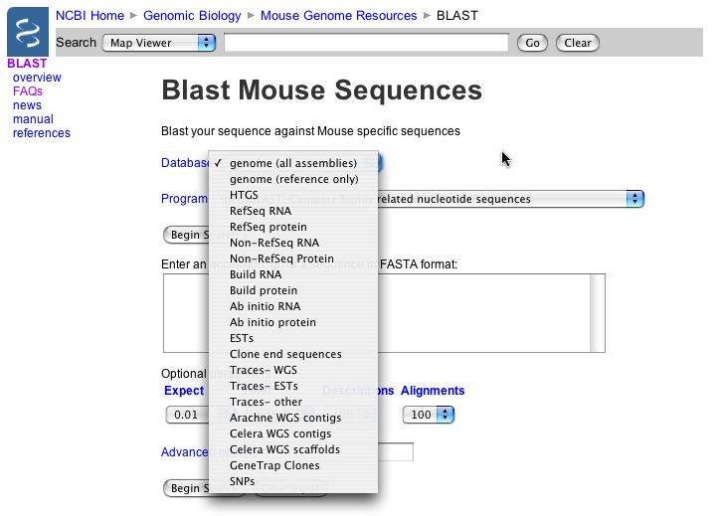

Slide 23
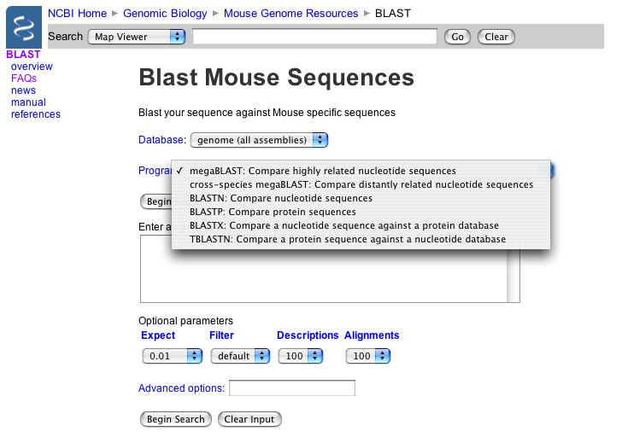

Slide 24
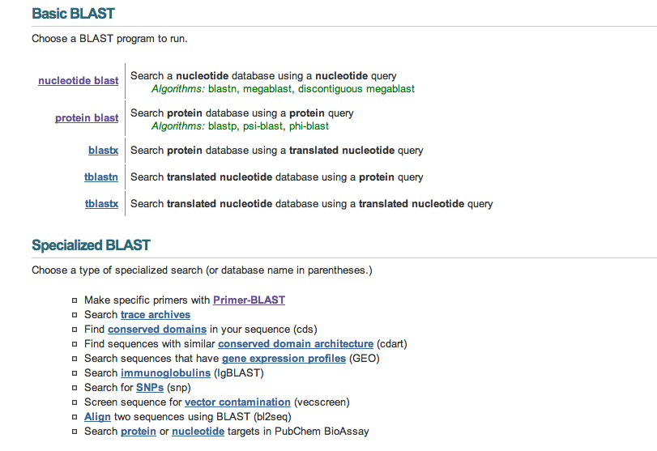
Align 2 Sequences with BLAST

Slide 25
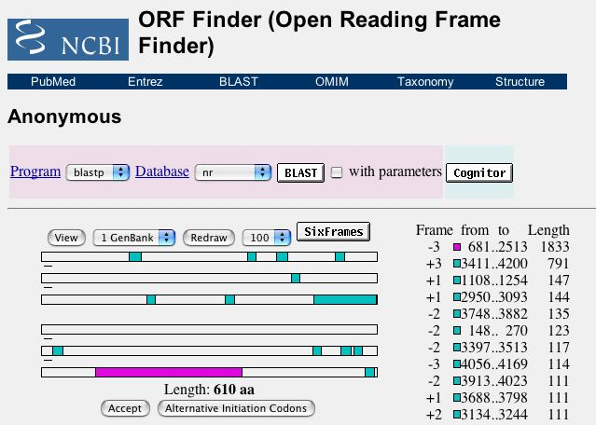
BLAST from ORF Finder

Slide 26
Primer BLAST

