Slide 1
MASTER THESIS FINAL REVIEW
HYBRID METHOD FOR MOVIE RECOMMENDATION SYSTEM using time aware cnn based personalized recommender(TCPR) system .
NAME: Ezhil Oviya . D
Reg no:20mcb1003
.

Slide 2
Introduction -Recommendation system
Recommendation systems involve predicting user preferences for unseen items.
Recommendation system have become very popular with increasing availability of millions of products in online.
Recommender system has received tremendous attention and has studied by scholars in recent years due to its wide application in different domains with the in depth study and application in deep learning algorithm, deep neural network is used in recommender system.
Recommending relevant products increases the sales.
Applied in variety of application like movie, books and so on.

Slide 3
Why we are using recommendation system?
Explosive growth of information has brought great trouble to people’s choices. As an effective tool to deal with “information overload” ,recommender system is introduced.

Slide 4
Deep learning
Deep Learning is a class of machine learning algorithm that use multiple layer to progressively extract higher level feature.
It is a subset of machine learning, which is essentially a neural network with three or more layers
Here we are using CNN algorithm.

Slide 5
Advantage of Deep Learning
Advantages of using deep neural networks to assist representation learning are in two-folds:
(1) It reduces the efforts in hand-craft feature design and
(2) It enables recommendation models to include heterogeneous content information such as text, images, audio, and even video.

Slide 6
Why neural networks are used in recommender systems?
Neural networks are used in many domains. we can transfer new developments, such as optimizers or new layers, to recommender systems.
Finally, DL frameworks are highly optimized to process terabytes to petabytes of data for all kinds of domains.
So we are using Deep Learning in this project.

Slide 7
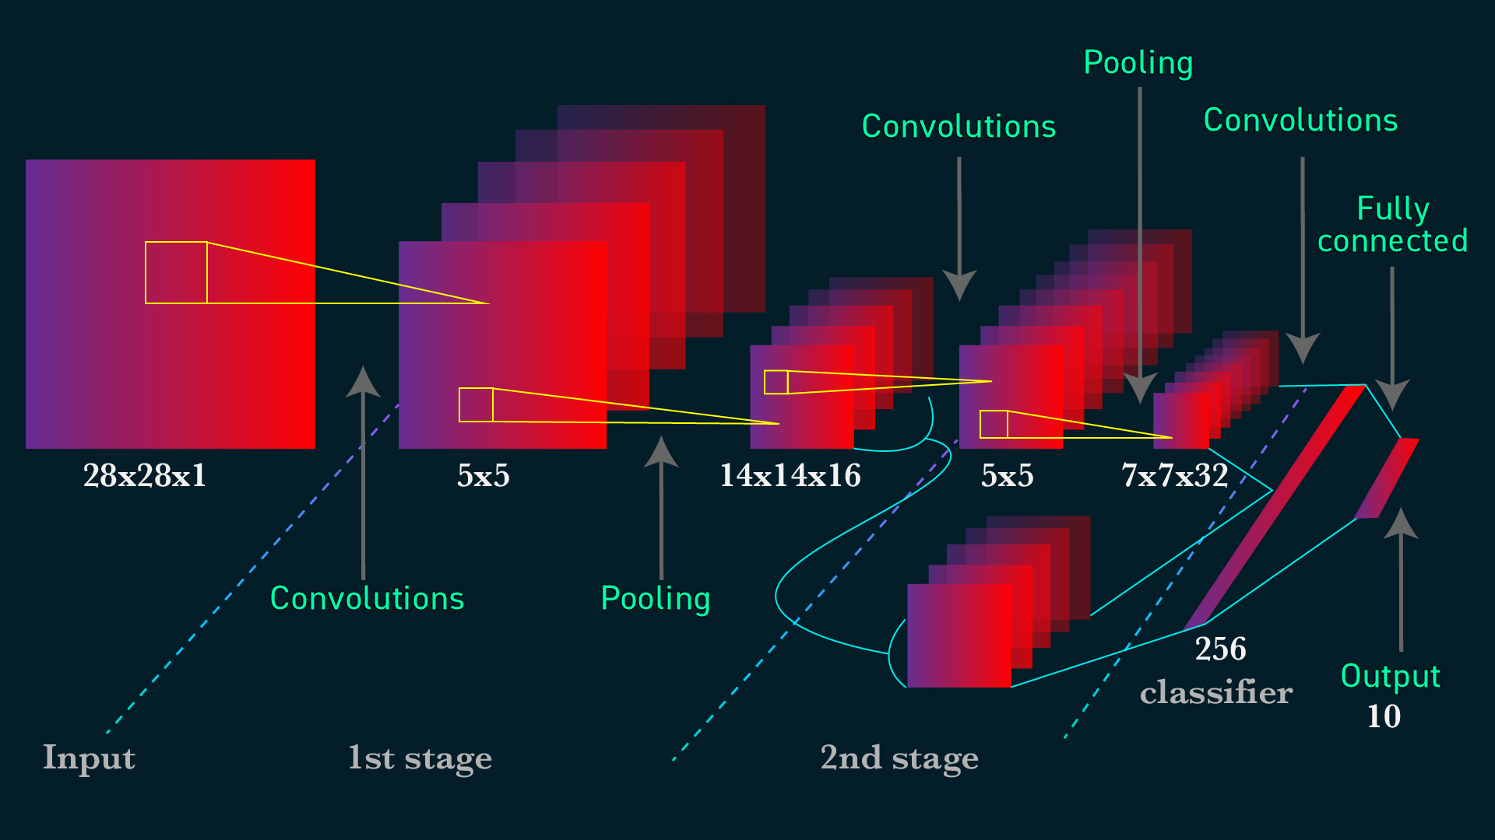
Convolution Neural Network
CNN-based recommendation algorithm can recommend items that meet users' interests by analysing users' features, items' features, and users' ratings information.

Slide 8
Types of Recommender system
Collaborative Recommender system.
Content-based recommender system.
Hybrid recommender system.
Demographic based recommender system.
Utility based recommender system.
Knowledge based recommender system.
Group recommendations.
Cross-domain recommendations.
Social recommender systems.

Slide 9
COLLABORATIVE
It is considered to be one of the very smart recommender systems that work on the similarity between different users and also items that are widely used as an e-commerce website and also online movie websites.
It checks about the taste of similar users and does recommendations.
The similarity is not restricted to the taste of the user moreover there can be consideration of similarity between different items also.
The system will give more efficient recommendations if we have a large volume of information about users and items.

Slide 10
CONTENT BASED
The content-based recommender system calculates items’ similarities. For example, Amazon suggests products similar to the products that users have in their basket.
This similarity can be based on rating correlations among users or item attributes such as item description and location of the user.
Content-based methods are useful for new items with few ratings. They take ad- vantage of the item descriptions, such as movie descriptions

Slide 11
Type of collaborative filtering
Memory based
And Model based
Memory-based method performs recommendation by accessing the database directly, while model-based method uses the transaction data to create a model that can generate recommendation
m/y -What is memory based collaborative filtering?
Memory-based collaborative filtering utilizes the entire user-item data to generate predictions. The system uses statistical methods to search for a set of users who have similar transactions history to the active user. This method is also called nearest-neighbour or user-based collaborative filtering .
What is model based collaborative filtering?
Model-based collaborative filtering algorithms provide item recommendation by first developing a model of user ratings. Algorithms in this category take a probabilistic approach and envision the collaborative filtering process as computing the expected value of a user prediction, given his/her ratings on other items.

Slide 12
collaborative filtering Advantages and disadvantages
Advantages
No domain knowledge necessary
Disadvantages
Cannot handle fresh items
The prediction of the model for a given (user, item) pair is the dot product of the corresponding embeddings.
So, if an item is not seen during training, the system can't create an embedding for it and can't query the model with this item.
This issue is often called the cold-start problem. However, the following techniques can address the cold-start problem to some extent:

Slide 13
Content based Advantages and disadvantages
Advantages
The model doesn't need any data about other users, since the recommendations are specific to this user. This makes it easier to scale to a large number of users.
The model can capture the specific interests of a user, and can recommend items that very few other users are interested in.
Disadvantages
Since the feature representation of the items are hand-engineered to some extent, this technique requires a lot of domain knowledge. Therefore, the model can only be as good as the hand-engineered features.
The model can only make recommendations based on existing interests of the user. In other words, the model has limited ability to expand on the users' existing interests.

Slide 14
Why we are going for hybrid method
Cold start and sparsity
Why recommender system is a classification problem?
A recommendation system suggests you recommendations, or any options for example any books to read, movies to watch so on. This is based on techniques of filtering and retrieval, so this an information filtering procedure. A classification problem on the other hand is capable of processing a large amount of data.
problem, data info is not there in history.

Slide 15
Hybrid method
Hybrid systems combine the CF and content-based methods.
There are two subcategories for hybrid methods: loosely coupled and tightly coupled methods.
Loosely coupled methods perform separate collaborative and content-based systems and then combine the outputs into final recommendations.
Tightly coupled methods consider auxiliary information (which is processed) as a feature for the collaborative methods.
Bayesian personalized ranking (BPR)
The rating information helps the learning of features. Also, the extracted features can improve the prediction . Bayesian personalized ranking (BPR) has been widely used for recommendation task.
BPR assumes users prefer an interacted item to an un-interacted item and optimizes objective function based on pairwise ranking between items.

Slide 16
Litrature review:
TITLE | OBJECTIVE | DATASET | METHODS
Paper1-Movie Recommendation using deep learning approach.-Jeffrey lund | Objective: This paper propose a deep learning approach based on auto encoder to produce a collaborative filtering. | Dataset: movie lens dataset. | Methods: collaborative filtering, Matrix factorization , Auto encoding approach , Baseline algorithm.
Paper2-machine learning model for movie recommendation system-apr 2020,chena kasava. | Objective: Recommends object to consumer based totally on ancient data. | Dataset:10k user and 1k movie. | Methods: They used 1)User item sparse matrix,2)user-user similarity matrix,3)item-item similarity, 4)cold start.
Paper3-Movie recommendation system.-july2020 | Objective: Recommender system is the model which is used to filter information and predict the output based on preference of user. | Dataset: yahoo research web scope database.-yahoo movie user rating and yahoo descriptive content. | Methods used: pearson’s correlation to find similarity between user rating, KNN.

Slide 17
TITLE | OBJECTIVE | DATASET | METHODS
Paper4-movie recommendation system using content based filtering | Objective: This paper discussed about recommendation system based on content based filtering . | Dataset – tmdb 500 movie dataset. 1)tmdv 500 credits .csv 2)tmdv 5000movies.csv | Algo-1)content base 2)Collaborative based 3)Hybrid based
Paper5-A Review paper on collaborative filtering based movie recommendation system. | Objective : This paper represent overview of approaches and techniques generated in collaborative based filtering. | Dataset : movie lens dataset. | Methods : Implementing collaborative filtering using KNN, Using alternative least square , user based collaborative filtering , item based collaborative filtering , using k means.
Paper6-movie recommendation system in ml technique.-Ashrita Kashyap. | Objective: This paper discuss about recommendation of movie. It is important in social life due to strength in providing enhance entertainment. | Dataset: movie lens small dataset.1)movies.csv,2)ratings.csv. | Methods used: Collaborative filtering, content based filtering, hybrid recommendation system.

Slide 18
Maximum Margin Matrix Factorization
Maximum Margin Matrix Factorization (MMMF) is used to optimize NDCG. Eigen Rank also directly models the recommendation task as a ranking problem and optimizes a preference function by Kendall rank correlation.
It extends the neighborhood-based collaborative filtering framework.

Slide 19
Collaborative Denoising Auto-Encoder (CDAE)
CDAE is mainly designed for ranking prediction. Users’ and items’ representations are learned by a Denoising Auto-Encoder. The input of CDAE (user partially observed preferences) is corrupted by Gaussian noise.
They took advantage of negative sampling. CDAE parameters increase linearly with both the number of users and the number of items.
Collaborative Deep Ranking (CDR) :
Collaborative Deep Ranking (CDR) employs Stacked Denoising Autoencoders to represent the feature of item content (such as the title and abstract of the articles and tags) into the pair-wise ranking model’s Bayesian framework.
CDR is a hybrid pair-wise approach with implicit feedback that jointly implements representation learning and collaborative ranking.
They confirmed that using the ranking loss can significantly improve the recommendation performance.

Slide 20
social Recommender System
Social networks can be used to improve recommendations. Items can be recommended to users based on the users’ ratings that have social relations with the given user.
The social recommendation is a task that occurs daily because we always ask friends for recommendations.
Thus, to enhance recommender systems and provide more personalized recommendation results and solve sparsity and cold start, we can use social network information among users.
Social networks can provide extra information for making recommendations. We can use information from the users who have a connection with the given user. If the user has not rated enough items in systems, her neighbors’ information in social networks can help solve sparsity and cold start problems.

Slide 21
Time Aware Collaborative Recommendation Introduction
Traditional collaborative filtering algorithms only take into account the users’ historical ratings, which ignore the user-interest drifting and item- popularity changing over a long period of time.
Aiming to the above problems, a time-aware collaborative filtering algorithm is proposed, which tracks user interests and item popularity over time.

Slide 22
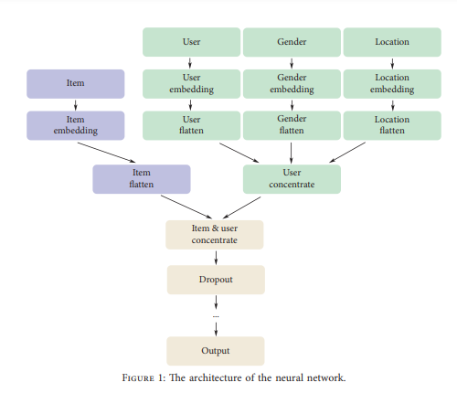
Related Works paper1-A Time-Aware Hybrid Approach for Intelligent Recommendation Systems for Individual and Group Users -Dan Yang , 1 Jing Zhang,1 Sifeng Wang , 2 and XueDong Zhang1-2019

Slide 23
This paper have two approach
Personalised recommender system.
Group recommender system.

Slide 24
Personalized recommendation
personalized recommender system that guides users through the decision-making process and allows them to focus on valid and relevant parts of the configuration space.
The system is based on configurations from previous users to generate personalized recommendations for a current user

Slide 25
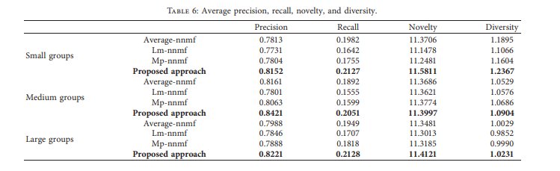
Group recommendation
A group recommender system analyses the interests of every member in the group and provides a final decision which would be accepted by all the members.
One of the major issues in group recommendation is the difficulty of the evaluation process.

Slide 26
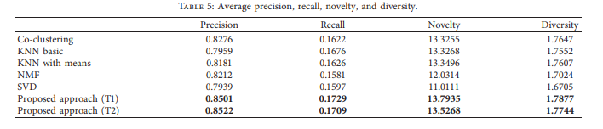
DRAWBACK
User preference will change. That affect the recommendation.
Changes in user preferences can be clearly identifies by measuring the similarity between the user preference and item feature throughout a period of time.
User preference changes precise user profile establishment, data sparsity& recommendation diversity still exist
SPARSITY AND COLD START PROBLEM.
Conclusion: They compared all the algorithm and produce result . t1 and t2 shows high values compare with other algorithm.

Slide 27
Paper2-A time aware CNN based personalized recommender system
.
OBJECTIVE: In this paper Time aware convolutional neural network based personalized recommendation system (TCPR)is used TCPR actively analyse user feature , item feature and user ratings for better recommendation using timestamp.

Slide 28
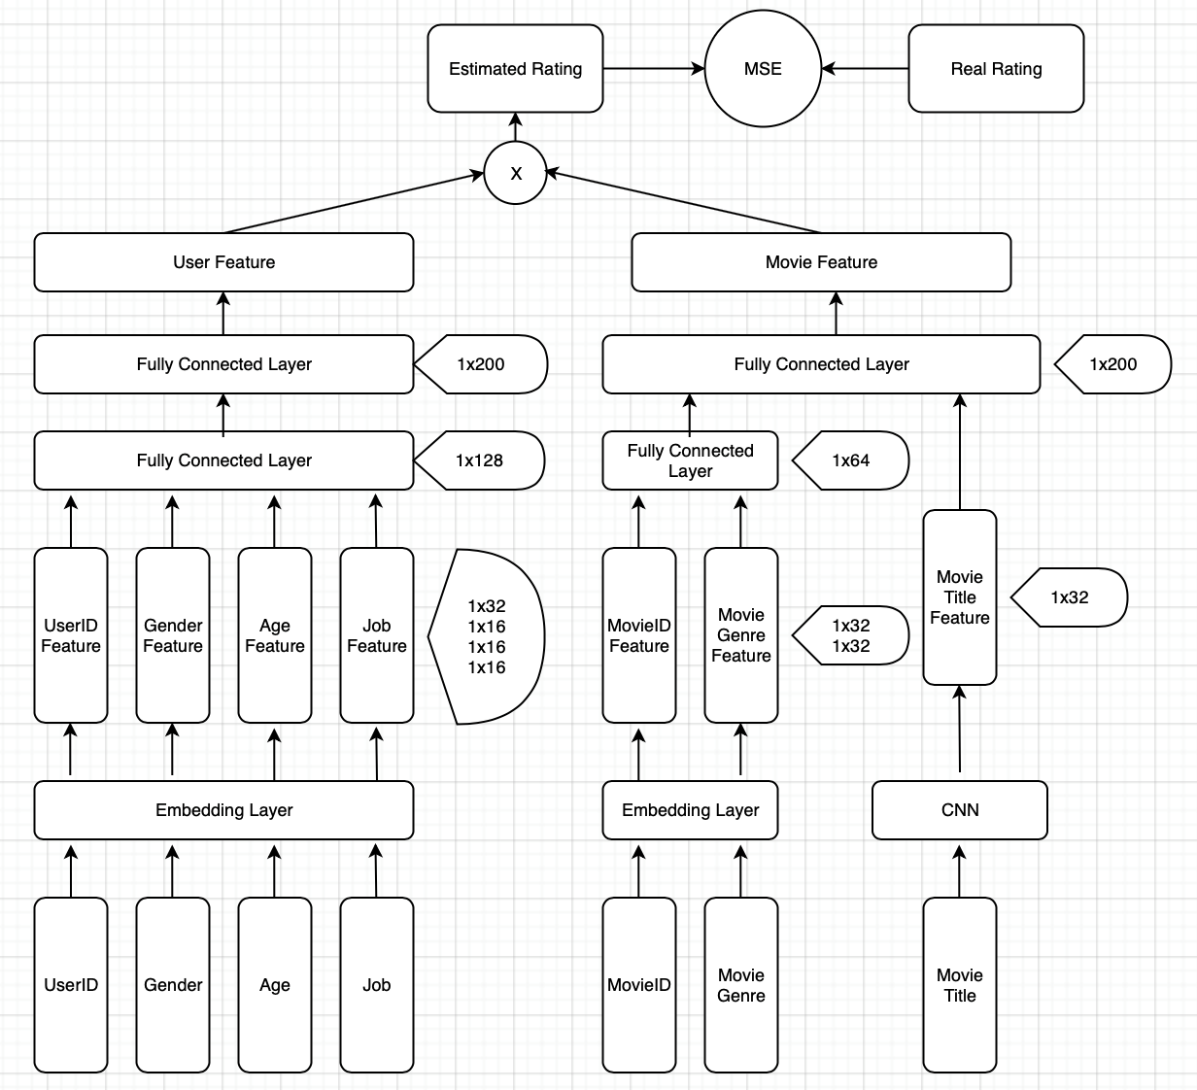
Existing Architecture

Slide 29
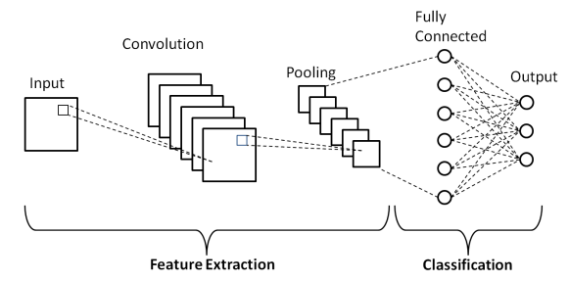
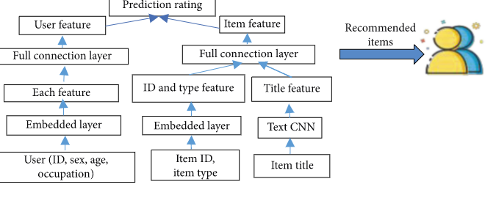
Working model

Slide 30
Challenges in the existing system
Accuracy of the traditional system is low.
Sparsity and cold start problem
Overcome:
TCPR Overcome limitation of traditional approach and improve the system performance by accuracy.
Overcome cold start problem and improve the speed of data processing and accuracy of recommendation.

Slide 31
Proposed method-Time aware CNN based personalised recommendation Algorithm
This system will provide recommendation to the user by analysing content and collaborative algorithm results.

Slide 32
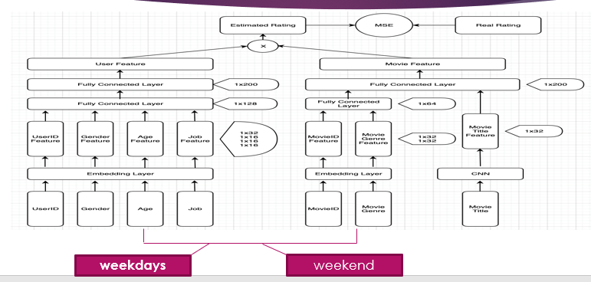
Proposed Method
CONTENT BASED ALGO

Slide 33
Dataset Description
The data set used for this notebook is the 1M ratings data set from MovieLens. This contains 1M ratings of movies from 3952 movies and 6040 Users.
Dataset includes
Atrributes:
Movie Id
User Id
Rating
Timestamp
Genres
Gender
Age
Occupation id
zipcode

Slide 34
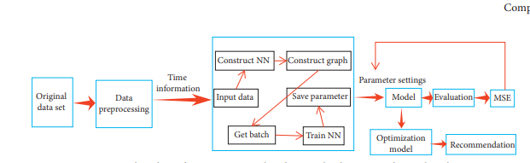
Flow chart of TCPR

Slide 35
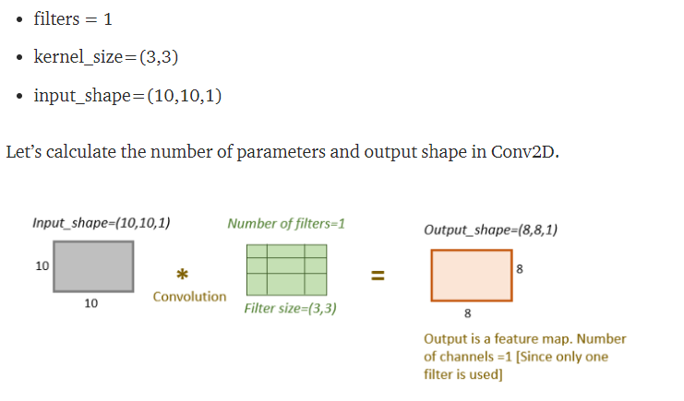
Background calculation

Slide 36
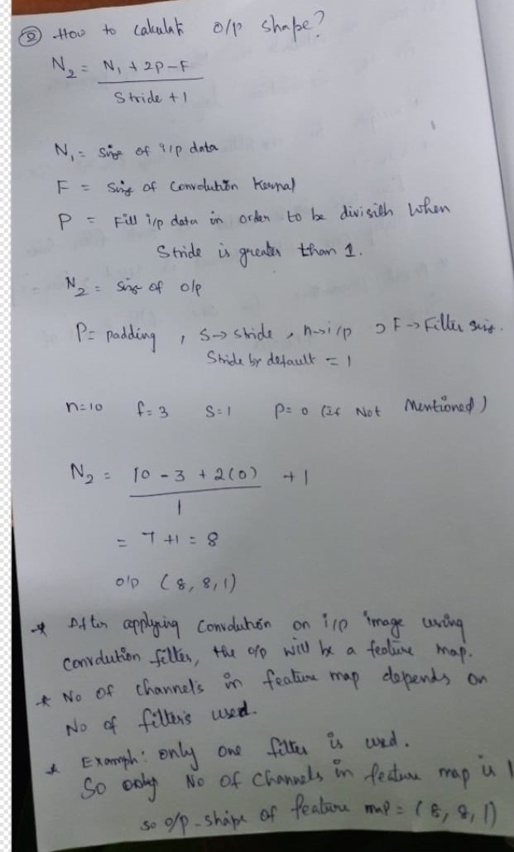

Problem

Slide 37
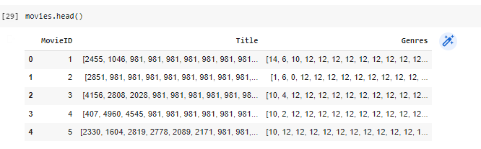
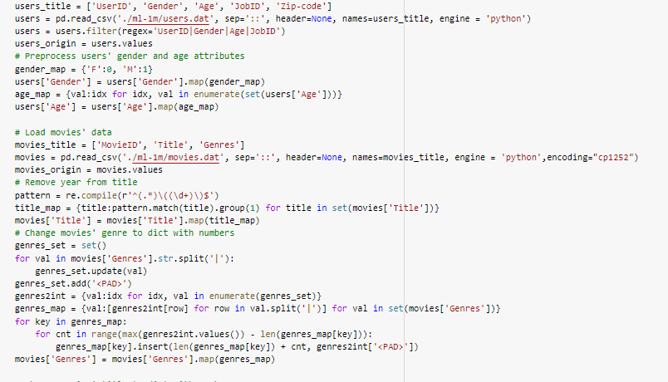
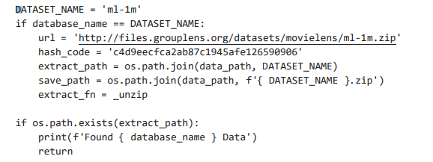
Implementation

Slide 38
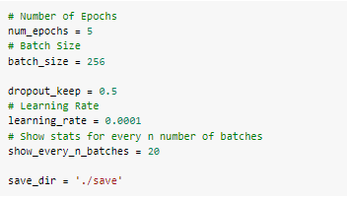
Hyperparameters ,train and testing

Slide 39
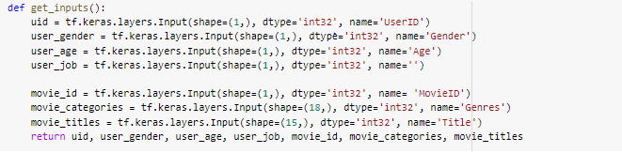

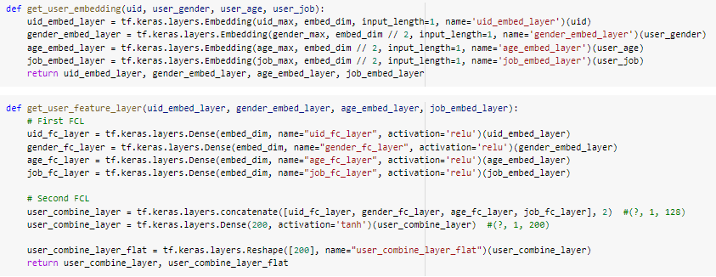
Input to the layers

Slide 40
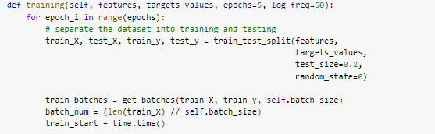
Split data into train and testing for 20 and 80

Slide 41
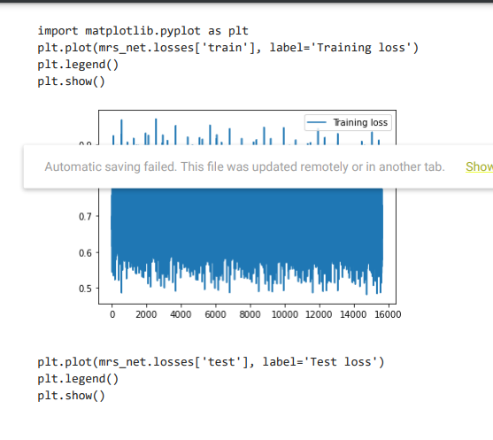
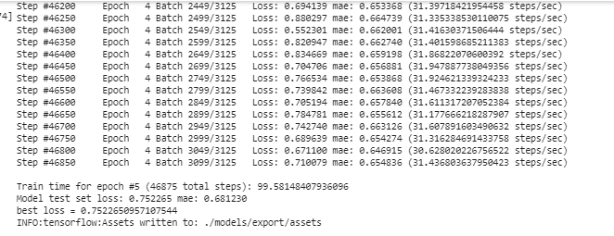

Slide 42
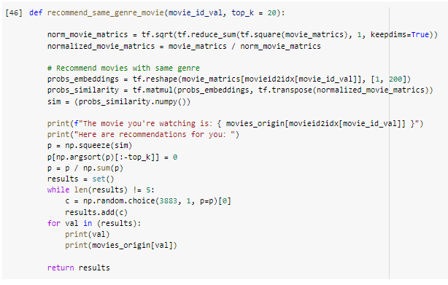
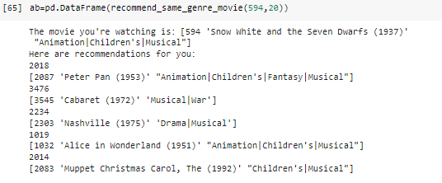
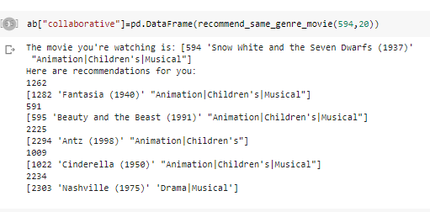
Based on MovieId

Slide 43
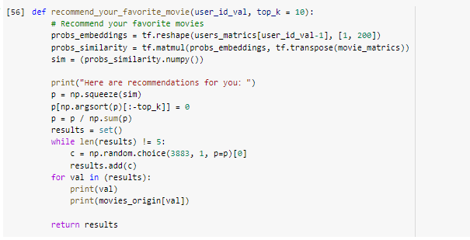
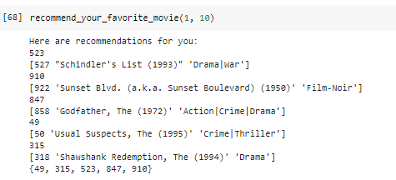
Based on UserId

Slide 44
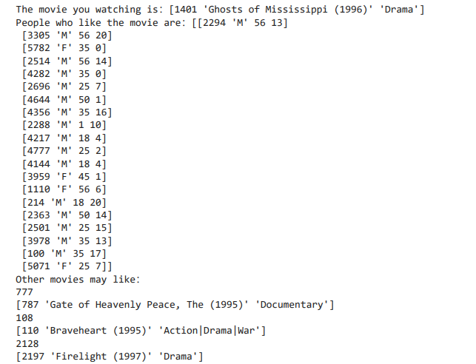
Recommendations

Slide 45
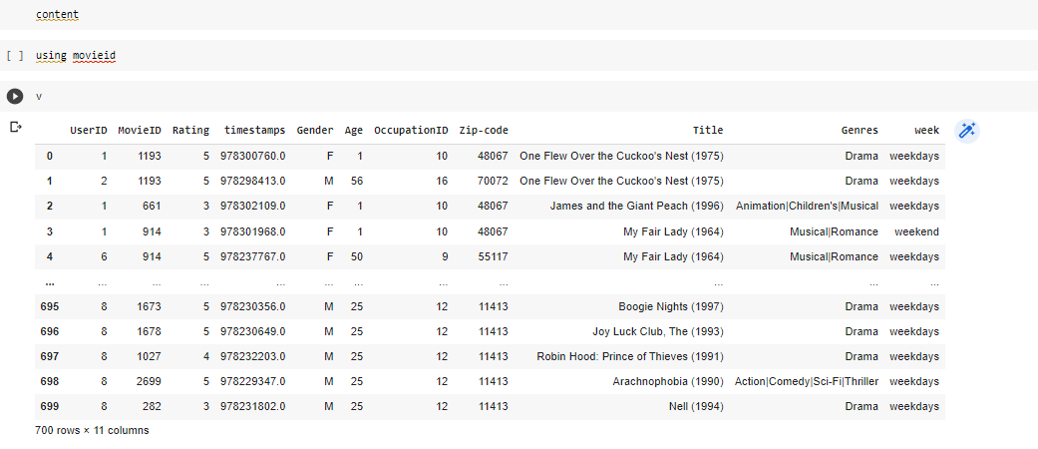
Content Based Algorithm

Slide 46
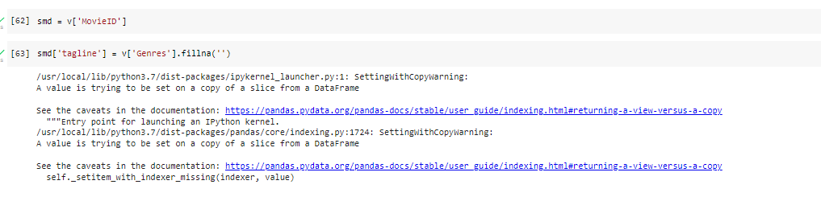
Reading Movieid

Slide 47
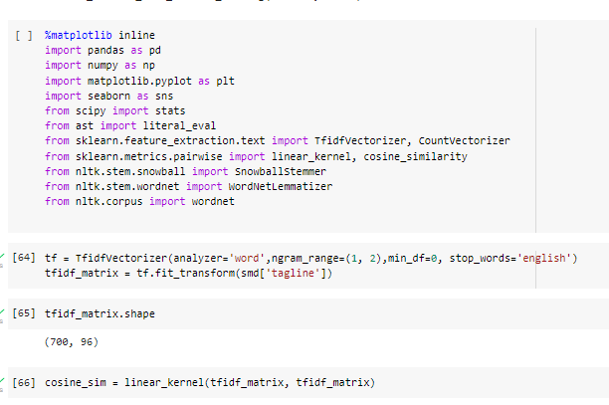
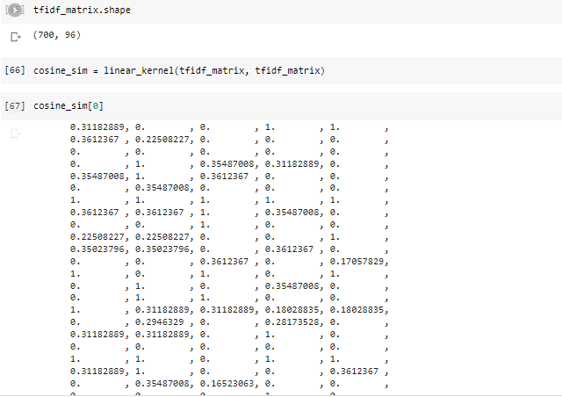
Using tfidf and cosine similarity

Slide 48
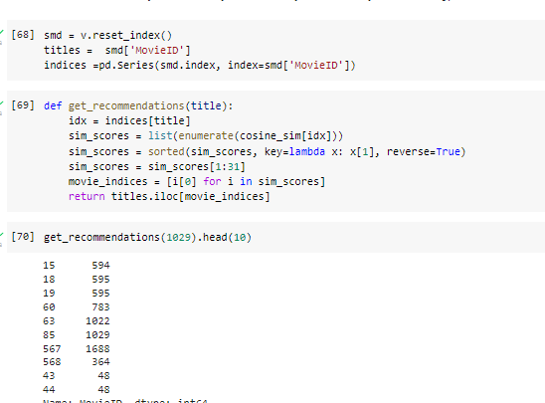
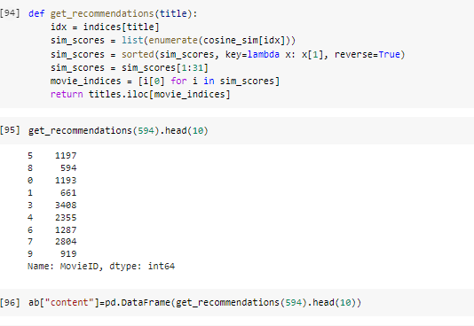
Recommendation for MovieId -661

Slide 49
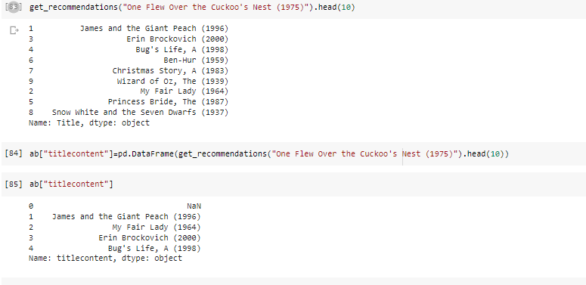
For Title content

Slide 50
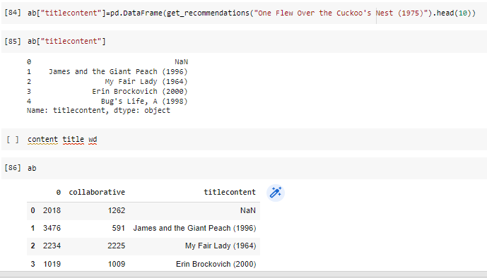
Recommendations for title

Slide 51
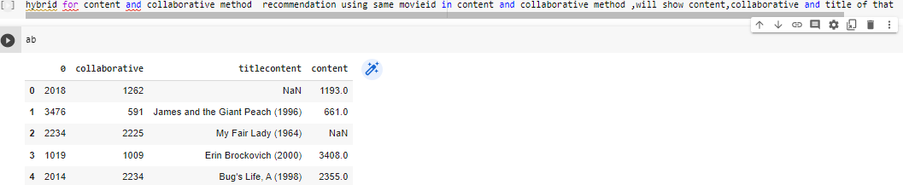
Hybrid Method combine both content and collaborative

Slide 52
Reference:
Paper1-https://www.irjet.net/archives/V7/i7/IRJET-V7I7199.pdf
paper2-http://www.riejournal.com/article_106395_c6c0038f1bf5d4c421bd552d0541d6be.pdf
paper3-http://www.ijstr.org/final-print/dec2019/A-Review-Paper-On-Collaborative-Filtering-Based-Moive-Recommedation-System-.pdf
Paper4-https://ieeexplore.ieee.org/document/8377825
Paper5-https://ieeexplore.ieee.org/document/7340527
Paper6-https://www.igi-global.com/pdf.aspx?tid=276374&ptid=253895&ctid=4&oa=true&isxn=9781799859062
Paper7-https://www.hindawi.com/journals/complexity/2019/9476981/
Paper8-https://arxiv.org/abs/1710.05980
Paper9-https://dl.acm.org/doi/abs/10.1155/2019/9476981
Paper10-https://www.researchgate.net/publication/318671349_Deep_Learning_Based_Recommender_System_A_Survey_and_New_Perspectives

Slide 53
Github for reference:-
https://github.com/Lei-Xu/Movie-Recommendation-System/blob/master/movie_recommender.ipynb
https://github.com/BALaka-18/Hybrid-Recommendation-system/blob/master/Task_BalakaBiswas.ipynb
https://github.com/sanchitbhasin/Content-Based-Movie-Recommendation-System/blob/master/movie%20recommendation%20system.ipynb
https://github.com/vivdalal/movie-recommender-system/blob/master/movie_recommendation_system.ipynb
https://github.com/vivdalal/movie-recommender-system/blob/master/movie_recommendation_system.ipynb
https://colab.research.google.com/github/mepky/movie-recommendation-system/blob/master/Movie_recommendation_engine.ipynb#scrollTo=vDa1jlAAddkz

Slide 54
THANK YOU!!!

