Slide 1
ZEROTH PROJECT REVIEW
Smart Grocery
Delivery App
A full-stack web application for online grocery shopping and delivery
Name Indiran.K
Reg no 310624104110
Subject Full Stack Development
Department Computer Science and Engineering
Guide/Trainer Nagamani Sagella

Slide 2
CONTENTS
Agenda
01
02
03
Abstract
Introduction
Problem Statement
04
05
06
Existing System
Proposed System
How It Works
07
08
09
System Architecture
Objectives
Scope & Literature Survey

Slide 3

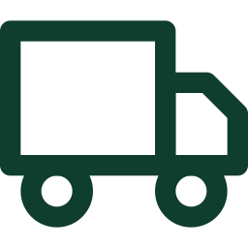

OVERVIEW
Abstract
The Smart Grocery Delivery App is a full-stack web application designed to make grocery shopping easier, faster, and more convenient for users. Customers can browse grocery products, search and filter items, add products to a shopping cart, place orders, and track their order status online.
The frontend provides a simple and user-friendly interface, while the backend manages user authentication, product information, cart details, orders, and delivery status. A database securely stores and retrieves user, product, and order information, and an admin module manages products, prices, stock availability, and customer orders.
Shop online
Order & track
Manage stock
Browse products, search and filter, and add items to the cart
Place an order and follow its status through to delivery
Admin control over products, prices and availability

Slide 4



BACKGROUND
Introduction
The Smart Grocery Delivery App is a full-stack web application developed to provide a convenient and efficient way for customers to purchase groceries online. In traditional grocery shopping, customers need to visit stores, search for products, wait in queues, and manually carry their purchases.
The frontend provides an interactive and user-friendly interface, while the backend handles user accounts, product management, cart operations, orders, and delivery details. A database securely stores and manages the required information.
The main aim of this project is to provide a smooth, reliable, and time-saving shopping experience by integrating frontend, backend, and database technologies into a single smart platform.
What the platform brings together
Customers
Shop from anywhere, at any time
Grocery stores
Reach buyers through one platform
Delivery
Orders tracked from cart to door
Secure data
Accounts and orders stored safely

Slide 5



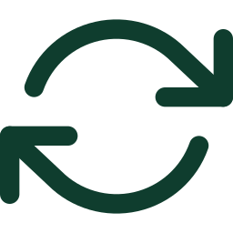
THE GAP
Problem Statement
Traditional grocery shopping is time-consuming and inconvenient — especially for people with busy schedules, elderly customers, and those who cannot visit stores regularly.
Time lost in travel and queues
Hard to compare and find items
Customers must physically visit stores, search the aisles, wait to pay, and carry purchases home.
Checking prices and locating required products across shelves takes effort on every trip.
Manual stock handling
Errors and delays
Small stores still track product stock, customer orders, and delivery details by hand.
Manual records lead to mistakes in inventory and slow order processing for local shops.
A smart, user-friendly system is needed to connect customers and grocery stores through a single digital platform.

Slide 6
TODAY
Existing System
Physical stores
General online platforms
Travelling to the shop for every purchase
Searching shelves for required products
Waiting in billing queues
Carrying purchases home
Stock and orders often recorded manually
Convenient, but very large product catalogues
Difficult to quickly find the items needed
Limited personalisation for regular buyers
Complex order handling for small local stores
Inventory management not well integrated
Where it falls short
Limited personalised shopping · inefficient inventory management · no easy order tracking · a shopping experience that is harder than it needs to be — creating the need for a smarter, more integrated grocery delivery solution.

Slide 7


THE SOLUTION
Proposed System
The proposed Smart Grocery Delivery App is a full-stack web application that provides a simple, fast, and convenient platform for online grocery shopping and delivery.
Users can register and log in, browse grocery products, search and filter items, view product details and prices, add products to the cart, place orders, and track their order status. The backend manages user authentication, product details, inventory, cart information, orders, and delivery status, while the database securely stores and retrieves the required data.
An admin module allows authorised users to add, update, or remove products, manage stock availability, and process customer orders. The system can also provide personalised product suggestions and low-stock information.
User module
Register, log in, shop, order, track
Admin module
Products, stock, prices, orders
Smart features
Suggestions and low-stock alerts

Slide 8

USER JOURNEY
How It Works
01
02
03
Register / Log in
Browse & search
Add to cart
Create an account and sign in securely
Filter products, view details and prices
Build the basket and review the total
04
05
06
Place order
Store processes
Track delivery
Confirm the order and delivery address
Stock updated, order prepared for dispatch
Follow order status until it arrives

Slide 9


THREE LAYERS
System Architecture
Frontend
Backend
Database
PRESENTATION LAYER
APPLICATION LAYER
DATA LAYER
Interactive user interface
Product browsing and search
Cart and checkout screens
Order tracking views
User authentication
Product and inventory logic
Cart and order processing
Delivery status handling
User account records
Product and price data
Cart and order history
Stock availability
Frontend, backend, and database are integrated into a single platform, so a customer action on screen updates inventory, orders, and delivery status consistently.

Slide 10


WHAT THE PROJECT SETS OUT TO DO
Objectives
Easy online grocery shopping
Quick product search and selection
Simple cart management
Easy online order placement
Real-time order tracking
Efficient stock management
Secure user authentication
Seven goals, one integrated platform.

Slide 11
NOW AND NEXT
Scope of Project
IN SCOPE
FUTURE WORK
Covered in this project
Planned enhancements
User registration and login
Product browsing, search and filtering
Cart management and order placement
Order tracking for customers
Backend handling of users, products, inventory, orders
Secure database storage of all records
Admin dashboard for products, stock, prices and orders
Online payment integration
Delivery partner integration
Personalised product recommendations
Offers and promotional pricing
Real-time delivery tracking on a map

Slide 12

RELATED WORK
Literature Survey
Online Grocery Shopping Recommender Systems
Jansen et al., 2024
Helps provide personalised product recommendations to users.
Studies recommendation systems for online grocery shopping.
Multi-Criteria Recommendation Systems to Foster Online Grocery
Hafez et al., 2021
Helps users find suitable alternative products.
Recommends grocery products based on product, package, and health information.
Assortment Planning for Recommendations at Checkout Under Inventory Constraints
Chen et al., 2023
Helps connect recommendations with inventory management.
Focuses on product recommendations while considering product availability.

Slide 13
SUMMARY
Conclusion
The Smart Grocery Delivery App provides a convenient and efficient solution for online grocery shopping by connecting customers, products, orders, and delivery management in one platform. It reduces the time and effort required for traditional grocery shopping through product search, cart management, order placement, and order tracking.
By integrating frontend, backend, and database technologies, the application delivers a complete and user-friendly shopping experience — and can be extended further with online payments, AI-based recommendations, real-time delivery tracking, and personalised offers.
KEY TAKEAWAYS
One platform
Customers, stores, orders and delivery in a single system
Less effort
No travel, queues or manual carrying for the customer
Better control
Stock, prices and orders managed from one dashboard
Room to grow
Payments, recommendations and live tracking can follow

Slide 14
Thank You
Indiran.K · 310624104110 · Computer Science and Engineering

Slide 15
FIRST PROJECT REVIEW
Smart Grocery
Delivery App
A full-stack web application for online grocery shopping and delivery
Name Indiran.K
Reg no 310624104110
Subject Full Stack Development
Department Computer Science and Engineering
Guide/Trainer Nagamani Sagella

Slide 16
FUNCTIONAL AND NON-FUNCTIONAL REQUIREMENTS
Functional Requirements:
The Smart Grocery Delivery App should allow users to register and log in, browse and search grocery products, view product details and prices, add items to the cart, place orders, and track order status. The system should also allow administrators to manage products, prices, stock, and customer orders.
Non-Functional Requirements:
The application should provide a secure, reliable, fast, and user-friendly experience. User and order data should be stored securely, pages should respond quickly, and the system should be available when users need to shop. The interface should also be simple and easy to use on different devices.

Slide 17
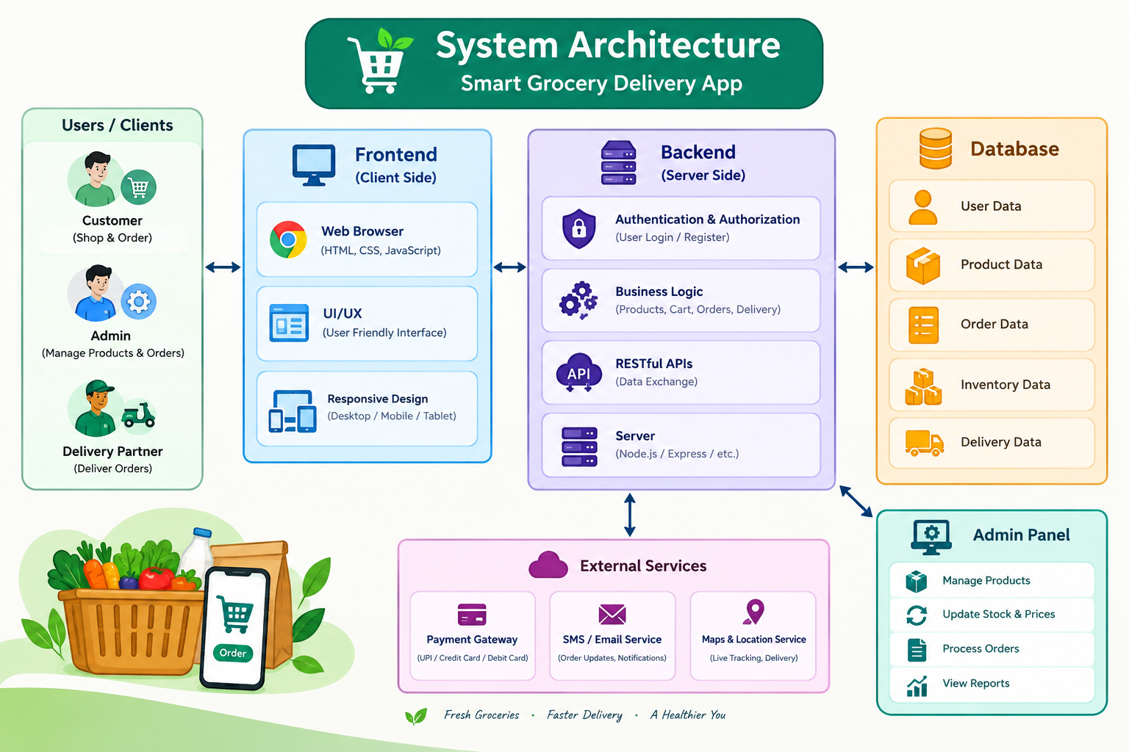
SYSTEM ARCHITECTURE

Slide 18
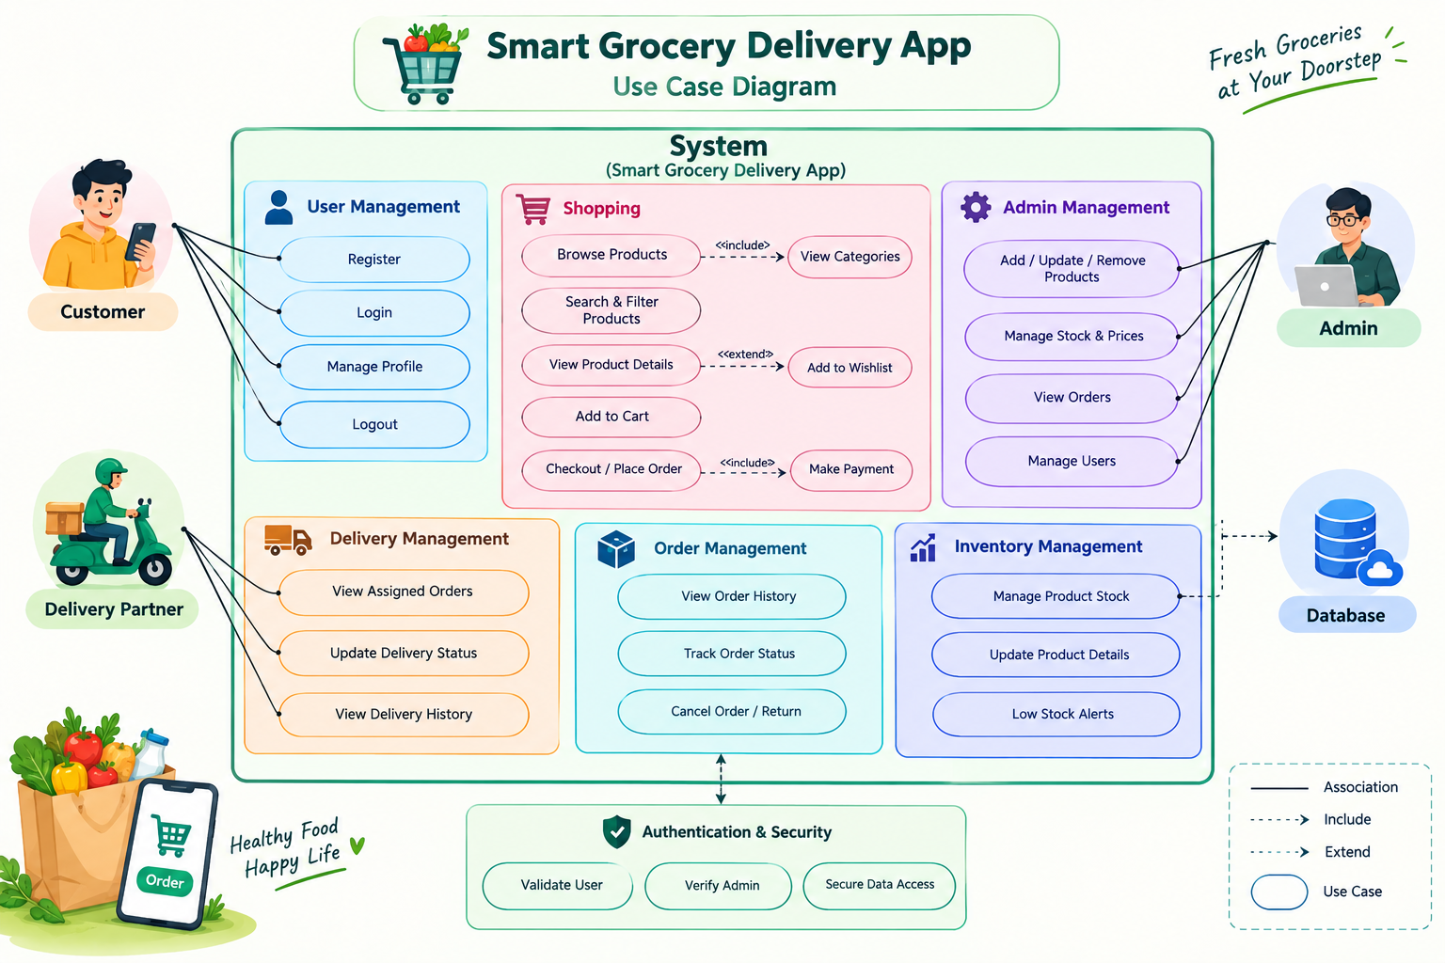
USE CASE DIAGRAM

Slide 19
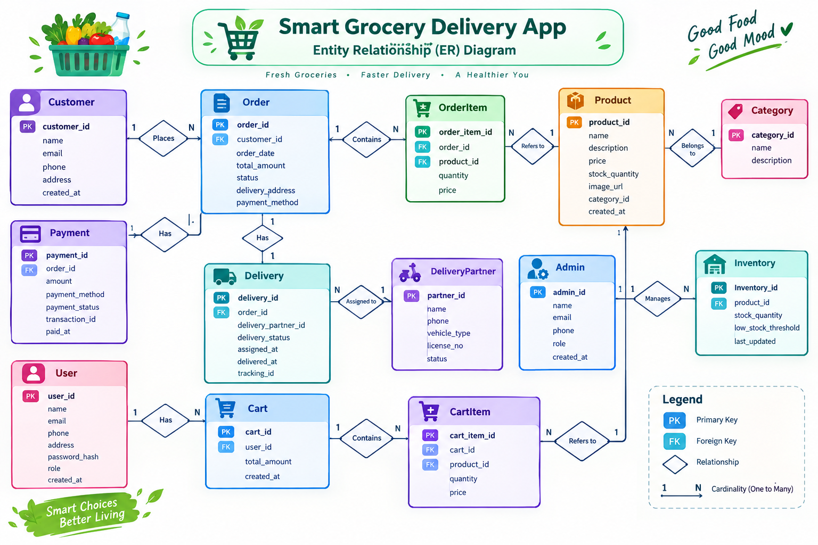
ER DIAGRAM

Slide 20
MODULE DESCRIPTION
User Module:
Allows customers to register, log in, browse products, manage their cart, place orders, and track order status.
2. Product Module:
Manages grocery products, including product details, prices, categories, and availability for customers.
3. Cart & Order Module
Helps users add products to the cart, review their items, place orders, and view their order history.
4. Inventory Module
Manages product stock and availability, helping the system keep inventory information updated.
5. Admin Module
Allows authorised admins to manage products, prices, stock availability, and customer orders.
6. Delivery Module
Handles delivery details and allows order status to be updated and tracked until the order reaches the customer.
7. Database Module
Securely stores and retrieves user, product, cart, order, stock, and delivery information.

Slide 21
TECHNOLOGY STACK
Frontend: HTML, CSS, JavaScript
Backend: Node.js, Express.js
Database: MongoDB
Authentication: User Login & Registration
API: RESTful APIs
Development: Full-Stack Web Application

Slide 22
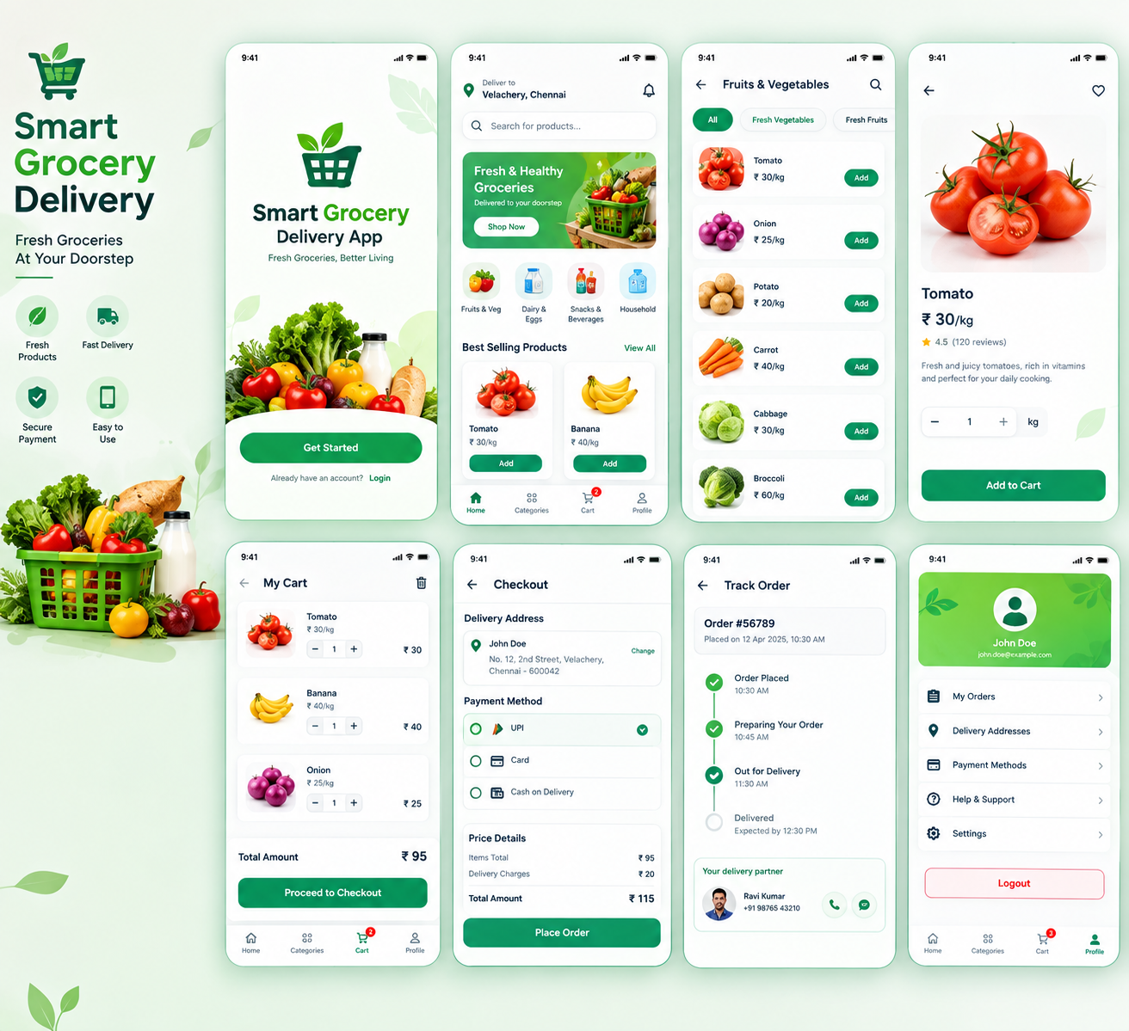
UI DESIGN
The Smart Grocery Delivery App provides a clean, simple, and user-friendly interface for customers. The design allows users to easily browse grocery products, search and filter items, and view product details and prices. Users can add products to the cart, review their items, and place orders conveniently. The interface also provides an order tracking view to help customers follow their delivery status. The overall design focuses on making the shopping experience smooth, clear, and easy to use.

Slide 23
Thank You
Indiran.K · 310624104110 · Computer Science and Engineering

Slide 24
SECOND PROJECT REVIEW
Smart Grocery
Delivery App
A full-stack web application for online grocery shopping and delivery
Name Indiran.K
Reg no 310624104110
Subject Full Stack Development
Department Computer Science and Engineering
Guide/Trainer Nagamani Sagella

Slide 25
FRONTEND DEVELOPMENT
User-friendly interface using HTML, CSS, and JavaScript.
Login and registration pages.
Homepage with product categories and search.
Product listing and shopping cart.
Checkout and payment selection.
Order tracking and delivery person details.
My Orders page with delivery status.
Responsive design for mobile and desktop.

Slide 26
BACKEND DEVELOPMENT
Develop server-side functionality using Node.js and Express.js.
Implement user registration and login authentication.
Manage product details and grocery inventory.
Handle shopping cart and order processing.
Store user and order data in MongoDB.
Manage delivery person details and order tracking.
Handle payment methods and order status updates.

Slide 27
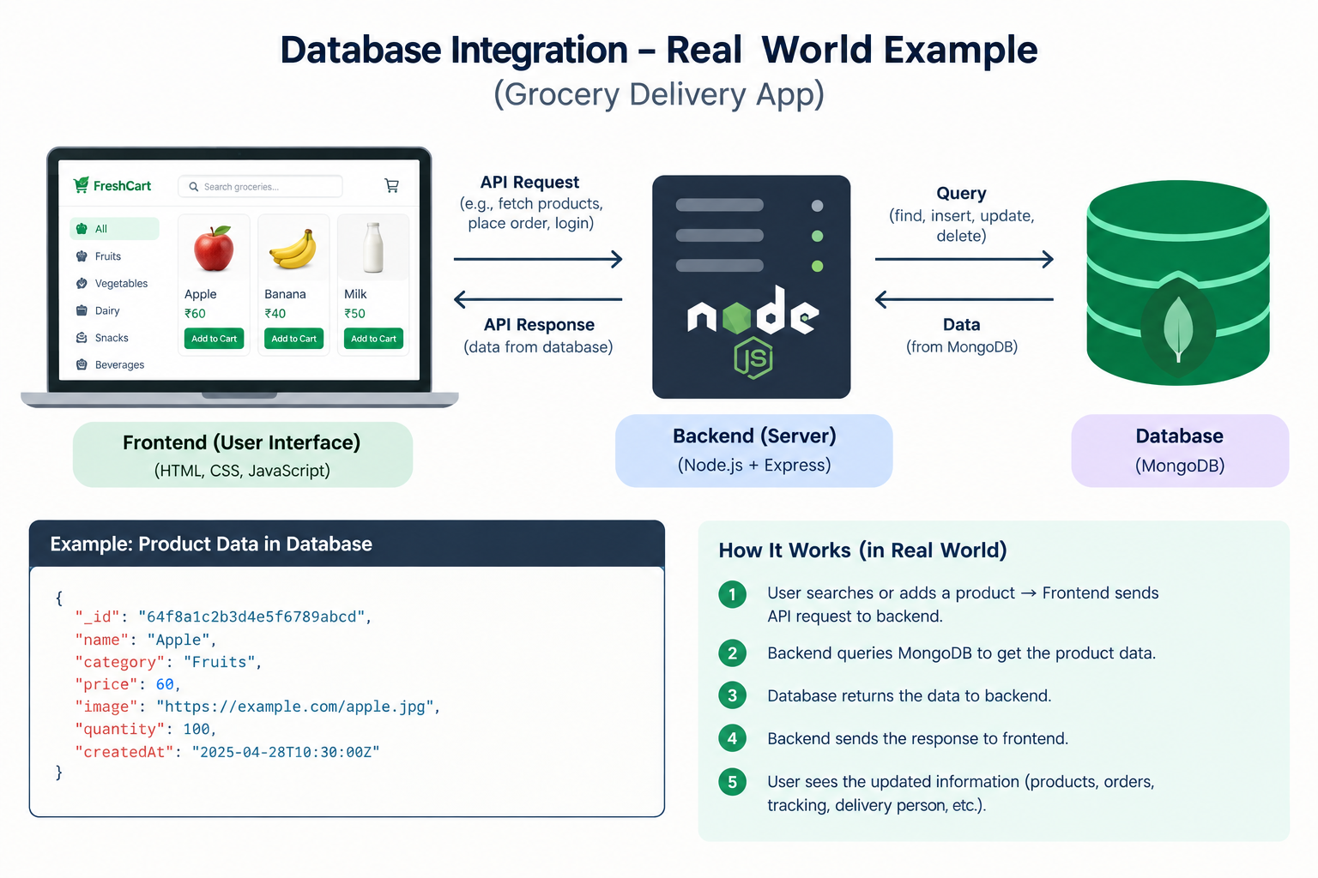
DATABASE INTEGRATION
MongoDB is integrated with the FreshCart Grocery Delivery App to store and manage user details, product information, customer orders, and delivery status. It securely maintains registration and login data and stores order details, including delivery addresses, payment methods, and tracking updates, enabling efficient data retrieval and management. The database also helps maintain accurate product availability and ensures that customer orders are stored systematically. It supports efficient data retrieval, updating, and management of records. MongoDB enables the application to handle customer information and order details in an organized and scalable manner.

Slide 28
API DEVELOPMENT
API development is carried out using Node.js and Express.js to establish smooth communication between the frontend, backend, and MongoDB database. RESTful APIs are implemented to manage user registration, login authentication, product information, shopping cart operations, and order processing. These APIs allow customers to browse groceries, place orders, and view their order history and delivery status. They also support delivery person details, order tracking, and updates to order information. The APIs ensure efficient data exchange between the application components and provide a seamless shopping experience for users. These APIs also include proper error handling and input validation to ensure reliable data processing and secure communication. They help maintain data consistency and improve the overall performance and functionality of the FreshCart Grocery Delivery App.

Slide 29
MODULE-WISE IMPLEMENTATION
1.User Registration and Login Module: Implements user signup, login authentication, and logout functionality using email and password.
2. Product Management Module: Displays grocery products with names, images, prices, categories, and product details.
3. Search and Category Module: Allows users to search for grocery items and filter products by category.
4. Shopping Cart Module: Enables users to add, remove, and update product quantities and view the total price.
5. Checkout and Payment Module: Collects delivery addresses, allows payment method selection, and processes order placement.
6.Order Management Module: Stores customer orders and displays order details, payment information, and order history.
7. Order Tracking Module: Displays order progress through stages such as confirmed, packing, out for delivery, and delivered.
8. Delivery Management Module: Displays delivery person details, contact information, and estimated delivery time.

Slide 30
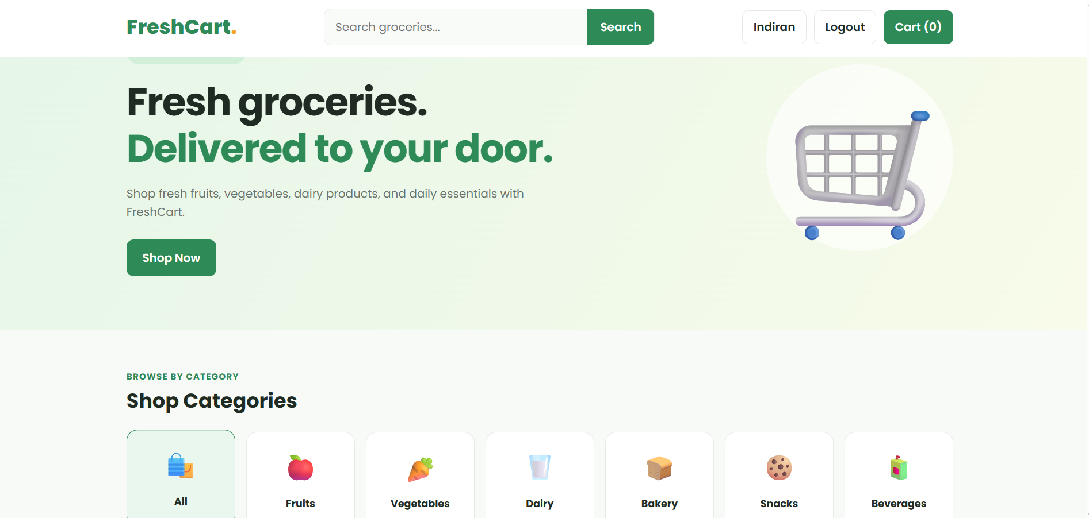
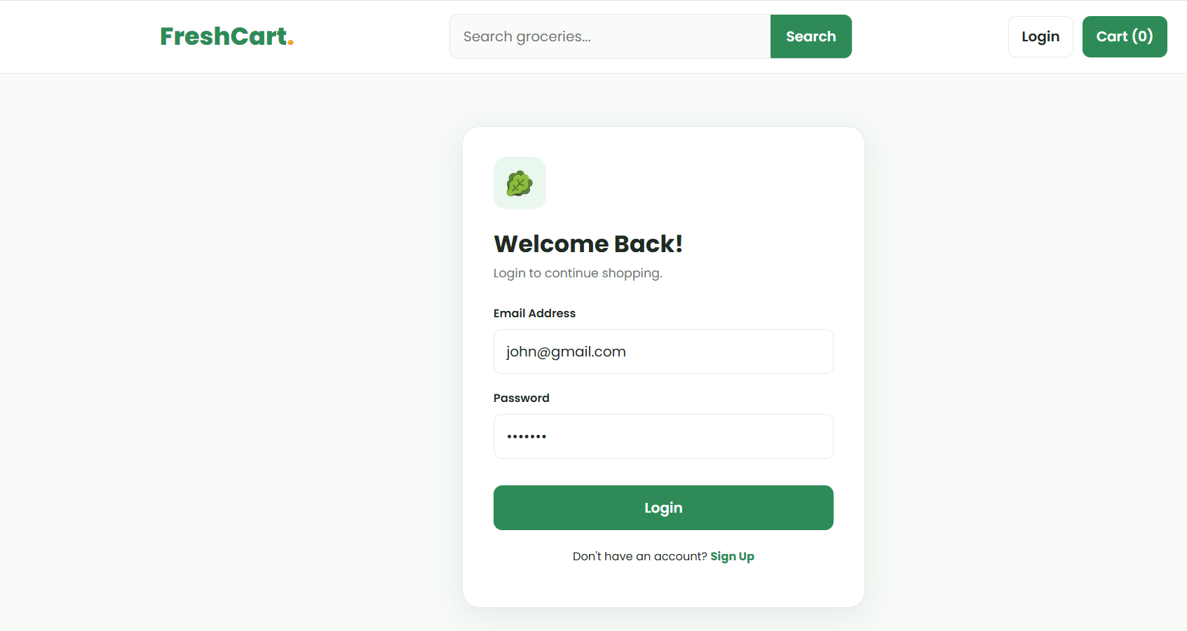
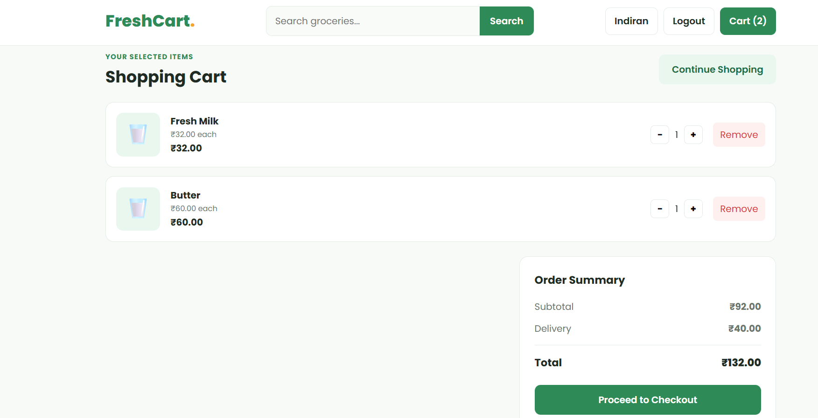
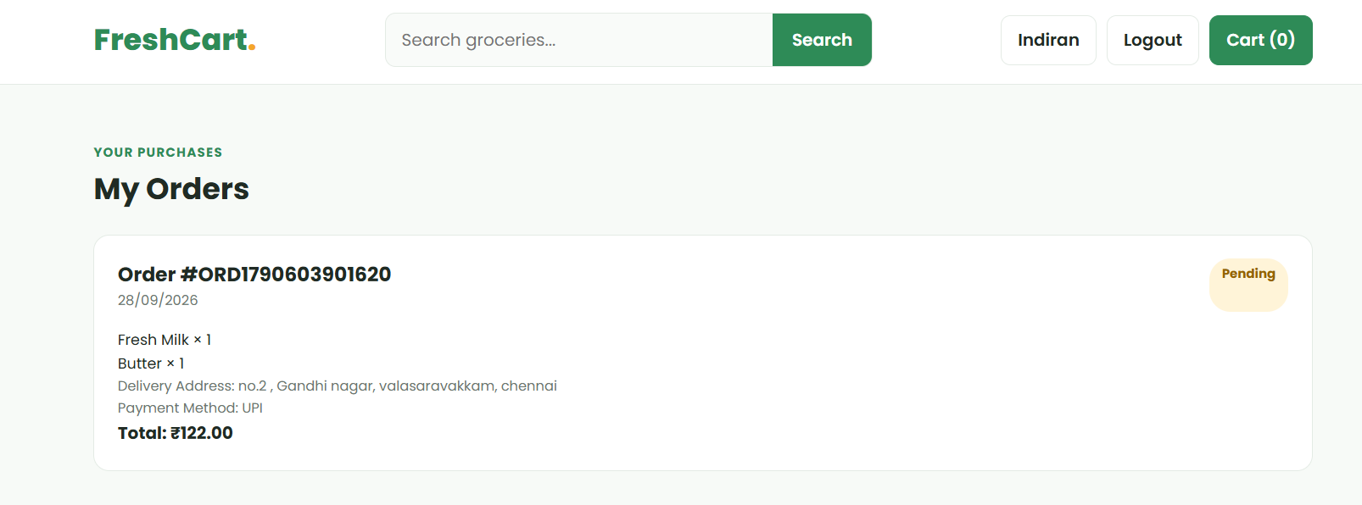
SCREENSHOTS

Slide 31
PROGRESS COMPLETED
Frontend design and responsive user interface have been implemented.
User registration, login, and logout functionality have been developed.
Product listing, search, and category filtering features have been implemented.
Shopping cart functionality with quantity updates and price calculation has been developed.
Backend development using Node.js and Express.js is in progress.
MongoDB database integration for storing user and order details is being developed.
Checkout and order management features are under development.
Order tracking and delivery person details are planned for further enhancement.

Slide 32
CHALLENGES FACED
1.Frontend Design: Creating a user-friendly and responsive interface that works properly on different screen sizes.
2. User Authentication: Implementing secure registration and login functionality and validating user details.
3. Database Integration: Connecting MongoDB with the Node.js backend and managing user, product, and order data efficiently.
4. Cart and Order Management: Handling product quantities, calculating the total price, and storing order details correctly.
5. API Integration: Connecting frontend pages with backend APIs and ensuring data is transferred correctly.
6. Order Tracking: Implementing order status updates and displaying delivery information to users.
7. Error Handling: Identifying and fixing errors during development, including issues with database connections, API requests, and data validation.

