Slide 1
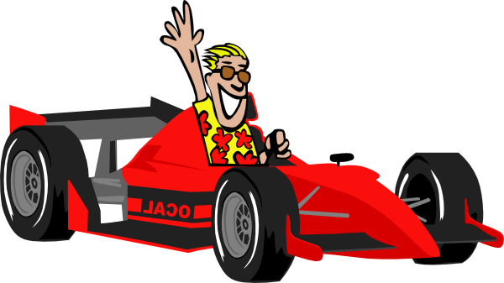
DASHING RUSH

Slide 2
TEAM NUMBER : 10
TEAM MEMBERS :
HARIPRIYA R : 711719205020
INDHU R : 711719205021
RONESH CHRISTOPHER L : 711719205042

Slide 3
ABSTRACT
Our game is named as DASHING RUSH , it is a car game made utilizing pygame. In this game the player needs to arrive at the trophy before the clock arrives at zero. The player loses the level if he arrives late at the trophy or crashes with the blocks. Player moves to next level if the vehicle arrives at the trophy within the given time and wins the game after completing all the levels.Timer starts for each levels differently according to the difficulty

Slide 4
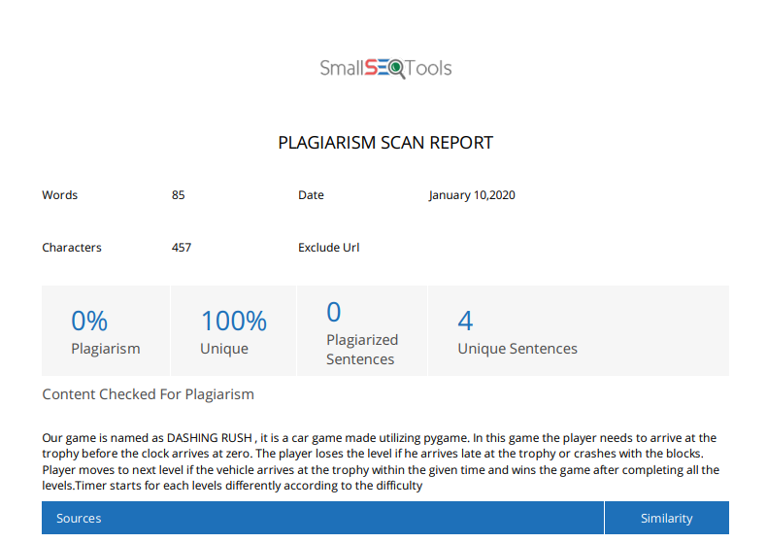

Slide 5
Existing system
Consists of only one level
Had no timer
Had no home page
Had some bugs

Slide 6
Proposal system
Added timer
Added level 2
Added home page
Changed the level layouts
Changed car icon
Fixed some bugs

Slide 7
MODULES
TIMER : WITHIN A PARTICULAR TIME, THE TASK SHOULD BE COMPLETED.
LEVELS : THE GAME CONSISTS OF TWO LEVELS.
CAR : WE HAVE USED A SPORTS CAR.
OBSTACLES : THE PLAYER SHOULD MOVE THE CAR WITHOUT CRASHING

Slide 8
REQUIREMENTS
CPU : INTEL PENTIUM(OR HIGHER) .
RAM : 2GB OR GREATER .
SOFTWARE : THONNY, ANYOTHER IDE .
LANGUAGE : PYTHON .
PACKAGES : PYGAME, SYS, TIME, MATH .

Slide 9
MODEL ARCHITECTURE
START
TIMER STARTS
CAR MOVES
GAME OVER
REACH THE TROPHY
GOES THROUGH OBSTACLES
1/10/20

Slide 10
PYGAME

Slide 11
SAMPLE CODE
while 1:
t1 = time.time()
dt = t1-t0
deltat = clock.tick(30)
for event in pygame.event.get():
if not hasattr(event, 'key'): continue
down = event.type == KEYDOWN
if win_condition == None:
if event.key == K_RIGHT: car.k_right = down * -5
elif event.key == K_LEFT: car.k_left = down * 5
elif event.key == K_UP: car.k_up = down * 2
elif event.key == K_DOWN: car.k_down = down * -2
elif event.key == K_ESCAPE: sys.exit(0) # quit the game
elif win_condition == True and event.key == K_SPACE: level2.level2() # to next level
elif win_condition == False and event.key == K_SPACE: #main game loop
level1()
t0 = t1
elif event.key == K_ESCAPE: sys.exit(0)

Slide 12
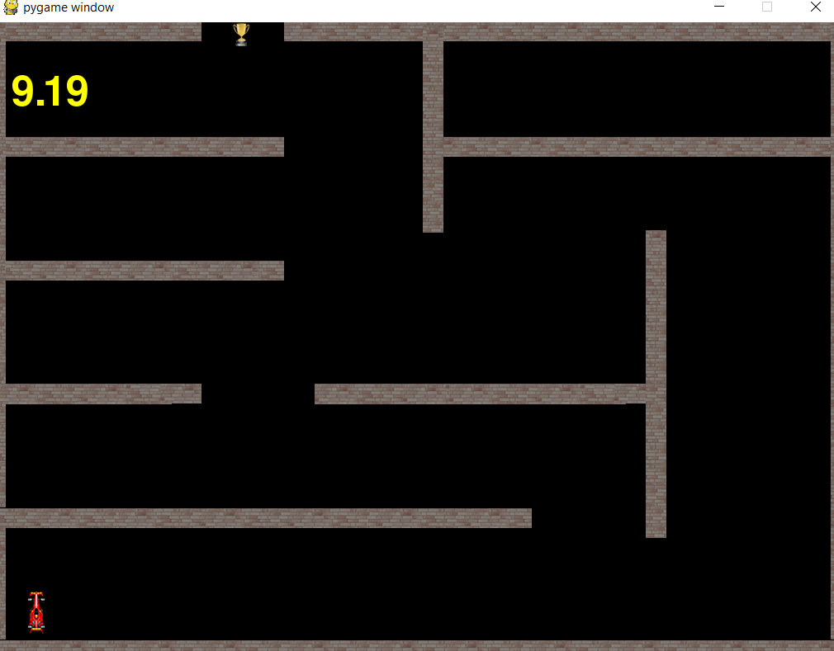
LEVEL 1

Slide 13
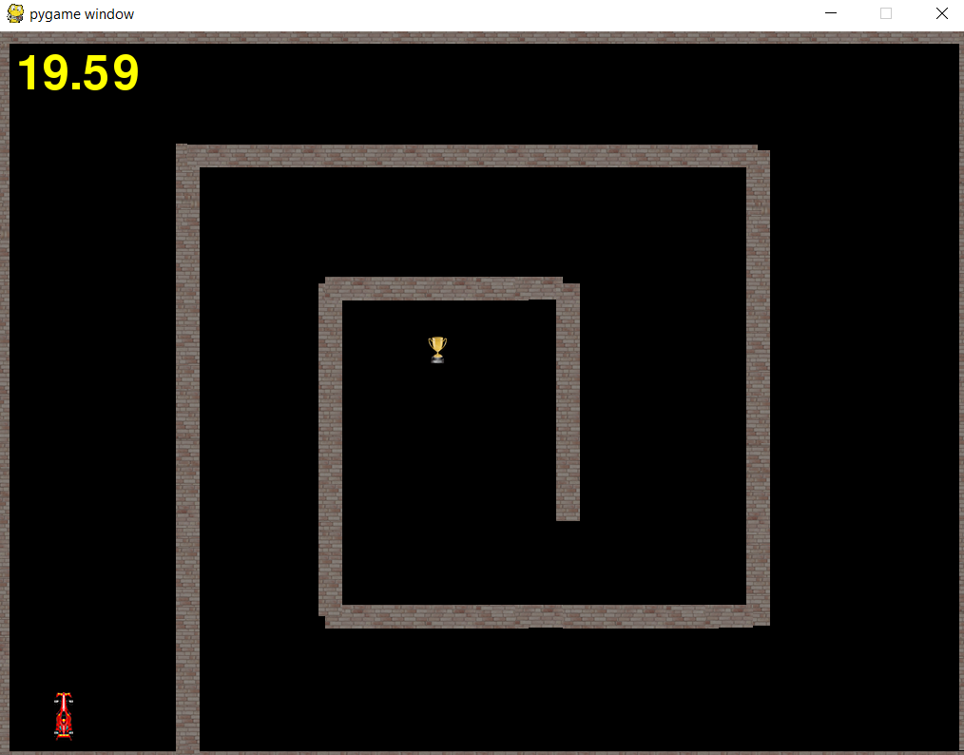
LEVEL 2

Slide 14
CONCLUSION
We have created this working on the basis of 2D racing game by using python module and pygame package and a future development is to add another player , sound effects and to add more levels on this basis.

Slide 15

QUERY

Slide 16
REFERENCES
WWW.TECHWITHTIM.NET
WWW.PYGAME.ORG
WWW.GITHUB.COM

Slide 17


