Slide 1
Data Storytelling & Statistical Validation
ApexPlanet Data Analytics Internship
Task 4
Presented by:
Indhu Ambadipudi
Dataset:
Sample Superstore Dataset

Slide 2
Project Overview
Project Objective
The objective of this project is to analyze the Sample Superstore dataset to identify sales trends, profit performance, customer behavior, and regional performance. The project combines data cleaning, exploratory data analysis, interactive dashboarding, and statistical validation to support business decision-making.

Slide 3
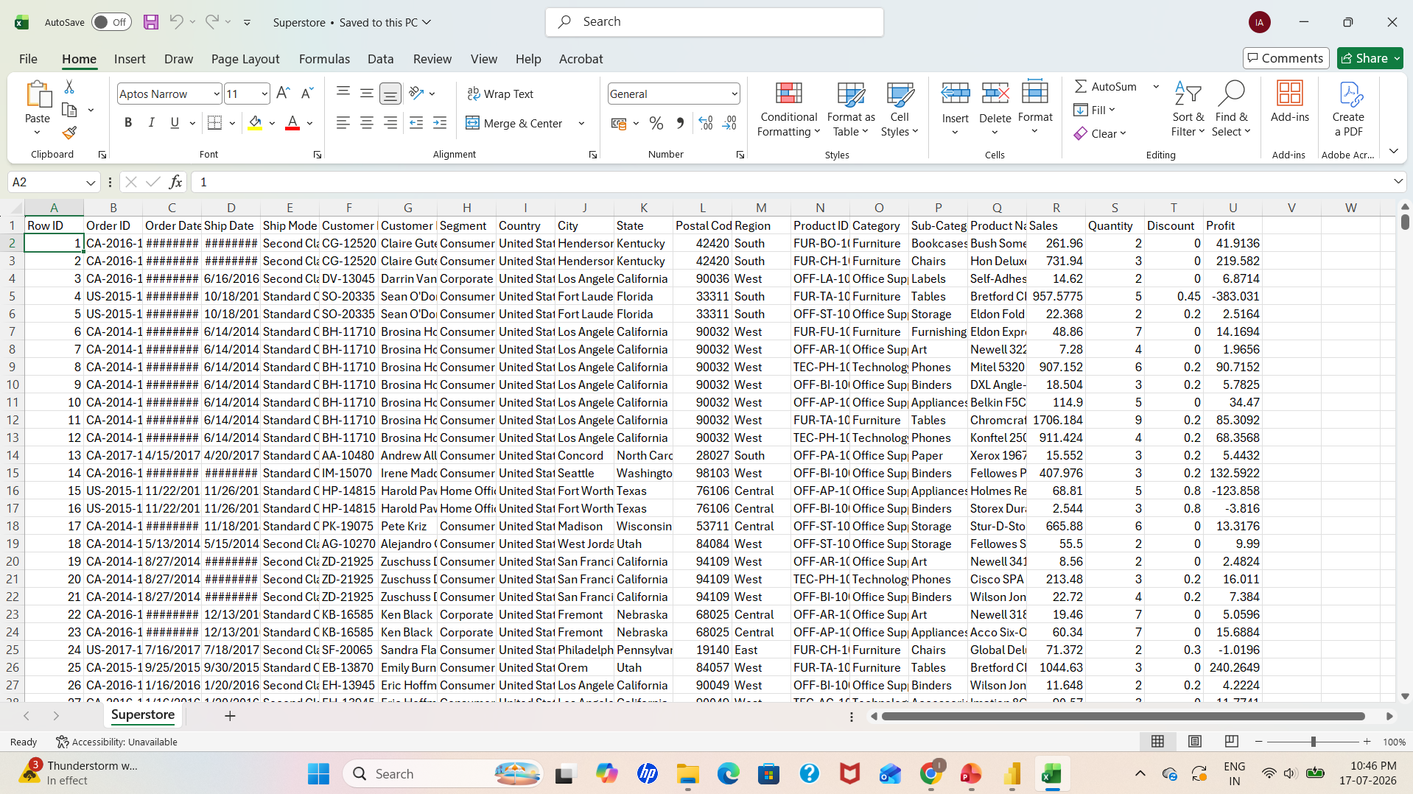
Dataset Overview
Dataset: Sample Superstore
Purpose: Retail sales analysis
Records: (Write the total number of rows in your
dataset)
Features: (Write the total number of columns)
Key Fields: Sales, Profit, Category, Region, Segment,
Quantity, Discount

Slide 4
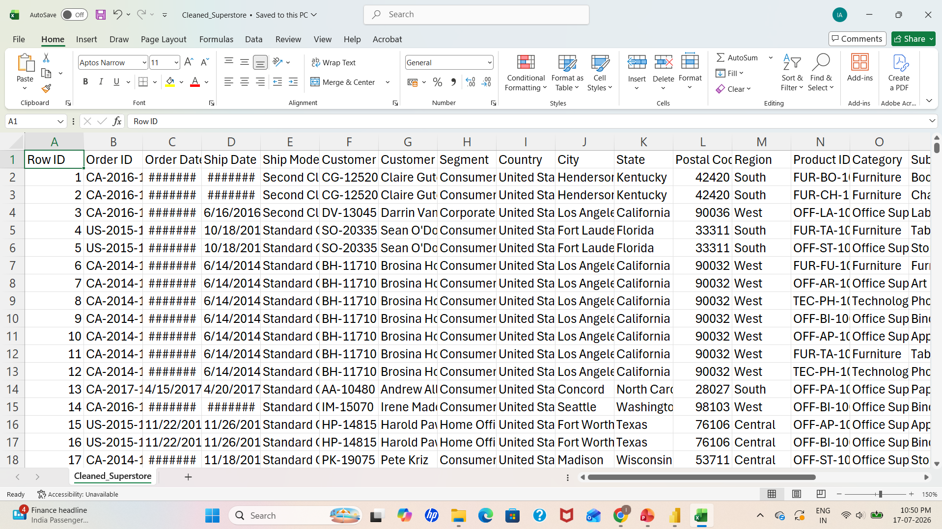
Data Cleaning Summary
Removed duplicate records.
Checked for missing values.
Standardized data formats.
Verified data types.
Cleaned and prepared the dataset for
analysis.

Slide 5
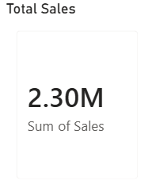
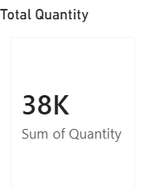
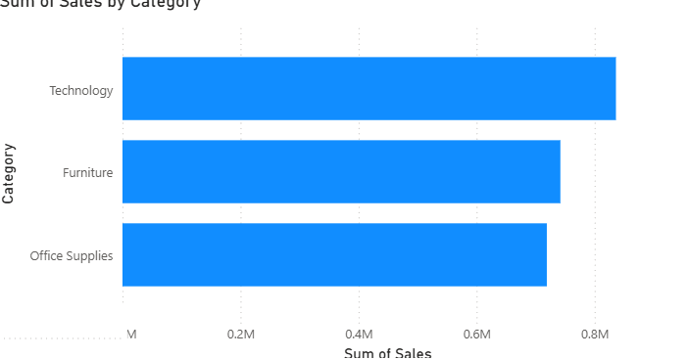
EDA Insights
Technology category generated the highest sales.
Sales varied across different regions.
Some sub-categories had high sales but low profit.
Discounts impacted overall profitability.
Customer segments showed different purchasing patterns.

Slide 6
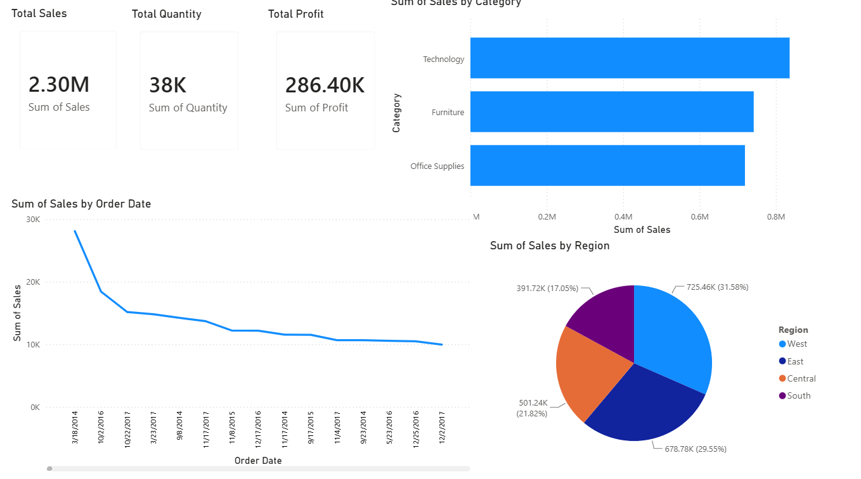
Interactive Dashboard Highlights
Interactive Power BI dashboard created.
KPIs displayed: Sales, Profit, Orders, Quantity.
Dashboard includes filters (Region, Category, Segment).
Visualizations help identify business trends and performance.

Slide 7
Business Insights & Recommendations
Key Business Insights
Technology products generated the highest sales.
The West region showed strong overall performance.
Higher discounts often reduced profit margins.
Some sub-categories need improvement due to low profitability.
Recommendations
Focus marketing on high-performing product categories.
Reduce excessive discounts on low-profit products.
Improve sales strategies in underperforming regions.
Monitor KPIs regularly using the Power BI dashboard.

Slide 8
Hypothesis Testing
Business Question
Does discount have a significant impact on profit?
Null Hypothesis (H₀)
There is no significant relationship between discount and profit.
Alternative Hypothesis (H₁)
There is a significant relationship between discount and profit.
Statistical Test
Correlation Analysis / T-Test

Slide 9
Conclusion
Successfully analyzed the Sample Superstore dataset.
Identified key sales and profit trends through EDA.
Built an interactive Power BI dashboard for business insights.
Performed hypothesis testing to support data-driven decision-making.
The project demonstrates how data analytics helps organizations make better business decisions.

Slide 10
Thank You!

