Slide 1
IBM GROUP 5 CLOUD COMPUTING phase-5 (final submission)
DISASTER RECOVERY WITH IBM CLOUD VIRTUAL SERVERS

Slide 2
PROJECT OVERVIEW
PHASE-1
Disaster recovery plan
Objective
Planning set up
Project definitions
PHASE-2
Disaster recovery
PHASE-3
Types of disaster recovery (Development-1)
PHASE-4
Types of disaster recovery(Development-2)

Slide 3
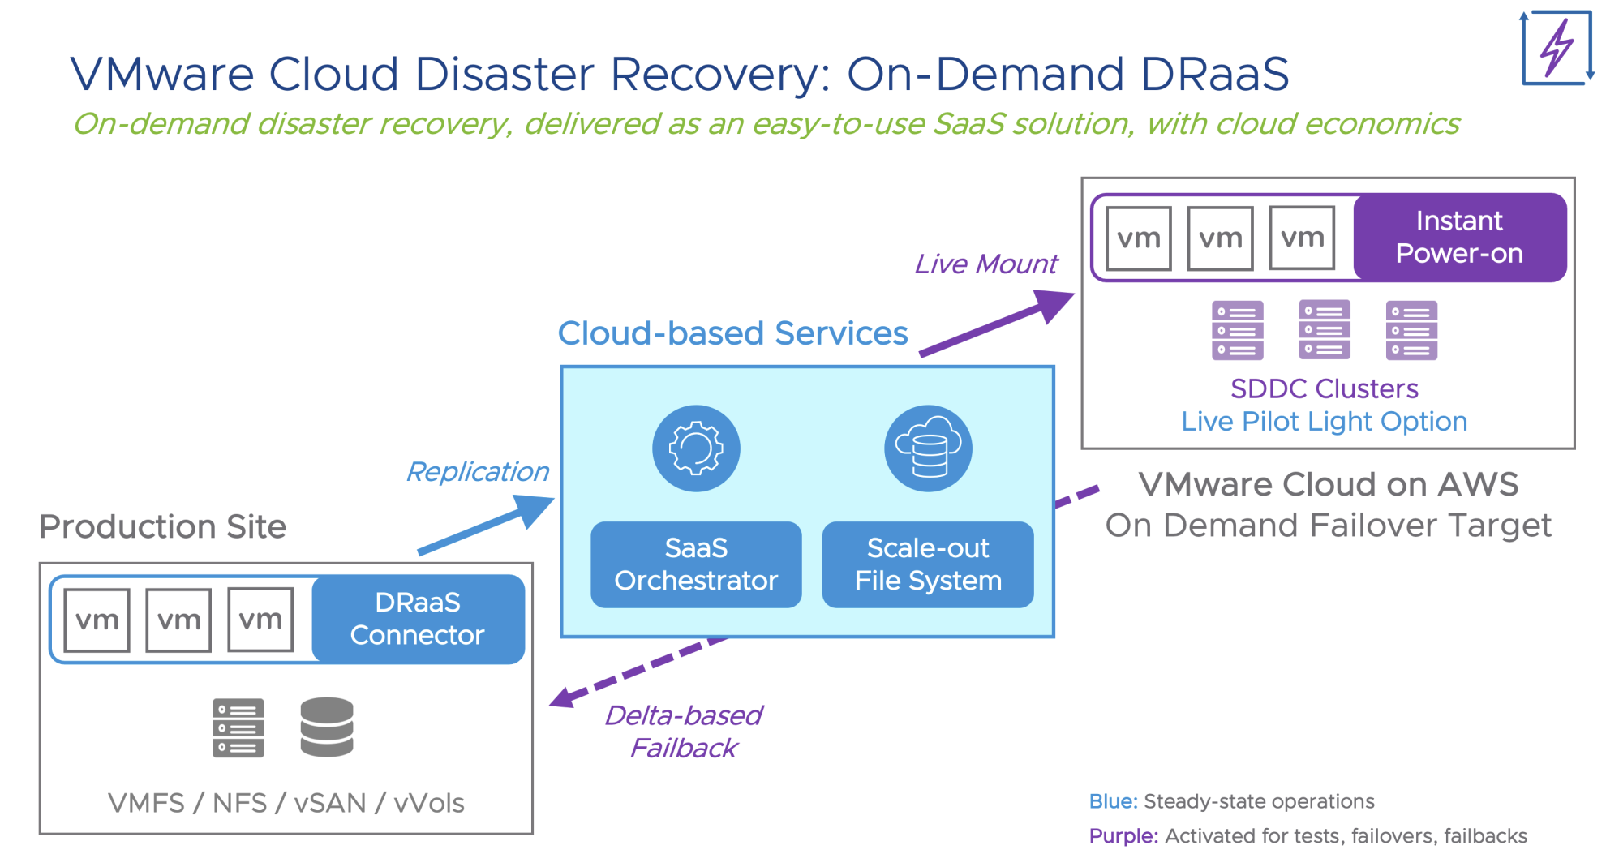

Slide 4
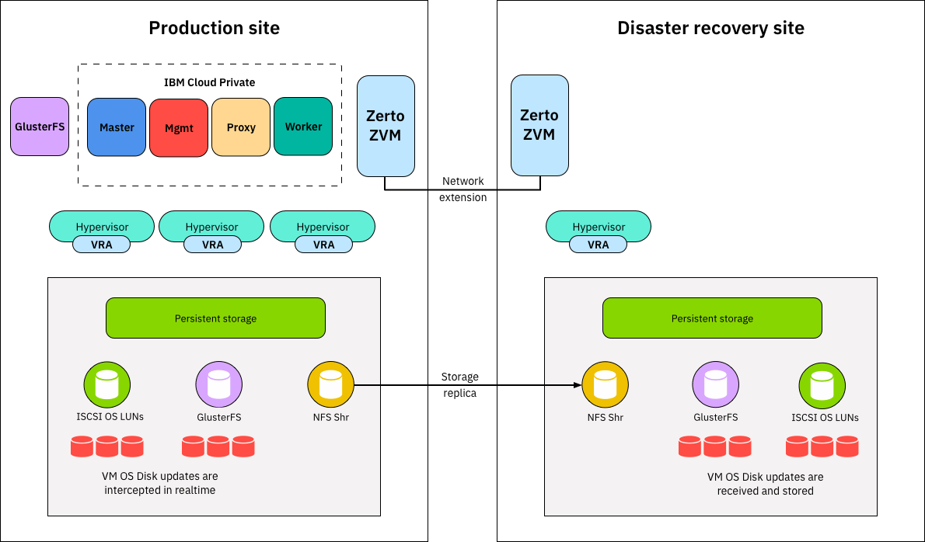

Slide 5
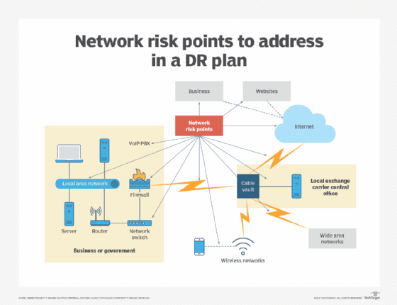
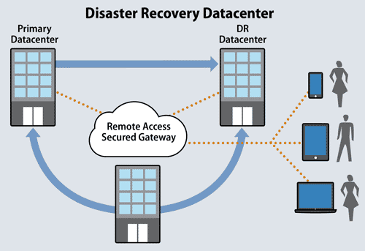
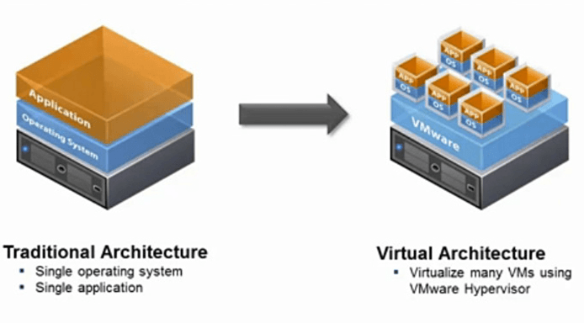
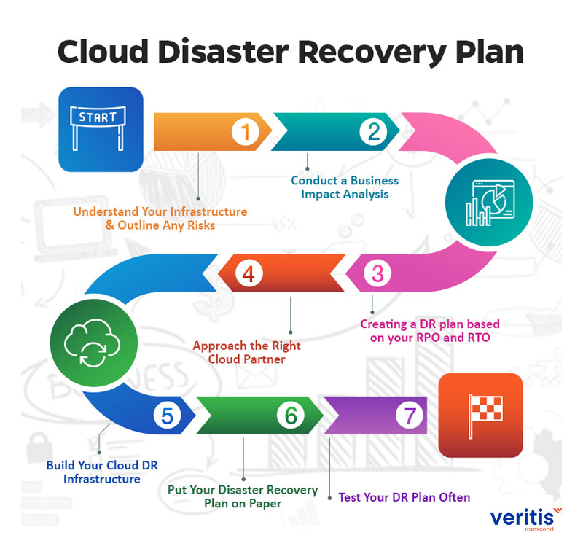

Slide 6
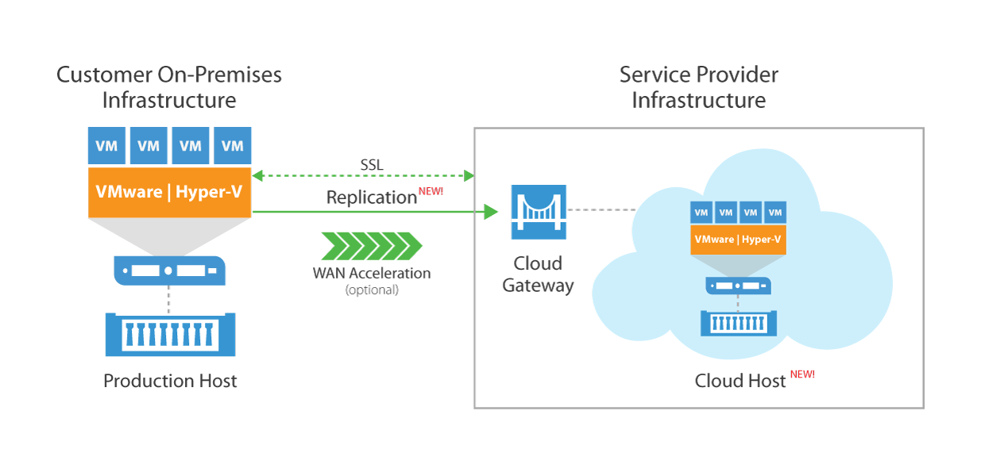

Slide 7
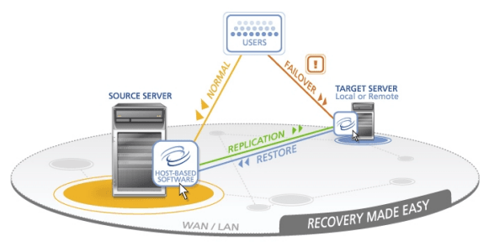

Slide 8
OVERVIEW
DISASTER RECOVERY PLAN:
A disaster recovery plan (DR or DRP) is a formal document created by an organization that contains detailed instructions on how to respond to unplanned incidents such as natural disasters, power outages, cyber attacks and any other disruptive events.
DISASTER RECOVERY:
Disaster recovery (DR) is an organization's ability to restore access and functionality to IT infrastructure after a disaster event, whether natural or caused by human action (or error).

Slide 9
TYPES OF DISASTER RECOVERY:
1. Data center disaster recovery
2. Network Disaster Recovery
3. Virtualized Disaster Recovery
4. Disaster Recovery in the cloud
5. Disaster Recovery as a Service(Draas)

Slide 10
Conclusion
These are all the final project submission of disaster recovery with IBM cloud virtual servers.
We have completed all phases in the disaster recovery with IBM cloud virtual servers

