Slide 1
CHATBOT DEPLOYMENT WITH IBM CLOUD WATSON ASSISTANT
Tutorial
1.Gain a basic understanding of Watson Assistant.
2.Understand the development steps.
3.Apply design thinking for a cognitive solution.
4.Create an instance of Watson Assistant and a workspace.
5.Define intent and entities to help natural language processing.
6.Build a simple dialog flow.
LANGUAGE:-
HTML AND CSS
VERSION:-
HTML -5.3
CSS -CSS3

Slide 2
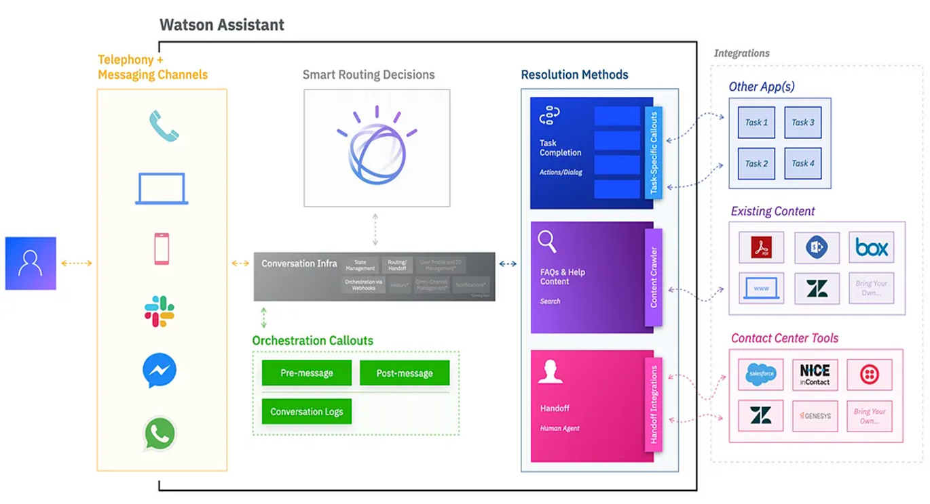
Build a chatbot project by using Watson Assistant

Slide 3
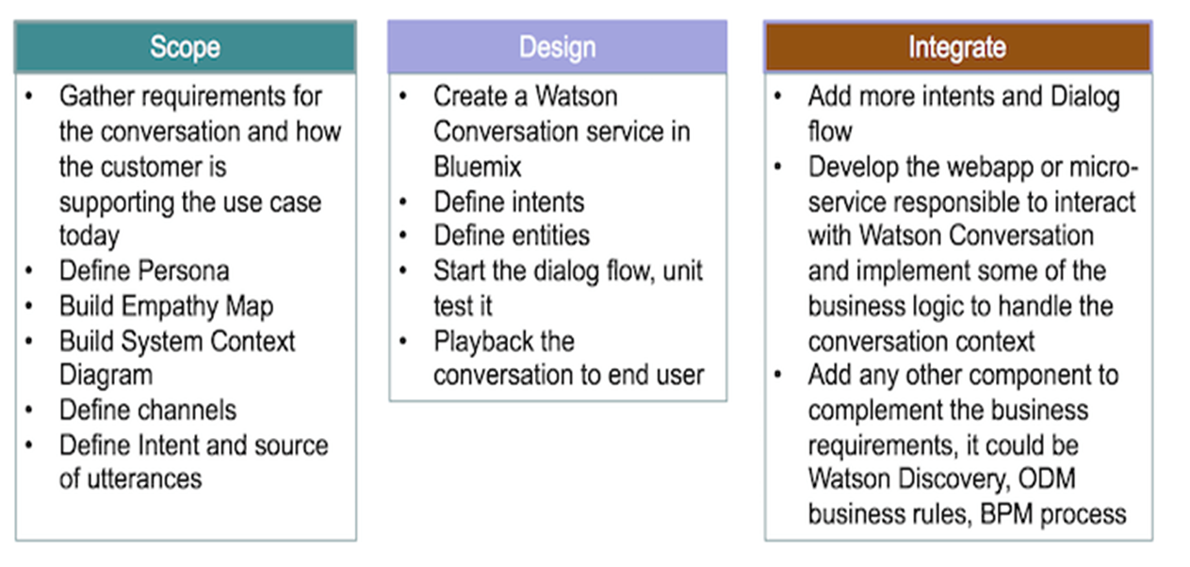
Chatbot projects that use Watson Assistant involve three phases:

Slide 4
Task 1: Create the Assistant service
Task 2: Create a workspace
Task 3: Create intents
Task 4: Test the intents
Task 5: Add entities
Task 6: Build the dialog
Task 7: Complete advanced dialog work
Task 8: Use the API

Slide 5
CHATBOT DEPLOYMENT WITH IBM CLOUD WATSON ASSISTANT
Deploying a chatbot using IBM Cloud Watson Assistant typically involves creating an integration with a website or application. Here's a step-by-step guide to deploying a Watson Assistant chatbot in a web application using HTML and JavaScript:

Slide 6
Create a Watson Assistant Instance:
Build and Train Your Watson Assistant:
Obtain API Credentials:
Create a Web Page:

Slide 7
HTML CODE
<!DOCTYPE html>
<html>
<head>
<title>Watson Assistant Chatbot</title>
</head>
<body>
<div id="chat-container">
<div id="chat"></div>
<input type="text" id="user-input" placeholder="Type your message here...">
<button id="send">Send</button>
</div>
<script>
// Your JavaScript code for interacting with Watson Assistant will go here
</script>
</body>
</html>

Slide 8
JAVASCRIPT
document.addEventListener("DOMContentLoaded", function () {
const chatDiv = document.getElementById("chat");
const userInput = document.getElementById("user-input");
const sendButton = document.getElementById("send");
const assistant = new ChatBotAssistant({
apiKey: "YOUR_API_KEY",
url: "YOUR_API_URL",
});
sendButton.addEventListener("click", function () {
const userMessage = userInput.value;
userInput.value = "";
displayUserMessage(userMessage);

Slide 9
assistant.sendMessage(userMessage).then(displayAssistantResponse);
});
function displayUserMessage(message) {
// Display the user message in the chat interface
}
function displayAssistantResponse(response) {
// Display the chatbot's response in the chat interface
}
});

Slide 10
CHATBOT DEPLOYMENT WITH IBM CLOUD WATSON ASSISTANT
DEVELOPMENT PART 1:
In IBM Watson Assistant, which is a cloud-based conversational AI platform, entities, intents, and dialogs are key components used to build and train chatbots or virtual assistants. Here's a brief explanation of each:
Entities:
In Watson Assistant, an entity represents a specific piece of information within user input. It is used to extract relevant data from user messages. Entities can be things like dates, numbers, product names, or any other data you want to capture. You define entities to help the assistant understand and process user queries more effectively.
For example, if you're building a chatbot for a restaurant, you might define an entity named "cuisine" to extract the type of cuisine the user is interested in (e.g., Italian, Chinese, Mexican).

Slide 11
Intents:
An intent is the purpose or goal expressed in a user's message. It represents what the user is trying to achieve or communicate. Intents are essential for routing user requests to the appropriate responses or actions. You define intents to help the assistant recognize and categorize user input accurately.
For instance, in a virtual assistant for a bank, you might define intents like "Check Account Balance," "Transfer Funds," or "Report Lost Card" to identify the user's intentions.
Dialogs:
Dialogs in Watson Assistant are used to structure the conversation flow between the user and the chatbot. You create dialog nodes to define how the assistant should respond to user input based on detected intents and entities. Dialogs help in creating dynamic and context-aware interactions.

Slide 12
•
Within a dialog node, you can define responses, conditions, and actions to take. You can also incorporate variables to store and retrieve information throughout the conversation, enabling personalized interactions.
➢
The typical workflow in Watson Assistant involves defining entities and intents, building dialog nodes to handle different conversation paths, and training the assistant using historical data or sample conversations. This training helps the assistant understand user input better, recognize intents and entities accurately, and respond appropriately.
➢
Entities, intents, and dialogs work together to enable natural and context-aware conversations between users and your chatbot or virtual assistant built with IBM Watson Assistant. By correctly defining and configuring these components, you can create effective and intelligent conversational interfaces.
➢
Now we are going to create the chatbot for that we will do the primary steps now.

Slide 13
STEP1:
Login To The IBM account and click on the Catalog and then search for Watson Assistant and give enter.
•
You will get the Watson Assistant There By default you will have this
Step 2:
•
Change the default location and give the location as London(eu-gb) and select the plan as Lite
•
Give tick mark for I have read and agree to the following license agreement
•
Now click on create it will create an instance for you
Step 3:
•
After creating an instance for Watson Assistant you need to launch the Watson Assistant by clicking the launch the assistant

Slide 14
Step 4:
•
It will give the access to create the assistant give the name for the Assistant and give the description for that assistant it's completely optional click on create and save it.
•
Here I have been created NM BOT as my chat bot assistant name
Now scroll down and then activate the dialog
Step 5:
•
After activating the Dialog, you will get the Intents, Entities, Dialog, and Content catalog like shown below
Step 6:
•
Create the Entities first and one variables for the entities you have been created.
•
Here I have been created the Entity with the name Entertainement and added variables as channels and star with some variable value.

Slide 15
Step 7:
•
Open the Intents and then create the Intents for Messages, Services, AboutMe give some example queries for them
Step 8:
•
Next open the Dialog and then add nodes for all the Intents you have created where we need to give the responses for the selected queries.
•
Whereby default we will have Anything else node.
Step 9:
•
Check the chat bot by clicking the try it before connecting the Facebook Messenger.

