Slide 1

Slide 1
ACKs &
Kro Resource Orchestrator

Slide 2
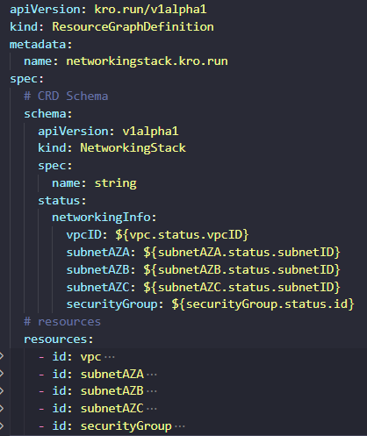
Demonstrating the Power of Kro
Kro works by abstracting dependent variables upon which resources depend.
Assuming a deployed ACK ec2 Controller is to be used to deploy a VPC, subnets, and security groups. The controller would first be installed, and then the manifests for the infrastructure would be deployed individually, whilst the user would have to ensure the dependent variables are transferred between the custom resources.
Kro instead, uses “Resource Graph Definitions” to assist with scaling this activity. With one resource graph you can provision and manage a fleet of otherwise separate manifests as “resources”.

Slide 3
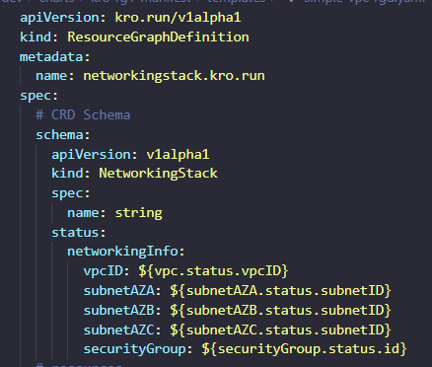
Demonstrating the Power of Kro
The graph connects the individual CRs using the status section of an RGD. It also creates a schema of the “Resource Graph” which is a template for “Graph Instance”. This schema is a template of the expected inputs of the RGD.

Slide 4
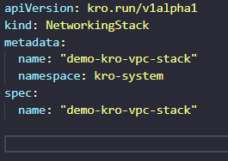
Demonstrating the Power of Kro
Here is a sample Graph Instance

Slide 5
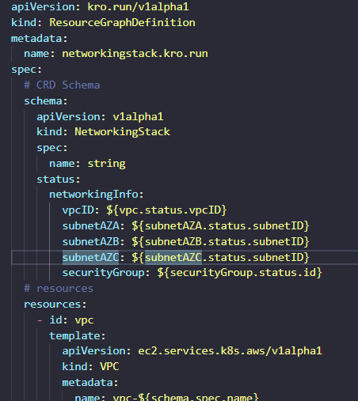
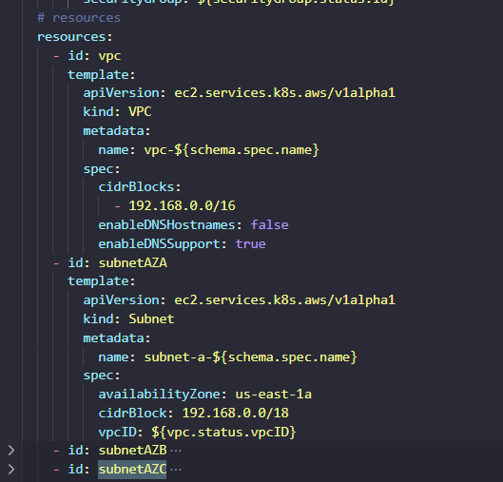
Demonstrating the Power of Kro

Slide 6
Layered RGDs

Slide 7
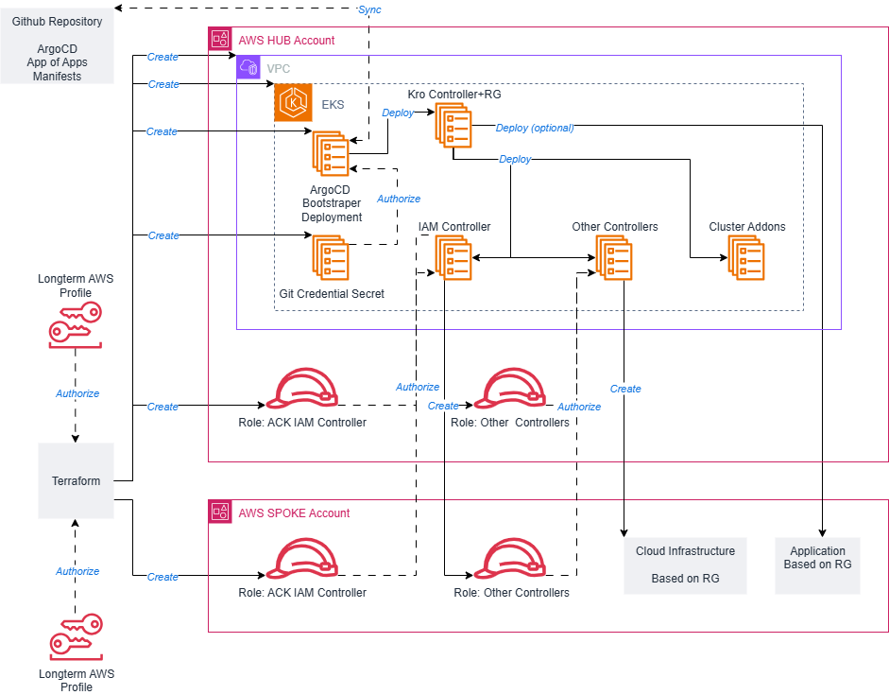
Goal

Slide 8

Slide 11
THANK YOU

