Slide 1
AF-Helper
The cardiovascular companion

Slide 2
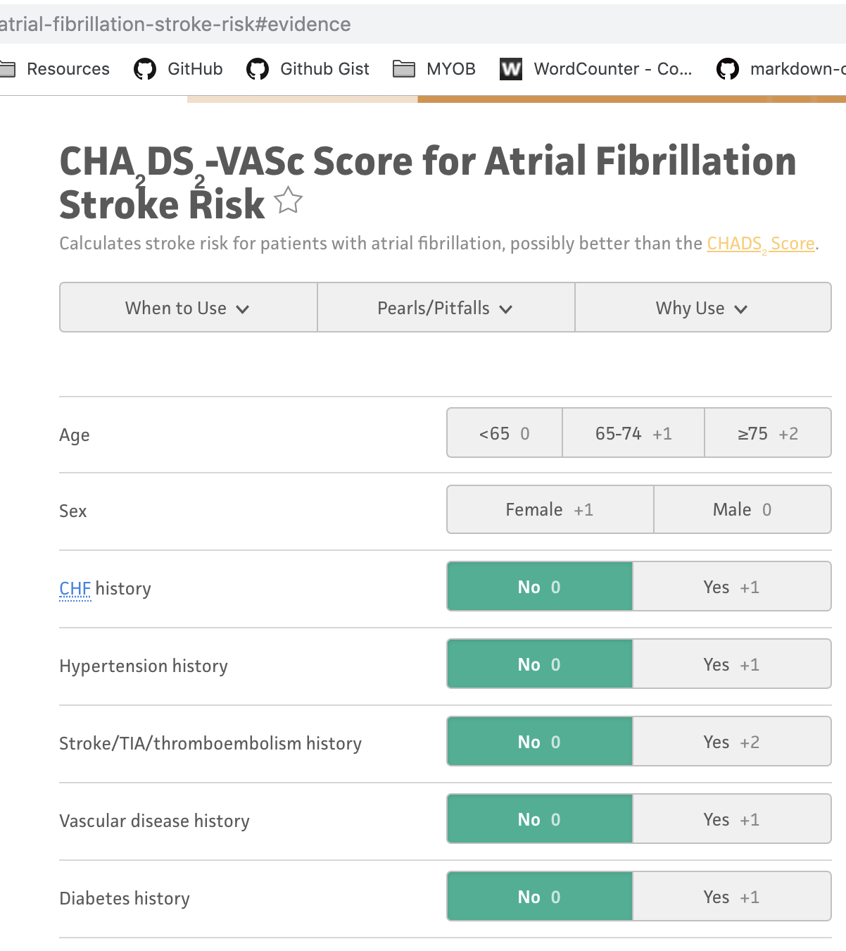
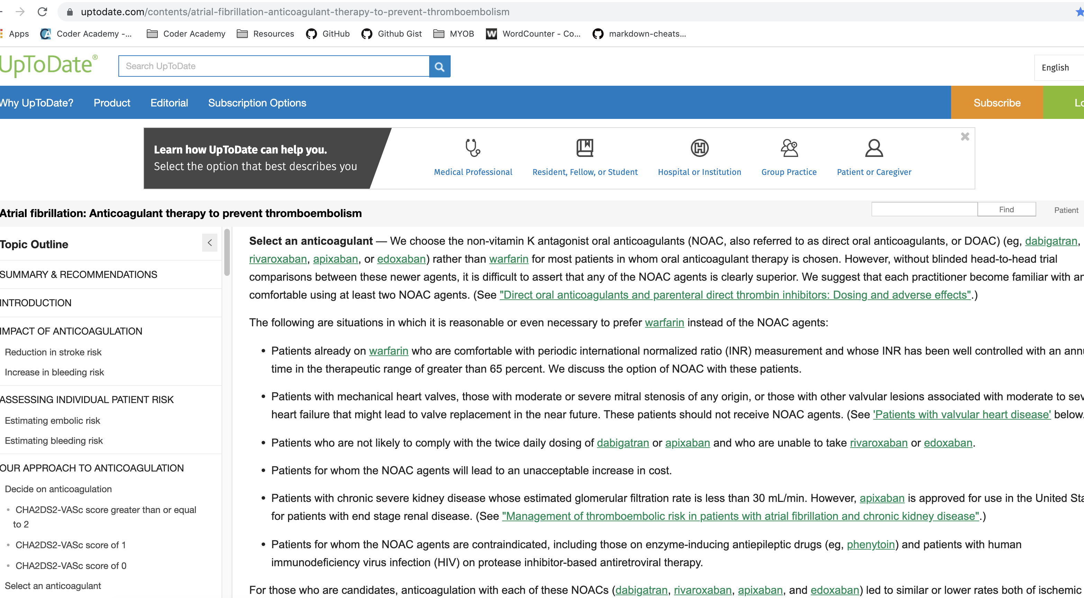
OVerview
Designed for doctors to calculate the risk of stroke for patients with atrial fibrillation
The risk of stroke caused by venous thromboembolism (blood clots) is increased five-fold in people who have atrial fibrillation!
Multiple useful features in the one application
Saves time googling and navigating to separate pages for the calculator and treatment options
Record is saved and easily retrieved
Notes:
Usually doctors are having to find one website to perform the calculation and a different website to view treatment information.
Furthermore, the record is not saved.

Slide 3
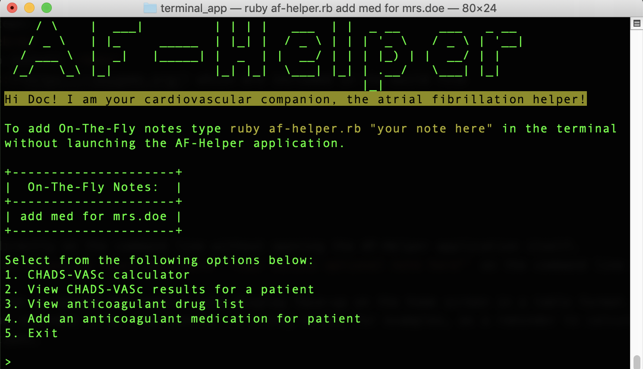
Features
Notes:
On the fly notes can be added without having to open the application.
This is an ideal place to put reminders and follow ups
The CHADS-VASc calculator will ask the users a series of standard questions then calculate the score
Results are stored by the system and can be viewed at any time
The drug list will display a list of recommended anticoagulant drugs and their doses
If the doctor makes a decision to anticoagulate then they can append the medication to the CHADS-VASc result record

Slide 4
demo

Slide 5
challenges
Appending added medications to the record
Error handling for prompts created using TTY-Prompt
Updating stored information
Notes:
Created a class called patient
Wanted to avoid parsing out CSV data for all patients and creating a new object for all patients when only one is required at a time
A workaround was to write the medication to a different CSV and set this to the medication attribute after loading the other attributes using the CHADS-VASC results CSV
This method appears to do the job but when I checked my CSV file it’s writing a new line to the medication CSV every time I retrieve a patient result.
TTY-Prompt requires the use of validation statements to handle invalid user input
for example, if a user types something other than “Y” or “N” for yes/no qs TTY=Prompt will throw a nasty error message which is not user friendly
Due to time constraints I was unable to analyse the documentation to learn how to use these validation statements
As a workaround the rescue error message will display
A functionality I would like to explore is whether it’s possible to update csv files in ruby – for instance, modifying or removing an existing row without affecting the other data.

Slide 6

Questions?

