Slide 1
GATLING
FRAMEWORK
Web & API Performance Testing
Framework, Reporting & Dashboards

Slide 2
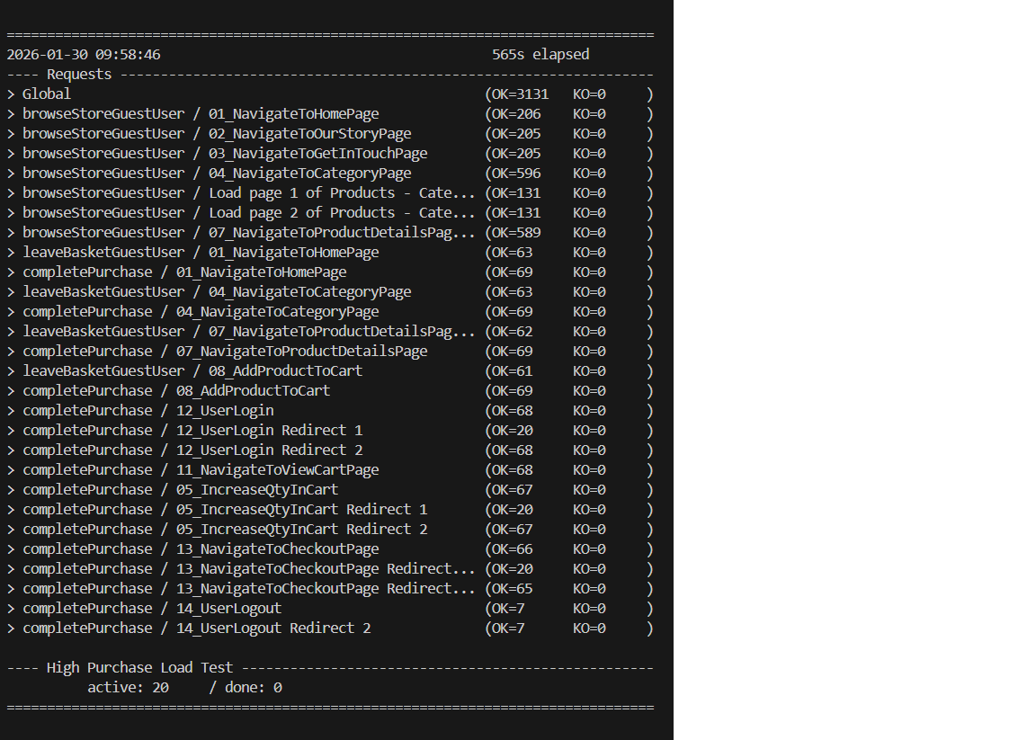
FRAMEWORK OVERVIEW
💻 Test Execution Output
⚡ Key Capabilities
🌐
Web Testing
HTTP/HTTPS, browser simulation, session management
🔌
API Testing
REST, SOAP, GraphQL with JSON/XML validation
📊
High-Volume Load
Test thousands of concurrent virtual users
📈
Real-Time Analytics
Live monitoring and comprehensive reporting

Slide 3
PROJECT STRUCTURE
🎯
simulations/
🔄
scenarios/
Main test simulations with Scala/Java classes defining complete load scenarios
Reusable scenario definitions with user journeys and behavior patterns
GATLING
PROJECT
⚙️
config/
📡
requests/
Configuration files: gatling.conf, logback.xml, environment settings
HTTP request builders, headers, payloads, API endpoint configs

Slide 4
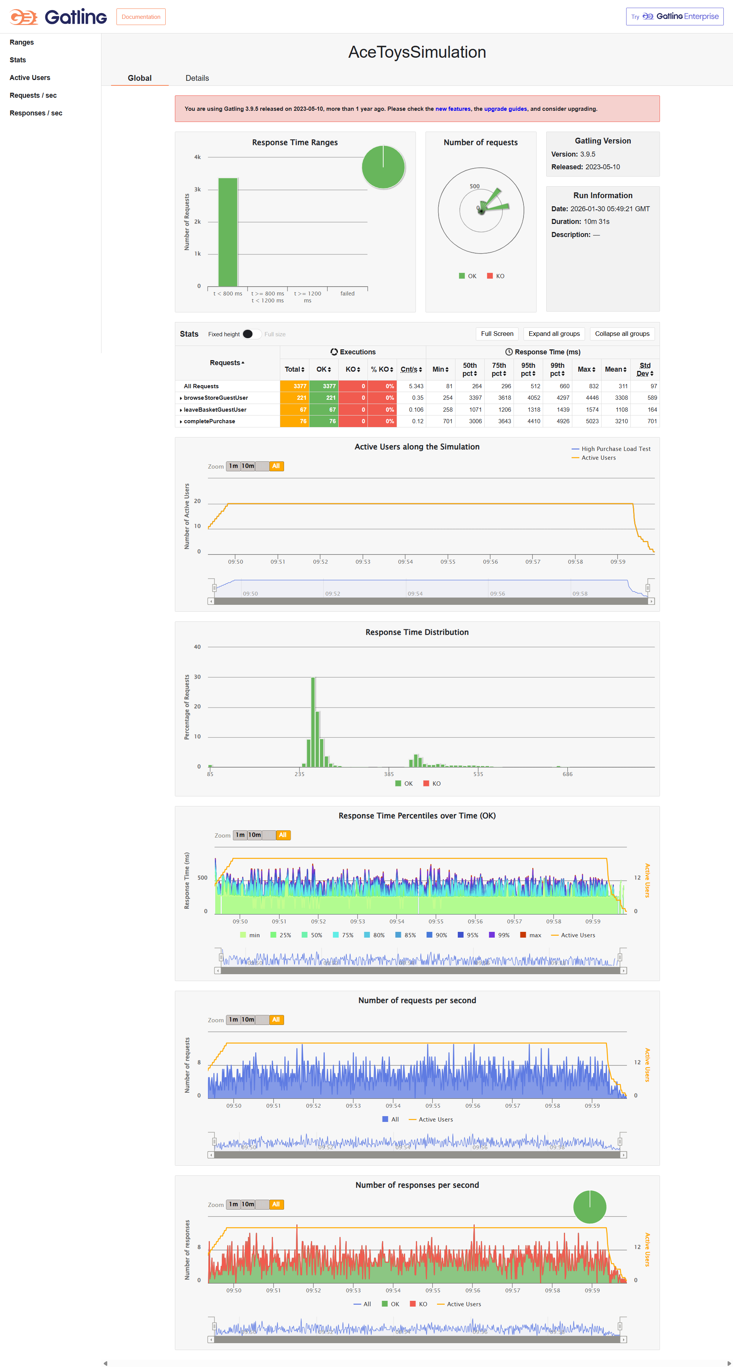
BUILT-IN HTML REPORTS

Slide 5
REPORTING & EXPORT CAPABILITIES
📊
Global Statistics
🎯
Request Details
👥
Active Users
Complete overview of requests, response times, and success rates
Individual metrics with percentile distribution analysis
Concurrent user simulation tracking over time
📈
Percentile Graphs
💾
JSON Export
🔄
InfluxDB Stream
P50, P75, P95, P99 response time visualization
Structured data output for CI/CD integration
Real-time metrics for live dashboard monitoring

Slide 6
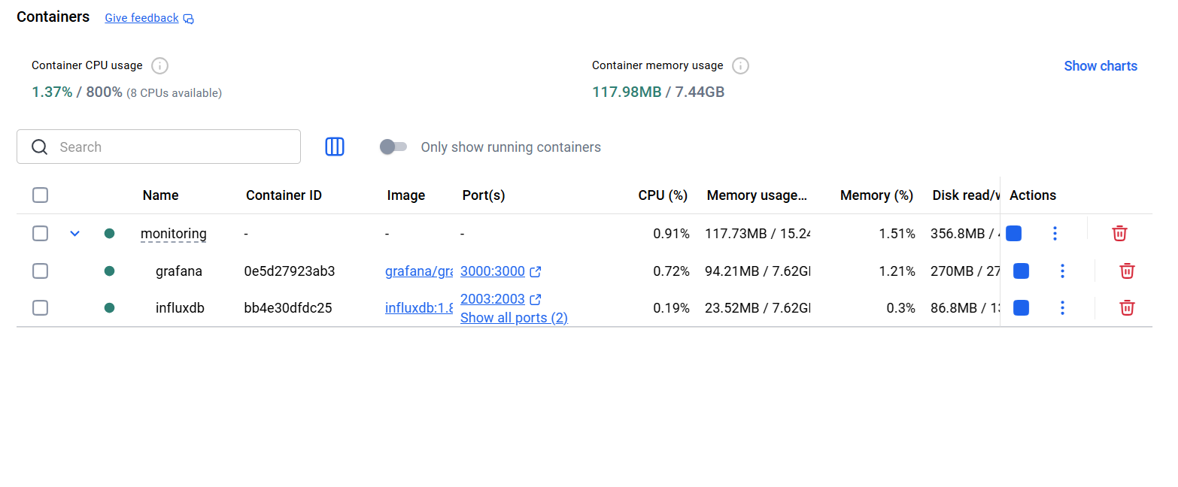
DOCKER DASHBOARD ARCHITECTURE
⚡
💾
📊
GATLING
INFLUXDB
GRAFANA
Test Execution
Time-Series DB
Visualization
Setup Process
Configure InfluxDB in gatling.conf (database, retention, connection)
Launch docker-compose.yml (InfluxDB:2003, Grafana:3000)
Execute tests with real-time streaming to InfluxDB
Configure Grafana datasource and import templates

Slide 7
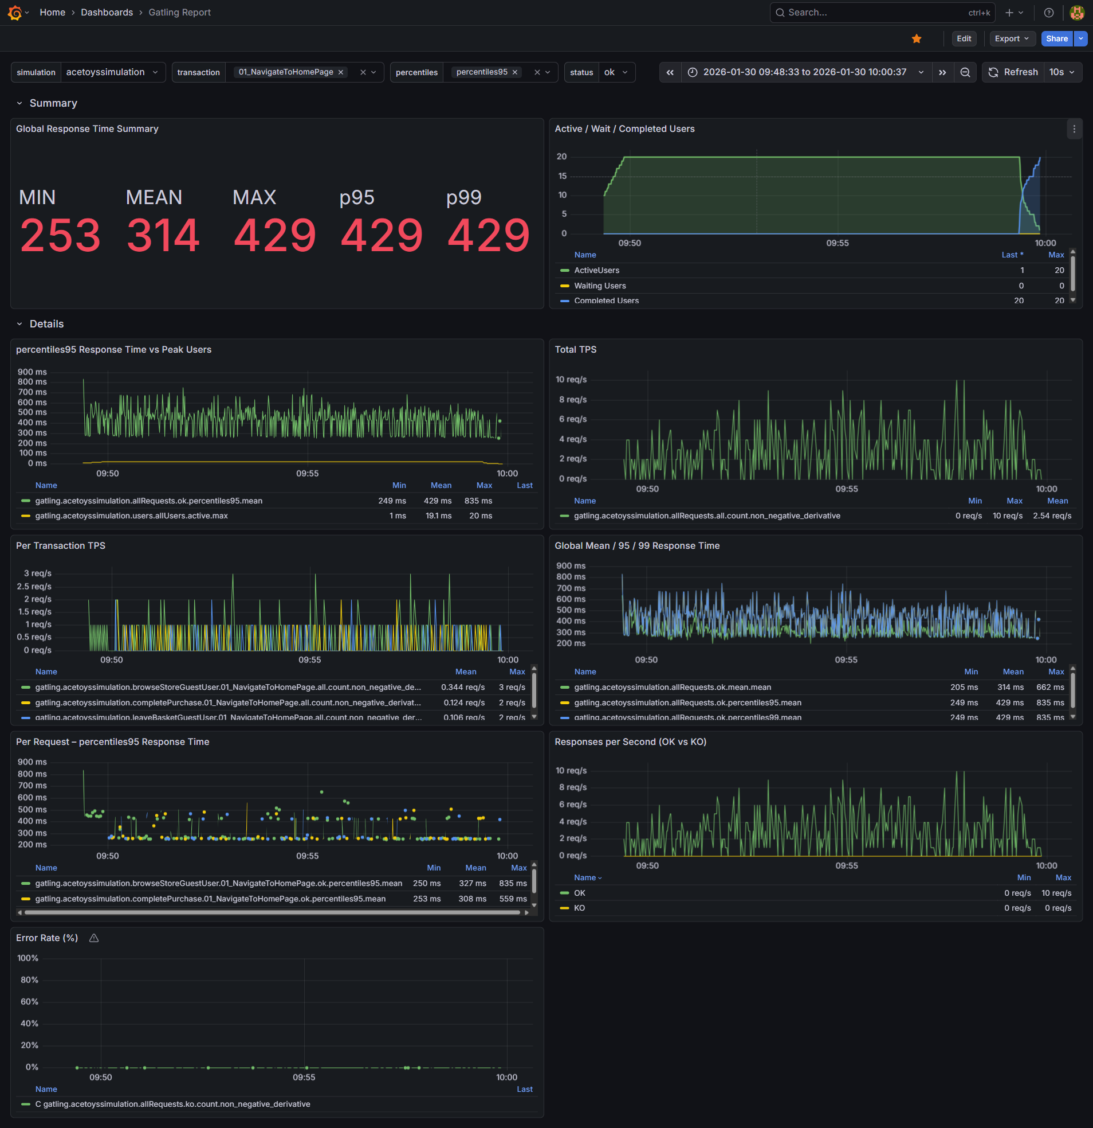
GRAFANA DASHBOARD

Slide 8
PERFORMANCE METRICS GUIDE
📊
99th Percentile (p99)
⏱️
Response Time
429ms
MIN 253 | MEAN 314 | MAX 429
99% of requests complete within this time. Critical SLA metric for performance compliance.
Complete request-response cycle including network, processing, and transfer time.
👥
Active Users
📈
Total TPS
Peak: 20 concurrent
Throughput Capacity
Virtual user simulation showing load intensity and ramp-up patterns over time.
Transactions Per Second showing system capacity and request/response rate metrics.
📉
Percentile Distribution
🔍
Bottleneck Analysis
P50 | P75 | P95 | P99
System Constraints
Response times visualized over time showing performance consistency and outliers.
Identifies slowest requests, saturation points, error spikes, and queue buildup.

