Slide 1
Flexible Coding for
802.11n MIMO Systems
Keith Chugg and Paul Gray
TrellisWare Technologies
Bob Ward
SciCom Inc.
kchugg@trellisware.com
(with support provided by UCLA’s UnWiReD Lab.)

Slide 2
Overview
TrellisWare’s Flexible-Low Density Parity Check (F-LDPC) Codes
  FEC Requirements for IEEE 802.11n
  Introduction to F-LDPC Codes
  F-LDPC Turbo/LDPC dual interpretation
Example Applications of F-LDPC Codes to the IEEE 802.11n PHY Layer
  SVD-based MIMO-OFDM with Adaptive Rate Allocation
  MMSE-SIC V-BLAST MIMO-OFDM
Conclusions

Slide 3
FEC Requirements for IEEE 802.11n
Frame size flexibility
  Packets from MAC can be any number of bytes
  Packets may be only a few bytes in length
  Byte-length granularity in packet sizes rather than OFDM symbol
Code rate flexibility
  Need fine rate control to make efficient use of the available capacity
Good performance
  Need codes that can operate close to theory for finite block size and constellation constraint
High Speed
  Need decoders that can operate up to 300-500 Mbps
Low Complexity
  Need to do all this without being excessively complex
Proven Technology
  Existing high-speed hardware implementations

Slide 4
Benefits of Modern FEC Flexibility for 802.11n
Flexibility in code rate and modulation
  Large range of spectral efficiencies (bps/Hz) with fine resolution
  Maximize the data rate for the current channel conditions
  Minimizes need for pad bits
Flexibility in the Block Size
  Essential for the MAC
  Block size selection on-the-fly allows one to optimally meet latency requirements
“Future Proof”
  High FEC flexibility will support virtually any evolution of the standard and unforeseen operational scenarios
  Can alter FEC block length to account for changes in the latency budget (hardware, software implementation technology)

Slide 5
TrellisWare’s F-LDPC Codes
A Flexible-Low Density Parity Check Code (F-LDPC)
  Systematic code overall
Concatenation of the following elements:
  Outer code: 2-state rate ½ non-recursive convolutional code
  Flexible algorithmic interleaver
  Single Parity Check (SPC) code
  Inner Code: 2-state rate 1 recursive convolutional code
F-LDPC Encoder
P/S (2:1)
S/P (1:J)
input bits
SPC
parity bits
Outer
Code
…
Inner
Code
I
J bits wide
systematic bits

Slide 6
TrellisWare’s F-LDPC Codes (2)
Use of 2-state constituent codes means very low decoder complexity
  Outer code polynomials: (1+D, 1+D)
  Inner code polynomial: (1/(1+D)) [accumulator]
  Outer code uses tail-biting termination
  Inner code is not terminated
For K-bit frames the interleaver is fixed at 2K bits, regardless of rate.
  Any good algorithmic interleaver will give frame size programmability down to bit level
SPC forms single-parity check of J bits.
  Different code rates are achieved by only varying J
  Code rate = J/(J+2)
  Inner code runs at 1/J fraction of speed of outer code

Slide 7
F-LDPC Features
Unparalleled flexibility without complexity penalty
  Input Block Sizes: 3 bytes to 1000 bytes in single byte increments
  Code Rate: ½ to 32/33 with virtually any rate in between
Uniformly good performance over these modes
  ~< 1 db of SNR from random coding bounds (best point designs are 0.5 dB)
Low complexity traits of LDPC codes
  Similar edge complexity
  Lower memory requirements and simpler memory design and access
Proven high-speed hardware implementation
  300 Mbps single FPGA prototype
  F-LDPC code is simplification of TrellisWare’s FlexiCode ASIC design
  Options for architectures associated with LDPC decoders and Turbo decoders

Slide 8
F-LDPC Alternative Interpretations
Proposed code can be viewed as either
  Concatenation of two-state convolutional codes with a single-parity check (SPC) block code
  Punctured irregular-LDPC (IR-LDPC)
  IR-LDPC
Proposed code can be decoded using
  Forward-backward algorithm (BCJR) type SISO decoders (typically associated with concatenated convolutional codes)
  Parallel “check node” and “variable node” processors (typically associated with LDPC codes)

Slide 9
F-LDPC Alternative Interpretations (2)
Performance is comparable to good IR-LDPC codes
  Near best performance of best known codes over wide range of block sizes and code rates
Decoding complexity (measured by operation counts) is very low
  Similar to that of the IR-LDPC used in DVB-S2
  Significantly less than that of an 8-state PCCC (e.g., 3GPP)
Both LDPC and “turbo” architectures can be used
  Third parties with good solutions for concatenated convolutional codes and LDPC codes can apply their technology
  Yields high degree of freedom for trade-off between parallelism, memory architectures, etc.

Slide 10
F-LDPC as Concatenated CCs
Encoder
P/S (2:1)
S/P (1:J)
K input bits
SPC
V=(2K)/J parity bits
1+D
…
1/(1+D)
1+D
I
Rate=J/(J+2)
J bits wide
“zig-zag” code
K systematic bits
Decoder (standard rules of iterative decoding)
Channel Metrics (LLRs)
for parity bits
>
<
0
Outer
SISO
I⁻¹
SPC
SISO
Inner
SISO
…
Hard decisions
I
J bits wide
“zig-zag” SISO
Channel Metrics (LLRs)
for systematic bits
Note: activation begins with outer code

Slide 11
F-LDPC as Punctured IR-LDPC
Recall: Encoder
c
Tc
PTc
e
1+D
SPC
p
I
…
1/(1+D)
b
1+D
(K x 1)
(K x 1)
(2K x 1)
J bits wide
“zig-zag” code
b
c = Gb
e = JPTc
e + Sp = 0
G: generator of outer (1+D) code (K x K)
S: “staircase” accumulator block (V x V)
T: repeat outer code bit twice (2K x K)
P: permutation of interleaver (2K x 2K)
J: SPC mapping (V x 2K )
p
V
S
JPT
0
c
= 0
K
0
I
G
b
V
K
K
Low Density Parity Check: Hc’ = 0

Slide 12
F-LDPC as Punctured IR-LDPC (2)
1 0 0 … 0 0 0
1 0 0 0 … 0 0 0
0 1 0 0 0 … 0 0
0 1 0 0 0 0 … 0
0 0 1 0 0 0 … 0
0 0 1 0 0 0 … 0
0 0 0 1 0 0 … 0
0 0 0 1 0 0 … 0
0 0 … 0 0 0 1 0
0 0 0 … 0 0 1 0
0 0 … 0 0 0 0 1
0 0 0 … 0 0 0 1
1 0 0 … 0 0 1
1 1 0 0 … 0 0 0
0 1 1 0 0 … 0 0
0 0 1 1 0 0 … 0
0 0 0 1 1 0 … 0
0 0 … 0 0 1 1 0
0 0 0 … 0 0 1 1
1 0 0 … 0 0 0
1 1 0 0 … 0 0 0
0 1 1 0 0 … 0 0
0 0 1 1 0 0 … 0
0 0 0 1 1 0 … 0
0 0 … 0 0 1 1 0
0 0 0 … 0 0 1 1
0 0 0 0 … 1 0 0
0 0 0 1 … 0 0 0
1 0 0 0 0 … 0 0
0 0 … 1 0 0 0 0
0 1 0 … 0 0 0 0
G =
S =
P =
T =
(pseudo-random permutation matrix)
(K x K)
(2K x 2K)
(V x V)
This element is 1 if outer code is tail-bit; 0 if unterminated
This element is 1 if outer code is tail-bit; 0 if unterminated
J
(2K x K)
1 1 … 1
0
1 1 … 1
J =
1 1 … 1
S
JPT
0
0
1 1 … 1
H =
…
0
I
G
1 1 … 1
(V x 2K)

Slide 13
F-LDPC as Punctured IR-LDPC (3)
Inner (zig-zag) code
Present if inner code it tail-bit
…
J
J
J
J
J
I/I⁻¹
2
2
2
2
2
…
Present if outer code it tail-bit
Outer code

Slide 14
F-LDPC as Punctured IR-LDPC (4)
K check nodes (from outer code); (dc=3)
V=(2K/J) check nodes (from inner code); (dc=J+2)
…
…
3
3
3
3
3
J+2
J+2
J+2
J+2
J+2
Structured Permutation
2
2
2
2
…
2
3
3
3
3
…
3
2
2
2
2
…
2
b: K Systematic Bits (dv=2)
c: K (hidden) bits (dv=3)
p: V=(2K/J) parity bits (dv=2)
dv | Frac. of 2K(1+1/J) total
2 | (J+2)/(2J+2)
3 | J/[2(J+1)] (hidden)
dc | Frac. of K(1+2/J) total
3 | J/ (J+2)
J+2 | 2/(J+2)
Note: this assumes inner and outer codes are tail-bit. If not, there will be a small difference as implied in the previous slides

Slide 15
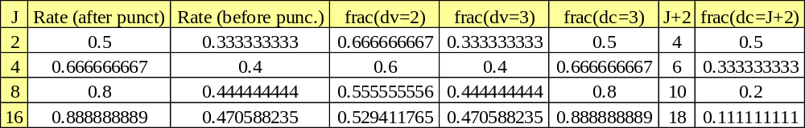
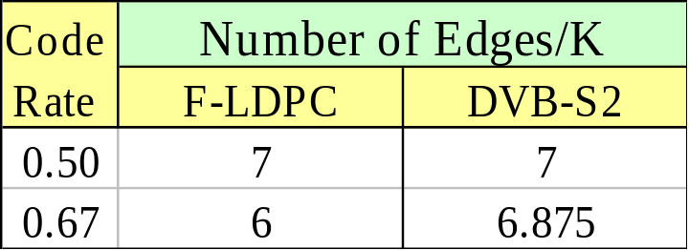
F-LDPC as Punctured IR-LDPC (5)
Example of degree distribution for various code rates
Complexity is roughly measured by number of edges in the parity check graph
  F-LDPC has edge complexity slightly less than the DVB-S2 IR-LDPC code

Slide 16
F-LDPC as Punctured IR-LDPC (6)
Decoder Activation schedules
  “Standard LDPC”: parallel variable-node, parallel check node
    Number of internal messages stored = number of edges (~7K)
  “Piecewise Parallel (green-red-blue)” schedule
    Number of internal messages stored (~2K)
  “Standard Concatenated Convolutional Code” schedule
    Same as discussed when interpreting F-LDPC as CCC
    Number of internal messages stored (~2K)
  Piecewise Parallel and Standard CCC exploit structure of the punctured IR-LDPC permutation

Slide 17
F-LDPC as Punctured IR-LDPC (7)
…
…
3
3
3
3
3
J+2
J+2
J+2
J+2
J+2
I/I⁻¹
2
2
2
2
…
2
3
3
3
3
…
3
2
2
2
2
…
2
  Structure of permutation enables potential memory savings and different high-speed decoding architectures

Slide 18
F-LDPC as Punctured IR-LDPC (8)
Standard LDPC schedule (~7K internal messages stored)
1
2
1
2
1
2
1
2
1
2
1
2
Piecewise Parallel (green-red-blue) schedule (~2K internal messages stored)
1
8
2
7
3
6
4
5
Standard CCC schedule (Outer SISO -> Inner SISO; ~2K messages)
Outer SISO
Inner SISO

Slide 19
F-LDPC as Punctured IR-LDPC (9)
Schedule properties
  All are examples of the same standard iterative message-passing decoding rules with different activation schedules
  Each have the same computational complexity per iteration
  Iteration convergence, degree of parallelism,memory needs, etc. vary with schedule

Slide 20
F-LDPC as IR-LDPC
Possible to eliminate hidden variables
  Formulates the F-LDPC as in a standard IR-LDPC format
    i.e., N variable nodes, V=(N-K) check nodes
p
V
S
JPT
0
p
c
= 0
V
0
I
G
V
S
JPTG
=
K
b
b
K
V
K
K
V
K

Slide 21
F-LDPC as IR-LDPC (2)
Degree distribution
  For high-spread interleaver and K>>J
    V variable nodes with dv=2
    K variable nodes with dv=4
    All checks have dc=2J+2
      Example: r=1/2: 50% dv=2, 50% dv=4, dc=6
This form has many four-cycles
  Modified schedule or H-matrix transformations likely required for good performance based on this graphical model

Slide 22
Example Applications of F-LDPC Codes to the IEEE 802.11n PHY Layer

Slide 23
F-LDPC Applied to IEEE 802.11n
A single, flexible encoder that is suitable for use in a variety of MIMO-OFDM systems
F-LDPC encoder is coupled with a simple puncture circuit for fine rate control, a bit channel interleaver, and a flexible mapper of QAM symbols to the MIMO-OFDM subcarrier frequencies
Code rate and modulation profile can be tuned to maximize throughput
11n Encoder
output
symbols
P/S (2:1)
S/P (1:M)
input bits
systematic bits
F-LDPC
Encoder
Coded Bit
Interleaver
Flexible
Mapper
I
Puncture
…
Q
parity bits

Slide 24
F-LDPC Applied to IEEE 802.11n (2)
F-LDPC Encoder
  3-1024 input bytes, in single byte increments (negligible performance gains above 1Kbytes)
  Block size is programmable on the fly and can be used to meet latency requirements
  5 Coarse rates of r = 1/2, 2/3, 4/5, 8/9, and 16/17
Fine rate control with a simple algorithm
  Provides fine resolution – especially for code rates between ½ and 2/3
  9 Fine rates of p = 16/16, 15/16,…., 8/16
  Overall rate of r/(r+p(1-r)), with r=J/(J+2)
  45 code rates from 1/2 to 32/33
  Fine rate control means that pad bits can be minimized
Coded Bit Interleaver
  Bit interleaving of a single code word
  A simple relative prime interleaver is used here (the size of this interleaver must be very flexible)
Flexible Mapper
  5 modulations of BPSK, QPSK, 16QAM, 64QAM, and 256QAM (more possible)
  Gray mapping
  Bit-loading is easily supported

Slide 25
Uniformly Good Performance
PER vs. SNR curves are shown for a range of code rates and modulation orders
  Min-sum decoding (“log-max-APP”)
  1% PER can be achieved from -2 dB to 27 dB SNR in approximately 0.25 steps
Bandwidth efficiency is shown against SNR required to achieve a PER of 1%
  Full range of code rate, modulation types, and frame sizes (from 128 to 8000 information bits)
Performance is compared with finite block size bound and capacity
  Generally within 1 dB of finite block size bound
  Higher order modulation performance could be improved by iterating the soft-demapper (more complex though)
  Demonstrates the fine code rate granularity possible

Slide 26
AWGN Perf.: Varying Rate & Modn.
1
0.1
PER
0.01
~0.25 dB
Rate 1/2 BPSK – 32/33 256QAM
0.001
0
5
10
15
20
25
30
SNR (dB)

Slide 27
AWGN Perf.: Bandwidth Efficiency
8
128 bits
256QAM
256 bits
7
512 bits
1024 bits
6
2048 bits
8000 bits
5
64QAM
Bandwidth Efficiency (info bits/symbol)
4
16QAM
3
2
QPSK
1
BPSK
Rate 1/2 - 32/33
0
-5
0
5
10
15
20
25
30
Required SNR for 1% PER (dB)

Slide 28
AWGN Perf.:Comparison with Bound
9
BPSK
8
QPSK
16QAM
7
64QAM
256QAM
BPSK Bound
6
QPSK Bound
16QAM Bound
5
64QAM Bound
Bandwidth Efficiency (info bits/symbol)
256QAM Bound
4
log2(1 + SNR)
3
All 8000 info bits
2
1
0
-5
0
5
10
15
20
25
30
Required SNR for 1% PER (dB)

Slide 29
Frame Size Flexibility
Coding and modulation is fixed at rate 4/5 16QAM
PER vs. SNR curves are shown for a range of frame sizes from 8 to 1000 bytes
SNR required to achieve a PER of 1% is shown against frame size
  Both automated search and hand tuned interleaver parameters are shown. It is expected that performance matching that of the hand tuned parameters can achieved everywhere
  The finite block size performance bound is also plotted, showing that the automated search parameters are within 1 dB of this bound, and the hand tuned parameters are with 0.75 dB

Slide 30
AWGN Perf.: Frame Size Flexibility
1
0.1
All 4/5 16QAM
PER
0.01
1000 bytes
8 bytes
Frame Size
0.001
10.5
11
11.5
12
12.5
13
13.5
14
SNR (dB)

Slide 31
AWGN Perf.: Frame Size Flexibility (2)
13.5
Automated search parameters
Hand tuned parameters
13
Finite block bound
Modulation constrained capacity
12.5
12
Required SNR for 1% PER (dB)
11.5
11
10.5
10
0
1000
2000
3000
4000
5000
6000
7000
8000
Frame Size (bits)

Slide 32
Early Stopping
F-LDPC codes can use early-stopping to reduce the average number of iterations and decreasing complexity for a given data throughput
Performance with early stopping is almost as good as that with 32 iterations
  Flow control algorithm active with early stopping results
  50% larger input buffer is assumed
Average iterations as a function of required SNR for a 1% PER
  With early stopping the average number of iterations is less than 12
  Average number of iterations reduces as the code rate increases
32 iteration performance with an average of less than 12 iterations

Slide 33
AWGN Perf.: Early Stopping
8
BPSK 32 its
QPSK 32 its
7
16QAM 32 its
64QAM 32 its
6
256QAM 32 its
BPSK Early Stopping
5
QPSK Early Stopping
16QAM Early Stopping
64QAM Early Stopping
Bandwidth Efficiency (info bits/symbol)
4
256QAM Early Stopping
3
2
1
0
-5
0
5
10
15
20
25
30
Required SNR for 1% PER (dB)

Slide 34
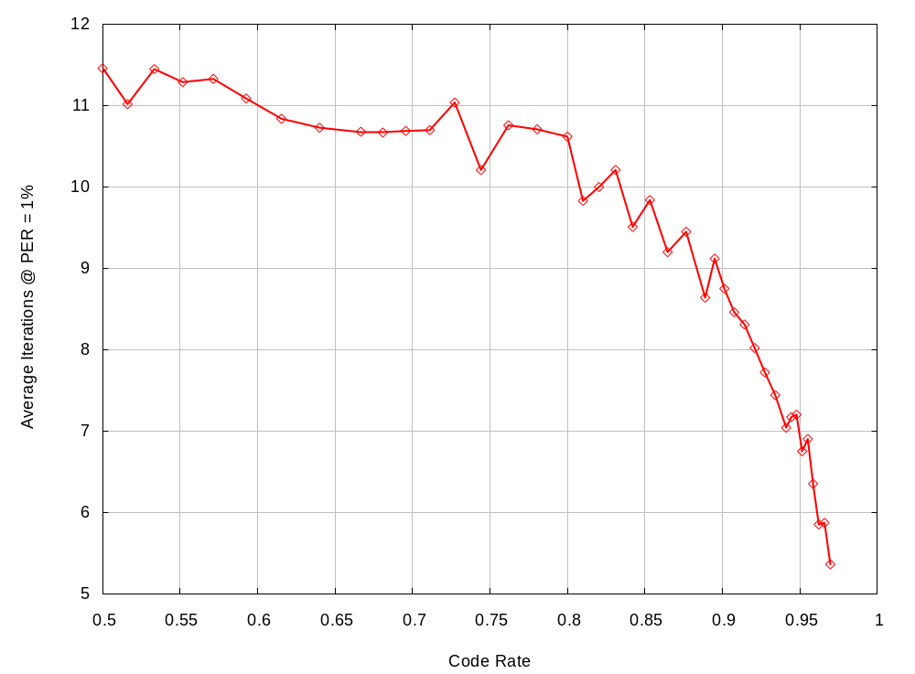
Higher Code Rates Converge Faster

Slide 35
Decoder Throughput
Structure of the code lends itself to low complexity, high speed decoding
We have used a baseline high speed architecture with a nominal degree of parallelism of P=1
  P=n throughput is n times higher, and complexity is n times greater
Plots for both throughput normalized to the system clock (bps per clk) and actual throughput with a number of system clock assumptions
Existing P=8 FPGA prototype
  System clock of 100 MHz
  Throughput is 300 Mbps @ 10 iterations
  Xilinx XC2V8000

Slide 36
Decoder Throughput – Bps/Clock
10
P = 1
P = 2
P = 4
8
P = 8
6
Decoder Throughput (bps per clock)
4
2
0
5
10
15
20
25
30
Iterations

Slide 37
Decoder Throughput – P=4 and P=8
600
P=4 f=100 MHz
P=8 f=100 MHz
500
P=4 f=150 MHz
P=8 f=150 MHz
P=4 f=200 MHz
P=8 f=200 MHz
400
P=4 f=250 MHz
P=8 f=250 MHz
P=4 f=300 MHz
Decoder Throughput (Mbps)
300
P=8 f=300 MHz
200
FPGA Prototype:
300 Mbps
100 MHz
Xilinx XC2V8000
100
10 iterations
0
5
10
15
20
25
30
Iterations

Slide 38
Decoder Latency
Decoder latency needs to be < ~6 μs
  Last bit in to first bit out
This can be achieved by a P=8 decoder with a 200 MHz clock
  12 iterations
  < ~2048 bit code words
With large MAC packets just ensure that final code word of packet is <2048 bits
As technology improves (higher clock or larger P) this minimum code word size can be increased

Slide 39
Decoder Latency (12 iterations)
20
P=4 f=100 MHz
P=8 f=100 MHz
P=4 f=150 MHz
P=8 f=150 MHz
15
P=4 f=200 MHz
P=8 f=200 MHz
P=4 f=250 MHz
P=8 f=250 MHz
P=4 f=300 MHz
Decoder Latency (us)
10
P=8 f=300 MHz
6 μs
5
0
0
1000
2000
3000
4000
5000
6000
7000
8000
Block Size

Slide 40
F-LDPC High Speed Implementation
Proven Technology
FPGA implementations of F-LDPC
  300 Mbps @ 10 iterations with 100 MHz clock
  Xilinx XC2V8000
ASIC implementation of FlexiCode
  A version of the F-LPDC with 4-state codes
  More complex than F-LDPC with more features
  BER of 10⁻¹⁰ in all modes
  196 Mbps @ 10 iterations with 125 MHz clock
  0.18 μm standard cell process

Slide 41
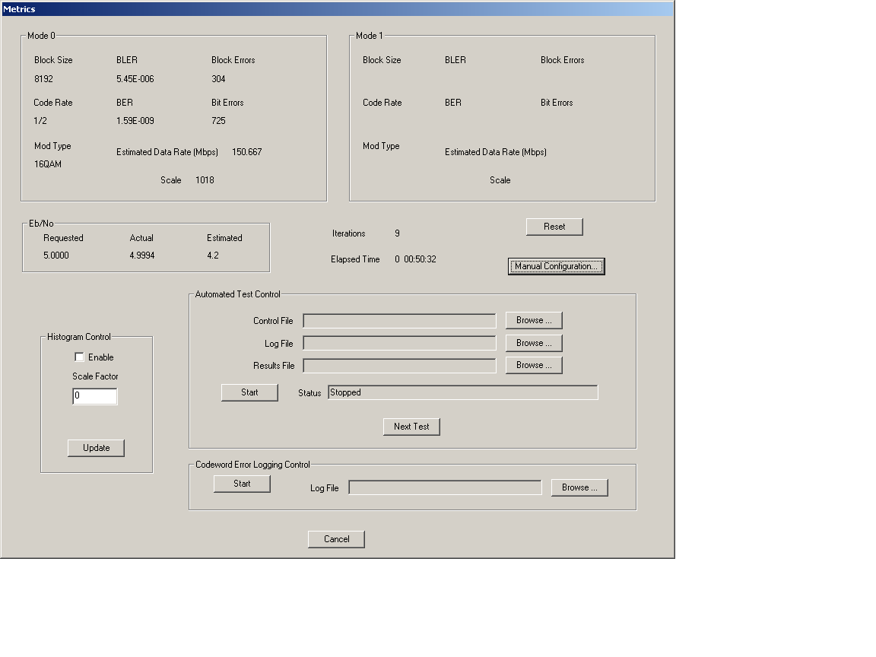
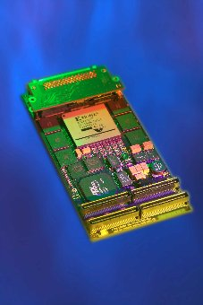
F-LDPC High Speed Implementation(2)

Slide 42
F-LDPC Examples for IEEE 802.11n
SVD-based MIMO-OFDM Example
  Assume perfect CSI at the Tx and Rx
  Adaptive power and rate allocation via a simple code-driven algorithm
  Greater than 300 Mbps demonstrated
V-BLAST Example
  No Tx-CSI
  MMSE interference suppression
  Independent application of TW’s F-LDPC code DLL by UCLA’s UnWiReD Lab. (Prof. Mike Fitz)
  Desired Packet error rates demonstrated

Slide 43
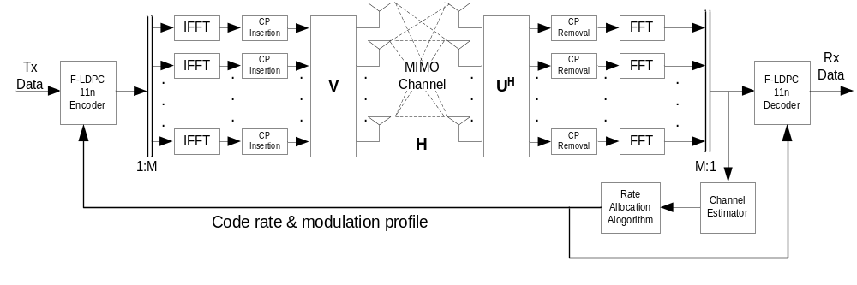
SVD-based Example
802.11n model

Slide 44
SVD-based Example: Power Allocation
Approaches Considered
  Space-Frequency Water-Filling (SFWF)
  “Constant Power Water-Filling (CPWF)” in Space and Frequency (Yu & Cioffi, 2003)
    Select a subset of subchannels to use and allocate power equally among these active subchannels
  “Code Driven CPWF” in Space and Frequency
    Compute the subchannel SNR assuming a constant power allocation across all subchannels
    If this is less than the minimum SNR supported by the FEC, do not use this subchannel (e.g., -2 dB for 8000 bit input blocks).
    Allocate power equally across subchannels used

Slide 45
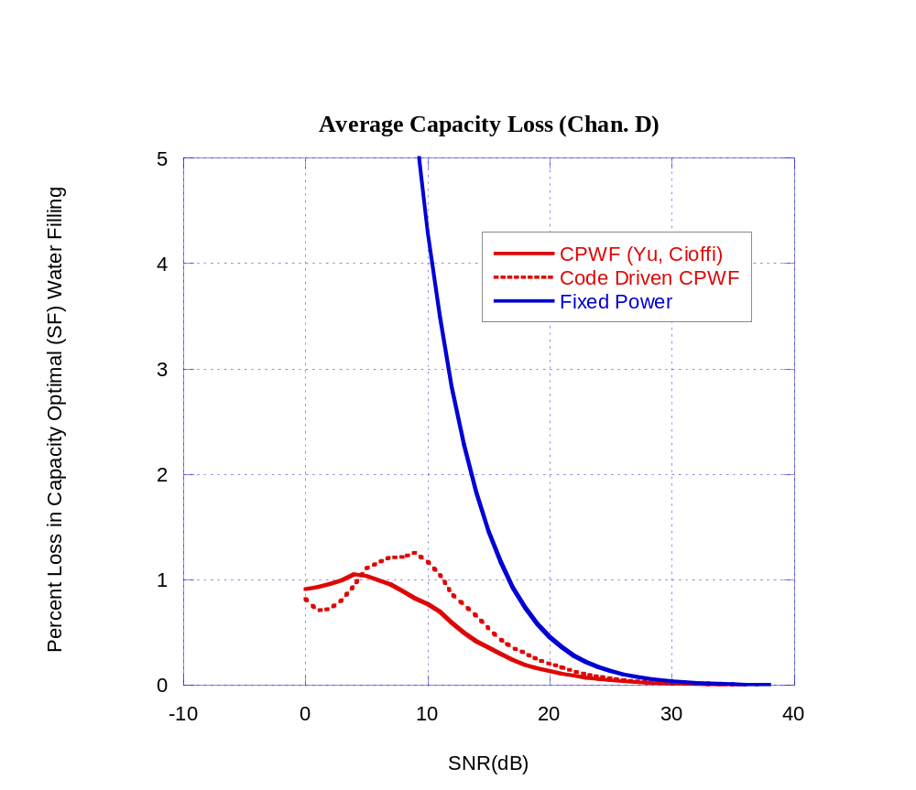
SVD-based Example: Power Allocation (2)

Slide 46
SVD-based Example: Rate Allocation
Given a set of subchannels with equal power assignments and known gain distribution
  1) Select modulation order (M) by FEC’s performance
  2) Compute AWGN channel capacity with Gaussian signals, with SNR degraded to account for finite block size, non-Gaussian signals, and imperfect FEC (=C)
  3) Compute channel bits carried by offered subchannels with given modulation assignments (=B)
  4) Select FEC code rate as r=C/B
Sets target information rate at the capacity plus the small code degradation
This requires a very flexible, uniformly good FEC solution

Slide 47
SVD-based Example: Rate Allocation (2)
K=8000 Input Bits
  1) Subchannel i: use SNR(i) to set M(i)
    SNR(i) <1.5 dB => BPSK
    1.5 dB<SNR(i) <6.6 dB => QPSK
    6.6 dB<SNR(i) <13 dB => 16QAM
    13 dB<SNR(i) <20 dB => 64QAM
    SNR(i) >20 dB => 256QAM
  2) FEC is ~2.9 dB from AWGN capacity
    C=Σ(log₂(1+SNR(i)*0.52))
  3) Channel bits available
    B= Σ (log₂(M(i))
  4) r= B/C

Slide 48
SVD-based Example: Performance
Channel was the IST project IST-2000-30148 I-METRA Matlab model (NLOS)
The following plots assume a 802.11a/g OFDM structure:
  64 sub-carriers/20 MHz sampling rate
  Same sub-carrier structure
  48 sub-carriers for data, 4 sub-carriers for pilot
  “DC” sub-carrier empty, 11 sub-carriers for guard band
  3.2 µs symbol, 800 ns cyclic prefix
  Both 8000 bit (best performance) and 2048 bit (low latency)
Rate and power allocation as described previously
Tests run with nominal SNR into the rate adaptation algorithm of 0, 5, 10, 15, 20, and 25 dB
Perfect synchronization and perfect CSI
Early stopping + buffer overflow protection enabled

Slide 49
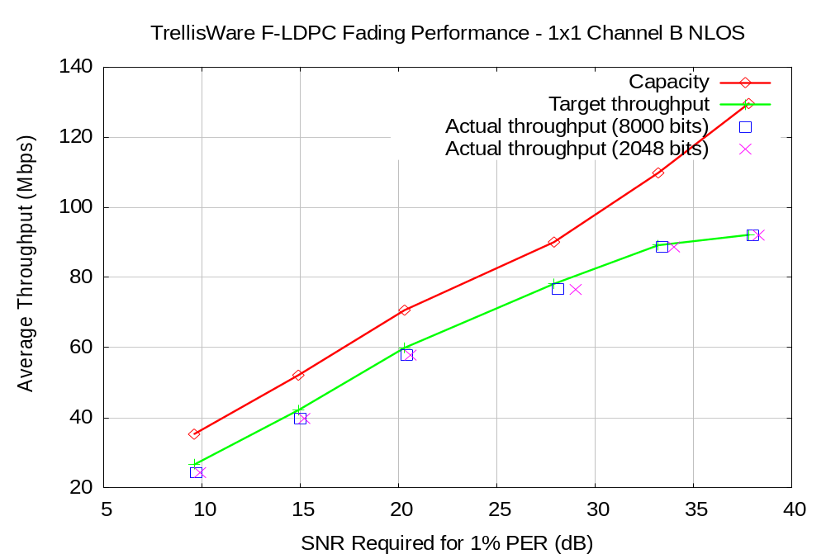
SVD –based Example: 1x1 Channel B

Slide 50
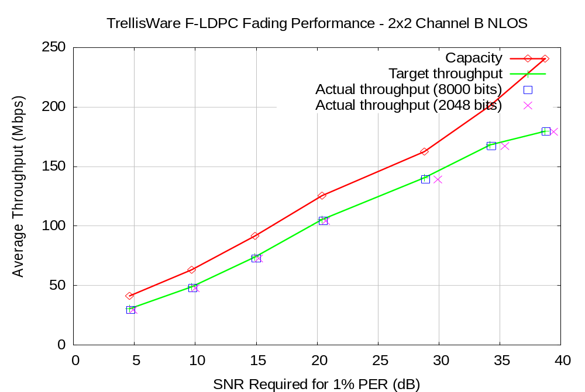
SVD –based Example: 2x2 Channel B

Slide 51
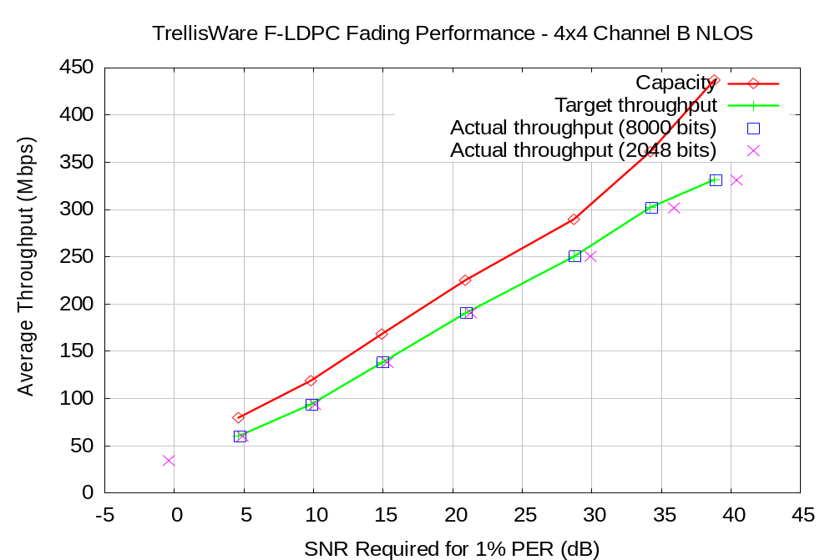
SVD –based Example: 4x4 Channel B

Slide 52

SVD –based Example: 1x1 Channel D

Slide 53
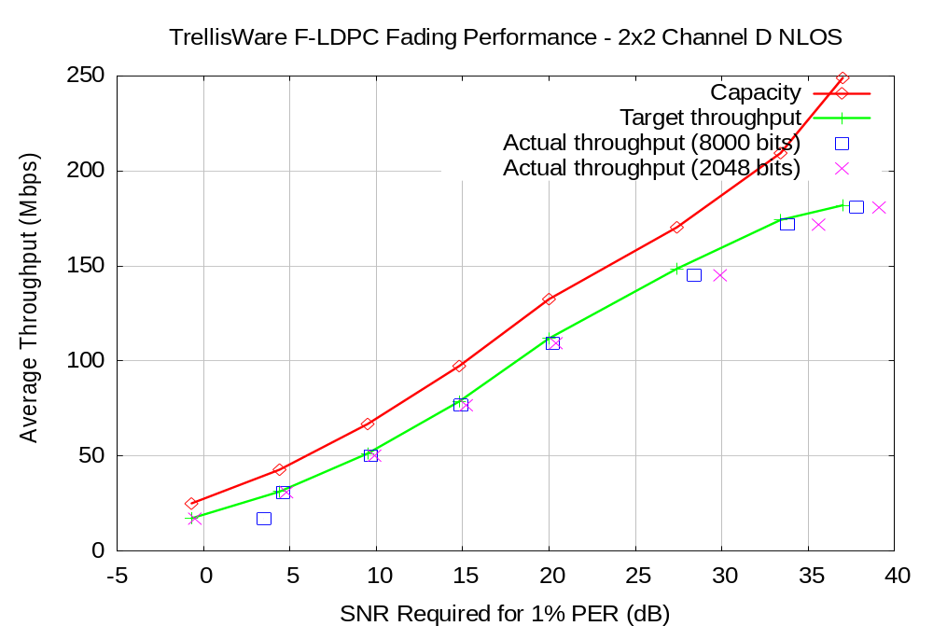
SVD –based Example: 2x2 Channel D

Slide 54
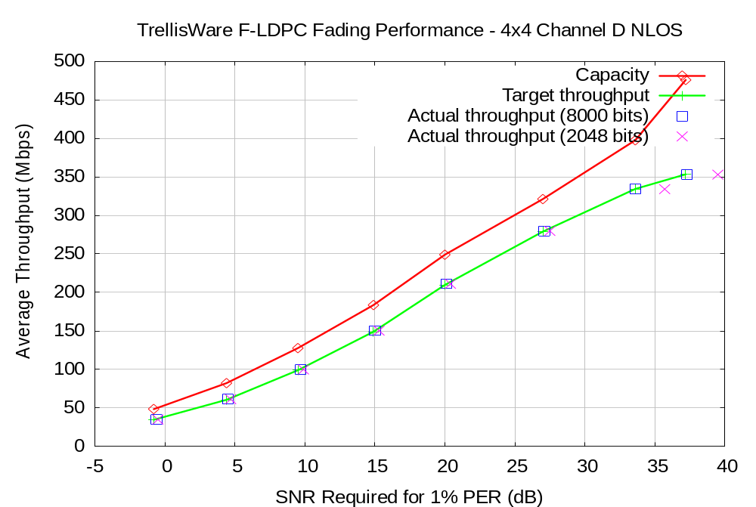
SVD –based Example: 4x4 Channel D

Slide 55
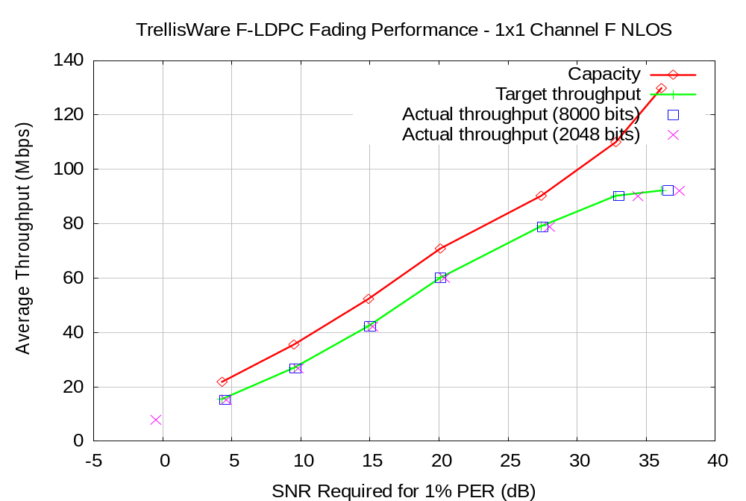
SVD –based Example: 1x1 Channel F

Slide 56

SVD –based Example: 2x2 Channel F

Slide 57
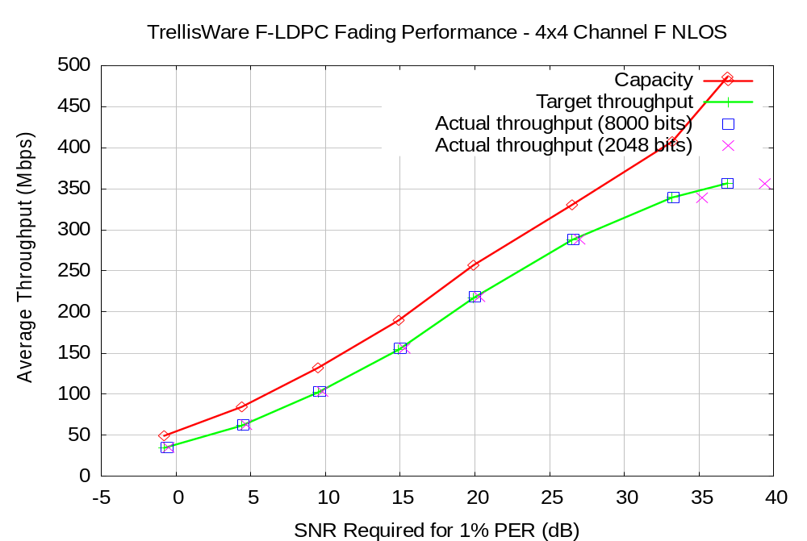
SVD –based Example: 4x4 Channel F

Slide 58
V-BLAST Example
The entire MIMO OFDM chain is implemented in ANSI C/C++
Use 802.11a PLCP for initial sync. & freq. tracking
Robust channel estimation is performed by special designed preamble structure using Pilot Symbol Assisted Modulation, PSAM
MMSE front detection and iterations on F-LDPC Decoder for both PCSI & PSAM scenario

Slide 59
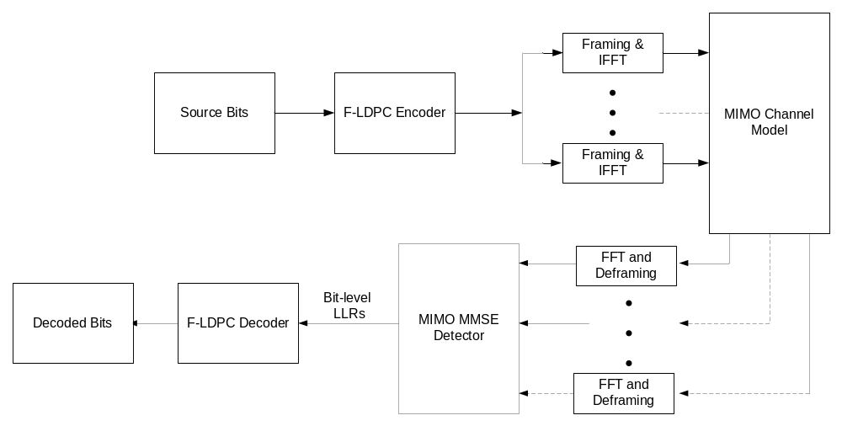
V-BLAST Example: Simulation Model

Slide 60
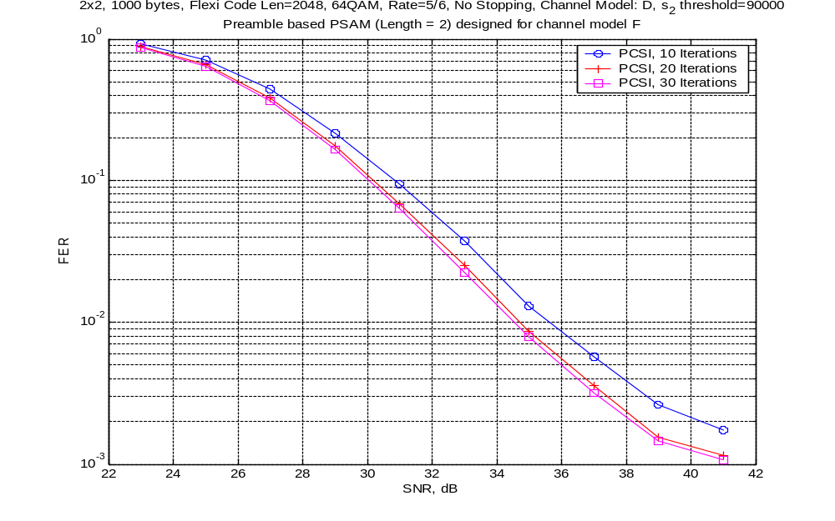

Slide 61
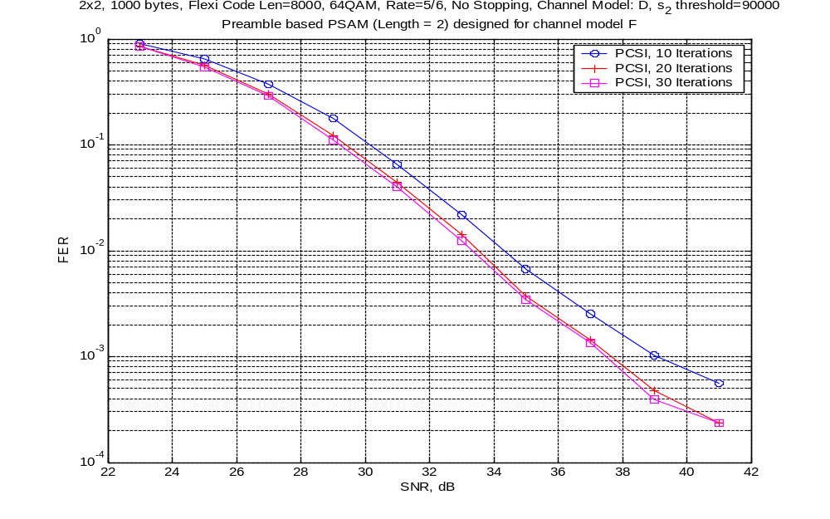

Slide 62
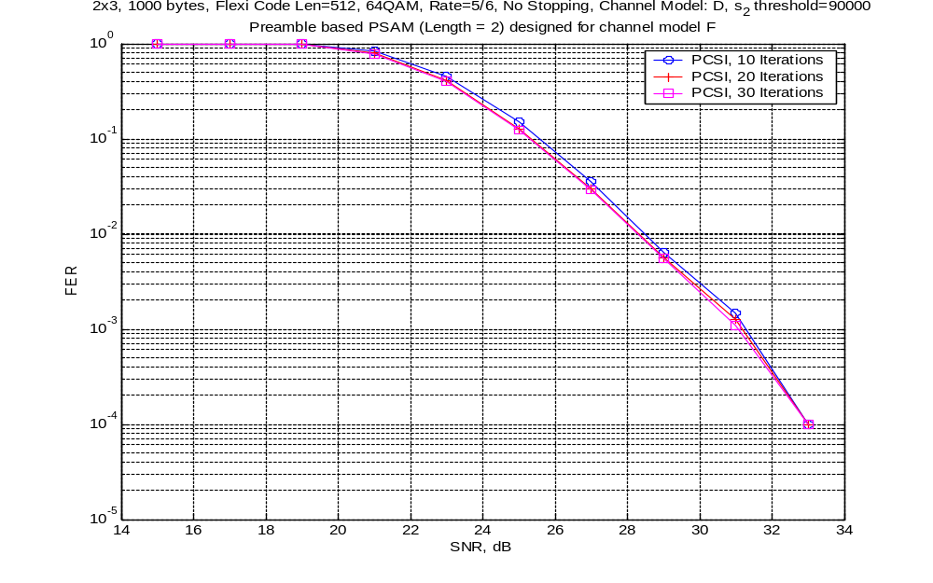

Slide 63
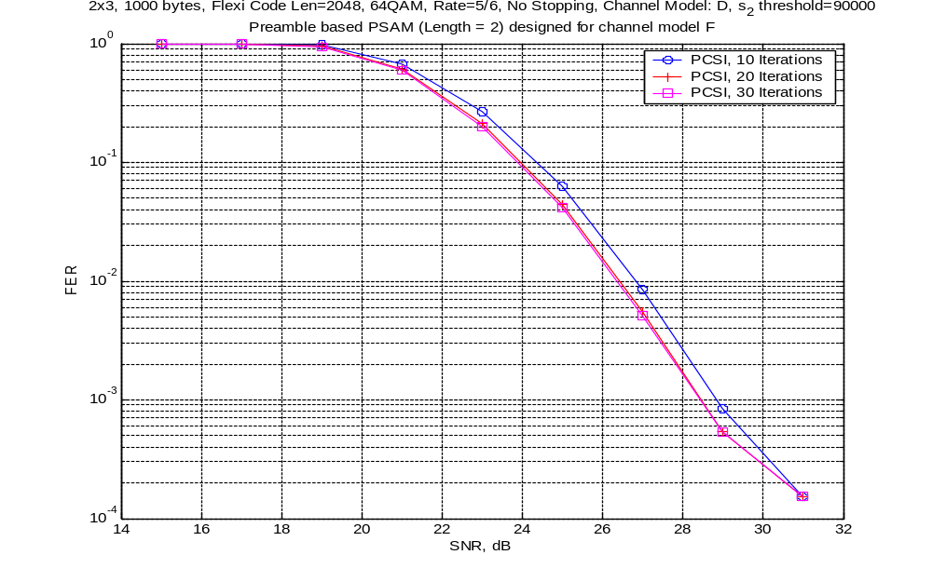

Slide 64
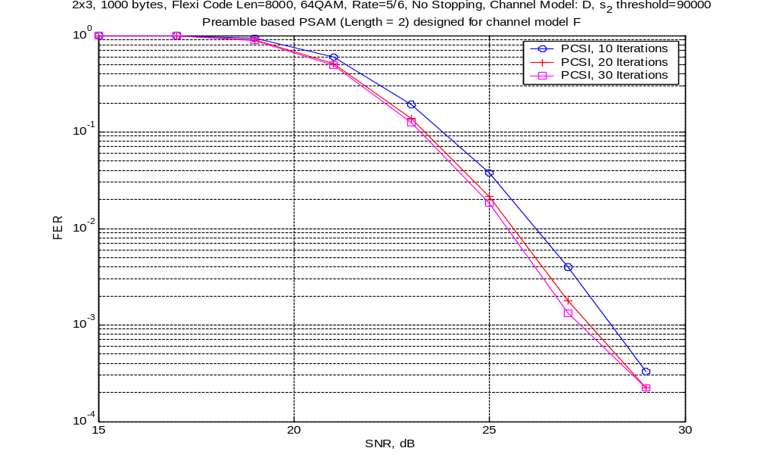

Slide 65
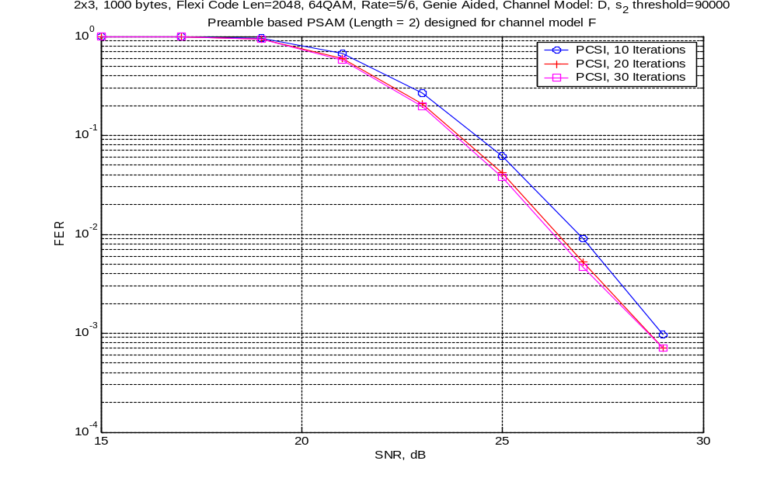

Slide 66
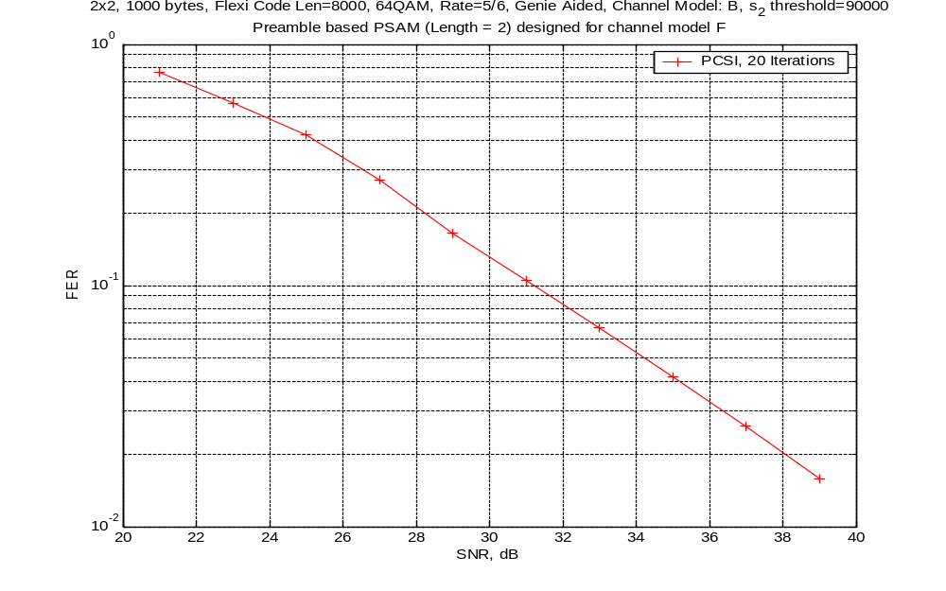

Slide 67
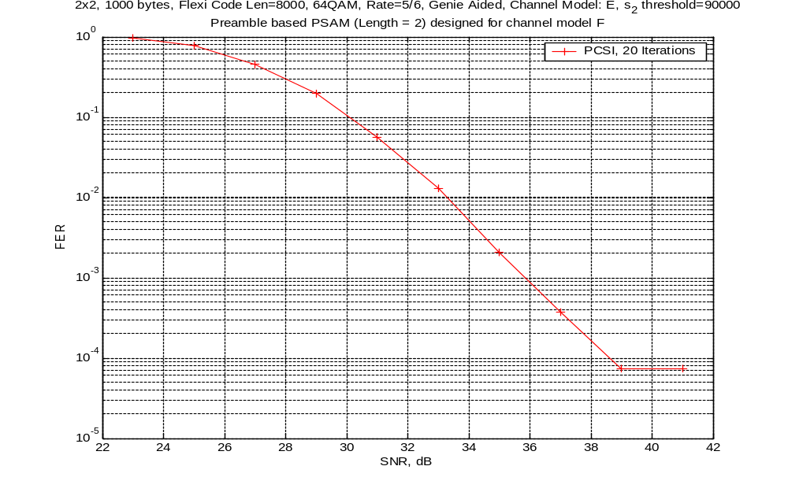

Slide 68
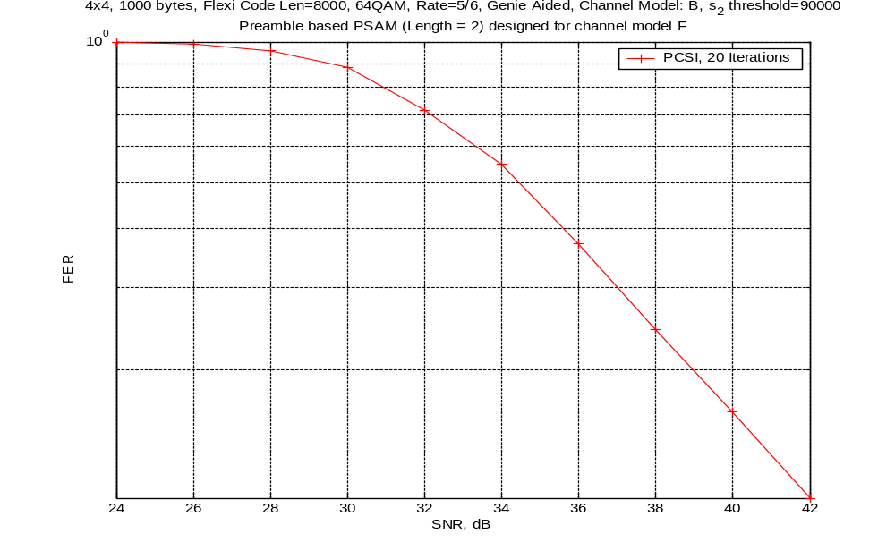

Slide 69
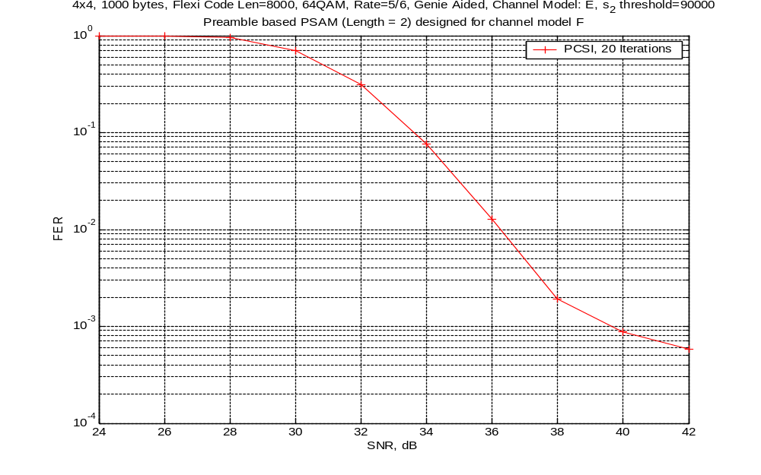

Slide 70
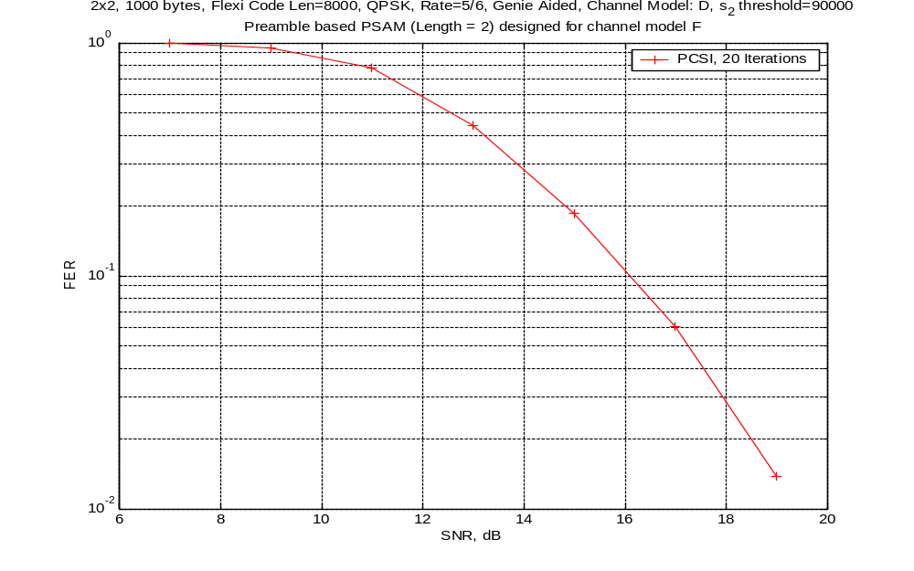

Slide 71
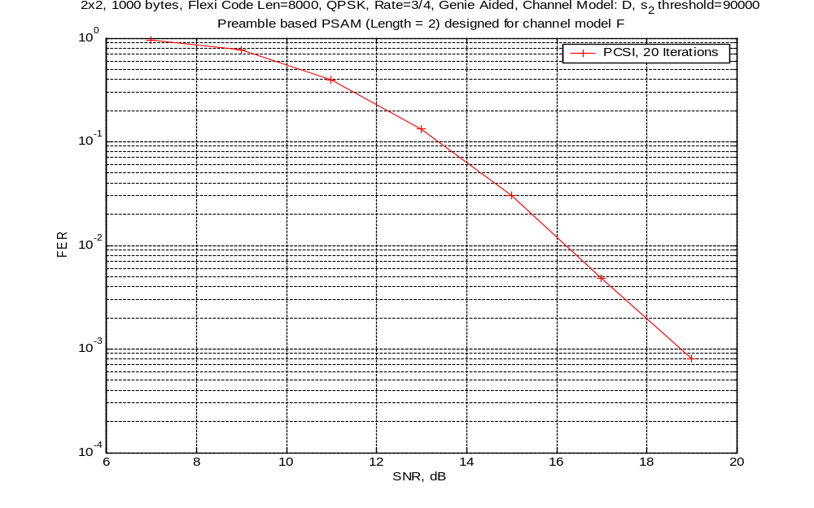

Slide 72
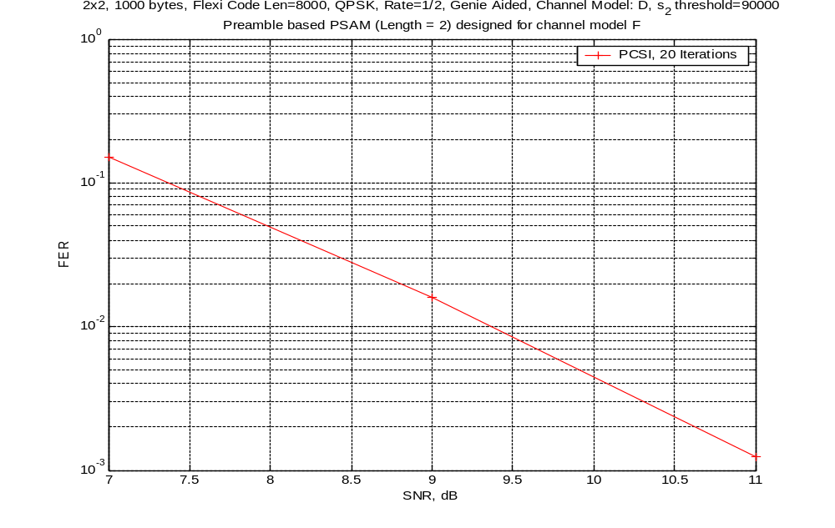

Slide 73
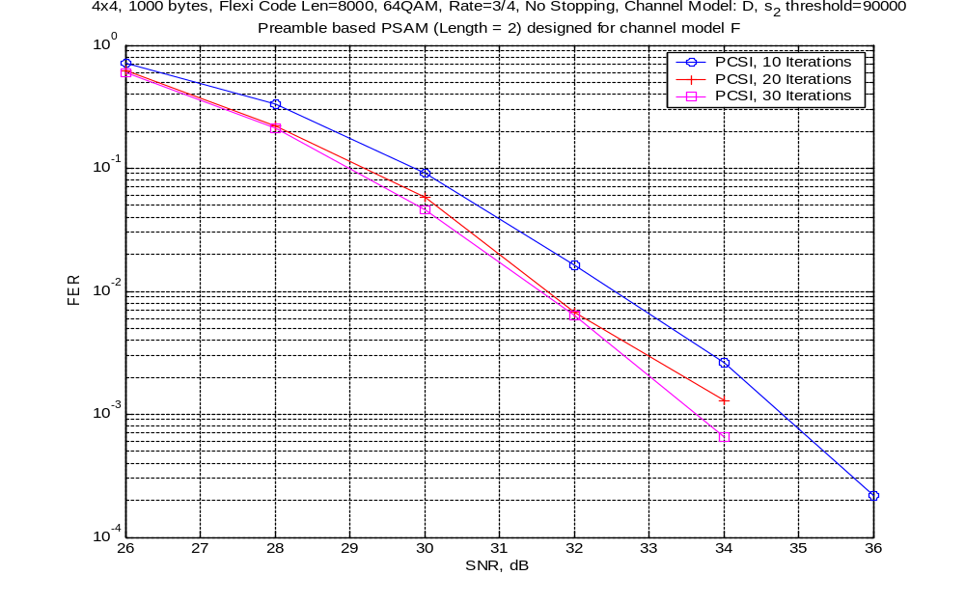

Slide 74
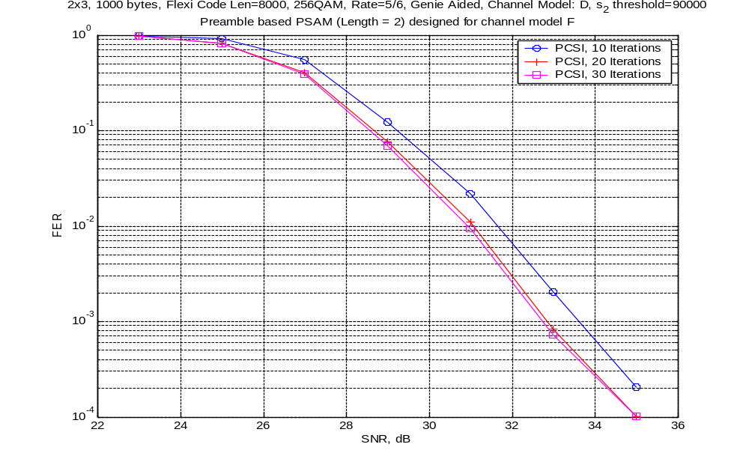

Slide 75
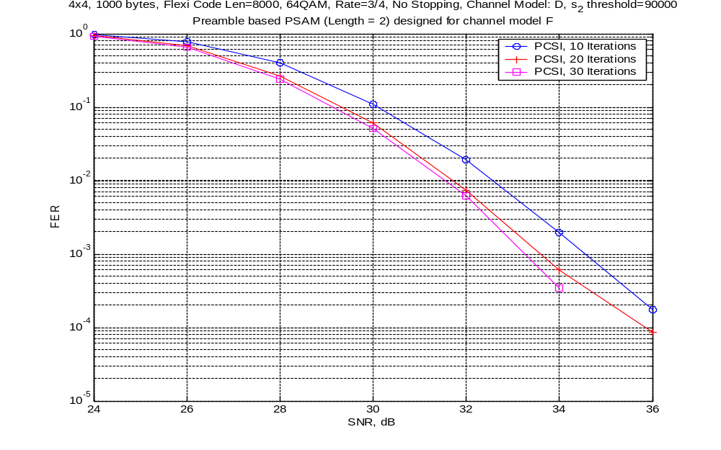

Slide 76
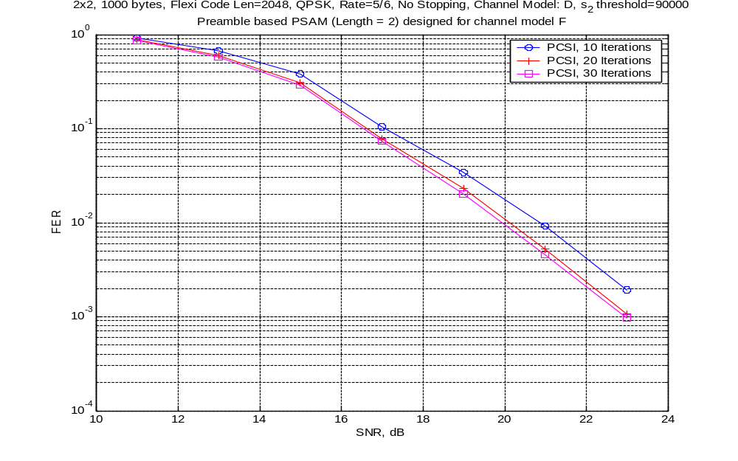

Slide 77
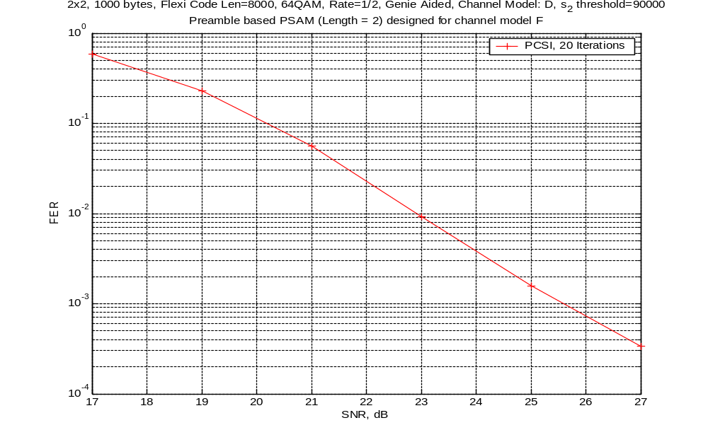

Slide 78
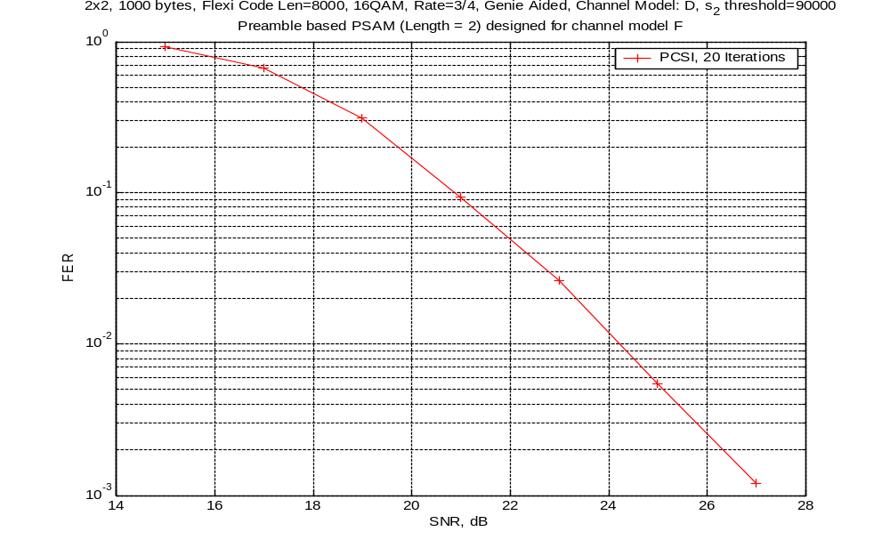

Slide 79
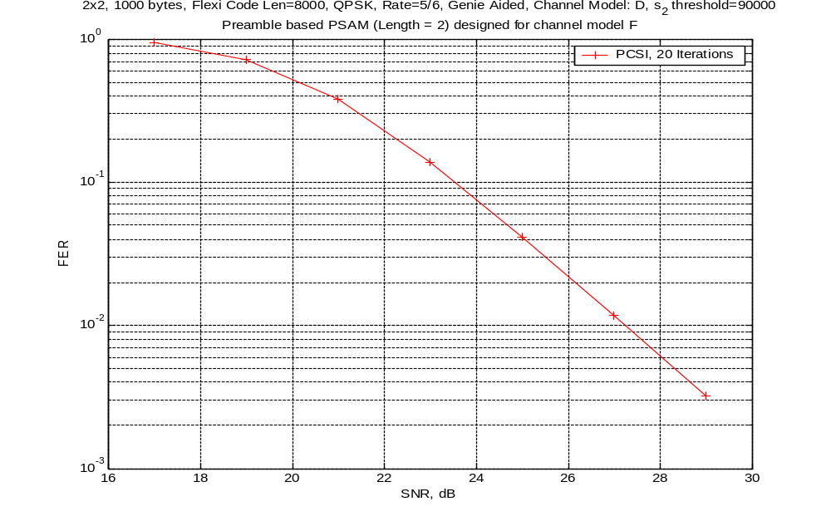

Slide 80
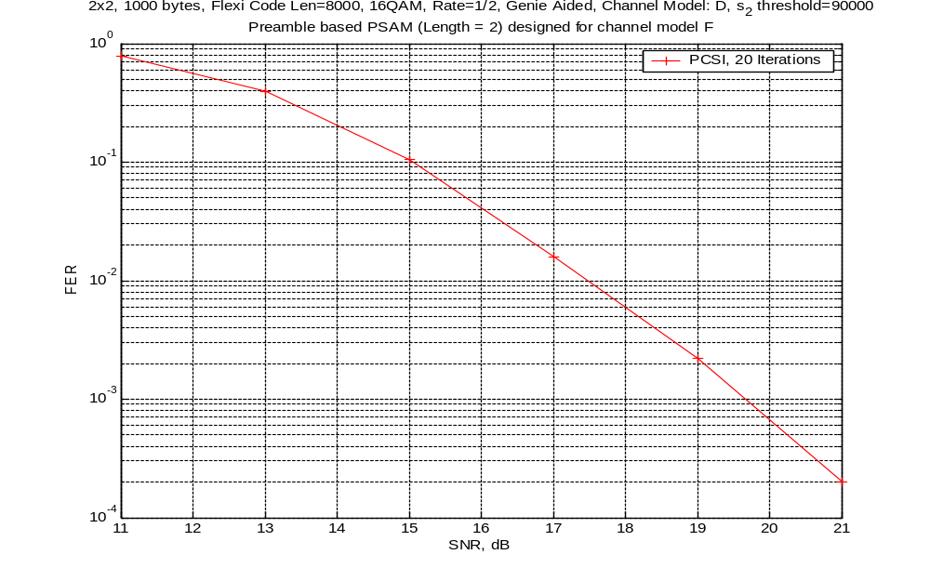

Slide 81
Conclusions: IEEE 802.11n FEC requirements well met by the F-LDPC
Frame size flexibility
  3 bytes – 1000 bytes in single byte increments
  Simplifies MAC interface & allows latency requirements to be met
Code rate flexibility
  ½ - 32/33 in 45 steps (~0.25 dB SNR steps)
  Maximizes throughput and minimizes pad bits
Good performance
  Operates within 1 dB of theory across entire range
High Speed
  Decoders can be easily built to operate 500+ Mbps
Proven Technology/Low Complexity
  300 Mbps FPGA-based decoders already built

Slide 82
Code Comparison
 | F-LDPC | Turbo | LDPC | Conv.
Frame Flexibility |  |  | ❒ | 
Rate Flexibility |  |  |  | 
Performance |  |  |  | ❒
High Speed |  |  | ⬧ | 
Complexity |  | ❒ |  | 
Proven |  |  | ⬧ | 

Slide 83
Appendix

Slide 84
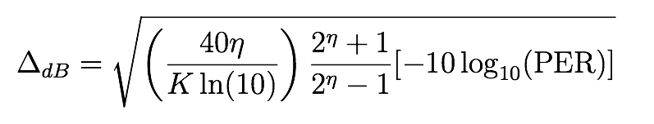
Finite Block Size Performance Bound
Random coding bound
Symmetric Information Rate w/ Sphere Packing Approximation
  SIR: mutual information rate with constellation constraint
  Sphere-packing penalty (Delta dB from SIR) [1]
SIR-SPBA and RCB yield nearly identical results
This is used to adjust rate allocation for different block sizes

Slide 85
References
[1] S. Dolinar, D. Divsalar, and F. Pollara, "Code Performance as a function of Block Size," JPL, TMO Progress Report 42-133.

