Slide 1
Flexible Coding for
802.11n MIMO Systems
Keith Chugg and Paul Gray
TrellisWare Technologies
Bob Ward
SciCom Inc.
kchugg@trellisware.com

Slide 2
Overview
FEC Requirements for IEEE 802.11n
Introduction to TrellisWare’s F-LDPC Codes
F-LDPC Turbo/LDPC dual interpretation
IEEE 802.11n PHY Layer FEC proposal
  Description
  Features
  Performance
  Complexity
Conclusions

Slide 3
FEC Requirements for IEEE 802.11n
There are a number of essential features that an FEC solution must possess to satisfy the requirements of IEEE 802.11n
Frame size flexibility
  Packets from MAC can be any number of bytes
  Packets may be only a few bytes in length
Code rate flexibility
  Need fine rate control to make efficient use of the available capacity
Good performance
  Need codes that can operate as close as possible to theory
High Speed
  Need decoders that can operate at 300-500 Mbps
Low Complexity
  Need to do all this without being excessively complex

Slide 4
FEC Requirements for IEEE 802.11n (2)
Benefits of flexibility in IEEE 802.11n:
  Allows one to future-proof the design – i.e., don’t let the FEC eliminate operational modes in the future
  Can hit best throughput that the channel allows
    maximize spectral efficiency
    Support various multiple antenna Tx/Rx strategies equally well
    Eliminate the need for stuff/padding to accommodate inflexible FEC
  Flexibility comes nearly for free with TrellisWare’s F-LDPC
Flexibility of the F-LDPC means that it can easily be configured to operate in 20 MHz or 40 MHz systems, or with any number of transmit and receive antennas

Slide 5
TrellisWare’s F-LDPC Codes
A Flexible-Low Density Parity Check Code (F-LDPC)
Serial concatenation of the following elements:
  Outer code: 2-state rate ½ non-recursive convolutional code
  Flexible algorithmic interleaver
  Single Parity Check (SPC) code
  Inner Code: 2-state rate 1 recursive convolutional code
  Systematic code overall
F-LDPC Encoder
P/S (2:1)
S/P (1:J)
input bits
SPC
parity bits
Outer
Code
…
Inner
Code
I
J bits wide
systematic bits

Slide 6
TrellisWare’s F-LDPC Codes (2)
Use of 2-state constituent codes means very low decoder complexity
  Outer code polynomials: (1+D, 1+D)
  Inner code polynomial: (1/(1+D))
  Outer code uses tail-biting termination
  Inner code is unterminated
For K-bit frames the interleaver is fixed at 2K bits, regardless of rate.
  Any good algorithmic interleaver will give frame size programmability down to bit level
SPC forms single-parity check of J bits.
  Different code rates are achieved by only varying J
  Code rate = J/(J+2)
  Inner code runs at 1/J fraction of speed of outer code

Slide 7
TrellisWare’s F-LDPC Codes (3)
The F-LDPC offers outstanding flexibility and performance
Code rate flexibility is achieved by simply varying the SPC J parameter
  Many different code rates are supported
  Good performance even for rates above 0.95
Frame size flexibility is achieved independently by changing the interleaver size
  Byte-level frame size programmability is simple
  Good performance even for frames as small as a few bytes
Performance is very close to finite block size performance bounds across a huge range of code rates and frame sizes
Unique features of code make it well suited to low complexity, high speed decoder architectures
  Can be decoded by either LDPC or Turbo code decoder architectures
  Similar logic complexity as typical LDPC decoders with less memory and faster convergence (and more flexibility)
Proven technology
  A number of F-LDPC variants have been implemented in FPGA
  A high speed ASIC is near completion that uses a 4-state variant of the F-LDPC called a FlexiCode (with 4-state codes floors are below 10⁻¹⁰ BER)

Slide 8
F-LDPC Duality Interpretations
Proposed code can be viewed as either
  Concatenation of two-state convolutional codes with a single-parity check (SPC) block code
  Punctured irregular-LDPC (IR-LDPC)
  IR-LDPC
Proposed code can be decoded using
  Forward-backward algorithm (BCJR) type SISO decoders (typically associated with concatenated convolutional codes)
  Parallel “check node” and “variable node” processors (typically associated with LDPC codes)

Slide 9
F-LDPC Duality Interpretations (2)
Performance is comparable to good IR-LDPC code
  Near best performance of best known codes over wide range of block sizes and code rates
Decoding complexity (measured by operation counts) is very low
  Similar to that of DVB-S2 IR-LDPC
  Significantly less that of an 8-state PCCC (e.g., 3GPPP)
LDPC and “turbo” architectures apply
  Third parties with good solutions for concatenated convolutional codes and LDPC codes can apply their technology
  Yields high degree of freedom for trade-off between parallelism, memory architectures, etc.

Slide 10
F-LDPC as Concatenated CCs
Encoder
P/S (2:1)
S/P (1:J)
K input bits
SPC
V=(2K)/J parity bits
1+D
…
1/(1+D)
1+D
I
Rate=J/(J+2)
J bits wide
“zig-zag” code
K systematic bits
Decoder (standard rules of iterative decoding)
Channel Metrics (LLRs)
for parity bits
>
<
0
Outer
SISO
I⁻¹
SPC
SISO
Inner
SISO
…
Hard decisions
I
J bits wide
“zig-zag” SISO
Channel Metrics (LLRs)
for systematic bits
Note: activation begins with outer code

Slide 11
F-LDPC as Punctured IR-LDPC
Recall: Encoder
c
Tc
PTc
e
1+D
SPC
p
I
…
1/(1+D)
b
1+D
(K x 1)
(K x 1)
(2K x 1)
J bits wide
“zig-zag” code
b
c = Gb
e = JPTc
e + Sp = 0
G: generator of outer (1+D) code (K x K)
S: “staircase” accumulator block (V x V)
T: repeat outer code bit twice (2K x K)
P: permutation of interleaver (2K x 2K)
J: SPC mapping (V x 2K )
p
V
S
JPT
0
c
= 0
K
0
I
G
b
V
K
K
Low Density Parity Check: Hc’ = 0

Slide 12
F-LDPC as Punctured IR-LDPC (2)
1 0 0 … 0 0 0
1 0 0 0 … 0 0 0
0 1 0 0 0 … 0 0
0 1 0 0 0 0 … 0
0 0 1 0 0 0 … 0
0 0 1 0 0 0 … 0
0 0 0 1 0 0 … 0
0 0 0 1 0 0 … 0
0 0 … 0 0 0 1 0
0 0 0 … 0 0 1 0
0 0 … 0 0 0 0 1
0 0 0 … 0 0 0 1
1 0 0 … 0 0 1
1 1 0 0 … 0 0 0
0 1 1 0 0 … 0 0
0 0 1 1 0 0 … 0
0 0 0 1 1 0 … 0
0 0 … 0 0 1 1 0
0 0 0 … 0 0 1 1
1 0 0 … 0 0 0
1 1 0 0 … 0 0 0
0 1 1 0 0 … 0 0
0 0 1 1 0 0 … 0
0 0 0 1 1 0 … 0
0 0 … 0 0 1 1 0
0 0 0 … 0 0 1 1
0 0 0 0 … 1 0 0
0 0 0 1 … 0 0 0
1 0 0 0 0 … 0 0
0 0 … 1 0 0 0 0
0 1 0 … 0 0 0 0
G =
S =
P =
T =
(pseudo-random permutation matrix)
(K x K)
(2K x 2K)
(V x V)
This element is 1 if outer code is tail-bit; 0 if unterminated
This element is 1 if outer code is tail-bit; 0 if unterminated
J
(2K x K)
1 1 … 1
0
1 1 … 1
J =
1 1 … 1
S
JPT
0
0
1 1 … 1
H =
…
0
I
G
1 1 … 1
(V x 2K)

Slide 13
F-LDPC as Punctured IR-LDPC (3)
Inner (zig-zag) code
Present if inner code it tail-bit
…
J
J
J
J
J
I/I⁻¹
2
2
2
2
2
…
Present if outer code it tail-bit
Outer code

Slide 14
F-LDPC as Punctured IR-LDPC (4)
K check nodes (from outer code); (dc=3)
V=(2K/J) check nodes (from inner code); (dc=J+2)
…
…
3
3
3
3
3
J+2
J+2
J+2
J+2
J+2
Structured Permutation
2
2
2
2
…
2
3
3
3
3
…
3
2
2
2
2
…
2
b: K Systematic Bits (dv=2)
c: K (hidden) bits (dv=3)
p: V=(2K/J) parity bits (dv=2)
dv | Frac. of 2K(1+1/J) total
2 | (J+2)/(2J+2)
3 | J/[2(J+1)] (hidden)
dc | Frac. of K(1+2/J) total
3 | J/ (J+2)
J+2 | 2/(J+2)
Note: this assumes inner and outer codes are tail-bit. If not, there will be a small difference as implied in the previous slides

Slide 15
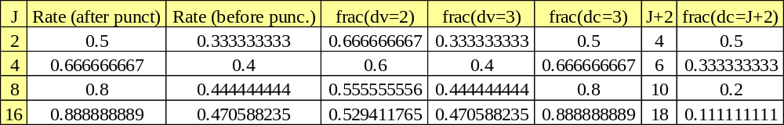
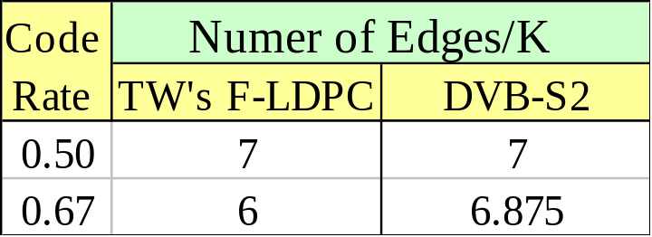
F-LDPC as Punctured IR-LDPC (5)
Example of degree distribution for various code rates
Complexity is roughly measured by number of edges in the parity check graph
  TW’s F-LDPC has edge complexity slightly less than the DVB-S2 IR-LDPC code

Slide 16
F-LDPC as Punctured IR-LDPC (6)
Decoder Activation schedules
  “Standard LDPC”: parallel variable-node, parallel check node
    Number of internal messages stored = number of edges (~7K)
  “Piecewise Parallel (green-red-blue)” schedule
    Number of internal messages stored (~2K)
  “Standard Concantenated Convolutional Code” schedule
    Same as discussed when interpreting F-LDPC as CCC
    Number of internal messages stored (~2K)
  Piecewise Parallel and Standard CCC exploit structure of the punctured IR-LDPC permutation

Slide 17
F-LDPC as Punctured IR-LDPC (7)
…
…
3
3
3
3
3
J+2
J+2
J+2
J+2
J+2
I/I⁻¹
2
2
2
2
…
2
3
3
3
3
…
3
2
2
2
2
…
2
  Structure of permutation enables potential memory savings and different high-speed decoding architectures

Slide 18
F-LDPC as Punctured IR-LDPC (8)
Standard LDPC schedule
1
2
1
2
1
2
1
2
1
2
1
2
Piecewise Parallel (green-red-blue) schedule
1
8
2
7
3
6
4
5
Standard CCC schedule (Outer SISO -> Inner SISO)
Outer SISO
Inner SISO

Slide 19
F-LDPC as Punctured IR-LDPC (9)
Schedule properties
  All are examples of the same standard iterative message-passing decoding rules with different activation schedules
  Each have the same computational complexity per iteration
  Iteration convergence, degree of parallelism,memory needs, etc. vary with schedule

Slide 20
F-LDPC as IR-LDPC
Possible to eliminate hidden variables
  Formulates the F-LDPC as in a standard IR-LDPC format
    i.e., N variable nodes, V=(N-K) check nodes
p
V
S
JPT
0
p
c
= 0
V
0
I
G
V
S
JPTG
=
K
b
b
K
V
K
K
V
K

Slide 21
F-LDPC as IR-LDPC (2)
Degree distribution
  For high-spread interleaver and K>>J
    V variable nodes with dv=2
    K variable nodes with dv=4
    All checks have dc=2J+2
      Example: r=1/2: 50% dv=2, 50% dv=4, dc=6
This form has many four-cycles
  Modified schedule or H-matrix transformations likely required for good performance based on this graphical model

Slide 22
IEEE 802.11n PHY Layer FEC Proposal

Slide 23
Proposal Description
A single, flexible encoder that is suitable for use in a variety of MIMO-OFDM systems
F-LDPC encoder is coupled with a simple puncture circuit for fine rate control, a bit channel interleaver, and a flexible mapper
Code rate and modulation profile can be tuned to maximize throughput
11n Encoder
output
symbols
P/S (2:1)
S/P (1:M)
input bits
systematic bits
F-LDPC
Encoder
Bit
Interleaver
Flexible
Mapper
I
Puncture
…
Q
parity bits

Slide 24
Proposal Description (2)
F-LDPC Encoder
  Code words of 3-1024 bytes
  Larger packets transmitted by concatenating multiple code words of near equal length (avoids small code words)
  5 Coarse rates of r = 1/2, 2/3, 4/5, 8/9, and 16/17
Puncture for fine rate control
  Needed for code rates between ½ and 2/3
  9 Fine rates of p = 16/16, 15/16,…., 8/16
  Overall rate of r/(r+p(1-r))
  45 code rates from 1/2 to 32/33
Interleaver
  Bit interleaving of a single code word
  A simple relative prime interleaver is used here (the size of this interleaver must be very flexible)
Flexible Mapper
  5 modulations of BPSK, QPSK, 16QAM, 64QAM, and 256QAM
  Gray mapping
  Bit-loading is easily supported

Slide 25
Rate Adaptation
A single encoder is recommended, regardless of the number of sub-carriers and the number of spatial channels.
A simple rate adaptation algorithm is used to determine the optimal code rate given the SNR profile of the channel, and to provide a modulation profile (bit loading)
The modulation can be the same on all sub-carriers, but better performance is achieved if the modulation is varied across sub-carriers and spatial channels
The fine code rate control can be used to eliminate or minimize pad bits. The code rate is decreased slightly to reduce the number of pad bits

Slide 26
Code Rate Flexibility
The following slides demonstrate the code rate flexibility of the F-LDPC
Firstly PER vs. SNR curves are shown for a range of code rates and modulation orders.
  AWGN channel
  8000 information bit code word length
  32 iterations (with early stopping 32 iteration performance can be achieved with considerably less iterations in practice)
1% PER can be achieved from -2 dB to 27 dB SNR in approximately 0.25 steps
Next the bandwidth efficiency is shown against SNR required to achieve a PER of 1%, for the full range of code rate, modulation types, and frame sizes (from 128 to 8000 information bits)

Slide 27
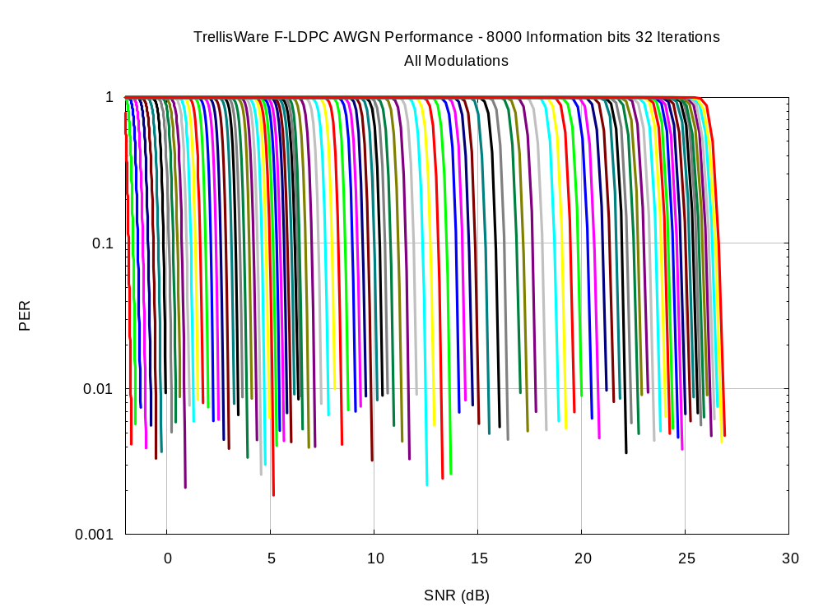
Rate 1/2 BPSK – 32/33 256QAM

Slide 28
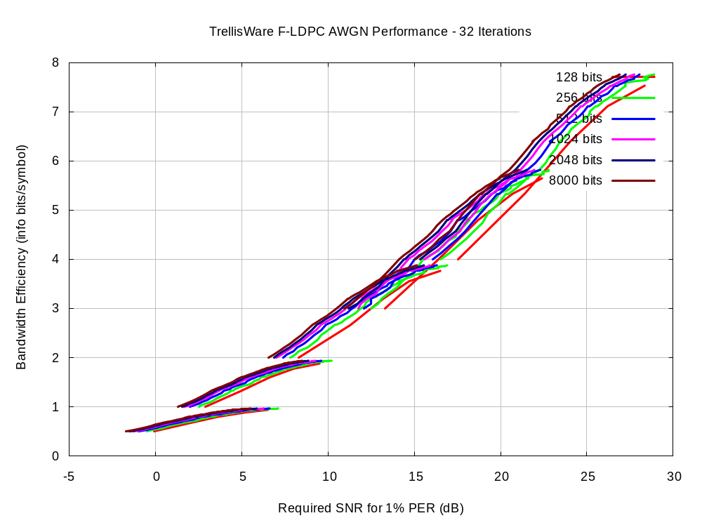
Rate 1/2 - 32/33

Slide 29
Frame Size Flexibility
The following slides demonstrate the frame size flexibility
The coding and modulation is fixed at rate 4/5 16QAM
Firstly PER vs. SNR curves are shown for a range of frame sizes from 8 to 1000 bytes
  AWGN channel
  8000 information bit code word length
  32 iterations (with early stopping 32 iteration performance can be achieved with considerably less iterations in practice)
Next the SNR required to achieve a PER of 1% is shown against frame size
  Both automated search and hand tuned interleaver parameters are shown. It is expected that performance matching that of the hand tuned parameters will be achieved everywhere eventually
  The finite block size performance bound is also plotted, showing that the automated search parameters are within 1 dB of this bound, and the hand tuned parameters are with 0.75 dB (see the performance section for a description of this bound)

Slide 30
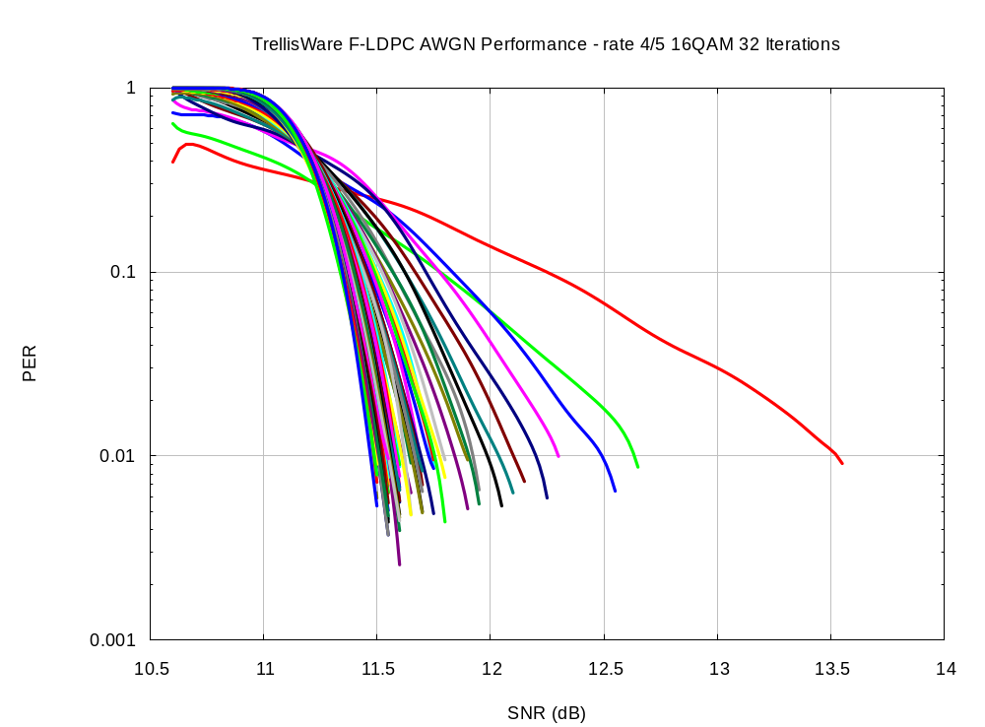
1000 bytes
8 bytes
Frame Size

Slide 31
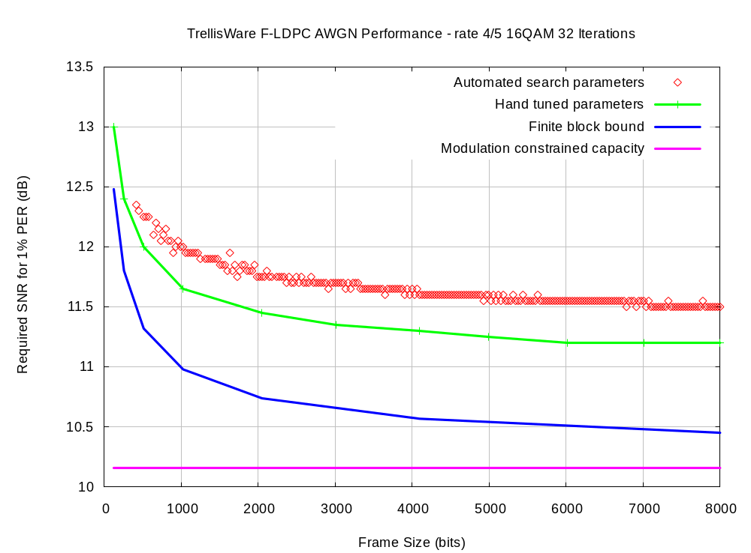

Slide 32
Early Stopping
F-LDPC codes can use early-stopping to reduce the average number of iterations and increase the data throughput
  The hard decisions from the outer code are re-encoded and compared to hard decisions of the extrinsic information from the outer code
  If all bits in a codeword agree then no more iterations are performed
  More iterations can be performed when needed
  Requires a larger input buffer and flow-control algorithm to avoid buffer overflow
The following plot shows that the performance with early stopping is almost as good as that with 32 iterations
  Flow control algorithm active with early stopping results
  50% larger input buffer is assumed
The next plot shows the average throughput as a function of required SNR for a 1% PER, for a range of modulation schemes and code rates
  With early stopping the average number of iterations is less than 12
  Note also that the average number of iterations reduces dramatically as the code rate increases
With early stopping we can achieve 32 iteration performance from a decoder capable of an average of less than 12 iterations

Slide 33
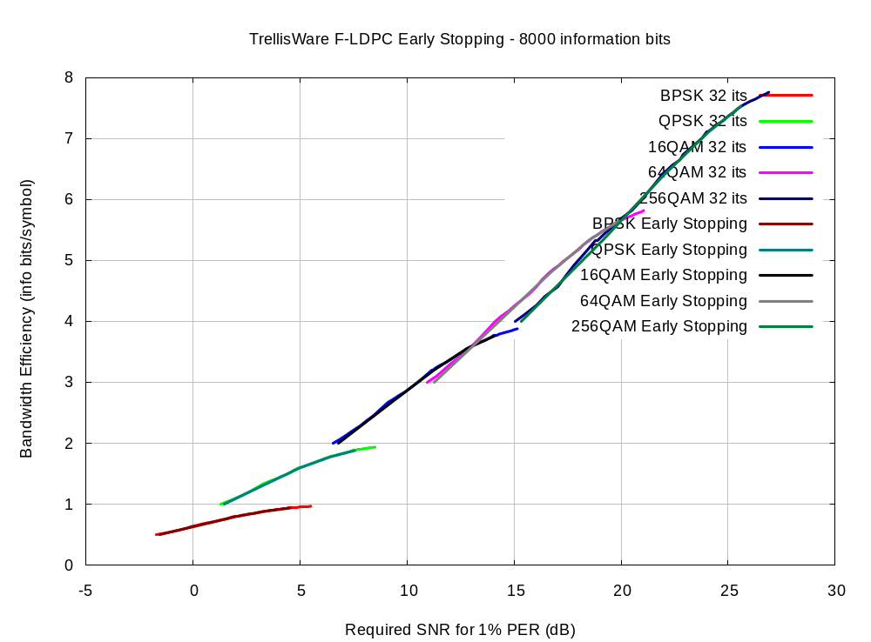

Slide 34
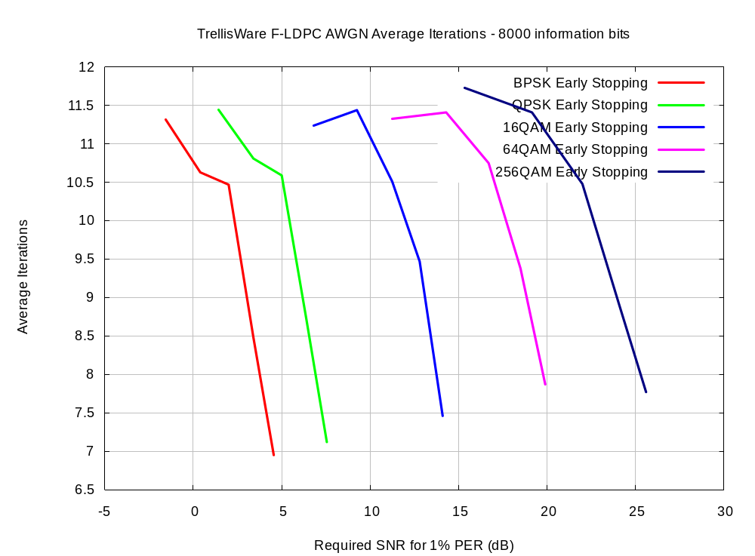
1/2
2/3
4/5
8/9

Slide 35
Finite Block Size Performance Bound
Useful to compare results to finite block size performance bound
We use a symmetric information rate (SIR) and sphere packing bound approximation with a constellation constraint (equation (11) from [1])
This gives an Eb/No penalty (in dB) for a finite input block size. This is a function of rate, target PER, and input block size.
Dolinar, et. al. demonstrate that this penalty approximation is accurate for no modulation constraint for most cases of interest.
We observed that this is true relative to constrained constellations as well. Specifically, adding this penalty to the min. Eb/No(dB) predicted by the SIR yields performance limits that are useful.

Slide 36
AWGN Performance
The following plot shows AWGN performance with an 8000 information bit code word for a range of code rates and modulation types.
32 iterations are shown, but with early stopping 32 iteration performance can be achieved with an average of less than 12 iterations
All results are for max-log MAP decoding
Also shown are the finite block size bounds and capacity
Performance is very good compared to bound
  Except for low code rate, higher order modulation schemes
  This could be improved by iterating the soft-demapper, but this would increase the complexity significantly
This plot also demonstrated the fine code rate granularity possible

Slide 37
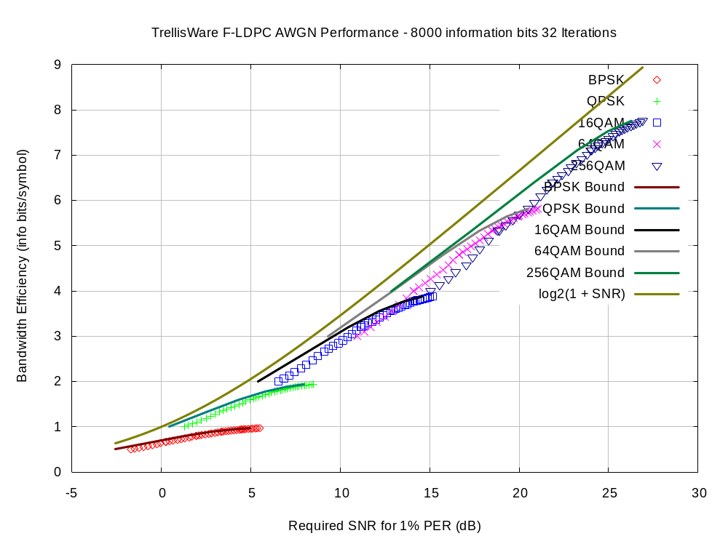

Slide 38
Non-AWGN Performance
Non-AWGN results were generated using SVD with perfect channel information
Channel was the IST project IST-2000-30148 I-METRA Matlab model
The following plots assume a 801.11a/g OFDM structure:
  64 sub-carriers/20 MHz sampling rate
  Same sub-carrier structure
  48 sub-carriers for data, 4 sub-carriers for pilot
  “DC” sub-carrier empty, 11 sub-carriers for guard band
  3.2 µs symbol, 800 ns cyclic prefix
Bit-loading of each sub-carrier is performed, with the rate adaptation algorithm determining the code rate and modulation profile
Tests run with nominal SNR into the rate adaptation algorithm of 0, 5, 10, 15, 20, and 25 dB

Slide 39
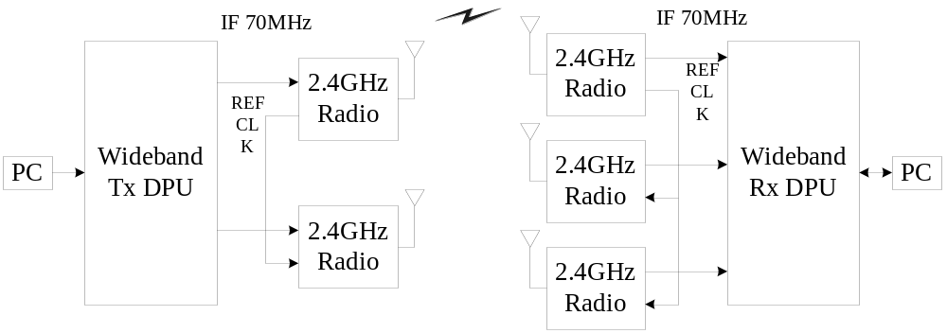
Well suited to MIMO Environment
FLDPC
  Facilitates variable length packet transmissions, with same byte level resolution as viterbi coded systems
  Consistent performance across wide variety of code rates
  Supports increased capacity operation with single encoder achitecture adapting across multiple MIMO channels
  Applied in 802.11n modelled environment as well UCLA testbed demonstrating these principles with excellent performance
UCLA

Slide 40
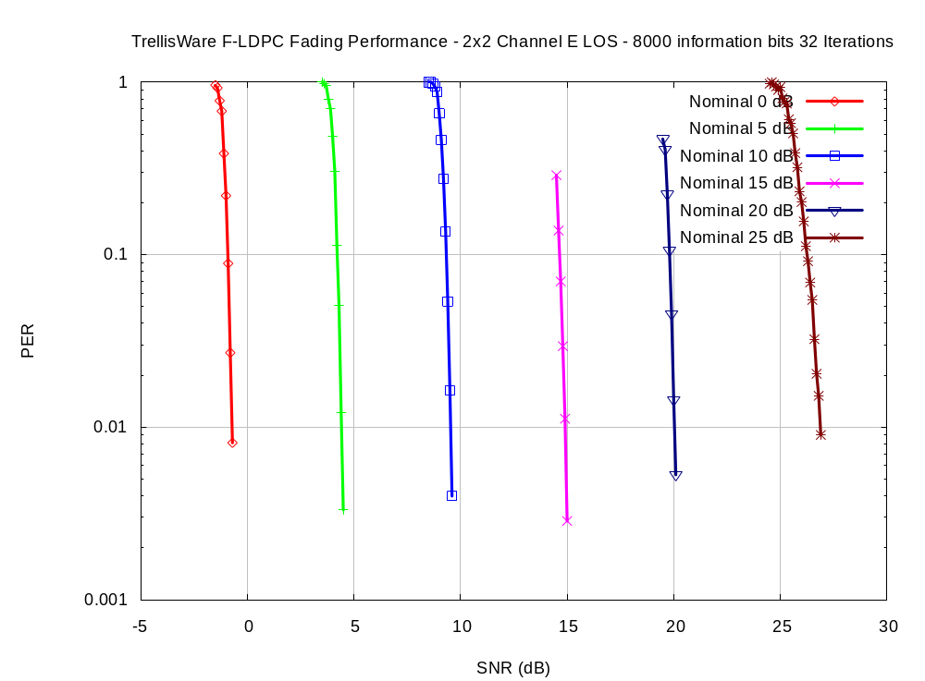

Slide 41
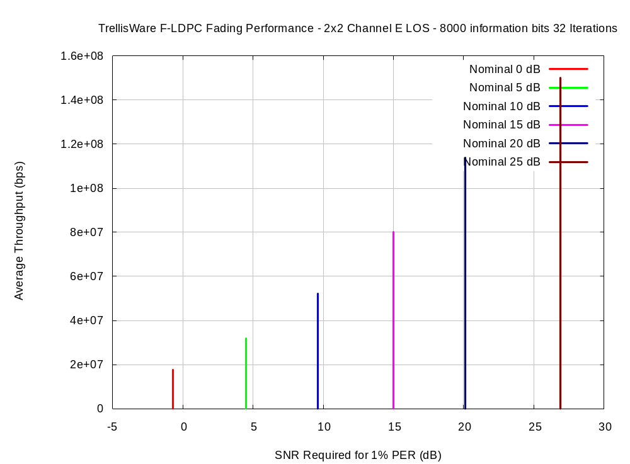

Slide 42
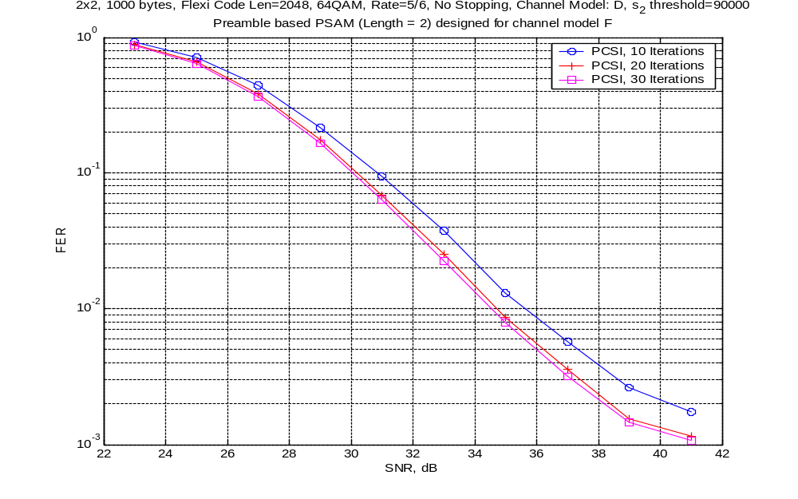

Slide 43
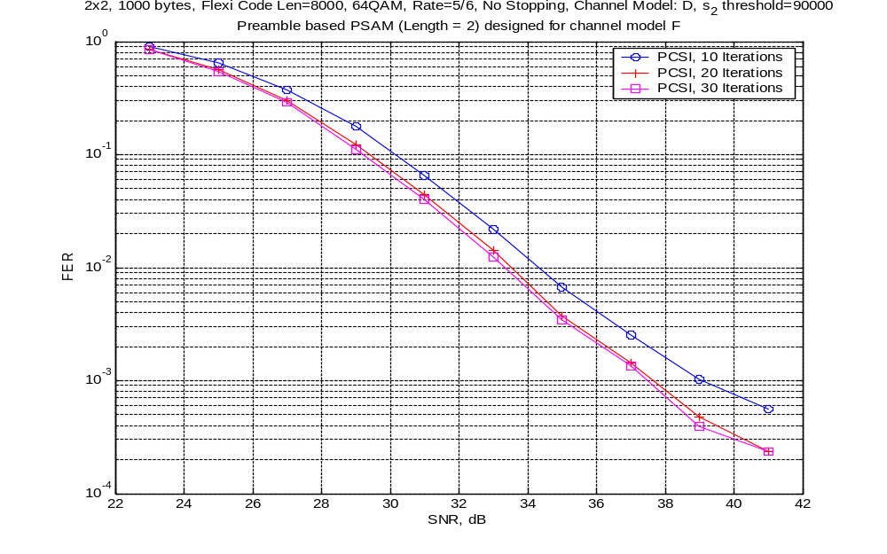

Slide 44
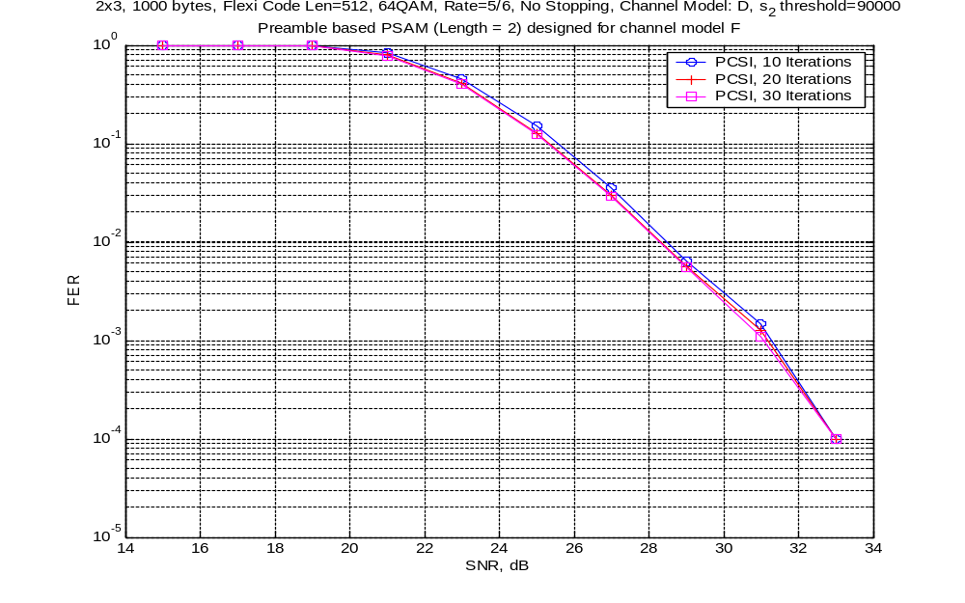

Slide 45
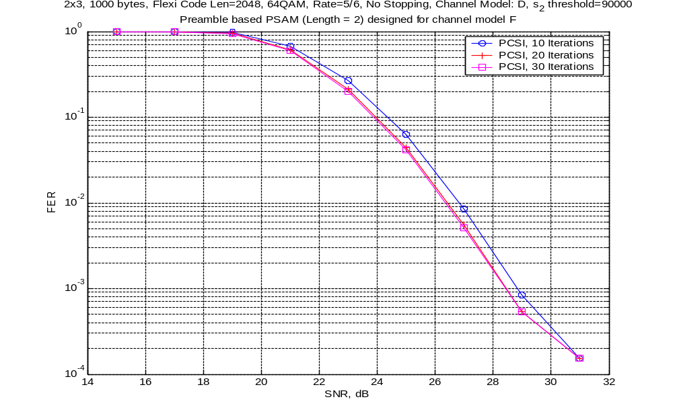

Slide 46
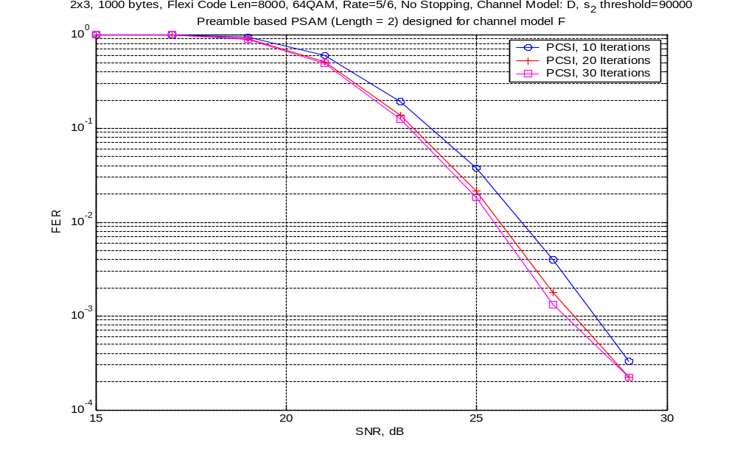

Slide 47
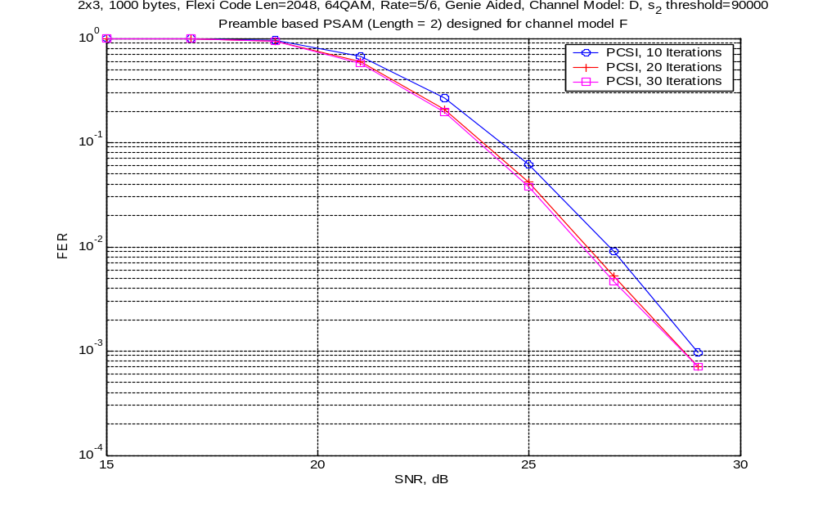

Slide 48
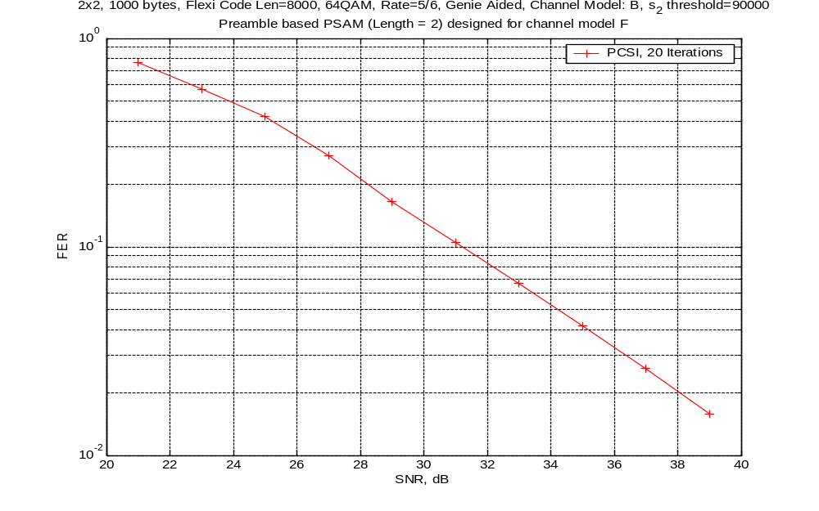

Slide 49
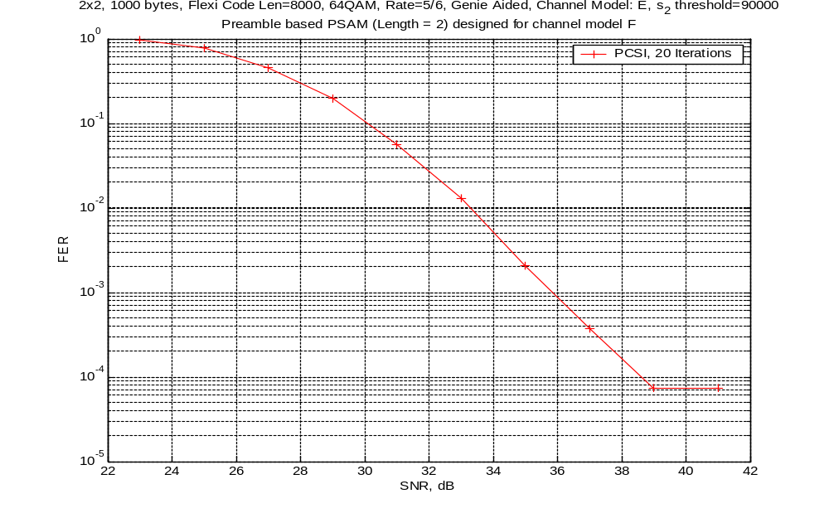

Slide 50
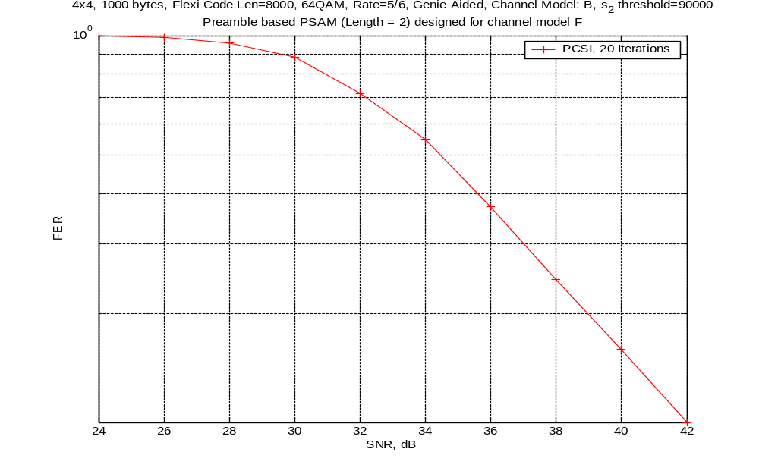

Slide 51
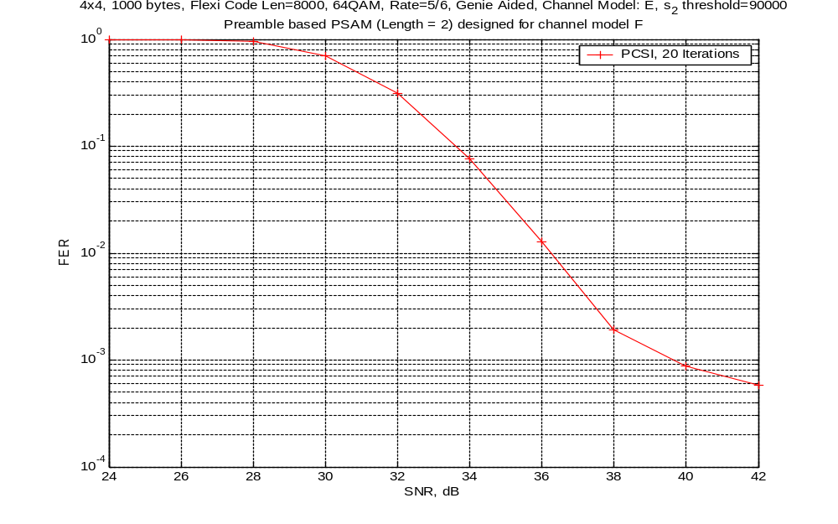

Slide 52
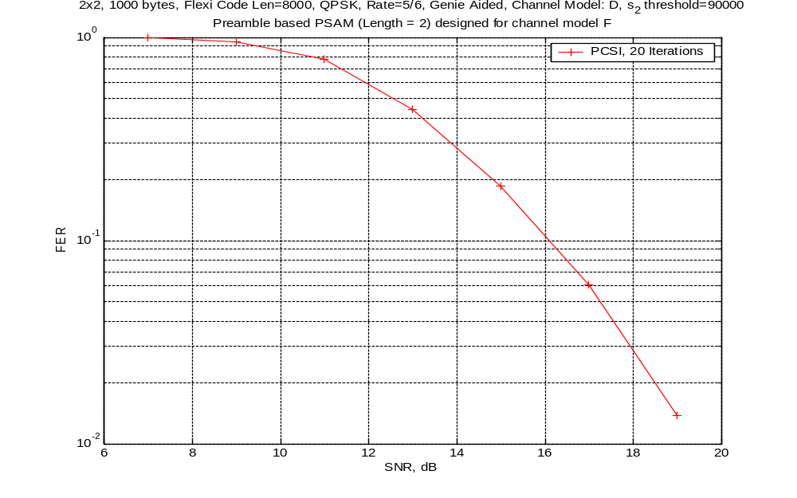

Slide 53
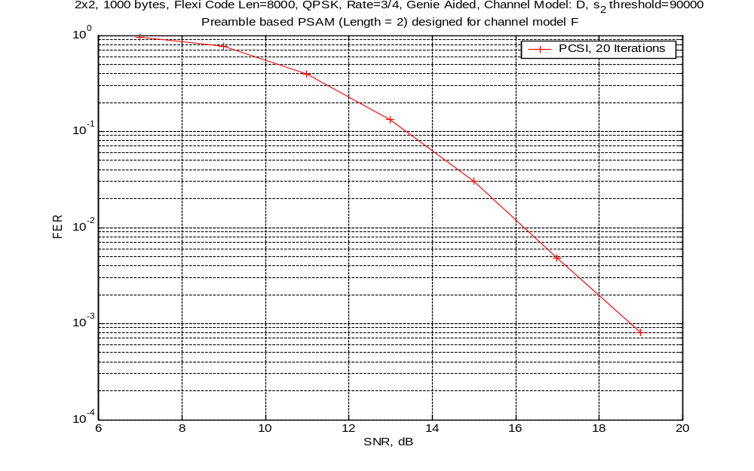

Slide 54
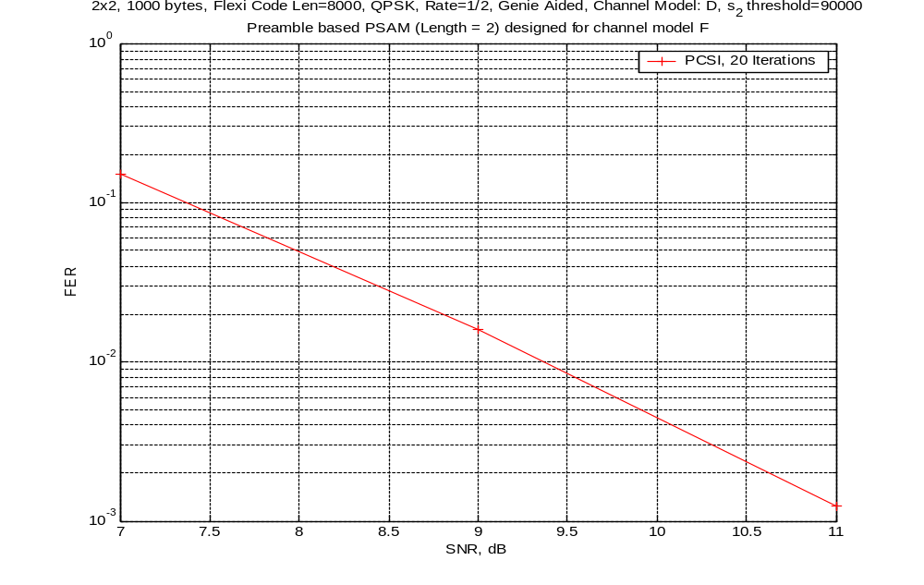

Slide 55
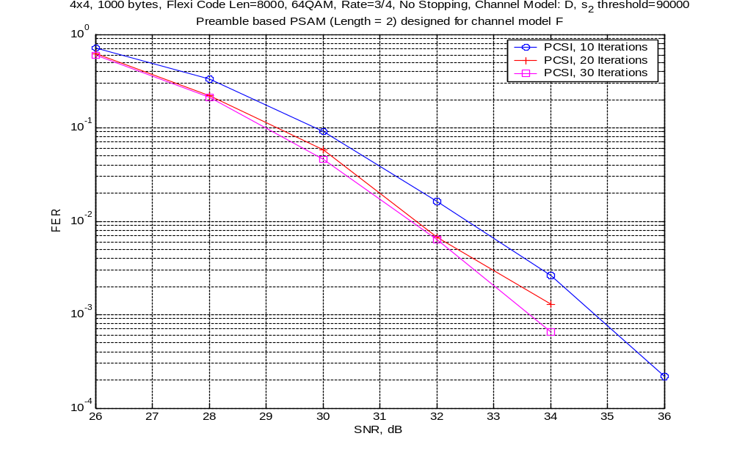

Slide 56
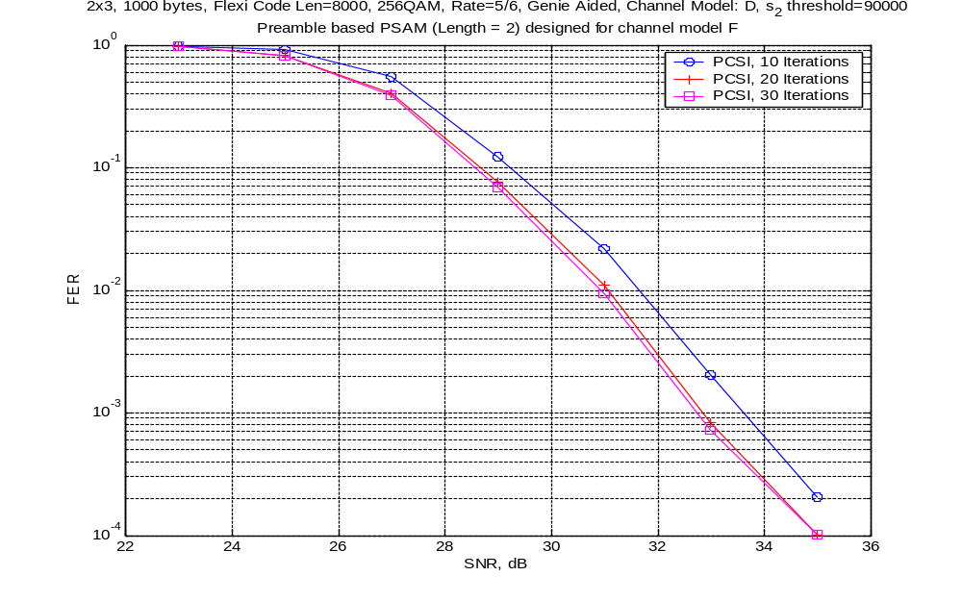

Slide 57
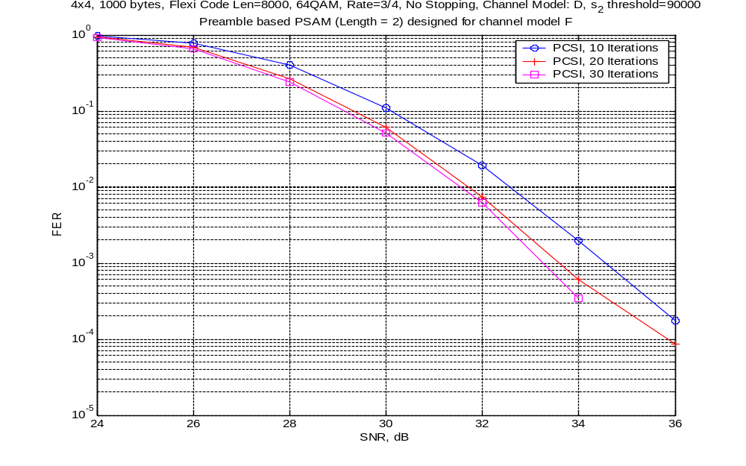

Slide 58
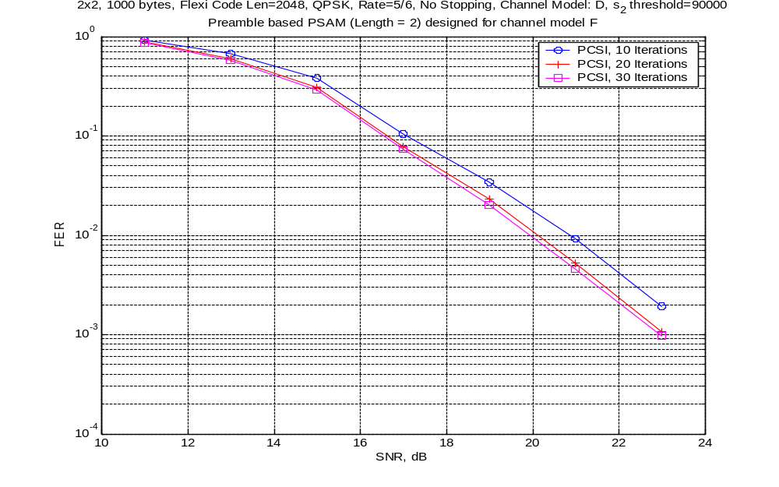

Slide 59
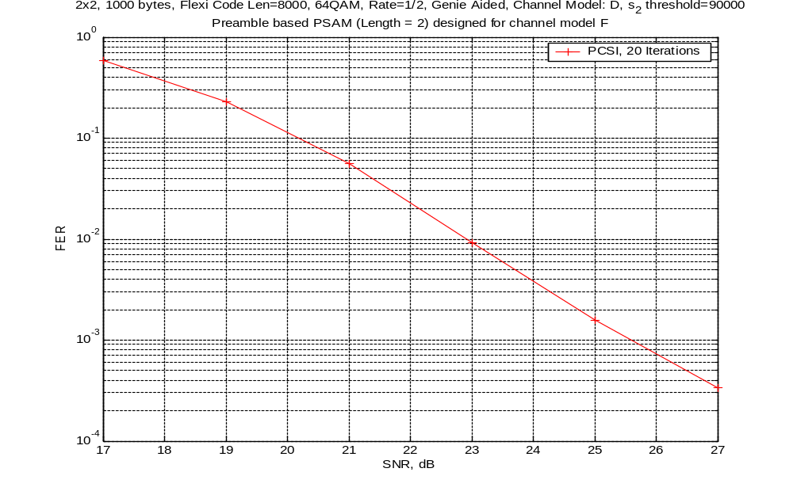

Slide 60
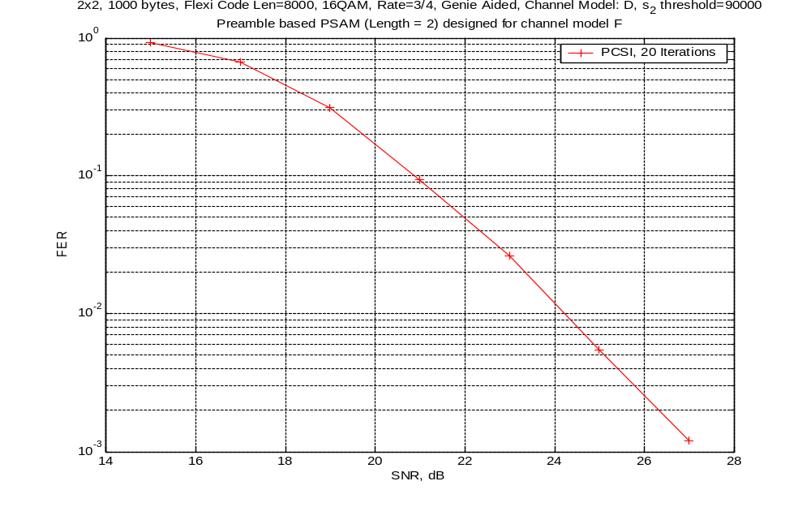

Slide 61
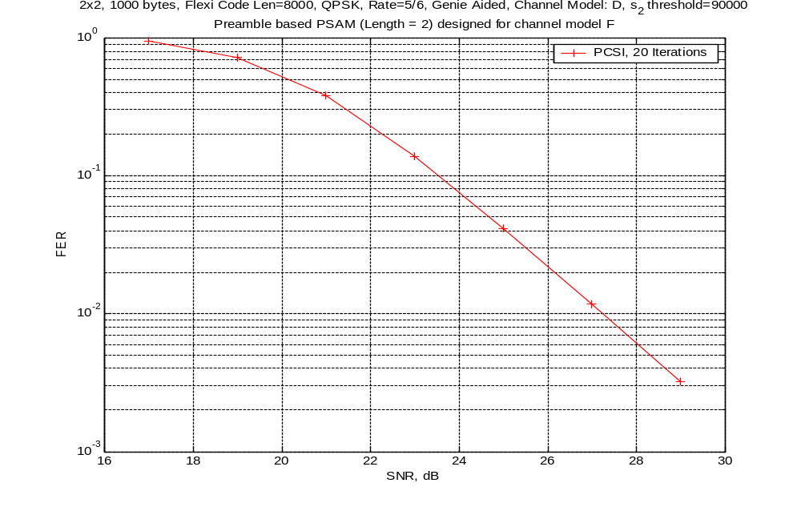

Slide 62
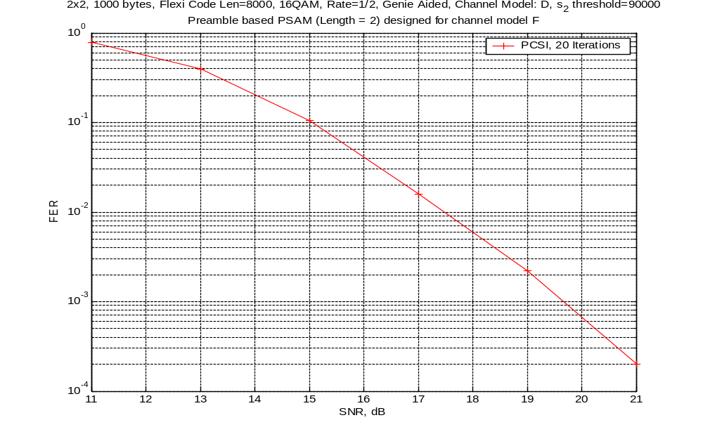

Slide 63
Decoder Throughput
Structure of the code lends it to low complexity, high speed decoding
  Similar complexity to DVB-S2 LDPC
  Significantly lower complexity than 3GPP TC
TrellisWare is near completion of a high speed ASIC implementation of a 4-state variant of this code
Based upon this experience the following decoder throughputs have been calculated
We have used a baseline high speed architecture with a nominal degree of parallelism of P=1. An architecture with a degree of parallelism of P=n is n approximately n times as complex as the baseline, with approximately n times the throughput
Plots are given for both throughput normalized to the system clock (bps per clk) and actual throughput with a number of system clock assumptions
We are currently developing an P=8 FPGA prototype which can operate with a system clock of 100 MHz and is expected to achieve a throughput of at least 300 MHz.

Slide 64
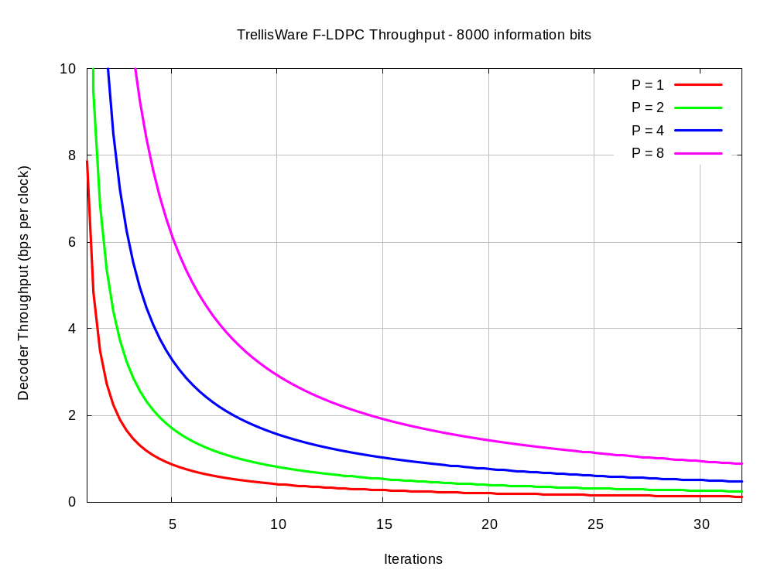

Slide 65
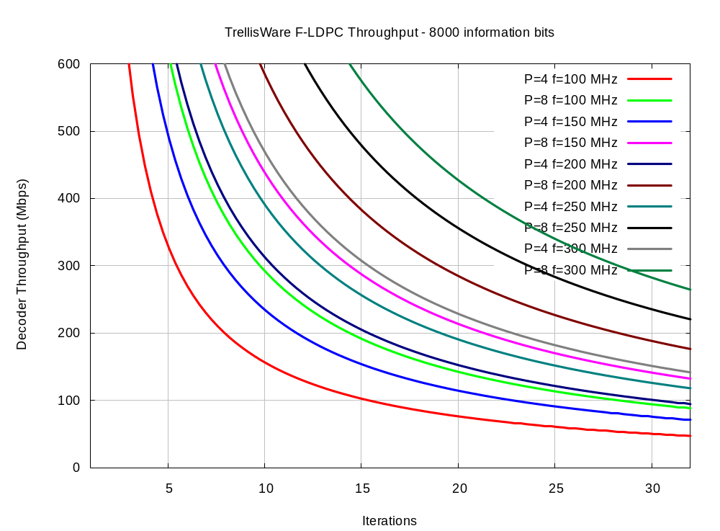
FPGA Prototype:
300 Mbps
<0.2 dB from 32 iterations

Slide 66
Comparion Criteria/11n Requirements are supported well
As a partial proposal
  Supports overall phy layer demanding requirements
  High Through-put operation – 300→ 500 Mbps
  Increased capacity – higher spectral efficiences
  Reliable performance → PERs below 1%
  Non Awgn environment
  Applies equally well to larger bandwidth operation 20/40 Mhz
  Supports backwards compatibility with variable length PDU performance

Slide 67
References
[1] S. Dolinar, D. Divsalar, and F. Pollara, "Code Performance as a function of Block Size," JPL, TMO Progress Report 42-133.

