Slide 1
Meddi-buddy by wissam boustany (201901136) and nour haddad (202101165) to dr. Clara zaiterr – cte 558

Slide 2
About meddi-buddy
Pill delivering system that can schedule the time to take three different pills daily, weekly or monthly. Helps patients who may forget to take their medication.

Slide 3
goals
Automate pill dispensing based on a schedule.
Provide an LCD interface to show current time and scheduled doses.
Offer a user-friendly joystick/button interface for editing time and schedules.
Connect to your phone through Bluetooth and a user’s app.

Slide 4
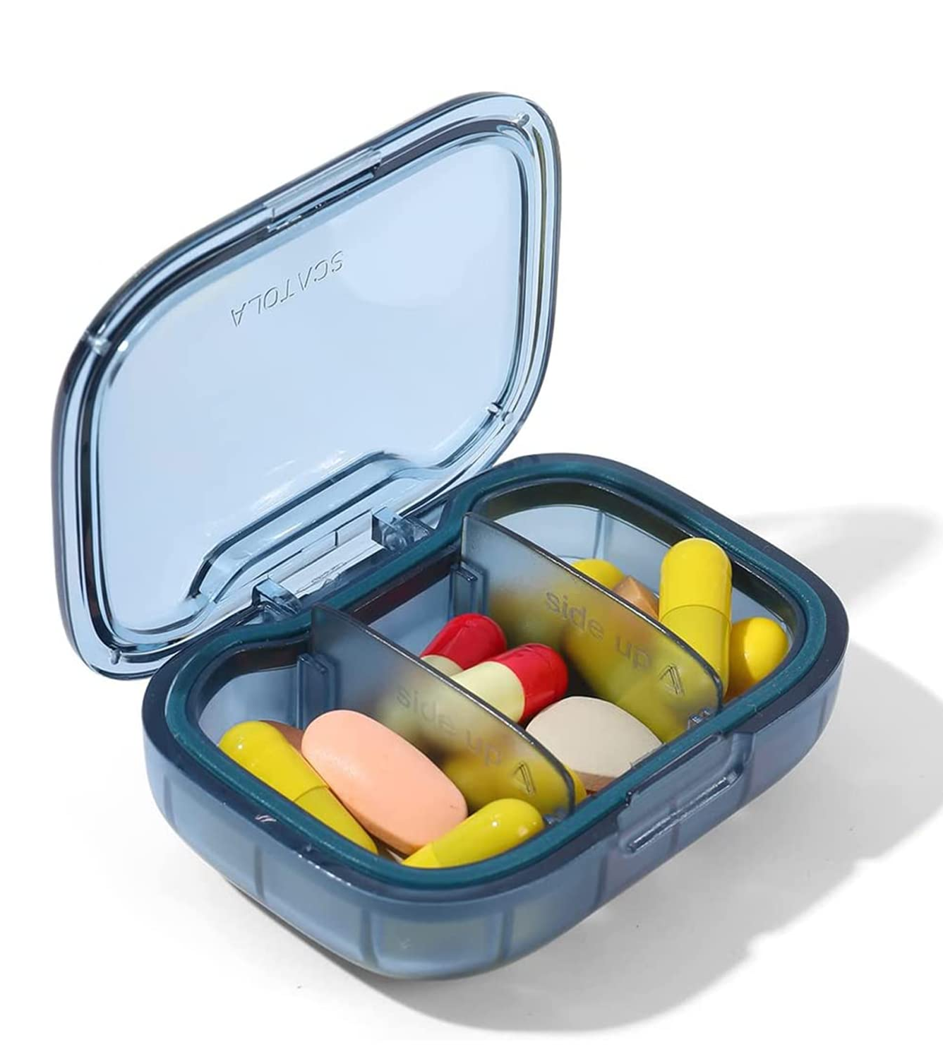
Project overview

Slide 5
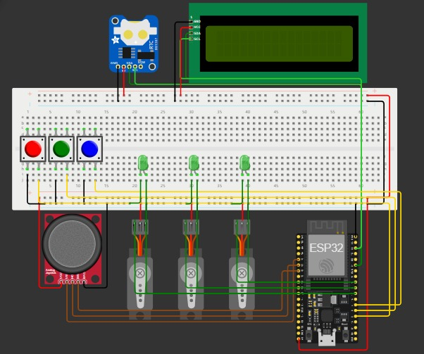
Circuit diagram
Components:
ESP32-WROOM-32U for integrated Bluetooth.
3 x Pushbuttons for interaction.
1 x Joystick to change the schedule time.
3 x Servos to dispense the medication.
3 x LEDs to indicate the dispensing medication.
1 x 16x2 LCD I2C to display time and help user adjust times.
1 x DS1307 (/DS3231) as an RTC clock.
Power Supply:
10 800mAh mini-UPS + Micro USB || Serial Cable.

Slide 6
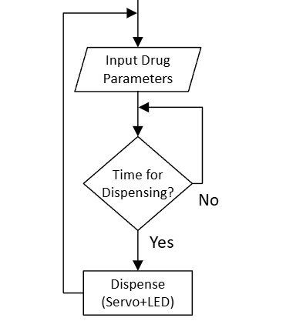
High level flow chart

Slide 7
Software/firmware implementation
Language & Environment:
ESP32 Framework
C++ code
Arduino IDE and Wokwi
2) Code Structure:
Meddi-Buddy/
├─ hardware.h
├─ hardware.cpp
├─ tasks.h
├─ tasks.cpp
├─ main.ino
└─ doc
3) Main helper functions:
setTimeUsingJoystick()
Scheduling()
dispenseDrug()
4) Main Libraries
LiquidCrystal_I2C
ESP32Servo
RTCLib
BluetoothSerial

Slide 8
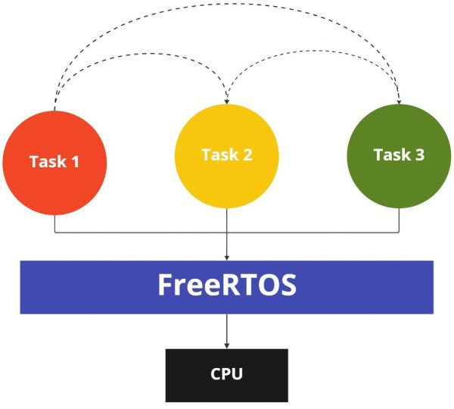
Modes of operation
Mode 0: Default mode, shows current time (or modified time).
Mode 1: Time setting mode. To change the current time.
Mode 2: Drug scheduling (up to 3).

Slide 9
Testing & results

Slide 10
Testing & results
Verified RTC accuracy & compatibility.
Checking pill dispensing times.
Ensuring LCD displays no overlaps.
Demonstrations of the proof of concept (end of presentation).

Slide 11
Challenges & lessons learned

Slide 12
Challenges & lessons learned
Working with an unfamiliar task scheduler (FreeRTOS).
Adapting whenever an idea doesn’t pan out.
Servo power requirements (<4)
Discovering the making of a mobile app.
Figuring out how to work together on GitHub instead of sending blocks of code on WhatsApp

Slide 13
Future improvements

Slide 14
Future improvements
IoT integration
Pill Counting and Verification
Remote Dosage Adjustment

Slide 15

Thank you
Wissam Boustany 79156930
wissam_boustany@outlook.com
Nour Haddad 76673777
nourhaddad065@gmail.com

