Slide 1
MSACL · DS301 DEEP LEARNING · SEGMENT 1 · LECTURE 1
What is deep learning?
A neuron is multiply–add–bend · stack them deep · something remarkable happens
Notes:
Sunday morning, hour one — the very first hour of the course. Welcome them and set the contract for all 15 hours: intuition first, mass spec always, a little arithmetic by hand because most of you are PhDs and numbers make it click. Promise of THIS hour: you will compute a neuron by hand, multiply a weight matrix by an input vector by hand, and say in one sentence how deep learning differs from the machine learning you may already use. Nothing today needs math beyond multiply-and-add. This hour is interactive: every worked example (I-do) is followed by one you do yourself (you-do) — and each you-do IS a Quiz 1 question, so by the recap you have already worked the whole quiz. Hand out Quiz 1 now, blank; they fill it as we go.

Slide 2



Lixing (lee-shin)
LECTURE 1 · YOUR INSTRUCTOR
Ph.D. in Computer Science
(2018-2026) Associated Professor at Rose-Hulman Institute of Technology
(2026-present) Research Advisor at Indigo BioAutomation Inc.
Can you briefly introduce yourself? Tell us about your expectation of this course?

Slide 3
LECTURE 1 · THE CONTRACT
What these 15 hours give you
• The fundamental math — intuition and arithmetic, no calculus
• The popular architectures — MLP, CNN, RNN, Transformer
• The learning paradigms — supervised and self-supervised
• Hands-on training on real data by filling in Colab blanks
• Judgment: the good, the bad, and the ugly of deep learning
Notes:
The contract for the whole course; stating it lowers anxiety for the least code-comfortable people in the room. "Fundamental math" = intuition and arithmetic, no proofs. "Architectures" is the tour ahead (Lectures 5-8). "Good, bad, ugly" is the honesty promise — where DL fails, when a simpler tool wins (Lecture 10). Read the goal line slowly: apply, and judge — the two verbs the whole course serves.

Slide 4
LECTURE 1 · THE ROADMAP
The course, one question per segment (3 hours)
(Sun AM) Foundations — what a neuron computes and how it learns
(Sun PM) Training & CNNs — what makes training work; patterns in spectra
(Mon AM) Sequences & Transformers — why order matters; what is attention
(Mon PM) Learning without labels — which representation; when NOT to use DL
(Tue AM) Frontier & Capstone — LLMs, agents, build-and-defend a project
Every lecture (1 hour) has a paper quiz/worksheet.
The third hour of every segment is a Colab-based Pytorch hands-on lab.
Notes:
The roadmap framed as the single driving question each segment answers — problem-driven, so every hour has a clear "why." You do not need to memorise this; just notice every lecture is one question, and today we answer the first. Labs turn each block hands-on in Colab, fill-in-the-blank with instant checks — never build a network from scratch.

Slide 5
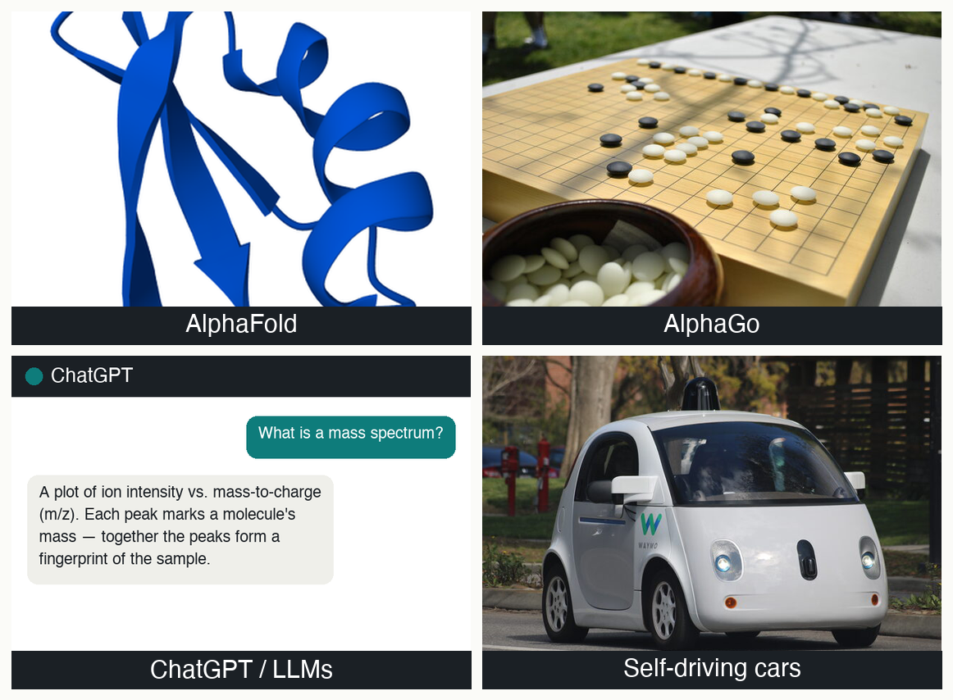
WHY THIS MATTERS · FOUR YOU ALREADY KNOW
Deep learning is already in your world
AlphaFold DB (CC0) · Go board: Xchen27 (CC BY-SA 3.0) · ChatGPT: Mattoutankamon (CC BY-SA 4.0) · Waymo car: Grendelkhan (CC BY-SA 4.0)
Do you know any other DL-based solutions?
Notes:
One line each — the point is breadth, not depth. AlphaFold: a decades-old folding problem cracked by a deep network; Nobel in Chemistry 2024. AlphaGo: more board positions than atoms in the universe. ChatGPT & LLMs: the same neurons-stacked-deep idea, scaled to the internet. Self-driving cars: perception from raw camera pixels in real time. Kept famous and general so nobody feels this is niche. Punchline to say aloud: every one of these is the same handful of ideas we begin assembling this hour. This is a single composite of four separately-licensed images (credits in the caption).

Slide 6
WHAT ML IS · THE WORKING DEFINITION
First — what is machine learning?
ML learns complex patterns from existing data to make predictions on unseen data.
Notes:
The spine of the whole field — read the five parts aloud. Contrast with ordinary software: normally YOU write the rules (if peak-area > threshold, flag it); in ML you show examples and the machine writes the rule itself (part 1). Part 5 is the one clinicians must never forget: performance is only real on data the model has NOT seen — hammered in Lecture 10 with external validation. Next slide is a 60-second do-it-together to pin down the boundary before we go further.

Slide 7
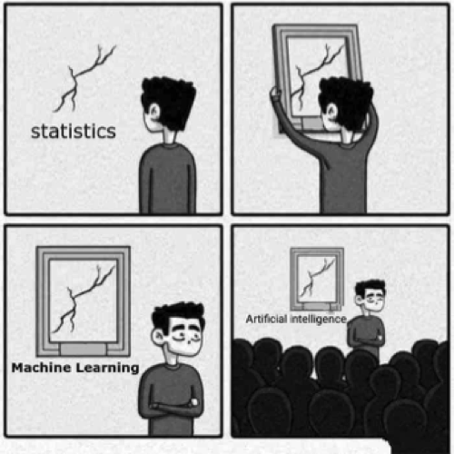
WHAT AI IS · THE BIGGER PICTURE
What is AI then?
Judea Pearl, a winner of the Turing Award (the “Nobel Prize of computing”), has argued that,
“All the impressive achievements of deep learning amount to just curve fitting.”
Notes:
Icebreaker — let them laugh, the room relaxes. A linear regression IS a fitted statistical model; calling it "AI" changes nothing about the maths. But there is a real gradient: statistics → ML → deep learning → the loose umbrella "AI" tends toward larger models that engineer fewer of their own features on messier data. Fix one relationship in their heads: deep learning is a subset of ML, not a competitor to it.

Slide 8

ENGINEERED VS. LEARNED · CLASSIC ML
Classic ML: you hand-build the features
Classic ML: a human picks what to measure — ear shape, whisker length, edge count — then a light model decides.
Strength: interpretable, data-thrifty.
Ceiling: only as good as the features you thought to compute.
What Classic ML approaches your lab/work is doing?
cat · Alvesgaspar, Wikimedia Commons, CC BY-SA 3.0
Notes:
Define "feature" carefully — the vocabulary word of the section, it recurs all week. Use the everyday cat task so nobody needs domain knowledge. A human expert decides what to measure and feeds a handful of numbers to a lightweight model. Strength: interpretable, data-thrifty. Ceiling: miss a discriminating cue and it is invisible to the model. That ceiling is what deep learning lifts — next slide.

Slide 9
ENGINEERED VS. LEARNED · DEEP LEARNING (PAIR)
Deep learning: the network learns the features
• hand it RAW input, not features you chose
• It discovers the useful edges, ears, and textures by itself
• It learns the features AND the decision, together
• Trade-off: less feature-guessing, but more data, more compute, less interpretability
You need a huge rocket engine, and you need a lot of fuel.
— Andrew Ng (Founder of Coursera, Standford Prof, Google Brain)
PAIR · Pair → Quiz 1, Q4 (MALDI Pipeline A vs. B). Name one hand-engineered feature your lab already computes. Turn to a neighbour, 1 minutes.
Notes:
The pivot of the lecture, and the live version of Quiz 1 Q4. The feature-engineering step disappears INTO the network — it learns what to measure and how to decide, jointly, from raw pixels. That is the one-sentence outcome for Lecture 1: learned features vs. hand-engineered features. Honest trade-off: DL removes feature-guessing but demands far more data and compute and gives up interpretability (theme of Lecture 10). PAIR (assessed) — this is Quiz 1 Q4: in Pipeline A a technician computes the peak area at m/z 2415 and the 2415/4100 ratio, then feeds those two numbers to logistic regression (hand-engineered); in Pipeline B the raw 6,000-bin spectrum goes straight into a network that grows its own "peak-ish here" detector (learned). Harvest 2-3 answers aloud — peak area, isotope ratio, retention time, S/N, adduct pattern — every one is a hand-engineered feature a network could learn from the raw spectrum.

Slide 10
Theory Fundamentals
LECTURE 1 · THEORY FUNDAMENTALS
The “simple” math behind the neural networks

Slide 11
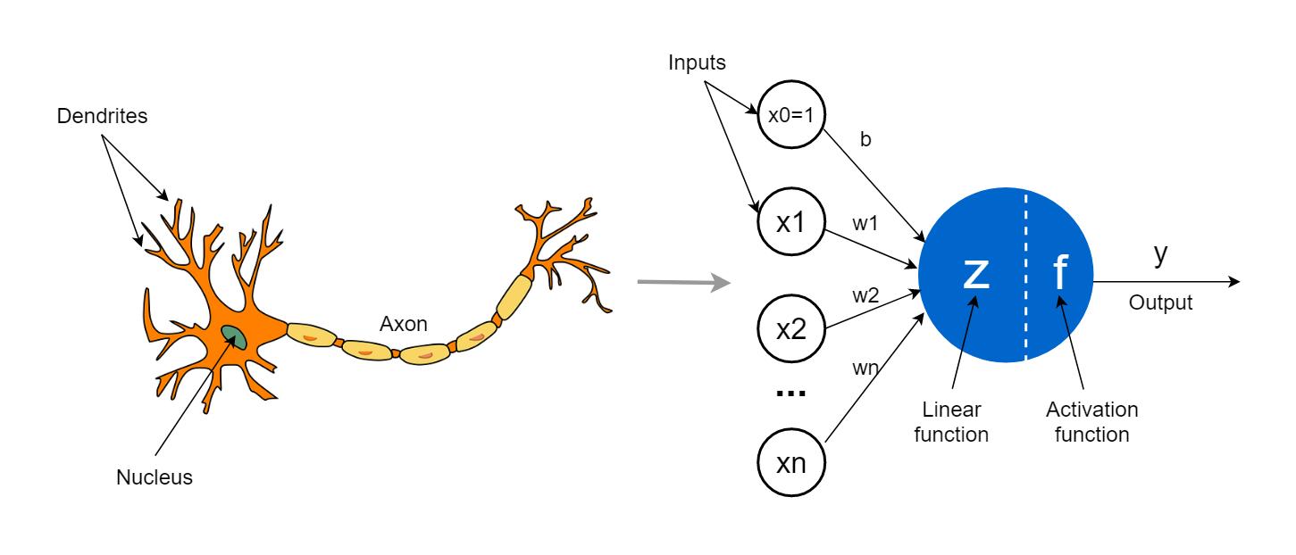
Perceptron
THE NEURON · THE PERCEPTRON

Slide 12
THE NEURON · ANATOMY
A neuron: weighted sum → bias → activation → output
inputs
x1, x2 (two numbers)
weighted sum
w1·x1 + w2·x2 + b
activation
bend f(z)
output
y
Weight and Bias will transform the feature;
Activation will make it non-linear.
(Lecture 2 will cover the training of the parameters).
Notes:
Walk left to right. Inputs are numbers (say two peak intensities). Each is multiplied by its own weight — how much this neuron cares about that input; weights are what training learns. Add the results plus a bias (a constant nudge) to get z. Then the activation f bends z into the output. Without the bend, stacking neurons collapses back to one big weighted sum (a single line); the bend is what lets networks model curves.

Slide 13
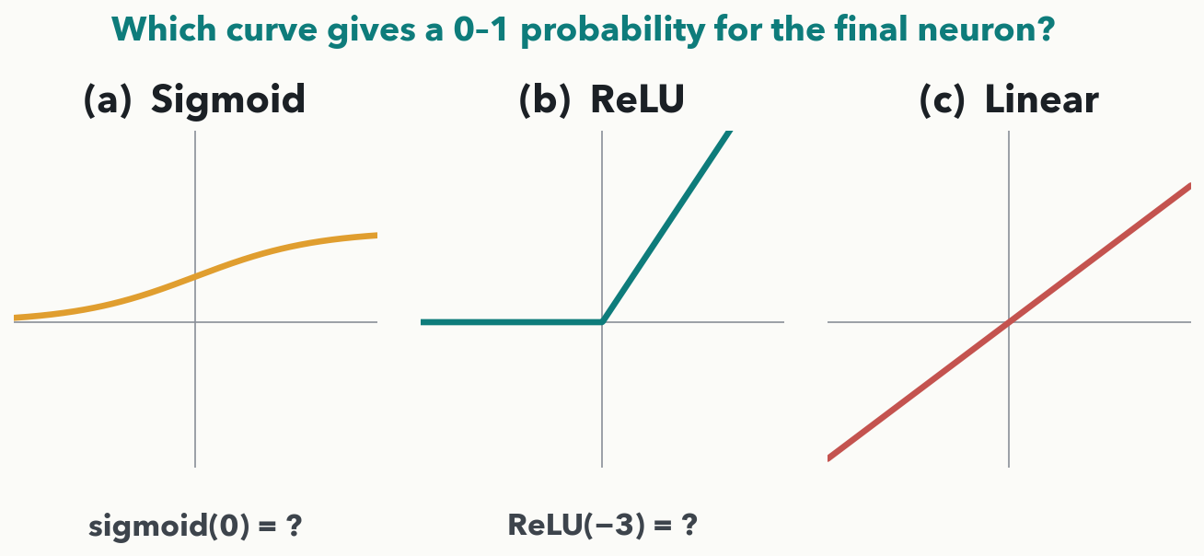
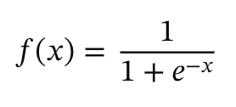

THE NEURON · YOUR TURN (YOU-DO)
Pick the activation — then compute one
❌
CHECKPOINT · Your turn → Quiz 1, Q1. Your MRSA classifier's FINAL neuron must output a 0–1 probability of resistant: which curve goes there? Then compute ReLU(−3) and sigmoid(0). 90 seconds — answers in the notes.
Notes:
YOU-DO = Quiz 1 Q1 — an apply/decide item, NOT naming. Three tasks: (i) which activation belongs on the final neuron of a resistant-vs-susceptible classifier? Answer: (a) the SIGMOID — it is the only curve whose output is squeezed into (0, 1), so it reads as a probability; ReLU is unbounded above and Linear is unbounded both ways, so neither can be a probability. (ii) ReLU(−3) = max(0, −3) = 0 — the neuron is silent (the on/off idea again). (iii) sigmoid(0) = 1/(1+e^0) = 0.5 — maximally uncertain, a coin flip. The point: shape → range → job. Poll the room on (i) before revealing, then have them fill Q1 on the sheet.

Slide 14
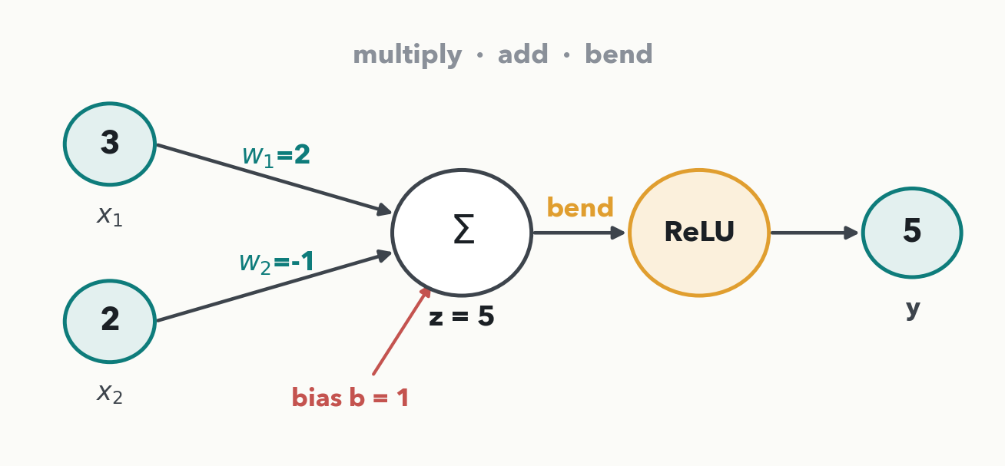
THE NEURON · WORKED BY HAND (I-DO)
One neuron, real numbers
Math· z = (2·3) + (−1·2) + 1 = 5, so ReLU(5) = 5 — the neuron fires. Read x as two peak intensities: this neuron likes input 1 and distrusts input 2.
Notes:
I-DO, done aloud and slowly — the first hand-computation of the course. z is the dot product of weights and inputs, plus bias: 2·3=6, −1·2=−2, +1 → z=5. Then bend: ReLU leaves 5 alone (positive passes); sigmoid would map 5 to about 0.99, a confident yes. Note the schematic: inputs → weighted edges → Σ (the sum, z) → activation (the bend) → output y. Next slide you run the SAME machine on different numbers — and this time the sum comes out negative. That is Quiz 1 Q2.

Slide 15
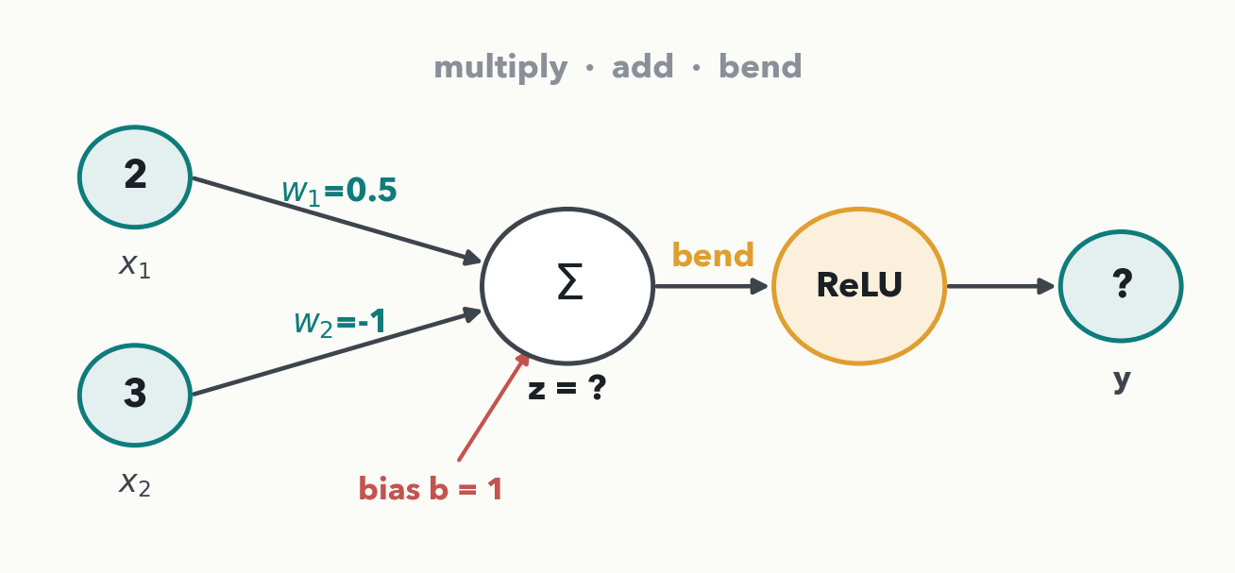
THE NEURON · YOUR TURN (YOU-DO)
Your neuron — compute it
CHECKPOINT · Your turn → Quiz 1, Q2. Compute z = w·x + b, then apply ReLU. 90 seconds with a neighbour — worked answer in the notes.
Notes:
YOU-DO = Quiz 1 Q2 (same schematic, different numbers — and the sum lands negative on purpose). Worked answer: z = (0.5·2) + (−1·3) + 1 = 1 − 3 + 1 = −1. ReLU(−1) = max(0, −1) = 0 — the neuron stays SILENT. This is the on/off behaviour that, times millions of neurons, is how a network routes information: a negative weighted sum is clamped to zero and that neuron contributes nothing. Ask a couple of pairs for their z before revealing, then have them fill Q2 on the sheet.

Slide 16
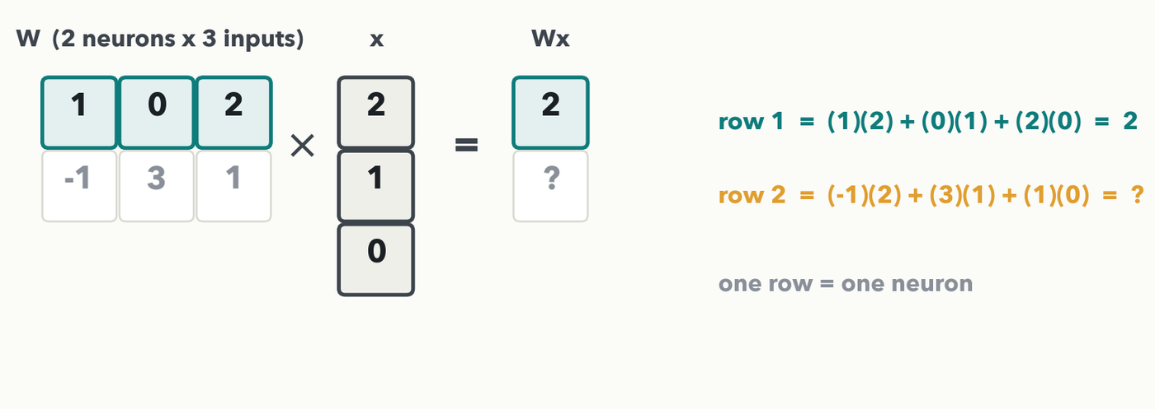
STACKING · A LAYER IS A MATRIX, ROW 1 (I-DO)
Two neurons, three inputs — row 1
Each ROW of W is one neuron; running the layer is W·x. Shapes must click: 3 inputs → 3 columns · 2 neurons → 2 rows → 2 outputs. Row 1 = (1·2)+(0·1)+(2·0) = 2.
Notes:
I-DO. Frame first: each ROW of W is one neuron's weight list; the input x is the same three numbers for both neurons (three peak intensities: 2, 1, 0). Running the layer is the matrix–vector product W·x. The one gotcha is the shape rule: the column count (3) must equal the number of inputs (3); the row count (2) sets how many outputs. Compute row 1 live — take row 1 of W, pair term-by-term with x, multiply, add: 1·2=2, 0·1=0, 2·0=0; sum = 2. Say "dot product" once. One row left — they do it next, and it is Quiz 1 Q3.

Slide 17
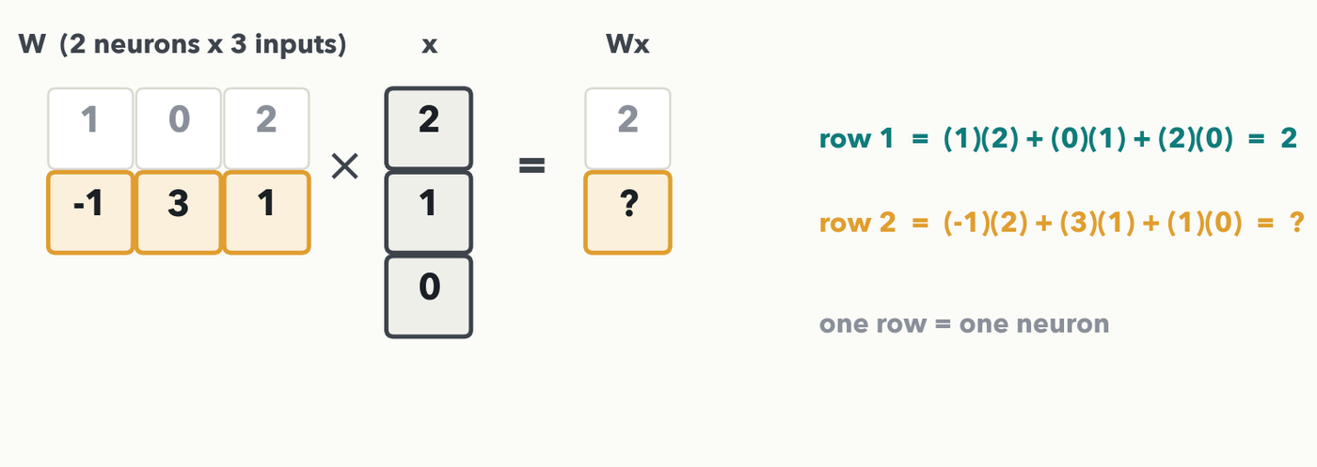
STACKING · YOUR TURN, ROW 2 (YOU-DO)
Row 2 — your turn, then read Wx
CHECKPOINT · Your turn → Quiz 1, Q3. Compute row 2's dot product and read the full output Wx. Worked answer in the notes.
Notes:
YOU-DO = Quiz 1 Q3 (the second row of the same matrix — different numbers from row 1, so genuine practice). Row 2 (−1, 3, 1) dotted with (2, 1, 0): (−1)(2) + (3)(1) + (1)(0) = −2 + 3 + 0 = 1. So Wx = (2, 1). Land it: a 2×3 matrix times a length-3 vector gives a length-2 output — one number per neuron, a full forward pass, and a fresh two-number representation that simply becomes the input to the next layer. Have them fill Q3 on the sheet.

Slide 18
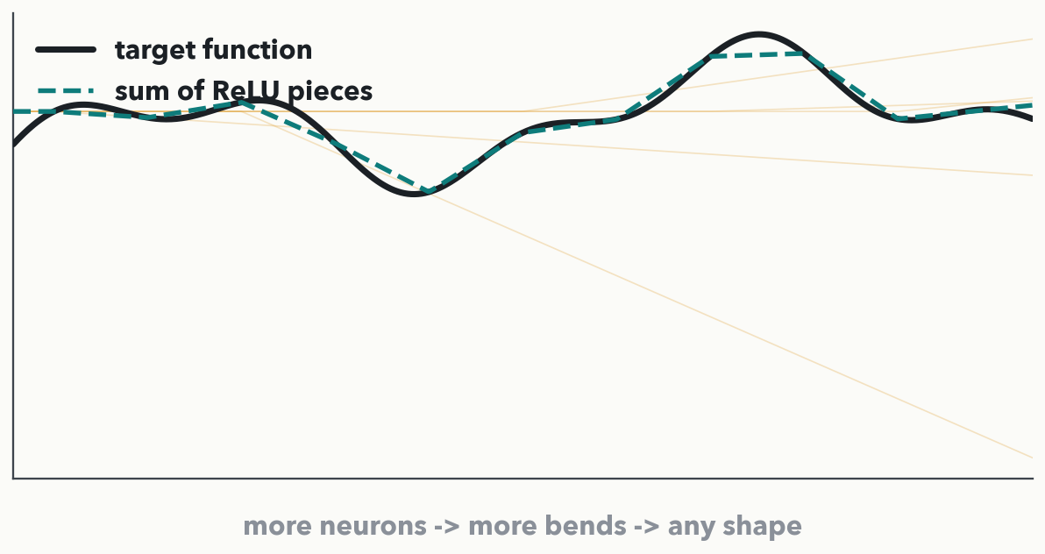
WHY THE BEND MATTERS · THE BIG PICTURE
Core Belief: Enough ”layers” can trace ANY curve
Universal approximation theorem, in one picture: add up enough (multi-add-bend) pieces and the network approximates any shape. Depth and width buy you bends — that is the whole magic.
Notes:
The reassuring theorem, shown not stated: a network with enough neurons can approximate essentially any function. Each ReLU contributes one bend (the faint amber lines); summed, the bends chase the wiggly black target (teal dashed). The takeaway is intuition, not a proof: more neurons → more bends → more shape. This is WHY the non-linear bend from the last few slides matters — without it every stack collapses to a single straight line and no amount of depth would help. No math required; just "bends add up."

Slide 19
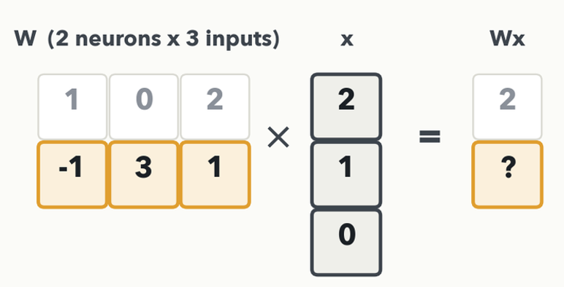
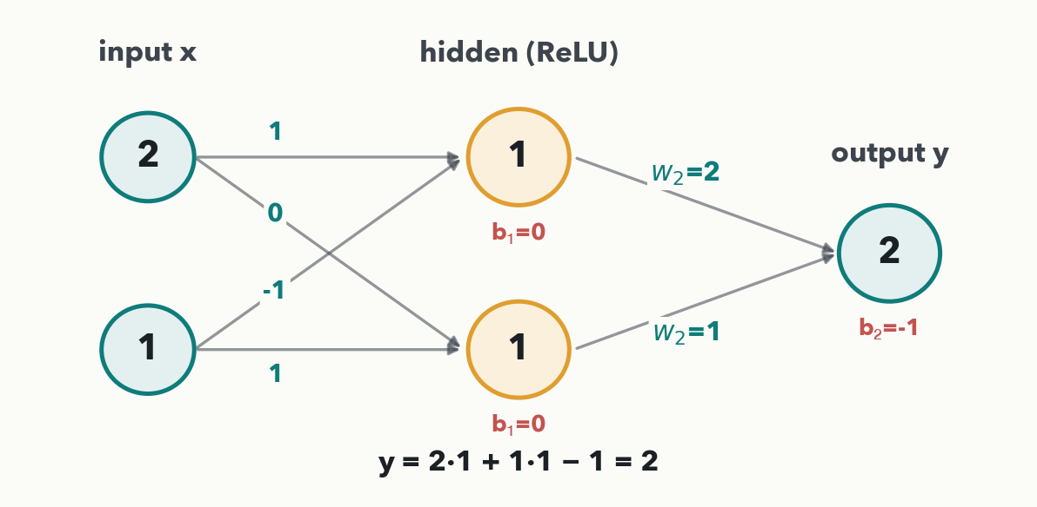
STACKING · ONE LAYER FEEDS THE NEXT (I-DO)
Deep = repeat the move, feeding each layer the last
A layer's output is the next layer's input — stack it and you have depth.
Notes:
I-DO, read straight off the diagram (same 2→2→1 node layout as the you-do next slide, every weight and bias now printed on the figure). Feed x = (2, 1) into layer 1: hidden neuron 1 = (1)(2) + (−1)(1) + 0 = 1 → ReLU 1; hidden neuron 2 = (0)(2) + (1)(1) + 0 = 1 → ReLU 1. Both neurons fire, so hidden h = (1, 1) — a fresh representation, and a layer's output is just the next layer's input. Layer 2 reads h like any input, with weights W2 = (2, 1) and bias b2 = −1: y = (2)(1) + (1)(1) − 1 = 2. That is all "deep" means — multiply, add, bend, pass it on; stack the same move and depth builds the hierarchy on the next two slides. Soft callback: layer 1 is the same multiply-add-bend the room just ran on the matrix–vector slides, now feeding a second layer that reads the hidden vector — we do NOT claim the hidden layer just copies the input; here it recomputes to (1, 1). Next slide you take a fresh (2, 1) through your own two layers, with different weights — that is Quiz 1 Q6.

Slide 20
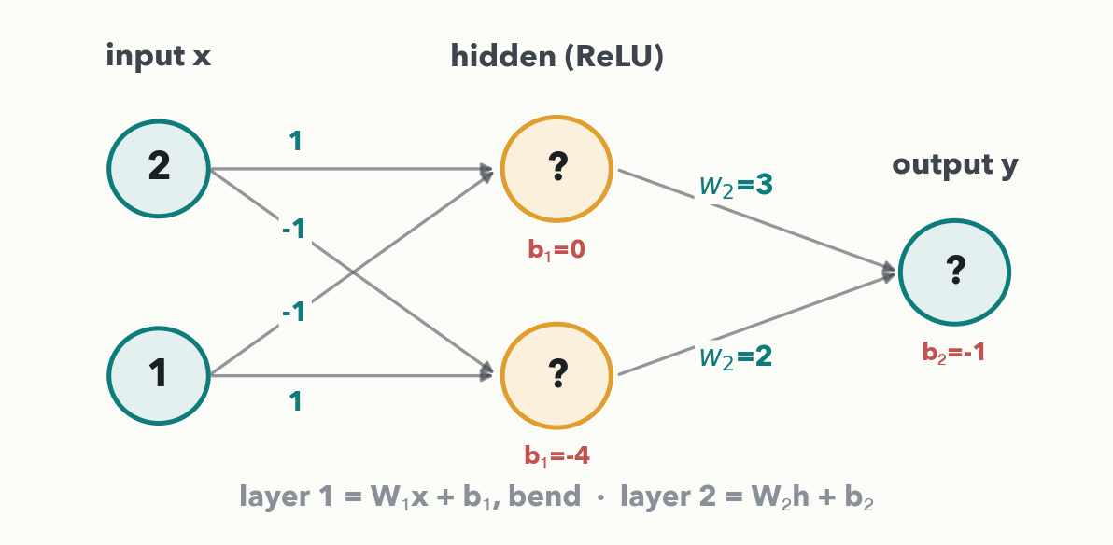
STACKING · YOUR TURN, TWO LAYERS (YOU-DO)
Your two-layer pass — compute it
CHECKPOINT · Your turn → Quiz 1, Q6. Run layer 1 (W₁x + b₁, then ReLU) for the hidden vector, then layer 2 for y. Worked answer in the notes.
Notes:
YOU-DO = Quiz 1 Q6 (same input → hidden(ReLU) → output shape as the I-do, taking the (2, 1) you just computed forward as the input). Given x = (2, 1); W1 = [[1, −1], [−1, 1]], b1 = (0, −4); W2 = (3, 2), b2 = −1. Layer 1: row 1 = (1)(2) + (−1)(1) + 0 = 1 → ReLU 1; row 2 = (−1)(2) + (1)(1) + (−4) = −5 → ReLU 0. Hidden h = (1, 0) — the second neuron is silent again. Layer 2: y = (3)(1) + (2)(0) − 1 = 2. Ask a pair for their hidden vector before revealing y, then have them fill Q6 on the sheet.

Slide 21
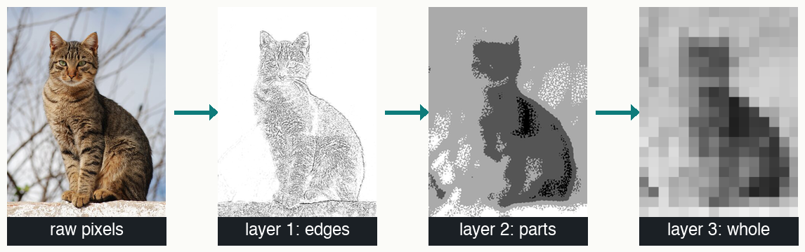
STACKING · WHY GO DEEP
Depth = a hierarchy of features
one photo, abstracted further at each layer · cat: Alvesgaspar, Wikimedia Commons, CC BY-SA 3.0
No one told it to look at edges first — it LEARNED that edges build into parts, and parts into whole objects. That is why 'deep.'
Notes:
Close the loop opened at the start. This is DEPTH, not parallel filters: each layer takes the previous layer's output and builds something more abstract — pixels → edges → parts → whole → label. Early layers see fragments, deep layers see meaning. Crucial honesty: this hierarchy is LEARNED, not designed — it echoes the engineered-vs-learned pivot and previews Lecture 5, where a network's first layer literally becomes edge and peak detectors. The composite here is one cat photo (CC BY-SA 3.0) abstracted left-to-right at successive layers.

Slide 22
LECTURE 1 · DISCUSSION (PAIR)
Full circle — and over to your lab
• A neuron multiplies, adds, and bends
• Stacking layers builds a hierarchy of learned features
• 💬 Your bench: name one task a network could learn straight from YOUR raw data
• Next hour (Lecture 2): how to find the best weight setting? The network learns them.
PAIR · Pair → Quiz 1, Q5, in one sentence: how does deep learning differ from the classic ML you use today? Then say which of YOUR lab signals a network could learn. 2 minutes.
Notes:
Close the hour with the Quiz 1 Q5 reflection as a think-pair-share, then widen it to the room. Full-credit Q5 answers capture "learned features from raw data" vs. "human-engineered features first." After harvesting a sentence or two, push the problem-driven follow-up that seeds Lab 1 and the Segment 1 discussion: what data in YOUR lab could train a network, and would it likely beat the methods you rely on today? Harvest a few aloud — peak area, isotope ratio, retention time, S/N, a QC rule — each a hand-engineered feature a network could learn. Gain (patterns you never thought to measure) vs. risk (more data, less interpretability, validation burden — Lecture 10). Bridge to Lecture 2: today we assumed the weights; next hour we learn where they come from.

