Slide 1
Deep Learning Tutorial
李宏毅
Hung-yi Lee

Slide 2
Deep learning
attracts lots of attention.
I believe you have seen lots of exciting results before.
Deep learning trends at Google. Source: SIGMOD/Jeff Dean
This talk focuses on the basic techniques.

Slide 3
Outline
Lecture I: Introduction of Deep Learning
Lecture II: Tips for Training Deep Neural Network Lecture III: Variants of Neural Network
Lecture IV: Next Wave

Slide 4
Lecture I: Introduction of Deep Learning

Slide 5
Outline of Lecture I
Introduction of Deep Learning
Let’s start with general machine learning.
Why Deep?
“Hello World” for Deep Learning

Slide 6
Machine Learning
≈ Looking for a Function
Speech Recognition
f (
Image Recognition
f (
)=“How are you”
)=“Cat”
Playing Go
f (
)=“5-5”
(next move)
Dialogue System
f (
“Hi”
(what the user said)
)=
“Hello”
(system response)

Slide 7
Framework
Image Recognition:
f (
)=
“cat”
A set of
function
Model
f₁ , f₂ ☹
f₁ (
)=
“cat”
f₂ (
)=
“money”
f₁ (
)=
“dog”
f₂ (
)=
“snake”

Slide 8
Framework
Image Recognition:
f (
)=
“cat”
A set of
function
Model
f₁ , f₂ ☹
Better!
Goodness of function f
Supervised Learning
Training Data
function input:
function output: “monkey”
“cat”
“dog”

Slide 9
Framework
Image Recognition:
f (
)=
“cat”
Model
Training
Testing
A set of
function
Step 1
f₁ , f₂ ☹
“cat”
Goodness of
Pick the “Best” Function
_{f} ∗
Using
function f
_{f} *
Step 2
Step 3
Training Data
“monkey”
“cat”
“dog”

Slide 10
Three Steps for Deep Learning
Step 1: define a set of function
Step 2: goodness of function
Step 3: pick the best function
Deep Learning is so simple ……

Slide 11
Three Steps for Deep Learning
Step 1:
Step 2: goodness of function
Step 3: pick the best function
e_{N}fin_{e}e_{ur}a_{al}set o_{N}f f_{e}u_{t}n_{w}c_{o}t_{r}io_{k}n
Deep Learning is so simple ……

Slide 12
Human Brains

Slide 13
Neural Network
Neuron
z = a₁w₁ + ☹ + a_{k} w_{k}
+ ☹ + a_{K} w_{K} + b
A simple function
a₁
a_{k} a_{K}
w₁
w_{k}
…
…
z
σ(z) a
Activation
function
+
…
…
w_{K}
b
weights
bias

Slide 14
Neural Network
Sigmoid Function
σ(z)
Neuron
σ(z)=
1
1+ e^{− z}
z
2
1
4
-1
-2
+
σ(z)
Activation
function
bias
0.98
-1
1
1
weights

Slide 15
Neural Network
Different connections leads to different network structure
+ σ(z)
+
σ(z)
+
σ(z)
+
σ(z)
Each neurons can have different values of weights and biases.
Weights and biases are network parameters 𝜃

Slide 16
Fully Connect Feedforward
Network
1
4
0.98
1
-2
1
-1
-2
0.12
-1
1
0
Sigmoid Function
σ(z)
σ(z)=
1
1+ e^{− z}
z

Slide 17
Fully Connect Feedforward
Network
1
4
0.98
2
0.86 3
0.62
1
-2
-1
-1
1
0
-2
-1
-2
0.12 -2
0.11
-1
0.83
-1
1
-1
4
0
0
2

Slide 18
Fully Connect Feedforward
Network
1
0.73
2
0.72
3
0.51
0
-2
-1
-1
1
0
-2
-1
0.5 -2
0.12
-1
0.85
0
1
-1
4
0
0
2
This is a function.
Input vector, output vector
1
−1
0.62
0.83
0
0
0.51
0.85
𝑓
=
𝑓
=
Given parameters 𝜃, define a function
Given network structure, define a function set

Slide 19
Fully Connect Feedforward
Network
neuron
Input Layer 1
x₁
Layer 2
Layer L
Output
y₁
……
x₂
……
y₂
……
……
……
……
……
x_{N}
……
y_{M}
Input Layer
Output Layer
Hidden Layers
Deep means many hidden layers

Slide 20
Output Layer (Option)
Softmax layer as the output layer
Ordinary Layer
y =σ(z )
1 1
z
σ
1
In general, the output of network can be any value.
y =σ(z )
2 2
z
σ
2
y =σ(z )
3 3
May not be easy to interpret
z₃
σ

Slide 21
Output Layer (Option)
Probability:
1 > 𝑦_{𝑖} > 0
_{𝑖} 𝑦_{𝑖} = 1
Softmax layer as the output layer
Softmax Layer
3
_{e}z
20
0.88
3
∑
j =1
_{e}z
z
e
÷
y = e^{z}
j
1
1
1
1
1
_{e}z₂2.7
0.12
y₂ = e
≈0
y₃ = e
3
∑
j =1
_{e}z _{j}
z
e
÷
z
2
2
-3
_{e}z₃
0.05
3
∑
j =1
z
e
÷
z₃
e
z _{j}
3
_{∑e}z _{j}
3
j =1

Slide 22
Example Application
Input Output
y₁
x
 | 0.1 |  |  | is 1
 | 0.7 |  |  | is 2
 |  | …… | ……
 | 0.2 |  |  | is 0
1
x₂
y₂
The image is “2”
……
^{x}256
^{y}10
16 x 16 = 256
Ink → 1
No ink → 0
Each dimension represents the confidence of a digit.

Slide 23
Example Application
Handwriting Digit Recognition
x₁ x₂
^{x}256
y₁
y₂
^{y}10
is 1
is 2
M^{N}a^{e}c^{u}h^{r}iªn^{l}e Network
“2”
……
……
……
What is needed is a
function ……
is 0
Input:
256-dim vector
output:
10-dim vector

Slide 24
Example Application
Input Layer 1 Layer 2
x₁
Layer L
Output
……
y₁
y₂
^{y}10
is 1
x₂
A function set c…o…ntaining the candidates for
Handwriting Digit Recognition
is 2
……
……
“2”
……
……
……
……
x_{N}
……
is 0
Input Layer
Output Layer
Hidden Layers
You need to decide the network structure to let a good function in your function set.

Slide 25
FAQ
Q: How many layers? How many neurons for each layer?
Trial and Error
+
Intuition
Q: Can the structure be automatically determined?

Slide 26
Three Steps for Deep Learning
Step 2: goodness of function
Step 1:
Step 3: pick the best function
de_{N}fin_{e}e_{ur}a_{al}set o_{N}f f_{e}u_{t}n_{w}c_{o}t_{r}io_{k}n
Deep Learning is so simple ……

Slide 27
Training Data
Preparing training data: images and their labels
“5”
“0”
“4”
“1”
“2”
“3”
“9” “1”
The learning target is defined on the training data.

Slide 28
Learning Target
x₁
……
y₁
y₂
^{y}10
is 1
x₂
……
Softmax
is 2
……
……
……
^{x}256
……
is 0
16 x 16 = 256
Ink → 1
No ink → 0
The learning target is ……
Input:
y₁ has the maximum value
Input:
y₂ has the maximum value

Slide 29
A good function should make the loss of all examples as small as possible.
Loss
“1”
x₁
……
y₁
1
As close as possible
x₂
Given a se…t…of parameters
y₂
0
……
……
……
……
……
Loss
𝑙
x_{N}
……
0
^{y}10
Loss can be the distance between the network output and target
target

Slide 30
Total Loss
Total Loss:
𝑅
𝐿 = 𝑙_{𝑟}
𝑟=1
For all training data …
_{x}1
NN
_{y}1
𝑦 ¹
𝑙₁
As small as possible
_{x}2
NN
_{y}2
𝑦 ²
Find a function in function set that minimizes total loss L
𝑙₂
_{x}3
NN
_{y}3
𝑦 ³
𝑙₃
……
……
……
……
Find the network parameters 𝜽∗ that minimize total loss L
_{x}R
NN
_{y}R
𝑦
𝑅
𝑙_{𝑅}

Slide 31
Three Steps for Deep Learning
Step 3: pick the best function
Step 1:
Step 2: goodness of function
de_{N}fin_{e}e_{ur}a_{al}set o_{N}f f_{e}u_{t}n_{w}c_{o}t_{r}io_{k}n
Deep Learning is so simple ……

Slide 32
How to pick the best function
Find network parameters 𝜽∗ that minimize total loss L
Layer l
Layer l+1
Enumerate all possible values
Network parameters 𝜃 =
𝑤₁, 𝑤₂, 𝑤₃, ⋯ , 𝑏₁, 𝑏₂, 𝑏₃, ⋯
10⁶
weights
……
……
Millions of parameters
E.g. speech recognition: 8 layers and 1000 neurons each layer
1000
neurons
1000
neurons

Slide 33
Network parameters 𝜃 =
𝑤₁, 𝑤₂, ⋯ , 𝑏₁, 𝑏₂, ⋯
Gradient Descent
Find network parameters 𝜽∗ that minimize total loss L
Pick an initial value for w
Total Loss 𝐿
Random, RBM pre-train
Usually good enough
w

Slide 34
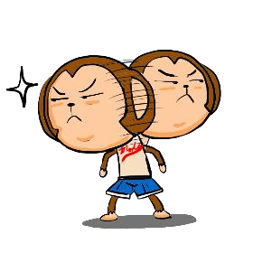
Network parameters 𝜃 =
𝑤₁, 𝑤₂, ⋯ , 𝑏₁, 𝑏₂, ⋯
Gradient Descent
Find network parameters 𝜽∗ that minimize total loss L
Pick an initial value for w
Compute 𝜕𝐿 𝜕𝑤
Total Loss 𝐿
Negative
Increase w
Positive
Decrease w
w
http://chico386.pixnet.net/album/photo/171572850

Slide 35
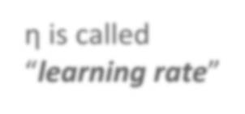



Network parameters 𝜃 =
𝑤₁, 𝑤₂, ⋯ , 𝑏₁, 𝑏₂, ⋯
Gradient Descent
Find network parameters 𝜽∗ that minimize total loss L
Pick an initial value for w
Compute 𝜕𝐿 𝜕𝑤
𝑤 ← 𝑤 − 𝜂𝜕𝐿 𝜕𝑤
Total Loss 𝐿
Repeat
η is called “learning rate”
w
−𝜂𝜕𝐿 𝜕𝑤

Slide 36

Network parameters 𝜃 =
𝑤₁, 𝑤₂, ⋯ , 𝑏₁, 𝑏₂, ⋯
Gradient Descent
Find network parameters 𝜽∗ that minimize total loss L
Pick an initial value for w
Compute 𝜕𝐿 𝜕𝑤
𝑤 ← 𝑤 − 𝜂𝜕𝐿 𝜕𝑤
Total Loss 𝐿
Repeat Until 𝜕𝐿 𝜕𝑤 is approximately small
(when update is little)
w

Slide 37



Gradient Descent
𝜃
Compute 𝜕𝐿 𝜕𝑤₁
𝜕𝐿
𝑤₁
𝑤₂
𝑏₁
0.2
0.15
−𝜇 𝜕𝐿 𝜕𝑤₁
Compute 𝜕𝐿 𝜕𝑤₂
−𝜇 𝜕𝐿 𝜕𝑤₂
𝜕𝑤₁
𝜕𝐿
-0.1
0.05
𝛻𝐿 =
𝜕𝑤₂
⋮
𝜕𝐿
……
Compute 𝜕𝐿 𝜕𝑏₁
𝜕𝑏₁
⋮
0.3
0.2
−𝜇 𝜕𝐿 𝜕𝑏₁
……
gradient

Slide 38






Gradient Descent
𝜃
Compute 𝜕𝐿 𝜕𝑤₁
Compute 𝜕𝐿 𝜕𝑤₁
−𝜇 𝜕𝐿 𝜕𝑤₁
Compute 𝜕𝐿 𝜕𝑤₂
−𝜇 𝜕𝐿 𝜕𝑤₂
𝑤₁
𝑤₂
𝑏₁
0.2
0.15
0.09
−𝜇 𝜕𝐿 𝜕𝑤₁
Compute 𝜕𝐿 𝜕𝑤₂
−𝜇 𝜕𝐿 𝜕𝑤₂
……
-0.1
0.05
0.15
……
……
Compute 𝜕𝐿 𝜕𝑏₁
Compute 𝜕𝐿 𝜕𝑏₁
−𝜇 𝜕𝐿 𝜕𝑏₁
0.3
0.2
0.10
−𝜇 𝜕𝐿 𝜕𝑏₁
……
……

Slide 39
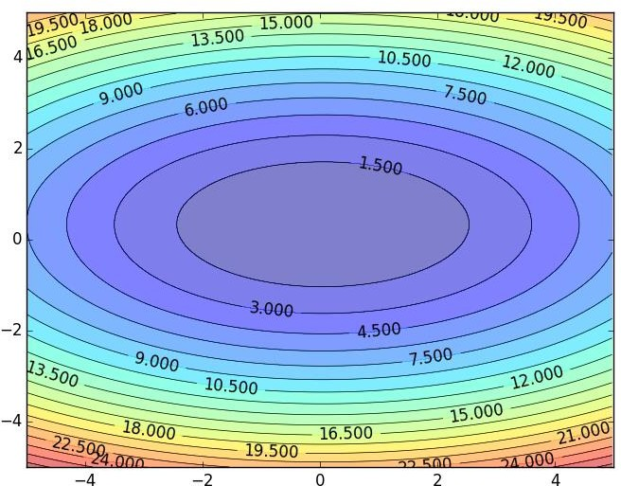
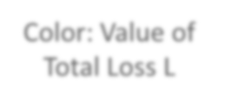






Gradient Descent
Color: Value of
Total Loss L
𝑤₂
Randomly pick a star
ting point
𝑤₁

Slide 40

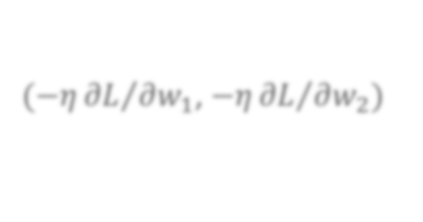


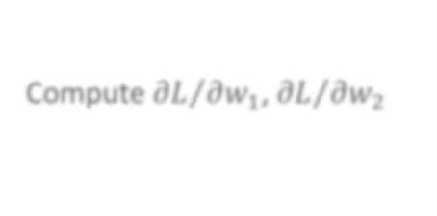


Gradient Descent
Hopfully, we would reach a minima …..
Color: Value of
Total Loss L
𝑤₂
(−𝜂 𝜕𝐿 𝜕𝑤₁, −𝜂 𝜕𝐿 𝜕𝑤₂)
Compute 𝜕𝐿 𝜕𝑤₁, 𝜕𝐿 𝜕𝑤₂
𝑤₁

Slide 41
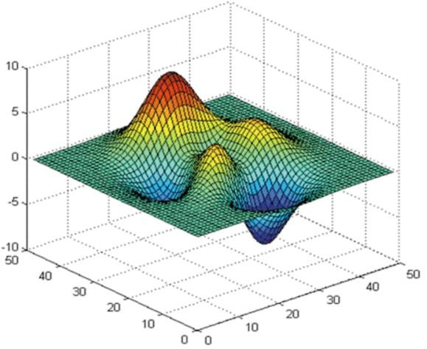




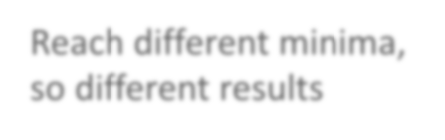




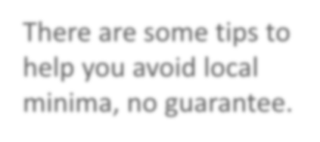


Gradient Descent - Difficulty
Gradient descent never guarantee global minima
Different initial point
Reach different minima, so different results
𝐿
There are some tips to help you avoid local minima, no guarantee.
𝑤₁
𝑤₂

Slide 42
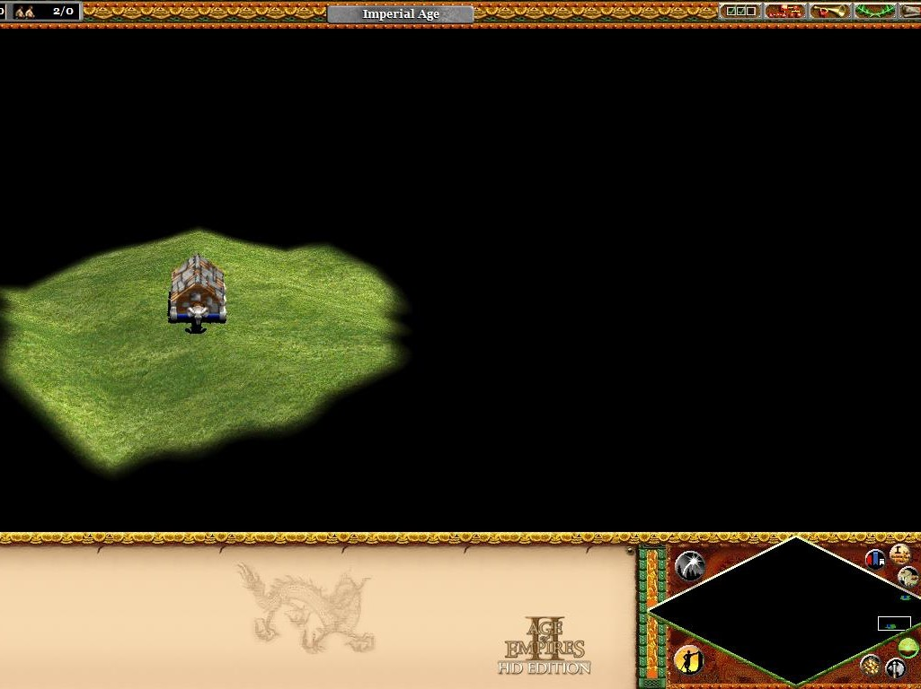
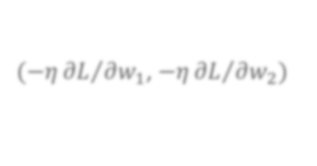

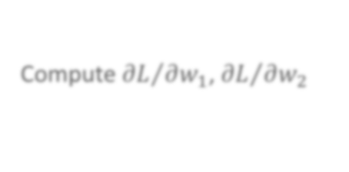

You are playing Age of Empires …
You cannot see the whole map.
Gradient Descent
(−𝜂 𝜕𝐿 𝜕𝑤₁, −𝜂 𝜕𝐿 𝜕𝑤₂)
Compute 𝜕𝐿 𝜕𝑤₁, 𝜕𝐿 𝜕𝑤₂
𝑤₂
𝑤₁

Slide 43
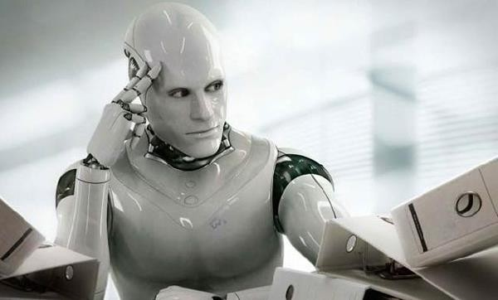
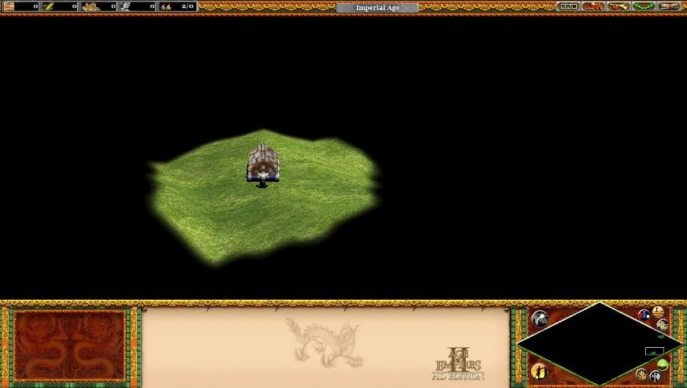
Gradient Descent
This is the “learning” of machines in deep learning ……
Even alpha go using this approach.
People image ……
Actually …..
I hope you are not too disappointed :p

Slide 44






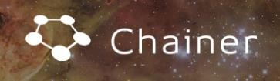

Backpropagation
Backpropagation: an efficient way to compute 𝜕𝐿 𝜕𝑤
  Ref:
http://speech.ee.ntu.edu.tw/~tlkagk/courses/MLDS_201 5_2/Lecture/DNN%20backprop.ecm.mp4/index.html
台大周伯威 同學開發
Don’t worry about 𝜕𝐿 𝜕𝑤, the toolkits will handle it.

Slide 45

Concluding Remarks
Step 1: define a set of function
Step 2: goodness of function
Step 3: pick the best function
Deep Learning is so simple ……

Slide 46
Outline of Lecture I
Introduction of Deep Learning
Why Deep?
“Hello World” for Deep Learning

Slide 47

Deeper is Better?
Layer X Size | Word Error Rate (%)
1 X 2k | 24.2
2 X 2k | 20.4
3 X 2k | 18.4
4 X 2k | 17.8
5 X 2k | 17.2
7 X 2k | 17.1
Layer X Size ^{Word Error}
Rate (%)
1 X 3772 22.5
1 X 4634 22.6
1 X 16k 22.1
Not surprised, more parameters, better performance
Seide, Frank, Gang Li, and Dong Yu. "Conversational Speech Transcription Using Context-Dependent Deep Neural Networks." Interspeech. 2011.

Slide 48
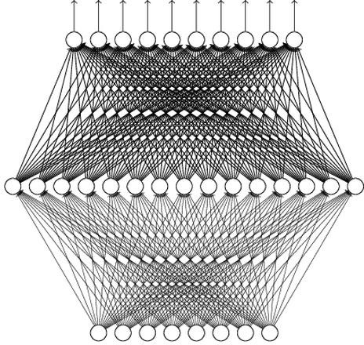
Universality Theorem
Any continuous function f
f : R ^{N} → R^{M}
Can be realized by a network with one hidden layer
(given enough hidden neurons)
Reference for the reason: http://neuralnetworksandde eplearning.com/chap4.html
Why “Deep” neural network not “Fat” neural network?

Slide 49
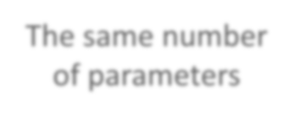






















Fat + Short v.s. Thin + Tall
The same number of parameters
…W…hich one is better?
……
x₁ x₂
……
x_{N}
x₁ x₂
x_{N}
Shallow
Deep

Slide 50



Fat + Short v.s. Thin + Tall
Layer X Size | Word Error Rate (%) | Layer X Size | Word Error Rate (%)
1 X 2k | 24.2
2 X 2k | 20.4 | W | hy?
3 X 2k | 18.4
4 X 2k | 17.8
5 X 2k | 17.2 | 1 X 3772 | 22.5
7 X 2k | 17.1 | 1 X 4634 | 22.6
 |  | 1 X 16k | 22.1
Seide, Frank, Gang Li, and Dong Yu. "Conversational Speech Transcription Using Context-Dependent Deep Neural Networks." Interspeech. 2011.

Slide 51
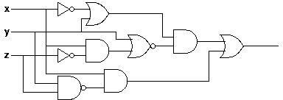






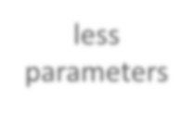
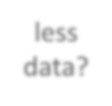









Analogy
Logic circuits
Neural network
Logic circuits consists of
gates
A two layers of logic gates can represent any Boolean function.
Using multiple layers of logic gates to build some functions are much simpler
Neural network consists of
neurons
A hidden layer network can represent any continuous function.
Using multiple layers of
neurons to represent some
functions are much simpler
less
parameters
less data?
less gates needed
This page is for EE background.

Slide 52
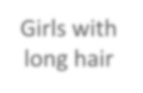






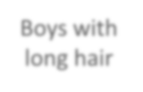










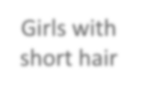






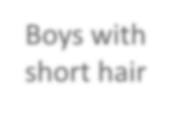






Modularization
Deep → Modularization
Classifier 1
Girls with long hair
長髮_{長髮長髮}
女_{女}
長髮
女_{女}
Classifier
Boys with
長髮
Image
2
weak
long hair
Litt^{男}le examples
Classifier 3
Girls with short hair
短髮_{短髮}
女
短髮_{短髮}
女_{女}
女
Classifier 4
Boys with short hair
短髮_{短髮短髮}
男_{男}
短髮
男_{男}

Slide 53

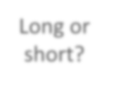


Each basic classifier can have sufficient training examples.
Modularization
Deep → Modularization
長髮_{長髮}
長髮 男
Basic Classifier
短髮_{短髮}女
長髮_{長髮}
Boy or Girl?
女
短髮^{女}女_{女}
v.s.
短髮_{短髮}
Image
女
短髮
短髮_{短髮}
女 _{女}
男
男 _{男}
男
長髮_{長髮長髮}
短髮_{短髮}
Long or short?
短髮_{短髮}
女
長髮
女
女_{女女}
v.s.
女_{女}
短髮_{短髮}
女
長髮
男
短髮_{短髮}
Classifiers for the
attributes
男
男 _{男男}

Slide 54
Modularization
can be trained by little data
Deep → Modularization
Classifier 1
Girls with
long hair
Boy or Girl?
Basic Classifier
Long or short?
Classifier
Boys with
^{long} L^{h}iªtt^{ir}le data
Image
2
fine
Classifier 3
Girls with short hair
Classifier 4
Boys with
short hair
Sharing by the following classifiers as module

Slide 55
Modularization
Deep → Modularization
→ Less training data?
x₁
……
x₂
The modularization is …… automatically learned from data.
……
……
……
……
x_{N}
……
The most basic
classifiers
Use 1st layer as module to build classifiers
Use 2nd layer as module ……

Slide 56
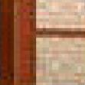




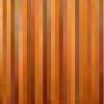






Modularization
Reference: Zeiler, M. D., & Fergus, R. (2014). Visualizing and understanding convolutional networks. In Computer Vision–ECCV 2014 (pp. 818-833)
Deep → Modularization
x₁
……
x₂
……
……
……
……
……
x_{N}
……
The most basic
classifiers
Use 1st layer as module to build classifiers
Use 2nd layer as module ……

Slide 57
Outline of Lecture I
Introduction of Deep Learning
Why Deep?
“Hello World” for Deep Learning

Slide 58

If you want to learn theano:
Keras
http://speech.ee.ntu.edu.tw/~tlkagk/courses/MLDS_2015_2/L ecture/Theano%20DNN.ecm.mp4/index.html
http://speech.ee.ntu.edu.tw/~tlkagk/courses/MLDS_2015_2/Le
cture/RNN%20training%20(v6).ecm.mp4/index.html
Very flexible
Need some effort to learn
or
Easy to learn and use
(still have some flexibility) You can modify it if you can write
TensorFlow or Theano
Interface of TensorFlow or Theano
keras

Slide 59
Keras
François Chollet is the author of Keras.
  He currently works for Google as a deep learning engineer and researcher.
Keras means horn in Greek
Documentation: http://keras.io/
Example: https://github.com/fchollet/keras/tree/master/exa mples

Slide 60

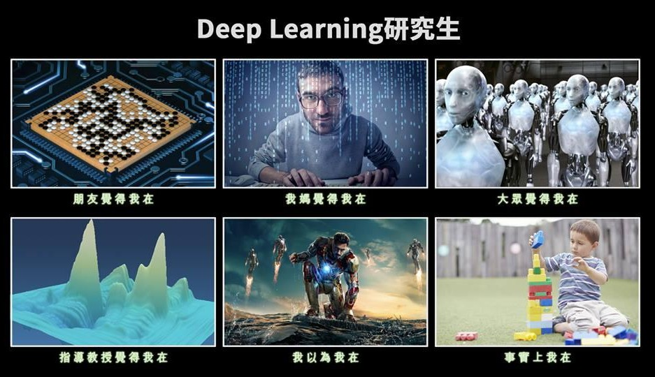
使用 Keras 心得
感謝 沈昇勳 同學提供圖檔

Slide 61
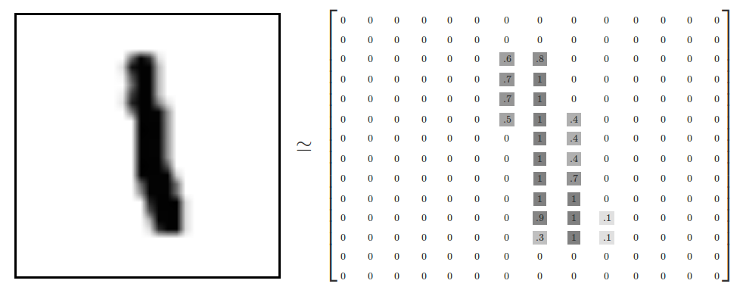
Example Application
Handwriting Digit Recognition
Machine
“1”
28 x 28
MNIST Data: http://yann.lecun.com/exdb/mnist/ “Hello world” for deep learning
Keras provides data sets loading function: http://keras.io/datasets/

Slide 62
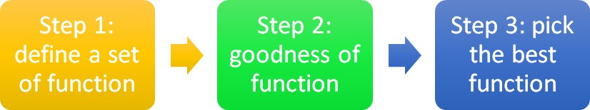












Keras
28x28
500
500
……
……
……
Softmax
y₁
y₂
^{y}10
……

Slide 63
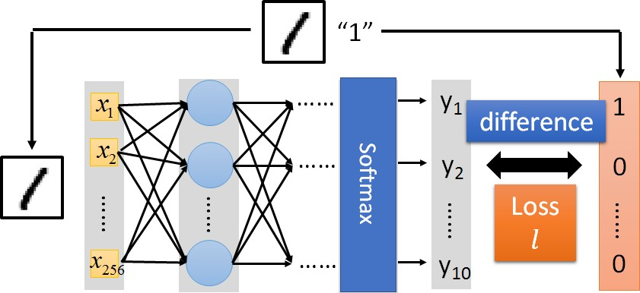

Keras

Slide 64
Keras
Step 3.1: Configuration
𝑤 ← 𝑤 − 𝜂𝜕𝐿 𝜕𝑤
0.1
Step 3.2: Find the optimal network parameters
Training data (Images)
Labels (digits)
Next lecture

Slide 65
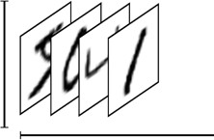
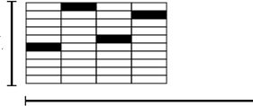
Keras
Step 3.2: Find the optimal network parameters
numpy array
numpy array
28 x 28
=784
……
10
……
Number of training examples
Number of training examples
https://www.tensorflow.org/versions/r0.8/tutorials/mnist/beginners/index.html

Slide 66
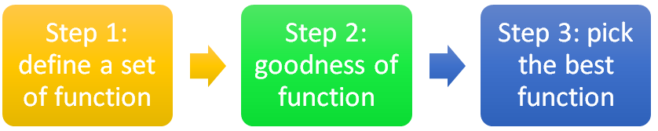

Keras
Save and load models
http://keras.io/getting-started/faq/#how-can-i-save-a-keras-model
How to use the neural network (testing):
case 1:
case 2:

Slide 67
Keras
Using GPU to speed training
  Way 1
    THEANO_FLAGS=device=gpu0 python YourCode.py
  Way 2 (in your code)
    import os
    os.environ["THEANO_FLAGS"] = "device=gpu0"

Slide 68
Live Demo

Slide 69
Lecture II:
Tips for Training DNN

Slide 70
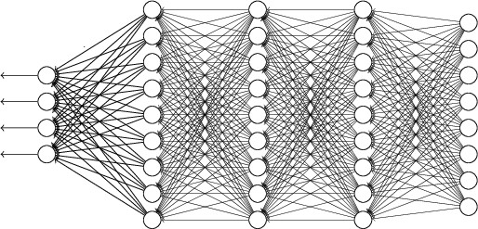
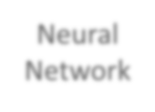

Recipe of Deep Learning
YES
Step 1: define a set of function
NO
Good Results on Testing Data?
Overfitting!
Step 2: goodness of function
YES
NO
Good Results on
Training Data?
Step 3: pick the best function
Neural
Network

Slide 71



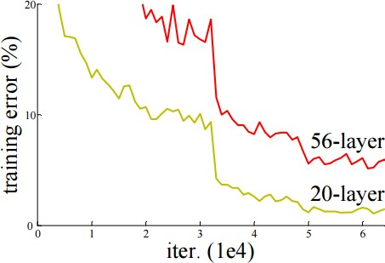
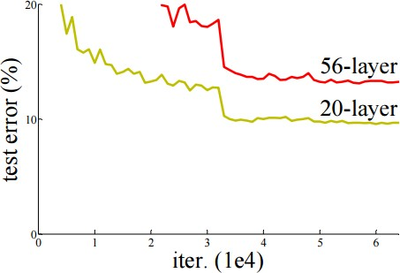



Do not always blame Overfitting
Not well trained
Overfitting?
Training Data
Testing Data

Slide 72
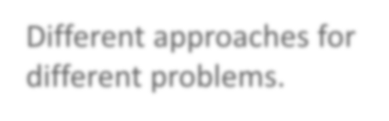



Recipe of Deep Learning
YES
Good Results on Testing Data?
Different approaches for different problems.
YES
e.g. dropout for good results on testing data
Good Results on
Training Data?
Neural
Network

Slide 73

Recipe of Deep Learning
YES
Choosing proper loss
Good Results on Testing Data?
Mini-batch
YES
New activation function
Good Results on
Training Data?
Adaptive Learning Rate
Momentum

Slide 74




Choosing Proper Loss
“1”
x₁
……
y₁
y₂
^{y}10
1
𝑦 ₁
1
x₂
……
Softmax
0
𝑦 ₂
0
……
……
……
……
……
……
loss
^{x}256
……
𝑦 ₁₀ 0
0
Which one is better?
10
10
target
Square Error
Cross Entropy
𝑦_{𝑖} − 𝑦 _{𝑖}
2
− 𝑦 _{𝑖}𝑙𝑛𝑦_{𝑖}
𝑖=1
=0
𝑖=1
=0

Slide 75
Let’s try it
Square Error
Cross Entropy

Slide 76
Testing:
 | Accuracy
Square Error | 0.11
Cross Entropy | 0.84
Let’s try it
Training
Cross Entropy
Square Error

Slide 77
Choosing Proper Loss
When using softmax output layer, choose cross entropy
Cross Entropy
Total Loss
Square Error
http://jmlr.org/procee dings/papers/v9/gloro t10a/glorot10a.pdf
w₁
w₂

Slide 78
Recipe of Deep Learning
YES
Choosing proper loss
Good Results on Testing Data?
Mini-batch
YES
New activation function
Good Results on
Training Data?
Adaptive Learning Rate
Momentum

Slide 79
We do not really minimize total loss!
Mini-batch
Randomly initialize
network parameters
_{x}1
NN
_{y}1
Pick the 1st batch
𝐿′ = 𝑙¹ + 𝑙³¹ + ⋯
Update parameters once
Pick the 2nd batch
𝐿′′ = 𝑙² + 𝑙¹⁶ + ⋯
Update parameters once
Mini-batch
𝑦 ¹
_{𝑙}1
_{x}31
NN
_{y}31
_{𝑦} 31
_{𝑙}31
……
_{x}2
NN
_{y}2
Mini-batch
𝑦 ²
_{𝑙}2
…
Until all mini-batches have been picked
_{x}16
NN
_{y}16
_{𝑦} 16
_{𝑙}16
one epoch
……
Repeat the above process

Slide 80
Mini-batch
Pick the 1st batch
𝐿′ = 𝑙¹ + 𝑙³¹ + ⋯
Update parameters once
Pick the 2nd batch
𝐿′′ = 𝑙² + 𝑙¹⁶ + ⋯
Update parameters once
_{x}1
NN
_{y}1
𝑦 ¹
Mini-batch
_{𝑙}1
_{x}31
NN
_{y}31
_{𝑦} 31
_{𝑙}31
……
100 examples in a mini-batch
…
Until all mini-batches have been picked
Repeat 20 times
one epoch

Slide 81
We do not really minimize total loss!
Mini-batch
Randomly initialize
network parameters
Pick the 1st batch
𝐿′ = 𝑙¹ + 𝑙³¹ + ⋯
Update parameters once
Pick the 2nd batch
𝐿′′ = 𝑙² + 𝑙¹⁶ + ⋯
Update parameters once
_{x}1
NN
_{y}1
Mini-batch
𝑦 ¹
_{𝑙}1
_{x}31
NN
_{y}31
_{𝑦} 31
_{𝑙}31
……
_{x}2
NN
_{y}2
Mini-batch
𝑦 ²
_{𝑙}2
…
L is different each time when we update parameters!
_{x}16
NN
_{y}16
_{𝑦} 16
_{𝑙}16
……

Slide 82
Mini-batch
Original Gradient Descent
With Mini-batch
Unstable!!!
The colors represent the total loss.

Slide 83
Mini-batch is Faster
Not always true with
parallel computing.
Original Gradient Descent Update after seeing all examples
With Mini-batch
If there are 20 batches, update
20 times in one epoch.
See all
See only one
examples
batch
Can have the same speed
(not super large data set)
1 epoch
Mini-batch has better performance!

Slide 84
Testing:
Mini-batch is Better!
 | Accuracy
Mini-batch | 0.84
No batch | 0.12
Training
Mini-batch
No batch
Accuracy
Epoch

Slide 85
Shuffle the training examples for each epoch
Epoch 1 Epoch 2
_{x}1
NN
_{y}1 _{x}1
NN
_{y}1
𝑦 ¹
𝑦 ¹
Mini-batch
_{𝑙}1
Mini-batch
_{𝑙}1
_{x}31
NN
_{y}31 _{𝑦} 31 _{x}31
NN
_{y}31
_{𝑦} 31
_{𝑙}31
_{𝑙}17
……
……
Don’t worry. This is the default of Keras.
_{x}2
_{y}2 _{x}2 _{y}2
NN
𝑦 ²
NN
𝑦 ²
Mini-batch
_{𝑙}2
Mini-batch
_{𝑙}2
_{x}16
NN
_{y}16
_{𝑦} 16
_{x}16
NN
_{y}16
_{𝑦} 16
_{𝑙}16
_{𝑙}26
……
……

Slide 86
Recipe of Deep Learning
YES
Choosing proper loss
Good Results on Testing Data?
Mini-batch
YES
New activation function
Good Results on
Training Data?
Adaptive Learning Rate
Momentum

Slide 87
Hard to get the power of Deep …
Results on Training Data
Deeper usually does not imply better.

Slide 88
Testing:
 | Accuracy
3 layers | 0.84
9 layers | 0.11
Let’s try it
Training
3 layers
9 layers

Slide 89
Vanishing Gradient Problem
x₁
……
y₁
x₂
……
y₂
……
……
……
……
……
x_{N}
……
y_{M}
Smaller gradients
Larger gradients
Learn very slow
Learn very fast
Almost random
Already converge
based on random!?

Slide 90
Vanishing Gradient Problem
Smaller gradients
x₁
…
… 𝑦1 𝑦 ₁
… 𝑦2 𝑦 ₂
…… …… _{𝑙 ……}
+∆𝑙
… 𝑦𝑀 𝑦 _{𝑀}
x₂
Small output
…
……
……
……
x_{N}
…
Large input
+∆𝑤
Intuitive way to compute the derivatives …
𝜕𝑙 ∆𝑙
=?
𝜕𝑤 ∆𝑤

Slide 91
Hard to get the power of Deep …
In 2006, people used RBM pre-training. In 2015, people use ReLU.

Slide 92
ReLU
Rectified Linear Unit (ReLU)
Reason:
𝑎
Fast to compute
Biological reason
𝜎 𝑧
𝑎 = 𝑧
𝑎 = 0
3. Infinite sigmoid with different biases
𝑧
4. Vanishing gradient problem
[Xavier Glorot, AISTATS’11] [Andrew L. Maas, ICML’13] [Kaiming He, arXiv’15]

Slide 93
ReLU
𝑎
𝑎 = 𝑧
𝑎 = 0
𝑧
0
x₁
y₁
0
y₂
x
2
0
0

Slide 94
ReLU
𝑎
𝑎 = 𝑧
A Thinner linear network
𝑎 = 0
𝑧
x₁
y₁
y₂
x₂
Do not have smaller gradients

Slide 95
Let’s try it

Slide 96
Testing:
9 layers | Accuracy
Sigmoid | 0.11
ReLU | 0.96
Let’s try it
9 layers
Training
ReLU
Sigmoid

Slide 97
ReLU - variant
𝐿𝑒𝑎𝑘𝑦 𝑅𝑒𝐿𝑈
𝑎
𝑎 = 𝑧
𝑃𝑎𝑟𝑎𝑚𝑒𝑡𝑟𝑖𝑐 𝑅𝑒𝐿𝑈
𝑎
𝑎 = 𝑧
𝑧
𝑧
𝑎 = 0.01𝑧
𝑎 = 𝛼𝑧
α also learned by gradient descent

Slide 98
Maxout
ReLU is a special cases of Maxout
Learnable activation function [Ian J. Goodfellow, ICML’13]
neuron
+ 5 +
1
Input
Max
7
Max
2
x₁
+ +
7
2
x₂
+ +
−1
4
Max
1
Max
4
+ +
1 3
You can have more than 2 elements in a group.

Slide 99
Maxout
ReLU is a special cases of Maxout
Learnable activation function [Ian J. Goodfellow, ICML’13]
  Activation function in maxout network can be any piecewise linear convex function
  How many pieces depending on how many elements in a group
2 elements in a group 3 elements in a group

Slide 100
Recipe of Deep Learning
YES
Choosing proper loss
Good Results on Testing Data?
Mini-batch
YES
New activation function
Good Results on
Training Data?
Adaptive Learning Rate
Momentum

Slide 101
Learning Rates
Set the learning rate η carefully
If learning rate is too large
Total loss may not decrease after each update
𝑤₂
𝑤₁

Slide 102
Learning Rates
Set the learning rate η carefully
If learning rate is too large
Total loss may not decrease after each update
𝑤₂
If learning rate is too small
Training would be too slow
𝑤₁

Slide 103
Learning Rates
Popular & Simple Idea: Reduce the learning rate by some factor every few epochs.
  At the beginning, we are far from the destination, so we use larger learning rate
  After several epochs, we are close to the destination, so we reduce the learning rate
  E.g. 1/t decay: 𝜂^{𝑡} = 𝜂 𝑡 + 1
Learning rate cannot be one-size-fits-all
  Giving different parameters different learning rates

Slide 104
Adagrad
Original: 𝑤 ← 𝑤 − 𝜂𝜕𝐿 ∕ 𝜕𝑤
Adagrad:
w ← 𝑤 − ߟ_{𝑤}𝜕𝐿 ∕ 𝜕𝑤
Parameter dependent learning rate
𝜂
constant
ߟ_{𝑤} =
𝑡
_{𝑔}𝑖 2
𝑔^{𝑖} is 𝜕𝐿 ∕ 𝜕𝑤 obtained at the i-th update
𝑖=0
Summation of the square of the previous derivatives

Slide 105
Adagrad
𝜂
ߟ_{𝑤} =
𝑡
_{𝑔}𝑖 2
𝑖=0
_{g}0
0.1
_{g}0
20.0
𝑤
g¹ ……
0.2 ……
𝑤
g¹ ……
10.0 ……
1
2
Learning rate:
𝜂
Learning rate:
𝜂
𝜂
=
0.1
𝜂
=
20
0.1²
𝜂
20²
𝜂
𝜂
0.1² + 0.2² ⁼ 0.22
𝜂
=
22
20² + 10²
Observation:
Learning rate is smaller and smaller for all parameters
Smaller derivatives, larger learning rate, and vice versa
Why?

Slide 106
Larger
derivatives
Smaller Learning Rate
Smaller Derivatives
Larger Learning Rate
2. Smaller derivatives, larger learning rate, and vice versa
Why?

Slide 107
Not the whole story ……
Adagrad
[John Duchi, JMLR’11]
RMSprop
  https://www.youtube.com/watch?v=O3sxAc4hxZU
Adadelta [Matthew D. Zeiler, arXiv’12]
“No more pesky learning rates” [Tom Schaul, arXiv’12]
AdaSecant [Caglar Gulcehre, arXiv’14]
Adam [Diederik P. Kingma, ICLR’15]
Nadam
  http://cs229.stanford.edu/proj2015/054_report.pdf

Slide 108
Recipe of Deep Learning
YES
Choosing proper loss
Good Results on Testing Data?
Mini-batch
YES
New activation function
Good Results on
Training Data?
Adaptive Learning Rate
Momentum

Slide 109
Hard to find
optimal network parameters
Total
Loss
Very slow at the
plateau
Stuck at saddle point
Stuck at local minima
𝜕𝐿 ∕ 𝜕𝑤
≈ 0
𝜕𝐿 ∕ 𝜕𝑤
= 0
𝜕𝐿 ∕ 𝜕𝑤
= 0
The value of a network parameter w

Slide 110
In physical world ……
Momentum
How about put this phenomenon in gradient descent?

Slide 111
Still not guarantee reaching global minima, but give some hope ……
Momentum
cost
Movement =
Negative of 𝜕𝐿∕𝜕𝑤 + Momentum
Negative of 𝜕𝐿 ∕ 𝜕𝑤
Momentum Real Movement
𝜕𝐿∕𝜕𝑤 = 0

Slide 112
Adam
RMSProp (Advanced Adagrad) + Momentum

Slide 113
Let’s try it
 | Accuracy
Original | 0.96
Adam | 0.97
Testing:
ReLU, 3 layer
Training
Original
Adam

Slide 114
Recipe of Deep Learning
YES
Early Stopping
Good Results on Testing Data?
Regularization
YES
Good Results on
Training Data?
Dropout
Network Structure

Slide 115
Why Overfitting?
Training data and testing data can be different.
Training Data:
Testing Data:
Learning target is defined by the training data.
The parameters achieving the learning target do not necessary have good results on the testing data.

Slide 116
Panacea for Overfitting
Have more training data
Create more training data (?)
Handwriting recognition:
Original Training Data:
Created Training Data:
Shift 15。

Slide 117
Why Overfitting?
For experiments, we added some noises to the testing data

Slide 118
Why Overfitting?
For experiments, we added some noises to the testing data
Testing:
 | Accuracy
Clean | 0.97
Noisy | 0.50
Training is not influenced.

Slide 119
Recipe of Deep Learning
YES
Early Stopping
Good Results on Testing Data?
Weight Decay
YES
Good Results on
Training Data?
Dropout
Network Structure

Slide 120
Early Stopping
Total Loss
Stop at
here
Validation set Testing set
Training set
Epochs
_{Keras:} http://keras.io/getting-started/faq/#how-can-i-interrupt-training-when- the-validation-loss-isnt-decreasing-anymore

Slide 121
Recipe of Deep Learning
YES
Early Stopping
Good Results on Testing Data?
Weight Decay
YES
Good Results on
Training Data?
Dropout
Network Structure

Slide 122
Weight Decay
Our brain prunes out the useless link between neurons.
Doing the same thing to machine’s brain improves the performance.

Slide 123
Weight Decay
Weight decay is one kind of regularization
Useless
Close to zero
(萎縮了)

Slide 124
Weight Decay
∂L
Implementation
Original:
w ← w −η
∂w
λ= 0.01
w ← ( )w −η
∂L
1−λ
Weight Decay:
0.99
∂w
Smaller and smaller
Keras: http://keras.io/regularizers/

Slide 125
Recipe of Deep Learning
YES
Early Stopping
Good Results on Testing Data?
Weight Decay
YES
Dropout
Good Results on
Training Data?
Network Structure

Slide 126
Dropout
Training:
Each time before updating the parameters
  Each neuron has p% to dropout

Slide 127
Dropout
Training:
Thinner!
Each time before updating the parameters
  Each neuron has p% to dropout
The structure of the network is changed.
  Using the new network for training
For each mini-batch, we resample the dropout neurons

Slide 128
Dropout
Testing:
No dropout
  If the dropout rate at training is p%, all the weights times (1-p)%
  Assume that the dropout rate is 50%.
If a weight w = 1 by training, set 𝑤 = 0.5 for testing.

Slide 129
Dropout - Intuitive Reason
我 的 partner 會擺爛，所以 我要好好做
When teams up, if everyone expect the partner will do the work, nothing will be done finally.
However, if you know your partner will dropout, you will do better.
When testing, no one dropout actually, so obtaining
good results eventually.

Slide 130
Dropout - Intuitive Reason
Why the weights should multiply (1-p)% (dropout rate) when testing?
Training of Dropout
Assume dropout rate is 50%
Testing of Dropout
No dropout
Weights from training
𝑤₁
𝑤₂
𝑤₃
𝑤₄
0.5 ×
𝑤₁
𝑧′ ≈ 2𝑧
0.5 × 𝑤₂
_{𝑧}′
𝑧
0.5 × 𝑤₃
0.5 × 𝑤₄
Weights multiply (1-p)%
𝑧′ ≈ 𝑧

Slide 131
Dropout is a kind of ensemble.
Training
Ensemble
Set
Set 1
Set 2
Set 3
Set 4
Network 1
Network 2
Network 3
Network 4
Train a bunch of networks with different structures

Slide 132
Dropout is a kind of ensemble.
Ensemble
Testing data x
Network 1
Network 4
Network 2
Network 3
y₁
y₂
y₃
y₄
average

Slide 133
Dropout is a kind of ensemble.
minibatch
1
minibatch 2
minibatch
3
minibatch 4
Training of Dropout
M neurons
2^{M} possible networks
Using one mini-batch to train one network
Some parameters in the network are shared
……

Slide 134
Dropout is a kind of ensemble.
Testing of Dropout
testing data x
All the weights multiply (1-p)%
……
y₁
y₂
y₃
?????
≈
average
y

Slide 135
More about dropout
More reference for dropout [Nitish Srivastava, JMLR’14] [Pierre Baldi,
NIPS’13][Geoffrey E. Hinton, arXiv’12]
Dropout works better with Maxout [Ian J. Goodfellow, ICML’13]
Dropconnect [Li Wan, ICML’13]
  Dropout delete neurons
  Dropconnect deletes the connection between neurons
Annealed dropout [S.J. Rennie, SLT’14]
  Dropout rate decreases by epochs
Standout [J. Ba, NISP’13]
  Each neural has different dropout rate

Slide 136
Let’s try it
……
500
……
model.add( dropout(0.8) )
500
……
model.add( dropout(0.8) )
Softmax
y₁
y₂
^{y}10
……

Slide 137
Let’s try it
No Dropout
Accuracy
Dropout
Testing:
Training
Epoch
 | Accuracy
Noisy | 0.50
+ dropout | 0.63

Slide 138
Recipe of Deep Learning
YES
Early Stopping
Good Results on Testing Data?
Regularization
YES
Good Results on
Training Data?
Dropout
Network Structure
CNN is a very good example! (next lecture)

Slide 139
Concluding Remarks of Lecture II

Slide 140
Recipe of Deep Learning
YES
Step 1: define a set of function
Step 2: goodness of function
NO
Good Results on Testing Data?
YES
NO
Good Results on
Training Data?
Step 3: pick the best function
Neural
Network

Slide 141
Let’s try another task

Slide 142
Document Classification
政治
“stock” in document
Machine
經濟
體育
“president” in document
體育
政治
財經
http://top-breaking-news.com/

Slide 143
Data

Slide 144
MSE

Slide 145
ReLU

Slide 146
Adaptive Lear
 | Accuracy
MSE | 0.36
CE | 0.55
+ ReLU | 0.75
+ Adam | 0.77
ning Rate

Slide 147
Dropout
 | Accuracy
Adam | 0.77
+ dropout | 0.79

Slide 148
Lecture III: Variants of Neural Networks

Slide 149
Convolutional Neural
Variants of Neural Networks
Network (CNN)
Widely used in image processing
Recurrent Neural Network (RNN)

Slide 150
Why CNN for Image?
When processing image, the first layer of fully connected network would be very large
……
……
Softmax
100
3 x 10⁷
……
……
……
100
100 x 100 x 3
1000
Can the fully connected network be simplified by considering the properties of image recognition?

Slide 151
Why CNN for Image
Some patterns are much smaller than the whole image
A neuron does not have to see the whole image to discover the pattern.
Connecting to small region with less parameters
“beak” detector

Slide 152
Why CNN for Image
The same patterns appear in different regions.
“upper-left beak” detector
Do almost the same thing
They can use the same
set of parameters.
“middle beak” detector

Slide 153
Why CNN for Image
Subsampling the pixels will not change the object bird
bird
subsampling
We can subsample the pixels to make image smaller
Less parameters for the network to process the image

Slide 154
Three Steps for Deep Learning
Step 1:
Step 2: goodness of function
Step 3: pick the best function
C^{d}o^{e}n^{f}v^{in}o^{e}lutªio^{s}n^{e}a^{t}l Neoufrfaul nNcettiwoonrk
Deep Learning is so simple ……

Slide 155
The whole CNN
cat dog ……
Convolution
Max Pooling
Can repeat
many times
Fully Connected Feedforward network
Convolution
Max Pooling
Flatten

Slide 156
The whole CNN
Property 1
Some patterns are much smaller than the whole image
Convolution
Property 2
Max Pooling
The same patterns appear in
different regions.
Can repeat
many times
Property 3
Convolution
Subsampling the pixels will not change the object
Max Pooling
Flatten

Slide 157
The whole CNN
cat dog ……
Convolution
Max Pooling
Can repeat
many times
Fully Connected Feedforward network
Convolution
Max Pooling
Flatten

Slide 158
CNN – Convolution
Those are the network parameters to be learned.
1 | -1 | -1
-1 | 1 | -1
-1 | -1 | 1
1 | 0 | 0 | 0 | 0 | 1
0 | 1 | 0 | 0 | 1 | 0
0 | 0 | 1 | 1 | 0 | 0
1 | 0 | 0 | 0 | 1 | 0
0 | 1 | 0 | 0 | 1 | 0
0 | 0 | 1 | 0 | 1 | 0
Filter 1 Matrix
Filter 2 Matrix
-1 | 1 | -1
-1 | 1 | -1
-1 | 1 | -1
……
6 x 6 image
Each filter detects a small pattern (3 x 3).
Property 1

Slide 159
CNN – Convolution
1 | -1 | -1
-1 | 1 | -1
-1 | -1 | 1
Filter 1
stride=1
1 | 0 | 0 | 0 | 0 | 1
0 | 1 | 0 | 0 | 1 | 0
0 | 0 | 1 | 1 | 0 | 0
1 | 0 | 0 | 0 | 1 | 0
0 | 1 | 0 | 0 | 1 | 0
0 | 0 | 1 | 0 | 1 | 0
3
-1
6 x 6 image

Slide 160
CNN – Convolution
1 | -1 | -1
-1 | 1 | -1
-1 | -1 | 1
Filter 1
If stride=2
1 | 0 | 0 | 0 | 0 | 1
0 | 1 | 0 | 0 | 1 | 0
0 | 0 | 1 | 1 | 0 | 0
1 | 0 | 0 | 0 | 1 | 0
0 | 1 | 0 | 0 | 1 | 0
0 | 0 | 1 | 0 | 1 | 0
3
-3
We set stride=1 below
6 x 6 image

Slide 161
CNN – Convolution
1 | -1 | -1
-1 | 1 | -1
-1 | -1 | 1
Filter 1
stride=1
1 | 0 | 0 | 0 | 0 | 1
0 | 1 | 0 | 0 | 1 | 0
0 | 0 | 1 | 1 | 0 | 0
1 | 0 | 0 | 0 | 1 | 0
0 | 1 | 0 | 0 | 1 | 0
0 | 0 | 1 | 0 | 1 | 0
3 | -1 | -3 | -1
-3 | 1 | 0 | -3
-3 | -3 | 0 | 1
3 | -2 | -2 | -1
6 x 6 image
Property 2

Slide 162
CNN – Convolution
-1 | 1 | -1
-1 | 1 | -1
-1 | 1 | -1
Filter 2
stride=1
Do the same process for every filter
1 | 0 | 0 | 0 | 0 | 1
0 | 1 | 0 | 0 | 1 | 0
0 | 0 | 1 | 1 | 0 | 0
1 | 0 | 0 | 0 | 1 | 0
0 | 1 | 0 | 0 | 1 | 0
0 | 0 | 1 | 0 | 1 | 0
3 -1 | -1 -1 | -3 -1 | -1 -
-3 | 1 | 0 | -3
1
-
1 -1 -2
-3 0
1
Feature Map
-1 -2
-3
1
-1
1
6 x 6 image
3
-2 -2
0 -4
4 x 4 image
-1
-1
3

Slide 163
CNN – Zero Padding
1 | -1 | -1
-1 | 1 | -1
-1 | -1 | 1
Filter 1
0 0 0
0 0 | 1 | 0 | 0 | 0 | 0 | 1
 | 0 | 1 | 0 | 0 | 1 | 0
 | 0 | 0 | 1 | 1 | 0 | 0
 | 1 | 0 | 0 | 0 | 1 | 0
 | 0 | 1 | 0 | 0 | 1 | 0 | 0 0
 | 0 | 0 | 1 | 0 | 1 | 0
 |  |  |  |  | 0 0 0
You will get another 6 x 6 images in this way
Zero padding
6 x 6 image

Slide 164
CNN – Colorful image
1
-1
-1
-1
-1
1
1
-1
-1
1
-1
-1
-1 1 -1
1 -1 -1
-1
1
-1
-1
-1
1
1
-1
-1
-1
1
-1
-1 1 -1
Filter 2
-1 1 -1 Filter 1
-1
-1
1
-1
-1
1
1
-1
-1
-1
-1
1
-1 1 -1
-1 -1 1
Colorful image
 |  | 1 | 0 | 0 | 0 | 0 | 1
 |  | 0 | 1 | 0 | 0 | 1 | 0
 |  | 0 | 0 | 1 | 1 | 0 | 0
 |  | 1 | 0 | 0 | 0 | 1 | 0
 |  | 0 | 1 | 0 | 0 | 1 | 0
 |  | 0 | 0 | 1 | 0 | 1 | 0
1
0
0
0
0
1
1
0
0
0
0
1
0
1
0
0
1
0
0
1
0
0
1
0
0
0
1
1
0
0
0
0
1
1
0
0
1
0
0
0
1
0
1
0
0
0
1
0
0
1
0
0
1
0
0
1
0
0
1
0
0
0
1
0
1
0
0
0
1
0
1
0

Slide 165
The whole CNN
cat dog ……
Convolution
Max Pooling
Can repeat
many times
Fully Connected Feedforward network
Convolution
Max Pooling
Flatten

Slide 166
CNN – Max Pooling
1 | -1 | -1
-1 | 1 | -1
-1 | -1 | 1
-1 | 1 | -1
-1 | 1 | -1
-1 | 1 | -1
Filter 1
Filter 2
3 | -1 |  | -3 | -1
-3 | 1 |  | 0 | -3
-3 | -3 |  | 0 | 1
3 | -2 |  | -2 | -1
-1 | -1 |  | -1 | -1
-1 | -1 |  | -2 | 1
-1 | -1 |  | -2 | 1
-1 | 0 |  | -4 | 3

Slide 167
CNN – Max Pooling
New image but smaller
3 0
-1 1
3 ₀ 1 ₃
2 x 2 image
Each filter is a channel
1 | 0 | 0 | 0 | 0 | 1
0 | 1 | 0 | 0 | 1 | 0
0 | 0 | 1 | 1 | 0 | 0
1 | 0 | 0 | 0 | 1 | 0
0 | 1 | 0 | 0 | 1 | 0
0 | 0 | 1 | 0 | 1 | 0
Conv
Max Pooling
6 x 6 image

Slide 168
The whole CNN
0 ₁
3 ₀ 1 ₃
3
-1
Convolution
Max Pooling
Can repeat
many times
A new image
Smaller than the original image
The number of the channel is the number of filters
Convolution
Max Pooling

Slide 169
The whole CNN
cat dog ……
Convolution
Max Pooling
A new image
Fully Connected Feedforward network
Convolution
Max Pooling
A new image
Flatten

Slide 170










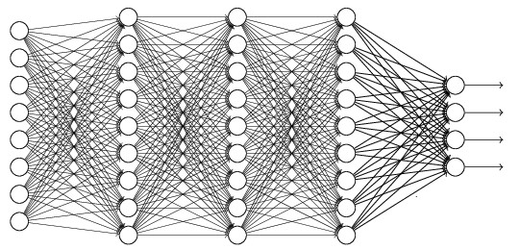
















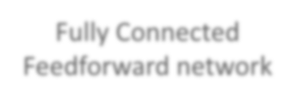






Flatten
3
0
1
3
-1
0
1
3
3 ₀ 1 ₃
-1
Flatten
1
Fully Connected Feedforward network
0
3

Slide 171
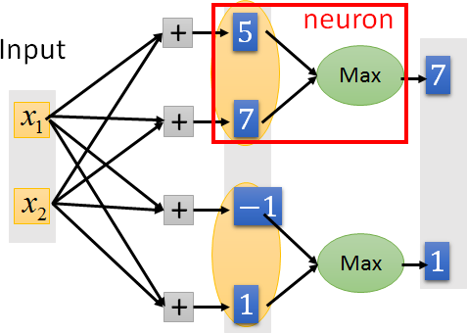
The whole CNN
Convolution
Max Pooling
Can repeat
many times
Convolution
Max Pooling

Slide 172






















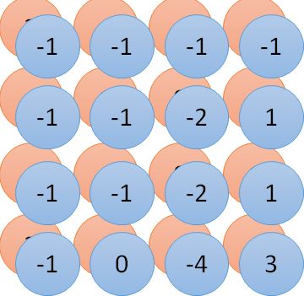
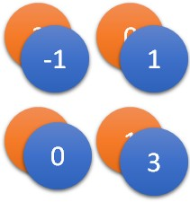
+ 5
Input
Max
7
x₁
+
7
x₂
+
−1
Max 1
+
1
1 | 0 | 0 | 0 | 0 | 1
0 | 1 | 0 | 0 | 1 | 0
0 | 0 | 1 | 1 | 0 | 0
1 | 0 | 0 | 0 | 1 | 0
0 | 1 | 0 | 0 | 1 | 0
0 | 0 | 1 | 0 | 1 | 0
1 | -1 | -1
-1 | 1 | -1
-1 | -1 | 1
-1 | 1 | -1
-1 | 1 | -1
-1 | 1 | -1
convolution
Max pooling
image
(Ignoring the non-linear activation function after the convolution.)

Slide 173

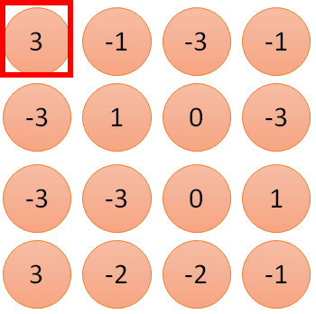




1
-1
-1
1: 1
Filter 1
-1
1
-1
2: 0
-1
-1
1
3: 0
1 | 0 | 0 | 0 | 0
0 | 1 | 0 | 0 | 1
0 | 0 | 1 | 1 | 0
1 | 0 | 0 | 0
 |  |  |  | 1 |  | 0
0 | 1 | 0 | 0 | 1 |  | 0
0 | 0 | 1 | 0 | 1 |  | 0
4: 0
3
1
0
0
…
7: 0
8: 1
9: 0
10: ₀
…
13: 0
6 x 6 image
14: 0
Less parameters!
15: 1
Only connect to 9 input, not fully connected
16: 1
…

Slide 174


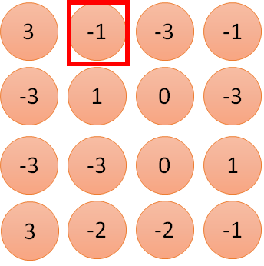





1: 1
2: 0
3: 0
1 |  | -1 |  | -1
-1 |  | 1 |  | -1 |  |  |  | Filter 1
-1 |  | -1 |  | 1 |  |  |  | 1 0
1 | 0 | 0 | 0 | 0
0 | 1 | 0 | 0 | 1
0 | 0 | 1 | 1 | 0
1 | 0 | 0 | 0
0 | 1 | 0 | 0 | 1 |  | 0
0 | 0 | 1 | 0 | 1 |  | 0
4: 0
3
1
0
0
…
7: 0
8: 1
9: 0
-1
10: ₀
…
13: 0
6 x 6 image
14: 0
Less parameters!
15: 1
16: 1
Shared weights
Even less parameters!
…

Slide 175
+
Max
−1
Max
5
Input
7
x₁
+
7
x₂
+
1
+
1
1 | 0 | 0 | 0 | 0 | 1
0 | 1 | 0 | 0 | 1 | 0
0 | 0 | 1 | 1 | 0 | 0
1 | 0 | 0 | 0 | 1 | 0
0 | 1 | 0 | 0 | 1 | 0
0 | 0 | 1 | 0 | 1 | 0
1 | -1 | -1
-1 | 1 | -1
-1 | -1 | 1
-1 | 1 | -1
-1 | 1 | -1
-1 | 1 | -1
convolution
Max pooling
image
(Ignoring the non-linear activation function after the convolution.)

Slide 176





































+ 5
Input
Max
7
x₁
+
7
x₁
+
−1
Max
1
+
1
3
-1
-3
-1
3
0
-3
1
0
-3
-3
-3
0
1
3
1
3
-2
-2
-1

Slide 177

+ 5
Input
Max
7
x₁
+
7
x₂
+
−1
Dim = 6 x 6 = 36
Max 1
parameters = 36 x 32 = 1152
+
1
Dim = 4 x 4 x 2
= 32
1 | 0 | 0 | 0 | 0 | 1
0 | 1 | 0 | 0 | 1 | 0
0 | 0 | 1 | 1 | 0 | 0
1 | 0 | 0 | 0 | 1 | 0
0 | 1 | 0 | 0 | 1 | 0
0 | 0 | 1 | 0 | 1 | 0
1 | -1 | -1
-1 | 1 | -1
-1 | -1 | 1
-1 | 1 | -1
-1 | 1 | -1
-1 | 1 | -1
convolution
Max
pooling
Only 9 x 2 = 18 parameters
image

Slide 178



Convolutional Neural Network
Step 2: goodness of function
Step 3: pick the best function
Step 1:
C^{d}o^{e}n^{f}v^{in}o^{e}lutªio^{s}n^{e}a^{t}l Neoufrfaul nNcettiwoonrk
“monkey” “cat”
0
1
CNN
……
“dog”
0
Convolution, Max Pooling, fully connected
target
Learning: Nothing special, just gradient descent ……

Slide 179
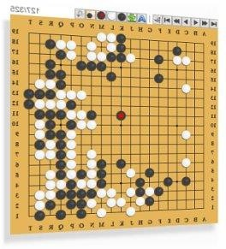
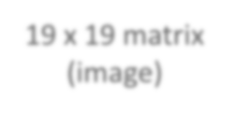


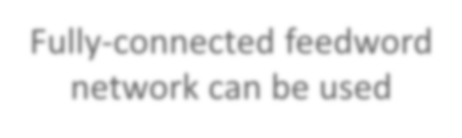





Playing Go
Network
Next move (19 x 19
positions)
19 x 19 matrix 19(ixm1a9gvee) ctor
19 x 19 vector
Black: 1
white: -1
none: 0
Fully-connected feedword network can be used
But CNN performs much better.

Slide 180
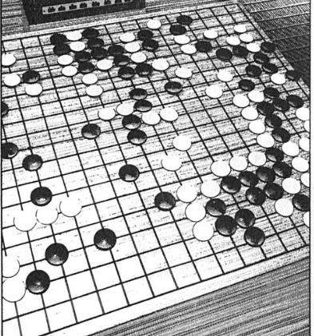


Playing Go
進藤光 v.s. 社清春 黑: 5之五
白: 天元 黑: 五之5
Training:
record of previous plays
Target:
“天元” = 1
else = 0
Network
Target:
“五之 5” = 1
else = 0
Network

Slide 181



Why CNN for playing Go?
Some patterns are much smaller than the whole image
Alpha Go uses 5 x 5 for first layer
The same patterns appear in different regions.

Slide 182






Why CNN for playing Go?
Subsampling the pixels will not change the object Max Pooling How to explain this???
Alpha Go does not use Max Pooling ……

Slide 183



Variants of Neural Networks
Convolutional Neural Network (CNN)
Recurrent Neural Network (RNN)
Neural Network with Memory

Slide 184

Example Application
Slot Filling
I would like to arrive Taipei on November 2nd.
ticket booking system
Destination: time of arrival:
Taipei November 2nd
Slot

Slide 185





Example Application
y₁
y₂
Solving slot filling by Feedforward network?
Input: a word
(Each word is represented as a vector)
Taipei
x₁
x₂

Slide 186
1-of-N encoding
How to represent each word as a vector?
1-of-N Encoding
lexicon = {apple, bag, cat, dog, elephant}
The vector is lexicon size.
Each dimension corresponds to a word in the lexicon
The dimension for the word is 1, and others are 0
apple = [ 1 0 0 0 0]
bag | = [ 0 | 1 | 0 | 0 | 0]
cat | = [ 0 | 0 | 1 | 0 | 0]
dog | = [ 0 | 0 | 0 | 1 | 0]
elephant | = [ 0 | 0 | 0 | 0 | 1]

Slide 187













Beyond 1-of-N encoding
Dimension for “Other” Word hashing
apple
bag
cat dog
elephant
0
0
0
0
0
a-a-a
a-a-b
0
0
1
1
1
…
…
a-p-p
…
…
26 X 26 X 26
p-l-e
…
…
…
p-p-l
“other”
1
…
…
w = “apple”
w = “Gandalf”
w = “Sauron”
187

Slide 188


Example Application
time of departure
y₂
dest
y₁
Solving slot filling by Feedforward network?
Input: a word
(Each word is represented as a vector)
Output:
Probability distribution that the input word belonging to the slots
Taipei
x₁
x₂

Slide 189










Example Application
time of departure
y₂
dest
y₁
Taipei on November
₂nd
arrive
other
dest
other
time
time
Problem?
leave Taipei on
November
₂nd
place of departure
Neural network needs memory!
Taipei
x₁
x₂

Slide 190


Three Steps for Deep Learning
Step 1:
Step 2: goodness of function
Step 3: pick the best function
de_{R}f_{e}i_{c}n_{u}e_{rr}a_{en}s_{t}et
Neoufrfaul nNcettiwoonrk
Deep Learning is so simple ……

Slide 191








Recurrent Neural Network (RNN)
y₁ y₂
The output of hidden layer are stored in the memory.
store
a₁ a₂
Memory can be considered as another input.
x₁
x₂

Slide 192












RNN
The same network is used again and again.
Probability of
“arrive” in each slot
Probability of “Taipei” in each slot
Probability of “on” in each slot
_{y}1
_{y}2
_{y}3
_{a}1
store
store
_{a}2
_{a}3
_{a}1
_{a}2
_{x}1
_{x}2
_{x}3
arrive
Taipei
on November
₂nd

Slide 193


















RNN
Different
Prob of “leave” in each slot
Prob of “Taipei” in each slot
Prob of “arrive” in each slot
Prob of “Taipei” in each slot
_{y}1
_{y}2
……
_{y}1
_{y}2
……
_{a}1
store
_{a}2
_{a}1
store
_{a}2
_{a}1
……
_{a}1
……
_{x}1
_{x}2
……
_{x}1
_{x}2
……
leave
Taipei
arrive
Taipei
The values stored in the memory is different.

Slide 194





























Of course it can be deep …
_{y}t _{y}t+1 _{y}t+2
……
……
……
……
……
……
……
……
……
_{x}t
_{x}t+1
_{x}t+2

Slide 195


























Bidirectional RNN
_{x}t
_{x}t+1
_{x}t+2
……
……
_{y}t
_{y}t+1
_{y}t+2
……
……
_{x}t
_{x}t+1
_{x}t+2

Slide 196




Long Short-term Memory (LSTM)
Other part of the network
Special Neuron: 4 inputs,
1 output
Signal control
the output gate
(Other part of
the network)
Output Gate
Memory Cell
Forget
Gate
Signal control
the forget gate
(Other part of the network)
Signal control the input gate (Other part of the network)
LSTM
Input Gate
Other part of the network

Slide 197



𝑎 = ℎ 𝑐′
𝑓 𝑧_{𝑜}
𝑧_{𝑜}
multiply
Activation function f is usually a sigmoid function
Between 0 and 1
Mimic open and close gate
𝑓 𝑧_{𝑜}
ℎ 𝑐′
𝑐 𝑓 𝑧_{𝑓}
𝑐c′
𝑧_{𝑓}
𝑐𝑓 𝑧_{𝑓}
𝑔 𝑧 𝑓 𝑧_{𝑖}
multiply
𝑔 𝑧
𝑐′ = 𝑔 𝑧 𝑓 𝑧_{𝑖}
+ 𝑐𝑓 𝑧_{𝑓}
𝑓 𝑧_{𝑖}
𝑧
𝑖
𝑧

Slide 198












0
≈0
-10
10
170
10
≈1
≈1
3
10
3
3

Slide 199









-3
≈1
10
-3
1-730
-10
≈0
≈1
-3
10
-3
-3

Slide 200





















LSTM
_{c}t-1
……
vector
_{z}f
_{z}i
z
_{z}o
4 vectors
_{x}t

Slide 201
















LSTM
_{y}t
_{z}o
_{c}t-1
×
＋
×
_{z}f
×
_{z}i
_{z}f
_{z}i
z
_{z}o
_{x}t
z

Slide 202



























Extension: “peephole”
LSTM
_{y}t
_{y}t+1
_{c}t-1
_{c}t
_{c}t+1
×
＋
×
×
＋
×
×
×
_{z}f
_{z}i
z
_{z}o
_{z}f
_{z}i
z
_{z}o
_{c}t-1
_{h}t-1
_{x}t
_{c}t
_{h}t
_{x}t+1

Slide 203







Multiple-layer LSTM
Don’t worry if you cannot understand this.
Keras can handle it.
Keras supports
“LSTM”, “GRU”, “SimpleRNN” layers
This is quite standard now.
https://img.komicolle.org/2015-09-20/src/14426967627131.gif

Slide 204





Three Steps for Deep Learning
Step 2: goodness of function
Step 1: define a set of function
Step 3: pick the best function
Deep Learning is so simple ……

Slide 205










Learning Target
dest
0 … ₁ …
other
other
… ₁ …
0 … 1 …
0 0
0
0
_{y}1
_{y}2
_{y}3
_{a}1
copy
copy
_{a}2
_{a}3
_{a}1
_{a}2
_{W}i
_{x}1
_{x}2
_{x}3
Training Sentences:
arrive
Taipei
on November
₂nd
other
dest
other
time
time

Slide 206

Three Steps for Deep Learning
Step 3: pick the best function
Step 1: define a set of function
Step 2: goodness of function
Deep Learning is so simple ……

Slide 207













Learning
y
y
1
2
Backpropagation through time (BPTT)
copy
a₁
a₂
𝑤
𝑤 ← 𝑤 − 𝜂𝜕𝐿 ∕ 𝜕𝑤
x₁
x₂
RNN Learning is very difficult in practice.

Slide 208




Unfortunately ……
感謝 曾柏翔 同學 提供實驗結果
RNN-based network is not always easy to learn
Real experiments on Language modeling
Total Loss
sometimes
Lucky
Epoch

Slide 209













The error surface is rough.
The error surface is either very flat or very steep.
Clipping
Total Loss
Cos
t
w₂
w₁
[Razvan Pascanu, ICML’13]

Slide 210













Why?
_{𝑦}1000 ₌ ₁
𝑦¹⁰⁰⁰ ≈ 20000
𝑤 = 1
𝑤 = 1.01
Large
𝜕𝐿 𝜕𝑤
Small
Learning rate?
_{𝑦}1000 _{≈ 0}
_{𝑦}1000 _{≈ 0}
𝑤 = 0.99
𝑤 = 0.01
small
𝜕𝐿 𝜕𝑤
Large Learning rate?
_{=w}999 _{y}1000
1
_{y}1
1
_{y}2
1
_{y}3
1
Toy Example
……
w
w
w
1
1
1
1
1
0
0
0

Slide 211



Helpful Techniques
Long Short-term Memory (LSTM)
  Can deal with gradient vanishing (not gradient explode)
    Memory and input are
added
    The influence never disappears unless forget gate is closed
No Gradient vanishing
(If forget gate is opened.)
add
Gated Recurrent Unit (GRU): simpler than LSTM
[Cho, EMNLP’14]

Slide 212


Helpful Techniques
Structurally Constrained
Recurrent Network (SCRN)
Clockwise RNN
[Jan Koutnik, JMLR’14]
[Tomas Mikolov, ICLR’15]
Vanilla RNN Initialized with Identity matrix + ReLU activation function [Quoc V. Le, arXiv’15]
Outperform or be comparable with LSTM in 4 different tasks

Slide 213













More Applications ……
Probability of
“arrive” in each slot
Probability of “Taipei” in each slot
Probability of “on” in each slot
_{y}1
_{y}2
_{y}3
Input _{s}a_{t}n_{or}d_{e} output are bot_{s}h_{to}s_{r}e_{e}quences
_{a}1
with the sam^{a2} e length
_{a}3
_{a}1
_{a}2
RNN can do more than that!
_{x}1
_{x}2
_{x}3
arrive
Taipei
on November
₂nd

Slide 214







Many to one
Keras Example: https://github.com/fchollet/keras/blob
/master/examples/imdb_lstm.py
Input is a vector sequence, but output is only one vector
超好雷 好雷 普雷
負雷 超負雷
Sentiment Analysis
看了這部電影覺 得很高興 …….
這部電影太糟了
…….
這部電影很 棒 …….
Positive (正雷)
Negative (負雷)
Positive (正雷)
……
我
覺
得
……
太
了
糟

Slide 215







Many to Many (Output is shorter)
Both input and output are both sequences, but the output
is shorter.
  E.g. Speech Recognition
Output: “好棒” (character sequence)
Problem?
Trimming
Why can’t it be
“好棒棒”
好
好
好
棒
棒
棒
棒
棒
(vector sequence)
Input:

Slide 216

Many to Many (Output is shorter)
Both input and output are both sequences, but the output
is shorter.
Connectionist Temporal Classification (CTC) [Alex Graves, ICML’06][Alex Graves, ICML’14][Haşim Sak, Interspeech’15][Jie Li,
Interspeech’15][Andrew Senior, ASRU’15]
“好棒”
Add an extra symbol “φ” representing “null”
“好棒棒”
好
φ φ
棒
φ φ φ φ
好
φ φ
棒 φ 棒 φ φ

Slide 217





Many to Many (No Limitation)
Both input and output are both sequences with different
lengths. → Sequence to sequence learning
  E.g. Machine Translation (machine learning→機器學習)
machine
learning
Containing all information about input sequence

Slide 218











Many to Many (No Limitation)
Both input and output are both sequences with different
lengths. → Sequence to sequence learning
  E.g. Machine Translation (machine learning→機器學習)
機
器
學
習 慣 性
……
……
machine
learning
Don’t know when to stop

Slide 219


Many to Many (No Limitation)
推 tlkagk: =========斷==========
Ref:http://zh.pttpedia.wikia.com/wiki/%E6%8E%A5%E9%BE%8D% E6%8E%A8%E6%96%87 (鄉民百科)

Slide 220






Many to Many (No Limitation)
Both input and output are both sequences with different
lengths. → Sequence to sequence learning
  E.g. Machine Translation (machine learning→機器學習)
機
器
學
習
===
machine
learning
Add a symbol “===“ (斷)
[Ilya Sutskever, NIPS’14][Dzmitry Bahdanau, arXiv’15]

Slide 221










One to Many
Input an image, but output a sequence of words
[Kelvin Xu, arXiv’15][Li Yao, ICCV’15]
A vector for whole image
a woman is
===
……
CNN
Input
image
Caption Generation

Slide 222









Application:
Video Caption Generation
A girl is running.
Video
A group of people is
knocked by a tree.
A group of people is walking in the forest.

Slide 223
Video Caption Generation
Can machine describe what it see from video?
Demo: 曾柏翔、吳柏瑜、盧宏宗

Slide 224
Concluding Remarks
Convolutional Neural Network (CNN)
Recurrent Neural Network (RNN)

Slide 225
Lecture IV: Next Wave

Slide 226
Outline
Supervised Learning
Ultra Deep Network
Attention Model
Reinforcement Learning
New network structure
Unsupervised Learning
Image: Realizing what the World Looks Like
Text: Understanding the Meaning of Words
Audio: Learning human language without supervision

Slide 227

Skyscraper
https://zh.wikipedia.org/wiki/%E9%9B%99%E5%B3%B0%E5%A1%94#/me
dia/File:BurjDubaiHeight.svg

Slide 228












Ultra Deep Network
22 layers
http://cs231n.stanford.e du/slides/winter1516_le cture8.pdf
19 layers
8 layers
6.7%
7.3%
16.4%
AlexNet (2012)
VGG (2014)
GoogleNet (2014)

Slide 229






Ultra Deep Network
101 layers
152 layers
3.57%
7.3%
6.7%
16.4%
AlexNet
(2012)
VGG
(2014)
GoogleNet (2014)
Residual Net (2015)
Taipei 101

Slide 230

Ultra Deep Network
Worry about overfitting?
152 layers
Worry about training first!
This ultra deep network have special structure.
3.57%
7.3%
6.7%
16.4%
AlexNet
(2012)
VGG
(2014)
GoogleNet (2014)
Residual Net
(2015)

Slide 231


Ultra Deep Network
Ultra deep network is the ensemble of many networks with different depth.
6 layers
4 layers
2 layers
Ensemble

Slide 232
















Ultra Deep Network
FractalNet
Resnet in Resnet
Good Initialization?

Slide 233









Ultra Deep Network
• •
+
copy
Gate controller
copy

Slide 234
























output layer
output layer
output layer
Highway Network automatically determines the layers needed!
Input layer
Input layer
Input layer

Slide 235
Outline
Supervised Learning
Ultra Deep Network
New network structure
Attention Model
Reinforcement Learning
Unsupervised Learning
Image: Realizing what the World Looks Like
Text: Understanding the Meaning of Words
Audio: Learning human language without supervision

Slide 236


Attention-based Model
What you learned
in these lectures
Lunch today
What is deep learning?
summer vacation 10 years ago
Organize
Answer
http://henrylo1605.blogspot.tw/2015/05/blog-post_56.html

Slide 237











Attention-based Model
Input
DNN/RNN
output
Reading Head Controller
Reading Head
……
……
Machine’s Memory
Ref: http://speech.ee.ntu.edu.tw/~tlkagk/courses/MLDS_2015_2/Lecture/Attain%20(v3).e cm.mp4/index.html

Slide 238











Attention-based Model v2
Input
DNN/RNN
output
Reading Head Controller
Writing Head Controller
Writing Head
Reading Head
……
……
Machine’s Memory
Neural Turing Machine

Slide 239





Reading Comprehension
Query
DNN/RNN
answer
Reading Head
Controller
Semantic
Analysis
……
……
Each sentence becomes a vector.

Slide 240

Reading Comprehension
End-To-End Memory Networks. S. Sukhbaatar, A. Szlam, J.
Weston, R. Fergus. NIPS, 2015.
The position of reading head:
Keras has example: https://github.com/fchollet/keras/blob/master/examples/ba bi_memnn.py

Slide 241

Visual Question Answering
source: http://visualqa.org/

Slide 242











Visual Question Answering
Query
DNN/RNN
answer
Reading Head
Controller
CNN
A vector for each region

Slide 243

Visual Question Answering
Huijuan Xu, Kate Saenko. Ask, Attend and Answer: Exploring Question-Guided Spatial Attention for Visual Question Answering. arXiv Pre-Print, 2015

Slide 244

Speech Question Answering
TOEFL Listening Comprehension Test by Machine
Example:
Audio Story:
(The original story is 5 min long.)
Question: “ What is a possible origin of Venus’ clouds? ” Choices:
gases released as a result of volcanic activity
chemical reactions caused by high surface temperatures
bursts of radio energy from the plane's surface
strong winds that blow dust into the atmosphere

Slide 245





Simple Baselines
Experimental setup: 717 for training,
124 for validation, 122 for testing
(2) select the shortest
choice as answer
(4) the choice with semantic most similar to others
Accuracy (%)
random
(1)
(2)
(3)
(4)
(5)
(6) (7)
Naive Approaches

Slide 246









Model Architecture
Everything is learned from training examples
Answer
…… It be quite possible that this be due to volcanic eruption because volcanic eruption often emit gas. If that be the case volcanism could very well be the root cause of Venus 's thick cloud cover. And also we have observe burst of radio energy from the planet 's surface. These burst be similar to what we see when volcano erupt on
earth ……
Select the choice most similar to the answer
Attention
Question
Semantics
Attention
Semantic
Analysis
Speech Recognition
Semantic
Analysis
Question: “what is a possible
origin of Venus‘ clouds?"
Audio Story:

Slide 247

Model Architecture
Word-based Attention

Slide 248

Model Architecture
Sentence-based Attention

Slide 249






(A)
(A)
(A)
(A)
(A)
(B)
(B)
(B)

Slide 250


Supervised Learning
Memory Network: 39.2%
Accuracy (%)
(proposed by FB AI group)
(1)
(2)
(3)
(4)
(5)
(6)
(7)
Naive Approaches

Slide 251


Supervised Learning
[Tseng & Lee, Interspeech 16]
[Fang & Hsu & Lee, SLT 16]
Word-based Attention: 48.8%
Memory Network: 39.2%
Accuracy (%)
(proposed by FB AI group)
(1)
(2)
(3)
(4)
(5)
(6)
(7)
Naive Approaches

Slide 252
Outline
Supervised Learning
Ultra Deep Network
Attention Model
New network structure
Reinforcement Learning
Unsupervised Learning
Image: Realizing what the World Looks Like
Text: Understanding the Meaning of Words
Audio: Learning human language without supervision

Slide 253



Scenario of Reinforcement Learning
Observation
Action
Agent
Don’t do that
Reward
Environment

Slide 254




Scenario of Reinforcement
Learning
Agent learns to take actions to
maximize expected reward.
Action
Observation
Agent
Thank you.
Reward
http://www.sznews.com/news/conte nt/2013-11/26/content_8800180.htm
Environment

Slide 255








Supervised v.s. Reinforcement
Supervised
“Hello”
Say “Hi”
Learning from teacher
“Bye bye”
Say “Good bye”
Reinforcement
……
…….
…….
Bad
Hello ☺
……
Learning from critics
Agent
Agent

Slide 256















Scenario of Reinforcement
Learning
Agent learns to take actions to
maximize expected reward.
Observation
Action
Reward
Next
Move
If win, reward = 1 If loss, reward = -1
Otherwise, reward = 0
Environment

Slide 257

Supervised v.s. Reinforcement
Supervised:
Next move: “5-5”
Next move: “3-3”
Reinforcement Learning
First move …… many moves ……
Win!
Alpha Go is supervised learning + reinforcement learning.

Slide 258

Difficulties of Reinforcement Learning
It may be better to sacrifice immediate reward to gain more long-term reward
  E.g. Playing Go
Agent’s actions affect the subsequent data it receives
  E.g. Exploration

Slide 259










Deep Reinforcement Learning
……
DNN
Observation
Action
Function Input
…
Function Output
Used to pick the
best function
Reward
Environment

Slide 260



Application: Interactive Retrieval
Interactive retrieval is helpful.
[Wu & Lee, INTERSPEECH 16]
“Deep Learning”
user
“Deep Learning” related to Machine Learning? “Deep Learning” related to Education?

Slide 261

Deep Reinforcement Learning
Different network depth
Some depth is needed.
Better retrieval performance, Less user labor
The task cannot be addressed by linear model.
More Interaction

Slide 262
More applications
Alpha Go, Playing Video Games, Dialogue
Flying Helicopter
  https://www.youtube.com/watch?v=0JL04JJjocc
Driving
  https://www.youtube.com/watch?v=0xo1Ldx3L 5Q
Google Cuts Its Giant Electricity Bill With DeepMind-Powered AI
  http://www.bloomberg.com/news/articles/2016-07- 19/google-cuts-its-giant-electricity-bill-with-deepmind- powered-ai

Slide 263
To learn deep reinforcement learning ……
Lectures of David Silver
  http://www0.cs.ucl.ac.uk/staff/D.Silver/web/Te aching.html
  10 lectures (1:30 each)
Deep Reinforcement Learning
  http://videolectures.net/rldm2015_silver_reinfo rcement_learning/

Slide 264
Outline
Supervised Learning
Ultra Deep Network
Attention Model
Reinforcement Learning
New network structure
Unsupervised Learning
Image: Realizing what the World Looks Like
Text: Understanding the Meaning of Words
Audio: Learning human language without supervision

Slide 265


Does machine know what the world look like?
Ref: https://openai.com/blog/generative-models/
Draw something!

Slide 266

Deep Dream
Given a photo, machine adds what it sees ……
http://deepdreamgenerator.com/

Slide 267

Deep Dream
Given a photo, machine adds what it sees ……
http://deepdreamgenerator.com/

Slide 268

Deep Style
Given a photo, make its style like famous paintings
https://dreamscopeapp.com/

Slide 269

Deep Style
Given a photo, make its style like famous paintings
https://dreamscopeapp.com/

Slide 270















Deep Style
CNN
CNN
content
style
CNN
?

Slide 271

Generating Images by RNN
color of 2nd pixel
color of 3rd pixel
color of 4th pixel
color of 1st pixel
color of 2nd pixel
color of 3rd pixel

Slide 272






Generating Images by RNN
Pixel Recurrent Neural Networks
  https://arxiv.org/abs/1601.06759
Real World

Slide 273





Generating Images
Training a decoder to generate images is unsupervised
?
code
Training data is a lot of images
Neural Network

Slide 274




Auto-encoder
NN
Decoder
code
Not state-of- the-art approach
Learn together
NN
Encoder
code
As close as possible
Input Layer
Output Layer
…
Layer
Layer
Layer
Layer
…
bottle
Encoder
Decoder
Code

Slide 275


Generating Images
Training a decoder to generate images is unsupervised
Variation Auto-encoder (VAE)
  Ref: Auto-Encoding Variational Bayes, https://arxiv.org/abs/1312.6114
Generative Adversarial Network (GAN)
  Ref: Generative Adversarial Networks, http://arxiv.org/abs/1406.2661
NN
Decoder
code

Slide 276

Which one is machine-generated?
Ref: https://openai.com/blog/generative-models/

Slide 277

畫漫畫!!!
https://github.com/mattya/chainer-DCGAN

Slide 278
Outline
Supervised Learning
Ultra Deep Network
Attention Model
Reinforcement Learning
New network structure
Unsupervised Learning
Image: Realizing what the World Looks Like
Text: Understanding the Meaning of Words
Audio: Learning human language without supervision

Slide 279



Machine Reading
Machine learn the meaning of words from reading a lot of documents without supervision
http://top-breaking-news.com/

Slide 280

Machine Reading
Machine learn the meaning of words from reading a lot of documents without supervision
Word Vector / Embedding
tree flower
dog
rabbit
run jump
cat

Slide 281




Machine Reading
Generating Word Vector/Embedding is unsupervised
Apple
Training data is a lot of text
Neural Network
?
https://garavato.files.wordpress.com/2011/11/stacksdocuments.jpg?w=490

Slide 282


Machine Reading
Machine learn the meaning of words from reading a lot of documents without supervision
A word can be understood by its context
You shall know a word by the company it keeps
蔡英文、馬英九 are something very similar
馬英九 520宣誓就職
蔡英文 520宣誓就職

Slide 283


Word Vector
Source: http://www.slideshare.net/hustwj/cikm-keynotenov2014
283

Slide 284
Word Vector
𝑉 𝐺𝑒𝑟𝑚𝑎𝑛𝑦
≈ 𝑉 𝐵𝑒𝑟𝑙𝑖𝑛
− 𝑉 𝑅𝑜𝑚𝑒
+ 𝑉 𝐼𝑡𝑎𝑙𝑦
Characteristics
𝑉 ℎ𝑜𝑡𝑡𝑒𝑟 − 𝑉 ℎ𝑜𝑡
≈ 𝑉 𝑏𝑖𝑔𝑔𝑒𝑟 − 𝑉 𝑏𝑖𝑔
≈ 𝑉 𝐵𝑒𝑟𝑙𝑖𝑛 − 𝑉 𝐺𝑒𝑟𝑚𝑎𝑛𝑦
≈ 𝑉 𝑢𝑛𝑐𝑙𝑒 − 𝑉 𝑎𝑢𝑛𝑡
𝑉 𝑅𝑜𝑚𝑒
𝑉 𝑘𝑖𝑛𝑔
− 𝑉 𝐼𝑡𝑎𝑙𝑦
− 𝑉 𝑞𝑢𝑒𝑒𝑛
Solving analogies
Rome : Italy = Berlin : ?
Compute 𝑉 𝐵𝑒𝑟𝑙𝑖𝑛 − 𝑉 𝑅𝑜𝑚𝑒 + 𝑉 𝐼𝑡𝑎𝑙𝑦 Find the word w with the closest V(w)
284

Slide 285


Machine Reading
Machine learn the meaning of words from reading a lot of documents without supervision

Slide 286
Demo
Model used in demo is provided by 陳仰德
Part of the project done by 陳仰德、林資偉
TA: 劉元銘
Training data is from PTT (collected by 葉青峰)
286

Slide 287
Outline
Supervised Learning
Ultra Deep Network
Attention Model
Reinforcement Learning
New network structure
Unsupervised Learning
Image: Realizing what the World Looks Like
Text: Understanding the Meaning of Words
Audio: Learning human language without supervision

Slide 288


Learning from Audio Book
Machine does not have any prior knowledge
Machine listens to lots of audio book
Like an infant
[Chung, Interspeech 16)

Slide 289







Audio Word to Vector
Audio segment corresponding to an unknown word
Fixed-length vector

Slide 290








Audio Word to Vector
The audio segments corresponding to words with similar pronunciations are close to each other.
dog
never
dog
never
dogs
never
ever
ever

Slide 291










Sequence-to-sequence Auto-encoder
vector
audio segment
RNN Encoder
The values in the memory represent the whole audio segment
The vector we want
How to train RNN Encoder?
x₁
x₂
x₃
x₄
acoustic features audio segment

Slide 292










Sequence-to-sequence
Auto-encoder
The RNN encoder and decoder are jointly trained.
Input acoustic features
x₁ x₂
x₃
x₄
y₁
y₂
y₃
y₄
RNN Encoder
RNN Decoder
x₁
x₂
x₃
x₄
acoustic features audio segment

Slide 293

Audio Word to Vector
- Results
Visualizing embedding vectors of the words
fear
fame
name
near

Slide 294

WaveNet (DeepMind)
https://deepmind.com/blog/wavenet-generative-model-raw-audio/

Slide 295
Concluding Remarks

Slide 296
Concluding Remarks
Lecture I: Introduction of Deep Learning
Lecture II: Tips for Training Deep Neural Network Lecture III: Variants of Neural Network
Lecture IV: Next Wave

Slide 297


AI 即將取代多數的工作?
AI 訓練師
New Job in AI Age
(機器學習專家、 資料科學家)
http://www.express.co.uk/news/science/651202/First-step-towards-The-Terminator-
becoming-reality-AI-beats-champ-of-world-s-oldest-game

Slide 298

AI 訓練師
機器不是自己會學嗎？ 為什麼需要 AI 訓練師
戰鬥是寶可夢在打，
為什麼需要寶可夢訓練師？

Slide 299
AI 訓練師
寶可夢訓練師
寶可夢訓練師要挑選適合 的寶可夢來戰鬥
  寶可夢有不同的屬性
召喚出來的寶可夢不一定 能操控
  E.g. 小智的噴火龍
  需要足夠的經驗
AI 訓練師
在 step 1，AI訓練師要挑 選合適的模型
  不同模型適合處理不 同的問題
不一定能在 step 3 找出
best function
  E.g. Deep Learning
  需要足夠的經驗

Slide 300

AI 訓練師
厲害的 AI ， AI 訓練師功不可沒
讓我們一起朝 AI 訓練師之路邁進
http://www.gvm.com.tw/web only_content_10787.html

Slide 301





















