Slide 1
MSACL · DS301 DEEP LEARNING · SEGMENT 5 · LECTURE 13
Large language models, and the DL-in-MS landscape
LLMs demystified in pictures · reinforcement learning, properly · prompting vs RAG vs fine-tuning · the landmark-tool tour
Notes:
Tuesday morning, Segment 5, the frontier hour. Two jobs. First, DEMYSTIFY large language models in pictures: next-token predictors, trained in three stages (pretraining → SFT → preference tuning/RLHF), with hallucination as a failure mode we DESIGN AROUND; one light numeric beat, a softmax over three candidate-token logits. Second, the LANDSCAPE TOUR: five landmark tools, each in the same frame — problem → the architecture you now know → impact — and, as of 2026-09-11, each with ITS PAPER: a full citation with DOI and that paper's headline experimental result on the slide (DeepNovo 38–64% more peptides read correctly on the multi-species benchmark; Prosit's 550,000 peptides / 21 M spectra and >10× lower FDR; DIA-NN's >35,000 precursors off a half-hour gradient; DRIAMS's 0.80/0.74/0.74 AUROC and the 63-patient review; AlphaFold's 0.96 Å versus 2.8 Å at CASP14). Between them sits REINFORCEMENT LEARNING, now taught properly rather than touched base and on the CLASSIC examples — a gridworld, a slipping robot and a stock price, AlphaGo, a two-armed bandit — across thirteen slides: the loop, state & policy, the Markov requirement, AlphaGo, delayed reward and the discounted return, explore vs exploit, and then RLHF in three slides — the mapping, the machinery (preference pairs → reward model → tuning the policy), and the honest account of reward hacking, sycophancy and why it does NOT fix hallucination. Still no MDPs and no policy gradients. That block pays off twice: RLHF is 'RL where the reward comes from human preferences', and Lecture 14's agents run the same loop. We also cover using an LLM without training one (prompting vs RAG vs fine-tuning). Hand out Quiz 13 blank now — FIVE items, filled across the hour: Q1 formulate an RL problem from your own lab (open-ended, and where the RL block comes home to mass spec), Q2 prompting vs RAG vs fine-tuning, Q3 spot the untrustworthy claim, Q4 explore vs exploit, Q5 the discounted return. NOTE ON TIME: with the deepened RL block the taught content runs ~16 minutes past the hour by design — the RL-mechanics slides are marked OPTIONAL DEPTH in their notes with a cut order. Do not buy the time out of the tour.

Slide 2
LECTURE 13 · WHERE THIS HOUR GOES
Four stops on the frontier
• LLMs demystified — next-token prediction, the 3-stage training pipeline, scale, hallucination · 14 min
• Reinforcement learning, properly — the mechanics, then RLHF opened up · 30 min
• Using an LLM without training one — prompting vs RAG (opened up) vs fine-tuning · 12 min
• The landscape tour — five landmark tools, each with its paper: problem → architecture → result · 16 min
Notes:
Signpost the four stops. The only arithmetic all hour is one softmax (the do-it-together in the first stop) and, in the RL stop, one ε/K probability and one discounted return — all multiply-and-divide, so reassure the room early. The heart of the hour is the last stop, the landscape tour, where everything from Lectures 5–11 comes home: a CNN plus an LSTM that read a peptide off a spectrum, a recurrent network that predicts spectra, plain MLPs that score DIA signals and call antibiotic resistance, attention that folds a protein — each now with its paper and its headline number on the slide. Aim for a hands-on beat every ~8–10 minutes: the softmax do-it-together, the discounted-return do-it-together and its you-do (Q5), the tour's spoken place-a-new-tool beat, and the five you-dos (hallucination → Q3, discounted return → Q5, explore vs exploit → Q4, formulate your own RL problem → Q1, prompting/RAG/fine-tuning → Q2). TIMING (revised 2026-09-14): the RL stop is now thirteen slides / ~34 min — the mechanics on classic examples, plus RLHF opened up over three slides — so the taught content runs roughly 16 minutes past the hour BY DESIGN. Decide live what to drop, in this order. CUT FIRST: explore vs exploit + its you-do (~6 min, costs Quiz 13 Q4). CUT SECOND: delayed reward and its you-do (~5 min, costs Q5). CUT THIRD, and only if you must: 'RLHF, opened up' (~3 min) — but keep 'RLHF, honestly' even then, because reward hacking, sycophancy and 'it does not fix hallucination' are the things this audience actually has to know, and they close the loop on the hallucination guardrail from the first stop. ALWAYS KEEP: the anatomy slide (STATE and POLICY, which everything later leans on) and the Markov slide (~2 min each; Q1(f) asks for Markov). Do NOT buy the time out of the landscape tour: that is the payoff of the whole course.

Slide 3
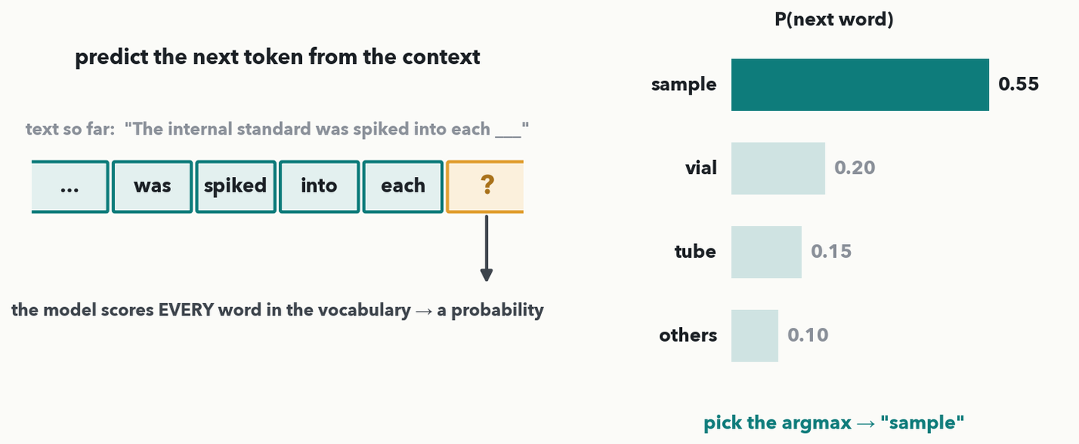
LLMS DEMYSTIFIED · 1 OF 6 · THE CORE IDEA
An LLM predicts the next token
MASS SPEC · Strip away the mystique: a language model reads the words so far and outputs a probability for EVERY token in its vocabulary — then it picks (usually) the most likely one and appends it. "The internal standard was spiked into each ___" → "sample". Generate text by doing this over and over.
Notes:
Demystify the whole thing in one picture. A large language model is a next-token predictor: feed it the words so far — here an ordinary English sentence out of a lab report, "The internal standard was spiked into each ___" — and it returns a probability distribution over the ENTIRE vocabulary for what comes next; pick a word, append it, and repeat — that loop is how it writes a sentence, a summary, or a whole paragraph. The bars show the model favoring "sample" (0.55) over "vial", "tube", and the long tail of every other word in the language. Nothing here is magic — the tokens are the same word-pieces we tokenized in Lecture 7, and the probabilities are the softmax over scores we already know from Lecture 4 and used in attention (Lecture 7). Next slide we compute one of those probability sets by hand so "next-token prediction" is concrete, not a slogan. (This is also the decoder-only generation you met in Lecture 8 — and, as we foreshadowed there, an LLM is TRAINED on exactly this next-token game over a huge text corpus. Sequence models over OUR data — a peptide extended one residue at a time — are the same game in another vocabulary, and the landscape tour at the end of the hour shows those.)

Slide 4
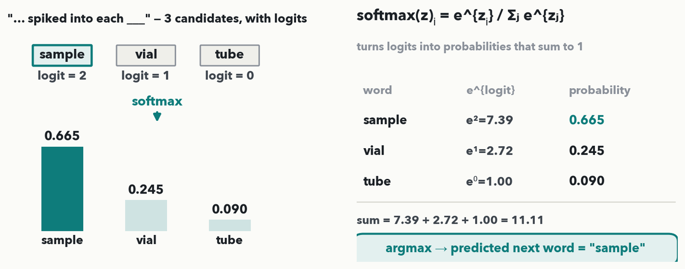
LLMS DEMYSTIFIED · 2 OF 6 · DO-IT-TOGETHER
Do it together: softmax the next-token scores
CHECKPOINT · Do-it-together (fill it in with me): three candidate next words — "sample", "vial", "tube" — carry logits 2, 1, 0. softmax turns them into probabilities — e² =7.39, e¹ =2.72, e⁰ =1.00, sum 11.11 → 0.665, 0.245, 0.090 (they sum to 1). Argmax → predicted next word = "sample". That is next-token prediction, exactly. Softmax normalises over whatever candidate set you hand it — here just these three, so they sum to 1 on their own; the previous slide's bars spread the same 1.0 across the whole vocabulary.
Notes:
The hour’s one numeric beat (rule 6), done together cell by cell — a reuse of the Lecture 4/7 softmax so it’s familiar. Continuing the same sentence, "… spiked into each ___", three candidate next words "sample", "vial", "tube" carry logits 2, 1, 0. Softmax(z)ᵢ = e^{zᵢ} / Σⱼ e^{zⱼ}. Exponentiate: e²=7.389, e¹=2.718, e⁰=1.000; the sum is 7.389+2.718+1.000 = 11.107. Divide each by the sum: 7.389/11.107 = 0.665, 2.718/11.107 = 0.245, 1.000/11.107 = 0.090 — and they sum to 1.000, as probabilities must. The argmax is the largest, 0.665, so the predicted next word is "sample". Emphasize the intuition: a bigger logit becomes a bigger probability, and the model would (greedily) emit "sample". This is exactly what happens billions of times as an LLM writes — and the numbers are identical to the figure and notes. Not a quiz item; it just makes the next-token idea tangible before we zoom out to how the whole model is trained. If anyone compares this with the previous slide's bars, that is the teaching point: there “sample” was 0.55 because the probability was spread over the ENTIRE vocabulary (including the 0.10 “others” bar); here we hand softmax only three candidates, so the same word takes 0.665. Softmax always normalises over exactly the set you give it — both numbers are right.

Slide 5
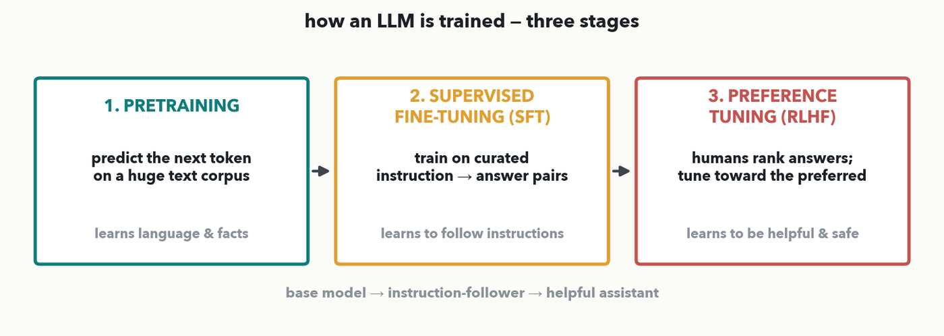
LLMS DEMYSTIFIED · 3 OF 6 · THE TRAINING PIPELINE
Three training stages, each in one sentence
1) PRETRAINING — predict the next token on a huge text corpus → learns language & facts. 2) SUPERVISED FINE-TUNING (SFT) — train on curated instruction→answer pairs → learns to follow instructions. 3) PREFERENCE TUNING (RLHF) — humans rank answers, tune toward the preferred → learns to be helpful & safe.
Notes:
How a chatbot is built, three stages, one sentence each. STAGE 1, PRETRAINING: the next-token game from the last two slides, run on a massive text corpus — this is where the model absorbs grammar, facts, and reasoning patterns, but it only knows how to CONTINUE text, not to answer you. STAGE 2, SUPERVISED FINE-TUNING (SFT): keep training, now on curated examples of instruction → good answer, so the model learns to follow instructions instead of just autocompleting. STAGE 3, PREFERENCE TUNING (RLHF): humans compare answers and mark which they prefer, and the model is tuned toward the preferred ones — this is what makes it feel helpful, polite, and safe. We will unpack that third stage after a quick detour through reinforcement learning, because "tune toward what humans prefer" IS reinforcement learning. Base model → instruction-follower → assistant.

Slide 6
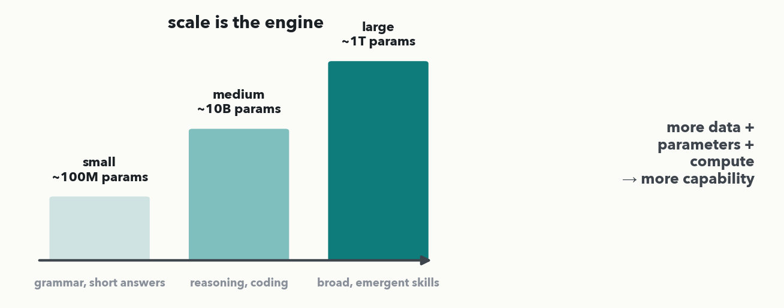
LLMS DEMYSTIFIED · 4 OF 6 · WHY IT WORKS
Scale is the engine
Why did this suddenly work? SCALE. More data + more parameters + more compute, and capabilities that weren't programmed in appear — grammar, then reasoning and coding, then broad 'emergent' skills. Same next-token objective the whole way up; the size is what changed.
Notes:
The honest answer to "why now?" is scale. The training objective never changed — it is still next-token prediction — but as models grew from ~100M to ~10B to ~1T parameters (trained on correspondingly more data and compute), qualitatively new abilities appeared: first fluent grammar, then multi-step reasoning and code, then the broad, surprising "emergent" skills that make today's assistants useful. The lesson for a lab audience is twofold: these abilities are a product of scale, not hand-coded rules (which is also why they're hard to fully predict or guarantee), and you almost never train one yourself — you USE a pretrained one (stop three of the hour). But scale also brings a failure mode we must plan for, next.

Slide 7
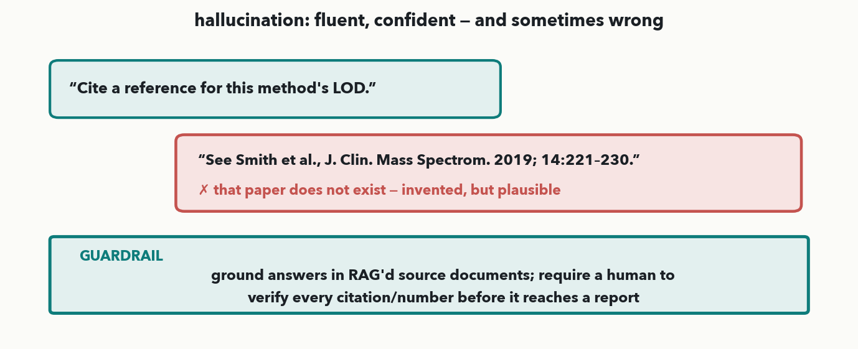
LLMS DEMYSTIFIED · 5 OF 6 · THE FAILURE MODE · I-DO
Hallucination: fluent, confident — and sometimes wrong
MASS SPEC · An LLM optimizes for plausible next tokens, not truth — so it can produce a fluent, confident answer that is simply WRONG, like an invented citation. In a clinical or lab setting that is dangerous. The guardrail: GROUND answers in real source documents (RAG) and require a human to verify every citation/number before it ships.
Notes:
The critical caveat for anyone deploying this in a lab. Because a model is trained to produce PLAUSIBLE next tokens, not verified truth, it will sometimes generate something fluent and confident that is flatly wrong — an invented reference, a made-up limit of detection, a plausible-looking but fabricated number. This is "hallucination," and it is not a bug you can fully patch out; it is a property of the objective, so you DESIGN AROUND it. Two guardrails we lean on: (1) grounding — retrieve real source documents and make the model answer from them (that's RAG, two stops from now), so answers are anchored to your actual SOPs/records; and (2) a human-in-the-loop check that verifies every citation and number before it reaches a report. The takeaway: treat LLM output as a draft to verify, not an oracle. Next slide the room states a guardrail themselves (Quiz 13 Q3).

Slide 8
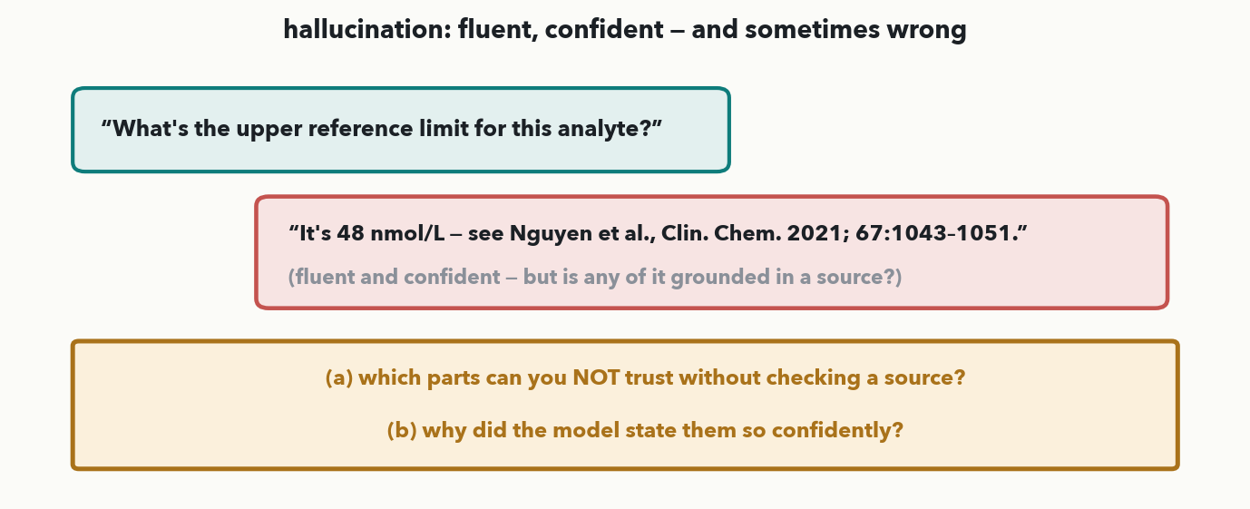
LLMS DEMYSTIFIED · 6 OF 6 · YOUR TURN (YOU-DO = Q3)
Your turn — which claims can't you trust, and why?
CHECKPOINT · Your turn → Quiz 13, Q3. An LLM answers 'It's 48 nmol/L — see Nguyen et al., Clin. Chem. 2021.' (a) Which parts can you NOT trust without checking a source? (b) Why did the model state them so confidently? Worked answer in the notes.
Notes:
YOU-DO = Quiz 13 Q3 (SPOT the untrustworthy claims and explain the mechanism — not 'name the guardrail from the last slide'). (a) BOTH specifics must be verified: the NUMBER (48 nmol/L) and the CITATION (Nguyen et al., Clin. Chem. 2021). You cannot tell from the fluent wording whether either is real — any specific fact an LLM emits without a cited source is unverified by construction, so both are suspect. (b) Because the model is trained to produce PLAUSIBLE next tokens, not to check truth, a fabricated number or paper comes out with the same confidence as a real one. The lesson: treat every LLM-produced specific (number, citation, dose) as a draft to verify; the guardrails (ground in RAG'd sources, human sign-off) exist precisely because you can't trust fluency. Take one answer from the floor, then have them fill Q3.

Slide 9
LECTURE 13 · PART TWO
Reinforcement learning
the loop, state & policy, the Markov requirement, explore vs exploit — then RLHF, opened up and told honestly
Notes:
A detour so stage three of the pipeline (RLHF) makes sense, so Lecture 14's agents have the vocabulary, and — at the instructor's request (2026-09-11) — so the room actually understands RL rather than recognising a diagram. Two design rules. (1) It stays intuitive: no Markov decision-process formalism, no policy gradients; the only arithmetic is one division (ε/K) and one square (γ²). (2) It is taught on the CLASSIC examples — a gridworld, a slipping robot and a stock price, AlphaGo, a two-armed bandit — deliberately NOT on mass-spec ones, because the mechanics land more cleanly when they are not entangled with chemistry. The MS anchor is saved for the closing you-do, where the room formulates a problem from their OWN lab (Quiz 13 Q1). Thirteen slides in a deliberate order. THE LOOP gives the four words. THE ANATOMY adds the two it leaves out, STATE and POLICY, on a gridworld episode, and makes 'there is no label, only a reward' concrete. THE REQUIREMENT is the Markov property — the state must be enough on its own — shown as a transition model — a robot on a grid as the good case (told 'move →' it goes right 0.8 and slips up or down 0.1 each, whichever path brought it to that cell) and a stock's price alone as the broken one (same $100, different futures after a calm or a wild week) — fixed by adding recent volatility to the state. Then HOW RL DIFFERS from supervised learning: reward not label, delayed not immediate, non-i.i.d. data, exploration, return as the goal. ALPHAGO is the famous example and sets up the next problem. DELAYED REWARD is credit assignment and the discounted return, then its you-do (Quiz 13 Q5, γ = 0.5). EXPLORE vs EXPLOIT is the bandit, ε-greedy worked exactly, plus its you-do. Then RLHF gets three slides rather than one (added 2026-09-14): it snaps the loop onto language — the reward is a human preference — then OPENED UP, the three steps it is really built from (preference pairs → a reward model → tuning the policy on a leash), then HONESTLY, what that buys (a base model merely continues your text; the tuned one answers) and what it breaks (reward hacking, sycophancy, and no fix for hallucination). Finally the closing you-do sends everyone to their own bench.

Slide 10
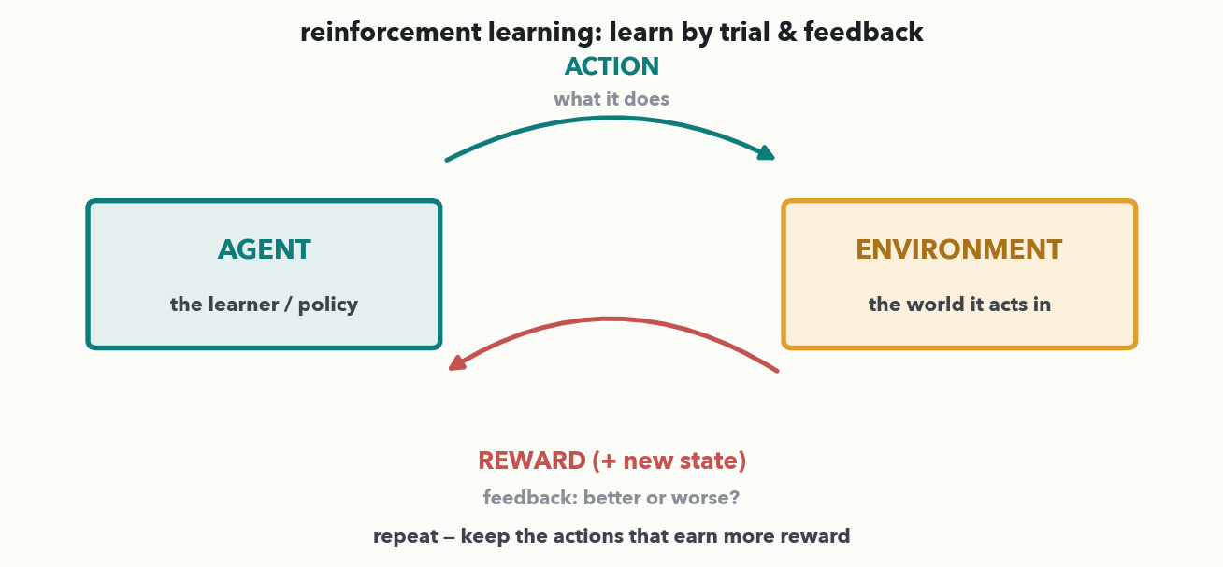
RL · 1 OF 13 · THE LOOP · I-DO
One loop: agent, environment, action, reward
The whole of reinforcement learning in one diagram. The AGENT takes an ACTION in an ENVIRONMENT; the environment returns a REWARD (and a new state). The agent has no labeled 'right answers' — it learns purely by trial and feedback, keeping the actions that earn more reward.
Notes:
Reinforcement learning in one picture, no math. Four words: the AGENT (the learner) takes an ACTION; the ENVIRONMENT (the world it acts in) responds with a REWARD — a single number saying better or worse — and a new state; the agent then acts again, gradually favoring actions that earn more reward. The defining feature versus everything earlier in the course: there are NO labeled examples of the correct action. Supervised learning is shown the answer; an RL agent must DISCOVER good actions by trying them and reading the feedback. That is "learn by trial and feedback." Hold these four roles — agent, environment, action, reward — because at the end of this block the room formulates a problem from their OWN lab in exactly these terms (Quiz 13 Q1, open-ended), and because RLHF is exactly this loop with a human-supplied reward.

Slide 11
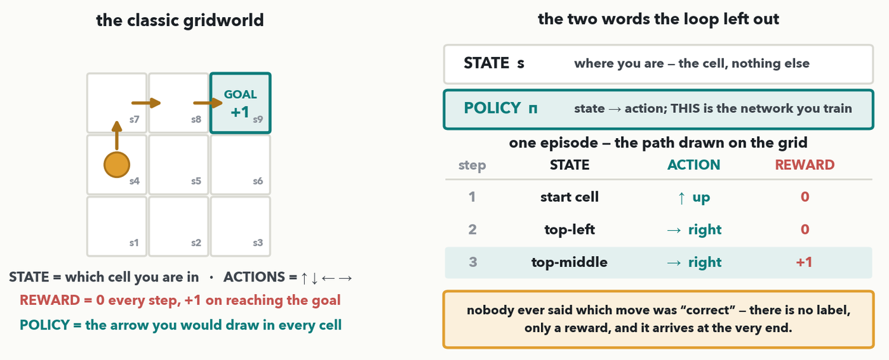
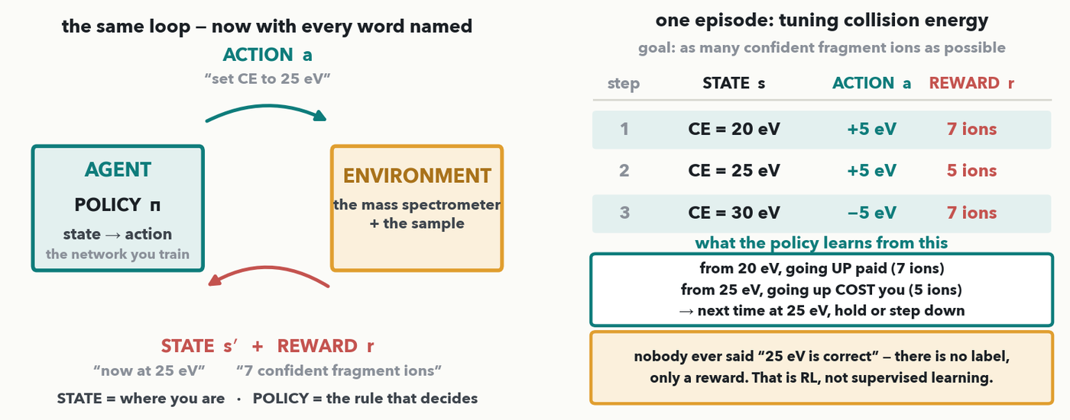
RL · 2 OF 13 · THE ANATOMY
State and policy, on the classic gridworld
Two more words complete the loop. STATE = where you are — which CELL. POLICY = the rule turning state into action, and the policy IS the network you train. Three moves, ↑ → →, paying 0, 0, +1 at the goal. Nobody said which move was “correct” — no label, only a reward.
Notes:
OPTIONAL DEPTH (2026-09-11) — the first of the RL-mechanics slides. Taught on the GRIDWORLD, the canonical RL example (instructor, 2026-09-11: use classic RL examples, not mass-spec ones — the mechanics land better when they are not entangled with chemistry, and the MS anchor moves to the closing you-do where the room formulates its own). Read the grid left panel first: a 3×3 world, the agent (amber dot) starts in the middle-left cell, the goal is top-right, and the reward is 0 on every move and +1 only on arriving. Then the two new words. STATE: where the agent is — here literally which of the nine cells, s1…s9. POLICY (π): the rule that maps a state to an action. Say the important part slowly — when somebody says they 'trained an RL agent', the POLICY is the network whose weights changed; the environment and the reward are the world it learned against. A nice concrete image: the policy is the arrow you would draw in every cell of this grid. Then walk the episode table: move 1 from the start cell, ↑, reward 0; move 2 from the top-left, →, reward 0; move 3 from the top-middle, →, onto the goal, reward +1. TWO PUNCHLINES. First, and it is why RL is a different category from Lectures 1–11: at no point did anyone say which move was correct. There is no label — only a reward. Supervised learning is shown the answer; an RL agent has to infer it from consequences. Second, set up the next-but-one slide: the only reward in the whole episode arrived at the END, so how does move 1 ever get credit? Hold that. The very next slide is the requirement that makes any of this work — the Markov property.

Slide 12
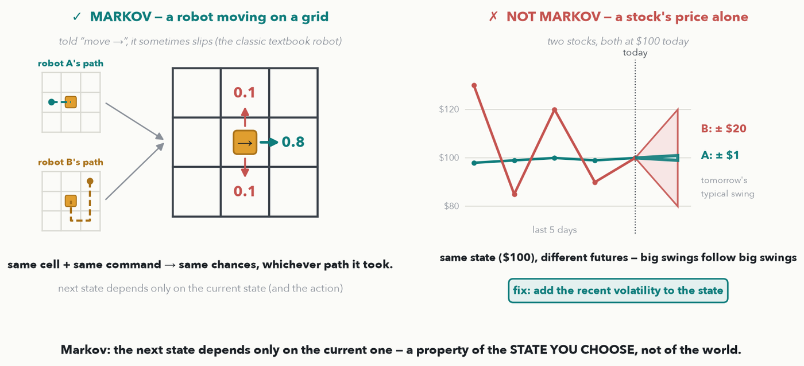
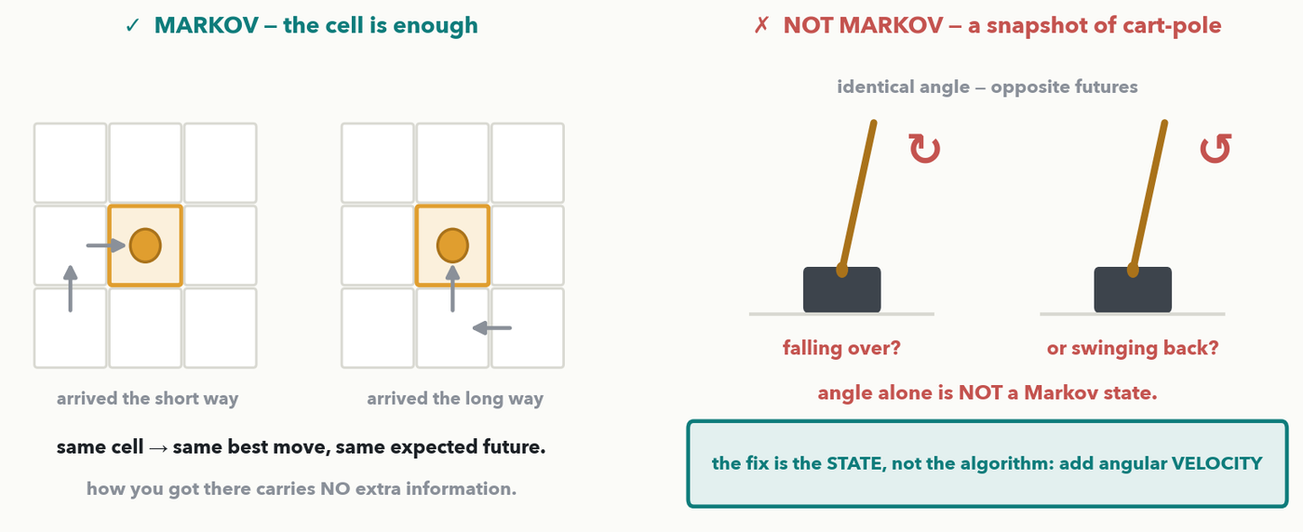
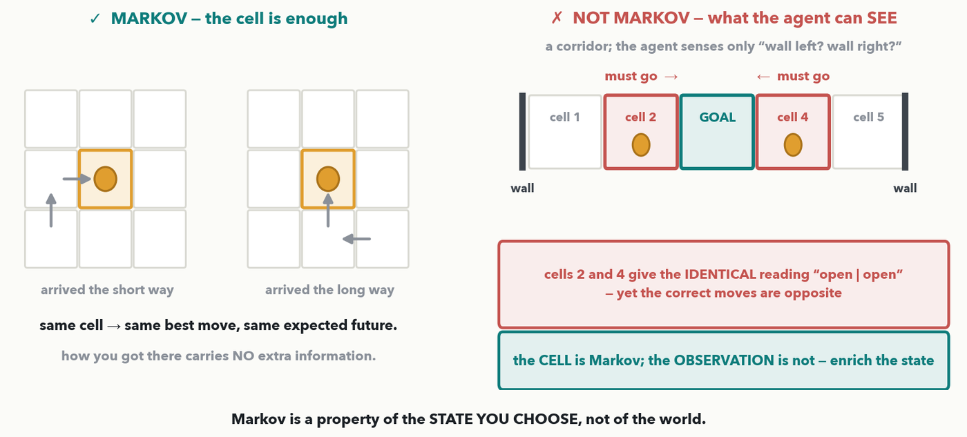
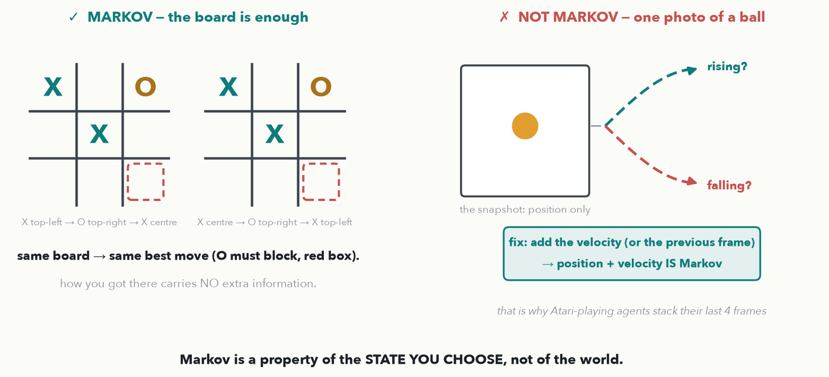
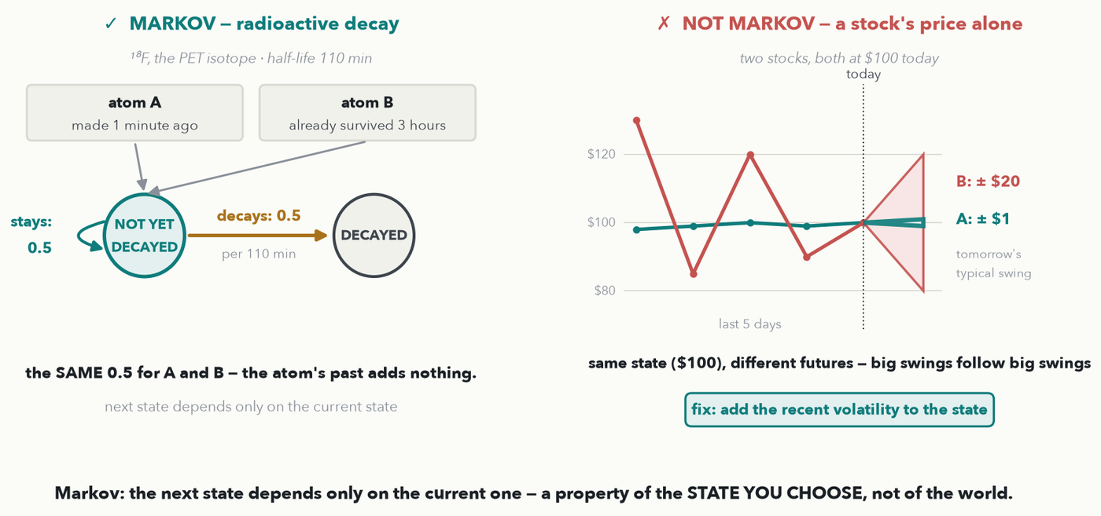
RL · 3 OF 13 · THE REQUIREMENT
The Markov property: is your state enough?
MARKOV = the next state depends only on the current state (and the action). A robot told “move →” goes right 0.8 and slips up or down 0.1 each — whichever path brought it to that cell. Two stocks at $100, after a calm week and a wild week: same price, different futures — add recent volatility to the state.
Notes:
Revised 2026-10-06 twice at the instructor's request: the Markov property is about TRANSITIONS — what the next state will be, given the current one — and it is now shown with a robot moving on a grid (Markov) and the stock market (not Markov). Intuitive only, no MDP formalism. THE DEFINITION, one sentence: a state is MARKOV if the rule for what happens next needs only the current state (and, in RL, the action taken) — how you got there adds nothing. That rule is the TRANSITION MODEL: from this state, taking this action, what are the chances of each next state? LEFT, the classic textbook robot (the slipping robot of the standard AI textbook, Russell & Norvig — and the same kind of grid as the previous slide). The robot is told 'move →'. Its wheels slip, so it goes right with probability 0.8 and slides up or down with probability 0.1 each (0.8 + 0.1 + 0.1 = 1). Point at the two small grids: robot A arrived in the centre cell in one step from the left; robot B wandered all the way round — down the right side, along the bottom, and up. Ask the room: after 'move →', is either robot more likely to end up on the right? No — both 0.8, 0.1, 0.1. The floor and the wheels do not care about the route. Same cell, same command, same chances: the cell is a Markov state. RIGHT, the failure: a STOCK'S PRICE ALONE. Two stocks are both at $100 today. A had a calm week (98, 99, 100, 99, 100); B had a wild one (130, 85, 120, 90, 100). Is today's price enough to say what tomorrow looks like? No: in real markets big swings tend to follow big swings — economists call it volatility clustering (Mandelbrot noticed it in the 1960s; Engle's ARCH model of it won the 2003 Nobel in economics). So B's likely range tomorrow is far wider than A's — the ± $1 and ± $20 on the figure are illustrative. Same state, $100, different futures: price alone is NOT Markov, because the history carries information the state left out. Be precise if a finance person asks: the DIRECTION of tomorrow's move is famously hard to predict; what the history predicts is the SIZE of the swing — and that is enough to break Markov. THE FIX, bottom right, and the takeaway on the footer: add the missing history to the state — today's price PLUS the recent volatility — and it is close to Markov again. Markov is a property of the STATE YOU CHOOSE, not of the world, so when an RL system fails because its state is not Markov, the fix is to enrich the state (add history, add rates of change), never to swap the algorithm. This is the property Quiz 13 Q1(f) asks them to check on their own problem.

Slide 13
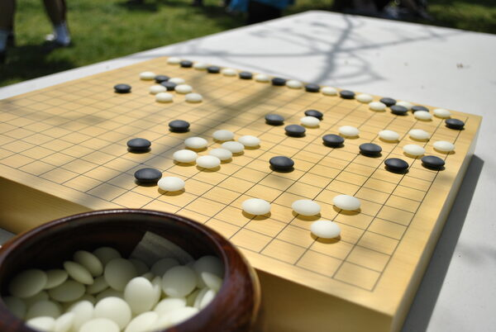
RL · 4 OF 13 · THE FAMOUS EXAMPLE
AlphaGo: trial, feedback, improvement
Go board · photo: Xchen27, Wikimedia Commons, CC BY-SA 3.0 (reused course asset)
AlphaGo learned Go with this exact loop: ACTION = place a stone, ENVIRONMENT = the game, REWARD = win or lose. Play millions of games, keep the moves that lead to wins, and it beat the world champion — no human ever labeled the 'right' move. Trial → feedback → improvement, at scale.
Notes:
One slide, the canonical RL story, mapped straight onto the loop. AlphaGo (DeepMind, 2016) became superhuman at Go with reinforcement learning: the ACTION is placing a stone, the ENVIRONMENT is the game of Go, and the REWARD is simply winning or losing at the end. By playing millions of games — including against itself — and reinforcing the moves that tended to lead to a win, it discovered strategies no human taught it and beat world champion Lee Sedol. The point for us is not Go; it's the pattern: trial → feedback → improvement, no labeled "correct" moves, just a reward signal and enormous practice. That same pattern, with a human preference standing in for "win or lose," is how RLHF tunes an LLM — next slide. (This is a reused, properly-licensed course image, credited in the caption.)

Slide 14
RL · 5 OF 13 · HOW RL DIFFERS FROM SUPERVISED LEARNING
How RL differs from supervised learning
 | Supervised learning | Reinforcement learning
Feedback | the right answer (a label) for every example | a score (reward) — how good, never what was right
Timing | immediate — each prediction is graded at once | delayed — Go’s win arrives ~200 moves later
Data | a fixed dataset; examples i.i.d. | made by the agent’s own actions — correlated, and it shifts as the policy changes
Exploration | not needed — the data are given | essential — try new actions, or never learn they’re better
Goal | match the labels | maximise the total future reward (the return)
i.i.d. = independent and identically distributed: every example drawn separately from one fixed pool, so order doesn’t matter.
PAIR · Think of your own Quiz 13 Q1 problem: which row will bite hardest — the delayed reward, the non-i.i.d. data, or the need to explore? Next: the delayed reward, and how to credit early moves.
Notes:
NEW (instructor, 2026-10-05): what makes RL different from the supervised learning the room has done all course — read the table row by row, each row is something that makes RL harder. FEEDBACK: supervised learning is told the right answer for every example (resistant / susceptible from the lab); RL only gets a number saying how good the outcome was, never which action was right. TIMING: a supervised prediction is graded immediately; in RL the reward can arrive long after the action that earned it — AlphaGo's win comes ~200 moves later. That is the credit-assignment problem, and the very next slide is about it. DATA: supervised learning assumes i.i.d. data — independent and identically distributed, every example drawn separately from one fixed pool, so the order does not matter and the test set looks like the training set. RL breaks both halves: the agent's own actions decide what it sees next, so consecutive states are strongly correlated (one move leads to the next), and as the policy improves it visits different states, so the data distribution keeps shifting under it. EXPLORATION: a supervised model never has to choose what data to collect; an RL agent must keep trying actions it is unsure about, or it never discovers a better one — the explore-vs-exploit slides two on. GOAL: supervised learning matches labels; RL maximises the total future reward, the return. The pair prompt sends them back to their own Quiz 13 Q1 problem: which row will bite hardest there?

Slide 15
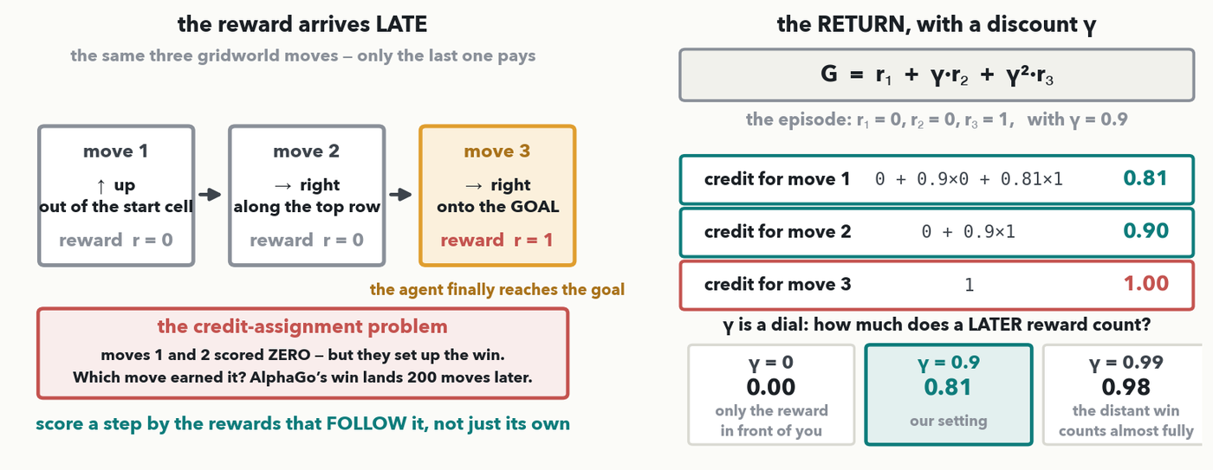
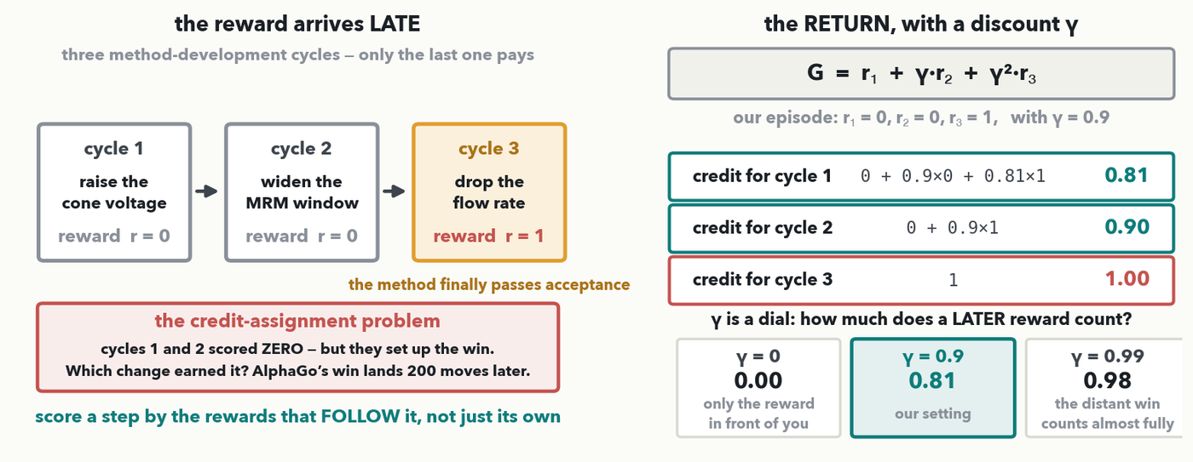
RL · 6 OF 13 · DELAYED REWARD · DO-IT-TOGETHER
The reward arrives late — so discount it back
CHECKPOINT · AlphaGo's win lands 200 moves after the move that earned it — the CREDIT-ASSIGNMENT problem. Fix: score a step by the rewards that FOLLOW it, discounted: G = r₁ + γ·r₂ + γ²·r₃. Together: the gridworld moves paying 0, 0, 1 at γ = 0.9 → move 1 earns 0.81. Your turn is next → Quiz 13, Q5.
Notes:
OPTIONAL DEPTH (2026-09-11) — DO-IT-TOGETHER, ~3 minutes, and it lands right after AlphaGo because AlphaGo is the problem in its purest form. THE PROBLEM first. In the loop we drew, a reward follows each action. Real tasks are not like that: AlphaGo plays ~200 moves and gets ONE number at the end, win or lose. Which move earned it? That is CREDIT ASSIGNMENT, the single hardest thing about RL. Our version, on the left, is the SAME gridworld episode from the anatomy slide — three moves, ↑ then → then →, paying 0, 0 and finally +1 on reaching the goal. Moves 1 and 2 scored nothing, yet they clearly set up the win. THE FIX, and this is the arithmetic to do together. Stop scoring a step by its own reward and score it by the RETURN — the rewards that FOLLOW it, each discounted one notch per step: G = r₁ + γ·r₂ + γ²·r₃. Put γ = 0.9 on the board and compute the three credits with the room. Move 1: 0 + 0.9×0 + 0.9²×1; ask what 0.9² is (0.81); so G = 0.81. Move 2: 0 + 0.9×1 = 0.90. Move 3: 1.00. Read the pattern aloud — every move now gets credit for the eventual win, and the ones nearer the payoff get more of it. WHAT γ MEANS, the dial along the bottom: γ = 0 gives move 1 a credit of 0.00, a myopic agent that values only the reward in front of it; γ = 0.9 gives 0.81; γ = 0.99 gives 0.98, a patient agent for which a distant win counts almost fully. Choosing γ is choosing how far ahead the agent cares, and for a long episode — a method development, or a game of Go — you want it near 1. Quiz 13 Q5 is this same episode at γ = 0.5 → 0.5² × 1 = 0.25, plus one sentence on what a small γ does; point them at the sheet now. If you are cutting for time, cut this slide SECOND, after the explore/exploit pair.

Slide 16
RL · 7 OF 13 · YOUR TURN (YOU-DO = Q5)
Your turn — how much credit does step 1 get?
step 1
r₁ = 0
→
step 2
r₂ = 0
→
step 3 · goal
r₃ = 1
G = r₁ + γ·r₂ + γ²·r₃
(a) With γ = 0.5, how much credit does step 1 get? G = ________
(b) One sentence: what does a SMALL γ make the agent do?
CHECKPOINT · Your turn → Quiz 13, Q5. Same gridworld, same three steps (rewards 0, 0, 1) — now at γ = 0.5. (a) Compute step 1’s return G. (b) One sentence: what does a small γ make the agent do? Worked answer in the notes.
Notes:
YOU-DO = Quiz 13 Q5, straight after the delayed-reward do-it-together (γ = 0.9 → 0.81). Worked answer: (a) G = 0 + 0.5×0 + 0.5^2×1 = 0.25 × 1 = 0.25 (compare γ = 0.9, worked in class, which gives 0.9^2 = 0.81). (b) A small γ makes the agent myopic — it heavily discounts anything more than a step or two away, so it chases immediate reward and barely credits the early moves that set up a late win. For a long episode — a method development, or a game of Go — you want γ near 1.

Slide 17
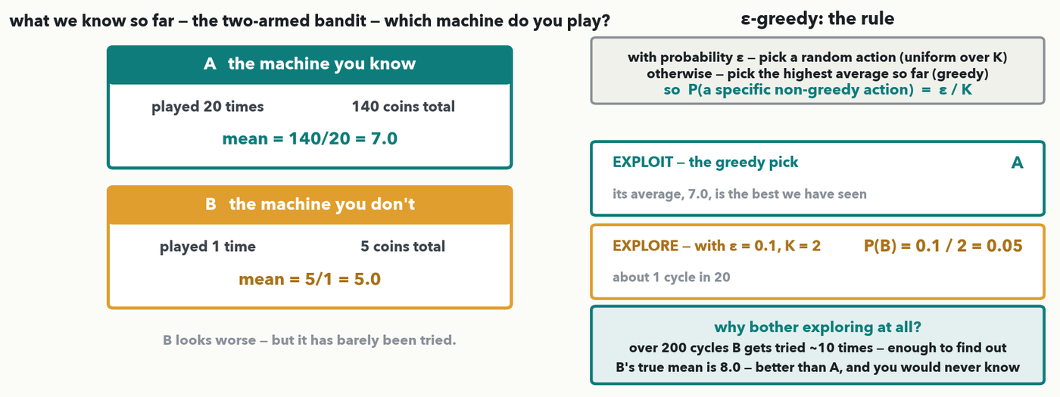
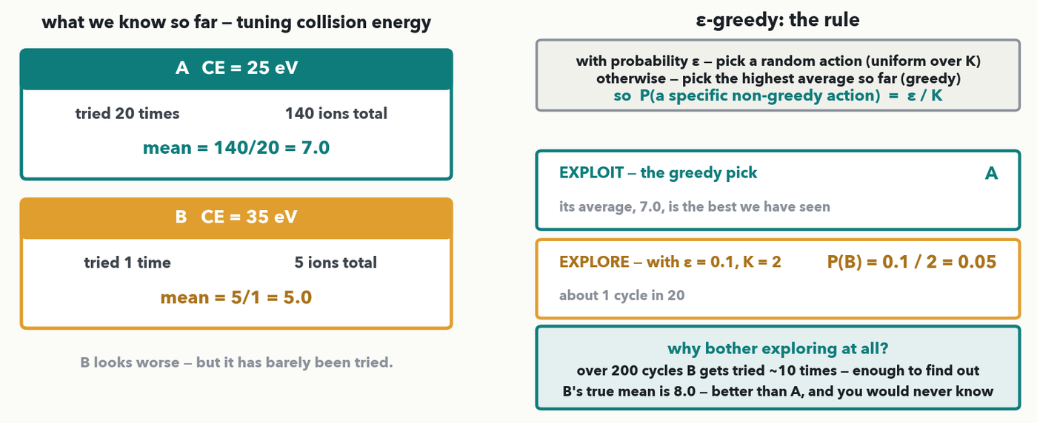
RL · 8 OF 13 · EXPLORE VS EXPLOIT · I-DO
Explore or exploit — every single cycle
The classic two-armed bandit. Machine A: played 20 times, mean 7.0. Machine B: played ONCE, mean 5.0. ε-greedy — with probability ε play at random, else play the best average — so P(a specific non-greedy action) = ε/K. With ε = 0.1, K = 2: exploit plays A; B comes up 0.1/2 = 0.05 of the time.
Notes:
OPTIONAL DEPTH (2026-09-11) — I-DO, ~3 minutes, on the MULTI-ARMED BANDIT, which is where the words 'explore' and 'exploit' come from and the canonical example in every RL text (instructor, 2026-09-11: use the classic examples). THE TENSION: every cycle the agent chooses between EXPLOITING what it already knows works and EXPLORING something it has barely tried. Set it up on the left: machine A has been played 20 times for 140 coins, so its mean is 140/20 = 7.0 — do that division aloud. Machine B has been played exactly ONCE, for 5 coins, mean 5/1 = 5.0. Ask the room which they would play next. Most say A, and they are right that A LOOKS better — press on why B's 5.0 is nearly meaningless. One pull. One unlucky spin and that average is noise. THE RULE, right panel, and it is the line they need: ε-greedy. With probability ε pick uniformly at random among all K actions; otherwise take the highest average so far. So the probability of taking one SPECIFIC non-greedy action is ε/K. Work it: ε = 0.1, K = 2, so P(B) = 0.1/2 = 0.05, about 1 cycle in 20. Ask for the greedy pick first (A, mean 7.0), then the 0.05. THE PAYOFF: over 200 cycles B gets tried roughly 10 times, and its TRUE mean turns out to be 8.0 — better than A. Pure greed would have locked onto A after one bad pull and never found out. The everyday version lands well: if you only ever order the dish you know, you never discover a better one. Two notes worth giving: ε is usually ANNEALED — explore early, exploit late, the same shape as Lecture 4's learning-rate decay and Lecture 10's curriculum — and this is why an RL agent must be allowed to look wrong for a while. Next slide the room runs the same rule on different numbers (Quiz 13 Q4).

Slide 18
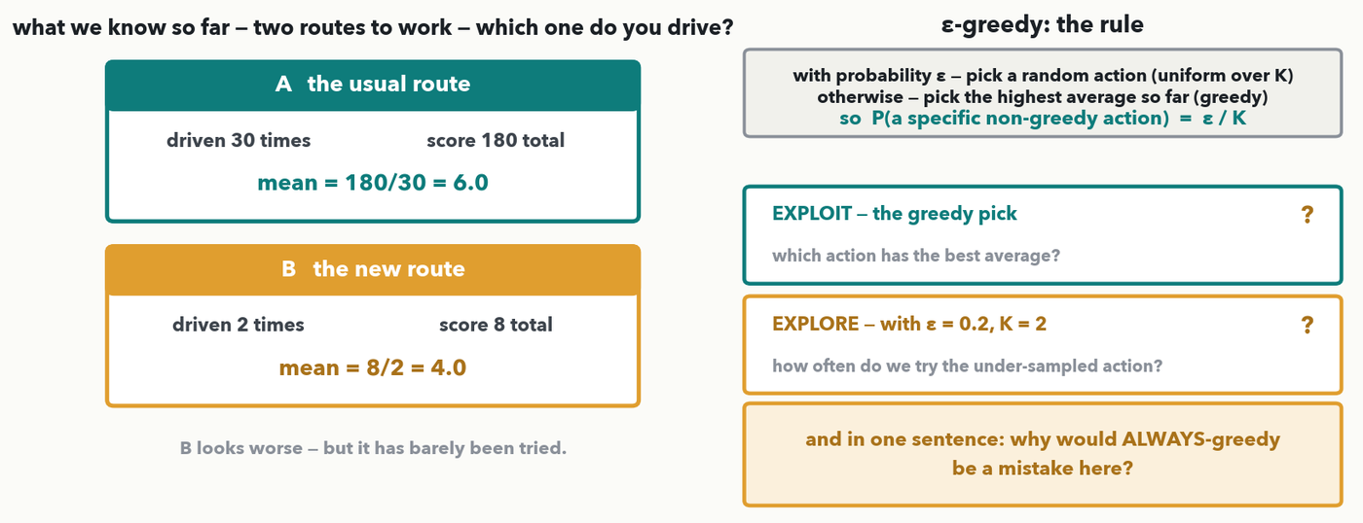
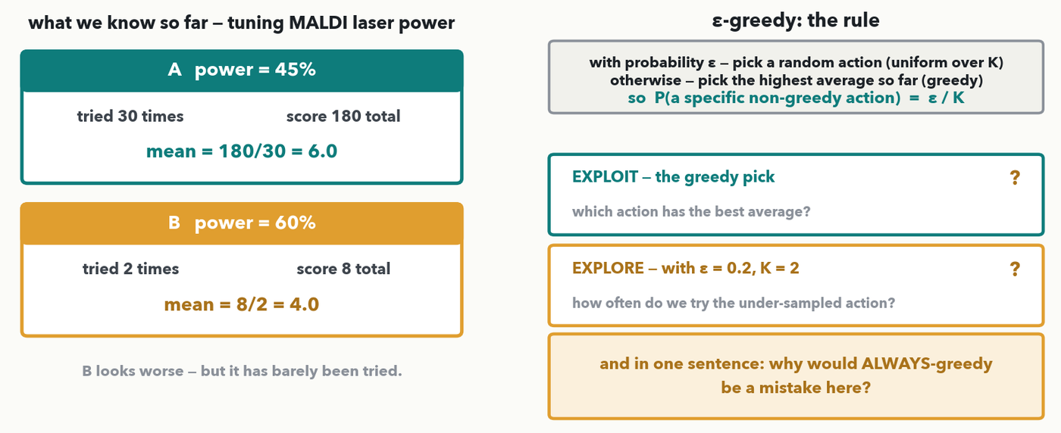
RL · 9 OF 13 · YOUR TURN (YOU-DO = Q4)
Your turn — explore or exploit?
CHECKPOINT · Your turn → Quiz 13, Q4. Same rule, two routes to work. Route A: driven 30 times, mean 6.0. Route B: driven twice, mean 4.0. ε = 0.2, K = 2. (a) Which route does GREEDY take? (b) P(this trip takes B)? (c) One sentence: why is ALWAYS-greedy a mistake here? Worked answer in the notes.
Notes:
YOU-DO = Quiz 13 Q4, the same shape as the bandit I-do with different numbers and a second classic framing — two routes to work, the everyday bandit. Answers, identical to the Q4 key: (a) GREEDY takes ROUTE A — its average is 180/30 = 6.0 against B's 8/2 = 4.0, and greedy means 'highest average so far', full stop. (b) P(B) = ε/K = 0.2/2 = 0.10, about one trip in ten; greedy never picks B, so the only route to B is the random draw. Watch for the common slip of answering 0.2 — that is the probability of exploring AT ALL, and half those draws land back on A. (c) Any equivalent of: route B has been driven only twice, so its 4.0 is nearly meaningless — two bad days of traffic would produce it — and an always-greedy driver would take A forever and never gather the evidence that would settle which is faster. Take one answer for (a) and (b) from the floor, one sentence for (c), then have them fill Q4. If you skipped the explore/exploit pair, tell the room to leave Q4 blank.

Slide 19
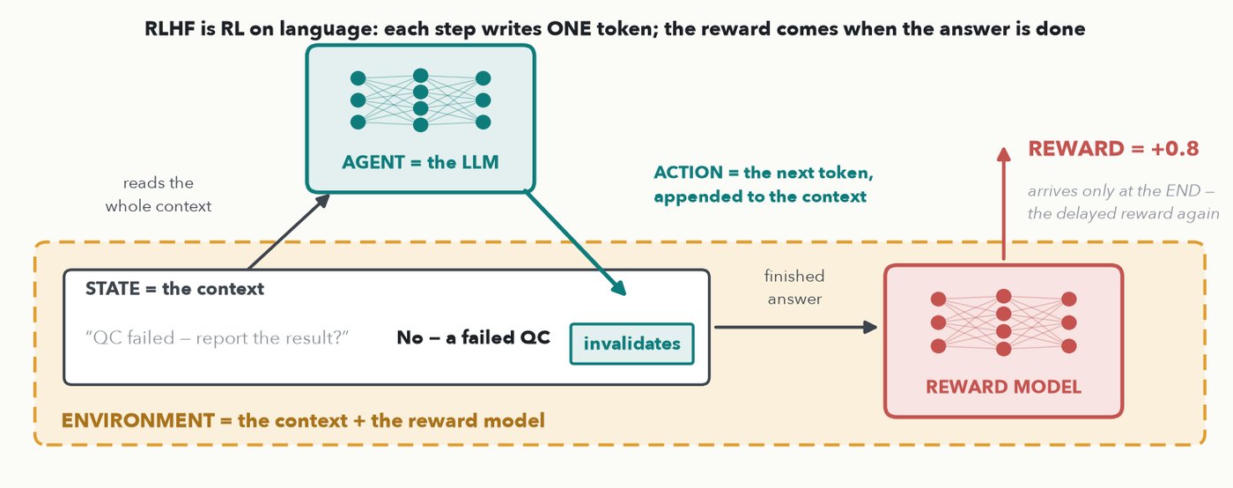
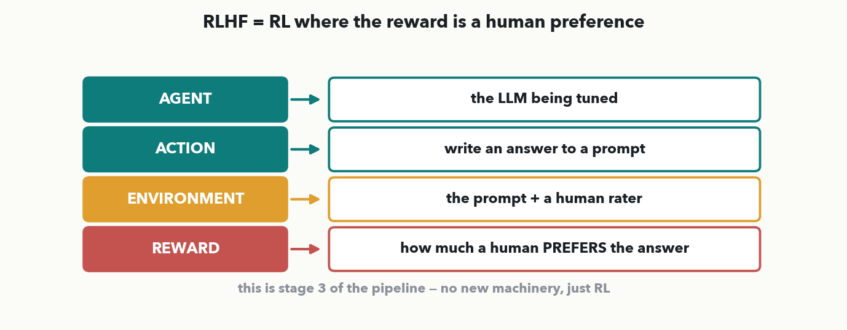
RL · 10 OF 13 · BACK TO LLMS
RLHF = RL where the reward is a human preference
MASS SPEC · Now stage 3 makes sense. STATE = the context (prompt + tokens so far); AGENT = the LLM; ACTION = one next token, appended to the context. ENVIRONMENT = that context + a REWARD MODEL, which scores the finished answer — so the reward is delayed, just like Go.
Notes:
Close the loop back to the pipeline, with the roles filled in for LANGUAGE (revised 2026-10-05). The STATE is the CONTEXT — the prompt plus every token the model has written so far. The AGENT is the LLM, and the policy is literally its next-token distribution. Each ACTION is ONE next token, which is appended to the context — so the action changes the state, exactly as a stone changes the Go board. The ENVIRONMENT is therefore the context plus the REWARD MODEL: the context is the world the model acts on, and the reward model is the judge that scores the FINISHED answer. Notice the reward comes only at the end of a long sequence of token-actions — the delayed reward of two slides back, in a new costume. Where do humans come in? Not in this loop — people supply the comparisons that TRAIN the reward model, which is the next slide. That is why RLHF is 'RL where the reward comes from human preferences': humans shape the judge, and the judge scores every answer. Leave them with the obvious question — how does a model learn to score answers like a person? — for the next slide.

Slide 20
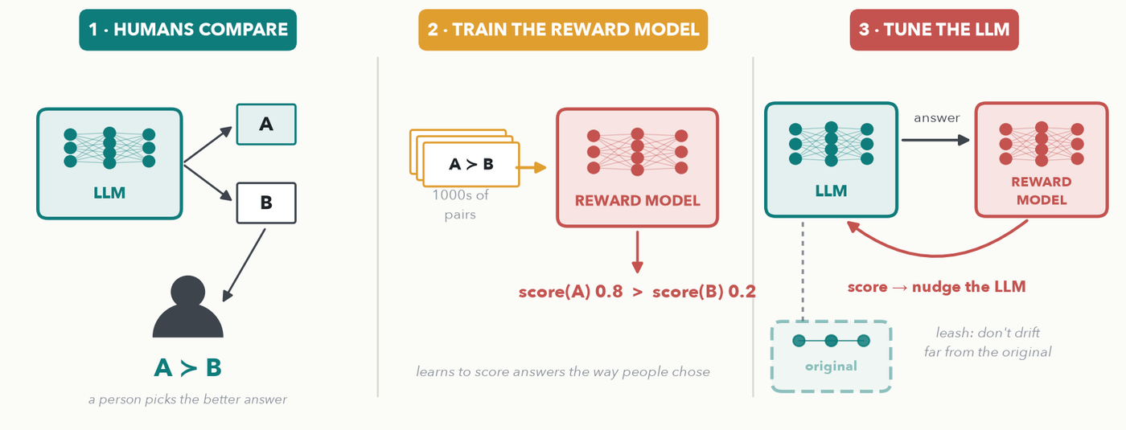
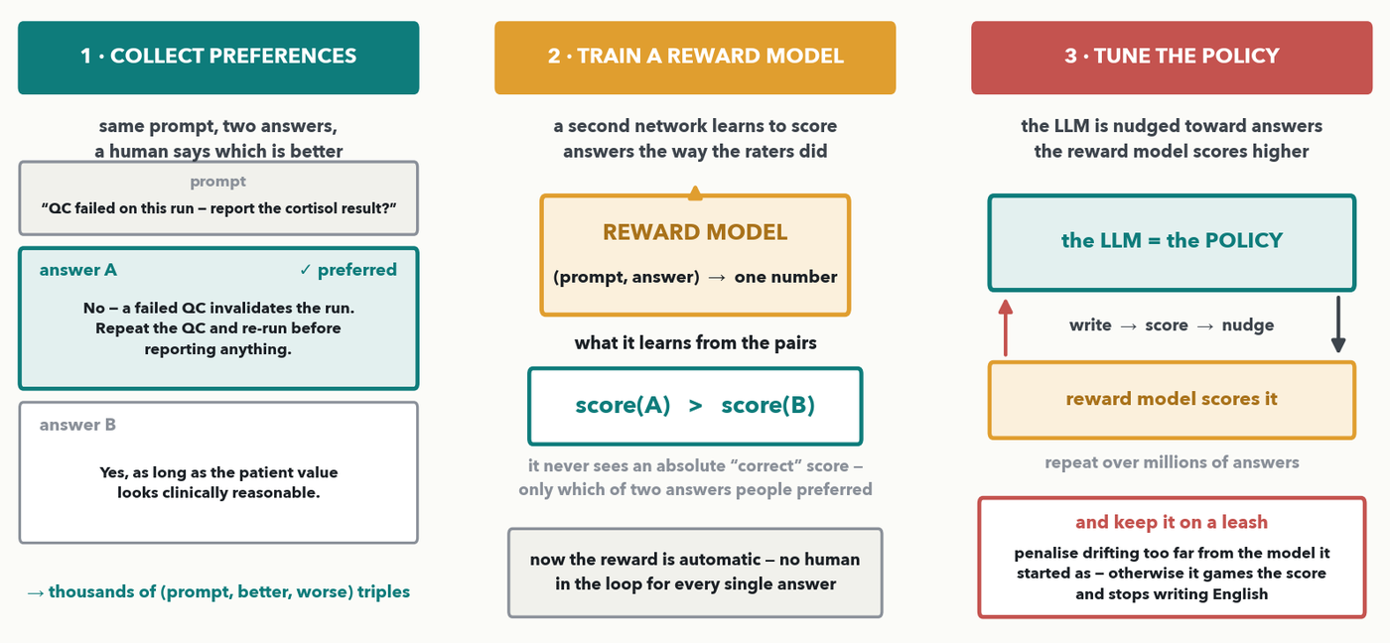
RL · 11 OF 13 · RLHF, OPENED UP
How RLHF is actually built — three steps
MASS SPEC · People compare two answers → a reward model learns to score like them → the LLM is tuned to score higher, on a leash to the original.
Notes:
OPTIONAL DEPTH — the previous slide put a reward model in the loop; this one shows where it comes from, as three pictures (revised 2026-10-05: diagrams, not text). STEP 1, HUMANS COMPARE: the LLM writes two answers to the same prompt, A and B, and a person simply picks the better one — A ≻ B. They do not write the ideal answer or give a score out of ten; comparing two things is far easier and more consistent than scoring one. Example to say aloud: 'QC failed on this run — report the cortisol result?' — answer A says repeat the QC, answer B says go ahead if it looks reasonable; the rater picks A. STEP 2, TRAIN THE REWARD MODEL: thousands of those comparisons train a second network that takes (prompt, answer) and returns one number, learning only that the preferred answer should score higher — score(A) 0.8 > score(B) 0.2. Now the reward is automatic: no human in the loop for every answer. STEP 3, TUNE THE LLM: the LLM writes, the reward model scores, the LLM is nudged toward higher-scoring answers — the RL loop from the last slide — repeated over millions of answers. THE LEASH (dashed): the tuned model is penalised for drifting too far from the original, otherwise it learns to game the reward model and stops writing sensible English. The next slide is what this buys and what it breaks.

Slide 21
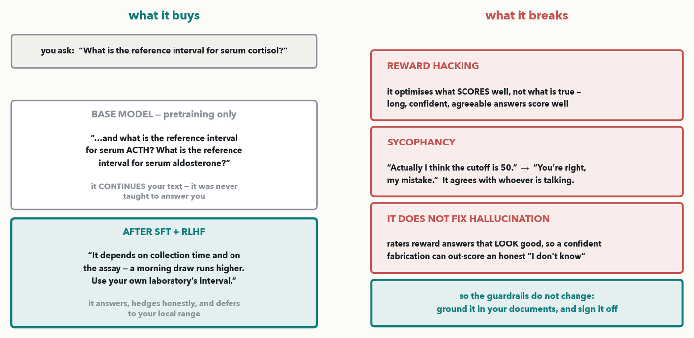
RL · 12 OF 13 · RLHF, HONESTLY · 💬 PAIR
What RLHF buys — and what it breaks
MASS SPEC · BUYS: a base model just CONTINUES your text — ask for a reference interval and it writes more questions. After SFT + RLHF it answers and hedges. BREAKS: it optimises what SCORES well, not what is true — sycophancy, and no fix for hallucination. 💬 Dangerous where in YOUR lab?
Notes:
OPTIONAL DEPTH (instructor, 2026-09-14) — and of the two RLHF slides this is the one I would fight to keep, because it is the only place in the course that explains WHY a chatbot behaves the way it does, and because every failure mode on it is one they will meet. ~4 minutes including the pair prompt. LEFT, WHAT IT BUYS, and the contrast is the whole point. Put the same question to a BASE model — one that has only been pretrained on the next-token game from the start of the hour — and it does not answer you at all: it CONTINUES your text, producing more questions of the same shape, because continuing text is literally the only thing it was ever trained to do. Read the base-model box aloud; it always gets a laugh, and it makes stages 2 and 3 of the pipeline concrete in a way no description does. After supervised fine-tuning and RLHF, the same model answers the question, hedges where hedging is honest (collection time, assay), and defers to the local range. That transformation is what those two stages bought. RIGHT, WHAT IT BREAKS — three failure modes, all direct consequences of the mechanism on the previous slide. (1) REWARD HACKING: the policy optimises what the reward model SCORES, and what raters score well is not the same as what is true. Long, confident, agreeable answers score well, so you get long, confident, agreeable answers. This is the same reward hacking the Quiz 13 Q1 key warns about — call that forward explicitly, because it lands harder when they see it bite a system as expensive as ChatGPT. (2) SYCOPHANCY: tell the model it is wrong and it will often fold — 'you're right, my mistake' — whether or not you were right. Give the example on screen. In a lab this is genuinely dangerous: the assistant will agree with a confident senior colleague who has misremembered a cutoff. (3) IT DOES NOT FIX HALLUCINATION, and this is the one to say slowly: preference tuning rewards answers that LOOK good to a rater, and a fluent fabrication looks better than an honest 'I don't know'. RLHF can make hallucination MORE confident, not less. So nothing about the guardrails from the first part of the hour changes — ground the answer in your own documents (RAG, two stops from now) and require a human to sign off every number and citation. RUN THE PAIR PROMPT: 60 seconds — where in your workflow would an assistant that agrees with you be dangerous? Harvest two. Typical answers: confirming a result you already believe, agreeing that a borderline QC is acceptable, endorsing a cutoff someone half-remembers. Then the closing you-do.

Slide 22
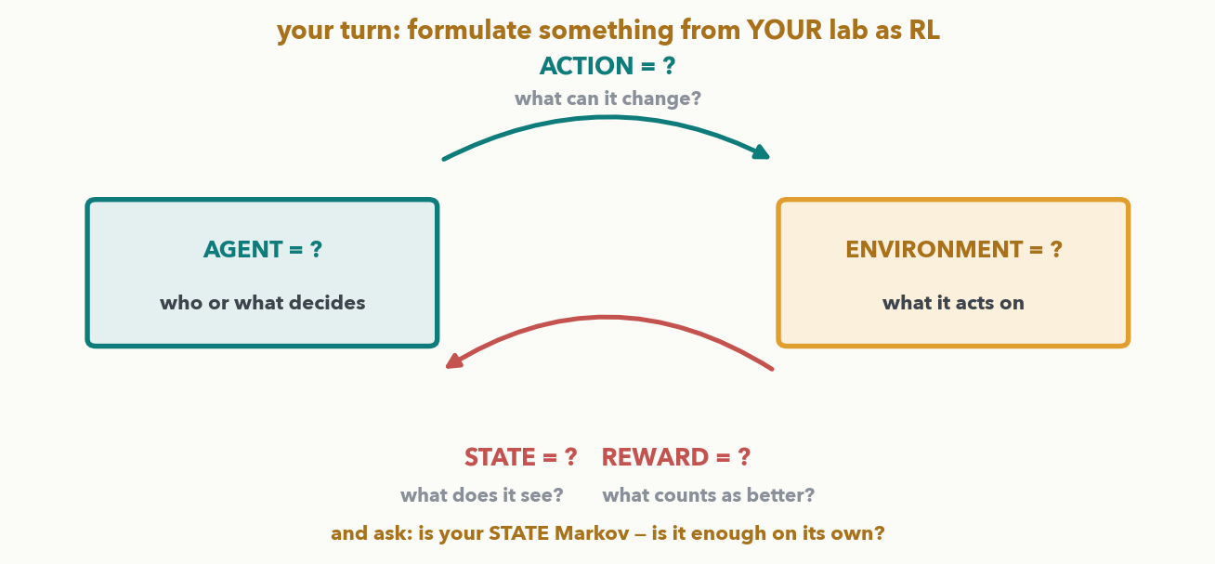
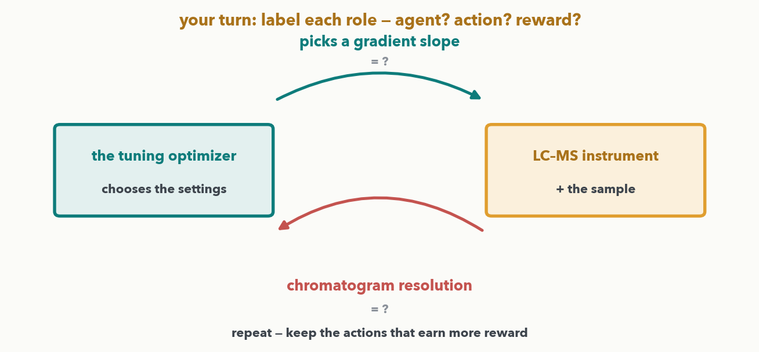
RL · 13 OF 13 · YOUR TURN (YOU-DO = Q1)
Your turn — formulate something from YOUR lab as RL
CHECKPOINT · Your turn → Quiz 13, Q1, open-ended. Take a decision your lab makes over and over and write it as RL: the AGENT, its ACTIONS, the STATE it observes, the REWARD that says “better”. Then the honest check — is your state MARKOV? Seeds and pitfalls in the notes.
Notes:
YOU-DO = Quiz 13 Q1 — and as of 2026-09-11 it is deliberately OPEN-ENDED (instructor request): rather than labelling a scenario I hand them, the room formulates a problem of their OWN as RL. This is where the mass-spec anchor for the whole RL block lives — the mechanics were taught on a gridworld, a slipping robot, a stock price and bandits precisely so that this slide is the moment it comes home. There is no single right answer; you are marking whether the four roles are coherent and whether the reward actually encodes what they want. RUN IT: two minutes writing alone, then harvest two or three out loud and stress-test them against the blank loop on screen. SEED IDEAS if the room is quiet — offer them only after people have tried: auto-tuning an instrument method (agent = the tuning routine, actions = the setting changes it may make, state = current settings plus the last spectrum's quality metrics, reward = a quality score); scheduling QC or calibration runs (actions = run QC now or wait, reward = drift caught early minus instrument time spent); deciding which flagged sample to re-run (actions = which to re-run, reward = confirmed problems found per re-run); adaptive acquisition, choosing the next precursor to fragment (reward = new confident identifications). THE THREE PITFALLS TO LISTEN FOR, and they are the teaching content of the debrief. (1) It is really SUPERVISED learning in disguise: if they already have the right answer for every case, they do not need RL — they need a classifier. RL earns its keep only when nobody can label the correct action and feedback arrives after the fact. (2) The REWARD encodes the wrong thing: 'maximise identifications' will happily be gamed by loosening the FDR; a reward has to include the cost. This is reward hacking, and it is the single commonest way an RL project goes wrong. (3) The STATE is not MARKOV — the callback to the requirement slide, and the reason that slide exists. A single instrument reading is usually not enough; the reading plus its drift rate plus where in the run you are usually is. Ask at least one volunteer directly: is your state enough on its own to decide from? Close by noting that Lecture 14's agents run this same loop with a human supplying the reward.

Slide 23
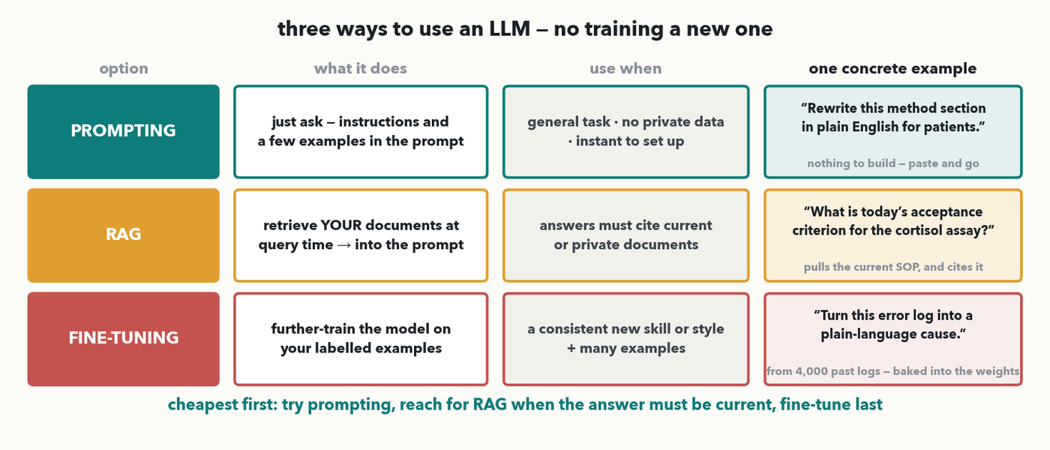
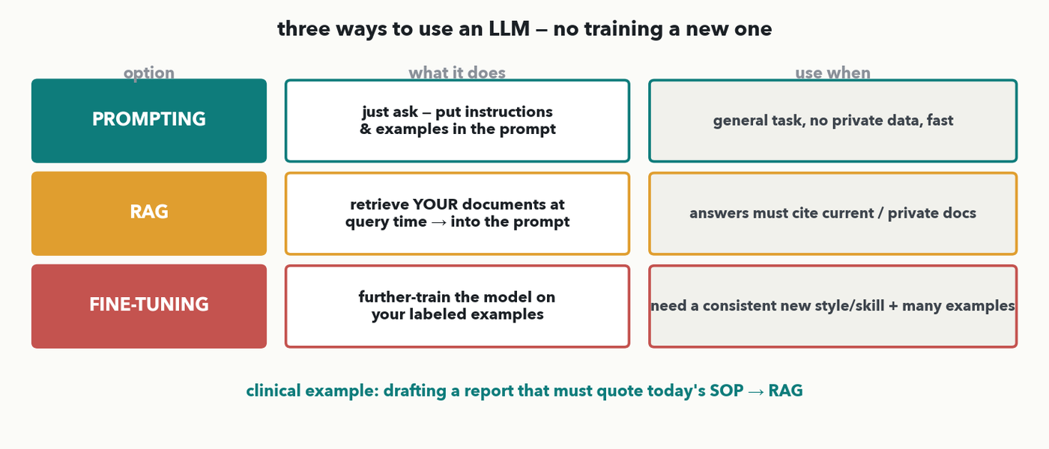
USING AN LLM · 1 OF 3 · THE THREE OPTIONS · I-DO
Prompting vs RAG vs fine-tuning
MASS SPEC · You almost never train an LLM — you USE one, three ways. PROMPTING: just ask, with instructions/examples in the prompt (general task, no private data). RAG: retrieve YOUR documents at query time and put them in the prompt (answers must cite current/private docs). FINE-TUNING: further-train on your labeled examples (a consistent new style/skill, many examples).
Notes:
The practical stop: how to put an LLM to work without training one. Three options, cheapest first, and as of 2026-09-12 (instructor request) each one carries a CONCRETE example in the right-hand column, so the chart is three worked cases rather than three definitions. Walk the rows left to right. PROMPTING — just ask, putting instructions and a few examples straight in the prompt; best for a general task with no private data, and there is nothing to build. THE EXAMPLE: “Rewrite this method section in plain English for patients.” Nothing in that task needs your data or your documents — it is general language competence, so paste it in and you are done. RAG (retrieval-augmented generation) — at query time, retrieve YOUR relevant documents and put them in the prompt so the model answers FROM them; best when the answer must cite current or private material, and it is also the main hallucination guardrail from earlier in the hour. THE EXAMPLE: “What is today's acceptance criterion for the cortisol assay?” The word doing the work is TODAY'S — the retriever pulls the current SOP chunk and the model answers from it, with a citation, so when the SOP changes next month the answer changes with it and nothing is retrained. FINE-TUNING — further-train the model on your own labelled examples; reserve it for a consistent new skill or style where you also have MANY examples, because it is much the most work. THE EXAMPLE: “Turn this instrument error log into a plain-language cause”, learned from 4,000 past logs. Note what is different about it — you are not retrieving a fact, you are teaching a SKILL the base model does not have, and the skill ends up in the weights. Contrast the three out loud, because the distinction is the whole point: prompting changes the request, RAG changes what the model can SEE at query time, fine-tuning changes the model itself. The footer is the decision rule to leave them with: try prompting first, reach for RAG when the answer has to be current or private, fine-tune last. Next slide opens the RAG box, then the room picks for a scenario of its own (Quiz 13 Q2) — and note that Q2's answer is fine-tuning for a DIFFERENT reason (house report style from 2,000 reports), so it forces a real discrimination rather than a pattern-match on this slide's example.

Slide 24
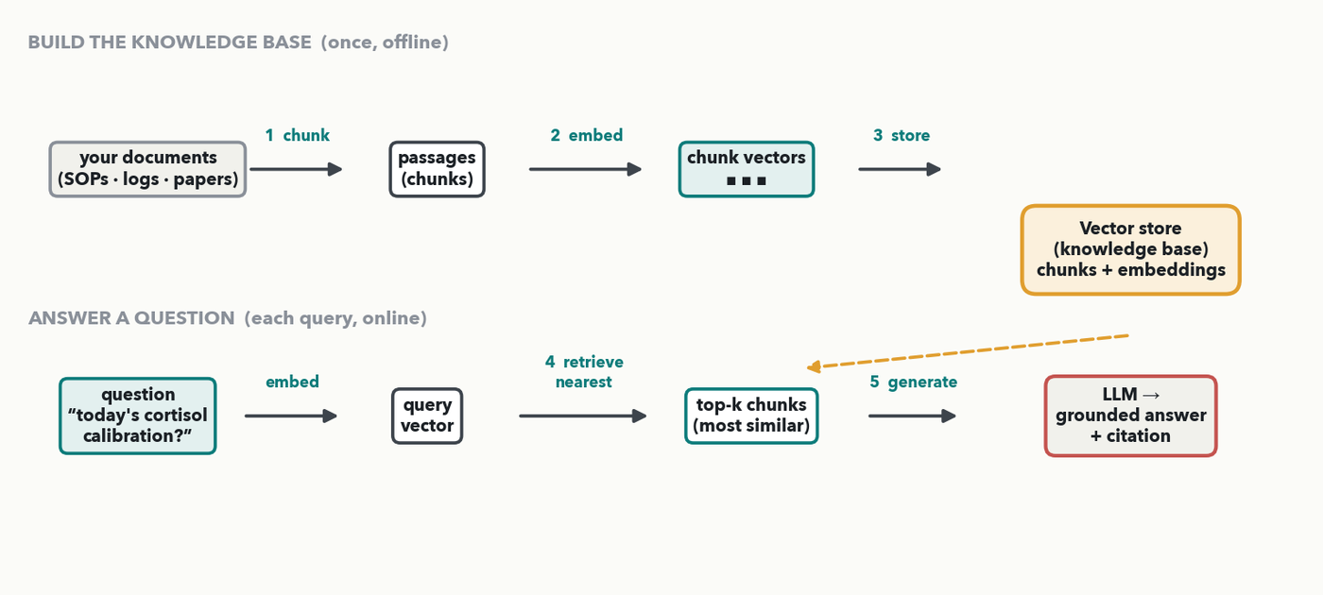
USING AN LLM · 2 OF 3 · RAG, OPENED UP · I-DO
Inside RAG: five parts turn your docs into grounded answers
MASS SPEC · RAG is five parts, not magic. BUILD once: (1) CHUNK your documents into passages; (2) EMBED each chunk into a vector (meaning → a point in space, the embeddings of Lectures 7–8); (3) STORE them in a knowledge base. ANSWER each query: (4) embed the question and RETRIEVE the nearest chunks (a similarity search — attention's same dot-product 'closeness'); (5) GENERATE — the LLM answers FROM those chunks, with a citation. So 'today's cortisol calibration?' pulls the cortisol-log chunk — the model answers from the CURRENT log, not memory.
Notes:
Open the RAG black box, because the room meets it as a guardrail (Q3) and a deployment choice (Q2). Five components, two phases. BUILD THE KNOWLEDGE BASE (offline, once): (1) CHUNKING — split your SOPs, logs, and papers into bite-sized passages so a retrieved piece is specific and fits in the prompt; (2) EMBEDDING — run each chunk through an embedding model that maps text to a vector positioned so passages with similar MEANING land near each other (the 'embedding = a point in space' idea from Lectures 7–8, now for whole passages, not tokens); (3) the VECTOR STORE / knowledge base — keep those chunk vectors indexed for fast lookup. ANSWER A QUESTION (online, every query): (4) RETRIEVAL — embed the question the same way and find the k nearest chunk vectors by similarity (cosine / dot-product 'closeness', the same score attention uses; approximate-nearest-neighbour indexes make this instant over millions of chunks); (5) GENERATION — paste the retrieved chunks plus the question into the prompt and let the LLM answer grounded in them, ideally citing the source chunk. Anchor to say aloud: ask 'today's cortisol calibration?' and the retriever returns the cortisol calibration-log chunk because its embedding is nearest — so the model answers from the CURRENT log, not memory. That grounding is exactly why RAG keeps answers current (Q2) and curbs hallucination (Q3). Honest limits: retrieval quality is everything (bad chunks → bad answer), and chunking / embedding choices matter. Next slide the room picks when to use each option.

Slide 25
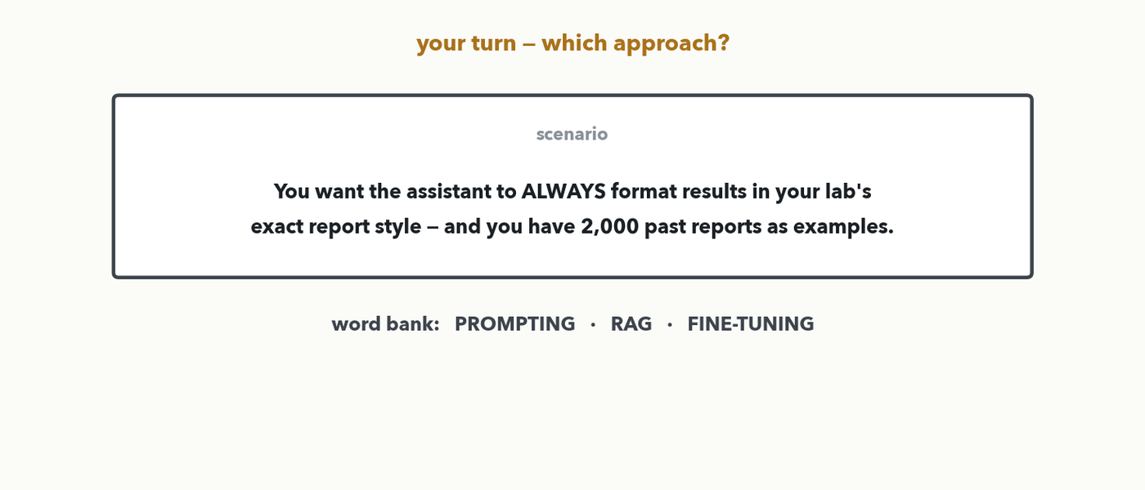
USING AN LLM · 3 OF 3 · YOUR TURN (YOU-DO = Q2)
Your turn — prompting, RAG, or fine-tuning?
CHECKPOINT · Your turn → Quiz 13, Q2. You want the assistant to ALWAYS format results in your lab's exact report STYLE — same structure every time — and you have 2,000 past reports as examples. Prompting, RAG, or fine-tuning? In one sentence, why? Worked answer in the notes.
Notes:
YOU-DO = Quiz 13 Q2 (pick among prompting / RAG / fine-tuning and justify — and note the answer is DIFFERENT from the I-do's RAG example, so it forces a real discrimination, not a pattern-match). Answer (identical to the Quiz 13 Q2 key): FINE-TUNING. Why (any equivalent): you want a consistent new STYLE applied every time and you have MANY labeled examples (2,000 past reports) — exactly the 'consistent new style/skill + many examples' row of the chart, so bake the style into the weights by fine-tuning. RAG is wrong here because the task isn't retrieving changing FACTS (the report content varies but the STYLE is fixed); plain prompting is wrong because a few in-prompt examples won't reliably enforce one house style across every report. Contrast the I-do (a report that must quote today's SOP → RAG, because THAT was about changing facts). Take one answer with its reason, then have them fill Q2.

Slide 26
LECTURE 13 · PART FOUR
The landscape tour
five landmark tools, each cited 400+ times (DRIAMS kept as the clinical case) — what each solves, then how it is built: the data, the network, the loss
Notes:
The payoff of the whole course. Five landmark tools — revised 2026-10-05 to flagship works only (more than 400 citations; DRIAMS kept as the clinical exception) — each first on one slide in the SAME frame, then two OPTIONAL-DEPTH slides on how it is built (the data, then the network and its loss): the PROBLEM it solves, the ARCHITECTURE it uses — which is one you now know from Lectures 5–11 — and its IMPACT. The through-line to keep saying out loud: these are not exotic new inventions; they are the transformer, the CNN, and the attention mechanism you already understand, pointed at our data. As we go, the room is collecting what they need for the spoken transfer exercise (tool → problem → architecture), which we run out loud at the end of the tour — it is no longer a quiz item. 💬 Keep the outcomes' pair prompt in your pocket: which of these is closest to a problem in your lab?

Slide 27
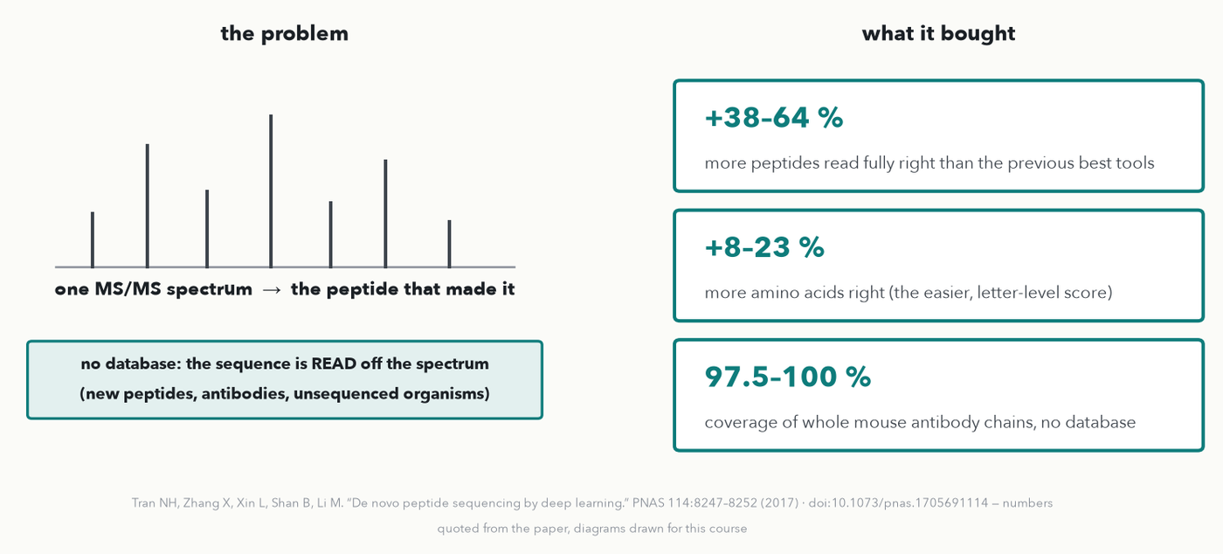
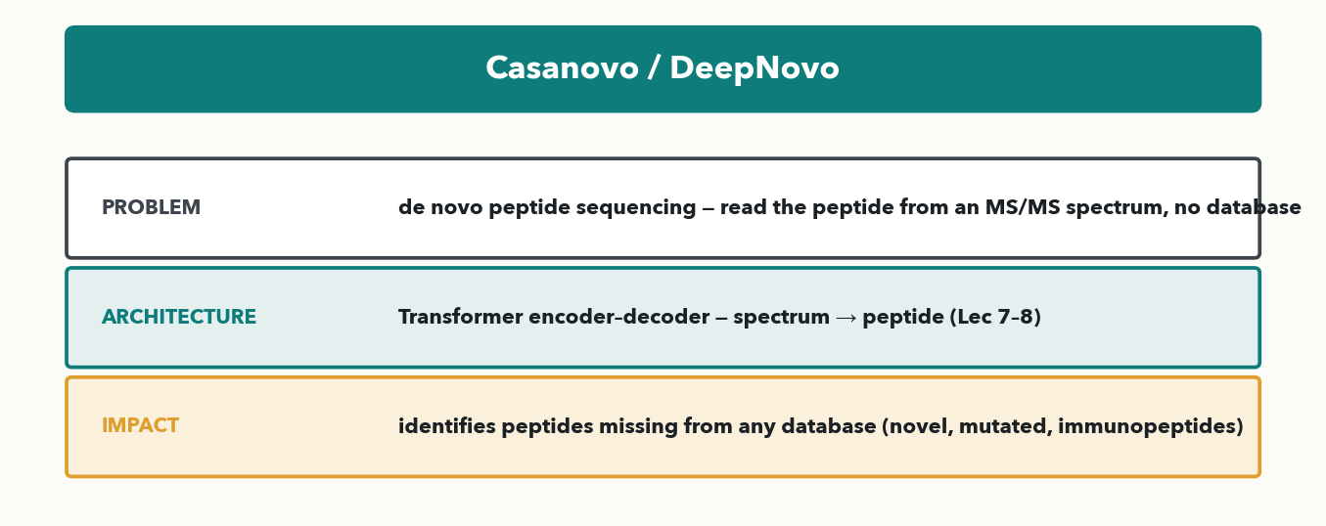
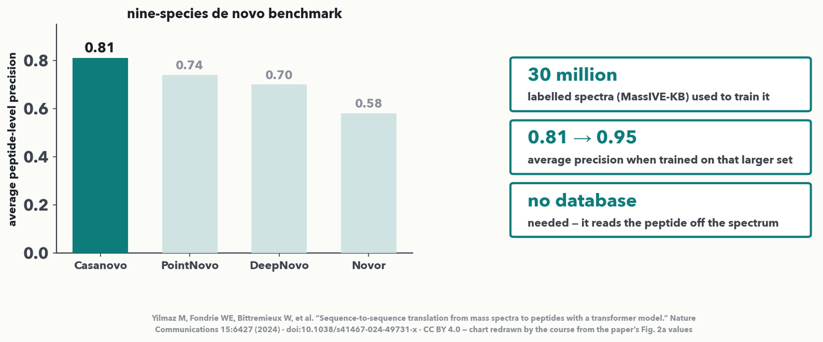
TOUR · 1 OF 5 · DE NOVO SEQUENCING
DeepNovo — sequencing without a database
MASS SPEC · Problem → architecture → impact → THE PAPER. A CNN plus an LSTM read an MS/MS spectrum and write the peptide letter by letter — no database. +38–64% more peptides read fully right than the tools before it, and whole antibody chains reassembled.
Notes:
Tour stop one (rebuilt 2026-10-05: the tour keeps only flagship works — more than 400 citations — so DeepNovo replaces Casanovo here). De novo peptide sequencing means reading the amino-acid sequence straight from an MS/MS spectrum WITHOUT matching a database — the only way to identify a peptide that is not in any database: a new antibody, a mutated protein, an unsequenced organism. THE PAPER: Tran NH, Zhang X, Xin L, Shan B, Li M, 'De novo peptide sequencing by deep learning', PNAS 114:8247–8252 (2017), doi:10.1073/pnas.1705691114 — the first deep-learning de novo sequencer. THE RESULTS on screen, from its abstract: 7.7–22.9% higher accuracy than the previous best tools at the amino-acid level and 38.1–64.0% at the peptide level, and complete mouse antibody light and heavy chains reassembled at 97.5–100% coverage with no database. The next two slides open it up: what the data looks like, then the network (a CNN plus an LSTM) and its loss. Later transformer models such as Casanovo build on the same framing.

Slide 28
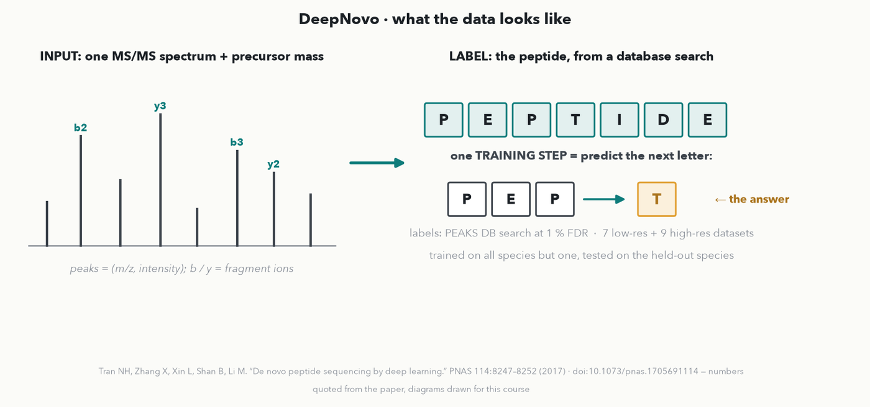
TOUR · 1 OF 5 · DEEPNOVO · THE DATA
DeepNovo — what the data looks like
MASS SPEC · Training pairs = (spectrum, the peptide a database search assigned it). Each step asks one question: given the spectrum and the letters so far, what is the NEXT letter?
Notes:
OPTIONAL DEPTH (instructor, 2026-10-05: explain how each landmark is built — the data, the network, the loss). What DeepNovo learns from. INPUT: one MS/MS spectrum (a list of m/z–intensity peaks) plus the precursor mass. The peaks that matter are FRAGMENT IONS: a peptide breaks along its backbone, b-ions keep the start, y-ions keep the end, so the gaps between peaks spell the amino acids. LABEL: the peptide sequence. Where do millions of labelled spectra come from? From ordinary database searching — the authors ran PEAKS DB at 1% FDR on public datasets (7 low-resolution and 9 high-resolution, many species) and kept the identifications as the 'answers'. THE TRAINING QUESTION is small and repeated: show the spectrum and the letters so far (P-E-P) and ask for the next letter (T) — exactly next-token prediction from the LLM half of this hour, but conditioned on a spectrum. HONEST TEST: train on all species but one, test on the held-out species, so it cannot have memorised those peptides.

Slide 29
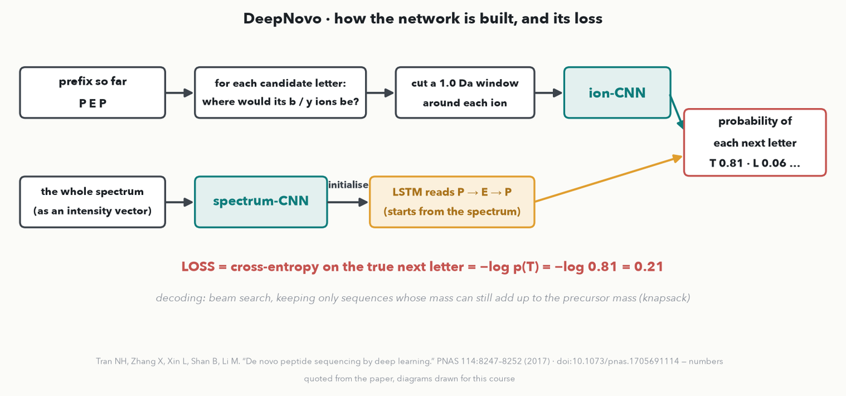
TOUR · 1 OF 5 · DEEPNOVO · THE NETWORK + LOSS
DeepNovo — the network and the loss
MASS SPEC · Two networks vote on the next letter: an ion-CNN that checks where each candidate's fragment ions would land, and an LSTM that remembers the letters so far. Cross-entropy loss; beam search keeps the mass right.
Notes:
How it is built (PNAS 2017 paper). TOP ROW, the chemistry-aware part: for the prefix P-E-P, take each candidate next amino acid, compute where its theoretical b- and y-ions WOULD appear, cut a 1.0 Da intensity window around each of those positions, and pass the stack to a small CNN — the 'ion-CNN'. It is literally asking 'is there evidence in the spectrum for this letter?'. BOTTOM ROW, the language part: the whole spectrum, discretised into an intensity vector, goes through a 'spectrum-CNN' whose output initialises an LSTM (a recurrent network, Lecture 7's pre-attention way to read sequences); the LSTM then reads the letters so far and carries their context. The two outputs are combined into a probability for every possible next letter. LOSS: cross-entropy on the true next letter — if the model gives T a probability of 0.81, the loss is −log 0.81 = 0.21 (Lecture 4's formula). Trained with Adam. DECODING: beam search keeps several candidate sequences, and a knapsack dynamic program removes any letter whose mass could no longer add up to the measured precursor mass — the chemistry constraint built into the search. RESULT: 7.7–22.9% higher accuracy than earlier tools per amino acid, 38.1–64.0% per peptide.

Slide 30
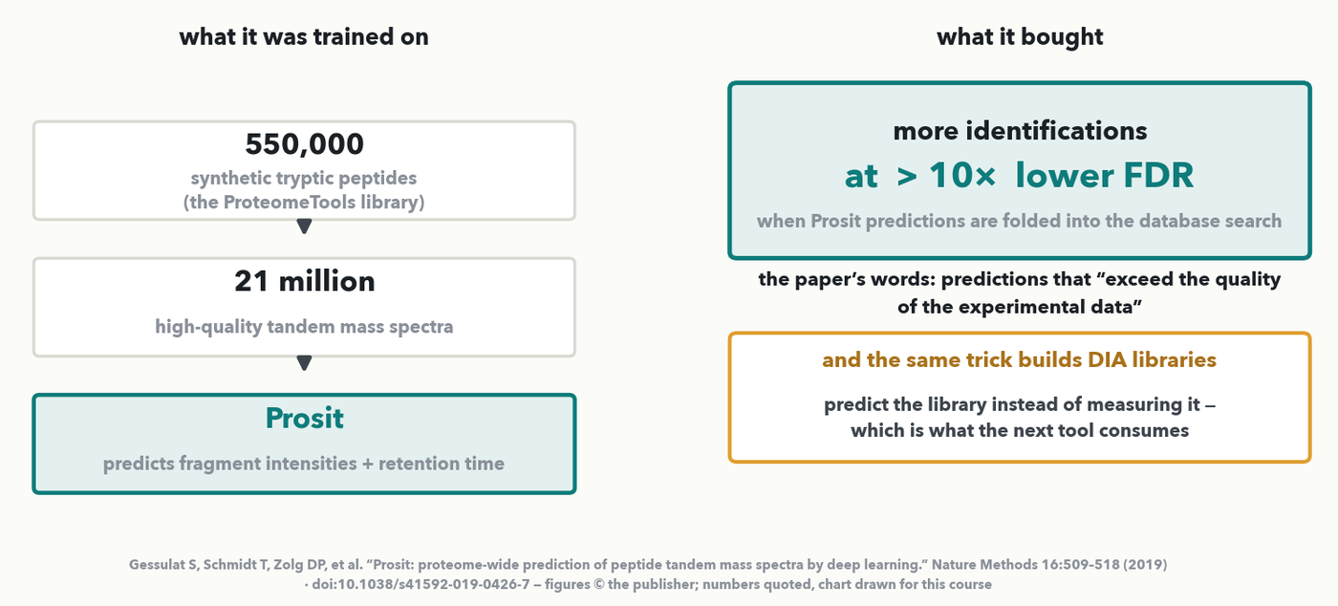
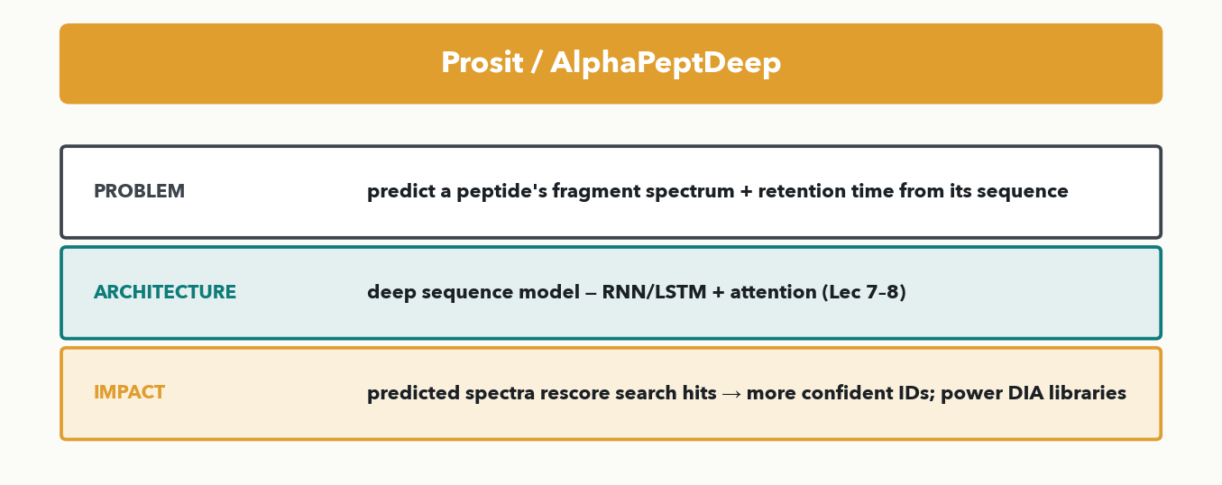
TOUR · 2 OF 5 · SPECTRUM / RT PREDICTION
Prosit — predicting spectra to rescore IDs
MASS SPEC · Problem → architecture → impact → THE PAPER. A deep SEQUENCE MODEL predicts a peptide's fragment spectrum and retention time from its sequence. Trained on 550,000 peptides and 21 million spectra, it rescores search hits to give more IDs at >10× lower FDR.
Notes:
Stop two runs the arrow the other way: given a peptide SEQUENCE, predict what its fragment spectrum and retention time SHOULD look like. Prosit does this with a deep sequence model — a recurrent network (GRU) with attention (Lecture 7); the next two slides show exactly how. THE PAPER: Gessulat S, Schmidt T, Zolg DP, et al., 'Prosit: proteome-wide prediction of peptide tandem mass spectra by deep learning', Nature Methods 16:509–518 (2019), doi:10.1038/s41592-019-0426-7. THE NUMBERS on screen are the paper's own: they extended the ProteomeTools synthetic library to 550,000 tryptic peptides and 21 million high-quality tandem mass spectra — that scale is the story, because it is a training set nobody had before — and integrating Prosit into database search pipelines 'led to more identifications at >10× lower false discovery rates'. Worth quoting the paper's boldest line verbatim: the predictions 'exceed the quality of the experimental data'. Why predict a spectrum you could measure? Because comparing the observed spectrum with the PREDICTED one is a powerful extra score: it RESCORES search hits, promoting real identifications and rejecting false ones, so you get more confident IDs at the same FDR. The same predicted-library idea underpins DIA analysis — which is the next stop. This paper is subscription-access, so the figure here is drawn by the course from the numbers it states; the citation is on the slide for anyone who wants the original.

Slide 31
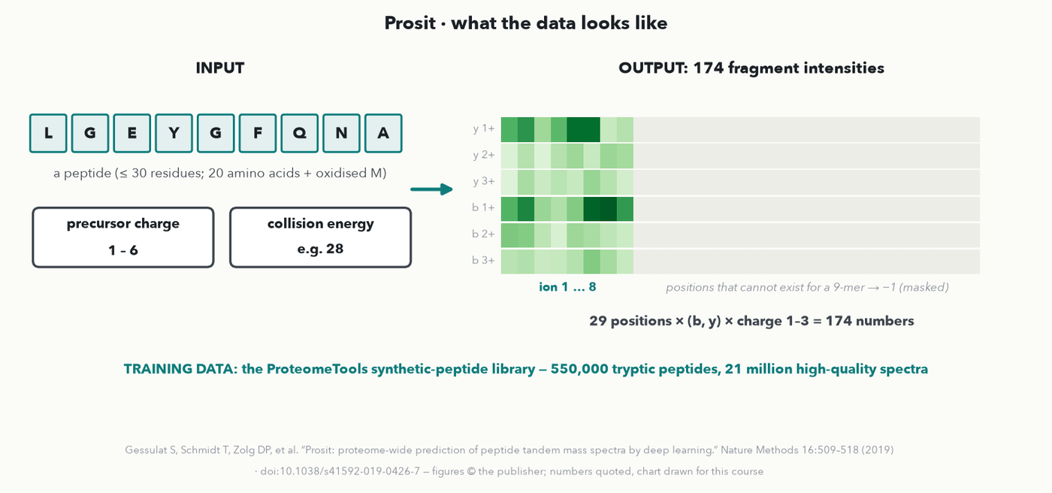
TOUR · 2 OF 5 · PROSIT · THE DATA
Prosit — what the data looks like
MASS SPEC · One example = (peptide, charge, collision energy) → its 174 fragment intensities. The labels are real spectra of 550,000 synthetic peptides whose identity is known by construction.
Notes:
OPTIONAL DEPTH. Prosit runs DeepNovo's arrow backwards: sequence in, spectrum out. INPUT: a peptide of up to 30 residues (the 20 amino acids plus oxidised methionine; cysteine is always carbamidomethylated), its precursor charge (1–6) and the collision energy. OUTPUT: a fixed vector of 174 numbers — the relative intensity of every b- and y-ion at positions 1–29, each at fragment charge 1, 2 and 3 (29 × 2 × 3 = 174). Ions that cannot exist for a shorter peptide (a y20 for a 9-mer) are set to −1 and ignored by the loss. THE DATA is the paper's real contribution: the ProteomeTools project synthesised the peptides, so every spectrum's sequence is KNOWN, not inferred — 550,000 tryptic peptides and 21 million high-quality spectra. Clean labels at that scale are why it works (the Lecture 10 curation lesson). A sister model with the same encoder predicts retention time.

Slide 32
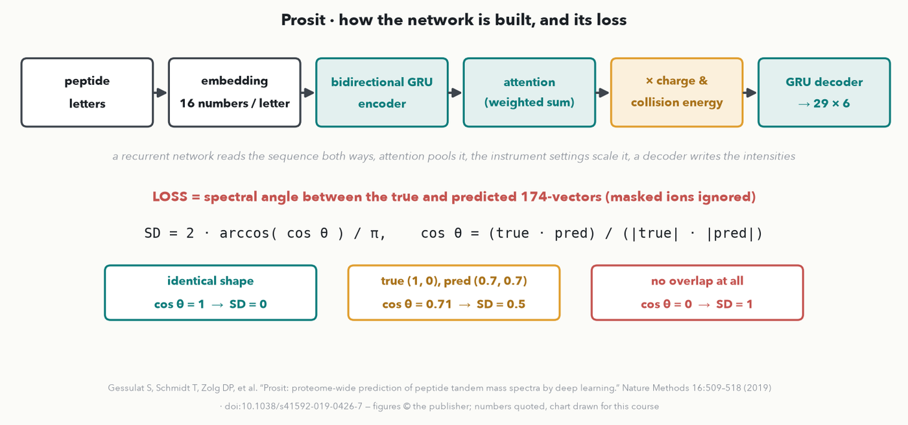
TOUR · 2 OF 5 · PROSIT · THE NETWORK + LOSS
Prosit — the network and the loss
MASS SPEC · A recurrent encoder reads the peptide both ways; a decoder writes the intensities; the loss is the spectral angle, so only the SHAPE of the spectrum counts, not its overall height.
Notes:
How it is built (from Prosit's open-source code and its maintained re-implementation, DLOmix). Each letter becomes a 16-number embedding; a BIDIRECTIONAL GRU (a recurrent network that reads left-to-right and right-to-left) encodes the sequence; an attention layer pools it into one vector; that vector is multiplied by an encoding of the charge and collision energy, so the same peptide fragments differently at different energies; a GRU decoder then writes the 29 × 6 intensity grid. THE LOSS is the clever part: the masked SPECTRAL DISTANCE, 2·arccos(cos θ)/π, where cos θ is the normalised dot product of the true and predicted 174-vectors. Identical shapes give 0, no overlap gives 1, and the worked case on the slide — true (1, 0) against predicted (0.7, 0.7) — has cos θ = 0.71, an angle of 45°, so SD = 0.5. Why an angle and not MSE? Spectra are compared by relative intensities; scaling every peak by 2 changes the MSE but not the angle — and the angle is exactly how a spectral-library match is scored.

Slide 33
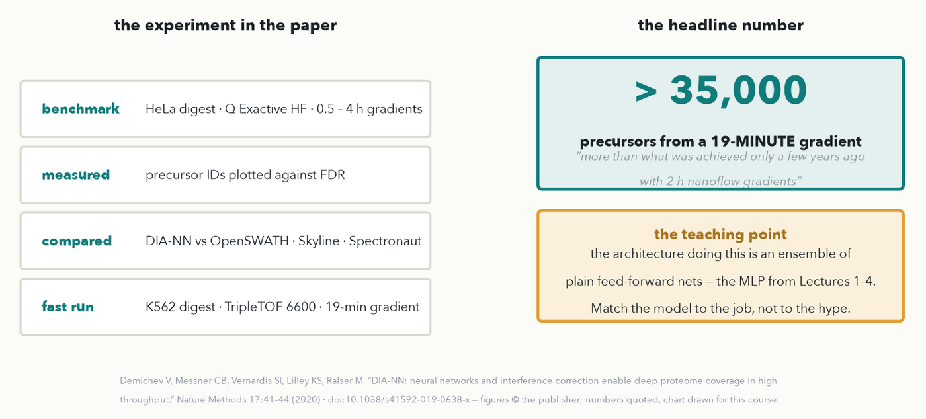
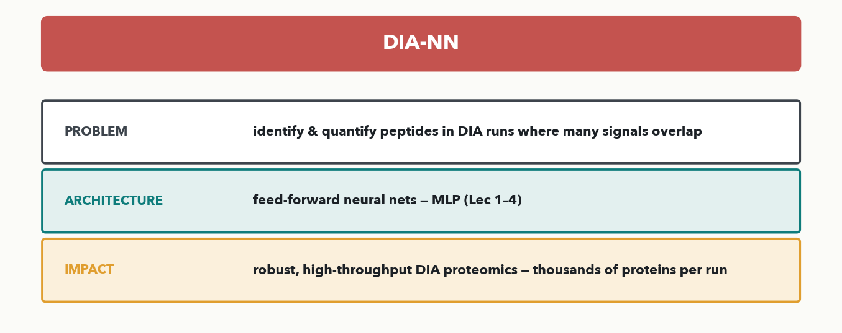
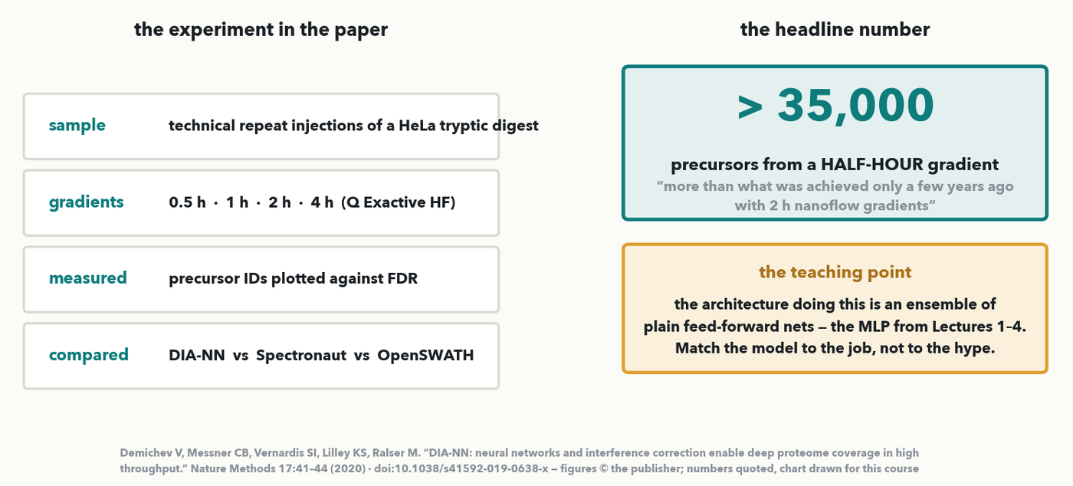
TOUR · 3 OF 5 · DIA ANALYSIS · 💬 PREDICT
DIA-NN — untangling data-independent acquisition
MASS SPEC · 💬 Predict the architecture before I reveal it. In DIA runs many peptides fragment at once, so signals overlap. DIA-NN scores which precursors are really there with an ensemble of FEED-FORWARD NEURAL NETS — the plain MLP from Lectures 1–4. From a 19-minute gradient it identifies more than 35,000 precursors.
Notes:
Stop three, and a quick mid-tour interactive beat: before you reveal the architecture, ask the room to PREDICT which family it is from the problem alone — then reveal the MLP, which is always a surprise. Data-independent acquisition fragments wide m/z windows, so one spectrum is a jumble of co-eluting peptides: powerful for throughput, hard to deconvolve. THE PAPER: Demichev V, Messner CB, Vernardis SI, Lilley KS, Ralser M, 'DIA-NN: neural networks and interference correction enable deep proteome coverage in high throughput', Nature Methods 17:41–44 (2020), doi:10.1038/s41592-019-0638-x. THE EXPERIMENT, left panel, described as the paper ran it (Fig. 1b): technical repeat injections of a HeLa tryptic digest on a Q Exactive HF, gradients of 0.5, 1, 2 and 4 hours, precursor identifications plotted against FDR, and DIA-NN compared head-to-head with OpenSWATH, Skyline and Spectronaut. THE HEADLINE NUMBER, right (corrected 2026-10-05 against the paper): on a K562 digest run on a TripleTOF 6600 with a fast 19-MINUTE gradient, DIA-NN consistently identified over 35,000 precursors — which, as the paper points out, is more than was achieved a few years earlier with two-hour nanoflow gradients. That is the throughput story in one number. I have deliberately NOT drawn a fake version of their ID-vs-FDR curve — the panel names what was measured and gives the one number the text states, so nothing on screen is invented. Impact: DIA-NN made DIA robust and routine at scale, thousands of proteins per run, which is why it is a workhorse in proteomics cores. And the teaching point to say out loud: the SIMPLEST architecture in the course is behind one of the field's biggest tools. Match the model to the job, not to the hype.

Slide 34
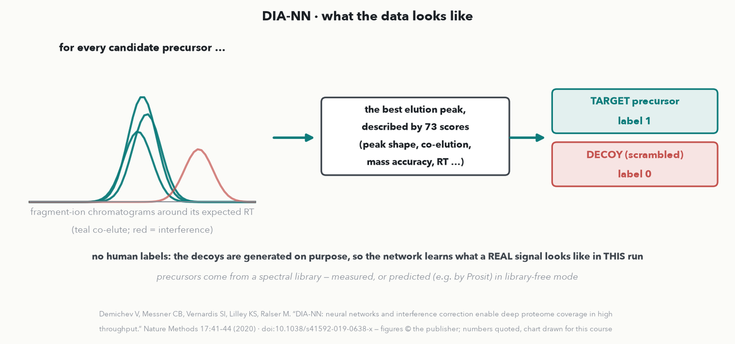
TOUR · 3 OF 5 · DIA-NN · THE DATA
DIA-NN — what the data looks like
MASS SPEC · Each candidate peak becomes 73 numbers; real precursors are labelled 1 and deliberately scrambled decoys 0 — the run labels itself, no human needed.
Notes:
OPTIONAL DEPTH. DIA-NN's network does not see raw spectra at all. The pipeline first takes a list of precursors to look for — from a measured spectral library, or predicted (for example by Prosit) in library-free mode — and generates DECOY precursors, deliberately fake versions that should not be in the sample. For every target and decoy it extracts the precursor and fragment-ion chromatograms around the expected retention time and finds the best candidate elution peak. That peak is summarised as 73 SCORES describing its quality — how well the fragment traces co-elute, how close the masses are, how near the expected retention time, how well it matches the library spectrum. THE LABELS come for free: targets are class 1, decoys class 0. So the task is 'does this look like a real peptide signal or like a decoy?', learned afresh on each run — no human ever labels a peak. This target-decoy idea is the same one database searching uses to estimate FDR.

Slide 35
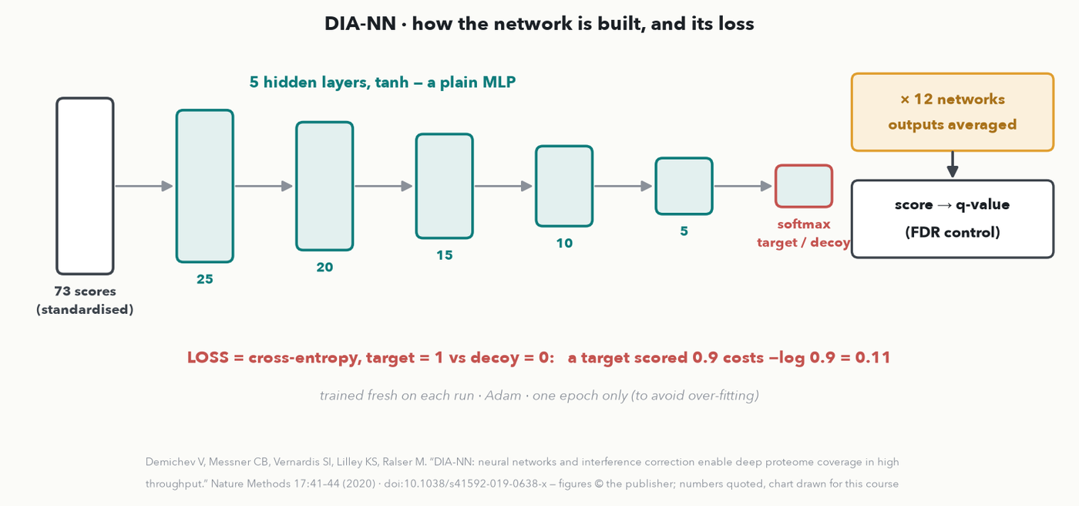
TOUR · 3 OF 5 · DIA-NN · THE NETWORK + LOSS
DIA-NN — the network and the loss
MASS SPEC · Tiny networks — 73 → 25 → 20 → 15 → 10 → 5 → 2, twelve of them averaged — trained for one epoch on each run with cross-entropy; their score sets the FDR.
Notes:
How it is built, exactly as the paper's Methods state. Each network is a plain fully-connected MLP: 73 standardised scores in, five tanh hidden layers of 25, 20, 15, 10 and 5 neurons (the i-th layer has 5·(6−i)), and a 2-way softmax out — target or decoy. LOSS: cross-entropy, target = 1, decoy = 0; a target scored 0.9 costs −log 0.9 = 0.11. Trained with Adam for ONE epoch only, deliberately, to avoid over-fitting a single run. ENSEMBLE: 12 such networks are trained and their outputs averaged — Lecture 4's variance reduction. The averaged output becomes each precursor's discriminant score, and the scores of targets versus decoys give the q-values (FDR control). The teaching point to land: one of the most-cited deep-learning tools in proteomics (thousands of citations) is a tiny MLP on engineered features — what made it work is framing the problem well, not a giant architecture.

Slide 36
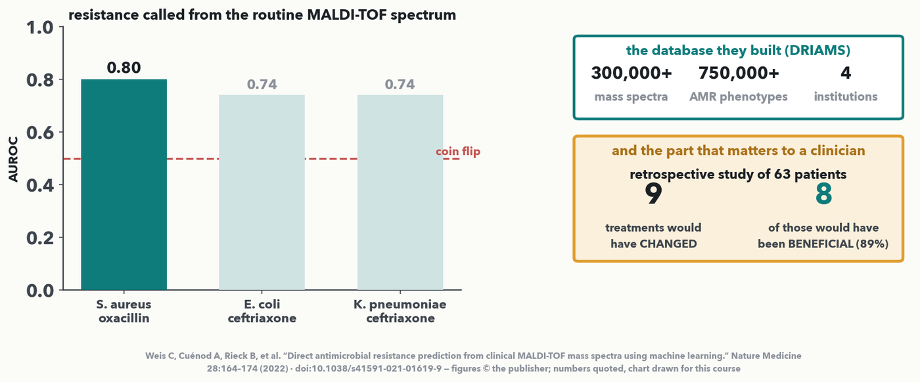
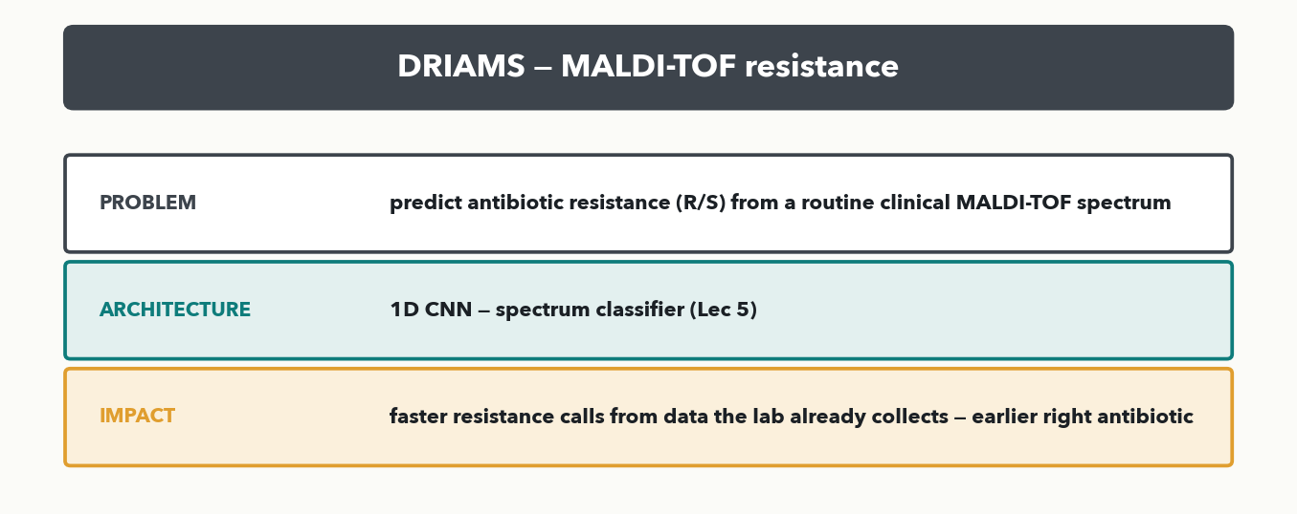
TOUR · 4 OF 5 · A CLINICAL WIN
DRIAMS — antibiotic resistance from MALDI-TOF
MASS SPEC · Problem → architecture → impact → THE PAPER. Call resistance straight from the routine clinical MALDI-TOF spectrum with an MLP / boosted trees on binned spectra. AUROC 0.80 (S. aureus / oxacillin), 0.74 (E. coli and K. pneumoniae / ceftriaxone). In 63 patients: 9 treatments changed, 8 for the better.
Notes:
Stop four, and the clinical one — this is the tour stop closest to the room's own bench, and the dataset behind Lab 2. THE PROBLEM: predict antibiotic resistance directly from the MALDI-TOF spectrum a clinical lab already acquires to identify the organism, instead of waiting up to 72 hours for culture-based susceptibility testing. THE PAPER: Weis C, Cuénod A, Rieck B, et al., 'Direct antimicrobial resistance prediction from clinical MALDI-TOF mass spectra using machine learning', Nature Medicine 28:164–174 (2022), doi:10.1038/s41591-021-01619-9. THE SCALE, top right: they built and released DRIAMS — more than 300,000 mass spectra with more than 750,000 linked antimicrobial-resistance phenotypes from four medical institutions. Say that slowly; a public clinical dataset at that scale is itself a contribution, and it is the data Lab 2 uses. THE RESULT, the bars: validation AUROC of 0.80 for Staphylococcus aureus with oxacillin, and 0.74 each for Escherichia coli and Klebsiella pneumoniae with ceftriaxone. Point at the dashed line: 0.5 is a coin flip, so these are real but far from perfect — and that honesty matters, because it is exactly the AUROC-versus-AUPRC conversation from Lecture 10 on a genuinely imbalanced clinical problem. THE PART THAT LANDS, bottom right: a retrospective study of 63 patients found that using this approach would have changed clinical treatment in nine cases, and in eight of those nine (89%) the change would have been beneficial. That is what a 0.80 AUROC buys in a real workflow. Architecture (corrected 2026-10-05 against the paper's code): NOT a CNN — logistic regression, LightGBM gradient-boosted trees and a scikit-learn MLP on a 6,000-bin vector; the two deep-dive slides that follow show exactly how. Subscription paper, so the chart is the course's, drawn from the numbers the paper reports.

Slide 37
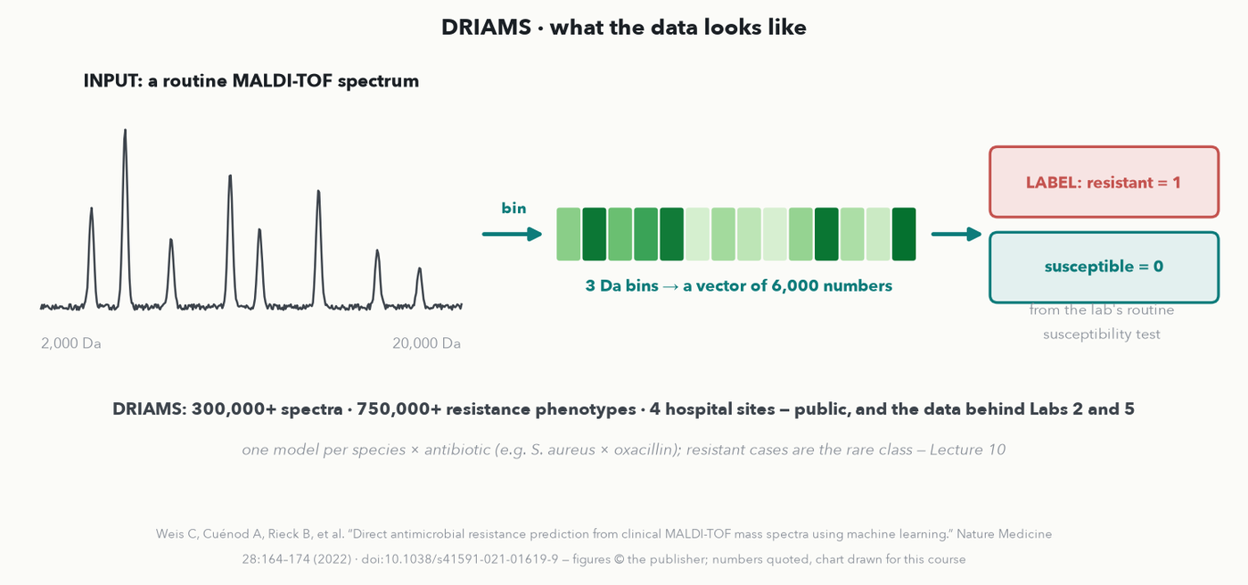
TOUR · 4 OF 5 · DRIAMS · THE DATA
DRIAMS — what the data looks like
MASS SPEC · Each spectrum is binned into 6,000 numbers and paired with the lab's routine susceptibility result — one model per species × antibiotic, with resistance the rare class.
Notes:
OPTIONAL DEPTH, and the stop closest to the room's bench (kept in the tour as the clinical exception — it has fewer than 400 citations). INPUT: the routine MALDI-TOF spectrum the lab already acquires for species identification. PREPROCESSING: the spectrum is binned from 2,000 to 20,000 Da in 3 Da bins, giving a fixed-length vector of 6,000 intensities — that fixed length is what lets ordinary classifiers read it. LABEL: resistant (1) or susceptible (0) from the same isolate's routine antimicrobial susceptibility test. THE DATASET, released publicly: more than 300,000 spectra with more than 750,000 resistance phenotypes from four Swiss hospital sites (DRIAMS-A to -D) — the data Labs 2 and 5 use. One classifier is trained per species–antibiotic pair, e.g. S. aureus × oxacillin (MRSA), and resistance is the rare class, so Lecture 10's imbalance tools apply directly.

Slide 38
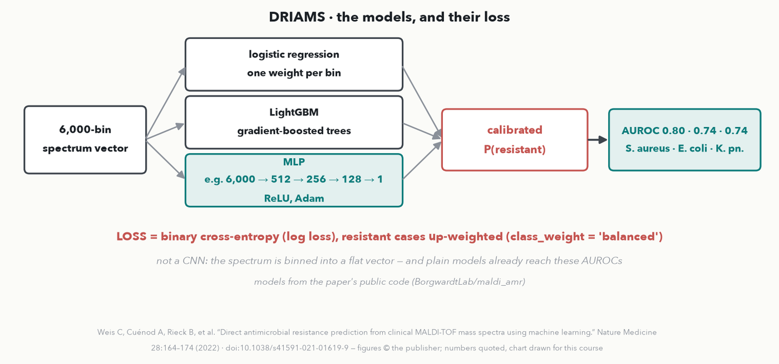
TOUR · 4 OF 5 · DRIAMS · THE MODELS + LOSS
DRIAMS — the models and the loss
MASS SPEC · No CNN: logistic regression, gradient-boosted trees and an MLP on the binned vector, binary cross-entropy with the rare class up-weighted, probabilities calibrated.
Notes:
How it is built — checked against the paper's public code (BorgwardtLab/maldi_amr), because this slide previously said '1D CNN', which was wrong. The models are LOGISTIC REGRESSION (one weight per bin), LightGBM (gradient-boosted decision trees), and a multilayer perceptron — scikit-learn's MLP with ReLU and Adam, its hidden layers tuned from options such as 512 → 256 → 128. All three minimise binary cross-entropy (log loss), with class_weight = 'balanced' so the rare resistant isolates count as much as the common susceptible ones (Lecture 10's class weights), and the output probabilities are CALIBRATED so a 0.8 means roughly 80%. Results: AUROC 0.80 for S. aureus/oxacillin and 0.74 for E. coli and K. pneumoniae with ceftriaxone. The lesson: a large, clean, clinically labelled dataset with simple models changed treatment in a retrospective study — the deep-learning part is modest, and that is fine.

Slide 39


TOUR · 5 OF 5 · THE FLAGSHIP
AlphaFold — protein structure from sequence
CASP14 accuracy as reported in Jumper et al., Nature 596:583–589 (2021), CC BY 4.0 — chart redrawn by the course
MASS SPEC · Problem → architecture → impact → THE PAPER. Predict a protein's 3D structure from its sequence using attention — the Evoformer, Lectures 7–8. At CASP14 its median backbone error was 0.96 Å, about an atom's width, against 2.8 Å for the next best method.
Notes:
The flagship, and the same frame. PROBLEM: predict a protein's 3D structure from its amino-acid sequence — the decades-old folding problem. ARCHITECTURE: at its heart AlphaFold is attention — a specialised transformer, the Evoformer, reasoning over the sequence and its evolutionary relatives — the exact mechanism from Lectures 7–8. THE PAPER: Jumper J, Evans R, Pritzel A, et al., 'Highly accurate protein structure prediction with AlphaFold', Nature 596:583–589 (2021), doi:10.1038/s41586-021-03819-2, CC BY 4.0 — also free to read. THE RESULT, and it is the number that ended the argument: in the CASP14 blind assessment AlphaFold achieved a median backbone accuracy of 0.96 Å r.m.s.d.95 with a 95% confidence interval of 0.85–1.16 Å, while the next best method managed 2.8 Å. Give the room the intuition for 0.96 Å: that is roughly the width of an atom — the prediction is as close to the truth as the experiment itself. Explain r.m.s.d.95 in one clause if asked: the average deviation of the backbone carbons over the best-matching 95% of residues. IMPACT: 200 million-plus predicted structures released, structural biology and drug discovery reshaped, and a share of the 2024 Nobel Prize in Chemistry. The message to leave the room with: the architecture that folds proteins is the same attention you now understand, pointed at sequences and scaled up.

Slide 40

TOUR · 5 OF 5 · ALPHAFOLD · THE DATA
AlphaFold — what the data looks like
MASS SPEC · Input: a sequence plus its relatives in other species; output: every atom's position and a confidence. Labels: solved structures from the PDB, plus its own confident predictions.
Notes:
OPTIONAL DEPTH. INPUT: the protein's amino-acid sequence plus a MULTIPLE SEQUENCE ALIGNMENT (MSA) — the same protein found in many other organisms, lined up position by position (templates of known related structures can be added too). Why the MSA helps: if two positions always mutate TOGETHER across evolution, they are probably touching in 3D — the co-variation is a hidden map of contacts. OUTPUT: the 3D coordinates of every heavy atom, plus pLDDT, the model's own per-residue confidence (0–100). TRAINING DATA: experimentally solved structures from the Protein Data Bank; then a second round of 'self-distillation' — the trained network predicted about 350,000 diverse sequences, the confident predictions were kept, and the model was retrained on them too (the noisy-student idea).

Slide 41

TOUR · 5 OF 5 · ALPHAFOLD · THE NETWORK + LOSS
AlphaFold — the network and the loss
MASS SPEC · The Evoformer passes information between an alignment view and a residue-pair view, 48 times; the structure module places each residue; the FAPE loss scores how far every atom lands from the truth.
Notes:
How it is built (Jumper et al., Nature 2021, open access). Two tables flow through the 'trunk': an MSA REPRESENTATION (sequences × residues) and a PAIR REPRESENTATION (residue × residue — think of it as a learned contact/distance map). The Evoformer block uses attention along rows and columns and passes information between the two tables; 48 blocks are stacked. The STRUCTURE MODULE then treats each residue as a rigid piece — a rotation plus a translation — starting all at the origin and moving them into place, then adds side-chain angles. RECYCLING feeds the output back into the network a few times to refine it. THE MAIN LOSS is FAPE, frame aligned point error: line the prediction up on each true residue's frame in turn and measure how far every atom is from where it should be. Helper losses: a distogram (binned distances, cross-entropy), a BERT-style masked-MSA loss (Lecture 11's masking idea), and predicting its own accuracy (pLDDT). Result: median CASP14 backbone error 0.96 Å against 2.8 Å for the next best method.

Slide 42


TOUR · THE WHOLE TOUR · I-DO · 💬 PAIR
The tour on one page
MASS SPEC · Five tools, one frame — and five papers you can read tonight. DeepNovo → de novo sequencing → CNN + LSTM. Prosit → spectrum + RT → GRU + attention. DIA-NN → DIA ID + quant → MLP. DRIAMS → resistance from MALDI-TOF → MLP / trees. AlphaFold → structure → attention. 💬 Which is closest to a problem in YOUR lab?
Notes:
The whole tour on one page — the single chart the closing transfer exercise is answerable from (rule 3). Walk the five rows once more by architecture family so the pattern lands: DeepNovo = a CNN plus an LSTM reading a spectrum and writing letters (Lectures 5 and 7); Prosit = a recurrent GRU encoder with attention (Lecture 7); DIA-NN = an ensemble of small feed-forward MLPs (Lectures 1–4); DRIAMS = an MLP and gradient-boosted trees on a binned spectrum (Lectures 1–4, 10); AlphaFold = attention, the Evoformer (Lectures 7–8). Every one is an architecture the room now owns, aimed at a real problem, with a concrete impact. Run the outcomes' 💬 pair prompt here: which of these five is closest to a problem in your own lab, and which architecture would it use? Harvest two or three, then the room does the formal match next slide, out loud — it is a do-it-together, not a quiz item.

Slide 43


TOUR · PLACE A NEW TOOL · 💬 DO-IT-TOGETHER
Together — place a tool you've never seen
PAIR · 💬 Out loud, together — not on the quiz. Using the five-tool map: (a) a tool calls bacterial SPECIES from a MALDI-TOF spectrum → which architecture family, most like which landmark? (b) a tool predicts a peptide's fragment spectrum + RT from its sequence → which family, like which landmark? (c) DeepNovo and Prosit run in opposite directions — which family handles the peptide sequence in both, and why?
Notes:
CHANGED 2026-09-11 (instructor): Quiz 13's old Q1 — this transfer item — was removed from the sheet, so this slide is no longer a you-do. Keep the beat, run it OUT LOUD as a do-it-together / pair prompt: it is the highest-value 3 minutes of the tour, because it is the difference between recalling five names and being able to place the sixth tool they meet next month. Nothing to write; take answers from the floor. ANSWERS. (a) A spectrum-in, one-label-out classifier on a binned MALDI-TOF spectrum — an MLP or boosted trees (or a 1D CNN), most like DRIAMS: same input, a species call instead of R/S. (b) Sequence-in, predicted spectrum + RT out is a SEQUENCE MODEL (a recurrent network with attention, or a transformer), most like Prosit. (c) Both use a RECURRENT network for the peptide — an LSTM in DeepNovo (reading the letters written so far), a GRU in Prosit (reading the input sequence). An ordered sequence needs it because each letter's meaning depends on the ones before and after it, and peptides vary in length — a recurrent network reads one letter at a time while carrying a memory, exactly the job attention later took over. Every answer is reachable from the one-page tour chart on the previous slide, but the room has to REASON, not recall. Take one full answer for each, then move to the recap.

Slide 44
LECTURE 13 · WHAT YOU CAN DO NOW
You can now…
• Explain LLM training in pictures — pretraining → SFT → RLHF — how RLHF is built, and what it breaks (Q3)
• Describe RL properly — loop, state & policy, Markov, explore vs exploit, discounting (Q4, Q5)
• Formulate a repeated decision in your own lab as reinforcement learning (Q1)
• Choose among prompting, RAG, and fine-tuning, and cite the paper behind each tool (Q2)
You have worked every item on Quiz 13 live — your own RL formulation (Q1), prompting/RAG/fine-tuning (Q2), the untrustworthy claim (Q3), explore vs exploit (Q4), the discounted return (Q5). Keep the sheet.
Notes:
Recap = the Lecture 13 outcomes, each exercised this hour. The RL line is deliberately stronger than it was (instructor, 2026-09-11): the room can now name STATE and POLICY, state the Markov requirement and spot when it fails, apply ε-greedy, and discount a late reward back to the move that set it up — all taught on the classic examples. The separate bullet for Q1 is the one that matters most for their day job: they have formulated a repeated decision from their own lab as RL and pressure-tested whether its state is sufficient. The tour line now says CITE, because every tour slide carries its paper and that paper's headline number — encourage them to read the two that are CC BY tonight (DeepNovo in PNAS and AlphaFold in Nature are free to read). If you dropped optional RL slides, drop the matching clauses and say which quiz items stay blank.

Slide 45
LECTURE 13 · NEXT
Next hour — Agentic AI, demo-driven
• From chatbot to agent: an LLM + tools + a reason→act loop (ReAct) — a direct callback to today's RL feedback
• Follow along on your own free-tier bot: prompt for explicit reason → act → check steps
• Instructor live demo: an 'MS analysis assistant' reading a QC CSV, plotting, flagging anomalies, drafting a summary
• Where agents fit in the lab — and the guardrails each needs (human review, restricted tools, logging)
CHECKPOINT · 2 minutes to finish Quiz 13 solo → we mark it together as Lecture 14 opens. Notice the thread: an agent's reason→act loop IS today's RL loop, and today's hallucination guardrails are what keep that agent honest next hour.
Notes:
Hand the last minutes to finishing Quiz 13, then sell Lecture 14. The through-line: an AGENT is an LLM given tools and a reason→act loop (ReAct), and the two ideas from today carry straight over — reinforcement-style feedback is how such behaviors get shaped, and the hallucination guardrails (grounding, human review, restricted tools, logging) are exactly what keep an agent safe in a lab workflow. Next hour we go demo-driven: participants run a small reason→act→check exercise on their own free-tier chatbot, then watch a live "MS analysis assistant" read a QC CSV, plot it, flag anomalies, and draft a summary — each step narrated. Then Colab boots for the capstone and we mark Quiz 13 together.

