Slide 1
MSACL · DS301 DEEP LEARNING · SEGMENT 5 · LECTURE 14
Agentic AI, demo-driven
from chatbot to agent · the ReAct reason→act loop, annotated on a transcript · a follow-along on your own bot · a live build in three steps: memory, then tools · where agents fit in the lab, and the guardrails each needs
Notes:
The FINAL lecture, Tuesday morning, straight after Lecture 13's LLMs — and then Lab 5 (the capstone). This hour is deliberately DEMO-DRIVEN and hands-on. One idea carries the whole hour: an AGENT is just an LLM given TOOLS and a reason→act LOOP (the ReAct pattern), and everything we do traces or builds that loop. Four stops. (1) From chatbot to agent — the ReAct pattern (Thought → Action → Observation → … → Answer) annotated on a real-looking transcript, with a one-line callback to Lecture 13's RL: reinforcement-style feedback/reward is how these reason→act behaviours get trained. (2) A FOLLOW-ALONG on your own free-tier bot — paste a small QC table from the handout and prompt for explicit reason→act→check steps, then compare with a neighbour. (3) An instructor LIVE DEMO — an 'MS analysis assistant' that reads a QC CSV, analyses it, plots, flags an anomaly, and drafts a summary, each reason→act step narrated. (4) WHERE agents fit in the lab (triage, report drafting, data wrangling, literature) and where they must NOT run unsupervised, with guardrails: human review, restricted tools, logging. The interactive spine (rule 8): the ReAct I-do → a you-do that points to Quiz 14 Q1 (LABEL reason vs act); the guardrails I-do → Quiz 14 Q2 (which guardrail for which failure); a human-review you-do → Quiz 14 Q3; the follow-along is a do-it-together on the handout; and a 💬 discussion on which task you'd hand an agent first. Hand out Quiz 14 (short) now, blank — the room fills it across the hour. Close with the Lab 5 capstone briefing.

Slide 2
LECTURE 14 · WHERE THIS HOUR GOES
Four stops — and it's demo-driven
• From chatbot to agent — the ReAct reason→act loop, annotated on a transcript (+ a one-line callback to Lecture 13's RL) · 12 min
• Follow-along on YOUR bot — paste a QC table, prompt for reason→act→check, compare with a neighbour · 10 min
• Instructor live demo — build an agent in three steps: no memory → memory → tools · 18 min
• Where agents fit in the lab — and the guardrails each needs; then Quiz 14 + capstone briefing · 12 min
Notes:
Signpost the four stops and set expectations: this hour has almost no new machinery — an agent is the LLM you already understand, wrapped in tools and a loop — so the work is TRACING and RUNNING that loop, not math. The single skill we assess all hour is reading a ReAct transcript and labelling each step reason vs act; the follow-along and the live demo are the same loop, first on your own bot, then on real code. Aim for a hands-on beat every ~8–10 minutes: the ReAct you-do (Quiz 14 Q1), the follow-along do-it-together on the handout, the demo's 💬 predict beat before stage 2's Q3, the guardrail you-do (Q2), the human-review you-do (Q3), and the closing 💬 discussion. THE DEMO STOP (restructured 2026-09-14): it is now a step-by-step walkthrough of the three scripts in demos/lecture14_agent/, six slides over ~18 minutes — the plan, then one slide per stage, the payoff, and the two lessons. Run the scripts live alongside the slides; the slide panels use the same terminal chips the scripts print. Reassure the room the quiz is short.

Slide 3
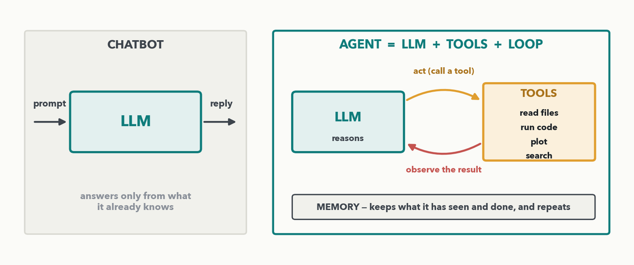
CHATBOT → AGENT · 1 OF 4 · THE DEFINITION · I-DO
An agent = LLM + tools + a reason→act loop
MASS SPEC · A CHATBOT answers only from what it already knows. An AGENT wraps that same LLM with TOOLS (read files, run code, plot, search) and a LOOP: it REASONS about what to do, ACTS by calling a tool, OBSERVES the result, and repeats — plus MEMORY of what it has seen and done. Same LLM; the tools and the loop are what's new.
Notes:
Demystify 'agent' in one picture. On the left, a plain chatbot: prompt in, reply out, answering only from what the model already learned — it cannot touch your files or run anything. On the right, an AGENT: the SAME LLM, now given a set of TOOLS (read a file, run code, make a plot, search) and run in a LOOP — it reasons about the next step, acts by calling a tool, observes what came back, and goes around again, keeping a memory of the run. That is the whole idea; there is no new neural architecture here — an agent is a wiring pattern around an LLM. One-line callback to Lecture 13 (say it out loud): reinforcement-style feedback and reward is how these reason→act behaviours get TRAINED — the model was tuned (RLHF and related) to plan, call tools, and use their results well. Next slide: chain of thought, the reasoning half of that loop; then we watch the loop turn, step by step, on a real-looking MS-analysis transcript.

Slide 4
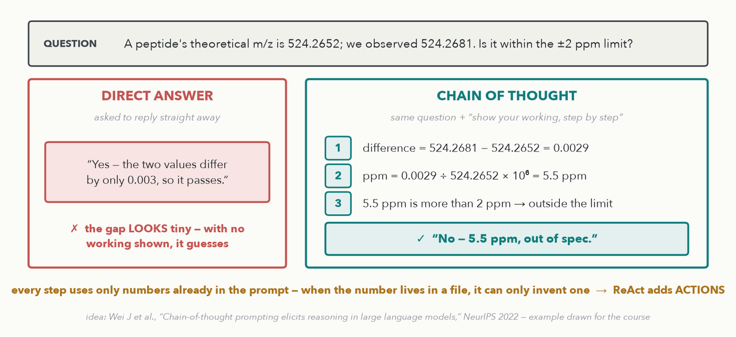
CHATBOT → AGENT · 2 OF 4 · CHAIN OF THOUGHT · I-DO
Chain of thought: show the working first
MASS SPEC · CHAIN OF THOUGHT = asking the model to write its reasoning steps BEFORE the answer. Same question, same model: worked step by step (0.0029 → 5.5 ppm) it catches what a one-shot answer waves through. But it can only reason over numbers already in the prompt.
Notes:
ADDED 2026-10-06 (instructor): chain of thought, the idea ReAct is built on — about 3 minutes, no quiz item. CHAIN OF THOUGHT (Wei et al., NeurIPS 2022) means prompting the model to write out its intermediate reasoning before it gives the answer — 'show your working', 'think step by step'. WALK THE EXAMPLE: theoretical m/z 524.2652, observed 524.2681, limit ±2 ppm. Asked to answer straight away, a model can be swayed by how small the gap looks (0.003 m/z) and wave it through. Asked to show its working: step 1, difference = 524.2681 − 524.2652 = 0.0029; step 2, ppm = 0.0029 ÷ 524.2652 × 10⁶ = 5.5 ppm (exactly 5.53); step 3, 5.5 > 2, so it is OUT of spec. Why it helps: the model produces its answer one token at a time (Lecture 13), so writing the steps out gives it room to compute intermediate results instead of jumping to a conclusion — the same reason we ask students to show their working. Honest framing: today's strong models often get this one right even when answering directly, and reasoning models do this internally; the left panel shows the failure the technique was invented to fix. THE BRIDGE, bottom line of the figure: every step here used only numbers that were in the prompt. Ask 'does QC-04 pass?' when QC-04 lives in a file, and a chain of thought can only reason its way to an invented number — stage 2 of the live demo shows exactly that. ReAct, next slide, keeps these Thoughts and interleaves them with ACTIONS that fetch the real data: ReAct = chain-of-thought reasoning + tool calls.

Slide 5
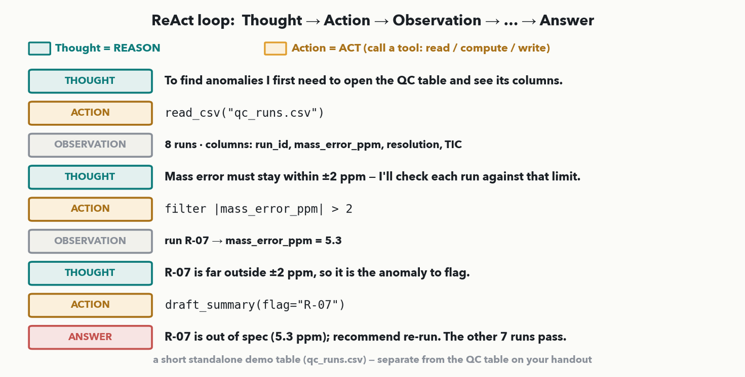
CHATBOT → AGENT · 3 OF 4 · THE REACT PATTERN · I-DO
ReAct, annotated: Thought → Action → Observation → … → Answer
MASS SPEC · The ReAct pattern, colour-coded on a transcript. A THOUGHT is the agent REASONING about what to do (teal). An ACTION is the agent ACTING — calling a tool (read a file, filter, compute/run code, write): here read_csv, filter, draft_summary (amber). An OBSERVATION is the tool's result (grey). The loop repeats until an ANSWER. Reason → act → observe → … → answer. (This qc_runs.csv is a short standalone demo table — separate from the QC table on your handout.) Callback: RL feedback is how this behaviour got trained.
Notes:
The centrepiece (rule 6/9). Open with the link to the previous slide: the THOUGHT lines are the chain of thought, and the ACTION lines are what plain chain of thought could not do. the ReAct loop annotated on a real-looking transcript of the 'MS analysis assistant' asked to flag QC anomalies. Walk it top to bottom, naming each colour. THOUGHT (teal) = the agent REASONING: "I first need to open the QC table and see its columns" — a plan, no tool used yet. ACTION (amber) = the agent ACTING by calling a tool: read_csv("qc_runs.csv"). OBSERVATION (grey) = what the tool returned: 8 runs, columns run_id/mass_error_ppm/resolution/TIC. Then it loops again: THOUGHT — mass error must stay within ±2 ppm, check each run; ACTION — filter |mass_error_ppm| > 2; OBSERVATION — R-07 = 5.3 ppm. Once more: THOUGHT — R-07 is far outside ±2 ppm, so it's the anomaly; ACTION — draft_summary(flag="R-07"); then the final ANSWER. The single distinction the room must carry to the quiz: a step is REASON if it's a Thought (planning/interpreting) and ACT if it's an Action (invoking a tool: read, run/compute, filter, plot, write/draft — so "compute the mean" is an act, because it runs a tool). Observations are the environment's replies, not the agent's steps. Note the qc_runs.csv here is a short standalone demo table, separate from the six-run QC-04 table on the follow-along handout — say so if anyone asks. One-line RL callback again: this reason-then-act behaviour is exactly what preference tuning (Lecture 13) shapes. Next slide the room labels a fresh transcript themselves (Quiz 14 Q1).

Slide 6
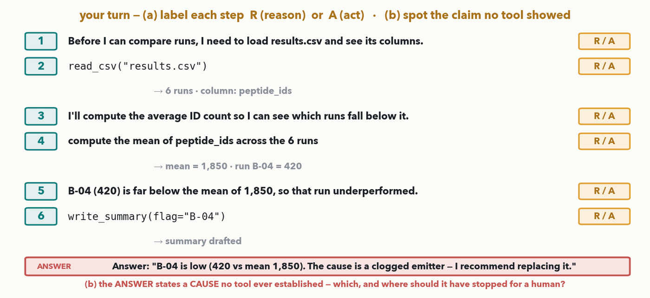
CHATBOT → AGENT · 4 OF 4 · YOUR TURN (YOU-DO = Q1)
Your turn — label the steps, then spot the claim no tool showed
CHECKPOINT · Your turn → Quiz 14, Q1. A new transcript (same ReAct shape). (a) Label each numbered step R (reason = a Thought) or A (act = a tool call); the grey observations are context, not steps. (b) The final ANSWER states one thing NO tool ever showed — spot it, and say where the agent should have stopped for a human. Worked answer in the notes.
Notes:
YOU-DO = Quiz 14 Q1 (label reason vs act on a transcript AND diagnose a fabricated claim — the hour's spine, now with a hallucination-spotting twist that ties the ReAct loop to the guardrails to come). Same ReAct shape, a different task (summarise this week's peptide-ID counts and note any underperforming run) and different numbers, reproduced verbatim on the Quiz 14 sheet. (a) Labels, fixed by the ReAct definition on the previous slide: Step 1 (plan: load results.csv, see its columns) = REASON; Step 2 (read_csv("results.csv")) = ACT; Step 3 (plan: compute the average to see which runs fall below) = REASON; Step 4 (compute the mean of peptide_ids) = ACT; Step 5 (interpret: B-04 at 420 ≪ mean 1,850 → underperformed) = REASON; Step 6 (write_summary(flag="B-04")) = ACT. So: 1 R, 2 A, 3 R, 4 A, 5 R, 6 A — interpreting/planning is reason; every step that calls a tool is act; the grey lines are observations. (b) The ANSWER claims "the cause is a clogged emitter" — that is UNSUPPORTED: no tool ever diagnosed a cause; the observations show only that B-04's count is low, not WHY. The agent should have stopped after flagging the low run (step 6) and left any root-cause claim — and any repair action — to a human; asserting an unverified cause is exactly the hallucination the next section's guardrails exist to stop. Take a few labels and the spotted claim from the floor, then have the room fill Q1.

Slide 7
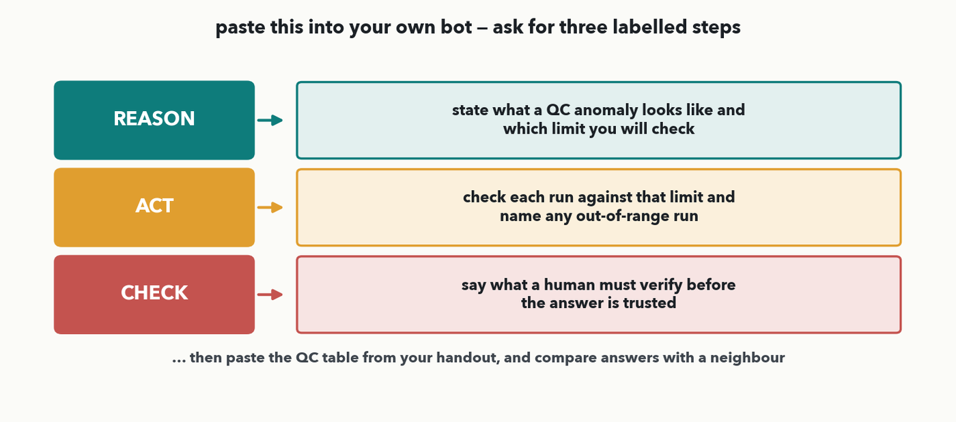
FOLLOW-ALONG · 1 OF 2 · DO-IT-TOGETHER
Do it together: reason → act → check, on your own bot
PAIR · Do-it-together → your handout. Open any free-tier bot (ChatGPT / Claude / Gemini). Paste the prompt template AND the small QC table from your handout, and ask for three labelled steps — REASON (what a QC anomaly is + which limit), ACT (check each run, name the out-of-range one), CHECK (what a human must verify). Then compare answers with a neighbour.
Notes:
DO-IT-TOGETHER (rule 8), pointing at the printed handout, not the quiz. Give the room ~5 minutes on whatever free-tier assistant they have — ChatGPT, Claude, or Gemini — no sign-ups beyond what they already use. The handout carries a small realistic QC table (six runs, one obviously out-of-range row, QC-04) and this exact reason→act→check prompt template. They paste both and read what comes back. The point is to FEEL the loop: a good bot states its REASON (the ±2 ppm / resolution / TIC limits) before it ACTS (checks the runs and names QC-04), and ends with a CHECK (what a human must verify). Walk the room; some bots will skip straight to an answer or invent a number — that is the teachable moment for the next slide and for guardrails later. Then have neighbours compare answers: did both flag QC-04? did either invent a value? Next slide, what a good answer looks like.

Slide 8
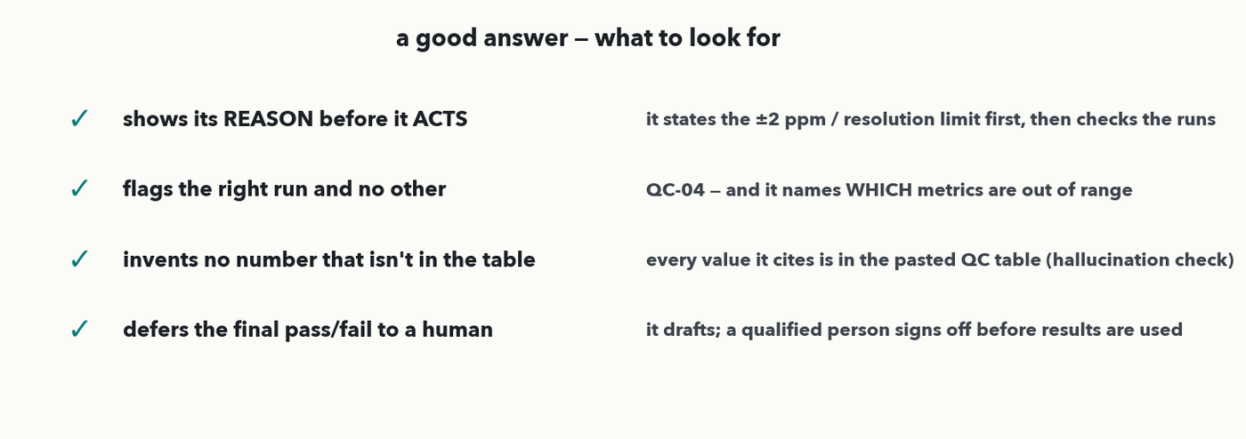
FOLLOW-ALONG · 2 OF 2 · DEBRIEF · 💬 PAIR
What a good answer looks like
PAIR · 💬 With your neighbour: did your bot (1) show its REASON before it ACTED, (2) flag QC-04 and name which metrics are out of range, (3) invent any number not in the table, and (4) leave the final pass/fail to a human? Answer in the notes.
Notes:
Debrief the follow-along against four checks (a genuine checklist, rule 9). A GOOD answer: (1) shows its REASON before it ACTS — it states the limits (±2 ppm, resolution > 30,000, TIC 8–12) first, then checks the runs; (2) flags the right run and no other — QC-04 — and names WHICH metrics are out of range (mass error +5.6 ppm, resolution 22,300, TIC 3.1); (3) invents no number that isn't in the pasted table — this is the hallucination check from Lecture 13, made concrete; (4) defers the final pass/fail to a human — it drafts, a person signs off. 💬 Run the pair prompt: have neighbours score each other's bot output on those four. The likely findings — some bots answer confidently without showing reasoning, and some cite a value that isn't in the table — are exactly why the lab needs guardrails, which we get to after the live demo. Harvest two observations, then move to the demo.

Slide 9
LECTURE 14 · PART THREE
Live demo — building an agent in three steps
three scripts under demos/lecture14_agent/, each adding exactly ONE idea — watch where each one breaks on the same three questions
Notes:
PART THREE, ~18 minutes, and as of 2026-09-14 it is a STEP-BY-STEP WALKTHROUGH of the three scripts in demos/lecture14_agent/ rather than a storyboard of a single finished agent. The reason is that the teaching value is in the DIFF: each script adds exactly one idea, and each one fails in a NEW way until the last. Run them live in order — 'python3 stage1_chatbot.py', then stage2, then stage3 — with the deck slide for each stage on screen beside the terminal; the slide panels deliberately use the same YOU / BOT / OBS / THINK / ACT chips the scripts print, so the room can follow either. BEFORE YOU START: export your ANTHROPIC_API_KEY, and run all three once so you know what you will get — stages 1 and 2 hallucinate the Q3 number and the exact wording varies. Keep a saved transcript as the fallback ('python3 stage3_react.py | tee transcript.txt' with FORCE_COLOR=1 keeps the colour) so the demo never fails live. The whole arc in one sentence, worth saying before you run anything: a chatbot forgets, a chatbot with memory confidently makes things up, and only an agent with TOOLS answers from your actual file.

Slide 10
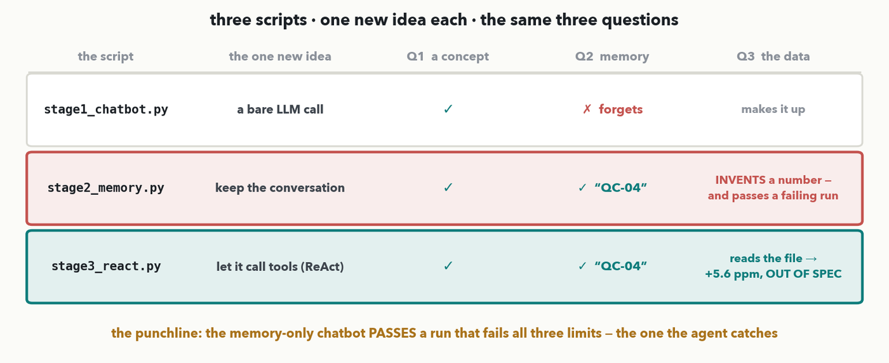
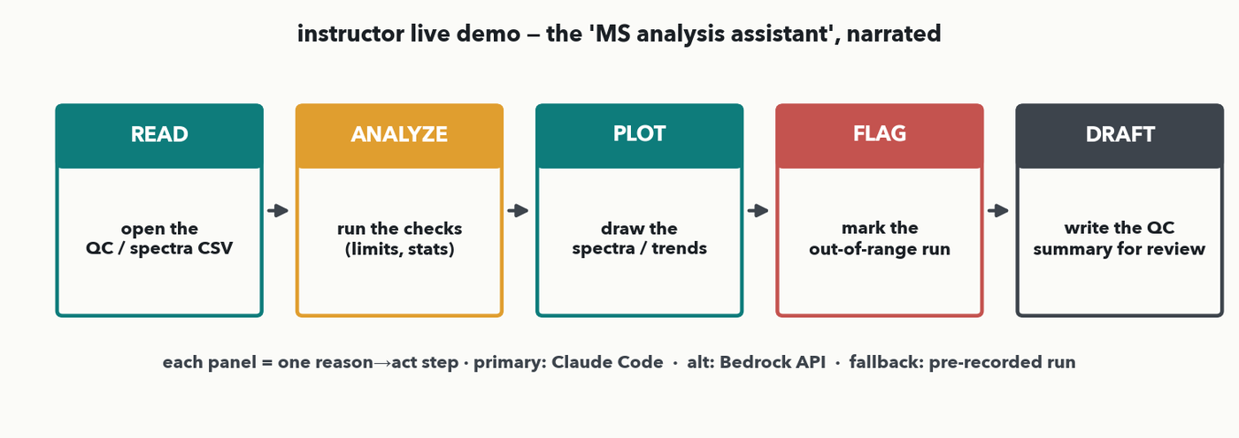
LIVE DEMO · 1 OF 6 · THE PLAN
Three scripts, one new idea each
MASS SPEC · Three scripts, asked the SAME three questions. STAGE 1, a bare LLM call: forgets which run we named. STAGE 2, keep the conversation: remembers QC-04, then INVENTS a mass error and passes it. STAGE 3, let it call tools: reads the file and flags QC-04 OUT OF SPEC. The punchline — the memory-only chatbot passes the one run that fails all three limits.
Notes:
The map to keep in their heads for the next five slides — the README's own table, on screen. Read the three QUESTIONS out loud first, because they are identical in all three scripts and that is the whole experiment: Q1 asks for a CONCEPT ('what does out of spec mean?'), Q2 asks for MEMORY ('which run did I just say?'), Q3 asks for the DATA ('what is QC-04's mass error, and does it pass?'). Then the three rows. Stage 1 answers Q1 and falls over on Q2. Stage 2 fixes Q2 and falls over on Q3 — and note the failure got WORSE, not better: forgetting is obvious, inventing a number is not. Stage 3 answers all three. Point at the amber footer and say it plainly: the memory-only chatbot PASSES QC-04, the single run in the table that breaks all three limits. That is a released bad batch. Ask the room to predict, before you run anything, which stage they would have shipped.

Slide 11
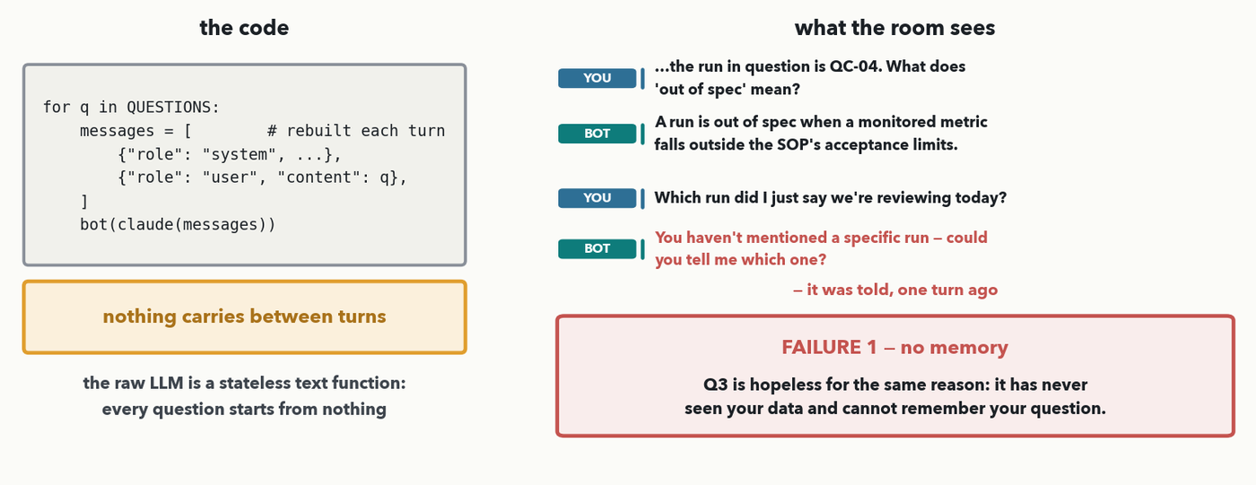
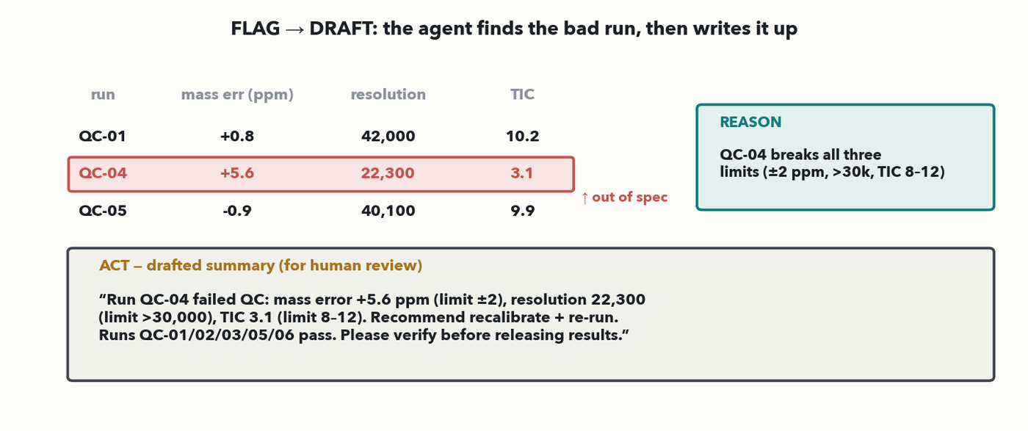
LIVE DEMO · 2 OF 6 · STAGE 1
A bare chatbot — no memory, no tools
MASS SPEC · The message list is rebuilt from scratch every turn, so nothing carries over. Q1 answers fine. Then Q2 — 'which run did I just say?' — and it asks you which run you mean. It was told, one turn ago. A raw LLM is a stateless text function: every question starts from nothing.
Notes:
STAGE 1, ~3 minutes. Run 'python3 stage1_chatbot.py' and let it play. THE CODE, left: point at the one thing that matters — 'messages' is rebuilt INSIDE the loop, so each call carries only the system prompt and the current question. Nothing else. WHAT HAPPENS: Q1 is answered perfectly well, because it is a definition the model already knows and needs no context. Then Q2 lands and the assistant asks which run you mean — one turn after you told it. Let that sit for a beat; it always gets a reaction, because it looks broken in a way people do not expect from something that just answered a technical question fluently. THE POINT: the raw LLM is a stateless text function. It is not 'forgetting' in any human sense — the previous turn was simply never sent. Q3 is hopeless for the same reason, plus a second one we are about to make the whole of stage 2 about: it has never seen your data. Do not fix it yet; let the room feel the gap before the next script closes it.

Slide 12
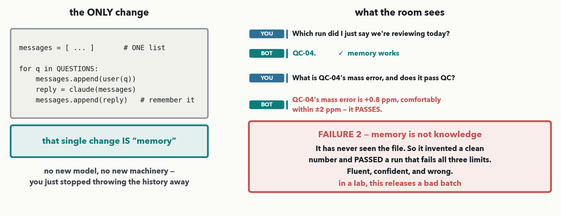
LIVE DEMO · 3 OF 6 · STAGE 2 · 💬 PREDICT
Add memory — and meet a worse failure
MASS SPEC · ONE change: `messages` persists and we append each reply. That single change IS memory, and Q2 now answers 'QC-04'. 💬 Before I run Q3, predict: what will it say QC-04's mass error is? It has never seen the file — so it invents a clean number (+0.8 ppm) and PASSES a run that fails all three limits. Fluent, confident, and wrong.
Notes:
STAGE 2, ~4 minutes, and the most important slide in the demo. Run 'python3 stage2_memory.py'. THE DIFF, left: diff it against stage 1 on screen if you can — the ONLY change is that 'messages' now lives outside the loop and we append each reply to it. No new model, no framework, no new machinery. That single change is what everyone means by 'memory'. Q2 now answers QC-04 correctly; take the small win. THEN THE 💬 PREDICT BEAT, and do not skip it: before you run Q3, ask the room to predict what the bot will say QC-04's mass error is. Someone will say it cannot know. They are right — and watch what it does anyway. It produces a specific, plausible, clean number (+0.8 ppm in the run I rehearsed; the exact value varies, which is itself worth pointing out) and concludes the run PASSES. WHY THIS IS WORSE THAN STAGE 1: stage 1's failure announced itself — the assistant said it did not know. Stage 2's failure is invisible. It is fluent, it is confident, it uses the right units and the right limit, and it is completely fabricated, because the model has no access to qc_runs.csv and is doing the only thing it can do — predicting plausible next tokens (straight back to Lecture 13). Say the lab consequence out loud: QC-04 fails ALL THREE limits, and this chatbot just released it. MEMORY IS NOT KNOWLEDGE — remembering what you SAID is not the same as knowing what is TRUE. That is the sentence to leave hanging before stage 3.

Slide 13
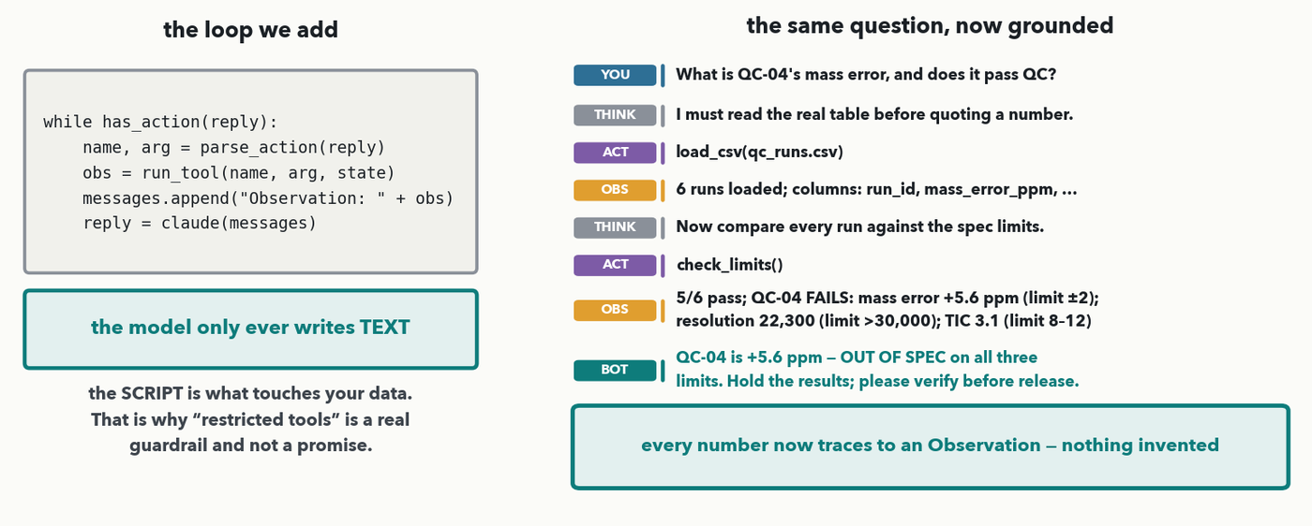
LIVE DEMO · 4 OF 6 · STAGE 3
Add tools — the ReAct loop closes the gap
MASS SPEC · Now the loop: when the model writes `Action:`, OUR script runs that Python function and feeds the result back as an `Observation:`. Think → act → observe, until it can answer. Same question, grounded: load_csv → check_limits → 'QC-04 is +5.6 ppm, OUT OF SPEC on all three limits.' Every number now traces to an Observation.
Notes:
STAGE 3, ~4 minutes, the payoff. Run 'python3 stage3_react.py'. THE LOOP, left: five lines. While the model's reply contains an Action, parse it, run that tool, append the result as an 'Observation:', and ask again. That inner loop is ReAct — the same Thought/Action/Observation pattern annotated back on slide 4, now actually executing. WALK THE TRANSCRIPT, right, one chip at a time, and narrate what is happening: THINK, the model plans to read the table — it has not done anything yet. ACT, it writes 'Action: load_csv'. OBS, the script ran that function and here is what came back: 6 runs, these columns. THINK again, ACT check_limits, OBS the real comparison against the spec limits. Only then the answer — QC-04, +5.6 ppm, out of spec on all three. THE SENTENCE THAT MATTERS, and it is on the left panel: the model only ever writes TEXT. It cannot open a file. It emits the string 'Action: load_csv' and OUR Python decides whether to honour it. That is why 'restricted tools' in the guardrails section is a real, enforceable control and not a promise — the agent literally cannot do anything you did not write a function for. Contrast the two answers side by side if you can: stage 2 said +0.8 ppm and PASSES; stage 3 says +5.6 ppm and FAILS. Same model, same question. The only difference is that one of them looked.

Slide 14
LIVE DEMO · 5 OF 6 · THE PAYOFF
It finds the bad run, then drafts it up
MASS SPEC · The FLAG→DRAFT beat on real numbers. QC-04 breaks all three limits: mass error +5.6 ppm (vs ±2), resolution 22,300 (vs >30,000), TIC 3.1 (vs 8–12). The agent drafts a summary naming the failed run, the exact out-of-range values and a recommendation — and ends 'please verify before releasing results'. Every number read from the table, none invented.
Notes:
STAGE 3 CONTINUED, ~3 minutes — the third tool, and the hand-off to a human. Having flagged QC-04, the agent calls draft_summary and produces the QC note: the failed run named, each out-of-range value with the limit it broke, a recommendation to recalibrate and re-run, and the results held. Read the closing line of the draft out loud — 'please verify before releasing any results' — because it is the whole ethic of this lecture in one sentence, and it is written into the tool, not left to the model's goodwill (tools.py, draft_summary). THREE THINGS TO POINT AT. (1) Every number in that draft traces back to an Observation; nothing is the model's recollection. (2) The draft is a DRAFT — it is explicitly marked for human review, which is the human-review guardrail arriving on its own rather than being bolted on. (3) Compare with the follow-along earlier in the hour: some bots in the room invented a value from the pasted table. This one cannot, because it is reading the file. Then move to the two lessons and on to the guardrails section, which this demo has now motivated rather than asserted.

Slide 15
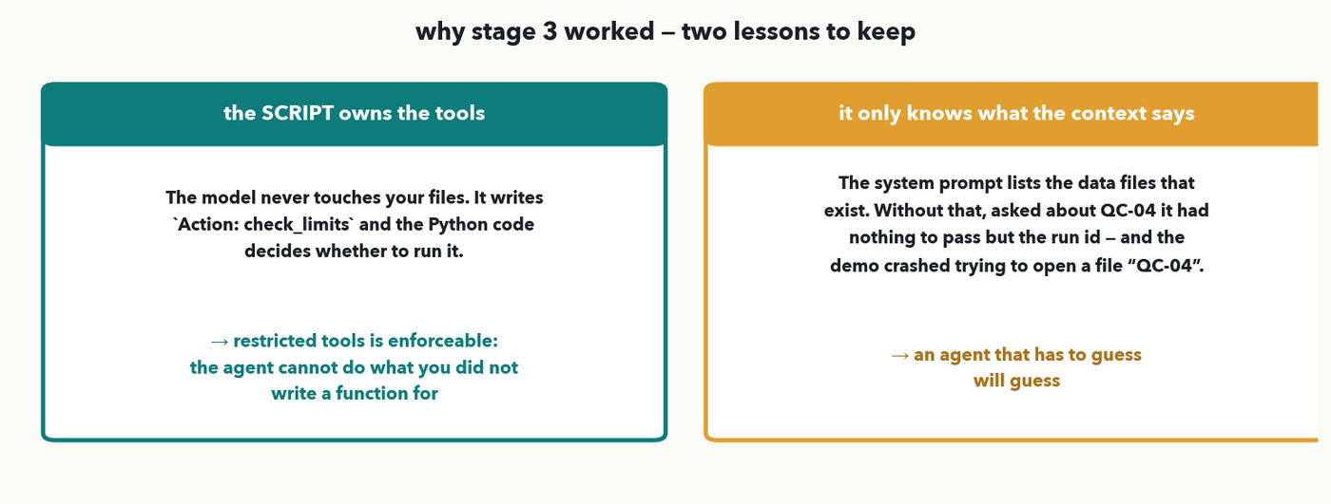
LIVE DEMO · 6 OF 6 · WHAT MADE IT WORK
Two lessons to carry into the guardrails
MASS SPEC · (1) The SCRIPT owns the tools. The model writes `Action: check_limits`; the Python decides whether to run it — so restricted tools is enforceable. (2) An agent only knows what its CONTEXT says exists. The system prompt lists the data files; without that, asked about QC-04 the model had nothing to pass but the run id — and the demo crashed opening a file called 'QC-04'.
Notes:
~3 minutes, and this slide is the bridge into the guardrails section — it turns the demo from a nice trick into two transferable rules. LESSON 1, the script owns the tools. Worth labouring because it is counter-intuitive: people assume an agent 'has access' to their files. It does not. It produces a string that looks like a function call, and a piece of ordinary Python you wrote decides whether to execute it. Everything the agent can do is the union of the functions in tools.py — three, in this demo, all read-only. So when the next section says 'restricted tools' is a guardrail, they have already watched the mechanism that makes it enforceable. LESSON 2, the context defines the world, and this one comes from a real bug in this very demo that is worth telling as a story. The first version's system prompt listed the three TOOLS but never named a single FILE. So when it was asked about QC-04, the model had nothing to put in 'Action Input' except the run id — and the script dutifully tried to open a file called 'QC-04' and crashed. The model was not being stupid; we never told it what existed. The fix was to put an inventory of the real data files into the system prompt, generated by reading the directory so it cannot drift. THE RULE: an agent that has to guess will guess. When you deploy one, the first question is not 'which model?' but 'does its context actually describe the world you want it to act in?'. Note for the curious: the demo now also survives a guessed filename, an unknown tool name and a runaway loop — belt and braces, so it cannot die mid-room — but the real fix was the context.

Slide 16
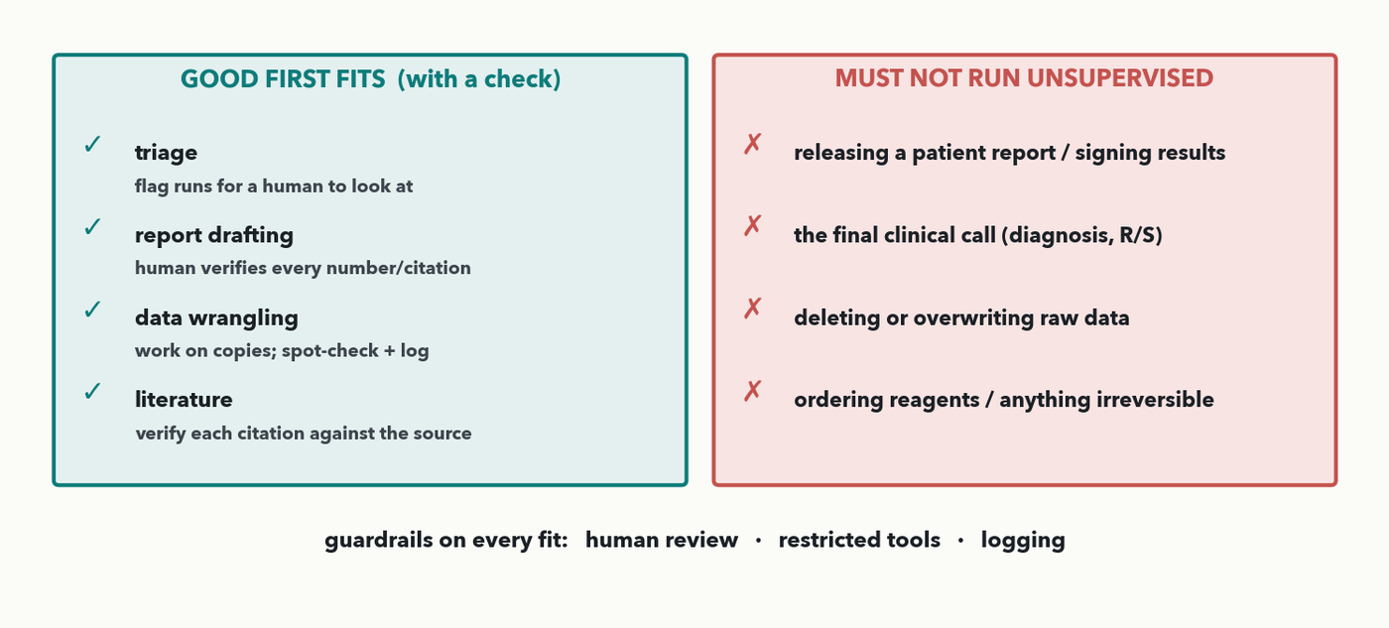
WHERE AGENTS FIT · THE MAP · I-DO
Where agents fit — and where they must not run alone
MASS SPEC · GOOD FIRST FITS (each with a check): triage (flag runs for a human), report drafting (human verifies every number), data wrangling (work on copies; spot-check + log), literature (verify each citation). MUST NOT run unsupervised: releasing a patient report, the final clinical call (R/S), deleting raw data, ordering reagents. Guardrails on every fit: human review · restricted tools · logging.
Notes:
The practical map for a clinical lab (rule 2). On the left, tasks an agent can plausibly help with FIRST — each paired with the check that keeps it honest: TRIAGE (flag runs/samples for a human to look at — the human still decides), REPORT DRAFTING (a person verifies every number and citation before release), DATA WRANGLING (reformat/merge tables — but on COPIES, with spot-checks and logging), LITERATURE (search and summarise — verify each citation against the source, per Lecture 13's hallucination lesson). On the right, what must NEVER run unsupervised: releasing a patient report or signing out results, making the final clinical call (a diagnosis or a resistance R/S decision), deleting or overwriting raw data, or ordering reagents / anything irreversible. Three guardrails ride on every fit — HUMAN REVIEW, RESTRICTED TOOLS, LOGGING — which we pair to failure modes next. This is also the setup for the Q3 human-review item.

Slide 17
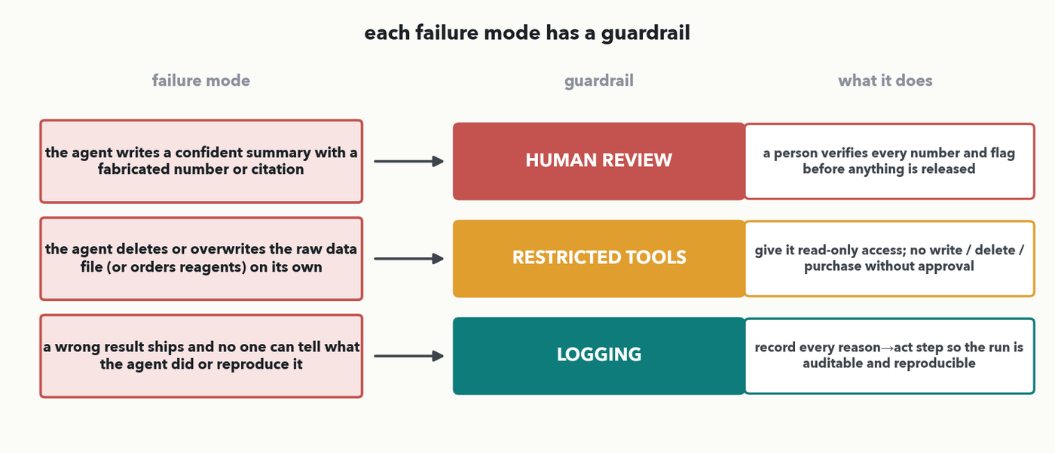
GUARDRAILS · FAILURE → GUARDRAIL · I-DO
Each failure mode has a guardrail
MASS SPEC · Three failures, three guardrails. FABRICATED number/citation in a summary → HUMAN REVIEW (a person verifies every number before release). Agent DELETES/overwrites raw data or orders reagents → RESTRICTED TOOLS (read-only; no write/delete/purchase without approval). A wrong result ships and no one can tell what happened → LOGGING (record every reason→act step so the run is auditable).
Notes:
The three guardrails from the outcomes, each tied to the specific failure it prevents (rule 3 — every guardrail and failure is taught HERE, before the Q2 match). FAILURE 1: the agent writes a confident summary containing a fabricated number or citation (the Lecture 13 hallucination, in an agent) → GUARDRAIL: HUMAN REVIEW — a qualified person verifies every number and flag before anything is released. FAILURE 2: the agent takes a destructive or irreversible action — deletes/overwrites the raw data file, or orders reagents — on its own → GUARDRAIL: RESTRICTED TOOLS — give it read-only access and a limited toolset; no write, delete, or purchase without explicit approval. FAILURE 3: a wrong result ships and no one can tell what the agent did or reproduce it → GUARDRAIL: LOGGING — record every reason→act step so the run is auditable and reproducible. Say the pairing PATTERN aloud (what each guardrail is FOR), because next slide the room matches three NEW, differently-worded failures — reasoning from purpose, not copying this chart (Quiz 14 Q2).

Slide 18
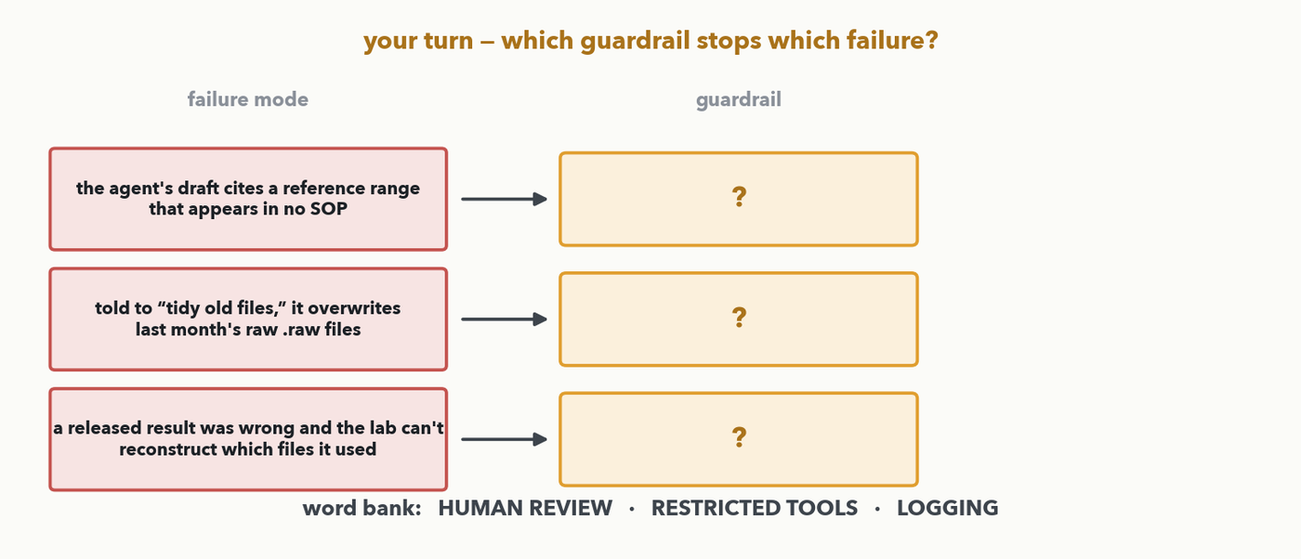
GUARDRAILS · YOUR TURN (YOU-DO = Q2)
Your turn — which guardrail for which failure?
CHECKPOINT · Your turn → Quiz 14, Q2. Three NEW failures — different wording from the chart above. Match each to the ONE guardrail that prevents it (word bank: HUMAN REVIEW · RESTRICTED TOOLS · LOGGING). Then Q2(d): human review CATCHES a fabricated citation — what would make such fabrications RARER in the first place? Worked answer in the notes.
Notes:
YOU-DO = Quiz 14 Q2 (now a TRANSFER: three disguised failures the room must reason about, not the three lines from the I-do chart). Answers: (a) the draft cites a reference range in no SOP → HUMAN REVIEW (a person verifies every number/citation against a source before release); (b) told to "tidy old files," it overwrites last month's .raw files → RESTRICTED TOOLS (read-only; no write/delete without approval — the destructive-action failure in disguise); (c) a wrong result shipped and the lab can't reconstruct which files it used → LOGGING (every reason→act step recorded, auditable). Each guardrail once. Q2(d), the catch-vs-prevent twist: human review is a CATCH-AFTER control (works only if the reviewer checks); to make fabrications rarer UP FRONT, ground the agent in real retrieved sources (RAG, Lecture 13) and/or restrict it to a vetted reference database so it can only cite documents that exist — prevention layered on detection. Take one match and one prevention idea from the floor, then have the room fill Q2.

Slide 19
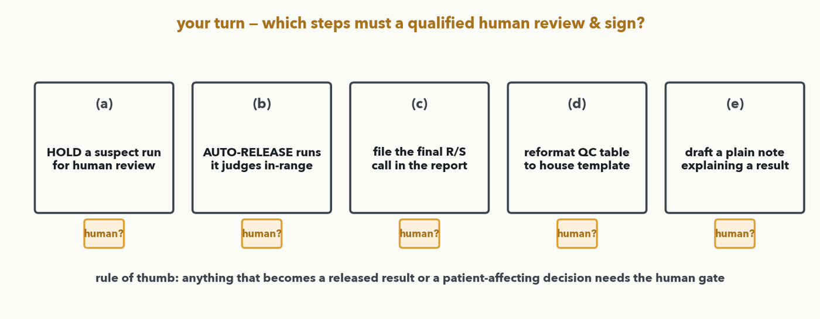
CLINICAL REVIEW · YOUR TURN (YOU-DO = Q3)
Your turn — what must stay human-reviewed?
CHECKPOINT · Your turn → Quiz 14, Q3. Five steps an agent could help with — some look alike but differ. Circle the ones a qualified human must review and sign before they affect a patient: (a) HOLD a suspect run for review (b) AUTO-RELEASE runs it judges in-range (c) file the final R/S call (d) reformat the QC table (e) draft a note explaining a result. Then state the rule you used. Worked answer in the notes.
Notes:
YOU-DO = Quiz 14 Q3 (decide + articulate the rule, on FRESH scenarios — with a deliberate near-miss pair). Answer (identical to the Quiz 14 Q3 key): (b) AUTO-RELEASING results and (c) the final resistance (R/S) call must stay human-reviewed and signed — each becomes a released clinical result or a patient-affecting decision. The key discrimination is (a) vs (b): (a) HOLDING/flagging a suspect run for review is CONSERVATIVE — it only routes work to a human, never releases anything — so an agent may do it freely, whereas (b) auto-releasing decides a patient result and needs the gate. (d) reformatting the QC table and (e) drafting an explanatory note are agent-friendly helpers (still spot-checked and logged), because they don't release a result or decide anything about a patient. Rule of thumb: anything that RELEASES a result or makes a PATIENT-AFFECTING decision needs the human gate — flagging, drafting, and reformatting do not. Take one answer plus the rule, then have the room fill Q3 — that's all three Quiz 14 items worked live.

Slide 20
WHERE AGENTS FIT · 💬 DISCUSS
💬 Which task would you hand an agent first?
• Pick ONE task from your own week you'd hand an agent first — triage, report drafting, data wrangling, or a literature scan
• Name the ONE check that keeps it honest — a human review, a restricted (read-only) toolset, or a log you can audit
• Say where it must stop — the point at which a human must review and sign before anything reaches a patient
PAIR · 💬 2 minutes with your neighbour: which task would you hand an agent first — and what ONE check keeps it honest? Be specific about where the agent stops and the human signs. Share-outs in the notes.
Notes:
💬 The outcomes' discussion beat (rule 8), and the bridge to using this in their own lab. Two minutes, then harvest three or four. Good answers pair a concrete first task with a concrete check and a clear stopping point: "an agent triages overnight QC runs and flags the suspect ones — a tech reviews the flags each morning (human review), it only READS the QC files (restricted tools), and every check is logged"; or "it drafts the method section of a validation report — I verify every number and citation before it goes anywhere (human review + logging)." Push for WHERE IT STOPS: the agent proposes, a qualified human reviews and signs before any result reaches a patient. This rehearses the exact judgement the course objective 5 asks for — deciding when the tool is and isn't appropriate — now for agents. Then finish Quiz 14 and brief the capstone.

Slide 21
LECTURE 14 · WHAT YOU CAN DO NOW
You can now…
• Define an agent as LLM + tools + a reason→act loop (ReAct), and label the reasoning vs acting steps on a transcript (Quiz 14 Q1)
• Say why a chatbot with memory still invents data, and what tools change — memory is not knowledge (the three-stage demo)
• Name where agents fit in lab workflows and the guardrail each needs — human review, restricted tools, logging (Quiz 14 Q2)
• Say what must stay human-reviewed in a clinical workflow — anything that becomes a released result or a patient decision (Quiz 14 Q3)
You've now worked every item on Quiz 14 live — labelling reason vs act on a transcript (Q1), matching guardrail to failure (Q2), and what stays human-reviewed (Q3) — plus a follow-along on your own bot and a live demo. Keep the sheet.
Notes:
Recap = the Lecture 14 outcomes, each already a you-do this hour tied to a Quiz 14 item: define/trace the ReAct loop and label reason vs act (Q1); run a reason→act→check interaction on your own bot (the follow-along); name where agents fit and the guardrail each needs (Q2); and what must stay human-reviewed in a clinical workflow (Q3). The sheet was filled across the hour, not as an end block. The big takeaway to send them off with: an agent is not a new kind of AI — it is the LLM you already understand, given tools and a reason→act loop, and the whole job of deploying it safely is putting a human in the loop where it matters and restricting and logging what it can do. Keep the sheet; the capstone is next.

Slide 22
LECTURE 14 · NEXT — LAB 5 CAPSTONE
Next — the Lab 5 capstone
• Pick ONE guided track: A — beat the Lab 2 spectra baseline · B — peak QC (good/bad integrations) · C — new question, same spectra (transfer learning)
• Adapt a working pipeline, evaluate it PROPERLY — split, metrics, honest error analysis (Lectures 4 & 10) — all rubric-scored
• Complete your project one-pager: problem → data & representation → architecture → validation plan → 'why not a simpler model?'
• Closing discussion D5: share your one-pager in pairs, a few 60-second share-outs, then resources to keep learning
CHECKPOINT · 2 minutes to finish Quiz 14 solo → we mark it together as Lab 5 opens. Then choose your capstone track and open the Colab. Bring everything: representation (Lec 10), the right architecture (Lec 5/8/11), and honest metrics (Lec 4/10).
Notes:
Hand the last minutes to finishing Quiz 14, then brief the Lab 5 capstone — the course's integrative finale. Each participant picks one guided, rubric-scored track: A (beat the Lab 2 spectra classifier by architecture / augmentation / tuning), B (peak QC — classify chromatographic peaks as good/bad integrations, the Lecture 5 object-detection segment made real), or C (a new question on the same spectra via fine-tuning / re-heading — transfer learning in practice). All reuse course datasets. The rubric rewards proper data handling, a justified model choice, correct split/metrics, and honest error analysis — everything from Lectures 4 and 10. Everyone also completes the one-page 'first DL project in my own lab' template: problem → data & representation → architecture → validation plan → why not a simpler model. Closing Discussion D5: share one-pagers in pairs, a few 60-second presentations, and a resources-to-keep-learning slide to send them off. Mark Quiz 14 together as Colab boots.

