Slide 1
MSACL · DS301 DEEP LEARNING · SEGMENT 2 · LECTURE 5
Convolutional networks: seeing patterns in images and spectra
Filters, feature maps, pooling — computed by hand · then peaks as objects
Notes:
Sunday afternoon, hour two, straight after Lecture 4. Energy check. The promise of the hour: by the end you compute a convolution by hand, and you see why the exact same machinery reads a MALDI-TOF spectrum and even finds chromatographic peaks. Nothing here needs more than multiply-and-add — no calculus, no new math. This hour is interactive the same way Lectures 1, 2 and 4 were: each worked example (I-do) is followed by one you do yourself (you-do), and every you-do IS a Quiz 5 item. Hand out Quiz 5 now, blank; the room fills it in across the hour, so by the recap they have worked the whole sheet. The grids on Quiz 5 are the same drill as the grids on screen, new numbers.

Slide 2
LECTURE 5 · WHERE THIS HOUR GOES
Four stops, one idea
• Why: three properties of the data · 8 min
• How: Convolution by hand — filters, stride, padding, output size, channels, pooling · 31 min
• Adaptation: The same trick in 1D — spectra and chromatograms · 6 min
• Application: Object detection · 11 min
Notes:
The order is deliberate: mechanics in 2D first with real numbers (easier to see on a grid), then transfer to the 1D data this room actually works with, then the architecture story and the detection reframe. Signpost the four stops so people can pace themselves. Quiz 5 reuses exactly these grids: the convolution maps (Q1), the max-pool (Q2), the output-size count (Q3), the peak-as-detection item (Q4), and the channel arithmetic (Q5). Keep it moving — the convolution block is the biggest, and every mechanic in it has a matching quiz item. Timing note: the channels block (slides 17–20) added about five minutes to the convolution stop, hence 31 min, and the last stop is trimmed 16 → 11 min to pay for it (the LeNet→VGG row at ~3 min and the segmentation slide are the compressible pieces). If channels have to go, drop slide 20 (the you-do) first and set Quiz 5 Q5 as homework.

Slide 3
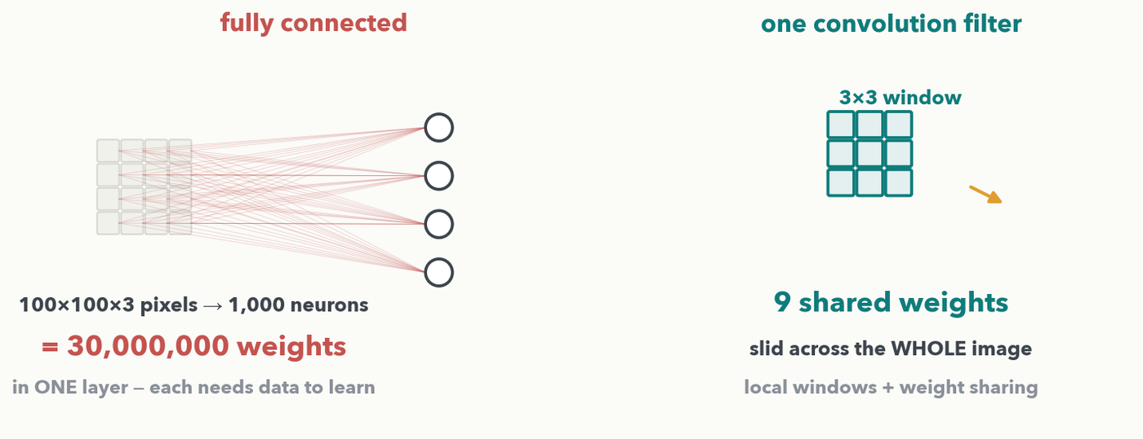
WHY CNN · 1 OF 4 · THE PROBLEM
A fully connected layer doesn't scale to images — or spectra
MATH · Same problem in 1D: feed a 6,000-bin spectrum straight into a dense layer and it is millions of weights — and the network must relearn 'what a peak looks like' separately at every m/z position. A convolution reuses ONE small detector everywhere.
Notes:
The motivating example is a plain photo — the classic doorway to CNNs. Wire every pixel of a modest 100x100x3 image to each of 1,000 neurons and layer one alone is 30 MILLION weights; the waste is not just memory, every one of those weights needs training data to pin down. Callback to Lab 1: our MLP was fine there because 189 metabolite features have no spatial order — but pixels do, and so do spectrum bins. On the right is the fix in one picture: a single 3x3 filter is 9 shared weights slid across the whole image (local windows + weight sharing). Three observations about images make this work, and each restates verbatim for spectra over the next three slides.

Slide 4
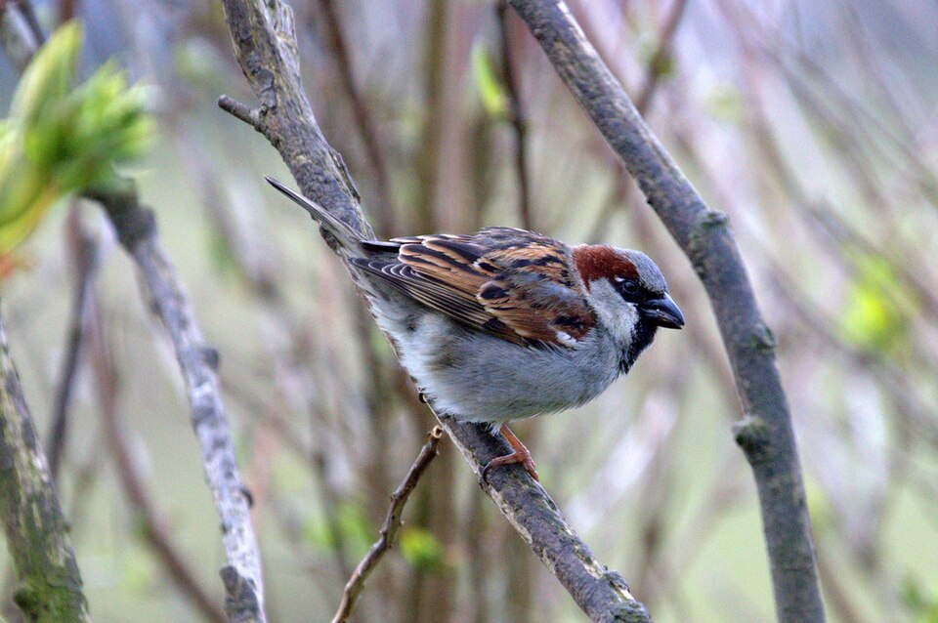
WHY CNN · 2 OF 4
Property 1 — patterns are local
To recognize a beak, a neuron doesn't need the whole bird — a small window is enough.
So connect neurons to windows, not to every pixel.
the beak lives here
a beak detector only needs this window · photo: M. Pennington, geograph.org.uk, CC BY-SA 2.0
MASS SPEC · A peak lives in a narrow m/z window — the rest of the spectrum is baseline.
Notes:
Hung-yi Lee's beak detector, told on the image itself. The consequence: connect each detector neuron to a small window instead of to everything, so far fewer weights. Then land the mass-spec beat via the callout — a peak is every bit as local in a spectrum as a beak is in the photo; you would never need the whole 6,000-bin trace to decide whether a peak sits at one m/z.

Slide 5
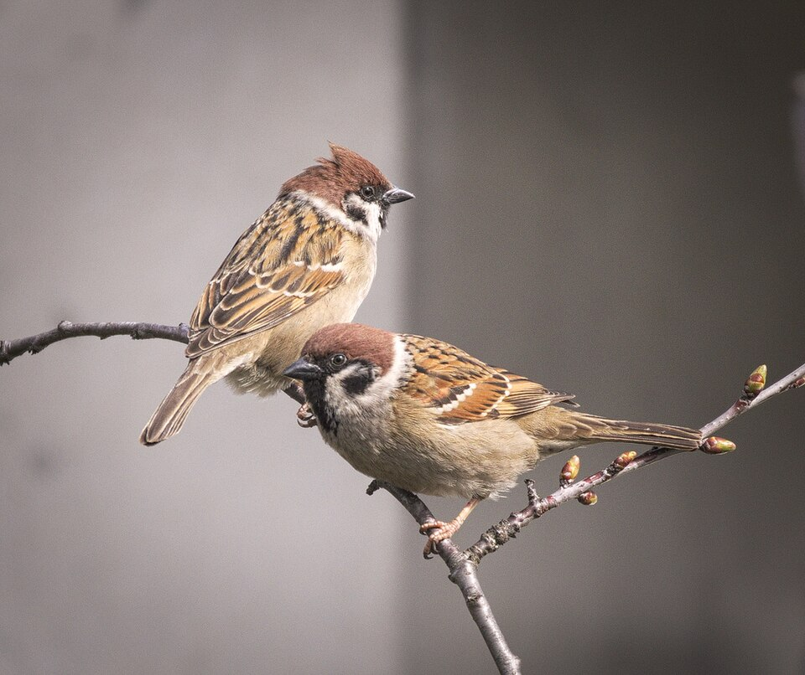
WHY CNN · 3 OF 4
Property 2 — the same pattern appears anywhere
An upper-left beak detector and a lower-right one do almost the same job.
So make them share one set of weights — one detector, slid everywhere.
a beak here…
…and here
one detector could handle both · photo: hedera.baltica, CC BY-SA 2.0
MASS SPEC · A Gaussian peak at m/z 300 looks like one at m/z 4,800 — one detector, slid along the whole axis.
Notes:
This is weight sharing — the single most important idea of the hour, and exactly what "convolution" will mean mechanically in a minute. One beak detector reused at every position instead of one detector per location. The callout lands the same move for spectra: one peak-shape detector for all 6,000 bins, because a Gaussian peak looks the same wherever it sits on the m/z axis. Say the phrase "weight sharing" out loud and promise them they will see it happen on the grid two slides from now.

Slide 6

WHY CNN · 4 OF 4
Property 3 — downsampling doesn't change what it is
full resolution · 960 × 638 px
kept 1 pixel in 20 · 48 × 32 px — still a bird
MASS SPEC · Downsample a spectrum from 6,000 bins to 1,500: it is still unmistakably itself. This is the license for pooling — coming up on the grid.
Notes:
Subsampling the pixels does not change the object: keep one pixel in twenty and it is still obviously a bird, but the next layer has far less to process. This is the license for pooling later in the hour. Wrap the whole "why" section here: three properties of the data map to three design moves — local windows, shared weights, and pooling — and each held just as well for spectra (the three mass-spec callouts). Now we compute all three by hand on a numeric grid.

Slide 7
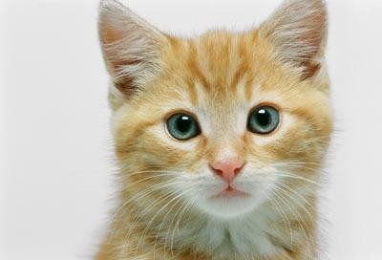



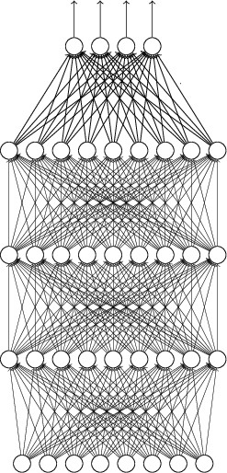


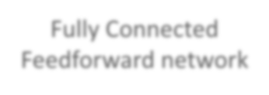









CNN General Architecture
CNN ARCHITECTURE · THE OVERVIEW
cat dog ……
Convolution
Max Pooling
Can repeat
many times
Fully Connected Feedforward network
Convolution
Max Pooling
Flatten
cc to deep learning in one day from Prof. Lee

Slide 8
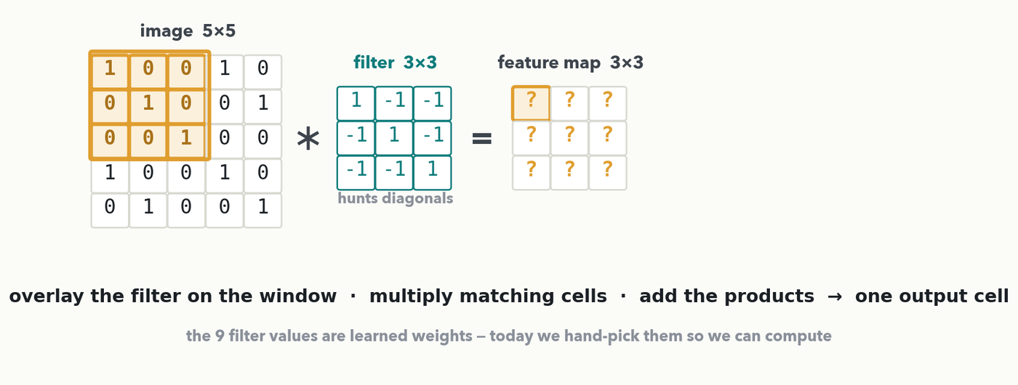
CONVOLUTION BY HAND · SETUP
Convolution: A Sliding Window
The rule for every cell, written before you use it: lay the 3×3 filter on a 3×3 window of the image, multiply each pair, add the nine products — that one number goes in the feature map. In a real CNN the 9 filter values are LEARNED (gradient descent, Lecture 2); today we hand-pick them so we can compute.
Notes:
Grids straight from the reference deck's CNN section (Hung-yi Lee, slides ~150-170). The image is 0/1 for arithmetic comfort; the filter is a diagonal detector, +1 down the diagonal and -1 off it, so it will "light up" wherever the image has a diagonal streak. State the rule on screen BEFORE any exercise asks for a number (rule 3): overlay, multiply the nine matching cells, add. Emphasize the punchline that WE do not choose these weights in practice — training discovers them; we fix them here only so the arithmetic is doable by hand. Next slide we compute the very first cell, every product out loud.

Slide 9
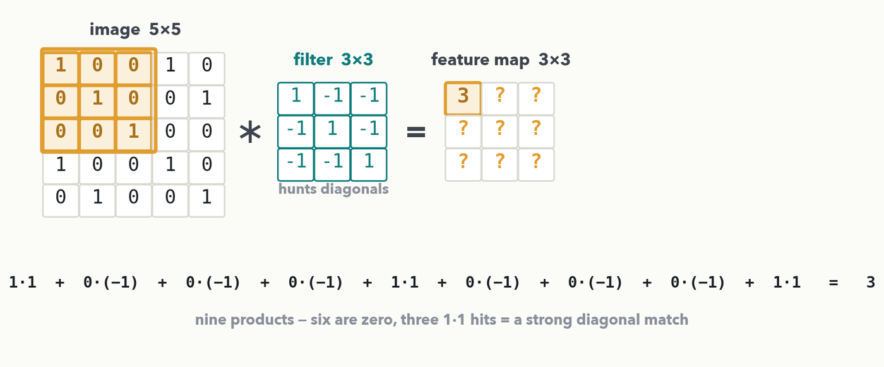
CONVOLUTION BY HAND · I-DO · STEP 1
One window, nine products, one output cell
Top-left window · overlay the filter · 1·1 + 0·(−1) + 0·(−1) + 0·(−1) + 1·1 + 0·(−1) + 0·(−1) + 0·(−1) + 1·1 = 3. Six products are zero; the three 1·1 hits sit on the diagonal — a strong diagonal match, written into the map as 3.
Notes:
The only full dot product we do out loud. Walk the nine products slowly: six are zero, and the three surviving 1·1 terms are exactly the diagonal matching, so the cell is 3 — a strong match. Point out that this 3 is just a neuron's weighted sum from Lecture 1, only arranged spatially over a window instead of over a feature vector. Every number here is exact and reproducible from the rule on the previous slide. Next: slide the same nine weights one step to the right.

Slide 10
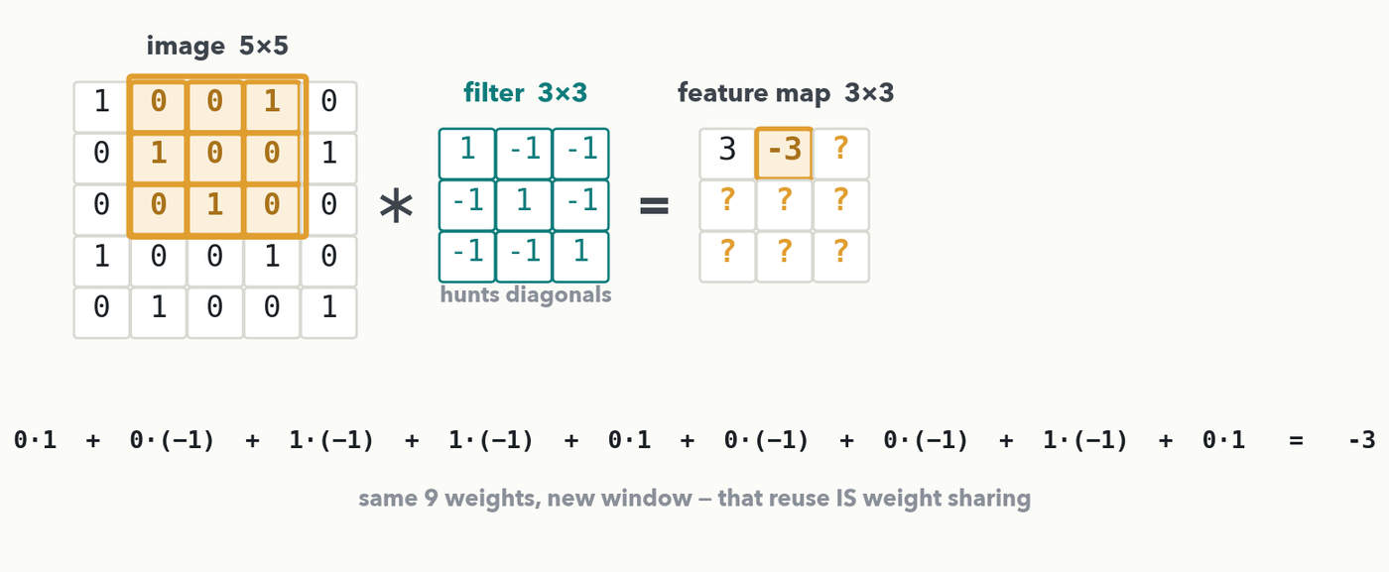
CONVOLUTION BY HAND · I-DO · STEP 2 · STRIDE 1
Slide one step — same 9 weights, new window
Stride 1 = jump the window one cell. Same 9 filter weights, new pixels: 0·1 + 0·(−1) + 1·(−1) + 1·(−1) + 0·1 + 0·(−1) + 0·(−1) + 1·(−1) + 0·1 = −3 — a weak (anti-)match here. Reusing the SAME weights at a new position is weight sharing, happening before your eyes.
Notes:
Second worked cell, so the you-do that follows is genuine practice, not a first attempt. The key idea to name: nothing about the filter changed — the same nine weights moved one column over. That reuse is weight sharing made concrete (Property 2). The value −3 says "no diagonal here." Stride is simply how far the window jumps each step; stride 1 means one cell. Keep momentum — don't recompute every term aloud a third time; the room is about to do it themselves.

Slide 11
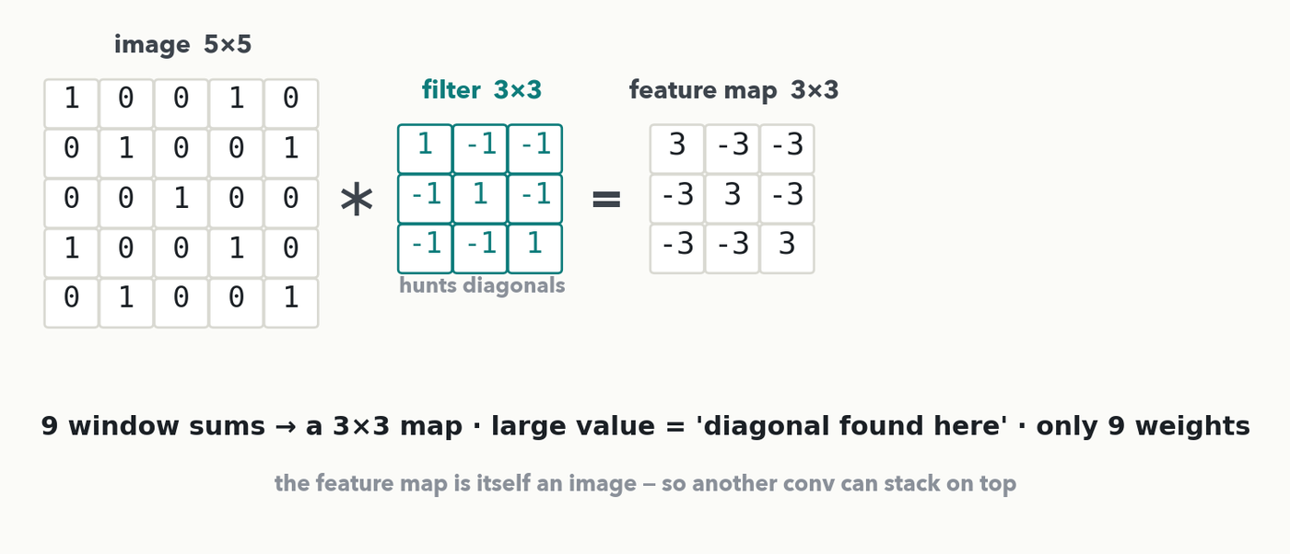
CONVOLUTION BY HAND · THE RESULT
The feature map is a 'where is my pattern' map
All 9 windows filled: 3 on the diagonal, −3 off it. Large value = 'diagonal found here.' 25 pixels became 9 responses using only 9 weights — and the feature map is itself an image, so another convolution can stack on top of it.
Notes:
Show the completed 3×3 map: the three 3's lie exactly where the image has diagonal streaks, and everything off-diagonal is −3. Read a feature map as a picture of "where did my detector fire." Contrast with the dense layer from slide 3: nine shared weights replaced thousands. Then the point that makes deep CNNs possible — a feature map is just another image, so the next layer convolves on top of it, building patterns of patterns. That is the Lecture 1 hierarchy, now with a mechanism.

Slide 12
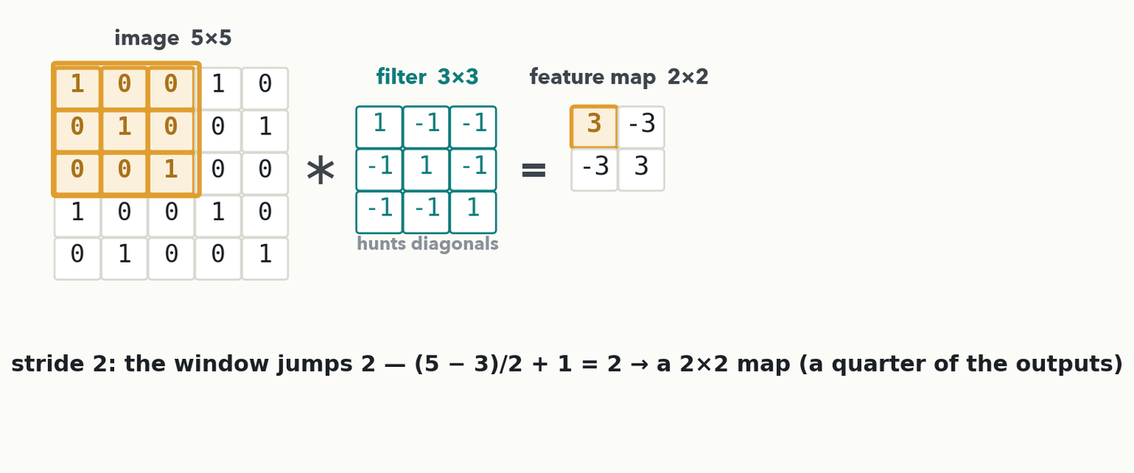
CONVOLUTION BY HAND · STRIDE
Stride 2: bigger jumps, a smaller map
Same 9 weights, but the window now jumps 2 cells each step, so it makes half the stops in each direction: (5 − 3)/2 + 1 = 2 → a 2×2 map, a quarter of the outputs. Stride is a resolution/cost dial you set.
Notes:
Stride 2 halves the number of window positions in each direction, so the map goes from 3×3 to 2×2 — a quarter of the outputs, cheaper for the next layer. Same nine weights, fewer stops. Stride is a resolution/cost dial, and in Lab 2 they will turn it themselves in the hyperparameter play. Note the stride-2 map is literally a subsample of the stride-1 map — the same cell values at every other position — which is why the you-do's stride-2 map needs no new arithmetic at all.

Slide 13
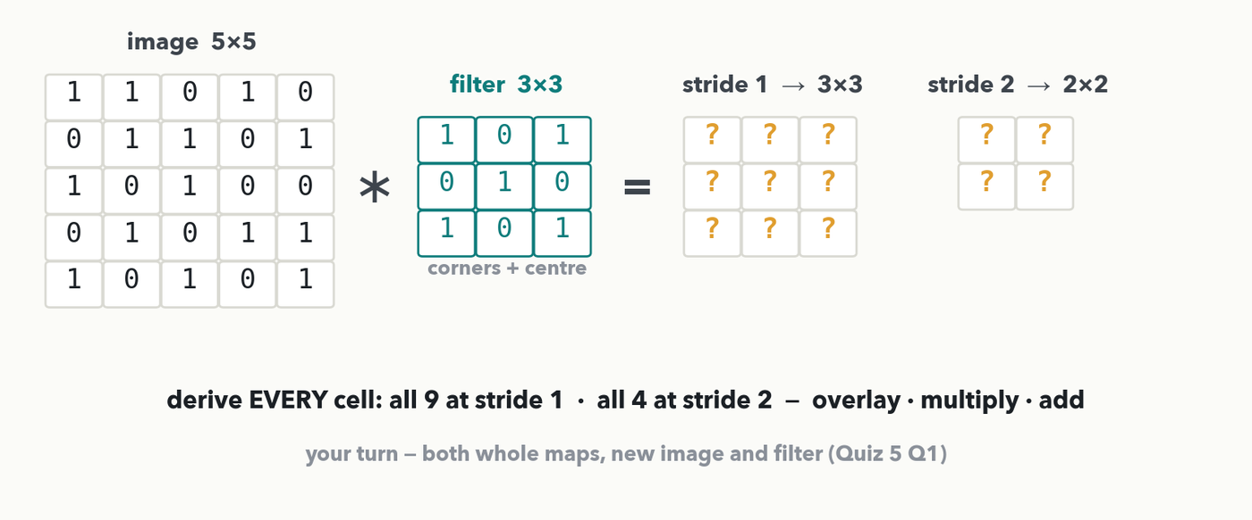
CONVOLUTION BY HAND · YOUR TURN (YOU-DO)
Your grid: derive both whole maps — stride 1 and stride 2
CHECKPOINT · Your turn → Quiz 5, Q1. Derive both whole maps, every cell.
Notes:
YOU-DO = Quiz 5 Q1 (same overlay-multiply-add drill, a different image and a simpler filter, so it is real practice and it assesses the by-hand convolution outcome). By now the full stride-1 map and the stride-2 map have both been worked on the board, so every rule this needs is already shown. The filter is [[1,0,1],[0,1,0],[1,0,1]] — the four corners plus the centre of each window, so each cell just counts how many of those five positions are 1: cell(r,c) = I(r,c) + I(r,c+2) + I(r+2,c) + I(r+2,c+2) + I(r+1,c+1), 1-indexed, the convention the quiz uses. (a) Stride 1, the whole 3×3 map — row 1: 1+0+1+1+1 = 4, 1+1+0+0+1 = 3, 0+0+1+0+0 = 1; row 2: 0+1+0+0+0 = 1, 1+0+1+1+1 = 4, 1+1+0+1+0 = 3; row 3: 1+1+1+1+1 = 5, 0+0+0+0+0 = 0, 1+0+1+1+1 = 4. So the map is [[4,3,1],[1,4,3],[5,0,4]]. (b) Stride 2 jumps the window by two, so its 2×2 map is exactly the four corners of the stride-1 map — output positions (1,1), (1,3), (3,1), (3,3) — giving [[4,1],[5,4]]: nothing new to compute, which is the point to land. Every number matches the Quiz 5 key exactly. Give the room ~3 minutes on the nine cells, take one row from volunteers, then ask who spotted that stride 2 needed no new arithmetic.

Slide 14
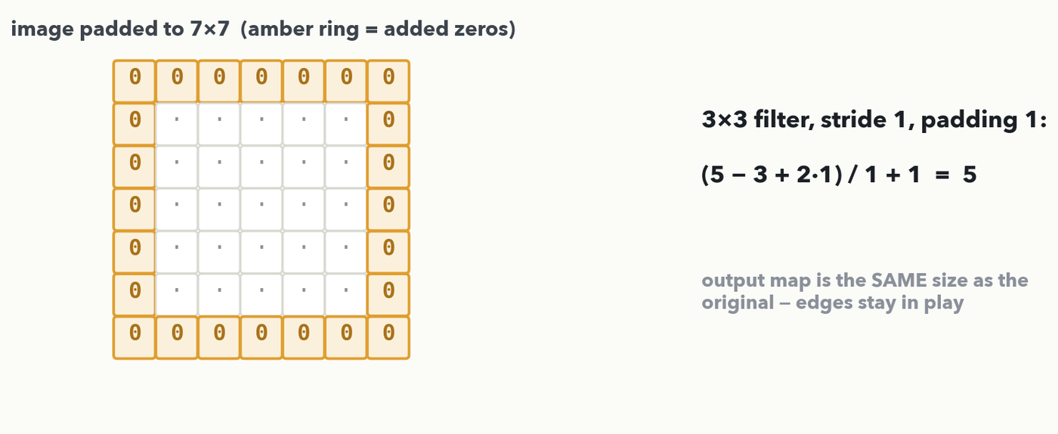
CONVOLUTION BY HAND · PADDING
Zero padding keeps the edges in play
Ring the image with zeros before convolving. A 5×5 padded to 7×7 gives a stride-1 map back at 5×5 — the same size as the original — and the edge cells now get as many looks as the middle. Without padding the map shrinks every layer and the edges are under-observed.
Notes:
One idea, one slide: add a ring of zeros so the output size matches the input and the border pixels are not shortchanged. In spectra terms, without padding the peaks at the very start and very end of your m/z range get fewer looks than peaks in the middle, and the signal shrinks a little at every layer. The count on the right, (5 − 3 + 2·1)/1 + 1 = 5, is the output-size formula we make general on the very next slide — so the number is bookkeeping, not magic.

Slide 15
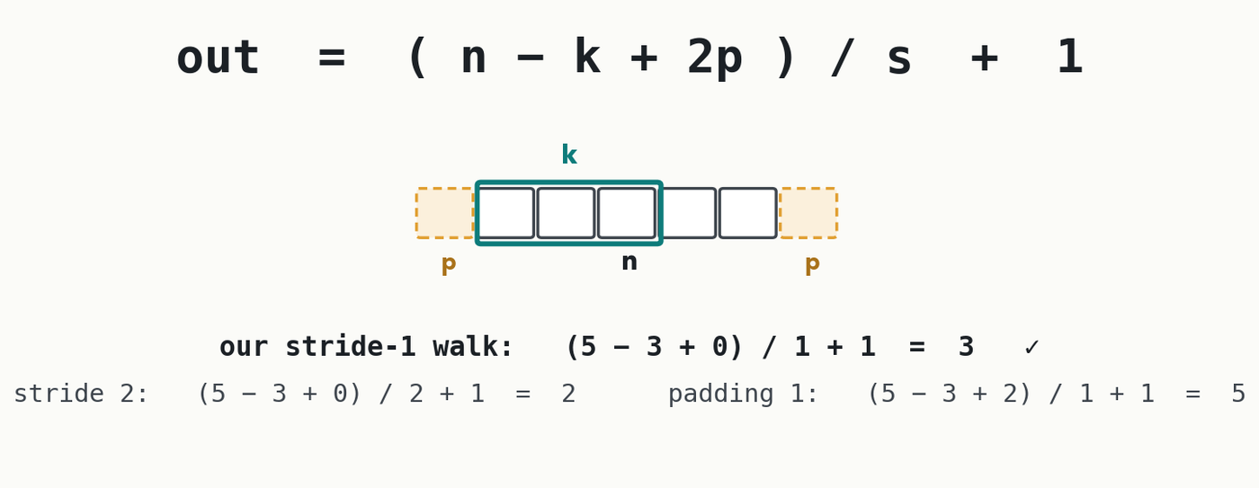
CONVOLUTION BY HAND · THE ONE FORMULA
How big is the output? 1D example, no calculus
out = (n − k + 2p) / s + 1. n = input size, k = filter size, p = padding per side, s = stride. Check it against the maps we built: stride-1 → (5−3+0)/1+1 = 3 ✓; stride 2 → 2 ✓; padding 1 → 5 ✓. This is the only formula of the hour.
Notes:
The diagram makes all four letters concrete before the formula runs: n is the plain input width (padding not counted), p is the ring added on each side, k is the filter window's own width, and s is how far the window jumps between stops. Then verify the formula against the three maps we just built by hand — it should feel like bookkeeping, not math. This is the only formula of the hour, and the next slide has the room run it once themselves (Quiz 5 Q3) before we move on to pooling.

Slide 16
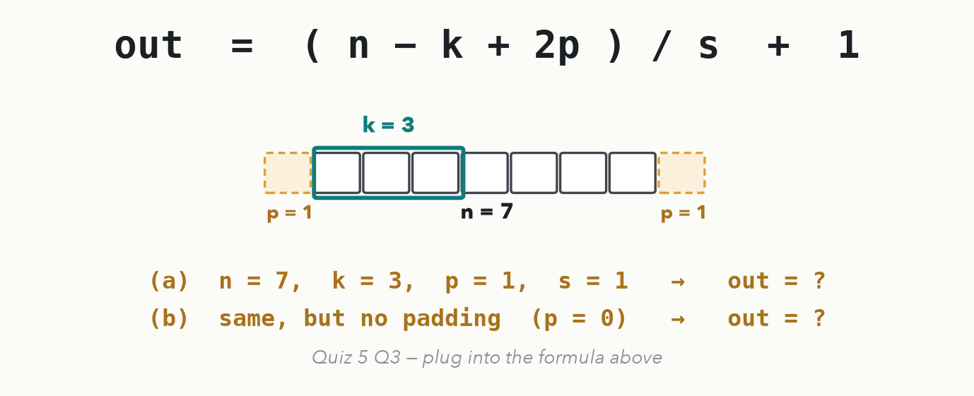
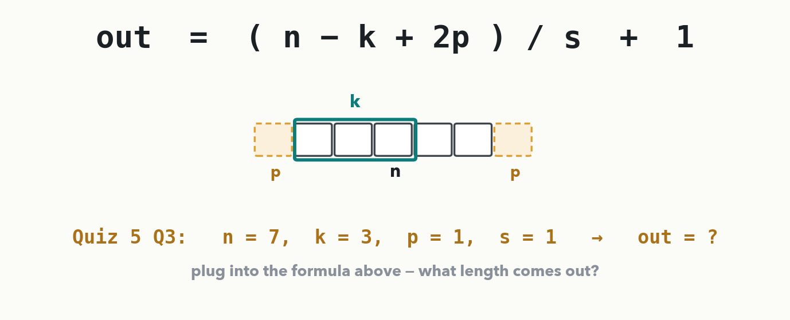
CONVOLUTION BY HAND · YOUR TURN (YOU-DO = Q3)
Run the formula once yourself
CHECKPOINT · Your turn → Quiz 5, Q3. A 3×3 filter runs over a 7-long input with padding 1 and stride 1. What is the output length? And what would it be with no padding? Worked answer in the notes.
Notes:
YOU-DO = Quiz 5 Q3 (the same (n − k + 2p)/s + 1 formula, new numbers, so it is real practice and it assesses the output-size outcome). Answer: with padding, (7 − 3 + 2·1)/1 + 1 = (7 − 3 + 2) + 1 = 6 + 1 = 7 — padding 1 with a 3×3 filter keeps the length unchanged. Without padding, (7 − 3 + 0)/1 + 1 = 4 + 1 = 5, so the map shrinks by two. Both numbers match the Quiz 5 key. Ask a pair for the padded length before revealing, then have them fill Q3.

Slide 17
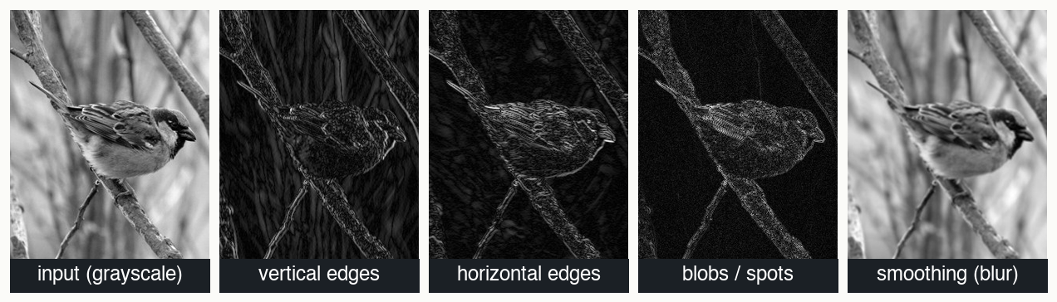
CONVOLUTION BY HAND · CHANNELS · 1 OF 4
Every filter its own map — real filters, really computed
Each map was made by sliding the named 3×3 kernel over the photo — Sobel-x (vertical edges), Sobel-y (horizontal edges), Laplacian (blobs/spots), box blur (smoothing). Stack many filters and one image becomes a multi-channel stack of pattern maps. A CNN LEARNS kernels like these in layer 1.
Notes:
These are genuine convolutions of the sparrow photo with the kernels named under each panel — not illustrations. Vertical branches blaze in the vertical-edge map and fade in the horizontal one; the Laplacian lights up fine texture and speckles; the all-ones kernel smooths instead of detecting. Define "channels" as the depth axis of the stack — every filter contributes one map, so a conv layer with 32 filters turns one image into a 32-channel stack. The punchline: nobody hand-picks these in a real CNN; gradient descent rediscovers edge- and blob-like filters in layer 1 because they are useful, and deeper layers combine them. Same story on spectra: layer-1 kernels become peak-shape and baseline-slope detectors. That is c_out — one map per filter. The next two slides make both channel axes exact: what a filter does when the INPUT has several channels, and the bookkeeping that ties c_in and c_out together.

Slide 18
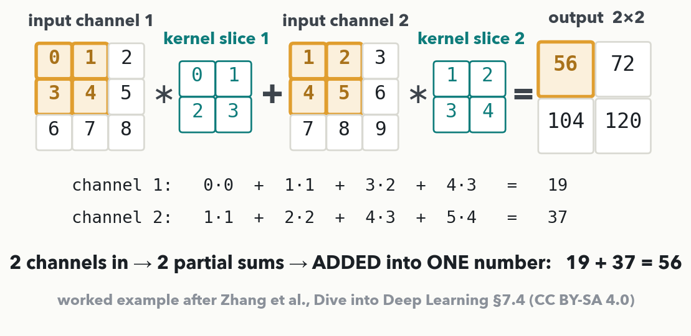
CONVOLUTION BY HAND · CHANNELS · 2 OF 4 · I-DO
One filter reads ALL the input channels at once
MASS SPEC · A filter carries ONE SLICE PER INPUT CHANNEL — here 2×2×2 = 8 weights — and the per-channel sums ADD, so 2 channels in still means ONE map out. Your channels are co-recorded traces: 3 MRM transitions of one analyte share a retention-time axis → in_channels=3, one filter reading all three. A single spectrum is in_channels=1.
Notes:
I-DO for the channel mechanic. The numbers are the canonical worked example from Dive into Deep Learning §7.4 (fig. 7.4.1, CC BY-SA 4.0), so anyone who reads the book afterwards meets the same figure. Setup: the input is 2 channels of 3×3; there is ONE filter, but it has 2 slices — one per input channel — so it is 2×2×2 = 8 weights. Take the SAME top-left 2×2 window from both channels (highlighted amber): channel 1 gives 0·0 + 1·1 + 3·2 + 4·3 = 19, channel 2 gives 1·1 + 2·2 + 4·3 + 5·4 = 37, and the two partials ADD: 19 + 37 = 56 — one number, one cell of ONE map. The other three cells are the same drill, giving [[56,72],[104,120]]. The misconception to kill out loud: a filter is not 'one per channel', and the channels are not combined at the end — the sum across channels happens inside every single output cell. So a filter's DEPTH is forced by the data (it must equal c_in); what you choose is how MANY filters. MS anchor: channels are co-recorded traces on a shared axis — 3 MRM transitions of one analyte, sample + internal standard, or one channel per selected m/z image in imaging MS; a single MALDI-TOF spectrum is in_channels=1, which is exactly Lab 2. Next slide: run several filters and the maps stack.

Slide 19
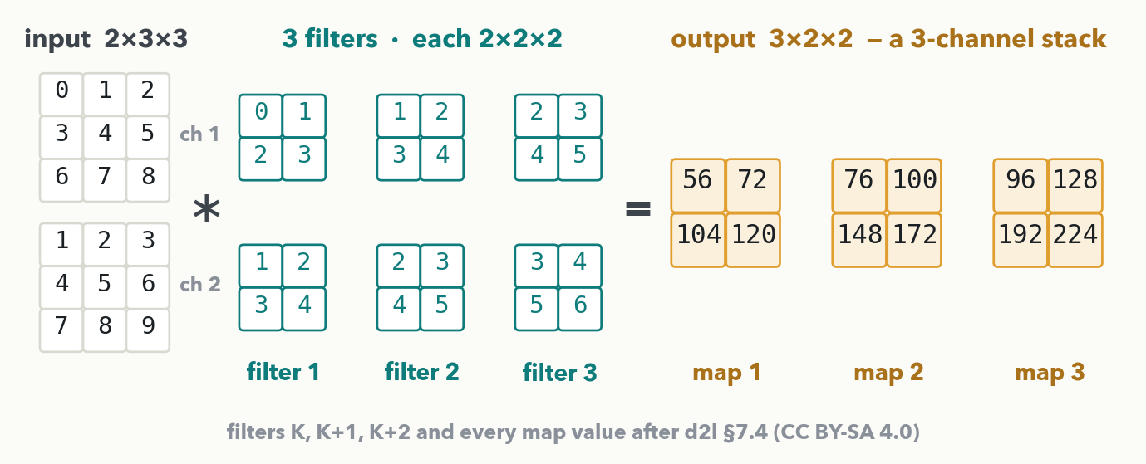
CONVOLUTION BY HAND · CHANNELS · 3 OF 4
Many filters, many maps: c_in in, c_out out
Two rules, no more: a filter's DEPTH = c_in (one slice per input channel), and the NUMBER of filters = c_out (one map each). So the kernel tensor is c_out × c_in × k × k = 3×2×2×2 = 24 weights + 3 biases — and the next layer must declare in_channels = 3.
Notes:
Same input, same drill, three different filters — filter 2 is filter 1 + 1 and filter 3 is filter 1 + 2, following d2l §7.4 so the numbers check against the book. Each filter is still 2 slices deep (c_in = 2) and each produces ONE map: map 1 = [[56,72],[104,120]] (the one we just computed by hand), map 2 = [[76,100],[148,172]], map 3 = [[96,128],[192,224]]. Three filters → a 3 × 2 × 2 output, which is itself a 3-channel image for the next layer — that is how depth grows through a CNN (VGG's 64→128→256→512 two slides from now is exactly this dial). Land the two rules and the one count: kernel tensor c_out × c_in × k × k, so 3×2×2×2 = 24 weights plus one bias per filter. Then the chaining rule they will need in Lab 2: this layer's out_channels IS the next layer's in_channels — Conv1d(1, 8, 15) then Conv1d(8, 16, 15). Both numbers on the slide are needed for the you-do next, so do not skip the formula. If someone asks about 1×1 convolutions (d2l §7.4.3): a 1×1 filter has no spatial reach at all, it only MIXES channels — c_out × c_in weights, a dense layer applied at every position. Answer it, but don't teach it.

Slide 20
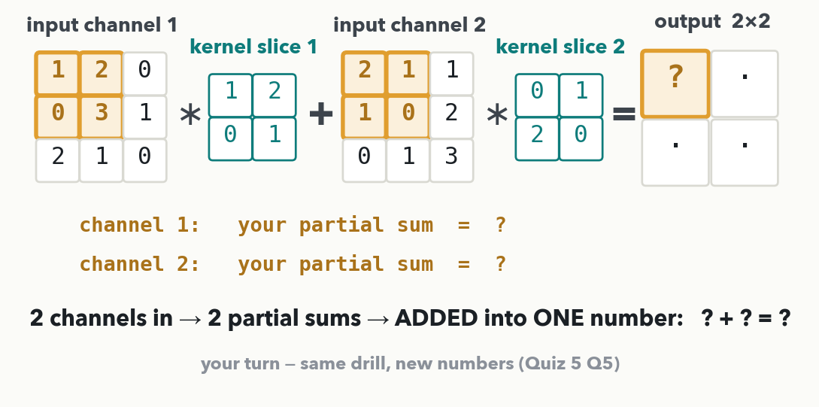
CONVOLUTION BY HAND · CHANNELS · 4 OF 4 · YOU-DO = Q5
Your turn: two channels in, one cell out
CHECKPOINT · Your turn → Quiz 5, Q5. (a) Compute the highlighted output cell — one partial sum per channel, then add. (b) A layer with in_channels=2, five 3×3 filters: how many weights and biases, and what in_channels does the next layer need? (c) Three MRM transitions of one analyte — what is in_channels?
Notes:
YOU-DO = Quiz 5 Q5 (the same two-channel drill, new numbers, so it is real practice and it assesses the channels outcome). Everything it needs is on the two previous slides: the per-channel partial sums that add, and the kernel-tensor count c_out × c_in × k × k. Answers — (a) channel 1: 1·1 + 2·2 + 0·0 + 3·1 = 8; channel 2: 2·0 + 1·1 + 1·2 + 0·0 = 3; the cell is 8 + 3 = 11. (b) kernel tensor 5×2×3×3 = 90 weights + 5 biases = 95 parameters; the layer emits 5 maps, so the next layer declares in_channels=5. (c) three co-recorded transitions on one retention-time axis = 3 input channels, so in_channels=3 — while out_channels stays your choice, because it is just the number of filters. Every number matches the Quiz 5 key exactly. Give the room ~2 minutes on (a), take the two partials from volunteers, then read (b) and (c) together.

Slide 21
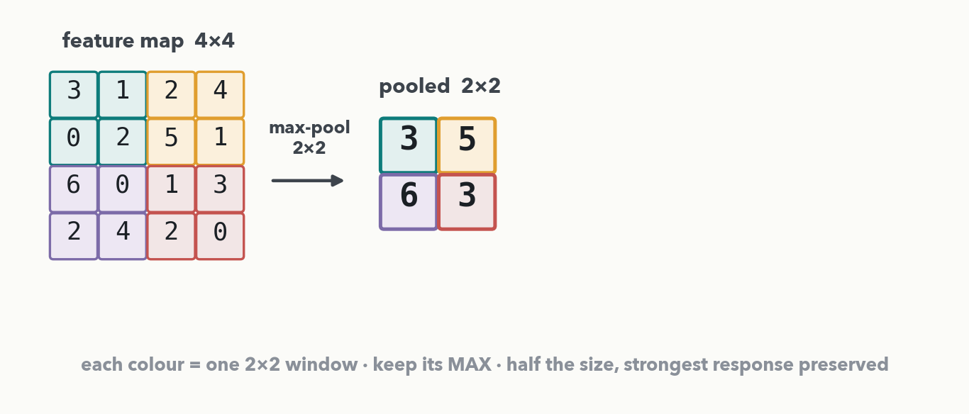
CONVOLUTION BY HAND · POOLING · I-DO
Max pooling: keep each region's strongest response
Split a 4×4 map into 2×2 windows and keep each window's MAX: {3,1,0,2}→3, {2,4,5,1}→5, {6,0,2,4}→6, {1,3,2,0}→3, giving a 2×2 pooled map. Half the size, the 'strongest response' story intact — and a peak wobbling one bin over gives the same answer (Property 3).
Notes:
Pooling has no weights — nothing to learn, purely mechanical. Read the four colour-coded 2×2 windows and keep the maximum of each: 3, 5, 6, 3. Two gifts: the next layer is cheaper (half the size each way), and the network tolerates tiny shifts — a peak drifting one bin left does not change the pooled answer, which is exactly why calibration jitter doesn't wreck CNNs on spectra. Every number here is exact; the next slide hands the room a different 4×4 to pool (Quiz 5 Q2).

Slide 22
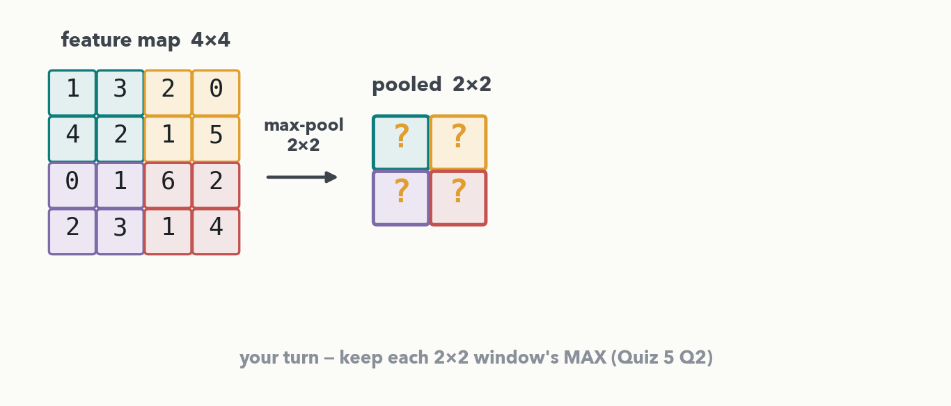
CONVOLUTION BY HAND · POOLING · YOUR TURN (YOU-DO = Q2)
Your turn: max-pool this 4×4 map
CHECKPOINT · Your turn → Quiz 5, Q2. Max-pool the 4×4 map with 2×2 windows (stride 2) into a 2×2 map — keep each colour block's largest value. Worked answer in the notes.
Notes:
YOU-DO = Quiz 5 Q2 (same 2×2 max-pool drill, different map). Answer, block by block: top-left {1,3,4,2} → 4; top-right {2,0,1,5} → 5; bottom-left {0,1,2,3} → 3; bottom-right {6,2,1,4} → 6. So the pooled map is [[4,5],[3,6]] — matches the Quiz 5 key exactly. Ask for one block from the room, then have them fill Q2. Note this is max pooling; average pooling would take the mean of each block instead, but max is the default and the one on the sheet.

Slide 23
CONVOLUTION BY HAND · ASSEMBLY
The whole CNN
input
spectrum / image
conv
pattern maps
pool
shrink
repeat ×N
patterns of patterns
flatten
to a vector
dense
your Lec 1–3 net
susceptible / resistant
softmax
Early layers find edges and peak shapes; deeper layers find patterns of patterns — the Lecture 1 hierarchy, now with a mechanism. Everything after 'flatten' is literally the MLP you trained in Lab 1.
Notes:
Land the composition: conv (their 5×5 grid) makes pattern maps, pooling shrinks them, repeat to build patterns of patterns, then flatten to a vector and feed the fully connected head — which is exactly the MLP from Lab 1. A CNN is a learned feature extractor bolted onto their old friend. The output labels are susceptible/resistant on purpose: this is the exact shape of Lab 2 on MALDI-TOF spectra, next hour.

Slide 24
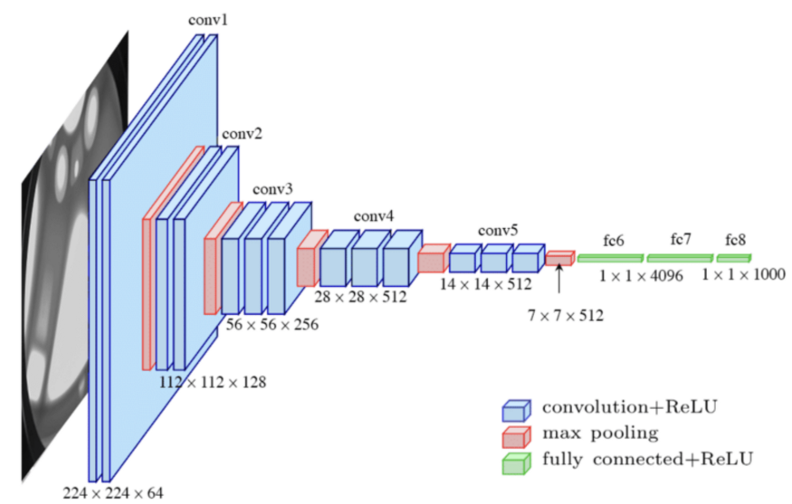
DEEPER · WHAT 'JUST STACK MORE' LOOKS LIKE
Inside VGG: your grid tricks, stacked sixteen deep
Notes:
Fast beat, ~60 seconds, part of the architecture story; do not walk every block. One point: there is nothing new here. Conv (their 5×5 grid), pooling (their max-pool), a fully connected head (Lab 1) — repeated sixteen layers deep, channels doubling as the maps shrink. The uniform all-3×3 design is why VGG became the "just stack more" poster child, and its ≈138M weights is the cliffhanger's setup: stacking further stopped working — the next slide is why, and the fix.

Slide 25
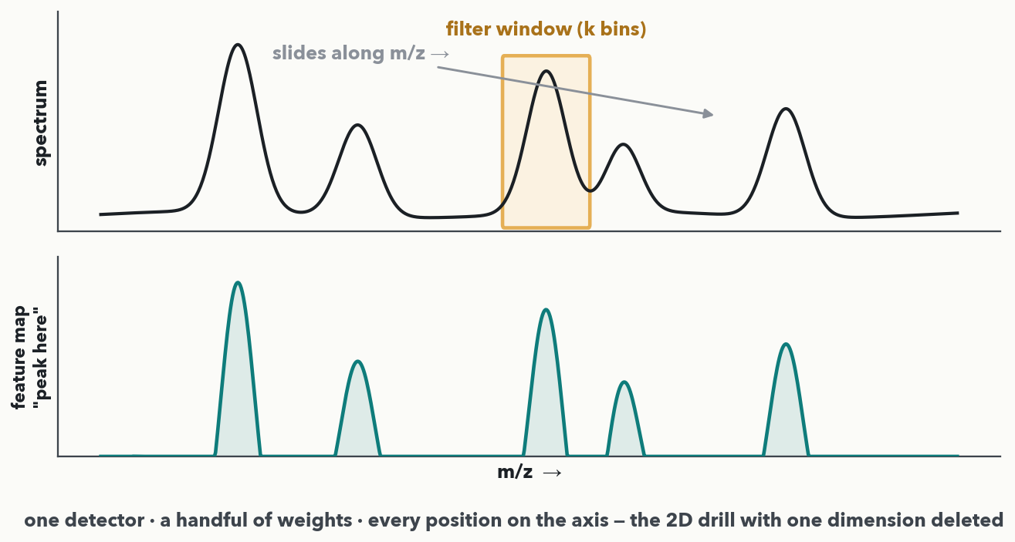
1D · SPECTRA
The same peak detector, everywhere on the m/z axis
MASS SPEC · Delete one dimension and the whole drill still holds: a short filter window slides along the spectrum, overlay-multiply-add at each position, and the feature map below lights up where the peak SHAPE is found. This is precisely the architecture of Lab 2.
Notes:
The transfer beat: everything we computed on the 2D grid works on a 1D signal by dropping a dimension. The filter is now a short segment of a few weights; slide it along the m/z axis, and the feature map is a new signal that spikes where the pattern lives. Chromatograms are the identical story on a retention-time axis. Say it plainly: your data was never really "images" — it was signals all along, and a 1D CNN reads them directly. This is the exact model they build next hour in Lab 2.

Slide 26
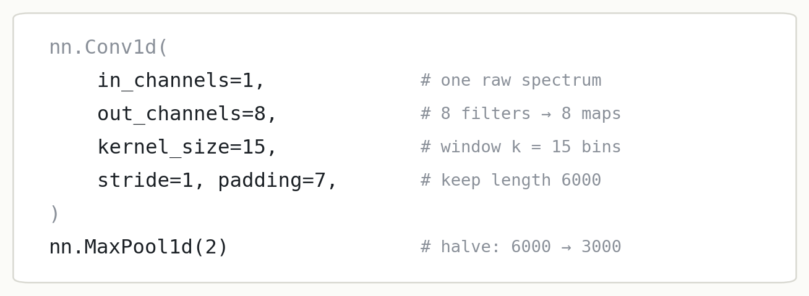
1D · IN PYTORCH
You already know every argument
Every argument is a dial you just turned by hand: in/out channels = how many maps, kernel_size = window k, stride, padding. Check the length with the formula — (6000 − 15 + 2·7)/1 + 1 = 6000 ✓ — so MaxPool1d(2) then halves it to 3000.
Notes:
Demystification moment: read each line of nn.Conv1d and point back to the slide where that concept was computed by hand. in_channels=1 is one raw spectrum and out_channels=8 is eight filters making eight maps — both computed by hand on the channel slides (17–20), so this line should read as bookkeeping now; kernel_size=15 is the window; padding=7 keeps the length, which the output-size formula confirms: (6000 − 15 + 14)/1 + 1 = 6000. Then MaxPool1d(2) halves it. In Lab 2 they fill these arguments in themselves, choosing the kernel size with exactly this arithmetic.

Slide 27
1D · YOUR DATA · 💬 PAIR
Which of your data would a CNN read?
1D convolutions: MALDI-TOF and full-scan spectra · chromatograms and EICs · QC drift traces across runs.
2D convolutions: MS imaging (each pixel a spectrum) · gels, plates, slide scans · LC×MS heatmaps (RT × m/z).
PAIR · 💬 Two minutes: name one signal in YOUR workflow a 1D CNN could read — and one that is really 2D. Shout out the best ones.
Notes:
The pair prompt from the session plan (a hands-on beat that keeps the ~8-10 minute cadence). Harvest two or three answers and write good ones on the whiteboard — they seed Discussion D2 after Lab 2. The teaching point: the dimensionality of the convolution matches the dimensionality of the signal — a single spectrum or chromatogram is 1D; an imaging-MS slide or an LC×MS heatmap is genuinely 2D. No single right answer; the goal is that they can classify their own data.

Slide 28
DEEPER · A 20-YEAR STORY IN ONE ROW
Deeper kept winning — until it didn't
LeNet
1998 · 5 layers · reads checks
AlexNet
2012 · 8 layers · ImageNet moment
VGG
2014 · 19 layers · just stack more?
…then deeper got WORSE
even on training data
2012's AlexNet halving the ImageNet error overnight is why this whole field exists. So people stacked deeper — VGG, 19 layers. But past ~20 layers, adding depth started HURTING, even on the training set. Why? (You already know — Lecture 4.)
Notes:
Tell it as a cliffhanger. LeNet reads bank-check digits in 1998; AlexNet in 2012 halves the ImageNet error overnight and launches the modern field; VGG pushes the "just stack more 3×3 convs" idea to 19 layers. Then the twist: beyond roughly 20 layers, extra depth made things WORSE even on training data — not overfitting, something else. Let the room answer the "why" themselves: Lecture 4's vanishing gradients, the whisper-down-the-lane problem. Wait for someone to say it before advancing to VGG's size and then the fix.

Slide 29
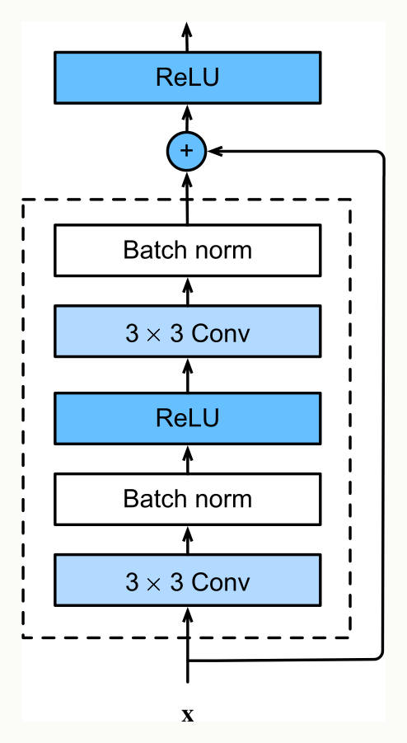
DEEPER · THE FIX · CALLBACK TO LECTURE 4
ResNet: give the gradient a highway
The skip connection lets the input x ride AROUND the block and add back in at the '+'.
So the gradient has a highway straight back through the net — no more vanishing whisper (Lecture 4).
Each block only learns a small correction to what already flows through.
residual block · Zhang, Lipton, Li & Smola (d2l.ai), Wikimedia Commons, CC BY-SA 4.0
MASS SPEC · 1D ResNets are now the standard workhorse for spectra — including the MALDI-TOF resistance models this course builds on.
Notes:
The payoff of the Lecture 4 setup, so make the callback explicit: vanishing gradients came from multiplying many small per-layer slopes down a deep chain, so the earliest layers barely learned. The residual block adds a skip connection — the identity path around the two conv layers — so at the '+' the block's output is x plus a learned tweak. Two consequences: the gradient can flow straight back along that identity highway without being multiplied down to nothing, and each block only has to learn a small correction rather than a full transformation. ResNet, 2015, went 152 layers deep and beat human ImageNet accuracy. Plant a flag: this same skip connection reappears inside transformers on Monday.

Slide 30
LECTURE 5 · PART FOUR
Where, not just what
object detection — and why it's secretly peak picking
Notes:
Final ~12 minutes. Classification answers "what is this?" — but a lot of lab work is "where are the things, and how many?" That is object detection, and for this room it is peak picking in disguise. The next three slides build detection at a high altitude (boxes + scores), reframe a chromatogram as an image whose objects are peaks (the you-do, Quiz 5 Q4), and show a real published system, PeakOnly, doing exactly this.

Slide 31
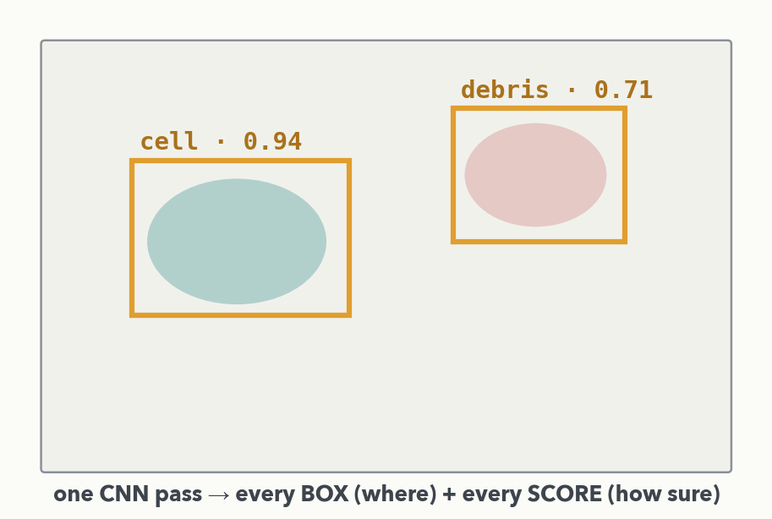
DETECTION · THE IDEA
Object detection = boxes + confidence scores
The CNN backbone is the one you just built. Only the last layers change: instead of one label for the whole image, predict a BOX (where) and a SCORE (how sure) for each object — in one pass (the YOLO idea). Faster R-CNN is the 'propose, then verify' cousin.
Notes:
Keep this at altitude — no anchor boxes, no non-max suppression, no detection loss. The message is small and important: detection is just a change of OUTPUT HEAD on the same convolutional machinery. The backbone that turns pixels into feature maps is exactly what we built; the new part predicts, for each location, a bounding box and a confidence score. Names they will meet: YOLO (fast, one pass over a grid of positions) and Faster R-CNN (propose regions, then verify). Then bring it home to their world on the next slide.

Slide 32
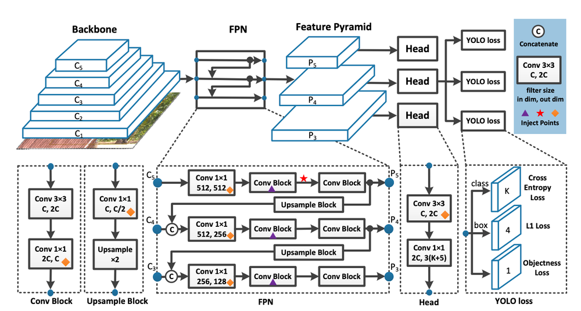
YOLOv7 Overview
DETECTION · YOLOV7

Slide 33
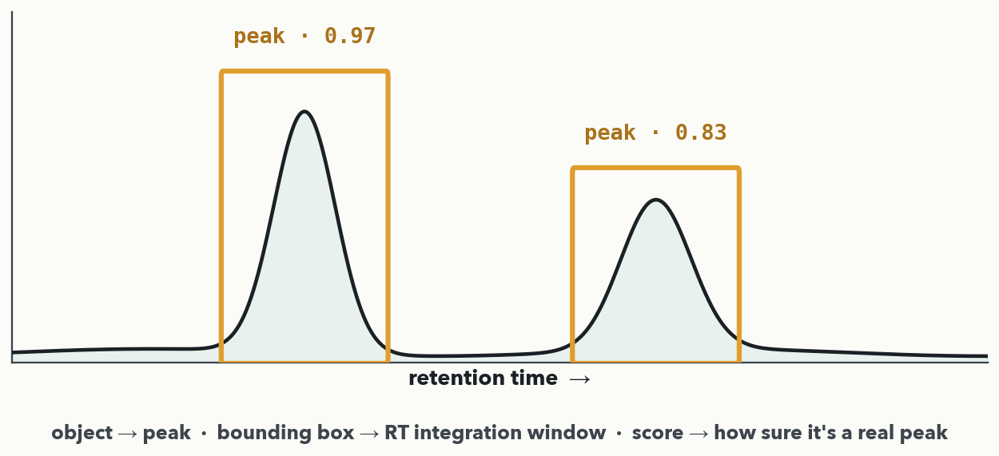
DETECTION · YOUR VERSION OF IT · I-DO
A chromatogram is an image whose objects are peaks
MASS SPEC · Every element maps: object → a peak · bounding box → the retention-time integration window · score → how sure it's a real peak. The manual step your lab calls 'peak review' is, to a CNN, a detection problem it already knows how to solve.
Notes:
The reframe of the segment, worked as the I-do for Quiz 5 Q4. Read the two boxed peaks like a detector: the box is the retention-time window that brackets the peak — the very integration bounds a technician draws by hand — and the score is the model's confidence that the boxed region is a real peak rather than noise or an artifact. Someone in this room integrates peaks by hand every week; speak to them. Next slide the room states the mapping themselves (Q4), then we show a real system that does it.

Slide 34
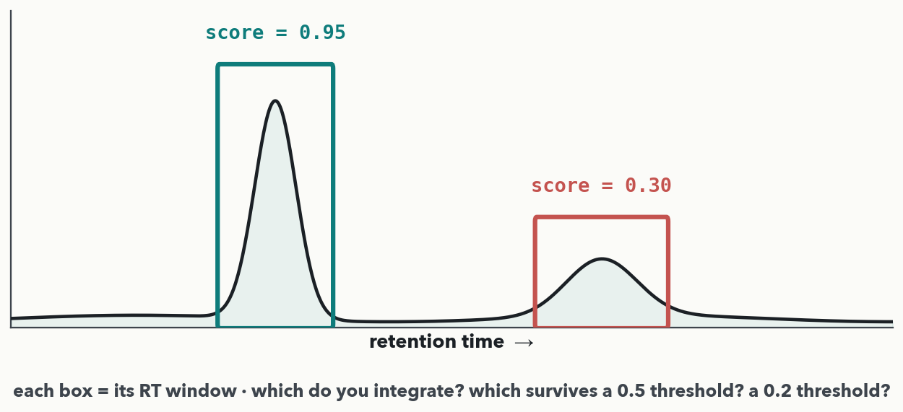
DETECTION · YOUR TURN (YOU-DO = Q4)
Read the detector's calls — which do you trust?
CHECKPOINT · Your turn → Quiz 5, Q4. The detector boxed two candidates: a sharp peak at score 0.95 and a small shoulder at 0.30. (a) Which do you integrate, and what does the 0.30 tell you? (b) Which peaks survive a 0.5 threshold? A 0.2 threshold? (c) What does lowering the threshold trade off? Worked answer in the notes.
Notes:
YOU-DO = Quiz 5 Q4 — a DECIDE beat, not "restate the mapping." The scores are the given data; each box = that peak's RT integration window (stated on the I-do slide before this). Answers: (a) integrate the 0.95 box — a confident, genuine peak; the 0.30 box is a low-confidence shoulder/noise the model is unsure is real, so flag-for-review or drop it. (b) threshold 0.5 keeps only the 0.95 peak (0.30 < 0.5 is dropped) → 1 clean peak; threshold 0.2 keeps BOTH (0.30 ≥ 0.2) → the dubious bump gets integrated too. (c) lowering the threshold catches more real peaks (higher sensitivity/recall) but admits more false ones (lower specificity/ precision) — the exact threshold trade-off from Lectures 4 and 10, and the SCORE is the dial that lets you choose. Have a pair make the 0.5-vs-0.2 call before revealing, then fill Q4.

Slide 35
DETECTION · A REAL SYSTEM
PeakOnly (2020): CNNs doing peak review for real
ROI
candidate window from raw LC-MS
CNN #1
peak or noise?
CNN #2
where are the boundaries?
integrate
area, reported
Trained on 5,365 hand-annotated windows, it approached expert-level manual curation — box (boundaries) and score (peak or noise) exactly as we just framed it. You train on this exact dataset in the capstone's peak-QC track.
Notes:
Melnikov et al., Analytical Chemistry 2020 — full citation on the reading list handout. The pipeline is precisely the detection reframe made real: take a candidate region of interest from raw LC-MS, one CNN decides peak vs. noise (the score), a second CNN finds the boundaries (the box), then integrate and report the area. Lineage if asked: PeakOnly (2020) → EVA (2021) → NeatMS (2022) → RL-based peak pickers (2026) — active, publishable territory. The dataset callout is real: our prepared slice is 3.8 MB, and the capstone's Track B uses it.

Slide 36
LECTURE 5 · OVER TO YOUR LAB
Next hour — Lab 2
• Build a 1D CNN on ~3,000 real clinical MALDI-TOF spectra (DRIAMS)
• Beat your own Lab-1 MLP at calling MRSA — the teachable moment
• Fill in the Conv1d arguments and choose a kernel size with today's formula
• Add augmentation and run a small hyperparameter search (Lecture 4's knobs)
CHECKPOINT · 4 minutes to finish Quiz 5 solo while Colab boots → we mark it together as Lab 2 opens. The first notebook blank is a Conv1d whose kernel size you choose with exactly this arithmetic.
Notes:
Hand the last minutes to the quiz-and-bridge: they finish Quiz 5 while Colab loads, and the walkthrough doubles as the Lab 2 opener. Sell Lab 2 hard — it is the same code skeleton as Lab 1 with a new superpower: the CNN reads the raw spectrum directly and should beat the MLP that needed hand-engineered features. Everything today — convolution, pooling, output size, the knobs from Lecture 4 — is now put to work on real DRIAMS resistance data. Then Colab is up and Lab 2 begins.

