Slide 1
MSACL · DS301 DEEP LEARNING · SEGMENT 3 · LECTURE 7
Sequence models and attention
Why order matters · RNNs primer· NLP tokens & embeddings · self-attention as a soft lookup
Notes:
Monday morning, the first hour of Segment 3 — we leave images behind and pick up SEQUENCES. The worked examples this hour are SENTENCES — attention was invented for language, the pictures everyone publishes are language, and the room needs no chemistry to check the answer. Your own sequences (chromatograms in time, QC across runs, peptides as strings of residues) ride along as applications, and Lecture 8 turns a spectrum into tokens for real. The promise of the hour: by the end you can read an attention heat map and run one attention head by hand — score with a dot product, soften with softmax, blend the values. Same interactive spine as Lectures 1, 2, 4 and 5: every worked example (I-do) is followed by one you do yourself (you-do), and every you-do IS a Quiz 7 item. Hand out Quiz 7 now, blank — the room fills it in across the hour, so by the recap the whole sheet is done. Quiz 7 has two items and we hit both live: read a heat map (Q1) and run one whole attention head end to end (Q2). The query/key/value roles are defined rigorously and then exercised inside Q2's computation. This hour sets up Lecture 8, where we assemble the full transformer on top of this same lookup.

Slide 2
LECTURE 7 · WHERE THIS HOUR GOES
Four stops, one destination
• Why order matters — sequence data, and RNN/LSTM in pictures (and their limits) · 12 min
• NLP Primer - Tokens & embeddings — words become IDs, then coordinates · 13 min
• Self-attention — a soft lookup: query / key / value, heat maps, one full attention head by hand · 23 min
• Why attention won — parallel + long-range — setting up the transformer · 7 min
Notes:
Signpost the four stops so people can pace themselves. The middle two blocks are the heart of the hour: tokens/embeddings, then self-attention, which is where both Quiz 7 items live. The self-attention block alone is ~23 minutes because it carries the numeric mechanic (one whole attention head) plus the two heat-map reads. Keep the first block brisk — RNNs are context and a contrast, not the destination. Nothing here needs more than multiply-add; the only new symbol is Σ, and it just means "add up the terms."

Slide 3
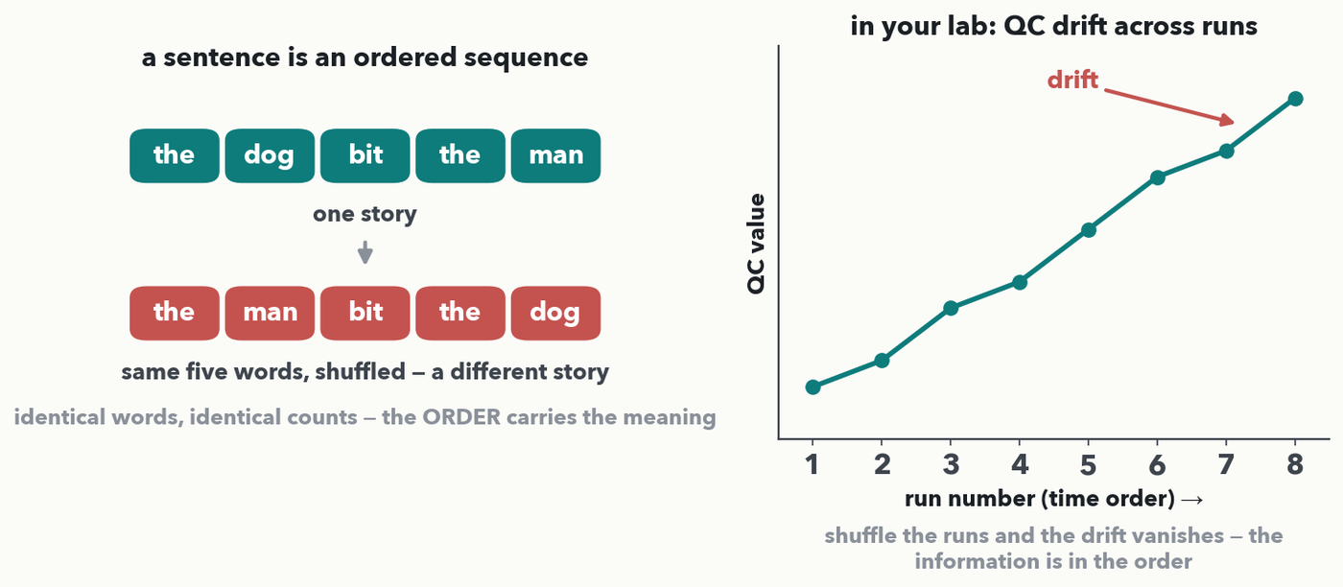
WHY ORDER · 1 OF 3 · THE DATA
Order carries the information
MASS SPEC · Your sequences work exactly the same way: a QC trace only reads as 'drift' because the runs are in time order, and the same residues in a different order are a different peptide. A dense net or a CNN sees a bag of numbers; sequence models are built to respect order.
Notes:
Land the motivating idea on language first — it needs no domain knowledge and everyone checks it instantly. Left: 'the dog bit the man' and 'the man bit the dog' contain identical words with identical counts, yet they are opposite statements; a model that treats a sentence as a BAG of words cannot tell them apart. Order is not decoration, it is the meaning. Right, the application: a QC value creeping up across runs is only 'drift' because run number is time — shuffle the runs and the thing you would flag disappears. Say the peptide version out loud too (the same residues in a new order are a different molecule with a different fragment ladder), but keep it as an application, not the example we compute on. Lab 1's MLP and Lab 2's CNN both ignore global order (a CNN sees only local windows); the rest of the hour is architecture that reads a sequence as a sequence.

Slide 4
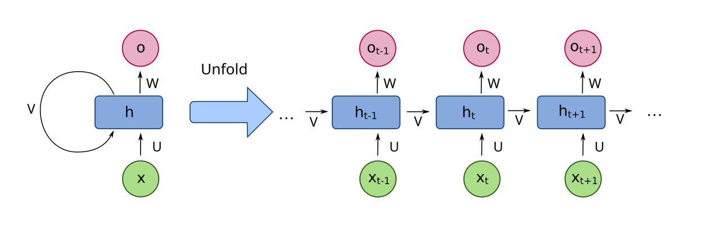
WHY ORDER · 2 OF 3 · THE CLASSIC ANSWER
An RNN reads one token at a time, passing a memory forward
recurrent net, rolled and unrolled · diagram: fdeloche, Wikimedia Commons, CC BY-SA 4.0
Read left to right: at each step the box takes the next token x and the running memory h, and passes an updated h onward. 'Unroll' it (right) and it is the same small network reused at every position — weight sharing along time, just like a CNN shared weights across space.
Notes:
The recurrent neural network (RNN) was the standard sequence model for years. Read the rolled form on the left: one cell with a loop — it feeds its own hidden state h back into itself. Unrolled on the right, it is that same cell copied at every time step, each step taking the next input xₜ and the previous memory hₜ₋₁ and emitting a new memory hₜ and an output oₜ. Two familiar ideas: it is weight sharing (the SAME cell at every step, like one convolution slid along the sequence), and the memory h is how information from early tokens is meant to reach later ones. Hold that "meant to" — it is exactly where the limits come from, two slides on.

Slide 5
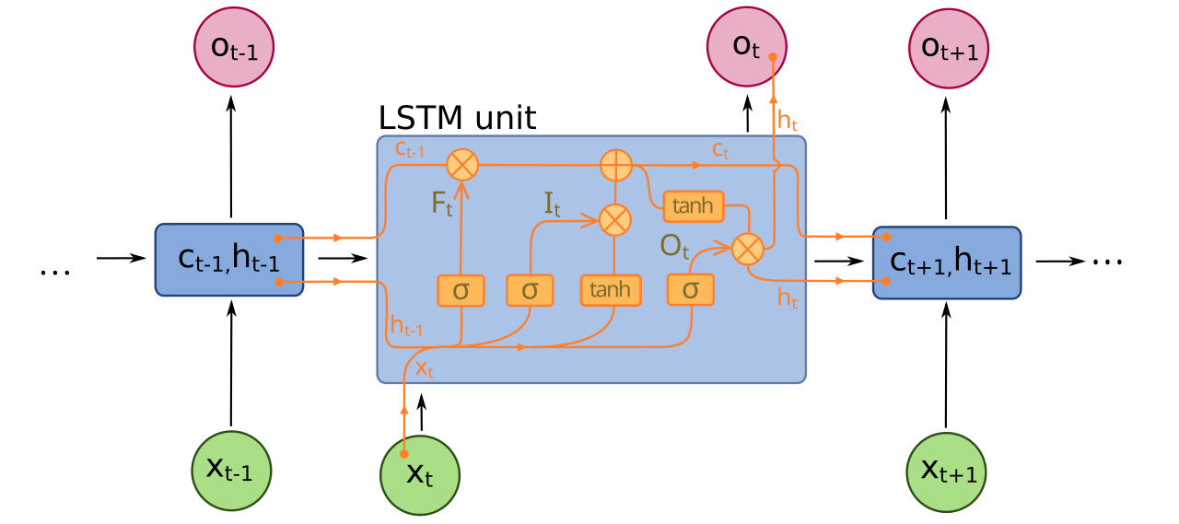
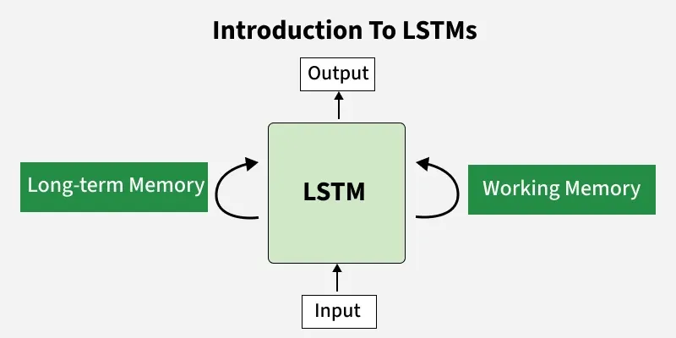
WHY ORDER · 3 OF 3 · GATES, AND THE CATCH
LSTMs added gates — but recurrence stays slow and forgetful
LSTM cell with input/forget/output gates · diagram: fdeloche, Wikimedia Commons, CC BY-SA 4.0
PAIR · The LSTM adds gates (the σ boxes) that learn what to keep, forget and output, so memory survives longer than a plain RNN. But two problems remain: it is SEQUENTIAL (step t waits for t−1 — no parallelism), and long-range memory still fades.
Notes:
The Long Short-Term Memory cell (LSTM) is the famous fix to the plain RNN's forgetfulness: the σ ("sigmoid") gates learn, per step, what to add to memory, what to erase, and what to read out — so a signal can ride the cell-state highway cₜ across many steps without being overwritten. Don't teach the gate equations; the picture is enough — gates = learned valves on a memory conveyor. Then the honest catch, the setup for the whole rest of the hour: (1) recurrence is inherently sequential, so it can't exploit a GPU's parallelism — long sequences are slow; (2) even with gates, tying token 1 to token 500 means passing information through 499 hand-offs, and it still degrades. Two problems — slow and forgetful — and attention answers both.

Slide 6
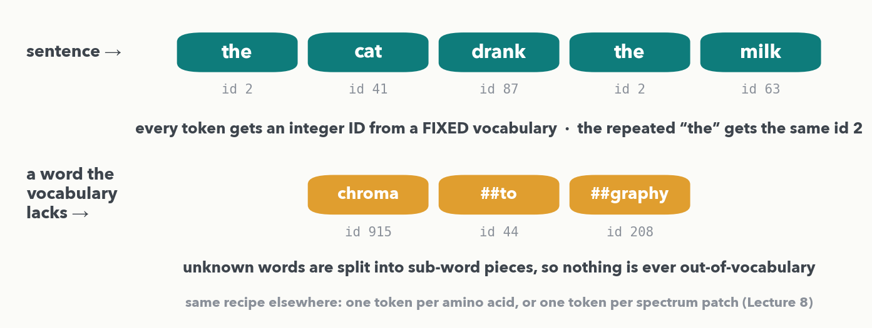
TOKENS & EMBEDDINGS · 1 OF 2 · 💬 PAIR
Input to Sequential Model – 1) Tokens
PAIR · 💬 Two minutes: your tokenizer meets “HbA1c”, “New York” and a hyphenated name — how should it cut them, and what breaks if it gets it wrong? Then the same question for YOUR sequences: one token per amino acid, per m/z bin, or per detected peak? Shout out your best vocabulary.
Notes:
First step for any sequence model: cut the input into TOKENS from a fixed vocabulary and give each an integer ID. The official example is text — 'the cat drank the milk' becomes five tokens, and note that the repeated 'the' gets the SAME id 2, because an id names a vocabulary entry, not a position. Second row: a word the vocabulary has never seen is not thrown away, it is split into sub-word pieces (chroma / ##to / ##graphy), which is why a real tokenizer never fails on a new word — and why token counts on your lab jargon run high, a point that comes back in Lecture 13 when we price LLM calls. The 💬 pair prompt is a genuine hands-on beat (rule 8): 'HbA1c' and 'New York' are the classic hard cases (one token or several? does a space mean a boundary?), and there is no single right answer. Then land the transfer in one line: the same recipe tokenizes a peptide (one token per residue, and a modified residue simply gets its OWN id — that is how ESM and the peptide-sequencing transformers do it) or a spectrum (Lecture 8 patches it). Harvest two or three vocabularies and move on.

Slide 7
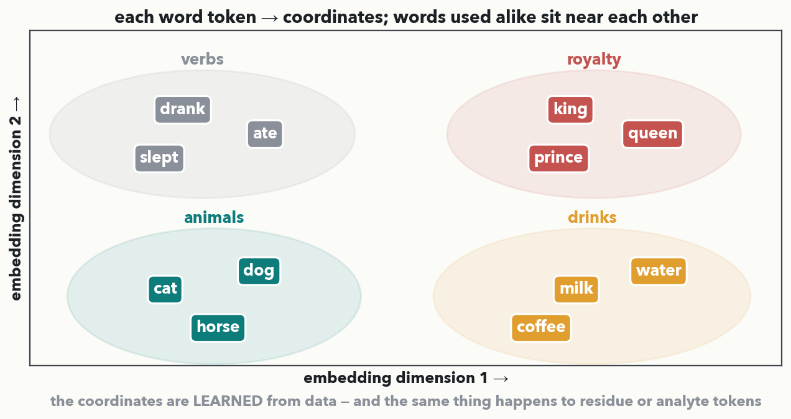
TOKENS & EMBEDDINGS · 2 OF 2
Input to Sequential Model – 2) Embedding
A token ID is just a name — it carries no meaning. The EMBEDDING maps each token to a point in space and the model LEARNS the coordinates, so words used alike land together: cat/dog/horse here, king/queen there. Train the same layer on residues and D/E land together, K/R/H together. Meaning becomes geometry.
Notes:
An integer ID says nothing about meaning — id 41 is not 'more' than id 2, and cat is not 39 units better than the. The embedding layer replaces each ID with a short vector of coordinates, and those coordinates are LEARNED during training (they are weights, tuned by the same gradient descent from Lecture 2). The payoff, shown in the picture: words that get used in similar contexts end up near each other — the animals cluster, the drinks cluster, the verbs cluster — because placing them near each other helps the model predict. 'Words → coordinates where similar things sit near each other.' Two dimensions here for drawing; real embeddings use hundreds. The application line to say once: run the identical layer over amino-acid tokens and the chemistry falls out the same way (D and E together, K/R/H together) — nobody hands the model the chemistry, it discovers it. This is the input to attention: attention works on these coordinate vectors, never on raw IDs.

Slide 8
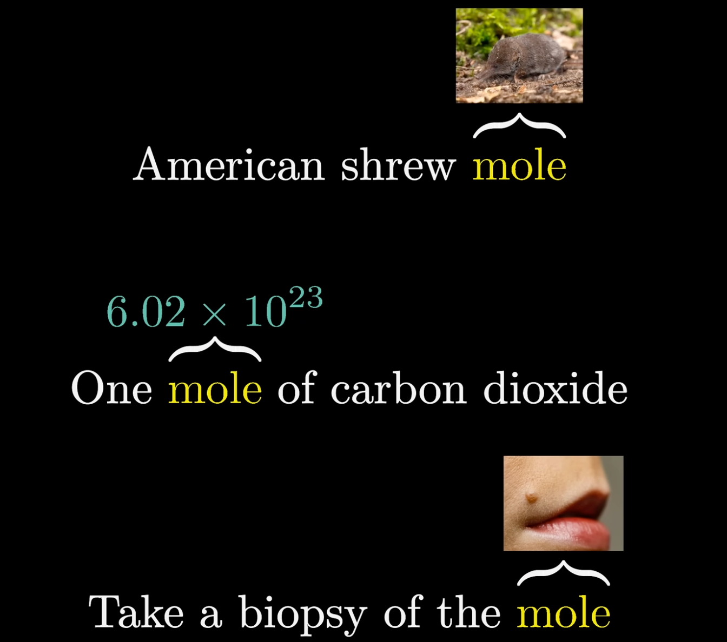
How to get “Context”
SEQUENCE MODELS · GETTING CONTEXT
RNN encodes the context in the hidden states
What are the limitations?

Slide 9
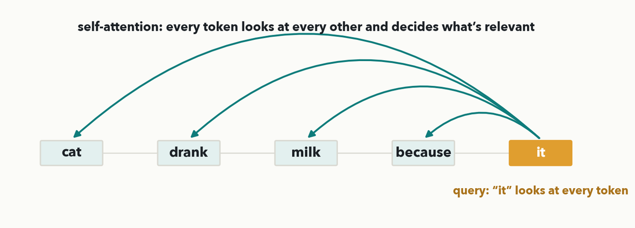
SELF-ATTENTION · THE BIG IDEA
A different approach: “Attention is All You Need*”
No passing a memory down a chain. Every token sends its question to EVERY token at once and gathers what's relevant back. Here 'it' looks at all five tokens directly — including the far-away 'cat' — in a single step. That's self-attention: all pairs, in parallel.
* Among the top 10 the most-cited papers of the twenty-first century
Notes:
The core move, before any mechanics. Where an RNN routes information step-by-step, self-attention lets every token attend directly to every other token in one shot. The cartoon: the query token 'it' reaches every token — near and far — and pulls back a blend of what is relevant. Read the clause aloud so the coreference is obvious: 'the cat drank the milk because IT was thirsty' — a human resolves 'it' to 'cat' instantly, and the next slide shows a model doing the same. Two things this buys, which we cash out at the end of the hour: it is parallel (all pairs computed together, GPU-friendly) and long-range (token 1 to token 5 is one hop, not a walk down the chain). Now the obvious question — HOW does a token decide what is relevant? That is the query/key/value lookup, next.

Slide 10
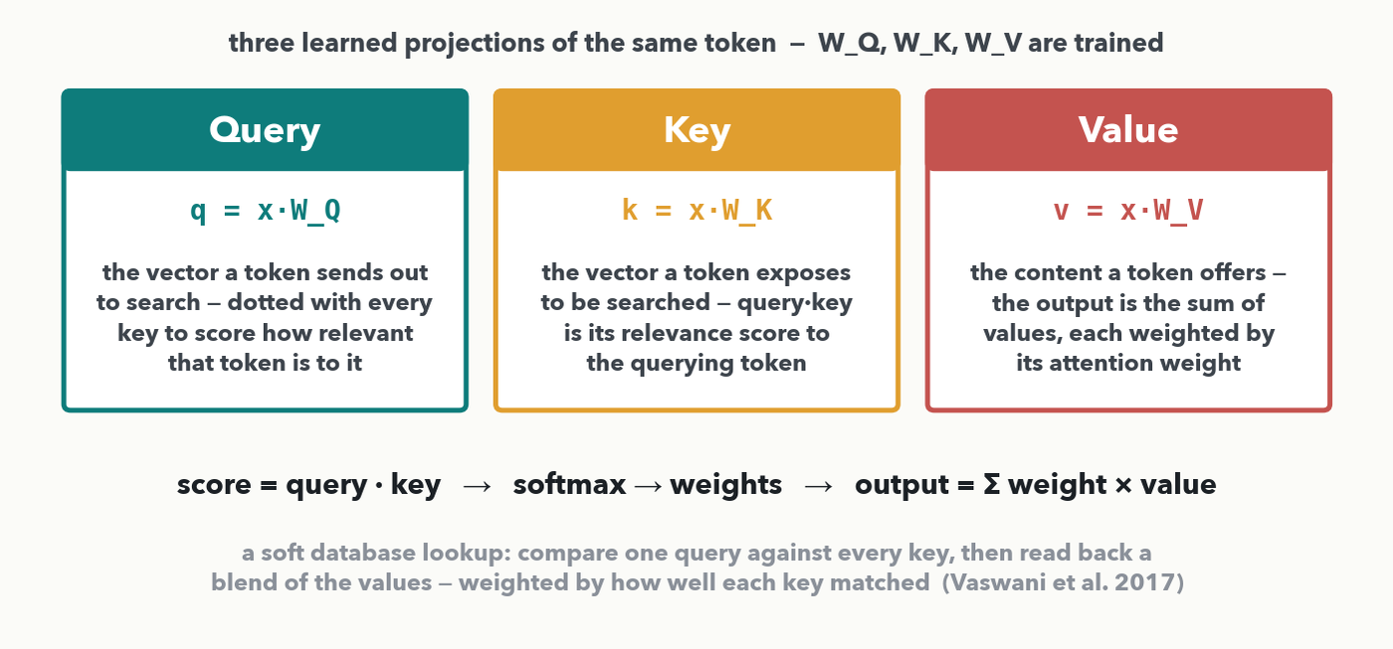
SELF-ATTENTION · THE LOOKUP · I-DO
Query, key, value: three learned projections
Each token is projected into three vectors by trained matrices: query q=x·W_Q, key k=x·W_K, value v=x·W_V. Define each by the operation it does: the QUERY is dotted against every KEY to score relevance (query·key = a compatibility score); softmax turns the scores into weights; the output is Σ weight × VALUE. It is a soft database lookup — match one query to all keys, read back a blend of the values.
Notes:
This replaces the old vague "what I'm looking for" wording with the rigorous definition (Vaswani et al. 2017; d2l.ai). The one thing to say clearly: query, key, and value are not three different things a token "has" — they are three LEARNED linear projections of the same token vector, q = x·W_Q, k = x·W_K, v = x·W_V, and the network learns the three weight matrices. Define each by its job in the computation, not by a feeling: the QUERY is the vector this token dots against every other token's KEY; that dot product query·key is a compatibility / relevance score (bigger = more relevant); softmax turns the row of scores into weights that sum to 1; the output is the sum of the VALUE vectors, each weighted by its attention weight. The honest analogy is a database key-value lookup made soft: a hard lookup returns the one value whose key matches; attention returns a weighted blend of ALL values, weighted by how well each key matched the query. Real attention also divides the scores by √d_k before softmax so they don't blow up (we skip that in the hand example). The heat map next IS the query-vs-keys scoring step; the weighted average after it is the value-mixing step — and Quiz 7 Q2 has you run one whole head end to end.

Slide 11
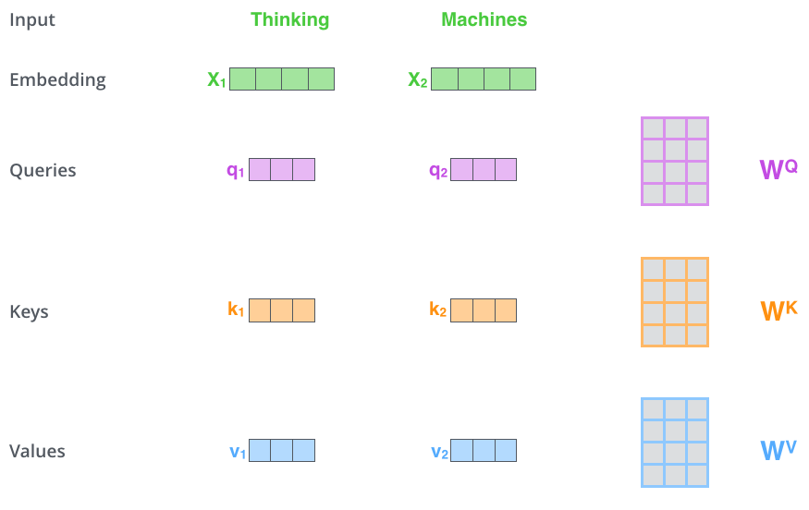
Generating QKV
SELF-ATTENTION · GENERATING Q, K, V
source: Jay Alammar, “The Illustrated Transformer” (jalammar.github.io) · © the author; all rights reserved, not for redistribution

Slide 12
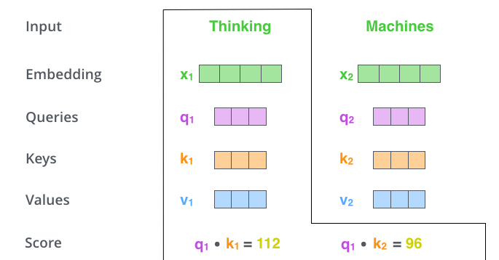
Compute Similarity (dot product)
SELF-ATTENTION · SIMILARITY · 1 OF 2

Slide 13
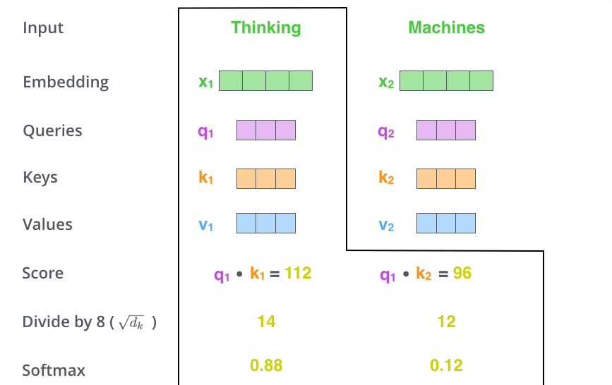
Compute Similarity (dot product)
SELF-ATTENTION · SIMILARITY · 2 OF 2

Slide 14
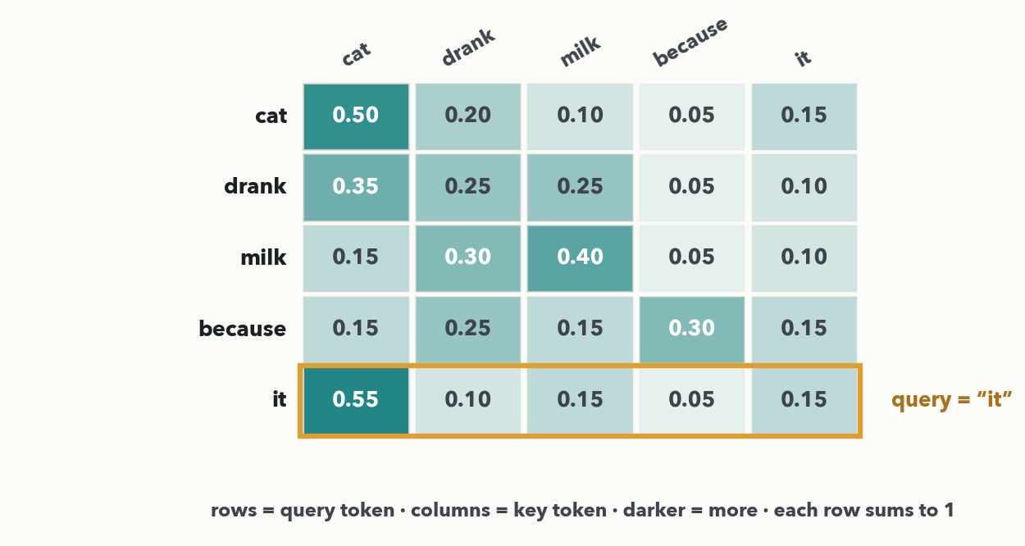
SELF-ATTENTION · HEAT MAP · I-DO
Reading a heat map: which token does 'it' look at?
Each row is one query token's attention over all key tokens; darker = more; every row sums to 1. Read the 'it' row (ringed): its darkest cell is 'cat' (0.55). The model has learned that 'it' refers back to 'cat' — coreference, straight off the picture.
Notes:
The heat map is how attention is visualized and debugged. Rows are query tokens, columns are key tokens, and cell (r,c) is how much token r attends to token c — darker means more, and because the weights are a softmax each row sums to 1. Work the ringed 'it' row out loud: 0.55 on 'cat', then 0.10 drank, 0.15 milk, 0.05 because, 0.15 it — so 'it' is attending mostly to 'cat'. That is coreference resolution falling out of attention: the model links the pronoun to its referent, and nobody wrote a rule for it. Point out one more row if there is time — 'milk' attends most to itself and to 'drank' (0.40 / 0.30), the verb it belongs to. This is exactly the query-vs-keys step from the lookup slide, drawn. Next slide the room reads a heat map on a new sentence (Quiz 7 Q1).

Slide 15
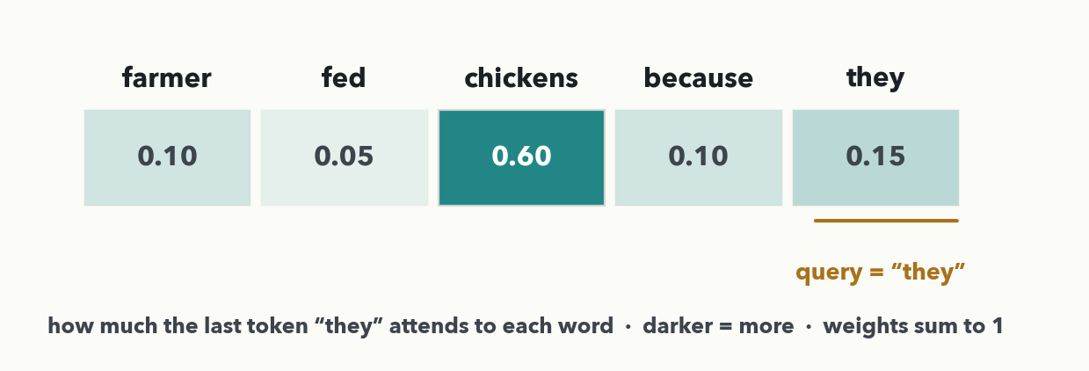
SELF-ATTENTION · HEAT MAP · YOUR TURN (YOU-DO = Q1)
Your heat map: which word does 'they' point back to?
CHECKPOINT · Your turn → Quiz 7, Q1. The sentence “the farmer fed the chickens because they were hungry”; the row shows how much the last token “they” attends to each word (weights sum to 1). (a) Which word does “they” attend to most? (b) Why is that linguistically sensible? Worked answer in the notes.
Notes:
YOU-DO = Quiz 7 Q1 (the same 'read the darkest cell, then justify it' skill on a new sentence; it assesses the heat-map-reading outcome). The five weights are farmer 0.10, fed 0.05, chickens 0.60, because 0.10, they 0.15 — they sum to 1. (a) 'they' attends MOST to 'chickens' (0.60, the darkest cell). (b) Because 'they' is a pronoun referring back to the chickens — coreference again — and the giveaway is number agreement: 'they' is plural and 'chickens' is the only plural noun in the sentence, so 'farmer' (singular) is ruled out. That is a real linguistic rule the model learned from data, not a coincidence. These numbers are identical to the Quiz 7 Q1 figure and key. Take one answer from the floor, ask WHY not 'farmer' to surface the agreement point, then have them fill Q1(a) and (b). If someone asks for the lab version: train the same model on peptide sequences and a head can light up on charge pairs (K with D or E) — same picture, different vocabulary.

Slide 16
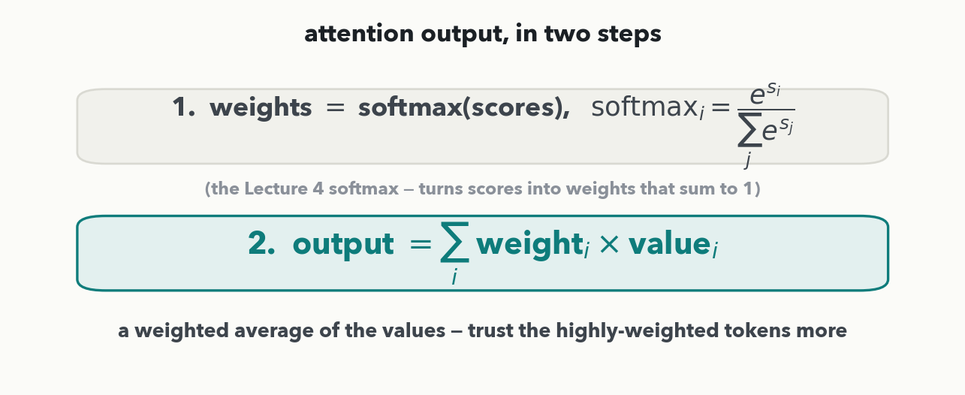
SELF-ATTENTION · THE MECHANIC · THE RULE
The attention output, in two steps
Written before you use it (so every number is computable): 0) score sᵢ = q·kᵢ — the dot product of the query with each key (multiply matching components, add). 1) weights = softmax(scores) — the SAME softmax you defined in Lecture 4, turning scores into weights that sum to 1. 2) output = Σ weightᵢ × valueᵢ — a weighted average of the values. That Σ just means 'add the terms.'
Notes:
State both rules explicitly before any exercise asks for a number (rule 3). Step 1 is softmax — the exact function from Lecture 4, which we already used and quizzed: it takes real-valued scores and returns positive weights that sum to 1, softmaxᵢ = e^{sᵢ} / Σⱼ e^{sⱼ}. Step 2 is the new, hand-computable piece: the output is Σ over tokens of weightᵢ × valueᵢ — literally a weighted average of the value numbers, where a bigger weight means you trust that token's value more. Reassure the room: Σ is just shorthand for "sum the terms," and with three tokens it's three multiply-adds. Next slide we work one all the way through.

Slide 17
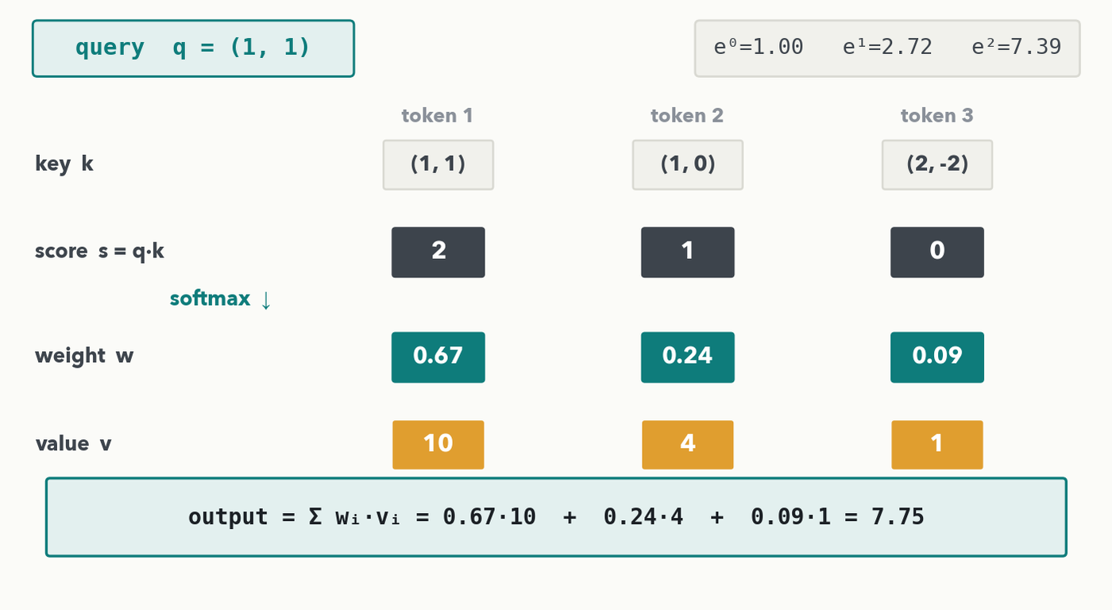
SELF-ATTENTION · THE MECHANIC · I-DO
One attention head, worked end to end
Query q=(1,1). Score each token by the dot product q·k: (1,1)·(1,1)=2, (1,1)·(1,0)=1, (1,1)·(2,-2)=0. Softmax(2,1,0) with e²=7.39, e¹=2.72, e⁰=1.00 (sum 11.11) → weights 0.67, 0.24, 0.09. Values 10, 4, 1. output = 0.67·10 + 0.24·4 + 0.09·1 = 7.75 — pulled toward token 1, the highest-weight token.
Notes:
The centerpiece, worked cell by cell — a whole attention head, not just the blend. Step 0, scores are DOT PRODUCTS of the query against each key: q·k₁=(1)(1)+(1)(1)=2, q·k₂=(1)(1)+(1)(0)=1, q·k₃=(1)(2)+(1)(-2)=0. Step 1 is the Lecture 4 softmax on s=(2,1,0): e²=7.39, e¹=2.72, e⁰=1.00, sum 11.11, so 7.39/11.11=0.67, 2.72/11.11=0.24, 1.00/11.11=0.09 (sum 1.00) — the e^x table is on the slide so it is fully hand-computable. Step 2, the weighted average of the values v=(10,4,1): 0.67·10 + 0.24·4 + 0.09·1 = 6.7 + 0.96 + 0.09 = 7.75. Intuition: token 1 scored highest (2) → got the most weight (0.67) → the output sits near its value (10). That is all "paying attention" is. Next slide the room runs a whole head themselves with a new set of keys (Quiz 7 Q2).

Slide 18
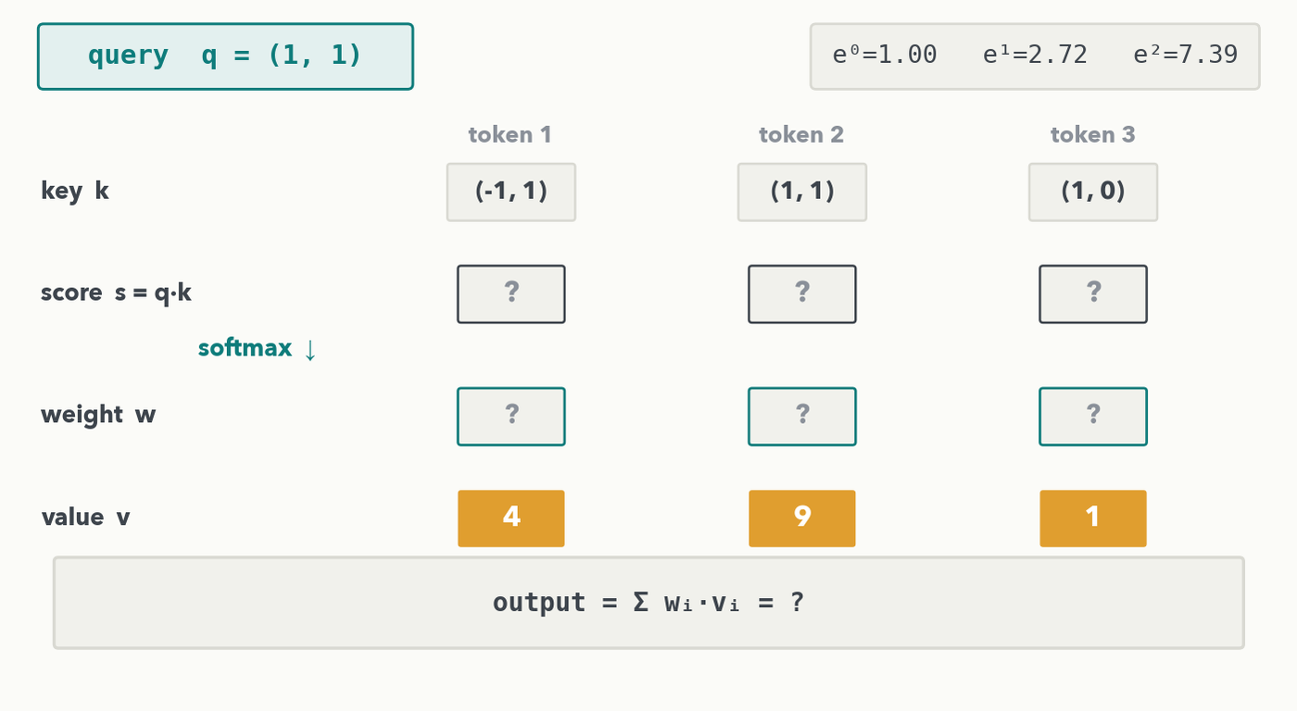
SELF-ATTENTION · THE MECHANIC · YOUR TURN (YOU-DO = Q2)
Your turn — run a whole head, start to finish
CHECKPOINT · Your turn → Quiz 7, Q2. Same query q=(1,1), new keys. (a) Score each token, sᵢ = q·kᵢ. (b) Softmax the three scores into weights — use e⁰=1.00, e¹=2.72, e²=7.39. (c) output = Σ wᵢ·vᵢ with values 4, 9, 1. Worked answer in the notes.
Notes:
YOU-DO = Quiz 7 Q2 — a whole head, the same shape as the I-do with new keys. (a) Scores are dot products with q=(1,1): q·(-1,1)=0, q·(1,1)=2, q·(1,0)=1, so s=(0,2,1). (b) Softmax with the e^x table: e⁰=1.00, e²=7.39, e¹=2.72, sum 11.11 → weights 1.00/11.11=0.09, 7.39/11.11=0.67, 2.72/11.11=0.24 (sum 1.00). (c) Values v=(4,9,1): output = 0.09·4 + 0.67·9 + 0.24·1 = 0.36 + 6.03 + 0.24 = 6.63 — pulled toward token 2 (value 9), the highest-weight token. Matches the Quiz 7 Q2 key. Give the room ~3 minutes (this is the whole head), take scores then weights then output from volunteers, then have them fill Q2. That is both Quiz 7 items now worked live.

Slide 19
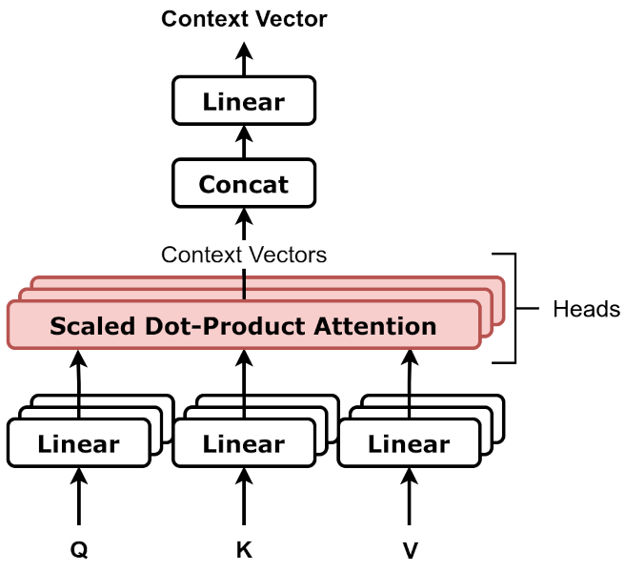
SELF-ATTENTION · MORE HEADS
Multi-head = several lookups in parallel
multi-head attention · diagram: dvgodoy, Wikimedia Commons, CC BY 4.0
One lookup catches one kind of relationship. Do several in parallel — each 'head' gets its own Query/Key/Value projection (the Linear boxes), runs the same scaled-dot-product attention we just computed, and the results are concatenated and mixed. One head might track charge pairings, another chain position.
Notes:
Real attention runs several lookups at once — "heads." Read the diagram bottom to top: the same Q, K, V are each passed through their own small Linear projection per head, every head runs the identical scaled dot-product attention we just did by hand (scores → softmax → weighted values), and the heads' outputs are concatenated and passed through a final Linear to mix them. Why bother: a single set of weights can only express one notion of "relevant," but language has many at once — one head tracks coreference (the it→cat link we just read), another subject–verb agreement, another plain adjacency. Train the identical architecture on residue tokens and a head can pick up charge complementarity (K with D or E) instead — same machinery, new vocabulary. "Scaled" just means the scores are divided by a constant before softmax to keep them well-behaved — a detail, not a new idea. This is a real published diagram; hand-drawn mechanics were ours, canonical architecture is sourced.

Slide 20
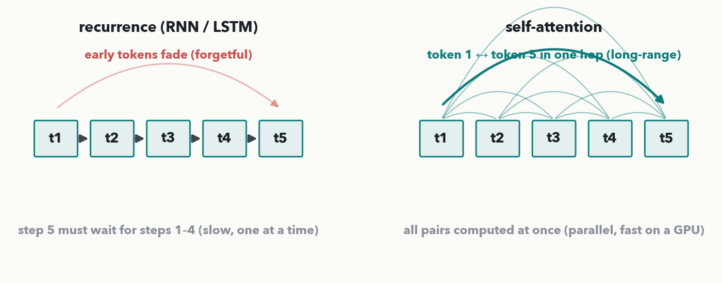
SELF-ATTENTION · WHY IT WON
Parallel and long-range — that's why attention replaced recurrence
MASS SPEC · Recurrence (left): token 5 must wait for tokens 1–4 (slow), and early tokens fade over the chain (forgetful). Self-attention (right): all pairs at once (parallel — fast on a GPU) and any two tokens are one hop apart (long-range). Both solved — which is what lets one model read a whole document, or a 500-residue protein, end to end.
Notes:
Close the loop opened on the LSTM slide. Left: recurrence is sequential (the hand-offs must happen in order, so no parallelism — long sequences are slow) and long-range signal degrades over many steps (forgetful). Right: self-attention computes every token-pair interaction simultaneously — which maps perfectly onto GPU parallelism and is why transformers train on far more data — and every pair is directly connected, so token 1 and token 500 interact in a single step with no fading. Parallel + long-range: those two wins are the whole reason "Attention Is All You Need" (2017) replaced RNNs and launched the transformer era. Next hour (Lecture 8) we bolt the missing pieces onto this lookup — positions, normalization, the encoder/decoder — and the full transformer falls out.

Slide 21
LECTURE 7 · NEXT
Next hour — the transformer, assembled
• Positional encoding — attention is order-blind, so positions must be injected (fixes the one thing today's lookup ignores)
• Layer norm and the encoder/decoder — every remaining block, made familiar
• How a spectrum becomes tokens — patch it, CNN-encode it, or peak-as-token
• Transfer learning — borrow a pretrained body, retrain a small head — why 500 labeled spectra can be enough
CHECKPOINT · 2 minutes to finish Quiz 7 solo → we mark it together as Lecture 8 opens. Notice one gap we left on purpose: our lookup never used token ORDER — the weighted average is the same if you shuffle the tokens. Fixing that is the first slide next hour.
Notes:
Hand the last minutes to finishing Quiz 7, then sell Lecture 8. Plant the cliffhanger honestly: the attention we built is order-BLIND — nothing in "output = Σ weight×value" depends on which token came first, so shuffling the inputs gives the same output. That's a problem for sequences (recall slide 3 — order is the identity!), and the fix, positional encoding, is exactly where Lecture 8 begins. From there we assemble the full transformer from blocks the room already owns — attention (today), softmax (Lecture 4), residual skips and normalization (Lecture 5) — and then turn it loose on spectra and, in Lab 3, fine-tune a real pretrained model. Then Colab boots and we mark Quiz 7 together.

