Slide 1
MSACL · DS301 DEEP LEARNING · SEGMENT 3 · LECTURE 8
The transformer, assembled
Positions (sinusoidal + RoPE) · layer norm · the full block · encoder / encoder–decoder / decoder-only + cross-attention · a spectrum → tokens · transfer learning
Notes:
Monday morning, hour two, straight on from Lecture 7. Last hour we built one thing — self-attention, a soft lookup that is just a weighted average. This hour we bolt on the four missing pieces and the whole transformer falls out, then we turn it loose on spectra and show how to borrow a pretrained one for a lab with only a few hundred labels. Nothing new that is hard: the only arithmetic is a mean and a subtract-and-divide (layer norm), both by hand. Same interactive spine as every lecture so far: each worked example (I-do) is followed by one you do yourself (you-do), and every quiz-backed you-do IS a Quiz 8 item. Hand out Quiz 8 now, blank; the room fills it across the hour. Quiz 8 has four items and we hit all four live — context is the values (Q1), the encoder's K,V is the cross-attention context (Q2), match data to a tokenization strategy (Q3), and the fine-tune-vs-scratch call (Q4). The diffusion primer that closes the hour carries a do-it-together rather than a quiz item. Keep the Quiz 7 sheet handy — attention is the beating heart of what we assemble today.

Slide 2
LECTURE 8 · WHERE THIS HOUR GOES
Six stops, one finished machine
• Order Info: Positional encoding — inject order: sinusoidal 'clocks' + relative (RoPE) · 10 min
• Standardize: Normalization — batch vs. layer norm, and why transformers pick layer norm · 6 min
• Put together: Assemble the block; encoder / encoder–decoder / decoder-only + cross-attention · 14 min
• Adaptation: A spectrum → tokens — three strategies, and which to pick · 10 min
• A Different Way to Use: Transfer learning — borrow a body, retrain a head; why 500–800 labels can be enough · 11 min
• Generate: Diffusion in one picture — what Lab 3 fine-tunes · 5 min
Notes:
Signpost the six stops so the room can pace itself. Every block today is one they already own: attention (Lecture 7), softmax (Lecture 4), residual skips and normalization (Lecture 5), embeddings (Lecture 7). The only two genuinely new pieces are positional encoding and layer norm, and both are a single picture plus a one-line calculation. The back half is the money for this room — how their actual data (spectra, peak lists, imaging-MS) becomes transformer input, and how to fine-tune a pretrained model on a handful of your own examples, which is exactly what Lab 3 does next hour. The hour closes with a four-slide diffusion primer (the idea, how it trains, a do-it-together, and how it generates a new image), because Lab 3's pretrained model is a diffusion GENERATOR — the primer makes its one training line (Lab 3's Blank 2) something they have already computed by hand. Timing: the primer costs ~5 min, taken from positional encoding (12 → 10), the assembly block (15 → 14) and transfer learning (13 → 11). Every quiz item gets worked live; there is no end-of-class quiz block.

Slide 3
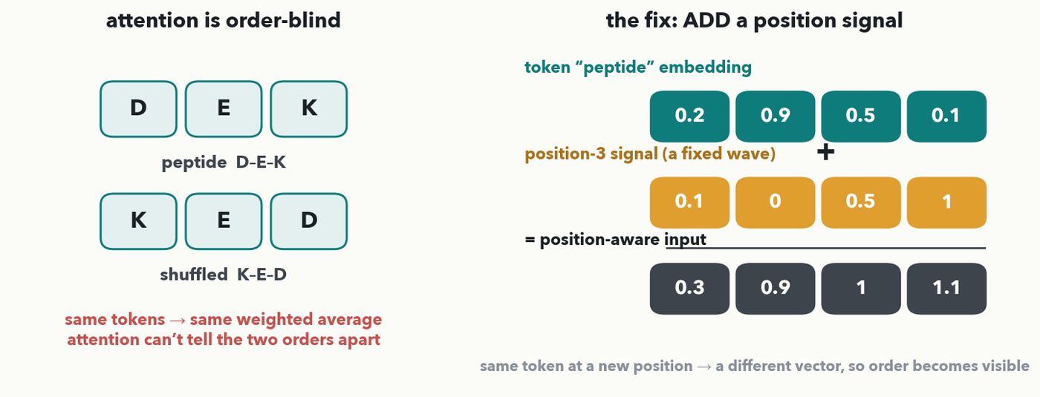
POSITIONAL ENCODING · ORDER-BLIND → INJECT POSITION · DO-IT-TOGETHER
Attention ignores order — so we add the order back in
Left: the gap we left on purpose last hour — 'output = Σ weight × value' has no notion of position, so D–E–K and K–E–D give the SAME output; attention is order-blind. Right (fill it in together): give each position its own fixed signal and ADD it to the token's embedding — 0.2+0.1=0.3, 0.9+0.0=0.9, 0.5+0.5=1.0, 0.1+1.0=1.1. Now the same token at a new position is a different vector.
Notes:
Open on the cliffhanger from Lecture 7's last slide: the weighted average is unchanged if you shuffle the tokens, so raw self-attention cannot tell D–E–K from K–E–D — a disaster for sequences, where order IS the identity (slide 3 of Lecture 7, SAGK vs GKAS). The fix is deliberately unglamorous: manufacture a distinct signal for each POSITION and add it, element-by-element, onto that slot's token embedding. Do the four sums live with the room (do-it-together, a genuine hands-on beat): 0.2+0.1, 0.9+0.0, 0.5+0.5, 0.1+1.0 → [0.3, 0.9, 1.0, 1.1] — exact, no rounding. The teaching point: because the position signal differs slot to slot, the SAME token "peptide" lands at a different vector depending on where it sits, so attention can finally see order. Where do the signals come from? Sine/cosine waves of different frequencies — each position is a unique blend, and neighbours get similar blends (that is the only reason the exact wave shape matters; don't derive it). Modern models often LEARN these position vectors instead, but the job is identical: positions must be injected because attention won't infer them.

Slide 4
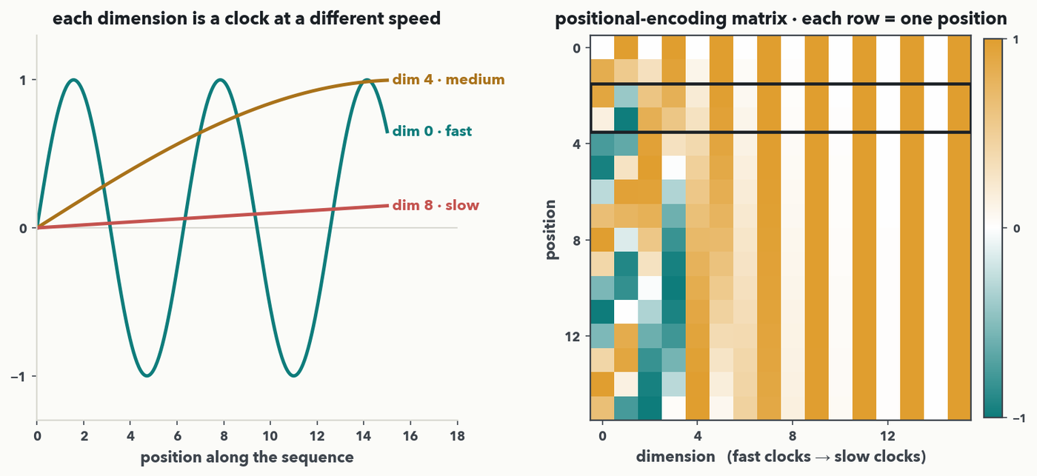
POSITIONAL ENCODING · WHERE THE SIGNAL COMES FROM · I-DO
The position signals are clocks at different speeds
PAIR · Where do those per-position signals come from? Sine/cosine waves at different speeds. LEFT: dim 0 ticks fast, dim 8 barely moves. RIGHT: stack every dimension and each POSITION gets a unique row — its fingerprint — and neighbours (boxed rows 2–3) look almost identical, so 'near' and 'far' become visible. 💬 Pair (60 sec): why do we need BOTH fast and slow clocks — what breaks with only slow ones?
Notes:
Answer "where do the per-position signals come from?" The classic choice (Vaswani 2017) is sine and cosine waves at geometrically-spaced frequencies. LEFT panel: three dimensions drawn as clocks — dim 0 ticks fast, dim 4 is medium, dim 8 barely moves across the whole sequence. RIGHT panel: stack all dimensions into the positional-encoding matrix and read it ROW by row — every position gets its own row, a unique blend of clock readings, so no two positions collide. Two teaching points: (1) neighbouring rows are nearly identical (boxed rows 2–3), so nearby positions get similar codes and attention can judge close-vs-far; (2) the pair beat — you need BOTH fast and slow clocks. Pair answer: with only slow clocks, adjacent positions look the same, so the model can't tell residue 4 from residue 5; fast clocks separate neighbours while slow clocks keep far-apart positions distinct — together every position in a long sequence gets a unique fingerprint. Modern models often LEARN the position vectors instead, but the job is identical. This is the one figure worth lingering on; don't derive the formula.

Slide 5
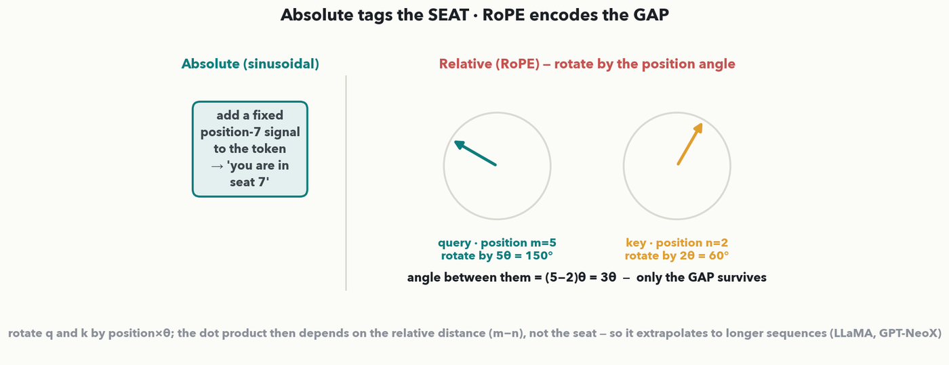
POSITIONAL ENCODING · ABSOLUTE VS. RELATIVE · I-DO
RoPE: encode the GAP between tokens, not the seat
PAIR · Absolute encoding tags each seat ('you are at position 7'). RoPE (used by LLaMA) instead ROTATES each token's query and key by an angle set by its position, so the attention score depends only on the GAP (m−n) between two tokens — the 3θ between the two clock hands. 💬 Pair (60 sec): why does encoding the gap, not the seat, let a model handle a sequence LONGER than any it trained on?
Notes:
The absolute scheme just shown tags each seat and adds it in. The modern alternative in LLaMA and GPT-NeoX is RoPE (rotary position embedding), and the intuition needs no matrices: rotate each token's QUERY and KEY by an angle proportional to its position (position m → angle mθ). When you then take the attention dot product query·key, the two rotations combine so the score depends only on the DIFFERENCE (m−n) — the gap between the tokens — not their absolute seats. Picture two clock hands: the query at 5θ and the key at 2θ; what the dot product feels is the angle between them, 3θ, the gap. Pair answer: because the model only ever experiences RELATIVE distances, it keeps working on sequences longer than any it trained on — a peptide or chromatogram longer than the training examples still presents in-range gaps, whereas an absolute seat #9000 was never seen. Keep it intuition-only; do NOT derive the rotation. 💬 60-second pair, harvest one answer, then move on.

Slide 6
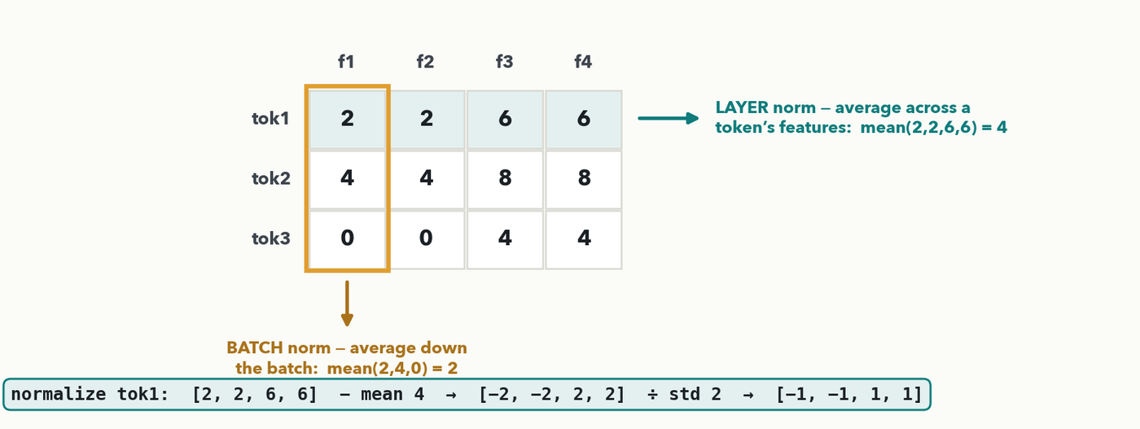
NORMALIZATION · WHICH AXIS GETS AVERAGED · I-DO
Batch norm vs. layer norm: what gets averaged?
Rows = samples in the batch, columns = features. BATCH norm averages DOWN a feature across the batch: mean(2,4,0)=2. LAYER norm averages ACROSS one token's features: mean(2,2,6,6)=4, then subtract and divide by the spread → [2,2,6,6] − 4 = [−2,−2,2,2], ÷ std 2 = [−1,−1,1,1]. Transformers use LAYER norm: it needs no batch, so it works at batch size 1 and with variable-length sequences.
Notes:
Normalization keeps activations in a sane range as signals pass through a deep stack — the same drift problem behind Lecture 4's vanishing/exploding gradients — by recentering and rescaling to mean 0, standard size. The only question worth teaching is WHICH AXIS the mean-and-spread is taken over, and the figure answers it with exact numbers. Batch norm (amber column) pools a single feature across every sample in the batch: mean(2,4,0)=2. Layer norm (teal row) pools across one token's own features: mean(2,2,6,6)=4; centre to [−2,−2,2,2]; the population variance is (4+4+4+4)/4=4 so std=2; divide to get [−1,−1,1,1] — all exact, reproducible from the numbers on screen (rule 3). Then the "why layer norm for transformers" beat: batch norm's statistics depend on the OTHER samples in the batch, which is fragile when batches are small, mixed-length, or size 1 at inference; layer norm looks only within a single token, so it is independent of batch size and sequence length — perfect for a model whose inputs are ragged sequences. Next slide the room computes both means on a new matrix (a quick do-it-together).

Slide 7
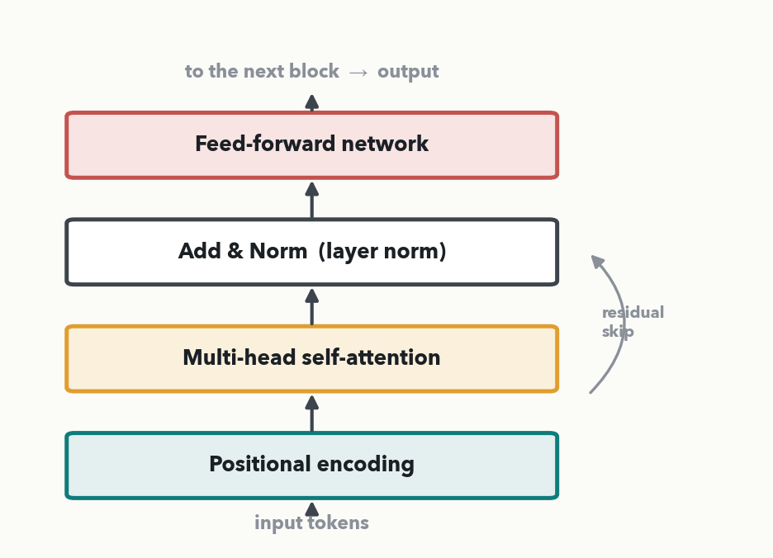
ASSEMBLE · ONE BLOCK, FOUR PARTS · I-DO
One block: four parts, each with a name
Simplify to one encoder block, bottom-up: ① Positional encoding (added to the input embeddings — inject order) → ② Multi-head self-attention (the Lecture-7 lookup) → ③ Add & Norm (residual skip + layer norm) → ④ Feed-forward network (the MLP). The residual skip carries the input around a block and adds it back — the Lecture-5 highway. Note: the real diagram (prev. slide) norms before each sub-layer; here we collapse to one Add & Norm per block for a clean picture.
Notes:
Strip the canonical diagram down to the four blocks the quiz will ask for, each labelled here so the room sees the whole machine is just parts it already owns. Bottom to top: ① the input — token embeddings with the positional encoding we added two slides ago (label it "Positional encoding"); ② multi-head self-attention, last hour's query/key/value weighted average run by several heads at once; ③ "Add & Norm" — the residual skip (Lecture 5) adds the block's input back to its output, then layer norm (this hour) rescales; ④ the feed-forward network, a small dense MLP applied to each position — exactly the Lecture-1 neuron stack. Name the residual skip explicitly (the curved arrow) so it isn't mistaken for decoration: it is why deep transformers train at all. One honesty note if a sharp eye catches it: the real dvgodoy diagram on the previous slide places its Norm BEFORE each sub-layer (the modern pre-norm arrangement), whereas this teaching block collapses to a single "Add & Norm" drawn after attention — same parts, the norms merged for a clean picture. The takeaway is assembly, not new material: every block here is something the room already owns. If anyone is unsure why attention comes before the feed-forward: attention mixes information across tokens, then the feed-forward refines each token on its own.

Slide 8
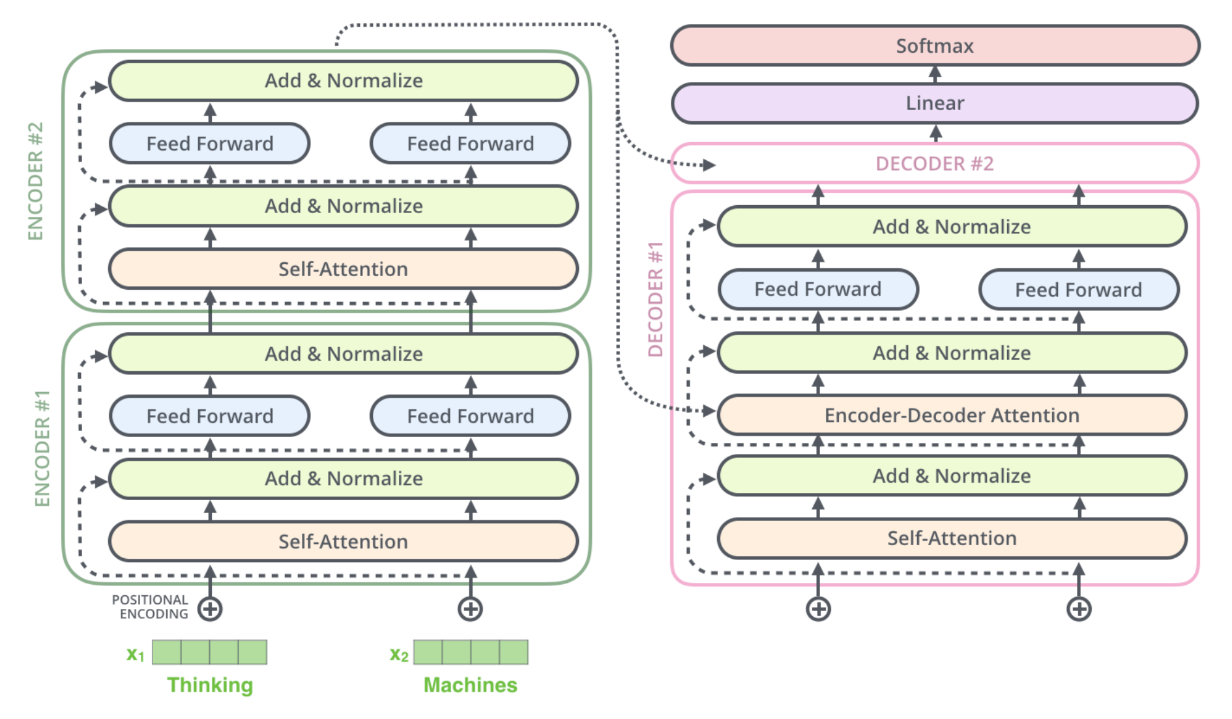
Encoder Decoder Zoomed in
ENCODER + DECODER · ZOOMED IN

Slide 9
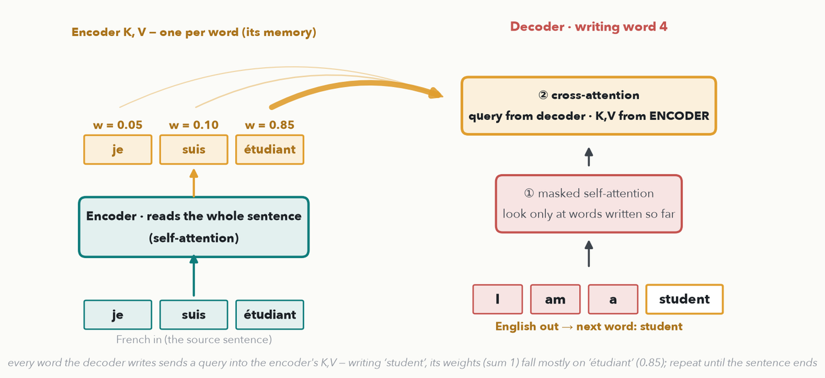
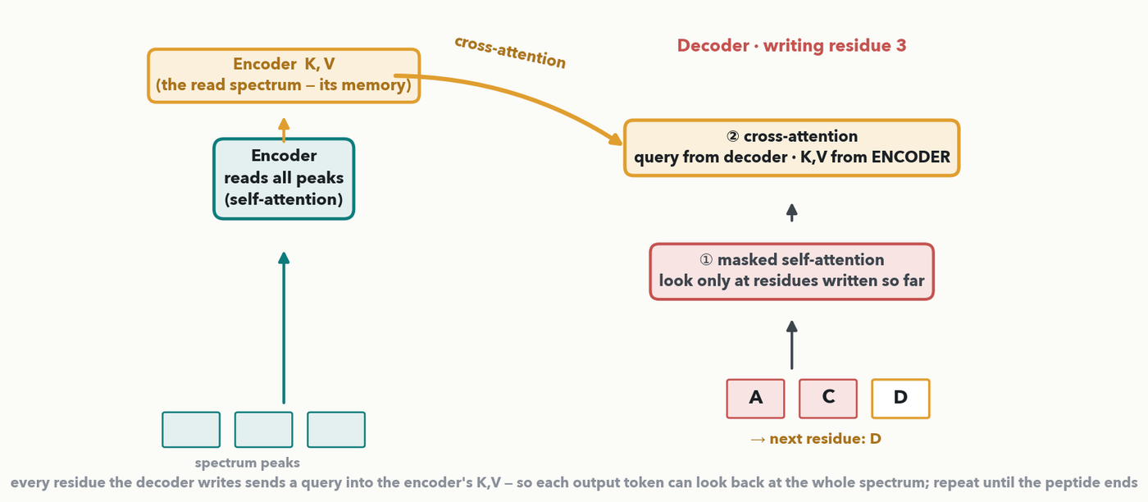
ENCODER + DECODER · CONTEXT = K,V · I-DO
Cross-attention: the decoder reads the encoder
CHECKPOINT · Context = the keys and values: a token's output is a weighted blend of the VALUES. Cross-attention makes it literal — the encoder computes K,V once (the French sentence's memory), and every English word the decoder writes queries it. Your turn is next → Quiz 8, Q1–Q2.
Notes:
This is the wire the two-stack diagram hides, and it carries the two Quiz 8 context items (Q1, Q2). Taught on the classic job an encoder-decoder was built for — TRANSLATION — and on the same sentence as the Illustrated-Transformer animation two slides on: French in, English out, 'je suis étudiant' → 'I am a student'. It works in two phases. First the ENCODER reads the whole French sentence once (self-attention over all three words) and keeps one key/value per word — the model's MEMORY of the sentence. Then the DECODER writes the English one word at a time, and at every step does two attentions: ① masked self-attention over the words it has already written (so it cannot peek ahead), and ② CROSS-attention, where the query comes from the decoder's current position but the keys and values come from the ENCODER's memory. Read the weights on the figure: writing 'student', the decoder puts 0.85 on 'étudiant', 0.10 on 'suis', 0.05 on 'je' — they sum to 1 — so the word it writes is grounded in the word it is translating. That second attention is how the output stays tied to the input; without it the decoder would just produce fluent English about nothing in particular. Quiz 8 answers: Q1 — of query/key/value, the VALUE carries the content that lands in the output (context = a blend of values; keys and query only set the weights). Q2 — the encoder's K,V is computed ONCE and held fixed for the whole decode (the memory of the source sentence); swap in a different sentence's K,V halfway through and the rest of the English is translated from the wrong sentence → a wrong / incoherent translation, because the K,V IS the context the output is grounded in. Harvest one answer for each, then the room works Q1–Q2 on the next slide.

Slide 10
ENCODER + DECODER · YOUR TURN (YOU-DO = Q1–Q2)
Your turn — what carries the context?
Q1 · Context is a blend of values
(a) Which of query, key or value carries the content that ends up in a token’s output — its context? ________
(b) A peak attends over four peaks with weights 0.1, 0.7, 0.15, 0.05. Its new context vector is built mostly from which peak’s value? ________
Q2 · The encoder’s K,V is the context
Translator, French → English (“je suis étudiant” → “I am a student”): the decoder writes one word at a time, querying the encoder’s K,V.
(a) As it writes word 1, then 2, then 3 …, is the encoder’s K,V recomputed every step, or computed once and held fixed? What does it represent?
(b) After “I am”, you swap in the K,V of “il fait froid” (“it is cold”). What happens to the rest of the translation, and why?
CHECKPOINT · Your turn → Quiz 8, Q1–Q2. Q1: which of Q/K/V carries the content, and which peak dominates the blend? Q2: is the encoder’s K,V fixed or recomputed each step — and what if you swap in another sentence’s K,V? Worked answers in the notes.
Notes:
YOU-DO = Quiz 8 Q1 and Q2, both problems on the slide. Q1 worked answer: (a) The value. The query and keys only decide how much of each token to take; the values are the content that is actually blended into the output, so the “context” a token ends up with is a weighted sum of values. (b) Peak 2 — its weight 0.7 is larger than all the others combined, so it dominates the blend. Weights are just the mixing proportions. Q2 worked answer: (a) Computed once and held fixed for the whole decode — it is the model's context / memory of the source sentence. Every word the decoder writes queries the same encoder K,V, which is how each output word can look back at the whole French sentence. (b) The rest of the English is now translated from the wrong sentence: it follows 'il fait froid' instead of 'je suis étudiant', so the output becomes a wrong / incoherent translation (e.g. 'I am … cold') — because the encoder's K,V is the context the output is grounded in. Change the context and you change what the decoder is 'reading.'

Slide 11
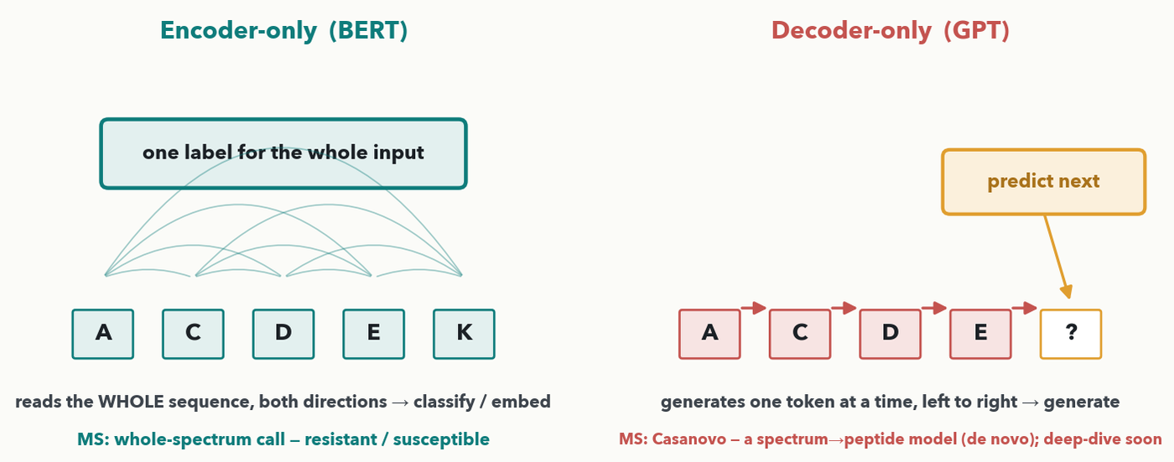
ASSEMBLE · TWO WAYS TO WIRE IT
Encoder-only reads; decoder-only writes
PAIR · Encoder-only (BERT): read the WHOLE sequence both directions → one label/embedding (call a spectrum resistant/susceptible, or embed a peptide). Decoder-only (GPT): generate the next token left to right → write a peptide residue by residue — and it's TRAINED this way too, by predicting the next token on massive text (that's LLM pretraining; Lecture 13). 💬 Your turn (30 sec): a model that writes a peptide one residue at a time — encoder-only or decoder-only, and why? Worked answer in the notes.
Notes:
Two dominant wirings, both built from the same block. Encoder-only models (BERT is the famous one) keep just the left stack: they read the entire input at once, every token attending both left and right, and produce either one label for the whole sequence (classification) or a rich per-token embedding — the natural fit for "is this spectrum resistant or susceptible?" or "embed this peptide for search." Decoder-only models (the GPT family) keep the right stack with masked attention: they generate one token at a time, each new token attending only to what came before — the natural fit for GENERATION, like writing a peptide sequence residue by residue. Foreshadow the training idea for Lecture 13: a decoder-only model is TRAINED exactly the way it generates — by predicting the next token over an enormous text corpus, a self-supervised objective that needs no human labels (the same "the data labels itself" trick Lecture 11 will make explicit). That next-token pretraining is what an LLM is. The old encoder→decoder pairing (translation: read all of language A, write language B) is exactly Casanovo's shape: read a spectrum, write a peptide. Tie it to the room's task list: classification jobs → encoder-only; generation/de-novo jobs → decoder-only or encoder–decoder. Lab 3 next hour fine-tunes a pretrained GENERATOR instead of a classifier — a diffusion UNet that draws images — so the transfer move is identical while the output is a picture; the primer at the end of the hour explains what that model is.

Slide 12
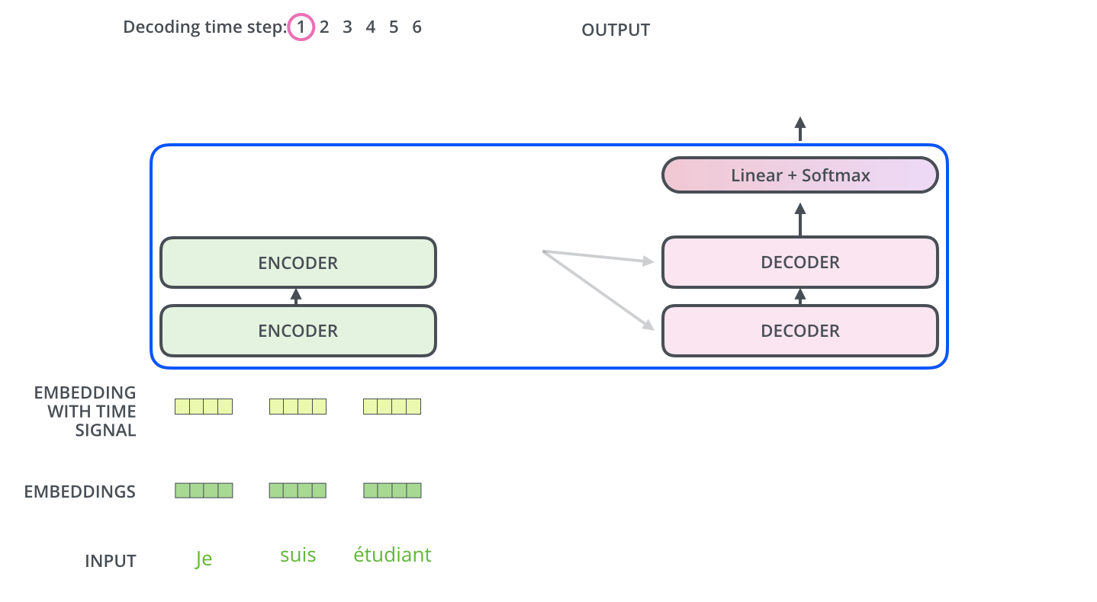
Encoder/Decoder Interaction
ENCODER + DECODER · STEP BY STEP · 1 OF 2
source: Jay Alammar, “The Illustrated Transformer” — decoding animation, step 1 (jalammar.github.io/illustrated-transformer/) · © the author; all rights reserved, not for redistribution

Slide 13

Encoder/Decoder Interaction
ENCODER + DECODER · STEP BY STEP · 2 OF 2
source: Jay Alammar, “The Illustrated Transformer” — decoding animation, step 2: the encoder’s K/V feed every decoder step (jalammar.github.io/illustrated-transformer/) · © the author; all rights reserved, not for redistribution

Slide 14
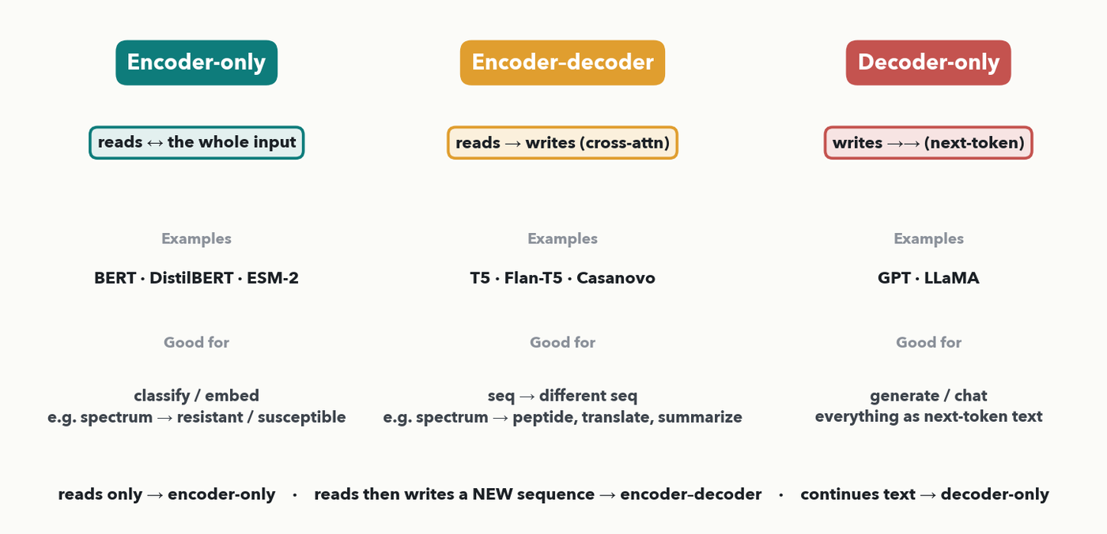
ENCODER + DECODER · THREE FAMILIES · I-DO → DECIDE
Three families, one block: which one for the job?
CHECKPOINT · Same block, three wirings. Encoder-only READS (BERT); encoder–decoder reads then WRITES a new sequence via cross-attention (T5/Flan-T5, Casanovo); decoder-only continues text (GPT, LLaMA). Your turn (60 sec) — pick the family: (a) call a spectrum resistant/susceptible · (b) turn a spectrum into a peptide sequence · (c) draft a free-text QC report. Answers in the notes.
Notes:
Zoom out: the same block wires into three families, and choosing the right one is a real design decision this room will make. Encoder-only (BERT, DistilBERT, ESM-2): read the whole input both directions, emit one label or embedding — classification/search. Encoder–decoder (the original Transformer, T5, Flan-T5, and Casanovo): an encoder reads the input, a decoder writes a DIFFERENT sequence, joined by the cross-attention we just drew — translation, summarization, de novo sequencing. Decoder-only (GPT, LLaMA): a single causal stack that continues text one token at a time — chat and free-text generation, "everything as next-token prediction." Decide beat (60 sec, then reveal): (a) resistant/susceptible call → ENCODER-ONLY (one label from the whole input); (b) spectrum → peptide sequence → ENCODER–DECODER (read spectrum, write a new sequence — Casanovo); (c) draft a free-text QC report → DECODER-ONLY (generate prose — GPT/LLaMA). This task→family mapping is a strong candidate for a new Quiz 8 item; for now it runs as a live decide beat.

Slide 15
LECTURE 8 · PART FOUR
Can Transformer work on spectrum?
a transformer eats a sequence of vectors — so what are the vectors for MS data?
Notes:
Pivot to the question this room actually cares about. Everything so far assumed the input is already a sequence of token vectors — trivial for a peptide (one token per residue, Lecture 7). But a raw spectrum is 6,000 intensities, an imaging-MS slide is a picture, a peak list is a ragged set of (m/z, intensity) pairs. None of those is "a sentence." So the design choice that matters for applying transformers to MS is TOKENIZATION: how to turn your signal into the sequence of vectors the transformer expects. Three strategies, all in real published use, coming up — then a decision chart the room uses on the quiz.

Slide 16
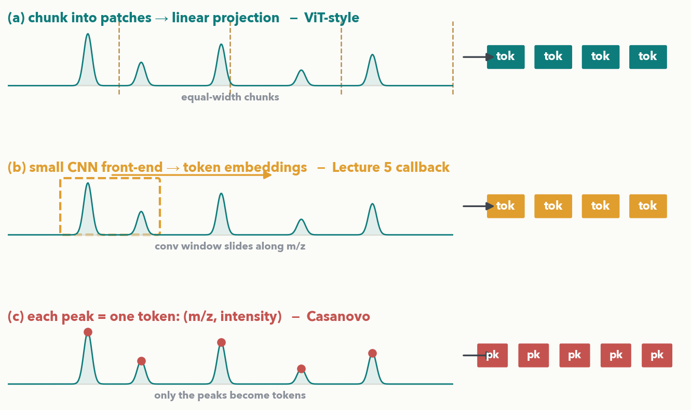
A SPECTRUM → TOKENS · THREE STRATEGIES · I-DO
Tokenization in Spectrum
(a) Patch + linear projection — cut the signal into equal chunks, project each to a vector (the ViT idea). (b) CNN front-end — slide a small 1D CNN (Lecture 5) that emits a sequence of token embeddings. (c) Peak-as-token — keep only the peaks; each becomes one token carrying its (m/z, intensity). Same spectrum, three sequences of vectors.
Notes:
The three tokenization strategies side by side on the identical spectrum, so the contrast is about the METHOD, not the data. (a) Patch + linear projection: chop the signal into fixed-width chunks and multiply each chunk by a learned matrix to get one token vector — this is exactly how a Vision Transformer (ViT) turns an image into tokens, and it works on a binned spectrum or a 2D imaging-MS tile. (b) CNN front-end: run a small 1D convolutional stack (their Lab-2 machinery) over the signal and treat its output positions as token embeddings — the conv does the local peak-shape detection, the transformer does the long-range mixing. (c) Peak-as-token: throw away the empty baseline and keep only the peaks; each peak becomes a token whose vector encodes its m/z and intensity — this is how Casanovo reads a spectrum, and it is efficient because a spectrum is mostly zeros. No single winner — which one fits depends on the data, which is the very next slide.

Slide 17
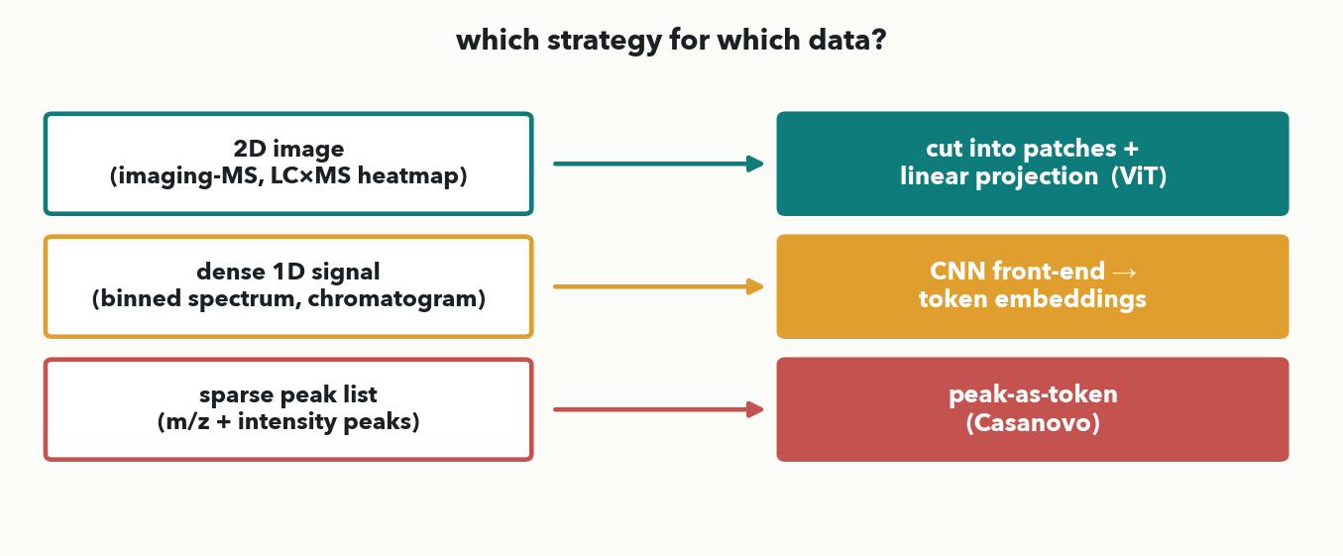
A SPECTRUM → TOKENS · WHICH ONE? · I-DO
Which strategy for which data?
Q3: Read it as three rules. A 2D image (imaging-MS, an LC×MS heatmap) → patches + linear projection (ViT). A dense 1D signal (a binned spectrum, a chromatogram) → a CNN front-end that emits tokens. A sparse peak list (a handful of m/z + intensity peaks) → peak-as-token (Casanovo).
Notes:
The decision chart makes the choice explicit and testable (rule 3: Q3 must be derivable from this chart). Match the strategy to the SHAPE of the data. If the signal is genuinely 2D — an imaging-MS image or an LC×MS heatmap — cut it into patches and project, the ViT recipe. If it is a dense, evenly-sampled 1D signal — a binned full-scan spectrum or a chromatogram — a small CNN front-end is the natural condenser: it exploits local structure before the transformer mixes globally. If it is already a sparse list of peaks with variable count — the (m/z, intensity) pairs a spectral library uses — treat each peak as a token, the most efficient path and the one Casanovo takes. These three rules are exactly the three matches on Quiz 8 Q3. Next slide the room does the matching.

Slide 18
A SPECTRUM → TOKENS · YOUR TURN (YOU-DO = Q3)
Your turn — match each data type to a tokenizer
(a) An imaging-MS image (a 2D picture, one spectrum per pixel) → ________________
(b) A raw binned spectrum (a dense 1D vector of ~6,000 intensities) → ________________
(c) A peak list (a sparse set of m/z + intensity peaks) → ________________
Word bank:
chunk into patches + linear projection (ViT)
CNN front-end
peak-as-token (Casanovo)
CHECKPOINT · Your turn → Quiz 8, Q3. A transformer eats a sequence of vectors, so MS data must become tokens. Match each data type to the ONE strategy that fits it best (each used once), using the decision chart. Worked answer in the notes.
Notes:
YOU-DO = Quiz 8 Q3, straight after the decision chart. Worked answer: (a) Patches + linear projection (ViT-style) — a 2D image is cut into equal patches, each projected to a token vector. (b) CNN front-end — a dense, evenly-sampled 1D signal is best condensed by a small 1D CNN that emits token embeddings (local peak-shape detection first, then the transformer mixes globally). (c) Peak-as-token — a sparse peak list is already a natural set of tokens; each peak becomes one token carrying its m/z and intensity, exactly how Casanovo reads a spectrum.

Slide 19
A SPECTRUM → TOKENS · A REAL SYSTEM
Casanovo: a spectrum in, a peptide out
peak list
each peak → a token
encoder
reads all peaks
decoder
writes residues one at a time
peptide
A-C-D-E-K …
PAIR · De novo sequencing as TRANSLATION: the encoder reads the spectrum's peaks (peak-as-token), the decoder writes the peptide residue by residue — the encoder→decoder shape on your MS/MS data. 💬 Quick (90 sec): why does this need a DECODER, not just an encoder-only classifier? Worked answer in the notes.
Notes:
Casanovo (Yilmaz et al., 2022) makes the whole hour concrete: it treats de novo peptide sequencing as machine translation — spectrum language in, peptide language out. The encoder tokenizes each fragment peak as a token (strategy c) and reads them all with self-attention; the decoder generates the amino-acid sequence one residue at a time, cross-attending back to the peaks, stopping at the end of the peptide — the encoder→decoder wiring from two slides ago. The point for this room: the transformer they just assembled is already doing real mass-spec work, and the tokenization choice (peak-as- token) is the same decision they just made on the quiz. If someone asks how to get started on this family: the encoder–decoder checkpoints are on the same Hugging Face Hub that Lab 3 downloads from next hour. Keep this fast, ~90 seconds; it is a payoff, not new mechanics. Beat answer: an encoder-only model can only emit ONE fixed output (a label or embedding); de novo sequencing must PRODUCE a variable-length peptide one residue at a time, which is exactly what an autoregressive decoder does — so you need the decoder to generate, the encoder to read the spectrum.

Slide 20
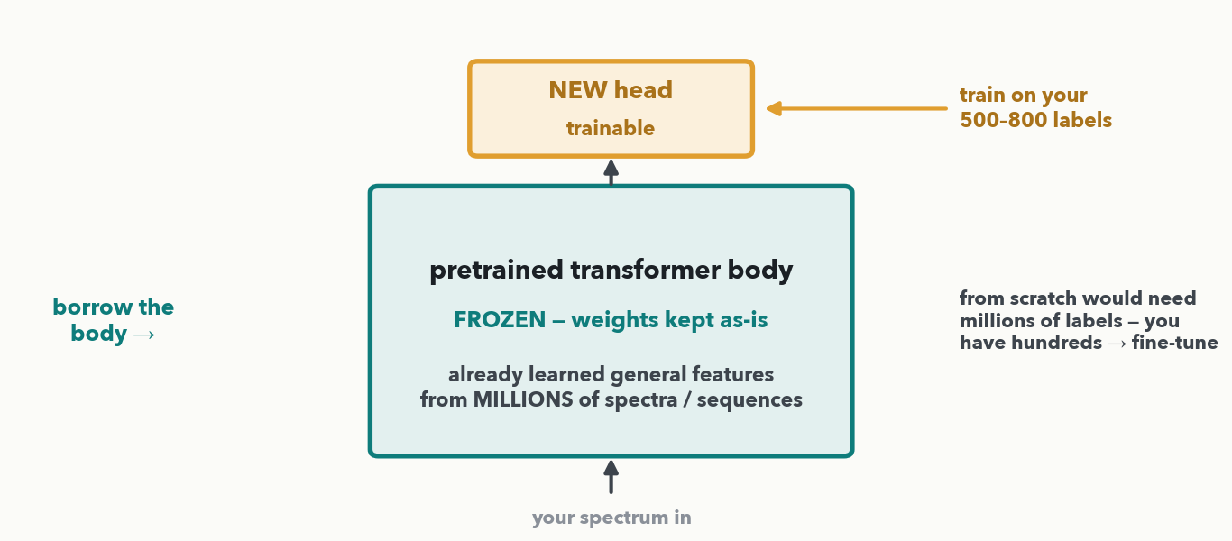
TRANSFER LEARNING · BORROW A BODY · I-DO
Don't train from zero — borrow a pretrained body
MASS SPEC · Someone pretrained a transformer on MILLIONS of spectra/sequences; its body already learned general features. FREEZE that body (weights kept as-is), bolt on a small NEW head for your task, and train only the head on your few hundred labels. That's transfer learning; training the head (± a little of the body) is fine-tuning.
Notes:
The single most useful idea for a small lab. A transformer has millions of weights; training them from scratch needs a mountain of labeled data most labs will never have. Transfer learning sidesteps that: take a model someone already pretrained on a huge unlabeled or loosely-labeled corpus — its BODY has learned general-purpose features (peak shapes, sequence motifs, context) — and reuse it. Two moves: FREEZE the body so its learned weights stay put, and attach a small NEW head (a fresh output layer) sized to YOUR task, say a two-class susceptible/resistant readout. You then train only the head on your few hundred labels — cheap, fast, hard to overfit because there are few new weights. "Fine-tuning" is the umbrella term for adapting the pretrained model: head-only training is the most conservative; you can also unfreeze a little of the top of the body and train it gently (a much smaller learning rate — why? you're nudging good weights, not discovering them, the Lab-3 blank). Next slide, why this rescues a 500–800-spectrum project; then the room makes the call.

Slide 21
TRANSFER LEARNING · YOUR TURN (YOU-DO = Q4)
Your turn — fine-tune, or train from scratch?
You have
800 labeled spectra for a new MS assay
You can borrow
a transformer pretrained on 2 million spectra
You need a classifier for the new assay.
(a) Would you train a new model from scratch on your 800 spectra, or fine-tune the pretrained one? ________
(b) In one sentence, why?
CHECKPOINT · Your turn → Quiz 8, Q4. 800 labeled spectra, and a transformer someone pretrained on 2 million spectra. Train from scratch, or fine-tune — and in one sentence, why? Worked answer in the notes.
Notes:
YOU-DO = Quiz 8 Q4, straight after the borrow-a-body I-do. Worked answer: (a) Fine-tune — freeze the pretrained body, bolt on a small new classification head, and train mostly that head on the 800 labels (optionally unfreeze a little of the top with a much smaller learning rate). (b) 800 labels are far too few to train a transformer's millions of weights from scratch — it would overfit or collapse toward the majority class — whereas the pretrained body already learned general spectral features from the 2 million spectra, so you only need to fit a small head, which 800 labels can do well. (Either reason earns full credit.)

Slide 22
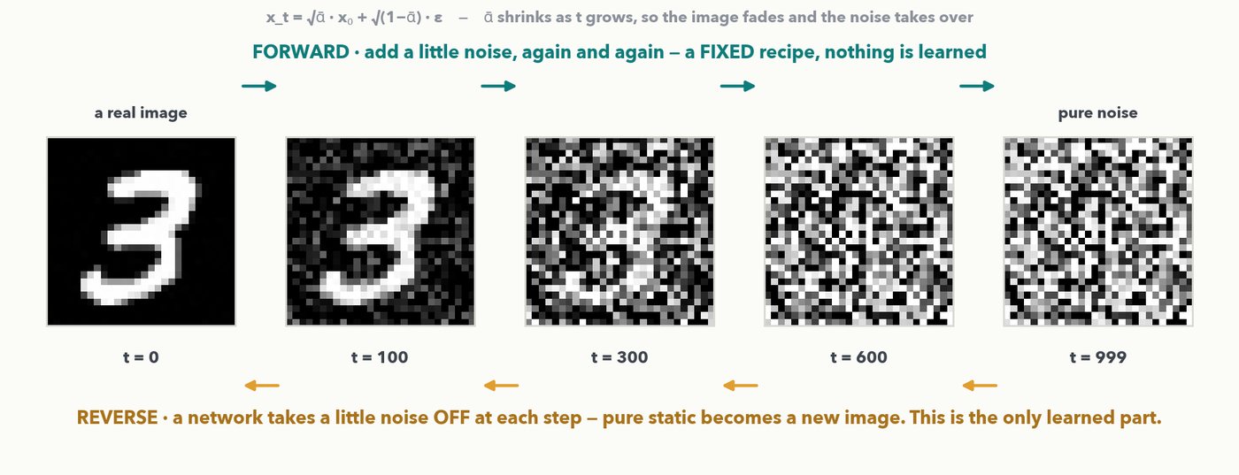
DIFFUSION PRIMER · 1 OF 4 · THE IDEA
Lab 3 Primer: Destroy an image with noise, then learn to undo it
Forward (top): add a little random noise, again and again, until the image is pure static — a FIXED recipe, nothing to learn. Reverse (bottom): a network takes a little noise back OFF at each step, so static becomes a NEW image. Only that reverse network is learned — and it IS the pretrained model you fine-tune in Lab 3.
Notes:
Why this primer is here: Lab 3 hands them a real pretrained DIFFUSION generator to fine-tune, and nothing in a lab should be a black box. Keep it to the two arrows and resist the probability. FORWARD: take a real image and mix in a little Gaussian noise, over and over — x_t = √ᾱ·x₀ + √(1−ᾱ)·ε, where ᾱ shrinks as t grows, so the picture fades out and the noise takes over; by t = 999 it is indistinguishable from static. There is nothing to learn in that direction: it is a fixed recipe (the 'scheduler' in the lab, and the numbers on this slide are that exact linear schedule, betas 1e-4 → 0.02 over 1000 steps). REVERSE: train a network to take a little noise back off, then run it repeatedly — start from pure static and after a few dozen steps a NEW image appears that was never in the training set. That is generation. Two asides worth 15 seconds each: (1) the denoiser here is a small UNet (~4M weights in Lab 3's checkpoint); swap that UNet for a transformer and you get a DiT — the backbone of Stable Diffusion 3 and Sora — so this is still the machine we assembled this hour; (2) for this room the interesting uses are generative molecule/spectrum design and topping up a rare class with synthetic examples, and Lecture 11 comes back to generative models properly with autoencoders and VAEs. Next slide: how the reverse network is trained, in one line.

Slide 23
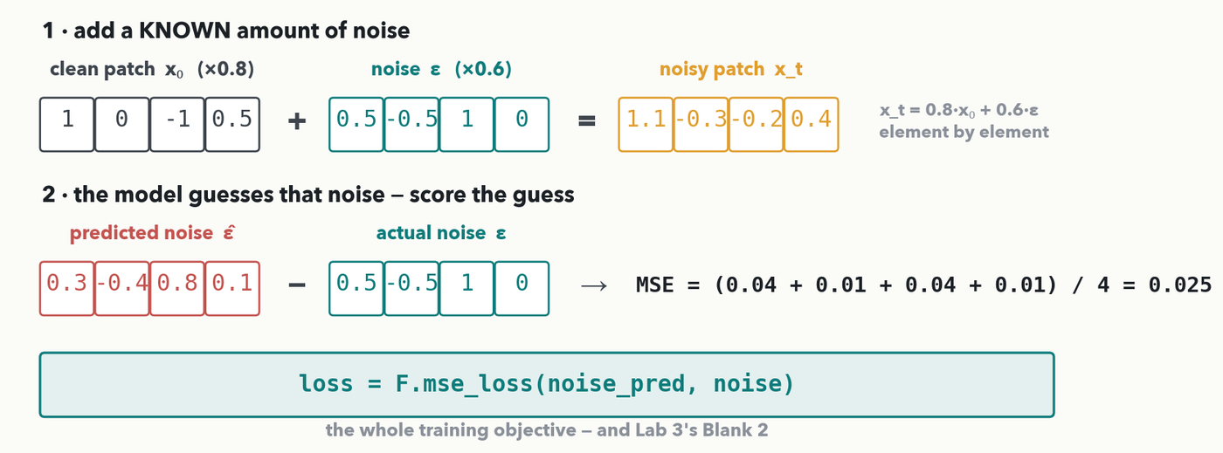
DIFFUSION PRIMER · 2 OF 4 · HOW IT TRAINS · I-DO
Training, in one line: predict the noise you added
You know the noise you added, so use it as the label: ask the model to predict that noise and score the guess with mean-squared error — the Lecture 2 loss, unchanged. Here (0.04 + 0.01 + 0.04 + 0.01)/4 = 0.025. No new mathematics: one line, and it is the entire training objective.
Notes:
The mechanic, worked (rule 6). Step 1, make the input: take a clean patch x₀ = (1, 0, −1, 0.5), draw noise ε = (0.5, −0.5, 1, 0), and mix them at one noise level — √ᾱ = 0.8, √(1−ᾱ) = 0.6 — element by element: 0.8(1)+0.6(0.5) = 1.1; 0.8(0)+0.6(−0.5) = −0.3; 0.8(−1)+0.6(1) = −0.2; 0.8(0.5)+0.6(0) = 0.4. So x_t = (1.1, −0.3, −0.2, 0.4). Step 2, the training signal: hand x_t to the model, which returns its guess of the noise, ε̂ = (0.3, −0.4, 0.8, 0.1). The errors are ε̂ − ε = (−0.2, 0.1, −0.2, 0.1), the squares are 0.04, 0.01, 0.04, 0.01, and the mean is 0.10/4 = 0.025 — mean-squared error, exactly the loss from Lecture 2. Say the punchline plainly: we never need a human label, because we ADDED the noise, so we already know the answer — the data labels itself, the same self-supervised trick Lecture 11 will name. One honest detail if asked: the model is also told t, so it knows how noisy its input is. And that is the whole training loop — pick an image, pick a random t, add noise, predict it, take a gradient step — which is why the code line on the slide, loss = F.mse_loss(noise_pred, noise), is the only thing they have to write in Lab 3's Step 3. Next slide they do one themselves.

Slide 24
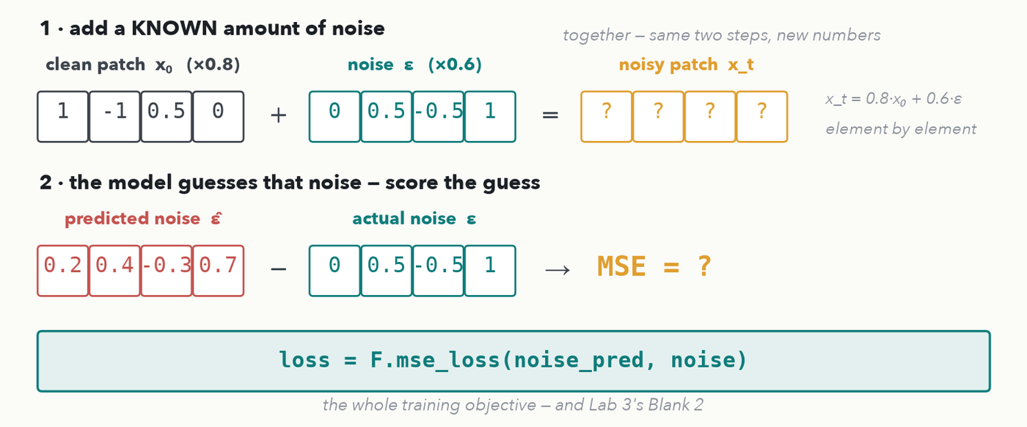
DIFFUSION PRIMER · 3 OF 4 · DO-IT-TOGETHER
Together — one training step, new numbers
CHECKPOINT · Together — same two steps, new numbers. Clean patch x₀ = (1, −1, 0.5, 0); the noise added ε = (0, 0.5, −0.5, 1); the model's guess ε̂ = (0.2, 0.4, −0.3, 0.7); same noise level, √ᾱ = 0.8 and √(1−ᾱ) = 0.6. (a) Fill in x_t = 0.8·x₀ + 0.6·ε. (b) Score the guess with MSE. Work it with a neighbour — answers in the notes.
Notes:
DO-IT-TOGETHER (restored 2026-09-28 at the instructor's request; it is no longer a quiz item — Quiz 8 Q5 was retired). The same two steps as the I-do, new numbers; fill it in with the room cell by cell. GIVEN: clean patch x₀ = (1, −1, 0.5, 0), the noise actually added ε = (0, 0.5, −0.5, 1), the model's guess ε̂ = (0.2, 0.4, −0.3, 0.7), at the same noise level as the I-do (√ᾱ = 0.8, √(1−ᾱ) = 0.6). STEP 1, make the noisy patch, element by element 0.8·x₀ + 0.6·ε: 0.8(1)+0.6(0) = 0.8; 0.8(−1)+0.6(0.5) = −0.8+0.3 = −0.5; 0.8(0.5)+0.6(−0.5) = 0.4−0.3 = 0.1; 0.8(0)+0.6(1) = 0.6. So x_t = (0.8, −0.5, 0.1, 0.6). STEP 2, score the guess: errors ε̂ − ε = (0.2, −0.1, 0.2, −0.3); squares 0.04, 0.01, 0.04, 0.09; sum 0.18; MSE = 0.18/4 = 0.045 — the Lecture 2 loss, unchanged. In code that whole line is loss = F.mse_loss(noise_pred, noise), Lab 3's Blank 2. Land the point: only REMOVING noise is learned — adding it is a fixed recipe with no weights — and because we added the noise ourselves we already know the right answer, so no human labels are needed. The next slide shows what the trained model does with that one skill: it generates.

Slide 25
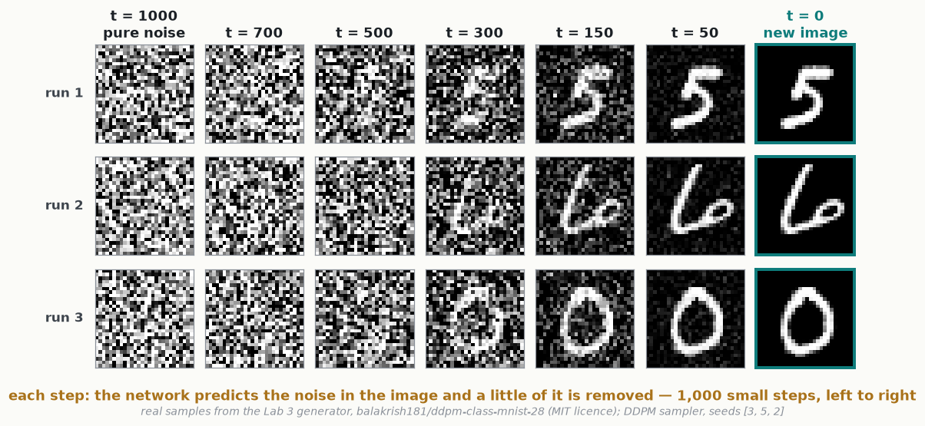
DIFFUSION PRIMER · 4 OF 4 · GENERATING A NEW IMAGE
Sampling: from pure noise to a new image
Start from pure static. At every step the network predicts the noise in the current image and a small slice of it is removed. After 1,000 small steps a brand-new digit appears — and different starting noise gives a different digit. This is exactly what Lab 3's sample() runs.
Notes:
How the trained model makes a NEW image — the payoff of the primer, and exactly what Lab 3's sample() does. Start from pure random static (t = 1000). At each step the network looks at the current image and predicts its noise ε̂ — the one skill training taught it — and the sampler subtracts a small, scaled slice of that prediction (and adds back a pinch of fresh noise, so every run stays different). Repeat 1,000 times and structure appears gradually: nothing visible at t = 700 or 500, a ghost by t = 300, a clear digit by t = 50. These are REAL intermediate images from the very model they download in Lab 3 (balakrish181/ddpm-class-mnist-28, MIT licence), generated by tools/make_diffusion_sampling_fig.py: three runs from three different starting noises → three different digits (a 5, a 6, a 0), none copied from the training set. One honest detail if asked: Lab 3's sample() uses the faster DDIM sampler — 50 bigger steps instead of 1,000 small ones — same idea. 💬 Ask the room: if the model only ever learned to REMOVE noise, where does the new digit come from? (From the starting noise: different static, different digit — the model keeps cleaning it toward something digit-like.)

Slide 26
LECTURE 8 · OVER TO YOUR LAB
Next hour — Lab 3
• Download a REAL pretrained generator from the Hugging Face Hub — it draws handwritten digits (~15 MB, no login)
• Invent your own symbol in an ASCII grid — a heart, a star, your initial — and it becomes ~32 training images
• Write the two lines that matter: the diffusion loss (from the primer) and a small fine-tune learning rate
• ~100 steps, under a minute: the same model now draws YOUR symbol — transfer learning you can see
CHECKPOINT · 2 minutes to finish Quiz 8 solo while Colab boots → we mark it together as Lab 3 opens. The loss line from today's diffusion do-it-together is Blank 2 of the lab, word for word.
Notes:
Hand the final minutes to finishing Quiz 8 and selling Lab 3. Lab 3 is the transfer-learning slide made visual: it downloads a real pretrained diffusion generator from the Hugging Face Hub (balakrish181/ddpm-class-mnist-28, ~4M parameters, public, no login), shows it drawing handwritten digits, and then fine-tunes it — about 100 steps, well under a minute — on ~32 jittered copies of a symbol the student draws in an ASCII grid. Same model, same denoising loop, and the after-grid is their symbol: transfer learning you can watch happen. Their three blanks: the symbol itself, the diffusion loss (which they just computed in the diffusion do-it-together and which is one line, F.mse_loss(noise_pred, noise)), and the fine-tune learning rate ~1e-4 — the rule, not the number, because you are nudging already-good weights. Note for anyone expecting the old lab: there is no DistilBERT/ESM-2 race any more; the lesson is the same transfer move, made generative and visual, and the discussion afterwards (D3) asks where in THEIR work a big pretrained model could be nudged with their few labels. Then Colab is up and we mark Quiz 8 together as Lab 3 begins.

