Slide 1
MSACL · DS301 DEEP LEARNING · SEGMENT 4 · LECTURE 10
Your data, your metrics — representation, evaluation, and trust
Pick a representation · read the RIGHT metric · survive imbalance and drift · know when NOT to use deep learning
Notes:
Monday afternoon, hour one of Segment 4 — the pivot from "how networks work" to "how to use one responsibly on YOUR assay." No new architecture today; instead the four judgment calls that decide whether a deep-learning project helps or harms a lab: (1) which representation fits your data type, (2) which metric actually answers your clinical question, (3) how to cope with imbalanced or scarce data, (4) how to spot distribution shift — and the honest boundary, when NOT to reach for deep learning at all. The only arithmetic is one confusion matrix by hand (sensitivity and specificity), which most of you already know from assay validation. The assessment is the Architecture Matchmaker WORKSHEET, not a quiz: six real lab scenarios plus a metrics item. Hand it out now, blank; we fill it across the hour and finish in pairs. Every worked example (I-do) is followed by a "your turn" that points at a worksheet item — same distributed spine as every lecture.

Slide 2
LECTURE 10 · WHERE THIS HOUR GOES
Four judgment calls, one worksheet
• Representation — map your data type to a representation and an architecture (Lectures 1-8) · 14 min
• Metrics that matter — why accuracy lies under imbalance; sensitivity, specificity, ROC & PR · 12 min
• Imbalanced & scarce data — class weights, focal loss, curation, augmentation, transfer, collect more · 10 min
• Distribution shift — batch effects, new instrument/site/lot; external + temporal validation · 8 min
• When NOT deep learning + regulatory reality → then the Architecture Matchmaker worksheet · 16 min
Notes:
Signpost the five stops. This is the "good, bad, and ugly" hour promised in Lecture 1: the tools you own (MLP, CNN, RNN, Transformer) are only as good as the representation you feed them, the metric you judge them by, and the validation you subject them to. Everything here is decision-making, anchored in mass-spec and clinical-lab scenarios. Pace yourself: the last 12-16 minutes are the paired worksheet plus a rapid debrief, so the taught content runs ~45 minutes with a hands-on beat about every 8-10 minutes.

Slide 3
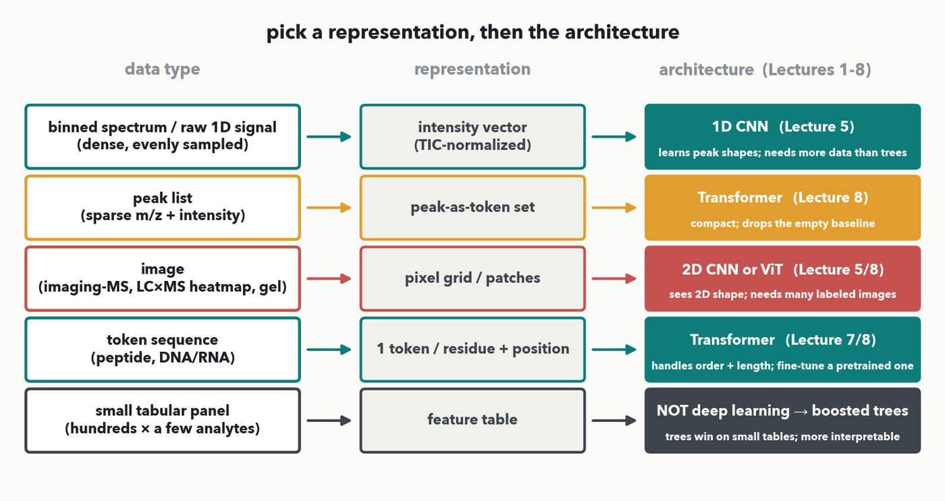
REPRESENTATION · THE DECISION CHART · I-DO
Your data isn't a sentence — pick a representation
MASS SPEC · Match the SHAPE of your data to a representation, then the architecture. Worked example (I-do): a full-scan MALDI spectrum is a dense 1D signal → a TIC-normalized intensity vector → a 1D CNN (Lecture 5). Trade-offs live in each box: CNNs learn peak shapes but need more data; peak-as-token is compact but drops the baseline; small tables → trees win and stay interpretable.
Notes:
The centrepiece of the first block and the tool the whole worksheet is answerable from (rule 3). Read the chart as five rules, top to bottom. (A) A dense, evenly-sampled 1D signal — a binned full-scan spectrum or a chromatogram — becomes a normalized intensity vector and goes to a 1D CNN, exactly Lab 2's machinery; the conv learns local peak shapes. (B) A sparse peak list (m/z + intensity pairs) becomes a set of peak-as-token vectors and goes to a Transformer (Lecture 8, the Casanovo recipe) — compact because it throws away the empty baseline. (C) A genuine 2D image — MALDI imaging, an LC×MS heatmap, a gel — becomes a pixel grid or patches and goes to a 2D CNN or a ViT (Lecture 5/8). (D) A token sequence — a peptide or a nucleotide string — becomes one token per residue with positional encoding and goes to a Transformer (Lecture 7/8); usually you fine-tune a pretrained one. (E) The honesty row: a SMALL tabular panel (a few hundred rows, a handful of analytes) is NOT a deep-learning problem — gradient-boosted trees win and stay interpretable. I-do the MALDI row aloud so the room sees the mapping; next slide they do the first worksheet scenarios off this same chart. Every architecture box carries its trade-off so "name the trade-offs" is on-screen.

Slide 4
REPRESENTATION · YOUR TURN (YOU-DO) → WORKSHEET
Your turn — match two scenarios
CHECKPOINT · Your turn → Worksheet, Scenarios 1 & 2. Read each scenario, then run it down the chart: pick a representation and an architecture. Leave the validation-risk line for now — we cover it after the metrics and drift slides. Worked answers in the notes.
Notes:
YOU-DO pointing to the worksheet (the distributed-worksheet spine). Same chart, now used as a lookup for two real scenarios. Scenario 1 — MALDI-TOF binned spectra labeled susceptible/resistant → representation: TIC-normalized binned intensity vector (dense 1D); architecture: 1D CNN (Lecture 5), row A. Scenario 2 — de novo peptide sequencing from MS/MS fragment PEAK LISTS → representation: peak-as-token set (each peak a token carrying m/z + intensity); architecture: Transformer encoder-decoder (Casanovo family, Lecture 8), row B. Take one answer per scenario from the floor, confirm against the chart, then have them write Scenarios 1-2 (representation + architecture columns). The validation-risk column comes after we teach drift.

Slide 5
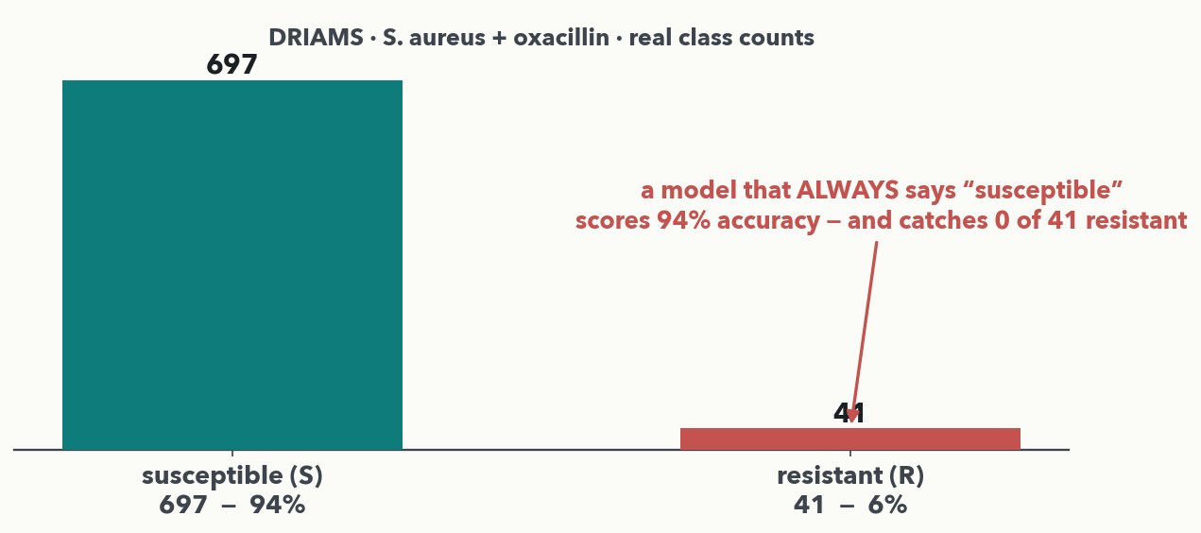
METRICS · ACCURACY'S FAILURE · HOOK
The 99%-accurate detector that never fires
MASS SPEC · Real DRIAMS counts: 697 susceptible vs. 41 resistant. A model that ALWAYS says 'susceptible' scores 94% accuracy — and catches ZERO of the 41 resistant. High accuracy, clinically useless. Under imbalance, accuracy measures the majority class, not the thing you care about.
Notes:
Open the metrics block with the trap, on REAL data (rule 2). These are the actual DRIAMS S. aureus + oxacillin class counts from Lab 2's dataset: 697 susceptible, 41 resistant — about 6% positive. A lazy model that always predicts the majority class ("susceptible") is right 94% of the time and yet never flags a single resistant isolate — the exact failure that would let a resistant infection go untreated. The point to land hard: when one class is rare, ACCURACY is dominated by the common class and tells you almost nothing about whether you catch the rare, important one. So we need metrics that look at the rare class directly — sensitivity and specificity, next. (This is the same imbalance figure from Lecture 4's discussion, now the launch point for the metrics we actually compute.)

Slide 6
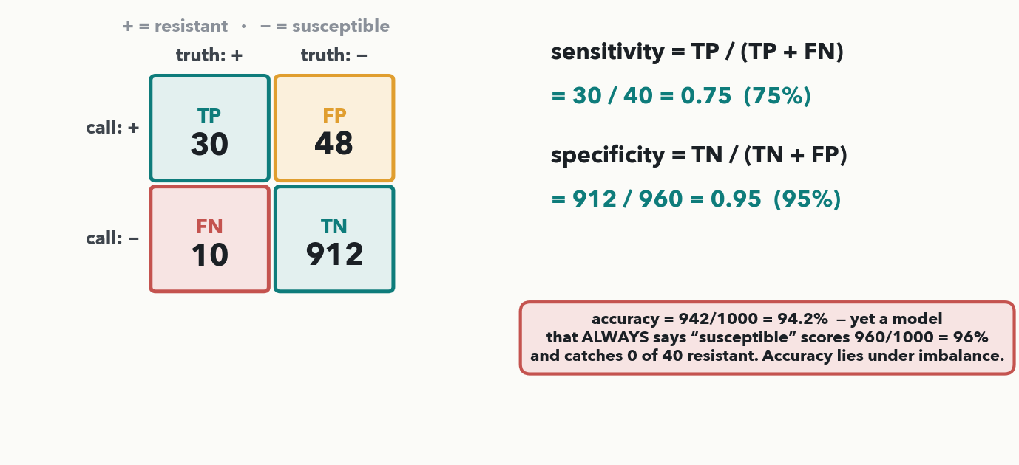
METRICS · SENSITIVITY & SPECIFICITY · I-DO
Sensitivity and specificity, worked by hand
MASS SPEC · sensitivity = TP/(TP+FN) = 30/40 = 0.75 (catches 75% of resistant). specificity = TN/(TN+FP) = 912/960 = 0.95 (95% of susceptible cleared). Accuracy = 94.2% — yet an always-'susceptible' model scores 96%. Sensitivity is the metric that exposes the missed cases.
Notes:
I-DO, the one numeric mechanic of the hour, and the formulas the worksheet needs ON THE DECK before it is asked (rule 3). Read the confusion matrix: rows are the model's CALL (+ / −), columns the TRUTH (+ = resistant, − = susceptible). TP = 30 resistant correctly caught, FN = 10 resistant MISSED, FP = 48 susceptible wrongly flagged, TN = 912 susceptible correctly cleared. Sensitivity (recall, true-positive rate) = TP/(TP+FN) = 30/(30+10) = 30/40 = 0.75 — we catch three of every four resistant isolates and MISS one in four. Specificity (true-negative rate) = TN/(TN+FP) = 912/(912+48) = 912/960 = 0.95 — we correctly clear 95% of susceptibles. Now the trap made exact: overall accuracy = (30+912)/1000 = 94.2%, but a model that always says "susceptible" scores 960/1000 = 96% — HIGHER accuracy, zero sensitivity. Every number here is exact and matches the worksheet Metrics key. Next slide the room computes both on a fresh matrix — that is the worksheet Metrics question.

Slide 7
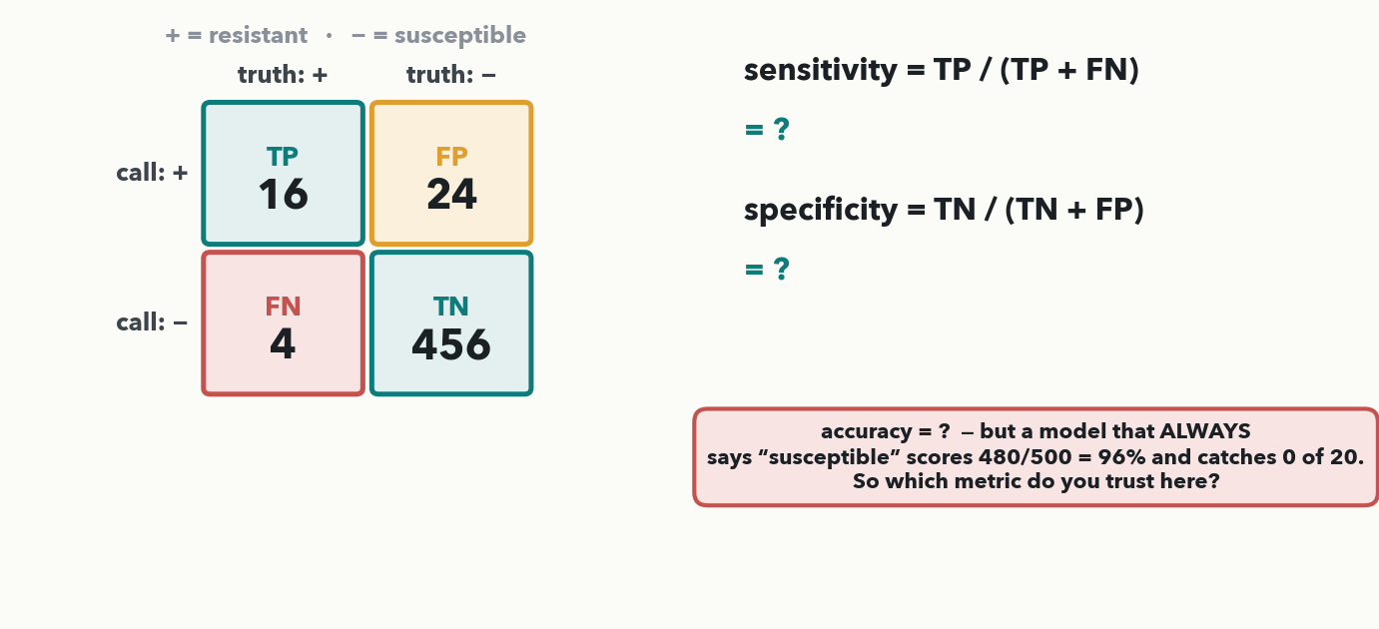
METRICS · YOUR TURN (YOU-DO) → WORKSHEET
Your matrix — compute sensitivity & specificity
CHECKPOINT · Your turn → Worksheet, Metrics Q. Same two formulas, new counts: TP=16, FN=4, FP=24, TN=456. Compute sensitivity and specificity, then pick the metric you trust under this heavy imbalance. Worked answer in the notes.
Notes:
YOU-DO = the worksheet Metrics question (same TP/(TP+FN) and TN/(TN+FP) skill, new numbers). A rapid resistance screen on 500 isolates, positive = resistant: TP = 16, FN = 4, FP = 24, TN = 456. Sensitivity = TP/(TP+FN) = 16/(16+4) = 16/20 = 0.80 (80%). Specificity = TN/(TN+FP) = 456/(456+24) = 456/480 = 0.95 (95%). Accuracy = (16+456)/500 = 472/500 = 94.4%, yet an always-"susceptible" model scores 480/500 = 96% and catches 0 of 20 resistant. Which metric to trust? SENSITIVITY (recall) — the lab must not miss resistant isolates — reported alongside the PR curve, never accuracy alone. Every value is identical to the worksheet key. Take the two numbers from the floor, then have them fill the Metrics item.

Slide 8
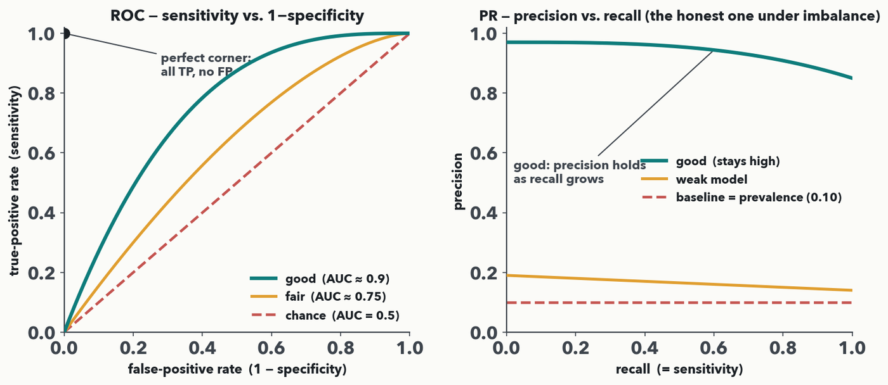
METRICS · ROC & PR AS PICTURES · I-DO
ROC and PR curves — read them as pictures
ROC (left): sensitivity vs. 1−specificity as you sweep the threshold — a GOOD model hugs the top-left corner (high sensitivity AND specificity); the diagonal is a coin flip (AUC 0.5). PR (right): precision vs. recall — the HONEST picture when positives are rare, because a good curve stays high while the baseline sits at the prevalence.
Notes:
A single classifier isn't one sensitivity/specificity pair — it's a whole curve, because moving the decision threshold trades one for the other. The ROC curve plots sensitivity (true-positive rate) against 1−specificity (false-positive rate) as the threshold sweeps; read it as a picture — a good model bows toward the TOP-LEFT corner (catch the positives without flooding false alarms), a useless model rides the diagonal (AUC = 0.5, no better than a coin). AUC is just the area under that curve, a single 0.5-to-1 summary. But under heavy imbalance ROC can look flatteringly good, so pair it with the PRECISION-RECALL curve: precision (of the cases you flagged, how many were truly positive) against recall (= sensitivity). A strong model keeps precision high as recall grows; the "chance" baseline is the prevalence itself (here 0.10), so a rare positive makes PR the honest, unforgiving view. No arithmetic here — the skill is reading the shape: hugs-the-corner good, diagonal/flat bad. These curves also connect forward to Lecture 11, where a VAE anomaly threshold is exactly a sensitivity/specificity choice on such a curve.

Slide 9
METRICS · YOUR TURN (YOU-DO) → WORKSHEET
Your turn — which curve tells the truth?
CHECKPOINT · Your turn → Worksheet, Part B(d). Your screen's positives are RARE — 20 resistant of 500 (4% prevalence). To report performance across all thresholds, would you trust the ROC-AUC or the PR curve, and why? Read it off this slide. Worked answer in the notes.
Notes:
YOU-DO that pairs the ROC/PR I-do with a worksheet item (rule 8 spine) and closes the rule-3 gap — the "read ROC/PR curves" outcome is now assessed, and it drops a compute-it-yourself beat into the middle of the metrics stretch. Same skill as the I-do (read the picture, no arithmetic), now applied to the room's own Part B screen. Answer: the PR CURVE. Positives are rare — only 20 of 500 (4%) — so the true-negatives dominate and ROC-AUC can look flatteringly high; the PR curve's chance baseline sits at the prevalence itself (0.04), so it stays honest and unforgiving as recall grows. Report sensitivity/recall alongside the PR curve, never accuracy or ROC-AUC alone. Take one answer from the floor, confirm against the previous slide's picture, then have them fill Part B(d). Every fact needed is on the prior ROC/PR slide.

Slide 10
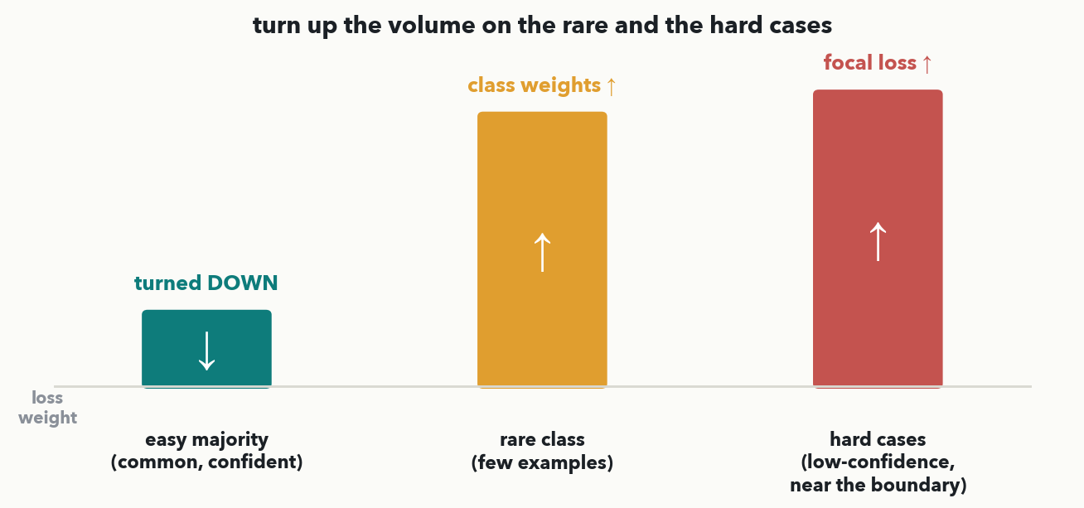
IMBALANCE · CLASS WEIGHTS & FOCAL LOSS
Turn up the volume on the rare and the hard
MASS SPEC · One idea, no derivation: make rare and hard examples count MORE in the loss. Class weights turn UP the rare class (each resistant isolate contributes more). Focal loss turns UP the hard, low-confidence cases near the boundary and turns DOWN the easy, already-correct majority. Same data, re-balanced attention.
Notes:
The first coping tool for imbalance, taught as one picture (rule 6/9, no math). The loss is what training minimizes; by default every example counts equally, so a rare class barely moves it and the model drifts to the majority. Two fixes, same spirit — "turn up the volume." CLASS WEIGHTS multiply each example's loss by a factor inversely proportional to its class frequency, so the 41 resistant isolates shout as loudly as the 697 susceptible. FOCAL LOSS goes further: it automatically turns DOWN examples the model already gets right with high confidence (the easy majority) and turns UP the hard, low-confidence cases near the decision boundary — the ones that actually teach it. You do not need the formula; the intuition is the equalizer picture. Practical note for the room: these change the LOSS, not the data, and they interact with the threshold you pick on the ROC/PR curve.

Slide 11
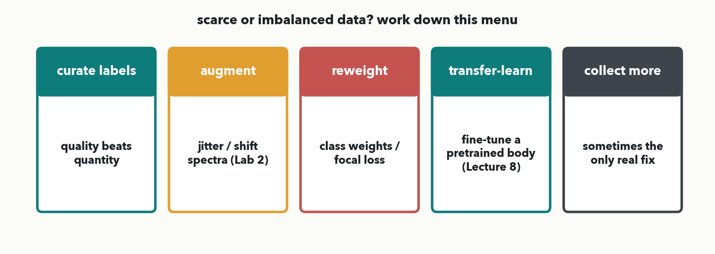
SCARCE DATA · THE MENU
Scarce or imbalanced? Work down this menu
PAIR · 💬 With your neighbor (60 sec): for YOUR rarest class, which TWO moves off this menu would you reach for FIRST — reweight, curate, augment, transfer-learn, or collect more — and which one won't rescue a model with almost no signal? (Answer in the notes: transfer-learning + curation usually pay off first; nothing beats more good labels when signal is truly absent.)
Notes:
The fuller toolkit, as a menu rather than a wall of text. CURATION: a few hundred clean, correctly-labeled spectra beat thousands of noisy ones — fix mislabels and remove junk runs before reaching for a fancier model. AUGMENTATION: manufacture plausible variants — small m/z shifts, intensity jitter, added baseline noise — so the model sees more variety without new samples; this is exactly the Lab 2 move on DRIAMS spectra. REWEIGHT: class weights / focal loss from the previous slide. TRANSFER LEARNING: borrow a body pretrained on millions of spectra or sequences and fine-tune a small head on your few hundred labels — the Lecture 8 game-changer, and why 500-800 spectra can be enough. And the unglamorous truth: sometimes the honest answer is COLLECT MORE (or better) data — no loss trick rescues a model with almost no signal. Which rung you pick depends on whether you're short on labels, short on the rare class, or short on both.

Slide 12
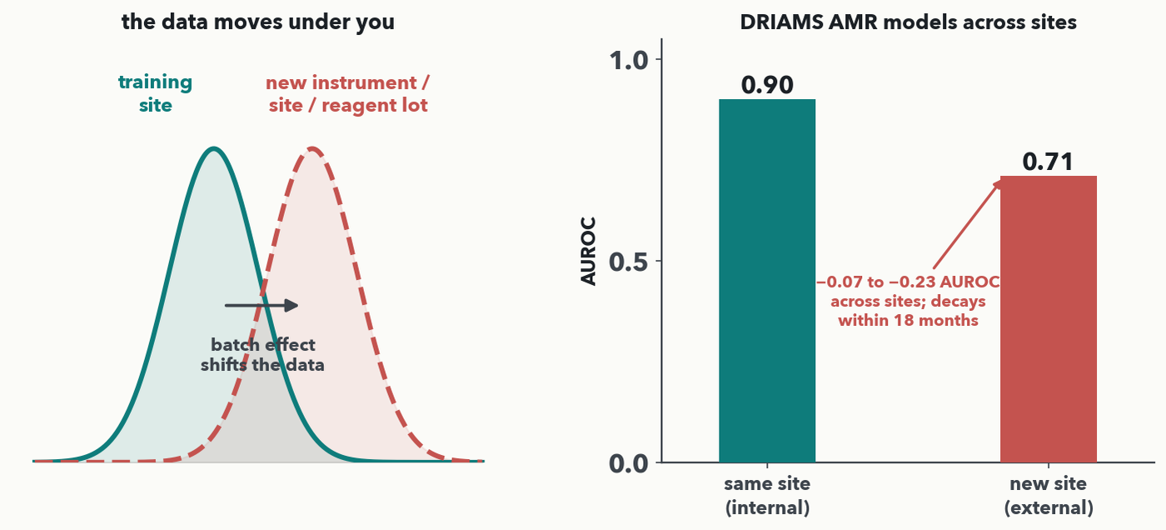
DISTRIBUTION SHIFT · THE CAUTIONARY TALE · I-DO
The data moves under you
MASS SPEC · A model is only validated on the distribution it was tested on. Batch effects — a new instrument, site, or reagent lot — SHIFT the data (left). Real tale (right): DRIAMS-trained AMR models lose 0.07–0.23 AUROC on a new site and decay within 18 months. Validation-risk rules: validate EXTERNALLY (new site/instrument) and TEMPORALLY (later runs); split by patient/isolate, never by pixel/spectrum; for sequences, split by homology.
Notes:
The "ugly" of deep learning, made concrete (rule 2). A model learns the distribution it was trained on; change the distribution and performance can collapse silently. BATCH EFFECTS are the everyday culprit — a different MALDI instrument, a new site's sample prep, a fresh reagent lot — each shifts the data cloud (left panel) even though the biology is identical. The cautionary tale is the SAME task as Lab 2: Wiesmann et al. (J Clin Microbiol 2025) took DRIAMS-trained antimicrobial-resistance models to German specimens and lost 0.07-0.23 AUROC across sites, with further decay within 18 months (right panel). The lesson is non-negotiable: internal cross-validation is not enough. You must validate EXTERNALLY (a held-out site or instrument the model never trained on) and TEMPORALLY (later time periods). And guard against leakage: split by patient or isolate, NEVER put two spectra of the same sample — or two pixels of the same imaging slide — on both sides; for sequences, split by homology so near-duplicates don't leak. These validation-risk rules are exactly what the worksheet asks you to name — read them off this slide.

Slide 13
DISTRIBUTION SHIFT · YOUR TURN (YOU-DO) → WORKSHEET
Your turn — name a validation risk
CHECKPOINT · Your turn → Worksheet, add ONE validation risk to Scenarios 1–3. Use the rules on the last slide: external (new site/instrument) + temporal validation, split by patient/isolate not pixel/spectrum, homology split for sequences. Worked answers in the notes.
Notes:
YOU-DO pointing back to the worksheet's validation-risk column, now that the rules are on the deck. Suggested risks: Scenario 1 (MALDI binned spectra) — instrument/site batch effect; train on one machine, so validate externally on a different instrument/site and split by isolate, not by spectrum (DRIAMS drop). Scenario 2 (de novo peptides) — shift across instrument / fragmentation settings; validate on a different instrument type and avoid homologous-peptide leakage. Scenario 3 (MALDI imaging) — data LEAKAGE if pixels from the same slide land in both train and test; split by patient/ slide and validate on held-out patients across staining batches. Any one defensible risk per scenario earns credit. Take one from the floor, then have them fill the risk column for Scenarios 1-3; they finish 4-6 in the paired block.

Slide 14
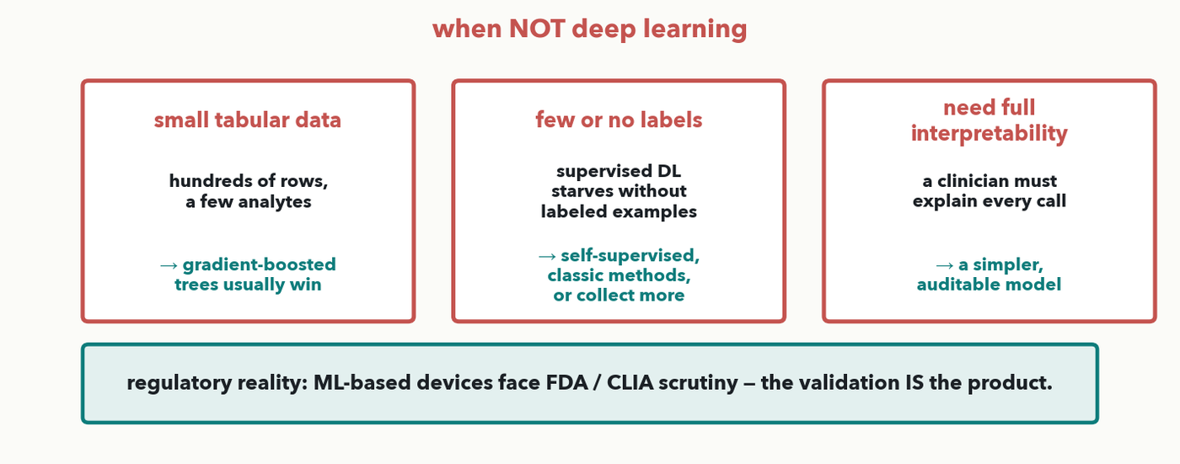
WHEN NOT DEEP LEARNING · I-DO
When NOT to reach for deep learning
MASS SPEC · Three honest stop signs: SMALL TABULAR data (a few hundred rows, a handful of analytes) → gradient-boosted trees usually win; FEW/NO LABELS → self-supervised, classic methods, or collect more; NEED FULL INTERPRETABILITY → a simpler, auditable model. And the regulatory reality: ML-based devices face FDA/CLIA scrutiny — the validation IS the product.
Notes:
The judgment that separates a practitioner from a hype-follower, and the closing outcome of the course's promise (Lecture 1: judge when a simpler tool wins). Three stop signs. SMALL TABULAR DATA — a few hundred patients by a dozen analytes — is the home turf of gradient-boosted trees (XGBoost, LightGBM); they beat deep nets on small tables and are far easier to tune, this is row E of the chart. FEW OR NO LABELS — supervised deep learning starves without labeled examples; consider self-supervised pretraining (Lecture 11), classic methods, or simply collecting more labels. NEED FULL INTERPRETABILITY — if a clinician must explain and defend every call, a transparent model (logistic regression, a small tree) can be worth more than a black box that scores a point higher. Then the one-sentence regulatory reality: ML-based diagnostic devices face FDA and CLIA scrutiny, and the VALIDATION — external, temporal, documented — is effectively the product you ship. Next slide the room makes this call on the worksheet's tabular scenario.

Slide 15
WHEN NOT DEEP LEARNING · YOUR TURN (YOU-DO) → WORKSHEET
Your turn — the tabular trap
CHECKPOINT · Your turn → Worksheet, Scenario 6. A 12-analyte panel on 400 patients: what representation, what 'architecture', and what validation risk? Careful — this is the stop-sign scenario. Worked answer in the notes.
Notes:
YOU-DO = worksheet Scenario 6, the deliberate trap that tests the judgment just taught. A small tabular panel — 12 numeric analytes, 400 patients → representation: a feature table (the 12 analytes as columns); "architecture": NOT deep learning — gradient-boosted trees (row E), which win on small tables and stay interpretable for clinical use. Validation risk: site/population shift and small n — validate externally on a different site's patients, and prefer the interpretable model because the call must be explainable (regulatory). Reward the room for RESISTING the urge to throw a neural net at it. Take one answer, confirm, then have them write Scenario 6 — and finish the remaining scenarios in the paired block next.

Slide 16
ASSESSMENT · ARCHITECTURE MATCHMAKER
Finish the worksheet in pairs, then debrief
• Six scenarios — representation + architecture straight off the decision chart, one validation risk each
• Finish any you haven't: Scenarios 4 & 5 (chromatogram QC → 1D CNN; peptide screen → fine-tuned Transformer)
• Metrics item — you already worked it: sensitivity 80%, specificity 95%, and at 4% prevalence trust sensitivity WITH the PR curve, not accuracy or ROC
• 💬 Pairs, 8 minutes; then we debrief 2-3 scenarios aloud and settle the tricky ones
PAIR · Pair → Worksheet, finish all six scenarios + the metrics item. Defend one choice to your partner: why THIS architecture, and what would break it in production?
Notes:
The assessment block: the Architecture Matchmaker worksheet completed in pairs (💬), then a rapid debrief. Most items are already done from the distributed you-dos — this closes the gaps. Scenario 4 (chromatographic peak QC) — raw 1D chromatogram → resampled fixed-length trace → 1D CNN (row A); risk: reagent-lot / column / retention-time drift → TEMPORAL validation. Scenario 5 (screen peptides as antimicrobial from sequence, ~800 labels) → token sequence with positional encoding → fine-tune a pretrained protein language model, a Transformer (row D); risk: few labels overfit and homologous sequences leak → split by sequence identity + external validation. The Metrics item (Part B) is already worked — sensitivity 80%, specificity 95% — and Part B(d) is the ROC-vs-PR call: at 4% prevalence trust the PR curve (its baseline sits at the prevalence), reported with sensitivity, not accuracy or ROC-AUC. Debrief the two trickiest — Scenario 3's leakage split and Scenario 6's NOT-deep-learning call — since those are the judgment payoffs. Collect the worksheet as the graded discussion artifact (course objectives 3-5).

Slide 17
LECTURE 10 · WHAT YOU CAN DO NOW
You can now…
• Map a lab data type to a representation and an architecture — and name the trade-offs
• Compute sensitivity and specificity, and say why accuracy lies under imbalance
• Read ROC and PR curves as pictures, and reach for class weights / focal loss / transfer when data is scarce
• Spot distribution shift, demand external + temporal validation, and know when NOT to use deep learning
You have worked the whole Architecture Matchmaker worksheet live — six scenarios off the decision chart plus the sensitivity/specificity computation. Keep the sheet; it's your project-planning checklist.
Notes:
Recap = the five Lecture 10 outcomes, each already exercised this hour: the representation chart (Scenarios 1-6), the confusion-matrix computation (the Metrics item), the ROC/PR reading, the scarce-data and imbalance toolkit, and the distribution-shift + when-NOT-DL judgment. There is no separate quiz — the worksheet IS the assessment, and it's largely done. Frame the sheet as a reusable checklist they can run against any future deep-learning idea in their own lab.

Slide 18
LECTURE 10 · OVER TO YOUR LAB · DISCUSSION
Next — learning without labels (Lecture 11 + Lab 4)
• Most lab data is UNLABELED — Lecture 11 asks what you can learn without labels
• Autoencoders & VAEs: reconstruction error as an anomaly/QC score — a sensitivity/specificity threshold, straight back to today
• Lab 4 trains a VAE on normal spectra and flags anomalies — your metrics knowledge picks the threshold
• 💬 Discussion D4: what does 'abnormal' look like in YOUR instrument's output, and would reconstruction error catch it before a human does?
PAIR · 💬 Discussion D4 (with the worksheet): name one place in your workflow where a metric — not accuracy — would change which model you'd trust.
Notes:
Close by bridging forward and back. Forward: Lecture 11 tackles the common case where labels are scarce or absent — autoencoders and VAEs — and its anomaly threshold is exactly a sensitivity/specificity decision on a curve like today's, so this hour's metrics carry straight into Lab 4. Back: the when-NOT-DL and validation lessons are the guardrails for every project they plan. Run Discussion D4 as a think-pair-share tied to their own bench: where would reconstruction error flag a bad run before a human notices, and which metric would they trust to set that alarm? Harvest two or three, then hand the last minutes to finishing the worksheet as Lab 4 context loads.

