Slide 1
MSACL · DS301 DEEP LEARNING · SEGMENT 2 · LECTURE 4
Making training actually work
Three parts: the right loss · tuning the knobs · beating overfitting
Notes:
Sunday afternoon, opening Segment 2 — straight after Lab 1. In Segment 1 they built a neuron (Lecture 1) and learned how a network learns — loss, gradient descent, backprop, the five-line loop (Lecture 2) — then ran it once in Lab 1. Today is the reality check: the plain loop works on a toy, but real training breaks in predictable ways, and there is a standard fix for each. The hour is three signposted parts: (1) LOSS — we only did regression loss, so what loss do we use to CLASSIFY? (2) TUNING — the knobs: mini-batches, the optimizer (Adam), the learning-rate schedule, activation choice, why deep nets fight back, and the hyperparameters like batch size; (3) OVERFITTING vs. UNDERFITTING — reading train-vs-validation curves and the fixes. Still intuition-first, only light arithmetic, no calculus beyond "slope." This hour is interactive the same way Lectures 1 and 2 were: the worked examples (I-do) are each followed by one you do yourself (you-do), and each you-do IS a Quiz 4 item. Hand out Quiz 4 now, blank; they fill it as we go, so by the recap they have worked the whole quiz.

Slide 2
RECAP · PICKING UP A THREAD FROM LECTURE 2
The loop runs — now make it work, in three parts
Part 1 · Loss
how to score a CLASS
Part 2 · Tuning
the knobs you turn
Part 3 · Overfitting
stop it memorizing
Lecture 2 measured loss with MSE — great for predicting a NUMBER, but it deferred one question: how do you score a CLASSIFICATION (resistant vs. susceptible)? We open that thread first, then walk the knobs you turn, then how to stop a model from memorizing.
Notes:
Two minutes to rebuild the bridge and set the map. The continuity point: Lecture 2 explicitly said "classification loss is deferred to Lecture 4" — we cash that cheque now. MSE answers "how far is my number from the truth," right for a concentration or retention time, wrong for a category, where the output is a probability and being confidently wrong should hurt much more than being unsure. Read the three boxes slowly — these are the three signposted sections of the hour, and each maps to items on Quiz 4: the cross-entropy loss choice (Q1), the overfitting curves (Q2), the batch- size trade-off (Q3), the vanishing-gradient chain (Q4), and the class- imbalance discussion (Q5). One categorization to nail up front: the OPTIMIZER (Adam) is a Part-2 "tuning" choice, not a data-feeding detail. Keep energy high — this is the most immediately useful hour of the course for their day job.

Slide 3
LECTURE 4 · PART 1 OF 3
Loss function choice
cross-entropy for classification — it punishes confident wrong answers
Notes:
Part one of three: which loss. One idea to hold: for a yes/no or a category, the network outputs a probability, and the right loss should barely shrug at an unsure guess but come down hard on a confident mistake. That loss is cross-entropy. We build it in four quick steps — turn scores into probabilities, look at the penalty shape, write the formula CE = −log(p_true), then compute one worked number on a real MS call — then give the one-line rule of thumb and move to tuning. Part 1 now has its own quiz-backed you-do (Quiz 4 Q1): right after the worked penalty numbers, the room compares two confidences and picks the loss for a NUMBER vs. a CLASS — assessing Outcome 1 (cross-entropy vs. MSE, and "punishes confident wrong answers"). This is the first hands-on beat, ~10 minutes in. Focal loss stays un-assessed — too advanced for Quiz 4 — but the core cross-entropy choice no longer goes untested.

Slide 4
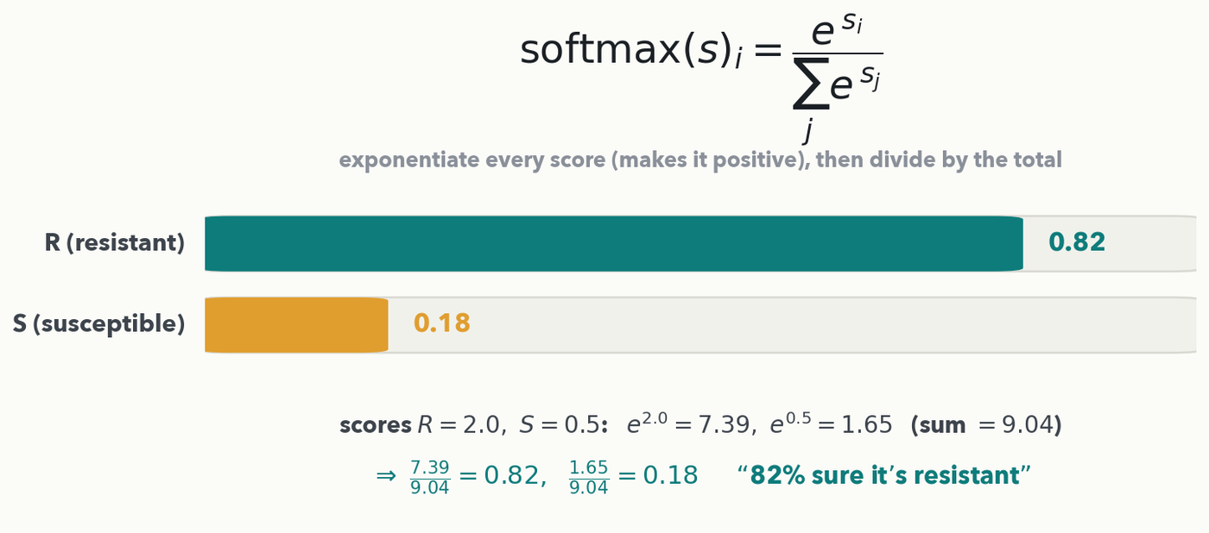
PART 1 · LOSS · STEP 1 · PROBABILITIES
Softmax turns raw scores into probabilities that sum to 1
MATH · The definition, once: softmax(s)ᵢ = e^{sᵢ} / Σⱼ e^{sⱼ} — exponentiate every class score (forces it positive), then divide by the total (forces the sum to 1). 'The answer' is now a CONFIDENCE per class. Remember this function — attention (Lecture 7) is built on the very same softmax.
Notes:
This is the FORMAL definition of softmax — worth stating cleanly here because Lecture 7's attention is built directly on it (weights = softmax(scores)). Walk the worked numbers on the slide: exponentiate each score, e^2.0 = 7.39 and e^0.5 = 1.65, sum to 9.04, then each probability is its exponential over that sum — 7.39/9.04 = 0.82, 1.65/9.04 = 0.18. The final layer gives a raw score per class (here R = 2.0, S = 0.5). Softmax exponentiates each score (which forces it positive) and divides by the sum of all the exponentials (the normalizer that forces the total to 1), landing near 0.82 / 0.18 — "82% sure it's resistant." Nothing about it is binary-only: the same sum-and-divide works for 2 classes or 200; a species-ID model just has a longer sum. That confidence is exactly what the next slide's loss grades: a good loss rewards high probability on the TRUE class and punishes high probability on a WRONG class. Anchor it in their world — this is precisely the output of a DRIAMS-style MALDI-TOF resistance classifier they meet in Lab 2.

Slide 5
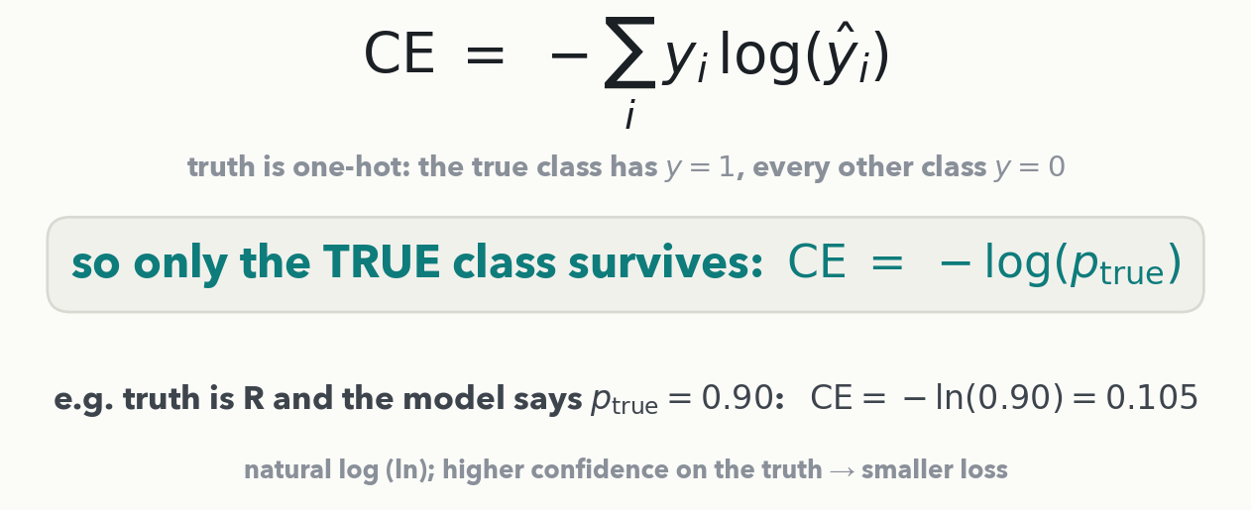
PART 1 · LOSS · STEP 2 · THE FORMULA
Cross-entropy, written out: CE = −log(p_true)
The full loss is CE = −Σ yᵢ·log(ŷᵢ). Because the truth is one-hot (the right class is 1, all others 0), every term drops except the true class — so it reduces to CE = −log(p_true), a natural log. That is the only formula you need for every number today.
Notes:
The explicit formula, so the worked numbers on the next slides are COMPUTED, not read off a curve (rule 3: exercises must be solvable and exact). Walk it in two beats. General form: cross-entropy sums −yᵢ·log(ŷᵢ) over every class, where yᵢ is the true label (1 for the correct class, 0 otherwise) and ŷᵢ is the model's probability for class i. Because the label is one-hot, every term with yᵢ=0 vanishes and only the true class's term survives, leaving CE = −log(p_true): "how surprised were you by the truth," now as an equation. Do the one substitution on the slide out loud — truth R, model says p_true = 0.90, so CE = −ln(0.90) = 0.105 — and note we use the natural log (ln), the PyTorch default; the base only rescales the loss, it never changes which model wins. Tell them to keep this line: the penalty-shape curve next, the STEP 4 worked example, the you-do, and Quiz 4 Q1 all just plug numbers into −ln(p_true).

Slide 6
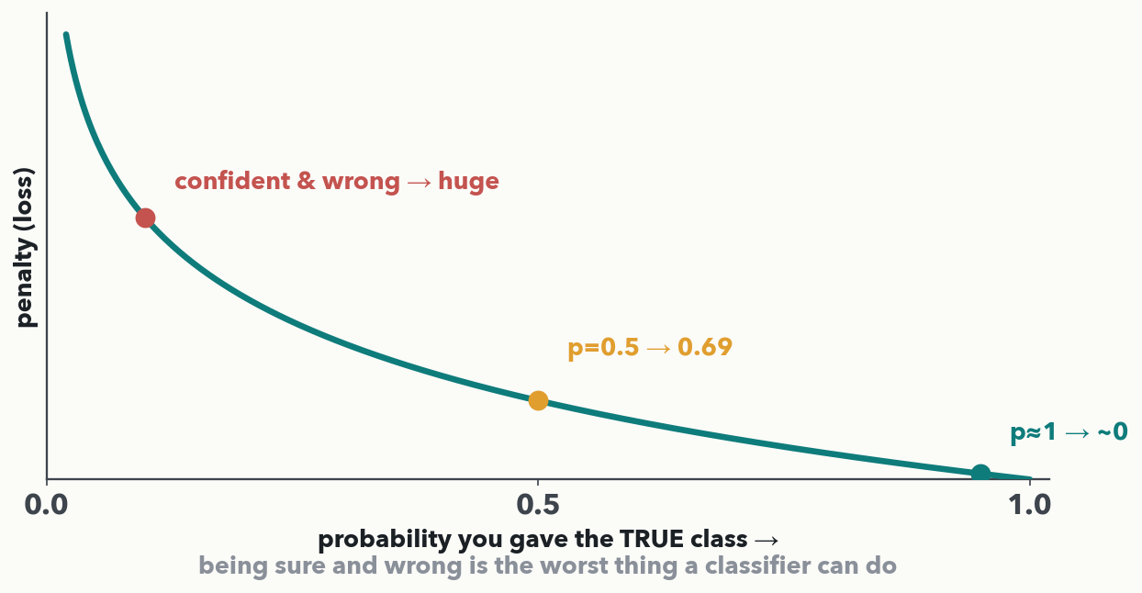
PART 1 · LOSS · STEP 3 · THE PENALTY SHAPE
Penalty = how surprised were you by the truth?
This curve IS the cross-entropy penalty −log(p_true). Said 0.9 and right → barely any penalty. Said 0.5 (a shrug) → moderate. Said 0.02 (confidently wrong) → the penalty rockets. That steep left wall is the whole idea — the formula from the last slide, drawn.
Notes:
This is the intuition to land, and it is the "penalize confident wrong answers" outcome verbatim. Read the curve right to left: give the true class a probability near 1 and you were right and sure, so the penalty is essentially zero; at 0.5 you were on the fence, a moderate penalty; as your probability for the truth heads toward zero — meaning you were confidently backing the WRONG class — the penalty shoots toward infinity. That asymmetry is deliberate and clinically sensible: a test that hedges is tolerable, a test that is loudly, confidently wrong is dangerous, and the loss reflects that. Name it plainly now: this curve is −log(p_true) — the previous slide already wrote the full formula out and did one substitution, so every number they compute later is exact, not eyeballed. One line of contrast with MSE: MSE treats 0.9-vs-1 and 0.1-vs-0 as similar-sized misses; cross- entropy blows the confident miss up enormously.

Slide 7
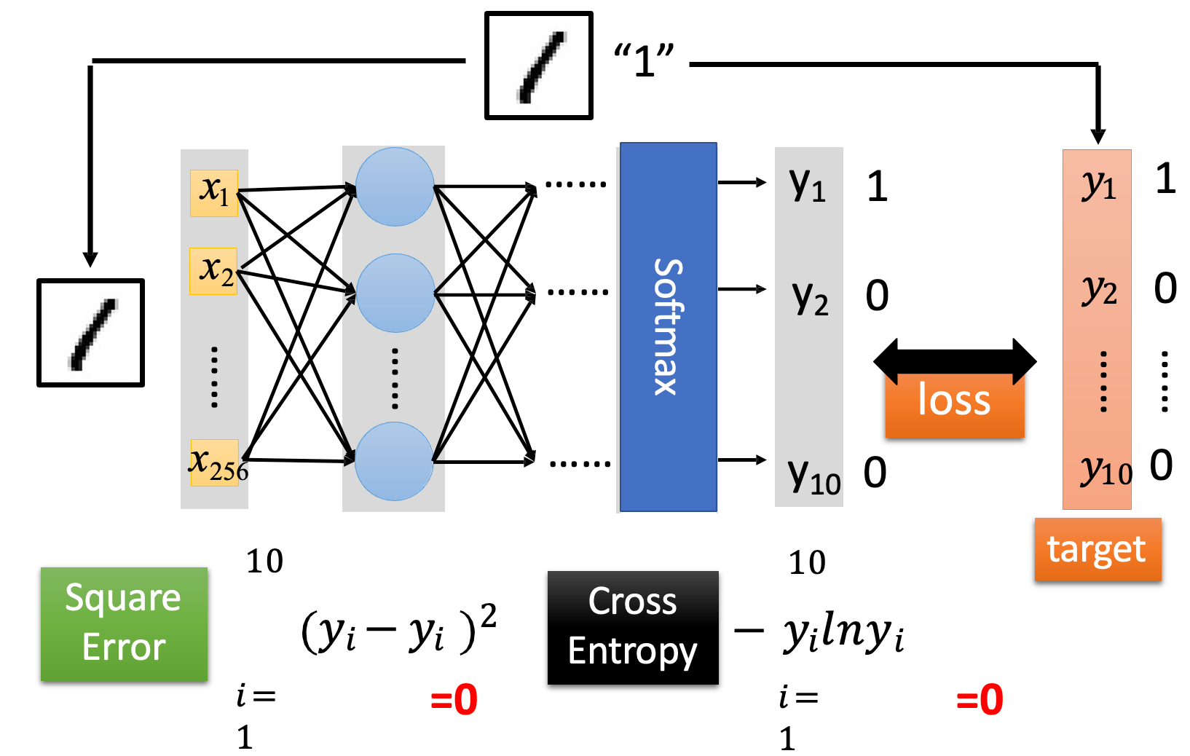
Why is Cross-Entropy Better?
PART 1 · LOSS · WHICH LOSS FOR WHICH TASK
Hand-written digit recognition - classification
cc deep learning in one day from Prof. Lee

Slide 8
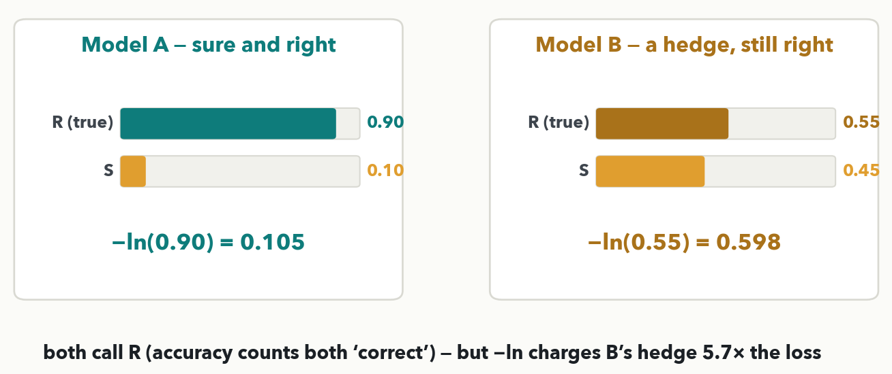
PART 1 · LOSS · STEP 4
CE Loss is harsher
MASS SPEC · Same call (both pick R, so accuracy counts both 'correct') — but plug into CE = −ln(p): A = −ln(0.90) = 0.105, B = −ln(0.55) = 0.598, so B's hedge costs 5.7× the loss. Rule of thumb: predict a NUMBER → MSE; choose a CLASS → cross-entropy. In PyTorch, one line: nn.MSELoss → nn.CrossEntropyLoss (it even applies softmax internally).
Notes:
The worked example — concrete numbers, straight from the formula. The truth is R (resistant). Model A puts 0.90 on R, so CE = −ln(0.90) = 0.105 — tiny. Model B ALSO calls R — it puts 0.55 on R and 0.45 on S, so its argmax is still R and accuracy counts it "correct" too — but it barely committed; CE = −ln(0.55) = 0.598, about 5.7 times larger. Both numbers come straight from the previous slide's formula CE = −ln(p_true) — exact, not eyeballed. Say the takeaway aloud: accuracy sees only the call (both R), so it cannot tell the sure bet from the hedge — cross-entropy grades the confidence and does, which is why we train on it. Close with the one-line rule of thumb and note a relative, focal loss, tilts this toward rare/hard cases — we meet it again under class imbalance. Leave the two penalties blank on the next slide — that is the you-do (Quiz 4 Q1): the room plugs 0.8 and 0.2 into −ln(p_true), then Part 2's knobs make training converge.

Slide 9
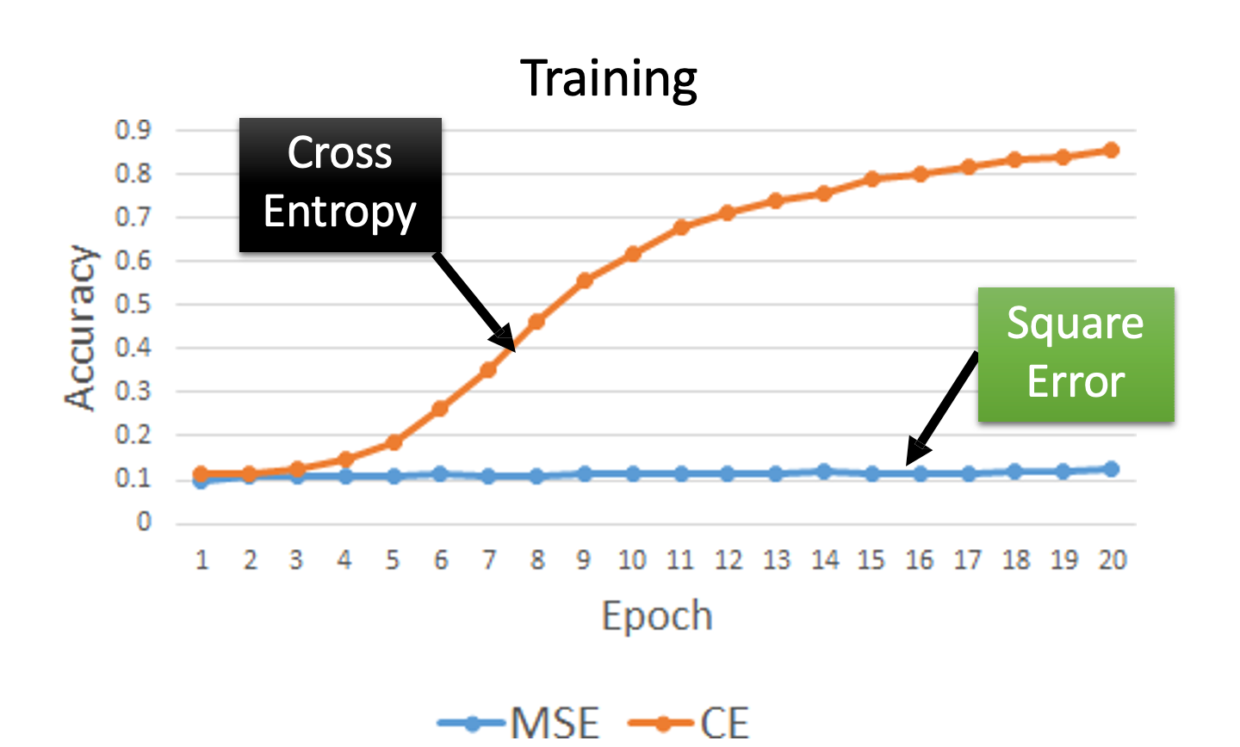
Results
PART 1 · LOSS · THE RESULT
cc deep learning in one day from Prof. Lee

Slide 10
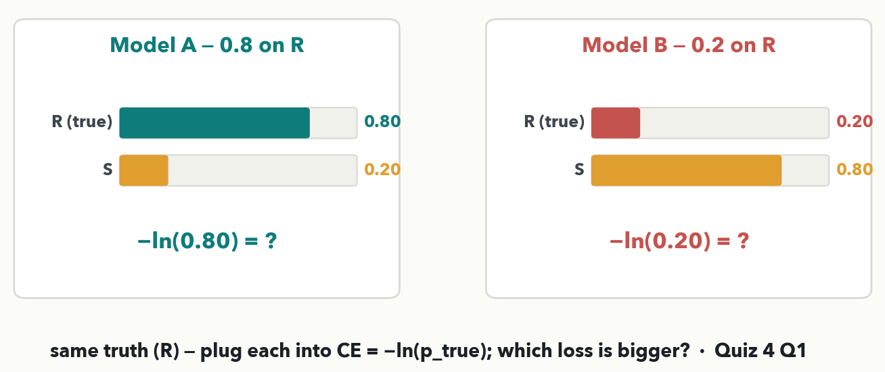
PART 1 · LOSS · YOUR TURN (YOU-DO = Q1)
Your call: which loss, and which model loses more?
CHECKPOINT · Your turn → Quiz 4, Q1. (a) Predicting an oxacillin MIC (a NUMBER) vs. calling R/S (a CLASS) — which loss for each? (b) Truth is R: Model A put 0.8 on R, Model B put 0.2 — use CE = −ln(p_true) to compute each loss; which is bigger? Worked answer in the notes.
Notes:
YOU-DO = Quiz 4 Q1 (same two-card shape as the I-do, different confidences, so it is real practice — and it assesses Outcome 1). Answer: (a) a NUMBER like a MIC concentration → MSE; a CLASS like R vs. S → cross-entropy (a probability, where being confidently wrong should hurt most). (b) MODEL B has the bigger loss — plug each into CE = −ln(p_true): Model A = −ln(0.8) = 0.223, Model B = −ln(0.2) = 1.609, about seven times larger. B gave the TRUE class (R) only 0.2, so it was confident in the WRONG answer, and −ln(p) rockets as the probability on the truth heads toward zero. Say the point aloud: both models might argmax differently — A calls R, B calls S — but the loss ALSO grades how confident each was, which plain accuracy can't. Ask a pair which model loses more before revealing, then have them fill Q1. Bridge to Part 2: right loss in hand, now the knobs that make training converge.

Slide 11
LECTURE 4 · PART 2 OF 3
Tuning the knobs
mini-batches · Adam · the learning-rate schedule · activations · batch size
Notes:
Part two of three: the settings you choose to make training converge well. We go in order — how we feed the data (mini-batches), which optimizer updates the weights (Adam), how we shrink the step over time (the schedule), which activation to use and why (it seeds the next beat), why very deep nets are still hard (vanishing/exploding — a quiz-backed you-do, Quiz 4 Q4, and the set-up for Lecture 5's ResNet), then the hyperparameters you actually dial: batch size — with its fingerprint on the loss curve (Quiz 4 Q3) — plus how to search them.

Slide 12
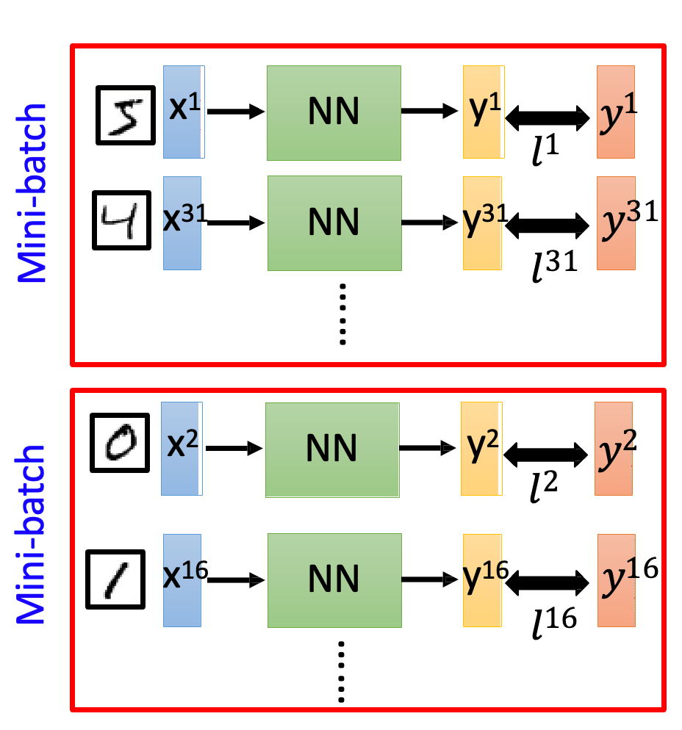
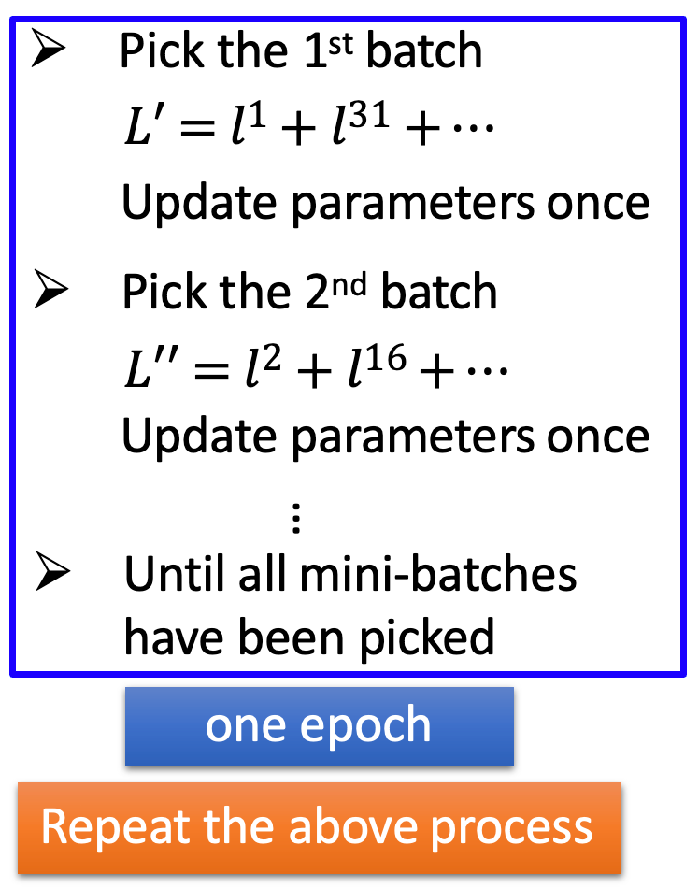
PART 2 · TUNING · HOW THE DATA IS FED · 1 OF 2
Mini-batches: step often, on a handful at a time
We don’t really optimize the TOTAL loss with all data at once.
Notes:
This follows the reference deck (Hung-yi Lee, "Deep Learning in one day," mini-batch section). Keep the categorization clean: a "batch" is how many samples you look at before ONE weight step — how the data is fed, not which optimizer you use. Full-batch = the entire dataset per step: gradient exact, path smooth, but one step per pass and everything must fit in memory. Mini-batch = chop into small groups (32, 64, …) and, crucially, UPDATE AFTER EACH GROUP; when every batch has been used that is one epoch, then repeat (shuffling between epochs). Two payoffs the source shows: FASTER — 20 updates per epoch instead of one; and BETTER — the gradient noise nudges the model toward flatter, better-generalizing minima (callback to Lecture 2's local-dip slide). "Stochastic" just means "a bit random." Say it plainly: this is separate from the OPTIMIZER, which decides how each step actually updates the weights — that is next.

Slide 13
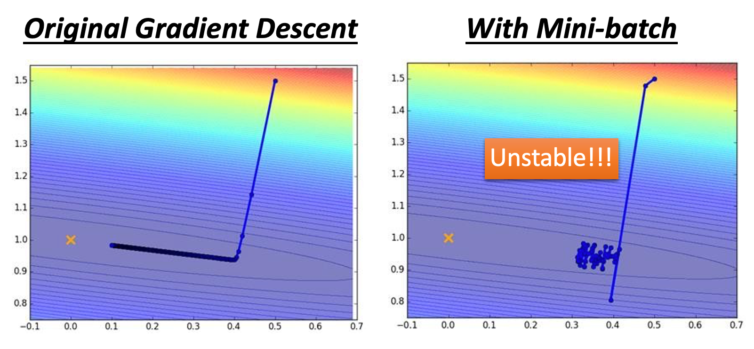
PART 2 · TUNING · HOW THE DATA IS FED · 2 OF 2
Mini-batches: step often, on a handful at a time
Split the data into mini-batches (say 32) and take one step after EACH batch — don't wait to see all the data. This is mini-batch SGD, a data-feeding choice, not an optimizer. 20 batches = 20 updates per epoch (vs. 1 for full-batch): faster, and the noise finds flatter, better-generalizing solutions.
Notes:
This follows the reference deck (Hung-yi Lee, "Deep Learning in one day," mini-batch section). Keep the categorization clean: a "batch" is how many samples you look at before ONE weight step — how the data is fed, not which optimizer you use. Full-batch = the entire dataset per step: gradient exact, path smooth, but one step per pass and everything must fit in memory. Mini-batch = chop into small groups (32, 64, …) and, crucially, UPDATE AFTER EACH GROUP; when every batch has been used that is one epoch, then repeat (shuffling between epochs). Two payoffs the source shows: FASTER — 20 updates per epoch instead of one; and BETTER — the gradient noise nudges the model toward flatter, better-generalizing minima (callback to Lecture 2's local-dip slide). "Stochastic" just means "a bit random." Say it plainly: this is separate from the OPTIMIZER, which decides how each step actually updates the weights — that is next.

Slide 14
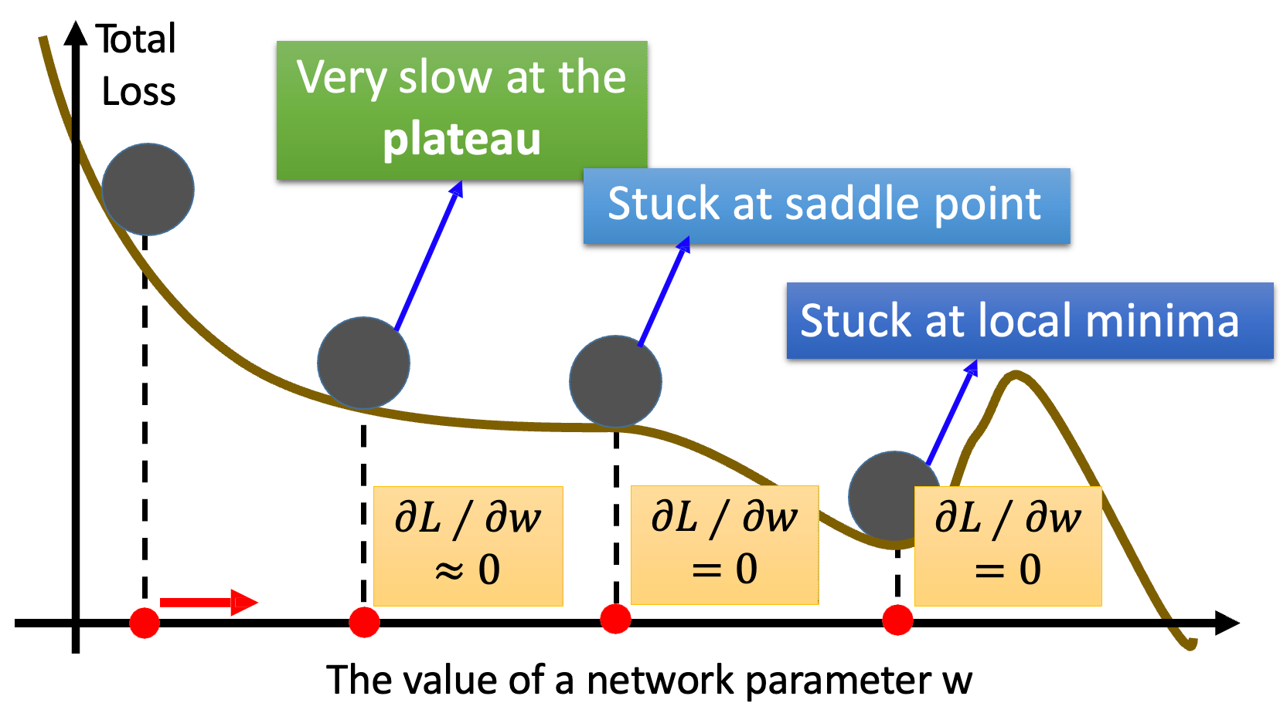
Hard to find best learning rate (step size)
PART 2 · TUNING · THE OPTIMIZER · 1 OF 3

Slide 15
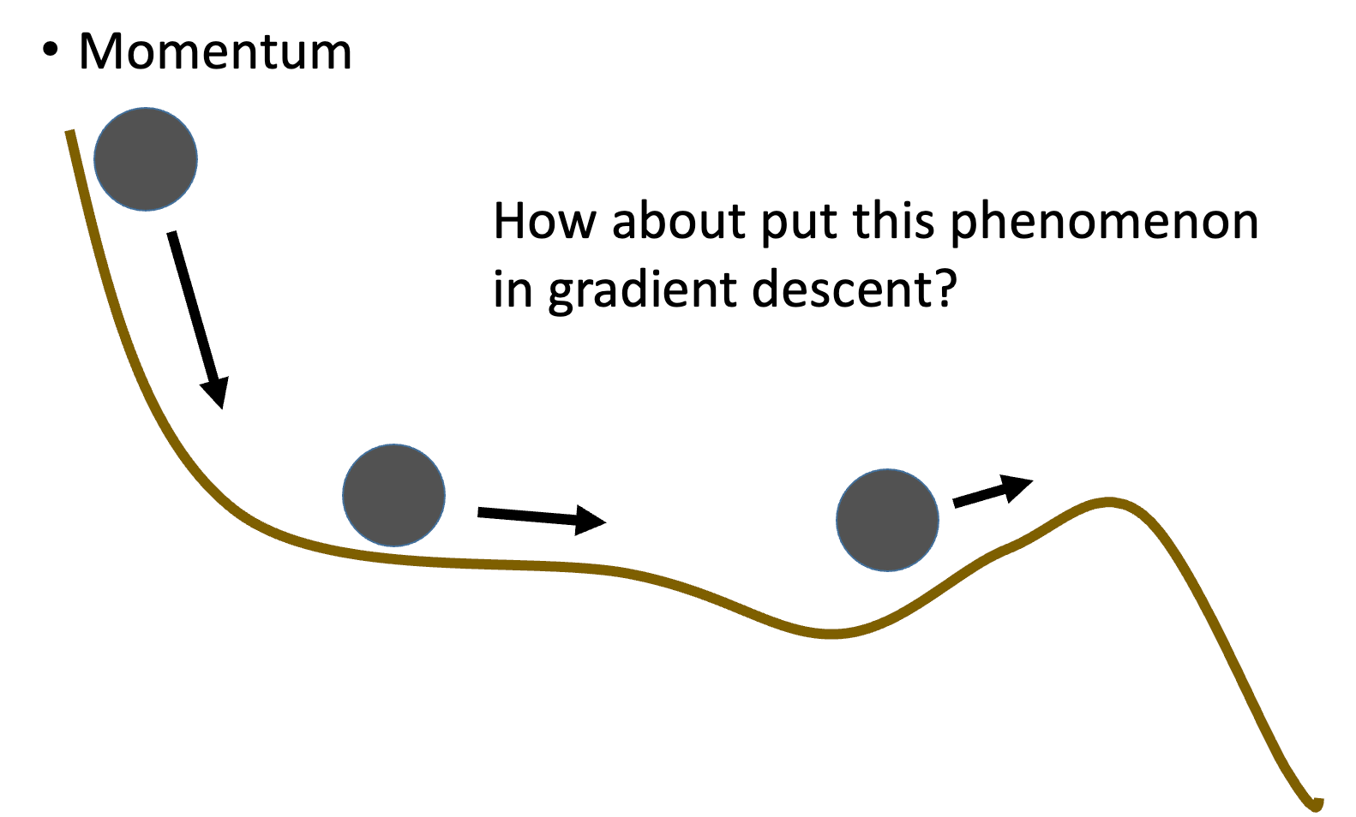
Adam: Motivation
PART 2 · TUNING · THE OPTIMIZER · 2 OF 3
In the real physical world

Slide 16
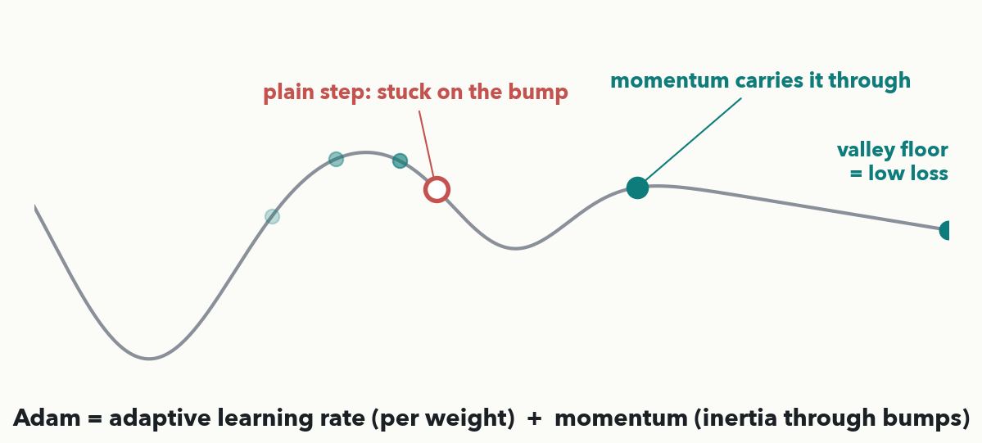
PART 2 · TUNING · THE OPTIMIZER · 3 OF 3
Adam: a per-weight, adaptive step size
Plain SGD uses one learning rate for every weight. Adam = adaptive rate (each weight's step tuned from its own gradient history) + momentum (inertia that glides through small bumps and flat spots). It is the sensible default optimizer and usually 'just works.'
Notes:
Follows the reference deck's optimizer section: the "Recipe of Deep Learning" lists Adaptive Learning Rate and Momentum as two tricks, and Adam is literally their combination. Give each in plain words. Adaptive rate: each weight gets its OWN learning rate scaled by its recent gradient sizes — flat directions get bigger steps, steep ones smaller, automatically. Momentum, drawn literally: a ball sliding down a hillside toward the valley floor (low loss). A PLAIN step only looks at the slope under its feet — hit a small bump or flat plateau (gradient ≈ 0) and it stalls there, stuck, even though the real valley is further down. A ball with MOMENTUM keeps some of its downhill velocity from earlier steps, so it coasts straight over that same bump and keeps going. That is what momentum adds: this step's move = mostly the accumulated velocity, nudged by the current gradient — it glides through bumps and shrugs off mini-batch noise. Use Adam as your default; it removes most of the pain of hand-tuning the rate — though the rate still matters, which is why we schedule it next.

Slide 17
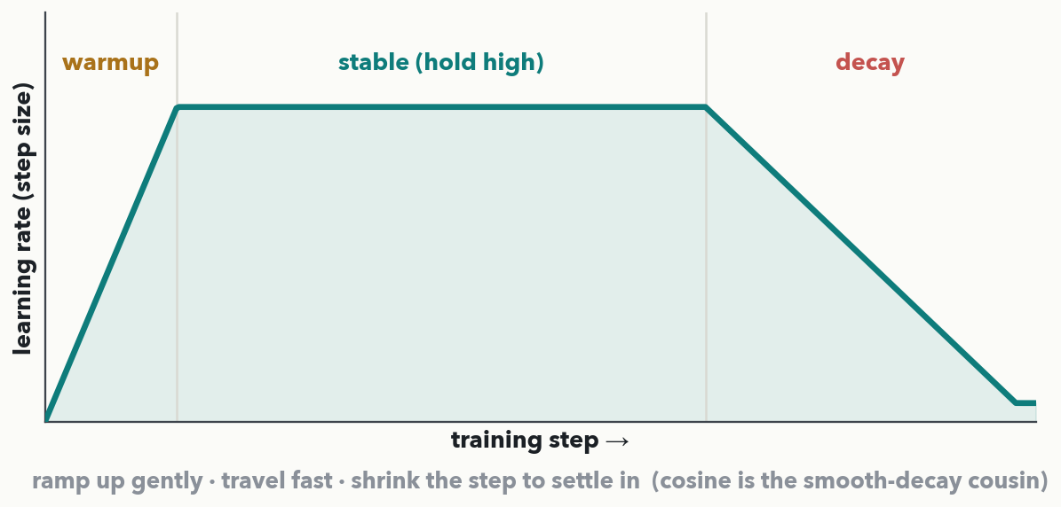
PART 2 · TUNING · THE LEARNING-RATE SCHEDULE
Schedule the rate: warmup → hold → decay
PAIR · 💬 30-sec poll: even with Adam adapting each weight's step, why still DECAY the overall rate as your spectra classifier settles into the valley? (Adam tunes the step PER WEIGHT; the schedule scales the WHOLE rate over TIME — they stack.) Callback to Lecture 2: the rate is the step size.
Notes:
The learning-rate SCHEDULE, the explicit Lecture 2 callback. Recall the three bowls from Lecture 2: too small crawls, too big overshoots, just right settles fast — the rate is the single most important dial. A schedule just changes that dial over training. The modern shape here is warmup–stable–decay (after arXiv:2410.05192): WARMUP ramps the rate up so early noisy steps don't blow up; STABLE holds a high rate to make fast progress (the loss can look choppy here without anything being wrong); DECAY drops the rate sharply so the model stops bouncing and settles into the valley — this is where the loss visibly falls off a cliff. Cosine is the smooth-decay cousin: it shrinks gradually the whole time. Clarify vs. Adam: Adam adapts the step per WEIGHT from recent gradients; the schedule scales the OVERALL rate over TIME — they stack. This is also the hands-on beat for this run (rule 8, ~a beat every 8–10 min) and a structured discussion prompt that assesses the schedule outcome (rule 3): put the poll to the room, take two answers, land "decay so the model stops bouncing and settles." Bridge: optimizer and schedule set, but two more things shape training — which activation you pick, and what happens to the gradient in a very deep net.

Slide 18
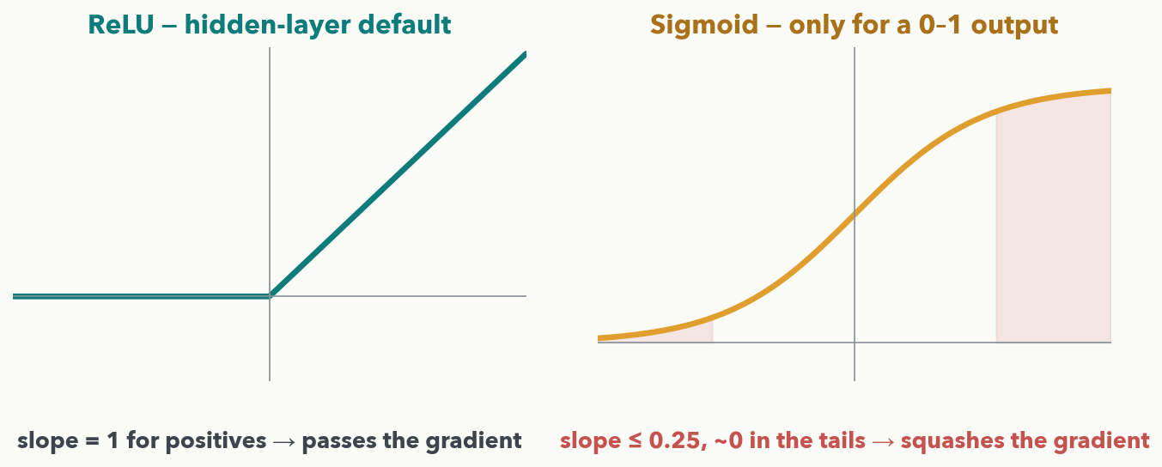
PART 2 · TUNING · WHICH ACTIVATION
Activation choice: ReLU by default, and why
Lecture 1's shapes, now as a CHOICE. ReLU is the hidden-layer default — its slope is 1 for positives, so it passes the gradient. Sigmoid belongs only at a 0–1 OUTPUT: its slope is at most 0.25 and near-zero in the tails, so stacked in hidden layers it SQUASHES the gradient — the seed of the next slide.
Notes:
A short but important beat, and the natural set-up for vanishing gradients. In Lecture 1 they met ReLU, sigmoid, and linear as shapes; now it is a choice of which to use where. ReLU (negatives → 0, positives unchanged) is the default inside the network for two reasons: trivial to compute, and its slope is exactly 1 wherever the input is positive, so it passes the backprop gradient through undamped. Sigmoid squashes any number into 0–1, which is perfect at the OUTPUT of a yes/no classifier (read as a probability) — but its slope is at most 0.25 and essentially zero once the input is large positive or negative (the shaded flat tails). Stack several sigmoids in the hidden layers and every layer multiplies the gradient by one of those small slopes — which is exactly the failure the next slide makes numeric. Linear (no bend) we still avoid in hidden layers (Lecture 1): remove the bend and the whole stack collapses to a line. Bridge: watch what those small per-layer slopes do when you multiply a lot of them.

Slide 19
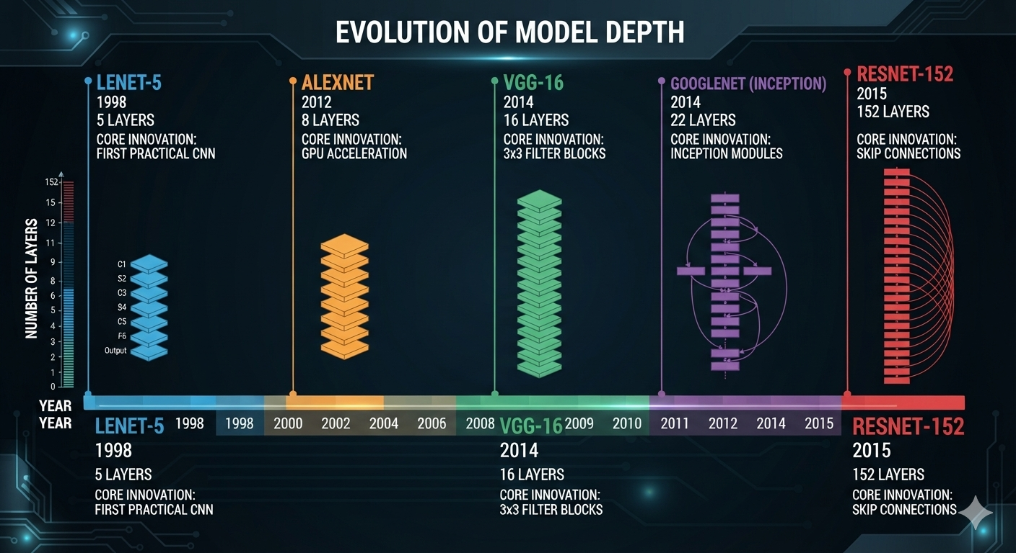
PART 2 · TUNING · WHY DEEP NETS ARE HARDER (I-DO)

Slide 20
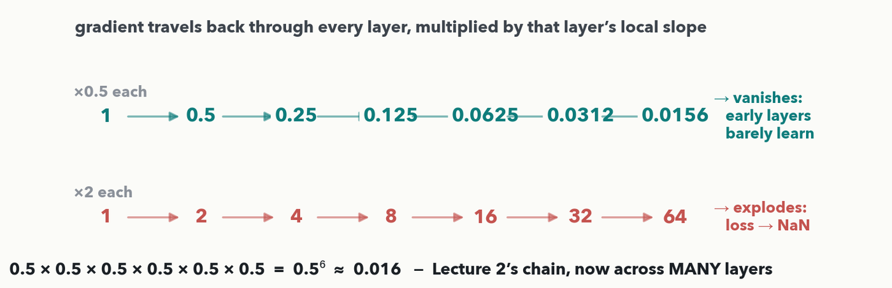
PART 2 · TUNING · WHY DEEP NETS ARE HARDER (I-DO)
Whisper down the lane: the gradient fades or blows up
From Lecture 2: a weight's gradient is the PRODUCT of the local slopes along its path back from the loss. In a deep net that path crosses every layer — so a factor a bit below 1 shrinks the gradient to nothing (vanishing), and a bit above 1 blows it up (exploding). No optimizer fully fixes this.
Notes:
I-DO, and a required beat: it names a limit the optimizer can't cure and sets up Lecture 5's ResNet. Ground it in Lecture 2's backprop: a weight's gradient is the product of the local slopes along the path from the loss back to that weight — "multiply the local effects along the path." In a deep net that path runs through every layer, so the gradient is a long product of per-layer factors. Show it on screen: if each factor is about 0.5 (a sigmoid's slope is at most 0.25, so this is optimistic), then six layers give 0.5×0.5×…×0.5 = 0.5⁶ ≈ 0.016 — the signal has withered to almost nothing by the time it reaches the EARLIEST layers, so those layers barely learn while layers near the output learn fast. That is vanishing gradients. Flip the factor to about 2 and the product 2⁶ = 64 explodes — updates blow up, weights fly off, the loss prints NaN. The whisper-down- the-lane image nails it. Partial fixes in a breath — ReLU (slope 1), careful initialization, normalization — then the hook: the real cure, the ResNet skip connection, is Lecture 5. Next slide you run the chain yourself — Quiz 4 Q4.

Slide 21
PART 2 · TUNING · YOUR TURN (YOU-DO = Q4)
Your turn — what gradient reaches layer 1?
loss
× 0.5
layer 5
× 0.5
layer 4
× 0.5
layer 3
× 0.5
layer 2
× 0.5
layer 1
gradient 1.0
gradient ?
A gradient is the PRODUCT of the local slopes along the path back to a weight (Lecture 2). Here it passes back through 5 layers, each multiplying it by a slope of 0.5.
(a) What gradient reaches the first layer? 1.0 × 0.5⁵ = ________
(b) Is this vanishing or exploding? ________
(c) In one line: what does that mean for how the earliest layers learn?
CHECKPOINT · Your turn → Quiz 4, Q4. Multiply the slopes down the chain: 1.0 leaves the loss and is multiplied by 0.5 at each of 5 layers. (a) What reaches layer 1? (b) Vanishing or exploding? (c) What does that mean for the earliest layers? Worked answer in the notes.
Notes:
YOU-DO = Quiz 4 Q4, straight after the whisper-down-the-lane I-do. Worked answer: (a) 1.0×0.5^5=0.5^5=0.03125≈0.03. (b) Vanishing — every factor is below 1, so the product shrinks fast. (c) The gradient reaching the earliest layers is almost zero, so those layers barely update / learn while layers near the output learn fine — which is why very deep plain networks are hard to train (the fix, ResNet skip connections, is Lecture 5). If each slope were instead about 2, the product 2^5=32 would explode and the loss would go to NaN.

Slide 22
PART 2 · TUNING · THE HYPERPARAMETERS
The knobs you set — tune the learning rate first
• Hyperparameters = settings you choose BEFORE training (the weights are what training learns)
• There are a huge number: depth · width · activation · optimizer · dropout · weight decay · schedule · batch size · epochs · …
• 1 · Learning rate — by far the most impactful (Lecture 2's three bowls)
• 2 · Batch size — memory and the trade-off, next two slides
• 3 · Model size / epochs — capacity and how long
Get the learning rate right and half your problems disappear; everything else can start at its library default. Order of attack: learning rate → batch size → model size / epochs.
Notes:
Set expectations honestly: the list of things you COULD tune is enormous — depth and width, activation, the optimizer and its momentum, dropout rate, weight-decay strength, the schedule, batch size, epochs, and more. Nobody sweeps all of them. The skill is knowing the handful that move the needle, and we cover only those basics. Define hyperparameter cleanly: a setting YOU pick before training, versus the weights the loop LEARNS. Then the ranking: the learning rate dominates (callback to Lecture 2's three bowls, the loss-curve diagnosis, and the schedule two slides back) — get it in the right ballpark before touching anything else; then batch size (its trade- off and loss-curve fingerprint are the next two slides); then model size and epochs. Give the order-of-attack line as the practical recipe. Regularization strength (dropout, weight decay) is also a hyperparameter, but we meet those as OVERFITTING fixes in Part 3, so they are off this list. Bullets are genuine list content here (an agenda of knobs), not a mechanic — the mechanics get pictures. Bridge: batch size next.

Slide 23
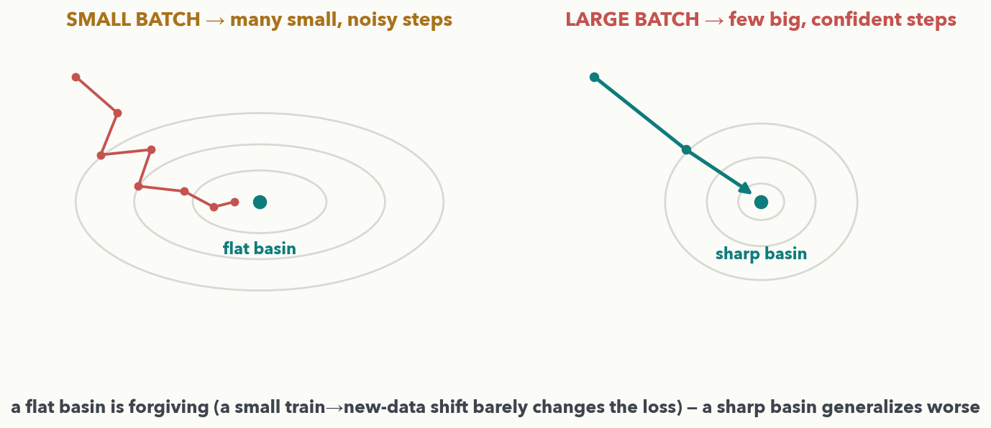
PART 2 · TUNING · BATCH SIZE · THE TRADE-OFF (I-DO)
Batch size shapes which valley you land in
Same loss plane, two batch sizes. SMALL batch: noisy gradient → many small, jittery steps into a wide FLAT basin that generalizes. LARGE batch: clean gradient → few big, confident steps into a narrow SHARP basin that generalizes worse. A bigger batch buys a cleaner gradient and better GPU use — but there is a too-big cost.
Notes:
I-DO for the batch-size trade-off — cover BOTH what a bigger batch buys AND the too-big problem (Quiz 4 Q3). Read the figure as one shared landscape seen from above (contour rings = equal loss). LEFT, small batch: each mini- batch gives a noisy, slightly-wrong gradient estimate, so every step is small and points a bit differently — many short jittery hops that wander into a wide, FLAT basin (loss stays low over a broad area). RIGHT, large batch: averaging over many examples gives a clean, accurate gradient, so each step is long and nearly straight — a few big strides into a narrow, SHARP basin. The generalization point (Keskar et al.): a flat basin is forgiving — a small shift between training data and new data barely changes the loss there — while a sharp basin is unforgiving, so the same shift sends the loss up the wall (a "generalization gap"). So a bigger batch buys a less noisy gradient and better hardware use, but too big costs you. Next slide you name those costs — Quiz 4 Q3 — reading the loss-curve fingerprint.

Slide 24
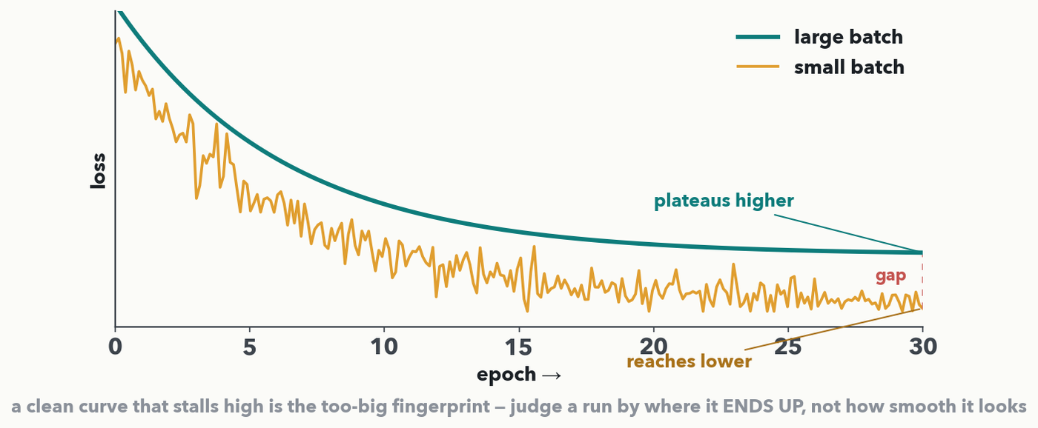
PART 2 · TUNING · YOUR TURN (YOU-DO = Q3)
Two runs went wrong — diagnose the batch size
CHECKPOINT · Your turn → Quiz 4, Q3. A colleague retrained this classifier and hit two problems: (a) batch 1024 → 'CUDA out of memory' before epoch 1; (b) batch 512 → smooth curve, but it plateaus HIGHER than batch-32 did (the picture). For each, say what it reveals about the batch and one change. Worked answer in the notes.
Notes:
YOU-DO = Quiz 4 Q3 — a symptom→cause diagnosis, NOT a list-the-tradeoffs recall. Each symptom points at one cause and one fix, all covered on the last two slides. (a) 'CUDA out of memory' before training even starts → the batch is simply TOO BIG TO FIT IN GPU MEMORY → shrink the batch (or keep it and use gradient accumulation). (b) smooth curve that PLATEAUS HIGHER than batch-32 (exactly the teal curve on screen) → with a very large batch you take FAR FEWER weight updates per epoch AND the too-clean gradient settles into a SHARP minimum that generalizes worse, so the loss stalls high → lower the batch toward ~32 (or train more epochs). (c) the trap, say it aloud: the smooth run is NOT automatically the better one — judge a run by where it ENDS UP and by validation, never by how steady the curve looks. Have a pair name each cause before revealing, then fill Q3.

Slide 25
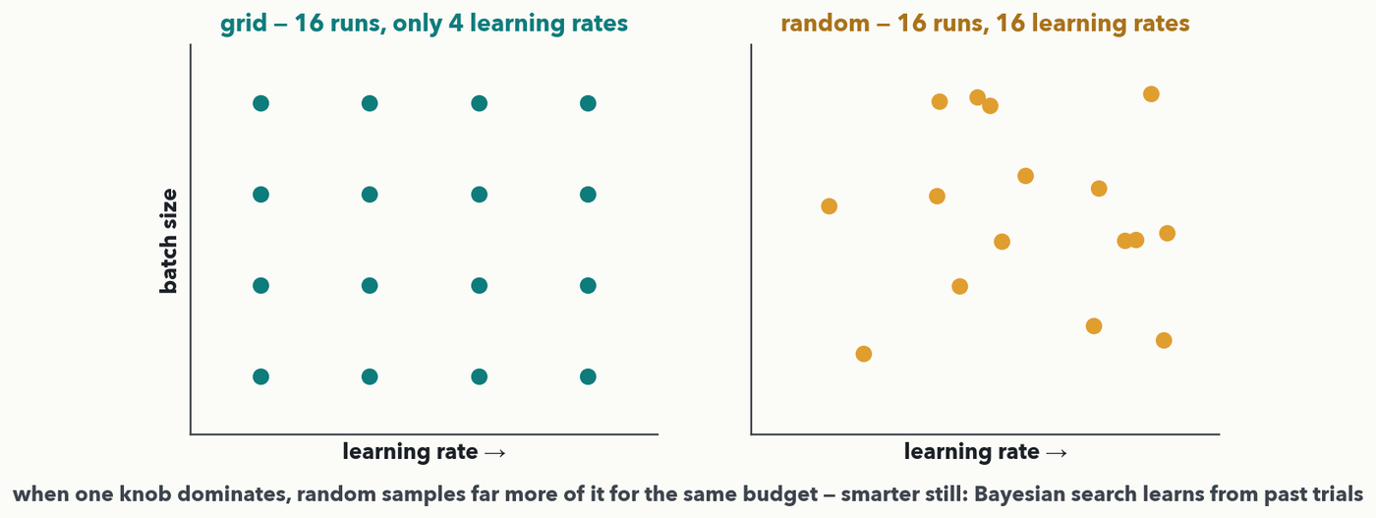
PART 2 · TUNING · SEARCHING COMBINATIONS
Grid vs. random search vs. Bayesian
Searching learning rate × batch size for a DRIAMS spectra classifier: when one knob (the learning rate) matters far more than others, random search samples many more values of it for the same budget — so it beats a rigid grid. Smarter still: Bayesian optimization (Optuna, Ray Tune) learns from your past trials and spends its budget where a good score looks most likely.
Notes:
Explain the ladder: grid → random → Bayesian. Grid: pick a few values per hyperparameter and try every combination — tidy, but 4 learning rates × 4 batch sizes = 16 runs yet only 4 distinct learning rates ever tested. Random: same 16-run budget, sample each hyperparameter randomly, so you test 16 different learning rates AND 16 batch sizes; since usually one knob (the learning rate) dominates, sampling it densely — which random does for free, because its points don't line up in columns — finds a better model sooner. Then the state-of-the-art correction: it is NOT purely random. Bayesian optimization keeps a running model of how settings map to validation score, fit to the trials you've already run, and uses it to pick the next trial intelligently — exploiting regions that scored well while still exploring uncertain ones. Name the tools (Optuna, Ray Tune, scikit- optimize); the math (Gaussian processes, acquisition functions) is beyond today. In Lab 2 they run a small structured search themselves. Bridge to Part 3: even perfectly tuned, a model can still fail the real test — generalizing to new samples.

Slide 26
LECTURE 4 · PART 3 OF 3
Overfitting vs. underfitting
reading train-vs-validation curves — and four ways to fix a leak
Notes:
Part three of three, and the most practically important skill. The single question: does your model actually generalize to new samples, or has it just memorized the training set? The answer lives in the gap between the training curve and the validation curve. We build the intuition with the classic fit picture, learn to read the two loss curves (the Quiz 4 Q2 you-do), anchor it in a real MS failure, then fix with more data, early stopping, dropout, and weight decay.

Slide 27
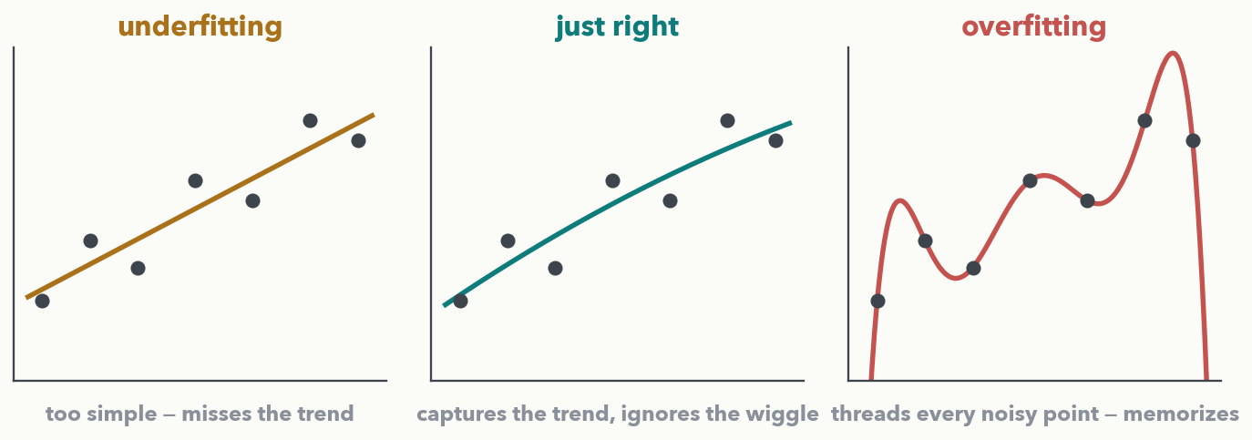
PART 3 · OVERFITTING · THE PICTURE EVERYONE MEANS
Fit the trend, not the noise
Same seven noisy points, three models. Underfitting: a line too simple to catch the trend. Just right: a smooth curve that follows the trend and ignores the wiggle. Overfitting: a curve contorted through every point — 'perfect' on these dots, useless on the NEXT one. The goal is the trend, not a perfect score on the training dots.
Notes:
Lead Part 3 with the picture everyone pictures for over/underfitting — more intuitive than loss curves, so it comes first. Same seven noisy points in all three panels; only the model differs. Left, underfitting: a straight line, too simple to bend with the data, so it misses the obvious trend ("high bias"). Middle, just right: a smooth curve that follows the underlying trend while ignoring the little up-and-down jitter — that jitter is noise, not signal. Right, overfitting: a wiggly curve contorted to pass exactly through every point, including the noise; it scores perfectly on these seven yet lurches wildly between them, so on the very next measurement it will be badly wrong. Say the lesson plainly: a perfect score on the training points is not the goal — capturing the trend that transfers to new data is. This is exactly the spectra story coming two slides on, and it is what the loss curves next detect.

Slide 28
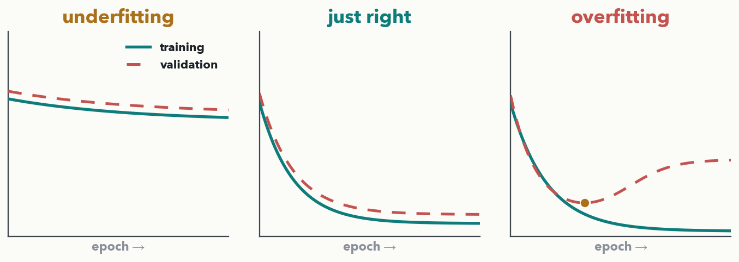
PART 3 · OVERFITTING · READ THE TWO CURVES (I-DO)
Watch training and validation loss together
Use a held-out validation dataset
Always plot BOTH: training loss (solid) on data the model learns from, validation loss (dashed) on held-out data it never trains on. Underfitting: both stay HIGH. Just right: both LOW, small gap. Overfitting: training keeps dropping while validation turns back UP. The GAP between them is the tell.
Notes:
I-DO — the diagnostic outcome, and the set-up for Quiz 4 Q2. Teach the reading protocol: always plot BOTH curves — training loss (teal, on data the model learns from) and validation loss (red dashed, on held-out data it never trains on). Three signatures. Underfitting: both curves stuck high and close — the model literally cannot fit the data yet (too small/simple or trained too briefly); the fix is MORE capacity or MORE training, not less. Just right: both fall low and stay close — validation follows training down; the target. Overfitting: training loss keeps dropping toward zero while validation bottoms out then climbs — the model is memorizing the training set's noise; the amber dot marks where validation was best. The one number to watch is the GAP: small and stable is healthy, wide and growing is overfitting. Next slide you diagnose four curves yourself, and one of them is a different problem entirely — Quiz 4 Q2.

Slide 29
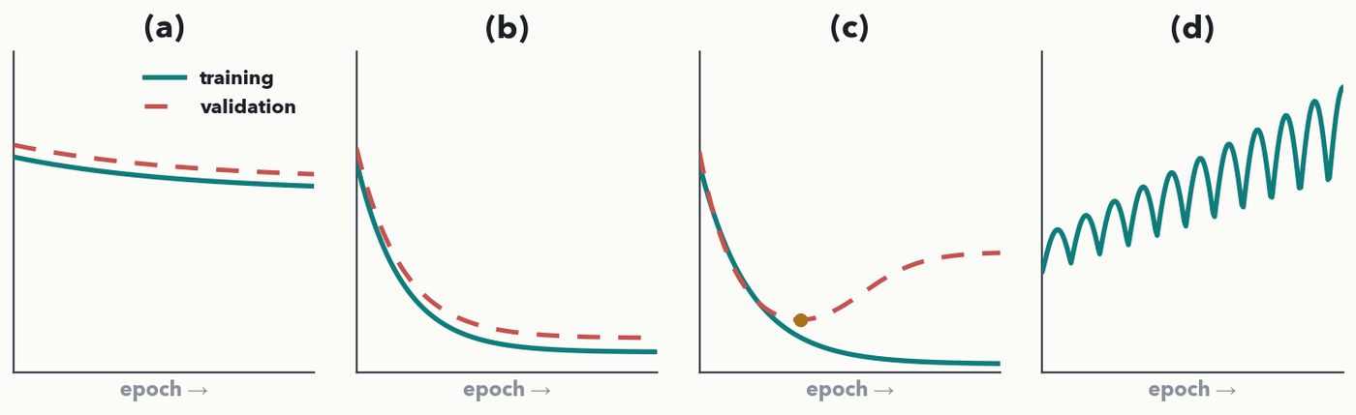
PART 3 · OVERFITTING · YOUR TURN (YOU-DO = Q2)
Diagnose four curve pairs — and name the fix
CHECKPOINT · Your turn → Quiz 4, Q2. For each pair write the diagnosis and one fix (use the word banks below). Watch out: (d) is NOT an overfitting problem. 2–3 minutes — worked answer in the notes.
Diagnosis bank: underfitting · just right · overfitting · learning rate far too high (diverging)
Fix bank: make the model bigger / train longer · keep it (ship it) · regularize (dropout / weight decay / early stopping / more data) · lower the learning rate
Notes:
YOU-DO = Quiz 4 Q2 (the same four pairs as the sheet, tagged a–d). Answers: (a) UNDERFITTING → make the model bigger / train longer — both curves sit high and close and barely move, so it hasn't fit even the training data yet. (b) JUST RIGHT → keep it (ship it) — both drop low and stay close with only a small gap. (c) OVERFITTING → regularize — training loss keeps falling toward zero while validation turns back up (the dot marks the best epoch); add dropout / weight decay, stop early, or get more/varied data. (d) LEARNING RATE FAR TOO HIGH → lower it — the (training) loss swings wildly and CLIMBS; the steps are overshooting, a bad-LR problem, not a capacity or memorizing problem. The tell that separates (c) from the rest: only in (c) do the two curves SPLIT APART — training good, validation bad. Harvest a couple of pairs, then have them fill Q2.

Slide 30
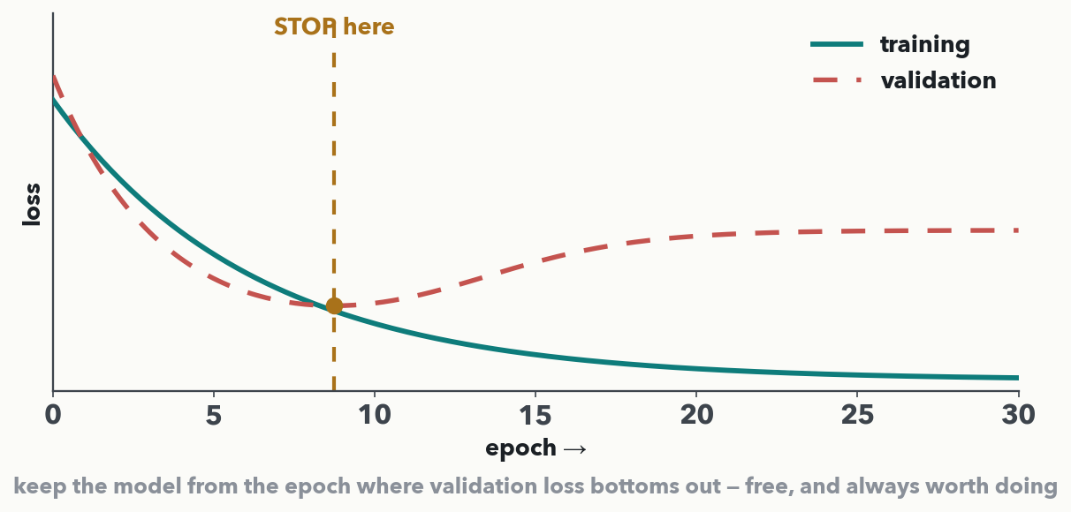
PART 3 · OVERFITTING · FIXES 1 & 2
More data · and early stopping
More (and more VARIED) data is the strongest fix — harder to memorize, easier to find the real pattern; spectra from several instruments beats many from one. Early stopping: watch validation loss and keep the model from its lowest point, before it turns back up. Free, and always worth doing.
Notes:
Two fixes, one slide. More data first because it is the most reliable and the least clever: a bigger, more diverse training set is simply harder to memorize, so the network is pushed toward the genuine pattern; emphasize DIVERSE — for spectra, data from several instruments/sites directly attacks the "memorized one machine" failure. When you cannot get more real data, augmentation (Lab 2) and transfer learning (Lecture 8) are cousins of "more data." Then early stopping, read straight off the curve: validation loss falls, bottoms out, and starts rising as overfitting sets in; the vertical amber line marks that bottom, and early stopping simply keeps the model from that best epoch and quits. It costs nothing, needs only a validation split you already have, and is standard practice. Bridge: the next two fixes actively handicap the network so it can't memorize — dropout and weight decay.

Slide 31
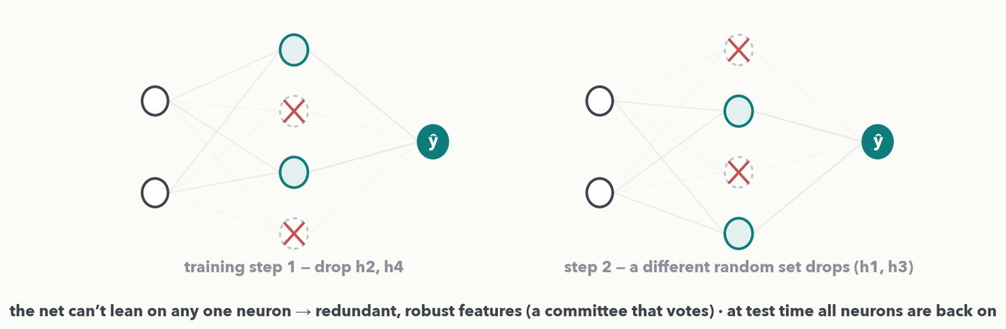
PART 3 · OVERFITTING · FIX 3 · REGULARIZATION
Dropout: randomly switch off neurons each step
On every training step, dropout zeroes a random ~half of the hidden neurons — and a DIFFERENT set each step. The net can't lean on any one neuron, so it builds redundant, robust features (like a committee that votes). At test time all neurons are back on. One line in PyTorch: nn.Dropout(0.5).
Notes:
Visualize it with the two panels — same network, two training steps, a different random ~half of the hidden neurons switched off (dashed, X'd out) each time. The mechanism: on every training step dropout randomly picks some fraction of neurons (say 50%) and temporarily zeroes them, so the network must predict without them; because which neurons vanish changes every step, no single neuron can become a linchpin that memorizes a training quirk, and the work spreads across many redundant features. The intuition to say aloud: it is like training a huge committee of smaller sub-networks that share weights, then letting them vote — averaging many views generalizes better than trusting one. Two practical notes: dropout is only ON during training; at test time every neuron is active (outputs scaled so the math balances), so inference is deterministic. And it is one line — nn.Dropout(0.5); typical rates 0.2–0.5. Fix four, weight decay, is next.

Slide 32
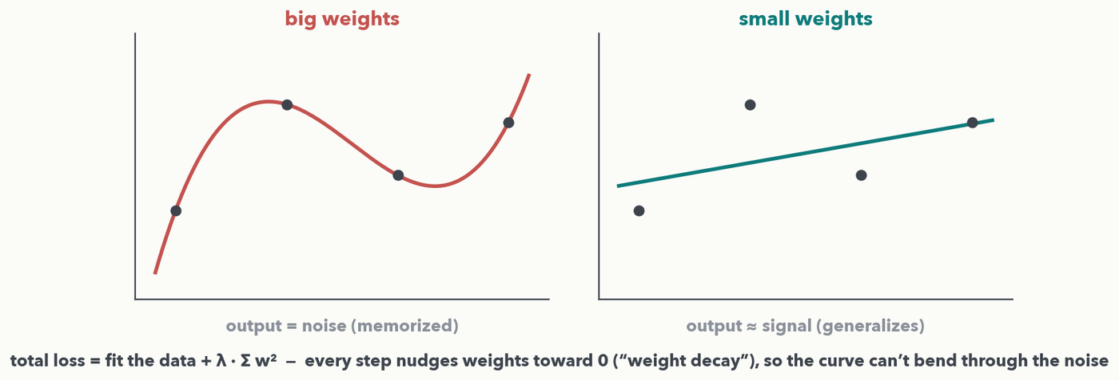
PART 3 · OVERFITTING · FIX 4 · REGULARIZATION
L2 regularization = weight decay
Big weights let the curve bend sharply enough to thread every noisy point — the output becomes the noise. Add λ·Σw² to the loss so every step also nudges weights toward 0 ('weight decay'): the curve can only track the trend. A spectra net then spreads reliance across many m/z channels instead of pinning one huge weight on a fluke.
Notes:
Frame L2 as weight decay. The idea: add a second term to the loss that grows with the size of the weights (the sum of the squared weights, scaled by a small knob λ). Now minimizing the loss means two things at once — fit the training data AND keep the weights small — and they trade off. Why smaller weights help, made explicit: the SAME four noisy dots sit in both panels. A network with huge weights has enough "bend" to route its curve through every dot exactly — at that point the output no longer represents the signal, it IS the noise, memorized point for point (the red curve: zero training error, useless on a new sample with different noise). Forcing weights to stay modest removes that bending power, so the curve can only track the broad trend (the teal curve) — it ignores the noise and generalizes. The nickname "weight decay" comes from the mechanics: on top of the normal gradient step, every weight is nudged a little toward zero each update, so unused weights quietly decay away. λ is just "how hard we pull toward zero"; in PyTorch it is the weight_decay argument on the optimizer. Round out: dropout and weight decay are the two everyday regularizers — use them with early stopping and enough data.

Slide 33
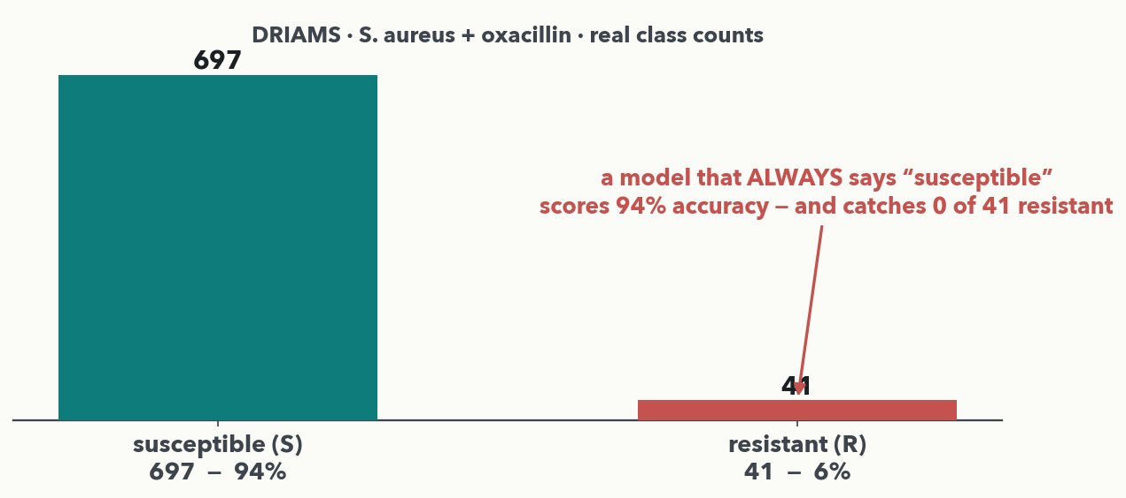
PART 3 · FORESHADOW · A RARE BUT CRITICAL CLASS (PAIR = Q5)
Another type of “Overfitting”: Data Imbalance
PAIR · Pair → Quiz 4, Q5. DRIAMS S. aureus + oxacillin: 41 R among 738; a classifier reports 94% accuracy. (a) Why is 94% misleading, and what would you look at instead? (b) You CAN'T collect more R this cycle — of oversample-R / undersample-S / class-weight / lower-threshold, which help, and what can NONE of them fix? Worked answer in the notes.
Notes:
PAIR = Quiz 4 Q5 — a real clinical problem we can't teach fully now (it returns in Lecture 10). REAL DRIAMS slice: 697 susceptible vs. 41 resistant (~6%) — the Lab 2 data. (a) A model that ALWAYS predicts "susceptible" scores ~94% while catching ZERO of the 41 resistant isolates — with a rare class, overall accuracy is dominated by the majority and hides total failure on the cases that matter; look INSTEAD at class-specific measures: sensitivity/recall on R, precision, the confusion matrix, a precision–recall curve / PR-AUC. (b) The constrained-decision half (this is the real thinking): oversampling R, undersampling S, class-weighting the loss, and lowering the decision threshold all legitimately shift the model's attention toward the 41 resistant cases — so all four "help." The catch they must name: NONE of them adds new resistant SIGNAL — every one reuses the same 41 examples — so the real ceiling still needs more/varied R data (more isolates, other sites). That reweighting ≠ new information insight is the point, and it seeds Lecture 10. Give two minutes, harvest a couple; don't expect one right answer.

Slide 34
LECTURE 4 · FULL CIRCLE — AND OVER TO YOUR LAB
The through-line: fit the data, don't memorize it
• The right loss scores the right thing; the knobs make training converge
• The gap between training and validation loss tells you if it generalizes
• Regularization (dropout, weight decay, early stopping, more data) shrinks that gap
• Next: Lecture 5 gives deep nets a gradient highway (ResNet) and reads spectra with CNNs; Lab 2 puts all of today on real DRIAMS data
Everything today serves one idea: fit the data + don't memorize it. If you can read a validation curve and name a fix, you can do every item on Quiz 4.
Notes:
Close the hour. Tie the three parts into one through-line: the right loss scores the right thing (Part 1), the knobs make training actually converge (Part 2), and reading the training-vs-validation gap tells you whether the model generalizes, with regularization to shrink that gap (Part 3). Vanishing gradients set up Lecture 5's ResNet skip connection — the "gradient highway" — and the CNNs that read spectra directly; Lab 2 puts all of today to work on real DRIAMS resistance data, including the class- imbalance problem from Q5. Then a ten-minute break before Lecture 5.

