Slide 1
MSACL · DS301 DEEP LEARNING · SEGMENT 4 · LECTURE 10
No perfect data: evaluation and treatment
When one class is rare — measure it with precision/recall & AUPRC, then treat it with curation, SMOTE, focal loss, and curriculum
Notes:
Monday afternoon, hour one of Segment 4 — the pivot from "how networks work" to "how to use one honestly on YOUR assay." One theme all hour: IMBALANCED DATA, the everyday reality of clinical mass spec — a handful of resistant isolates against hundreds of susceptible ones, a few bad runs against thousands of good. It breaks in two directions, and we take each deeply rather than gloss five topics. PART A — MEASURE it right: accuracy lies under imbalance, so compute precision, recall (= sensitivity), and specificity by hand, and see why AUROC looks flattering while AUPRC tells the truth. PART B — TREAT it: curation, SMOTE, class weights / focal loss, and curriculum learning, each matched to a situation, with one honest caveat — none of them manufactures new signal. The assessment is the distributed QUIZ 10: hand it out blank now; we fill it across the hour and finish with a quick pair debrief. Every worked example (I-do) is followed by a "your turn" that points at a Quiz 10 question — the same distributed spine as every lecture.

Slide 2
LECTURE 10 · WHERE THIS HOUR GOES
One problem, two halves
• PART A — Measure it: the accuracy trap, then precision / recall / specificity by hand · 11 min
• Build the ROC and PR curves from a threshold sweep — AUROC, AUPRC, and why AUROC flatters · 16 min
• A metric is only valid on the distribution you tested — external + temporal validation · 4 min
• PART B — Treat it: curation + dedup, augmentation, class weights, SMOTE, focal loss, curriculum · 29 min
• Quiz 10 (imbalanced-data evaluation + treatment) — filled across the hour, debriefed in pairs · 4 min
Notes:
Signpost the two halves. The whole hour lives on the real DRIAMS S. aureus + oxacillin split from Lab 2 — 697 susceptible, 41 resistant — so every number is a mass-spec number. Part A is the evaluation half: the only arithmetic is one confusion matrix by hand, which most of you already know from assay validation, plus reading two curves. Part B is the treatment half, and every move on it is now taught to depth with its own worked figure: curation (the pass on our 738) and its second half, DEDUPLICATION IN EMBEDDING SPACE (a cosine do-it-together); class weights (9.00 vs 0.53); SMOTE, worked in feature space AND shown as real spectra so the non-physical caveat is visible; focal loss, read off the whole FL curve for γ = 0/1/2/5, not just two points; and curriculum, given as an actual 20-epoch SCHEDULE with the two curves it anneals. Pace: a hands-on beat about every 8-10 minutes. TIMING CHANGE (2026-09-10): Part B goes 22 → 25 min to carry the new depth, paid for one minute at a time by the Part A opener (12 → 11), the validation slide (5 → 4) and the closing debrief (5 → 4) — the quiz is filled across the hour anyway, so the last block is only the pair debrief and collection. If you are running long, the two curve-reading beats (focal γ family, curriculum outcome) are the ones to compress: the numbers beside them carry the point on their own.

Slide 3
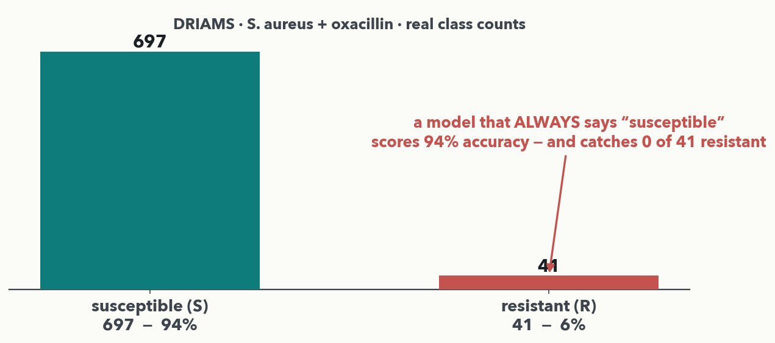
PART A · THE ACCURACY TRAP · HOOK
The 94%-accurate detector that never fires
MASS SPEC · Real DRIAMS counts: 697 susceptible vs. 41 resistant. A model that ALWAYS says 'susceptible' scores 697/738 = 94% accuracy — and catches ZERO of the 41 resistant. High accuracy, clinically useless. Under imbalance, accuracy measures the majority class, not the thing you care about.
Notes:
Open with the trap, on REAL data (rule 2). These are the actual DRIAMS S. aureus + oxacillin class counts from Lab 2's dataset: 697 susceptible, 41 resistant — about 6% positive (41/738 = 0.056). A lazy model that always predicts the majority class ("susceptible") is right 697/738 = 94% of the time and yet never flags a single resistant isolate — the exact failure that would let a resistant infection go untreated. The point to land hard: when one class is rare, ACCURACY is dominated by the common class and tells you almost nothing about whether you catch the rare, important one. So we need metrics that look at the rare class directly — precision, recall, and specificity — computed next. (Same imbalance figure introduced in Lecture 4's class-imbalance discussion, now the launch point for the metrics we actually compute.)

Slide 4
Evaluation metrics in plain language
PART A · THE METRICS IN PLAIN LANGUAGE
Precision: how many correct positive predictions out of all predictions for a specific class?
Recall (Sensitivity): how many correct positive predictions out of all positives?
Specificity: how many correct negative predictions out of all negatives?
False positive rate (FPR): how many negatives wrongly flagged as positive out of all negatives? FPR = 1 − specificity.
  e.g. 60 of 697 susceptible isolates flagged resistant → FPR = 60/697 = 8.6% (and specificity = 637/697 = 91.4%: the two always add to 100%)

Slide 5
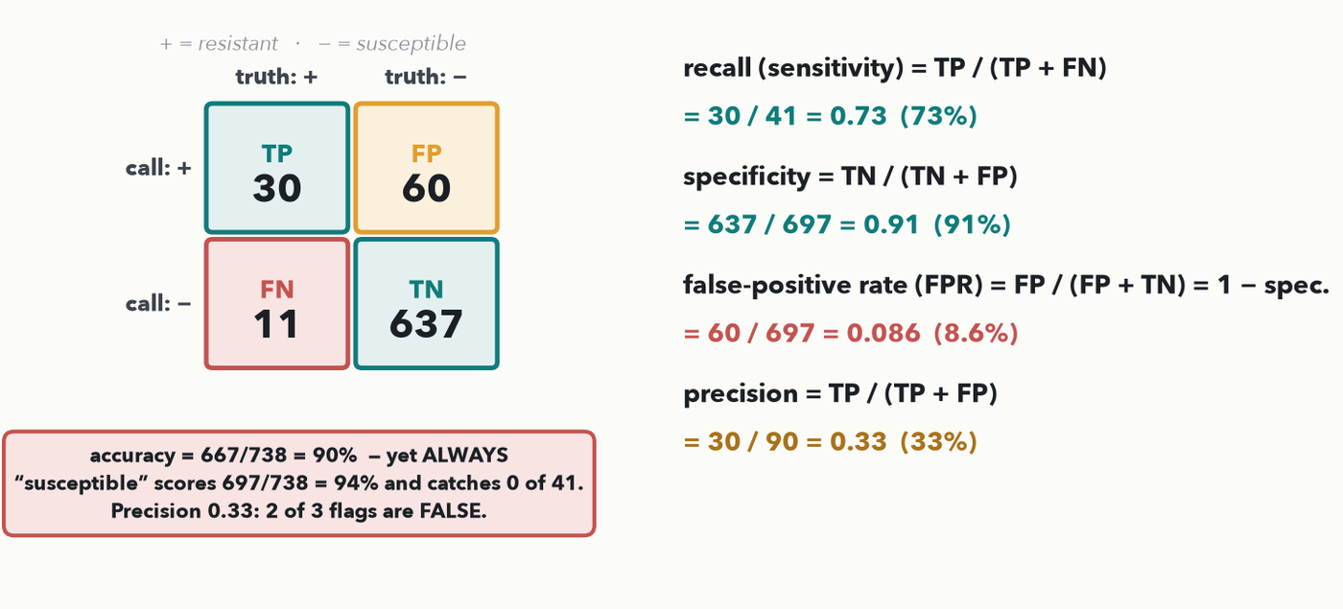
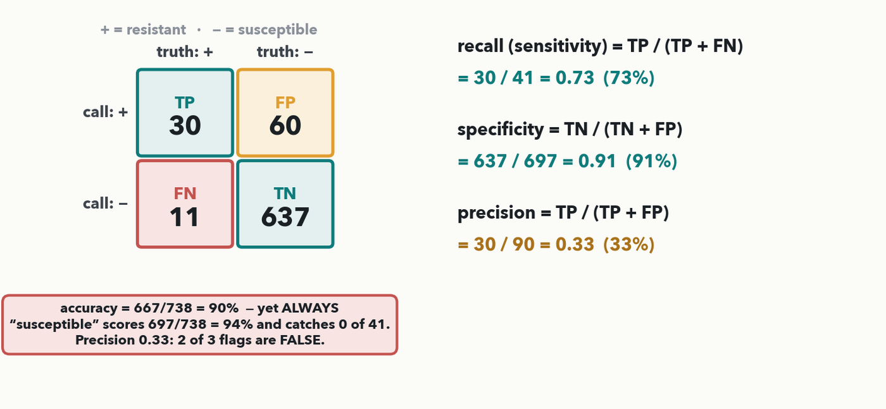
PART A · FOUR RATES BY HAND · I-DO
Recall, specificity, FPR, precision — by hand
MASS SPEC · recall 30/41 = 0.73 · specificity 637/697 = 0.91 · FPR 60/697 = 0.086 (= 1 − specificity) · precision 30/90 = 0.33 — the four formulas are in the figure. Accuracy = 667/738 = 90% — yet ALWAYS-'susceptible' scores 94%. Precision 0.33 means 2 of every 3 isolates we flag are FALSE alarms.
Notes:
I-DO, the one numeric mechanic of Part A, and the four formulas the quiz needs ON THE DECK before it is asked (rule 3). Read the confusion matrix: rows are the model's CALL (+ / −), columns the TRUTH (+ = resistant, − = susceptible). TP = 30 resistant correctly caught, FN = 11 resistant MISSED, FP = 60 susceptible wrongly flagged, TN = 637 susceptible correctly cleared (the 41 R and 697 S of DRIAMS). Four rates: RECALL / SENSITIVITY = TP/(TP+FN) = 30/(30+11) = 30/41 = 0.73 — we catch about three of every four resistant isolates and MISS one in four. SPECIFICITY = TN/(TN+FP) = 637/(637+60) = 637/697 = 0.91 — we correctly clear 91% of susceptibles. FALSE-POSITIVE RATE (FPR) = FP/(FP+TN) = 60/(60+637) = 60/697 = 0.086 — the share of susceptibles we wrongly flag, 8.6%; it is always exactly 1 − specificity (0.086 + 0.914 = 1), and it is the x-axis of the ROC curve three slides on, so define it now. PRECISION = TP/(TP+FP) = 30/(30+60) = 30/90 = 0.33 — of every three isolates we FLAG as resistant, only one truly is. Precision is the new rate this hour (Lecture 4 had only sens/spec): with a rare positive, even a modest false-positive count (60) swamps the true positives (30). And the trap made exact: accuracy = (30+637)/738 = 667/738 = 90%, but always-"susceptible" scores 697/738 = 94% — HIGHER accuracy, zero sensitivity. Every number is exact and matches the Quiz 10 Q1 key. Next slide the room computes all four on a fresh matrix.

Slide 6
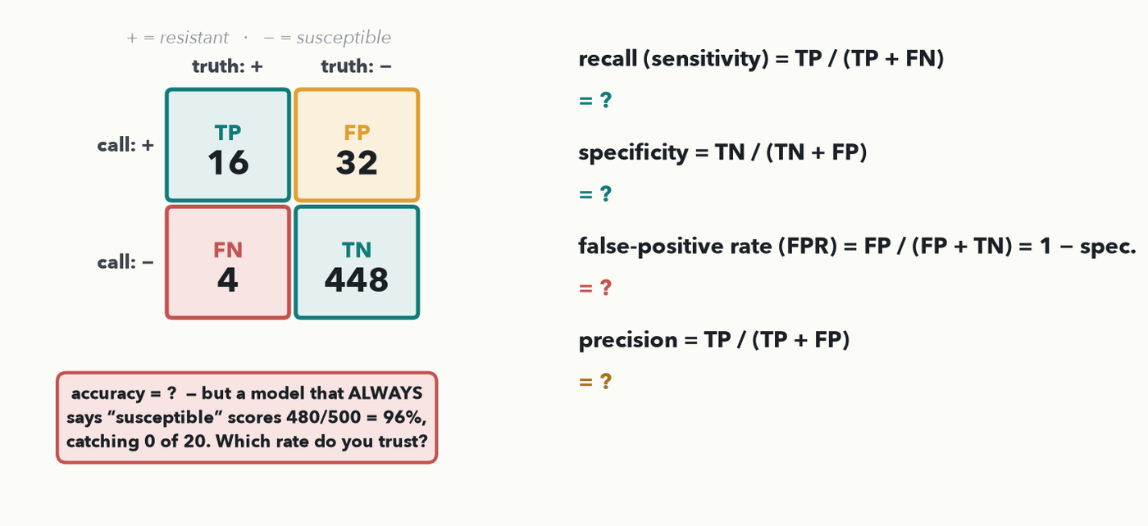
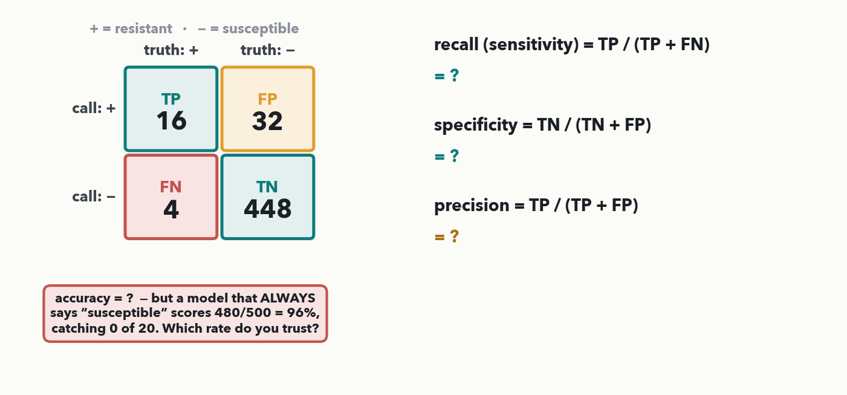
PART A · YOUR TURN (YOU-DO = Q1)
Your matrix — compute all four rates
CHECKPOINT · Your turn → Quiz 10, Q1. Same four formulas, new counts: TP=16, FN=4, FP=32, TN=448. Compute recall, specificity, FPR and precision — then say which rate you trust under this heavy imbalance, and why accuracy (which an always-'susceptible' model scores 96%) is misleading. Worked answer in the notes.
Notes:
YOU-DO = Quiz 10 Q1 (same four formulas, new numbers). A rapid resistance screen on 500 isolates, positive = resistant: TP = 16, FN = 4, FP = 32, TN = 448 (20 R / 480 S). RECALL = TP/(TP+FN) = 16/(16+4) = 16/20 = 0.80 (80%). SPECIFICITY = TN/(TN+FP) = 448/(448+32) = 448/480 = 0.93 (93%). FPR = FP/(FP+TN) = 32/(32+448) = 32/480 = 0.067 (6.7%) — exactly 1 − specificity, and the ROC x-coordinate the room reuses in Q2(a). PRECISION = TP/(TP+FP) = 16/(16+32) = 16/48 = 0.33 (33%). Accuracy = (16+448)/500 = 464/500 = 93%, yet an always-"susceptible" model scores 480/500 = 96% and catches 0 of 20 resistant. Which rate to trust? RECALL (sensitivity) — the lab must not miss resistant isolates — reported with PRECISION, because precision 0.33 warns that two-thirds of the flags are false and someone must confirm them. Never accuracy alone. Every value is identical to the Quiz 10 Q1 key. Take the four numbers from the floor, then have them fill Q1.

Slide 7
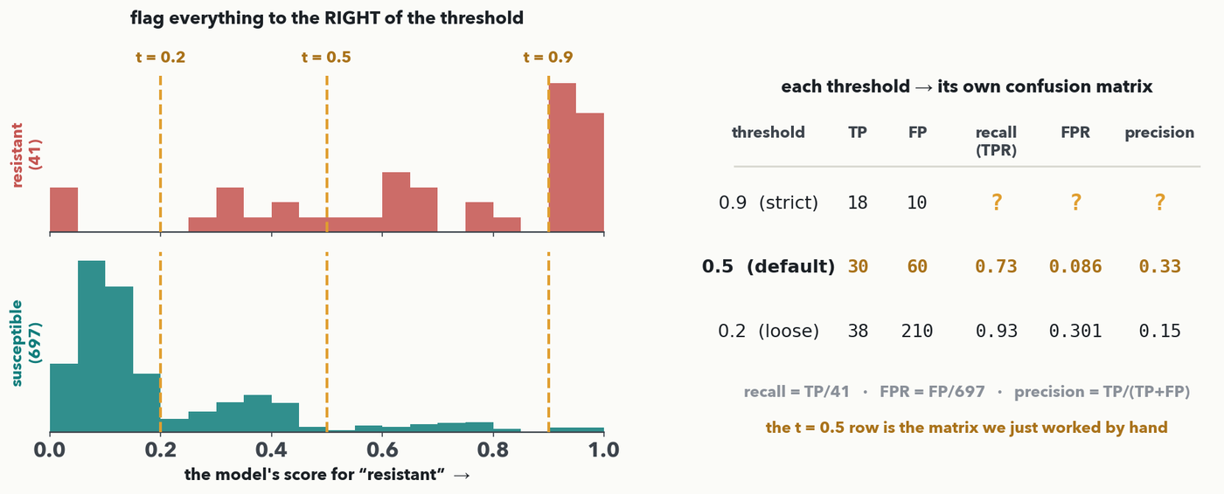
PART A · FROM ONE POINT TO A CURVE · DO-IT-TOGETHER
One model, many operating points
CHECKPOINT · A network never says “resistant” — it outputs a SCORE, and YOU pick the threshold that turns it into a call. Move the threshold and every count moves: strict (t = 0.9) catches 18 of 41 with 10 false alarms; loose (t = 0.2) catches 38 but flags 210. Do-it-together: fill the t = 0.9 row — recall, FPR, precision.
Notes:
The missing step before any curve: a classifier is not one operating point. The network's output layer gives a SCORE between 0 and 1 (the softmax from Lecture 4), and a human — you — decides where to cut. The two histograms are the DRIAMS scores: 41 resistant on top, 697 susceptible below; a good model pushes them apart, but they overlap, which is why the threshold is a judgement call and not a detail. Read the three dashed lines: at t = 0.9 we only flag what the model is sure about — 18 of the 41 resistant, and just 10 false alarms; at t = 0.5 (the matrix we worked by hand) 30 and 60; at t = 0.2 we cast the net wide — 38 of 41 caught, but 210 susceptibles flagged. DO-IT-TOGETHER: fill the t = 0.9 row on screen with the room, using the three formulas already on the deck — recall = 18/41 = 0.44; FPR = 10/697 = 0.014; precision = 18/28 = 0.64. Land the trade-off out loud: raising the threshold buys precision and loses recall; lowering it does the reverse. You cannot report one operating point and call it performance — which is exactly why we plot all of them, next slide. (The same threshold dial the room already met on Lecture 5's peak-detection slide, and the one Lab 4 turns for anomaly scores.)

Slide 8
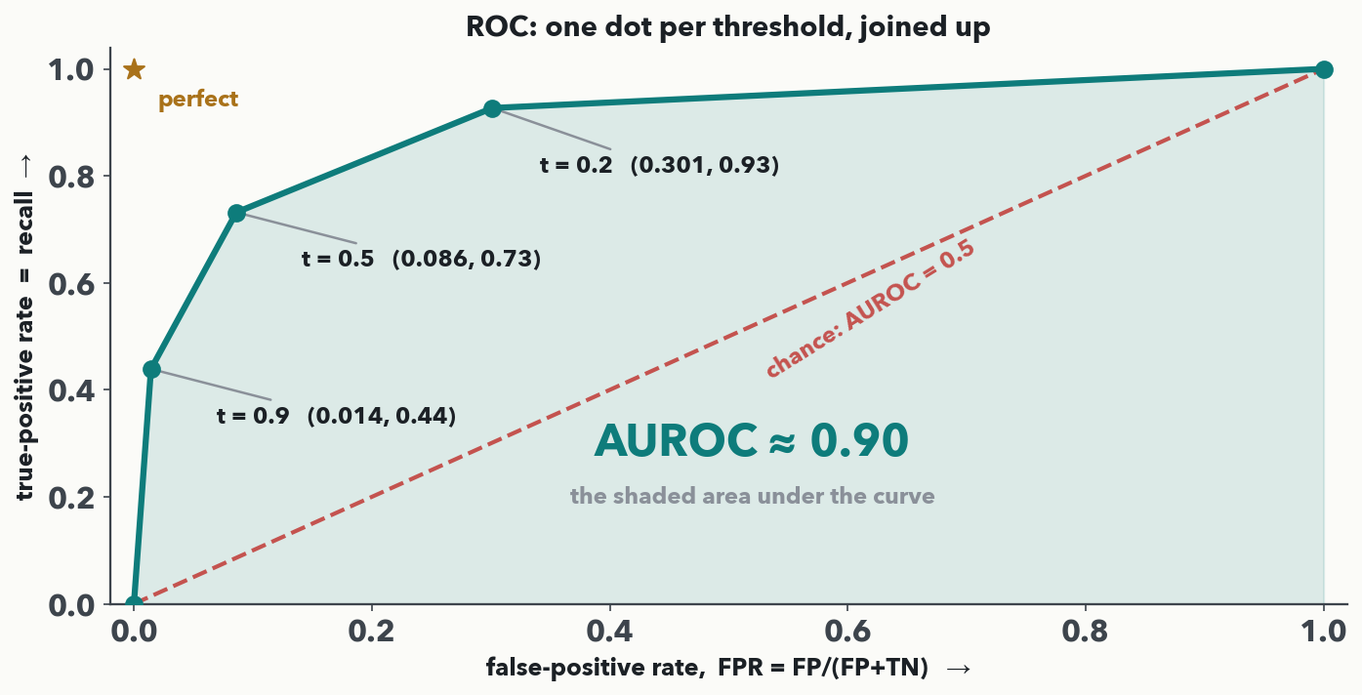
PART A · THE ROC CURVE · I-DO
ROC: plot every threshold, then take the area
Each threshold gives one dot — (FPR, recall). Join the dots and that is the ROC curve; AUROC is literally the shaded area under it. A perfect model reaches the top-left corner (AUROC 1.0); a coin flip is the diagonal (0.5). Ours is ≈ 0.90 — one number that summarises every threshold at once, which is why papers quote it.
Notes:
I-DO: build the curve in front of them from the table they just filled. Take each threshold's row and plot ONE dot — the false-positive rate FPR = FP/(FP+TN) across, the true-positive rate (recall) up: t = 0.9 → (0.014, 0.44); t = 0.5 → (0.086, 0.73); t = 0.2 → (0.301, 0.93). Add the two ends every ROC has for free: flag nothing → (0, 0), flag everything → (1, 1). Join them and you have the RECEIVER OPERATING CHARACTERISTIC — the name is wartime radar, ignore it. AUROC is then exactly what it says: the AREA under that curve, here ≈ 0.90 by adding up the trapezoids. Two anchors to fix the scale: the top-left corner is the perfect classifier (catch everything, no false alarms) so its area is 1.0; the diagonal is a coin flip, area 0.5 — anything below 0.5 means the model is worse than guessing. One plain-English reading worth giving: AUROC is the chance that a randomly chosen resistant isolate scores higher than a randomly chosen susceptible one. The virtue is that it needs no threshold — it is the whole sweep in one number. Hold the applause: the next slide plots the SAME sweep as precision vs. recall, and the two numbers do not agree.

Slide 9
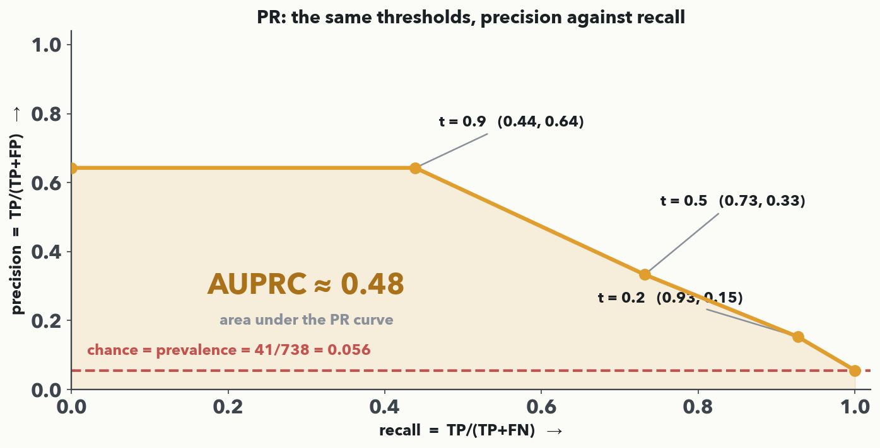
PART A · THE PR CURVE · I-DO
PR: the same sweep — and a moving baseline
The same three dots, now precision (up) against recall (across); AUPRC is the area under THIS curve, ≈ 0.48 for the same model. The difference that matters: ROC's chance line is always 0.5, but PR's chance line is the PREVALENCE — 41/738 = 0.056 — so AUPRC is scored against how rare your positive actually is.
Notes:
I-DO, same sweep, second picture. Re-plot each threshold as (recall, precision): t = 0.9 → (0.44, 0.64); t = 0.5 → (0.73, 0.33); t = 0.2 → (0.93, 0.15). Note the shape: precision FALLS as recall rises, because every extra resistant isolate you catch costs you a pile of false alarms — that downhill slope IS the trade-off, drawn. AUPRC is the area under it, ≈ 0.48 here. Now the point of the whole slide, and say it slowly: the chance line is NOT 0.5. A coin-flip model that flags a random fraction of isolates has precision equal to the prevalence, 41/738 = 0.056, so the PR baseline sits on the floor at 0.056 and moves with your class balance — make the positive rarer and the bar drops. Two consequences: (1) an AUPRC of 0.48 against a 0.056 floor is a genuinely good model, about eight times chance, even though it sounds worse than the AUROC of 0.90; (2) you cannot compare AUPRC across datasets with different prevalence, whereas AUROC is invariant to it — which sounds like a virtue and is exactly the trap the next slide springs. Check the right-hand end with them: at recall 1.0 we flag everything, so precision equals the prevalence — the curve lands on its own baseline.

Slide 10
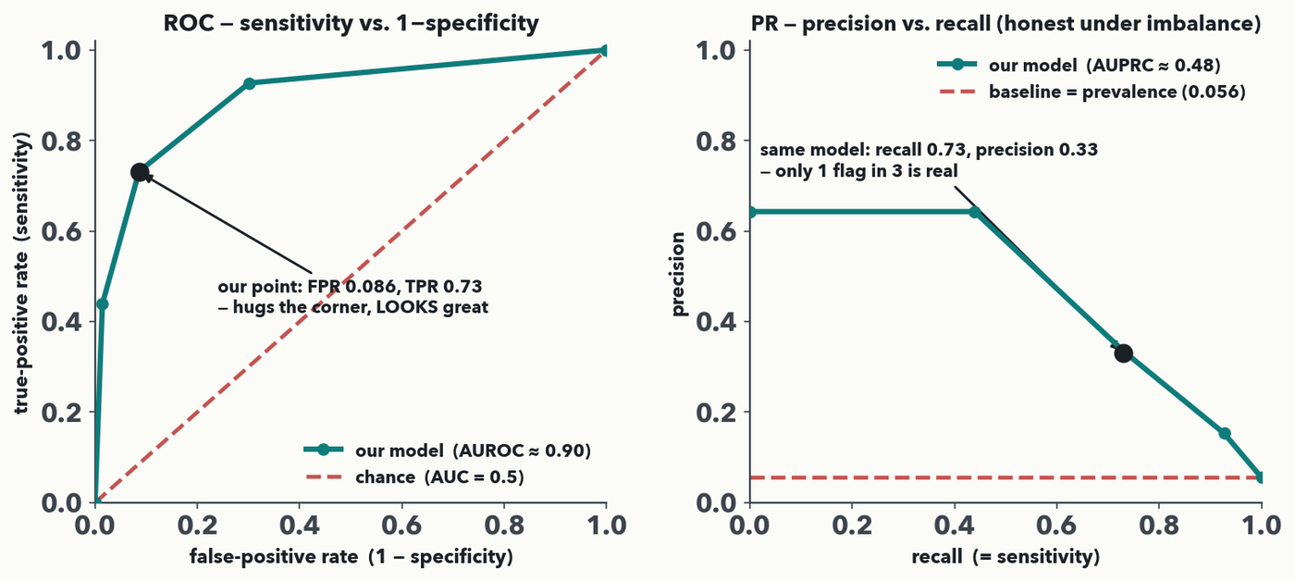
PART A · WHY AUROC FLATTERS · I-DO
AUROC looks great — the same model's precision is 0.33
MASS SPEC · One classifier, two pictures, one sweep. The ROC hugs the corner and AUROC ≈ 0.90 looks excellent — 60 false alarms among 697 negatives is only an 8.6% FPR. The SAME model's PR curve gives AUPRC ≈ 0.48, and at t = 0.5 just 1 flag in 3 is real. AUROC ignores the class ratio; AUPRC is measured against the 0.056 prevalence floor.
Notes:
The payoff of Part A — a comparison now, not an introduction, because the room has just built both curves from the same threshold sweep. Put them side by side and read the two areas: AUROC ≈ 0.90 against AUPRC ≈ 0.48, same model, same sweep, and the t = 0.5 point marked on both. ROC plots sensitivity (TPR 0.73) against 1−specificity (FPR = FP/(FP+TN) = 60/697 = 0.086). That point (0.086, 0.73) hugs the top-left corner, so the ROC — and its area, AUROC — looks excellent. WHY IT LIES: there are 697 negatives, so even 60 false alarms are only 8.6% of them; the false-positive RATE stays tiny no matter how many false flags we raise. AUROC is invariant to the class ratio. The PR curve plots the SAME model's precision (0.33) against recall (0.73): only one flag in three is a real resistant isolate. The PR chance baseline is the prevalence itself (41/738 = 0.056), not 0.5, so AUPRC collapses toward that floor and stays honest and unforgiving. The rule (Saito & Rehmsmeier 2015): under imbalance, report the PR curve / AUPRC with sensitivity, never AUROC or accuracy alone. Next slide the room decides which to trust on its own screen.

Slide 11
PART A · YOUR TURN (YOU-DO = Q2)
Your turn — AUROC or AUPRC for this screen?
Same screen: TP = 16 FN = 4 FP = 32 TN = 448 · rare positives: 20 of 500 = 4% prevalence
FPR = FP / (FP + TN) TPR = recall = TP / (TP + FN) precision = TP / (TP + FP)
the PR curve’s chance baseline sits at the prevalence (ROC’s sits at 0.5)
(a) ROC point: FPR = 32 / (32 + 448) = ________ TPR (recall) = ________ — does it hug the top-left corner? ________
(b) PR point: recall = ________ precision = ________ chance baseline = prevalence = ________
(c) To report this screen across ALL thresholds, would you trust the AUROC or the AUPRC (PR curve) — and why?
CHECKPOINT · Your turn → Quiz 10, Q2. Same screen, 4% prevalence. Place its one operating point on the ROC and on the PR curve, then decide which area to report across all thresholds — and why. Worked answer in the notes.
Notes:
YOU-DO = Quiz 10 Q2, straight after 'why AUROC flatters'. The formulas it needs are restated on the slide. Worked answer: (a) FPR = 32/(32+448) = 32/480 = 0.067; TPR = 0.80 — the point (0.067, 0.80) hugs the top-left, so the ROC/AUROC looks excellent. (b) PR point =(recall 0.80, precision 0.33); PR baseline = prevalence = 20/500 = 0.04 (ROC's baseline is 0.5). (c) Trust the AUPRC / PR curve (reported with recall). At 4% prevalence the 480 true-negatives dominate, so a tiny FPR keeps AUROC flatteringly high even though precision is only 0.33 (2 of 3 flags false). AUROC is invariant to the class ratio; AUPRC collapses toward the prevalence, so it stays honest as recall grows (Saito & Rehmsmeier 2015).

Slide 12
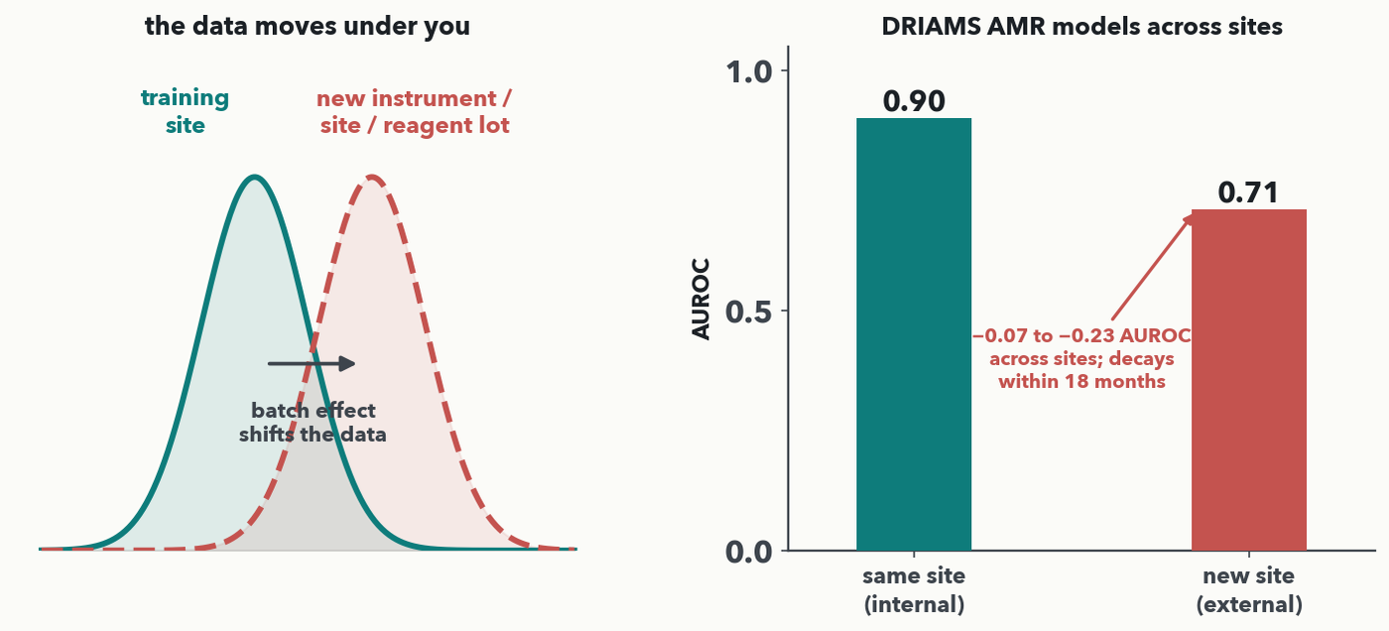
PART A · ONE HONESTY NOTE (NO QUIZ ITEM)
A metric is only valid on the data you tested
MASS SPEC · Even a good PR curve is only a promise about the distribution you validated on. A new instrument, site, or reagent lot SHIFTS the data (left). Real tale (right): DRIAMS-trained resistance models lose 0.07–0.23 AUROC on a new site and decay within 18 months. So validate EXTERNALLY (new site/instrument) and TEMPORALLY (later runs), and split by patient/isolate — never by spectrum.
Notes:
One folded-in honesty slide (no you-do — it frames the whole hour, not a compute). Your beautiful precision/recall numbers are a promise about ONE distribution: the data you tested on. Change the distribution and they can collapse silently. BATCH EFFECTS are the everyday culprit — a different MALDI instrument, a new site's prep, a fresh reagent lot — each shifts the data cloud (left panel) though the biology is unchanged. The cautionary tale is the SAME task as Lab 2: DRIAMS-trained antimicrobial-resistance models taken to new specimens lose roughly 0.07–0.23 AUROC across sites, and decay further within about 18 months (right panel; Wiesmann et al., J Clin Microbiol 2025). So internal cross-validation is not enough: validate EXTERNALLY (a held-out site/instrument the model never trained on) and TEMPORALLY (later time periods), and guard against leakage by splitting on patient or isolate, never putting two spectra of the same sample on both sides. Keep this brief — it is the trust guardrail that Part B's treatments must not paper over. Now, on to treating the imbalance itself.

Slide 13
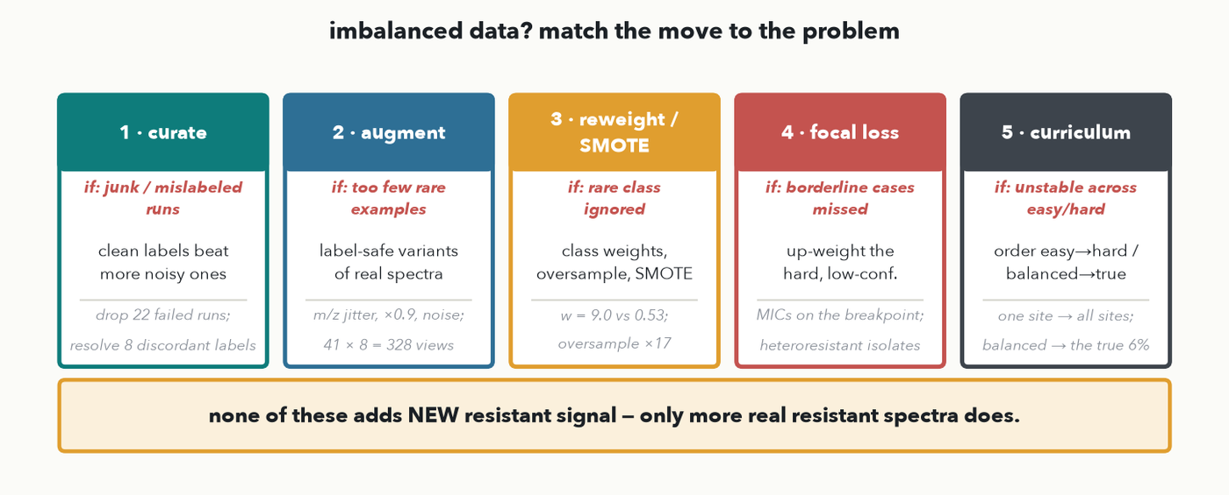
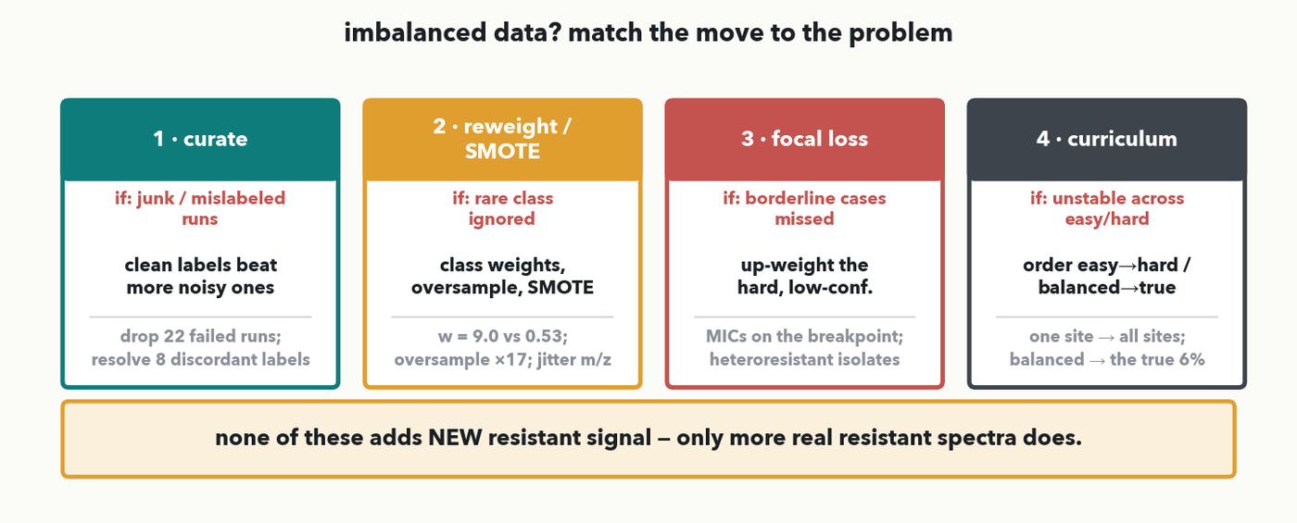
PART B · THE TREATMENT MENU
Treating imbalance — match the move to the problem
MASS SPEC · Five moves, each for a different symptom. CURATE when runs are junk/mislabeled. AUGMENT when rare examples are too few. REWEIGHT / SMOTE / oversample when the rare class is ignored. FOCAL LOSS when borderline cases are missed. CURRICULUM when training is unstable across easy/hard. The honest footer: none of these adds NEW resistant signal — only more real resistant spectra does.
Notes:
The Part-B roadmap as a menu, not a text wall (rule 9). Each move answers a different symptom, and we work the two quantitative ones (SMOTE, focal loss) by hand on the next slides. CURATE: a few hundred clean, correctly-labeled spectra beat thousands of noisy ones — fix mislabels and drop junk runs first. AUGMENT: make more label-safe VIEWS of the rare spectra you have — m/z jitter ±0.1%, intensity ×0.9, baseline + noise, never a left–right flip — so 41 resistant spectra × 8 views = 328 (17:1 becomes ≈ 2.1:1). REWEIGHT / SMOTE / OVERSAMPLE: make the rare class count — class weights multiply its loss, oversampling repeats it, SMOTE synthesizes new minority points. FOCAL LOSS: automatically turn up the hard, low-confidence cases near the boundary. CURRICULUM: order the training diet so early training isn't swamped. And the durable truth in the footer, which the decide beat returns to: every one of these RE-USES the 41 resistant spectra you already have — none manufactures new biological signal. Only collecting more real resistant isolates does that. Read the card that matches your symptom; we compute SMOTE next. Each card now carries a concrete example, and each move gets its own worked slide next — SEVEN of them, in card order: curation (the pass on our own 738 spectra), then curation's second half, deduplication in EMBEDDING space (a cosine do-it-together); augmentation (taught on a picture, then carried over to spectra); the reweighting family (class weights worked, then oversample / undersample / augment); SMOTE (worked in feature space and then shown as real spectra); focal loss (the whole FL curve, γ = 0/1/2/5, plus the two numbers); and curriculum (an actual 20-epoch schedule with its two curves). Every one of the five menu cards is now taught to the same depth.

Slide 14
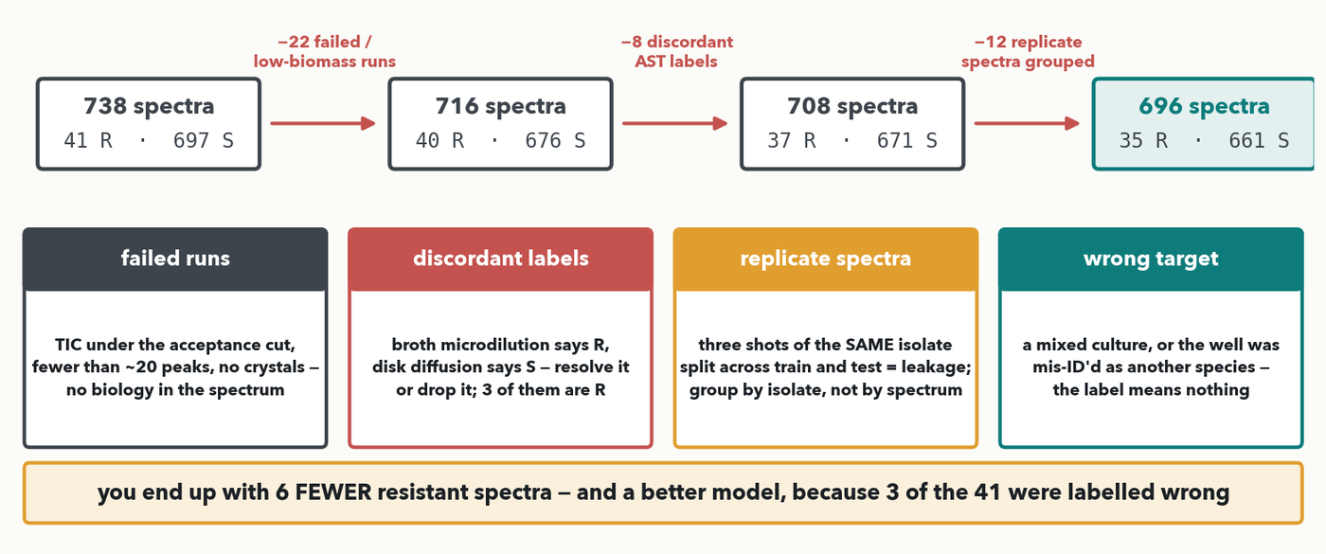
PART B · 1 · CURATION · WHAT IT ACTUALLY LOOKS LIKE
Curate first: fix the labels, drop the junk
MASS SPEC · A curation pass on our own 738 spectra: 22 runs failed acceptance, 8 carry an S/R label the two AST methods disagree on, and 12 are replicate shots of an isolate already in the set (train/test leakage). You finish with 35 resistant instead of 41 — fewer examples, a better model, because 3 of those 41 were labelled wrong.
Notes:
Curation leads the menu because it is the only move that changes the DATA instead of the training, and on a 41-member class it is worth more than everything else combined. Walk the pipeline left to right on our real numbers. Start: 738 spectra, 41 R / 697 S. (1) Drop 22 runs that failed acceptance — total ion current under the cut, barely twenty peaks, no crystal formation; one of them was resistant. (2) Resolve 8 spectra whose S/R label disagrees between broth microdilution and disk diffusion — 3 of those 8 are in the resistant class. (3) Group 12 replicate spectra so the same isolate cannot land in both train and test; that is leakage, and it is the commonest way a clinical ML paper reports a number nobody can reproduce. You end at 696 spectra, 35 R / 661 S. Now the punchline, and say it slowly: you have SIX fewer resistant examples and a BETTER model, because 3 of your 41 were teaching the network the wrong answer — with a class that small, three bad labels is 7% of everything the model knows about resistance. Two more cases worth naming from the cards: a mixed culture or a mis-identified species (the label refers to an organism that isn't in the well), and an MIC sitting exactly on the breakpoint, where one dilution flips the call — flag those, don't silently keep them. One thing this slide asserts but does not yet show: how you FIND those 12 replicates. You cannot eyeball 738 spectra pairwise, and the file names lie — so the next slide does it properly, by deduplicating in EMBEDDING space with a cosine ruler, as a do-it-together. And the ordering rule for the rest of Part B: curate BEFORE you reweight or synthesise, or every later move amplifies the mislabelled spectra.

Slide 15
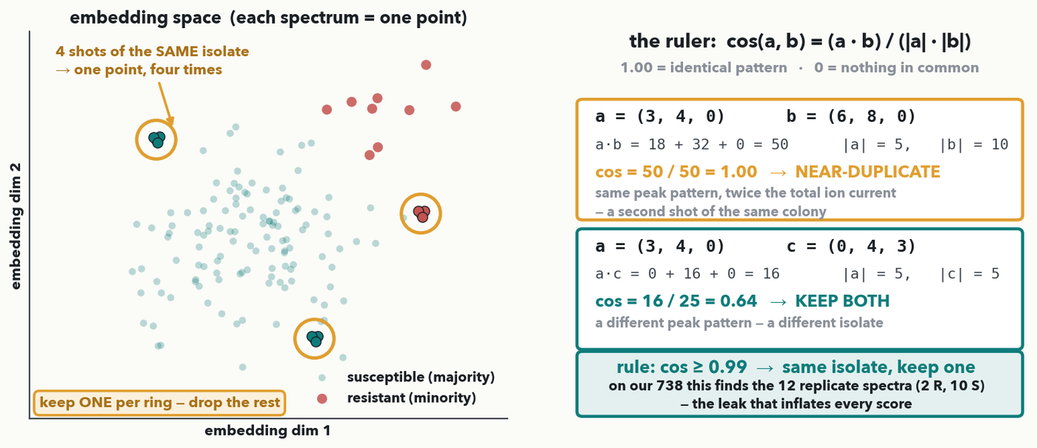
PART B · 1 · CURATION, CONTINUED · DO-IT-TOGETHER
Find the duplicates: dedup in embedding space
CHECKPOINT · How do you FIND 12 replicates among 738 spectra? Push each through the trained CNN — its last hidden layer IS the spectrum's embedding (Lecture 7), so two shots of one isolate land on top of each other. Ruler: cos(a,b) = (a·b)/(|a|·|b|). Together: a=(3,4,0) vs b=(6,8,0) → 50/(5×10) = 1.00, a near-duplicate; a vs c=(0,4,3) → 16/25 = 0.64, keep both. Rule: cos ≥ 0.99 → keep one.
Notes:
DO-IT-TOGETHER, and the second half of curation — the mechanism behind the '−12 replicate spectra grouped' step you just saw. Start with the problem: the previous slide asserted that 12 of our 738 spectra are repeat shots of an isolate already in the set. How would you actually find them in a real project? Not by eye — 738 spectra is 272,000 pairs. Not by file name or isolate ID either, because those are exactly what is unreliable in a merged, multi-site dataset (that is WHY the duplicates are there). So we let the model tell us. STEP 1, THE EMBEDDING. Push every spectrum through the trained CNN and stop one layer early: the activations of that last hidden layer are a short vector — a few hundred numbers instead of 6,000 — and that vector is the spectrum's EMBEDDING. This is Lecture 7's idea exactly ('things become coordinates'), and Lecture 5's feature maps are what produce it: the network has already learned which peak patterns matter, so spectra it considers alike land near each other. Left panel: every dot is one spectrum, and the three amber rings are the giveaway — a tight little knot of points where a single isolate was shot four times. STEP 2, THE RULER, and this is the arithmetic we do together, so work it cell by cell on the board. cos(a, b) = (a·b) / (|a|·|b|) — the dot product from Lecture 7's attention scores, divided by both lengths so only the DIRECTION counts. Take three toy 3-bin spectra. a = (3, 4, 0) and b = (6, 8, 0): the dot product is 3·6 + 4·8 + 0·0 = 18 + 32 + 0 = 50; |a| = √(9+16) = 5; |b| = √(36+64) = 10; so cos = 50 / (5 × 10) = 50/50 = 1.00. Ask the room what that means before you say it: b is exactly twice a, which is the SAME peak pattern at twice the total ion current — a second shot of the same colony, a hotter spot on the plate. Dividing by the lengths is precisely what makes the ruler blind to that intensity difference, and it is why cosine, not raw distance, is the right tool. Now a against c = (0, 4, 3): dot product = 3·0 + 4·4 + 0·3 = 16; |a| = 5, |c| = √(16+9) = 5; cos = 16/25 = 0.64. Different pattern, different isolate — keep both. STEP 3, THE RULE. Set a threshold: cos ≥ 0.99 means the same isolate, so keep one member of each cluster and drop the rest. On our split that is the 12 spectra (2 R, 10 S) from the curation pipeline, which is how the two slides tie together. WHY IT MATTERS, and say this as the payoff: a duplicate that lands in train AND test is leakage — the model has literally seen the test spectrum, so your AUPRC is a fiction. With a 41-member resistant class, two leaked resistant isolates can move the number by several points. This is the commonest way a clinical ML paper reports a score nobody can reproduce. TWO HONEST CAVEATS. (1) The threshold is a judgement call — 0.99 is strict; too low and you throw away genuinely distinct isolates of the same clone. (2) Chicken-and-egg: the embedding comes from a model trained on the un-deduplicated data, so in practice you iterate, or use a generic/pretrained encoder for the first pass. Assessed in Quiz 10 Q3(a), where the situation now names the repeated isolate. Then on to making the rare class count.

Slide 16
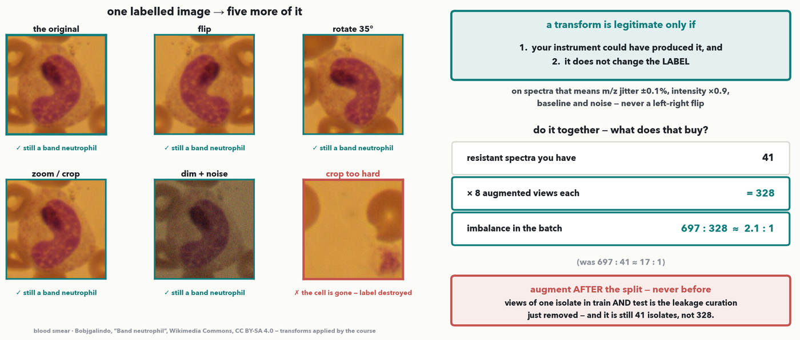
PART B · 2 · AUGMENTATION · DO-IT-TOGETHER
Augment: more views of the data you already have
CHECKPOINT · One labelled image, five more of it — flip, rotate, zoom, dim, add noise; every view is still a band neutrophil. Crop too hard and the cell is gone: the label is destroyed. On spectra the same idea is m/z jitter ±0.1%, intensity ×0.9, baseline and noise. Do-it-together: 41 × 8 views = 328, so 697:41 ≈ 17:1 → 697:328 ≈ 2.1:1 — but augment AFTER the split.
Notes:
NEW (instructor, 2026-09-16; retaught on a PICTURE 2026-09-17). Augmentation used to be three words on the class-weights slide. It sits HERE, straight after curation, because it is the other move that works on the DATA rather than on the training — and because the room needs the validity rule before SMOTE turns up two slides later and breaks it. WHY A MICROSCOPY IMAGE AND NOT A SPECTRUM: augmentation is a visual idea, and a ±0.1% m/z shift is invisible from the back of a room, so the concept is carried by a picture where every transform is unmistakable; the arithmetic underneath is still our real DRIAMS split, so the picture is the bridge and the spectra are the payload. It also happens to be the honest example for this audience: a cell has no canonical orientation, so rotating and flipping a smear genuinely preserves the label in a way that rotating, say, a chest film would not. DO-IT-TOGETHER, ~4 minutes. WALK THE SIX PANELS. Original, then flip, rotate 35°, zoom/crop, and dim + noise — ask the room after each one: is it still a band neutrophil? Yes, every time; the transform changed the pixels and not the truth. Then the sixth panel, and this is the one that teaches the rule: crop too aggressively and the neutrophil is simply outside the frame. Same operation, one step further, and the label is now a lie — you would be training the model to call a field of red cells a neutrophil. THE RULE, top right, and both halves matter: a transform is legitimate only if (1) your instrument could have produced it and (2) it does not change the label. THE TRANSFER, one line, say it explicitly so nobody thinks this is only about images: on spectra the same idea is m/z jitter of about ±0.1% because the mass axis drifts run to run, intensity scaling because ionisation efficiency varies, and added baseline and noise for a poorer acquisition — and never a left-right flip, because a mirrored spectrum is not something any instrument produces. THE ARITHMETIC, done together: 41 resistant spectra, 8 augmented views each, so you train on 41 × 8 = 328. Ask for the new batch imbalance before revealing it — 697 to 328, about 2.1 to 1, against the 697 to 41 ≈ 17 to 1 you started with. That is the biggest single change to effective imbalance in Part B and it costs no new data. THE TRAP, a callback to the slide you just did: augment AFTER the train/test split, never before, or eight views of one isolate scatter across both sides and the model recognises the isolate rather than resistance — the same leakage the embedding-dedup pass removed. THE HONEST FOOTER: still 41 isolates. Augmentation multiplies views, not biology, and your confidence interval is set by the 41. FORWARD POINTER: hold the validity rule, because SMOTE breaks it — a straight-line blend of two real 6000-dim spectra is NOT something an instrument could produce. ASSESSMENT (rule 3): this is the Lab 5 Track A blank — `augment`, an m/z-jitter function whose asserts check that it keeps the shape and changes the values. IMAGE CREDIT is on the figure: Bobjgalindo, 'Band neutrophil', Wikimedia Commons, CC BY-SA 4.0; the six views are produced by the course at build time from that one file.

Slide 17
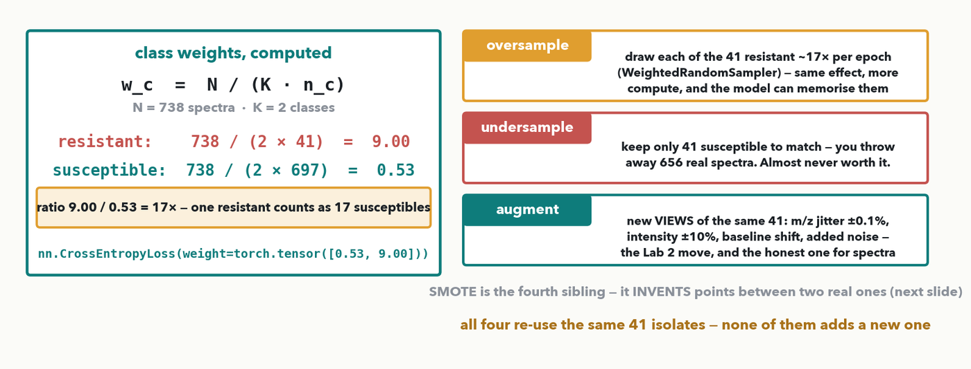
PART B · 3 · MAKE THE RARE CLASS COUNT · DO-IT-TOGETHER
Class weights, oversampling, undersampling
CHECKPOINT · Balanced weights: w = N / (K · n_c). Do-it-together on our split — resistant 738/(2×41) = 9.00, susceptible 738/(2×697) = 0.53; the ratio is exactly the 17:1 imbalance, so one resistant spectrum counts as 17. Oversampling repeats those 41, undersampling throws away 656 real susceptible spectra — and none of it adds a 42nd isolate.
Notes:
The workhorse of the menu and the one they will actually type. THE RULE, which is sklearn's class_weight='balanced' and PyTorch's weight= argument: w_c = N / (K · n_c) — the total, over the number of classes times that class's count. Do it together on the real split: resistant = 738/(2×41) = 9.00; susceptible = 738/(2×697) = 0.53. Ask for the ratio: 9.00/0.53 = 17, which is exactly 697/41 — the formula reproduces the imbalance by construction, so in the loss one resistant spectrum now shouts as loud as 17 susceptible ones. Then the three siblings and what each really means on spectra. OVERSAMPLE: draw each of the 41 about 17 times per epoch (a WeightedRandomSampler); same effect, more compute, and repeating the SAME spectrum invites memorisation. UNDERSAMPLE: cut the majority to 41 — you throw away 656 real spectra, which is almost never the right trade, though it is defensible when the majority is enormous and redundant. AUGMENT: covered on its own slide just before this one — new VIEWS of the 41 you already have, which is the Lab 5 Track A blank, and unlike SMOTE every augmented spectrum is still something an instrument could produce. Refer back to it rather than re-explaining. One warning to give out loud: weighting and oversampling both change the EFFECTIVE prevalence the model sees, so its output probabilities are no longer calibrated to the real 6% — recalibrate before you quote a probability to a clinician. SMOTE is the fourth sibling and gets the next slide because it INVENTS points rather than reusing them.

Slide 18
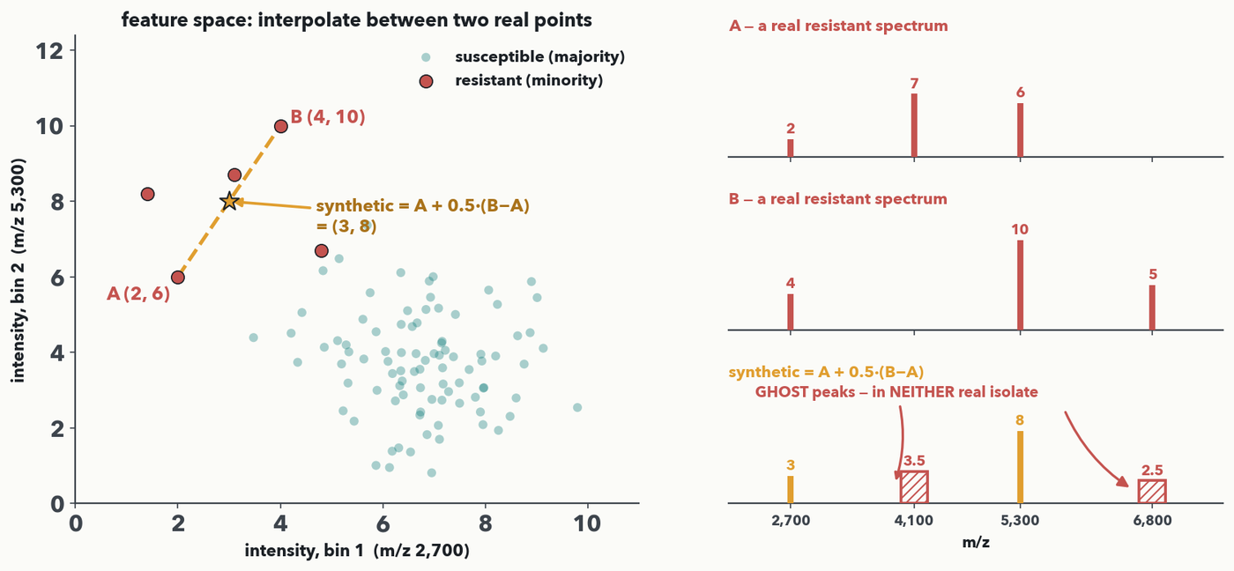
PART B · 4 · SMOTE · DO-IT-TOGETHER
SMOTE: synthesize a new minority point between two real ones
CHECKPOINT · SMOTE fills in the rare class by INTERPOLATING between two real minority points: synthetic = A + λ·(B−A). Do-it-together with two m/z-bin intensities, A = (2, 6) and B = (4, 10), λ = 0.5 → (3, 8). Now the same three points AS SPECTRA (right): the blend carries A's private peak at m/z 4,100 and B's at m/z 6,800 at HALF height — two ghost peaks no real isolate has. That is the caveat, drawn.
Notes:
Do-it-together (guided cell by cell), and the fourth member of the reweighting family from the previous slide — the only one that INVENTS a data point instead of reusing one. SMOTE = Synthetic Minority Over-sampling TEchnique (Chawla et al. 2002): instead of copying rare examples, it MANUFACTURES new ones on the line between two real minority points. Formula on screen: synthetic = A + λ·(B−A), with λ between 0 and 1 sliding the new point along the segment. LEFT PANEL, the arithmetic. Two toy features stand in for two m/z-bin intensities — bin 1 is m/z 2,700, bin 2 is m/z 5,300. A = (2, 6), B = (4, 10). At λ = 0.5, synthetic = (2 + 0.5·(4−2), 6 + 0.5·(10−6)) = (2 + 1, 6 + 2) = (3, 8) — exactly halfway, marked with the star. Do it live: pick λ, compute each coordinate. RIGHT PANEL, the same three points as SPECTRA, which is where the caveat stops being a warning and becomes something they can see. A is a real resistant spectrum: 2 at m/z 2,700, 6 at m/z 5,300, and a peak of 7 at m/z 4,100. B is another real one: 4 and 10 in the same two bins, plus a peak of 5 at m/z 6,800. Blend them at λ = 0.5 and the two shared bins interpolate sensibly — 3 and 8, exactly the toy answer, so the two panels are the same example. But EVERY other bin interpolates too: A's 4,100 peak survives at 0.5 × 7 = 3.5 and B's 6,800 peak at 0.5 × 5 = 2.5. Those are the hatched bars — half-height GHOST peaks belonging to NEITHER isolate. Ask the room what a half-height peak at 4,100 would mean at the bench: a subpopulation? a contaminant? It means nothing — no instrument produced it. Now scale that up: a real spectrum is 6,000-D, so a straight-line blend invents thousands of such peaks. So in practice pair SMOTE with curation and domain augmentation (small m/z shifts, intensity jitter — the Lab 2 move), or simply oversample real spectra. Quiz 10 Q4 asks for λ = 0.25 on the same A and B → (2.5, 7), and its part (b) is exactly this caveat in one sentence; point them at the sheet before moving on to focal loss.

Slide 19
PART B · 4 · SMOTE · YOUR TURN (YOU-DO = Q4)
Your turn — make one SMOTE point
synthetic = A + λ · (B − A)
Two real minority points: A = (2, 6) B = (4, 10) λ = 0.25
(a) synthetic = ( 2 + 0.25·(4 − 2), 6 + 0.25·(10 − 6) ) = ________
(b) One sentence: why is raw-spectrum SMOTE risky in 6,000 dimensions?
CHECKPOINT · Your turn → Quiz 10, Q4. Same formula, new numbers: A = (2, 6), B = (4, 10), λ = 0.25. (a) Compute the synthetic point. (b) Why is raw-spectrum SMOTE risky in 6,000 dimensions? Worked answer in the notes.
Notes:
YOU-DO = Quiz 10 Q4, straight after the SMOTE do-it-together. Worked answer: (a) synthetic = (2 + 0.25·2, 6 + 0.25·4) = (2 + 0.5, 6 + 1) = (2.5, 7) — a quarter of the way from A toward B. (b) A straight-line blend of two real 6,000-dimensional spectra can produce a non-physical spectrum (a peak pattern no instrument would ever record), so pair SMOTE with curation and domain augmentation (m/z jitter), or simply oversample real spectra.

Slide 20
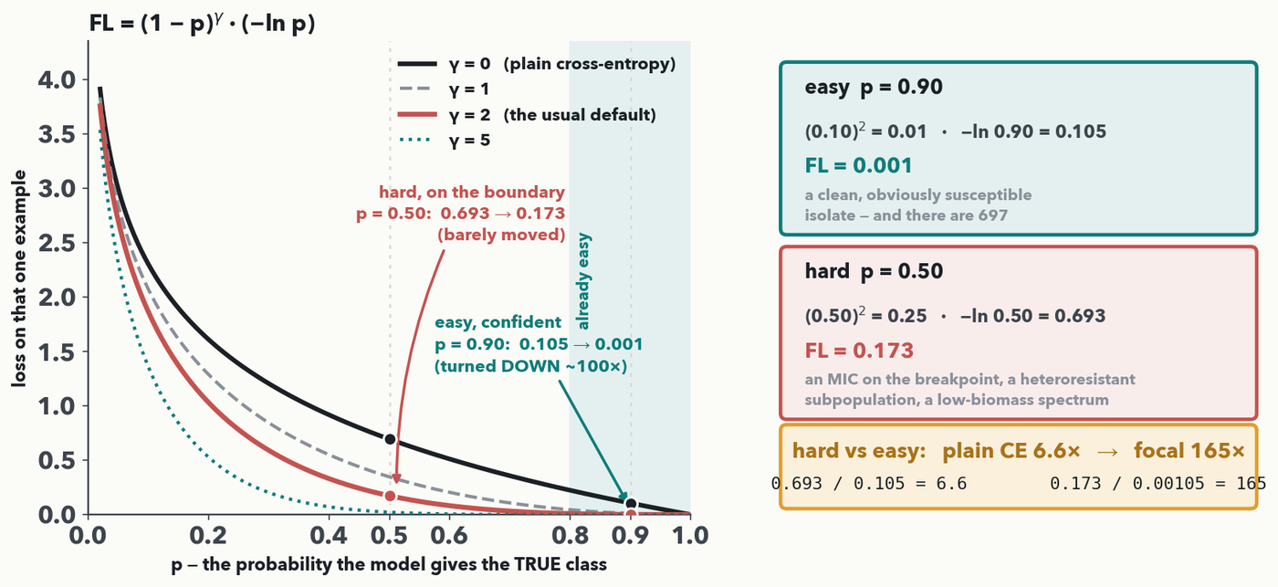
PART B · 5 · FOCAL LOSS · I-DO
Focal loss: turn the volume up on the hard cases
MASS SPEC · Focal loss reshapes the loss so easy, confident cases stop dominating: FL = (1−p)²·(−ln p). Read the CURVE: γ = 0 is plain cross-entropy; raising γ collapses the confident right-hand side and barely touches p = 0.50. Easy p = 0.90 → 0.001 (DOWN ~100×); hard p = 0.50 → 0.173 (barely moved) — so breakpoint MICs and low-biomass spectra count 165× the easy ones, not 6.6×.
Notes:
I-DO with the whole curve AND the numbers (rule 6). Plain cross-entropy is −ln p on the true class; every example counts by how wrong it is, but a sea of easy, already-correct majority examples still adds up and drowns the rare, hard ones. FOCAL LOSS (Lin et al. 2017) multiplies CE by a 'focusing' factor (1 − p)^γ, which shrinks toward zero as the model grows confident (p → 1). READ THE CURVE FIRST, left panel, and let the shape do the teaching. The black curve is γ = 0 — that IS plain cross-entropy, the −ln p from Lecture 2. Now watch what raising γ does: at the left edge (p small, the model badly wrong) every curve is high and they stay close together — focal loss does NOT let go of examples the model is failing. Move right into the shaded 'already easy' band (p > 0.8) and the curves peel apart and collapse to the axis: the confident examples stop contributing almost entirely. That gap between the black and red curves on the right, and their near-agreement at p = 0.5, is the whole mechanism in one picture. γ is a dial: γ = 0 is plain CE, γ = 2 is the usual default (the red curve), γ = 5 is aggressive. THEN THE TWO POINTS, marked on the curve and worked in the right panel. EASY, confident (p = 0.90): plain CE = −ln 0.90 = 0.105; factor = (1 − 0.90)² = (0.10)² = 0.01; FL = 0.01 × 0.105 = 0.00105 ≈ 0.001 — turned DOWN about 100×. HARD, on the boundary (p = 0.50): plain CE = −ln 0.50 = 0.693; factor = (0.50)² = 0.25; FL = 0.25 × 0.693 = 0.173 — barely reduced. The ratio is the point: under plain CE the hard case counts 0.693 / 0.105 = 6.6× the easy one; under focal loss it counts 0.173 / 0.00105 = 165×. Name the hard cases concretely, because 'low confidence' is abstract until you do: an isolate whose MIC sits one dilution either side of the breakpoint, so the S/R label is nearly a coin toss; a heteroresistant population where only a subclone carries the mechanism, so the spectrum is a blend; a low-biomass or poorly-crystallised run where the peaks the model needs are faint; and a borderline species that shares peaks with the target. Those are the spectra focal loss keeps loud. One practical note: focal loss composes with class weights — the α-weighted form is just this multiplied by the class weight from the earlier slide. No derivation, no separate quiz item — this is the I-do that anchors the 'focal loss' card the Q3 match asks about.

Slide 21
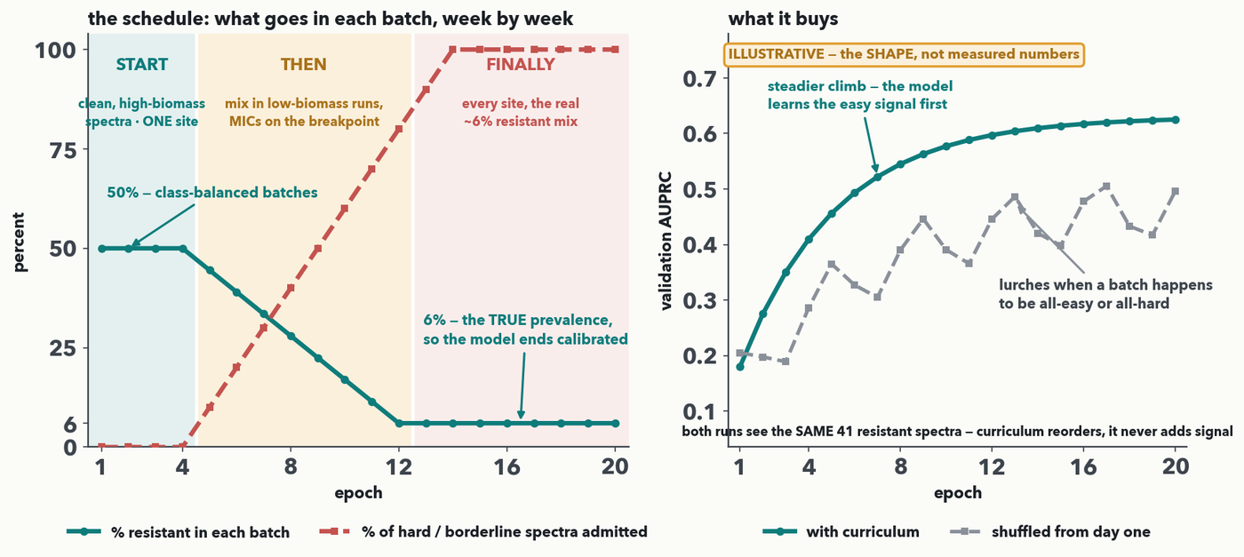
PART B · 6 · CURRICULUM LEARNING · THE SCHEDULE
Curriculum: the training diet as a schedule
MASS SPEC · Don’t feed the model the full, lopsided mix from day one — write a SCHEDULE. Left, over 20 epochs: the sampler anneals from 50% resistant per batch (class-balanced) down to the true 6%, while the hard cases — low-biomass runs, MICs on the breakpoint — are admitted from 0% to 100%. Right: the curriculum run climbs steadily where the shuffled run lurches. Same 41 resistant spectra in both.
Notes:
The last card on the menu, and now a concrete SCHEDULE rather than a slogan. Curriculum learning (Bengio et al. 2009) borrows from how we teach humans: start simple, build up. LEFT PANEL — the schedule you would actually code, on our own split, over 20 epochs. Two knobs, two curves. The TEAL curve is the fraction of each batch that is resistant: hold it at 50% for epochs 1-4 — class-balanced batches, so the rare class cannot be drowned while the model is learning the basics — then anneal it linearly down, reaching the TRUE 6% prevalence at epoch 12 and holding there. That tail matters: a model that finishes training at the real prevalence finishes CALIBRATED, which is the fix for the calibration warning we gave on the class-weights slide. The RED dashed curve is the fraction of hard, borderline spectra admitted at all: 0% for epochs 1-4 (only clean, high-biomass, well-crystallised runs from ONE site), then ramped in from epoch 5 and fully admitted by epoch 14 — low-biomass runs, MICs sitting on the breakpoint, every site. Read the three bands aloud: START (learn the assay), THEN (add the ambiguity), FINALLY (the real world, at the real prevalence). Note that one-site → all-sites is the version that matters for a multi-centre project, and it pairs with the external-validation guardrail from Part A. RIGHT PANEL — what it buys, and be honest about what this panel is: it is labelled ILLUSTRATIVE on the figure because it is a SHAPE, not measured data from our split; say that out loud. The claim it makes is the reproducible one from the literature: the curriculum run climbs smoothly because the model meets the easy signal first, while the shuffled run lurches whenever a batch happens to be all-easy or all-hard — which is exactly the 'training is unstable across easy/hard batches' symptom on the menu, and exactly what Q3(d) asks about. Land the footer: both runs saw the SAME 41 resistant spectra. Curriculum reorders the diet; like every other move in Part B, it adds no new biological signal. That is the last card — send them to Quiz 10 Q3 to match all four moves to their symptoms, and Q4 for the SMOTE point.

Slide 22
PART B · YOUR TURN (YOU-DO = Q3)
Your turn — match treatment to symptom
Menu (each used once):
curation
class weights / SMOTE / oversample
focal loss
curriculum
(a) Junk runs and mislabeled spectra contaminate the training set — and the same isolate appears three times. → ________
(b) Only 41 real resistant spectra; the model just predicts “susceptible”. → ________
(c) Easy cases are fine, but borderline isolates are missed. → ________
(d) Training is unstable when very easy and very hard batches alternate. → ________
(e) Which of these four adds NEW resistant signal to the dataset?
CHECKPOINT · Your turn → Quiz 10, Q3. Four situations, four moves from the menu — each used once. Then the honest question: which of the four adds NEW resistant signal? Worked answer in the notes.
Notes:
YOU-DO = Quiz 10 Q3, after the last treatment (curriculum). Worked answer: (a) curation — clean the labels and drop the junk before anything fancier, then deduplicate: embed every spectrum (the CNN's last hidden layer) and treat cosine ≥ 0.99 as the same isolate, keeping one — repeats split across train and test are leakage. (b) class weights / SMOTE / oversample — make the rare class count. (c) focal loss — up-weight the hard, low-confidence cases. (d) curriculum — order easy → hard, or class-balanced → true prevalence. (e) None of them. Every move re-uses the same 41 resistant spectra (reweighting shouts them louder, SMOTE interpolates between them, focal loss focuses on them, curriculum reorders them) — no new biological information enters. Only collecting more real resistant isolates adds signal.

Slide 23
LECTURE 10 · WHAT YOU CAN DO NOW
You can now…
• Compute precision, recall, specificity and FPR by hand — and say why accuracy lies under imbalance
• Build an ROC and a PR curve from a threshold sweep — report AUPRC, whose baseline is the prevalence
• Demand external + temporal validation — a metric is only valid on the distribution you tested
• Treat imbalance — curate, augment, SMOTE, class weights / focal loss, curriculum — knowing none adds new signal
You have worked the whole of Quiz 10 live — the four rates (Q1), AUROC vs. AUPRC (Q2), the treatment match (Q3), and a SMOTE point (Q4). Keep the sheet; it's your checklist for any rare-class assay in your own lab.
Notes:
Recap = the Lecture 10 outcomes, each already exercised this hour: the three-rate confusion-matrix computation (Q1), the AUROC-vs-AUPRC reading and decision (Q2), the external/temporal validation guardrail, and the four treatments — curation, SMOTE (worked), class weights / focal loss (worked), curriculum — with the honest "none add new signal" caveat (Q3-Q4). Quiz 10 was the distributed assessment, filled across the hour and now largely done. Frame the sheet as a reusable checklist they can run against any imbalanced-data project in their own lab.

Slide 24
LECTURE 10 · OVER TO YOUR LAB · DISCUSSION
Next — learning without labels (Lecture 11 + Lab 4)
• Most lab data is UNLABELED — Lecture 11 asks what you can learn without labels
• Autoencoders & VAEs: reconstruction error as an anomaly/QC score — a precision/recall threshold, straight back to today
• Lab 4 trains a VAE on normal spectra and flags anomalies — your metrics knowledge picks the threshold
• 💬 Discussion D4: what does 'abnormal' look like in YOUR instrument's output, and would reconstruction error catch it before a human does?
PAIR · 💬 Discussion D4: name one place in your workflow where a rare event hides in a majority-normal stream — and which metric, not accuracy, would tell you if a model caught it.
Notes:
Close by bridging forward and back. Forward: Lecture 11 tackles the common case where labels are scarce or absent — autoencoders and VAEs — and its anomaly threshold is exactly a precision/recall decision on a rare positive, so this hour's metrics carry straight into Lab 4. Back: the imbalance treatments and the external/temporal-validation guardrail are the tools for every rare-class project they plan. Run Discussion D4 as a think-pair-share tied to their own bench: where does a rare event hide in a majority-normal stream, and which metric would they trust to know a model caught it? Harvest two or three, then hand the last minutes to finishing Quiz 10 as Lab 4 context loads.

