Slide 1
MSACL · DS301 DEEP LEARNING · SEGMENT 4 · LECTURE 11
Learning without (many) labels
Autoencoders · reconstruction error as a QC alarm · VAEs (points vs clouds) · self-supervised & DINO · the semi-supervised middle path
Notes:
Monday afternoon, Segment 4 hour two, straight on from Lecture 10's "your data, your metrics." Here is the uncomfortable truth for a clinical lab: most of your data is UNLABELED — thousands of QC runs, spectra, chromatograms nobody ever annotated. This hour is about what you can still learn without labels. Four stops: (1) autoencoders — compress then reconstruct, and use the reconstruction error as an anomaly / QC score; (2) VAEs, intuitively — points vs. clouds, told entirely in pictures with NO derivation; (3) self-supervised learning — how foundation models pretrain by letting the data label itself (masking, contrastive, DINO); (4) semi-supervised in one slide — the "10,000 unlabeled + 100 labeled" pseudo-labeling middle path. The topic is conceptual, so the one numeric beat is reconstruction error: an MSE by hand, then a normal-vs-anomaly decision against a threshold — a straight callback to Lecture 10's sensitivity/specificity choice. Same interactive spine as every lecture: each I-do is followed by a you-do that IS a Quiz 11 item. Hand out Quiz 11 now, blank; we hit all four items live — sample-the-latent (Q1), the semi-supervised decision (Q2), the reconstruction-error trap (Q3), and the DINO/contrastive safe-vs-corrupt augmentation call (Q4). Lab 4 next hour builds a VAE on real spectra, so everything here is the on-ramp.

Slide 2
LECTURE 11 · WHERE THIS HOUR GOES
Four stops, no labels required
• Autoencoders — compress → reconstruct; reconstruction error as an anomaly / QC score · 14 min
• VAEs, intuitively — points vs. clouds; sample and interpolate; tell an AE latent from a VAE latent · 16 min
• Self-supervised — the data labels itself: masking (BERT), contrastive, DINO · 17 min
• Semi-supervised in one slide — pseudo-labeling, the 10,000 + 100 middle path; then Quiz 11 · 13 min
Notes:
Signpost the four stops so the room can pace itself. Nothing here needs new math: the only arithmetic all hour is one mean-squared-error, computed by hand, which most of this room already knows from assay QC. Everything is anchored to mass-spec: an autoencoder that flags a bad run, a latent map of your spectra, a VAE that morphs one spectrum into another, a model that pretrains by masking peaks. The back half — self-supervised learning — is the "how do the big foundation models actually learn without labels" story, a callback to Lecture 8's BERT and a preview of Lecture 13. Aim for a hands-on beat about every 8–10 minutes; the compute beat is Q3 (reconstruction error) framed as a trap; the rest are predict/decide you-dos.

Slide 3
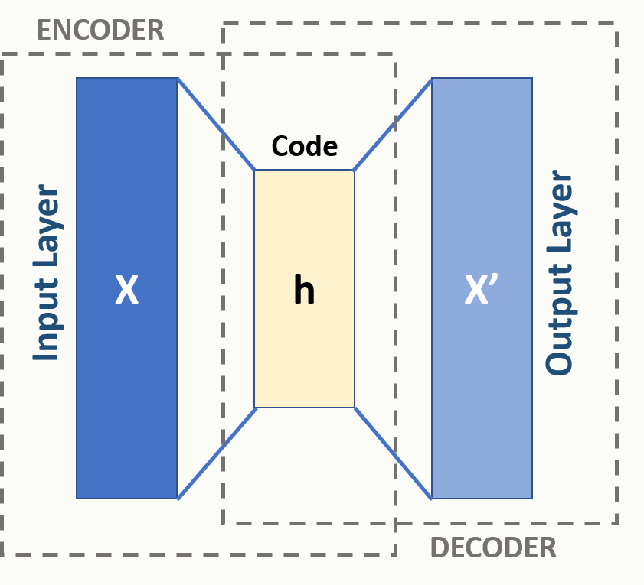
AUTOENCODERS · COMPRESS → RECONSTRUCT · I-DO
An autoencoder squeezes, then rebuilds
canonical autoencoder: input x → code z → reconstruction x′ · diagram: Michela Massi, Wikimedia Commons, CC BY-SA 4.0
An autoencoder has two halves. The ENCODER squeezes the input down to a tiny latent code z; the DECODER rebuilds the input from just that code. It is trained with NO labels — the target is the input itself, so it learns to make output ≈ input. The squeeze is the whole point: forced through a narrow code, the network can only keep what matters.
Notes:
Open the autoencoder with the canonical picture (rule 7 — a real, CC BY-SA licensed diagram, credited). Read it left to right: the input x (here a generic vector; for us, a spectrum) is compressed by the encoder into a small CODE z in the middle, then the decoder expands that code back out to a reconstruction x′. The training signal is unusual and the key to the whole lecture: there is no human label — the network's target is its own input, so it simply tries to copy the input to the output. The catch is the bottleneck. Because everything must pass through a code far smaller than the input, the network cannot just memorize; it has to learn a compact representation that keeps the important structure and throws away noise. That single idea — compress then reconstruct — powers all three lab uses we care about: denoising (rebuild a clean version), dimensionality reduction (the code is a compact summary), and anomaly detection (next). Next slide, the same picture MS-anchored, with the latent code as a map of your spectra.

Slide 4
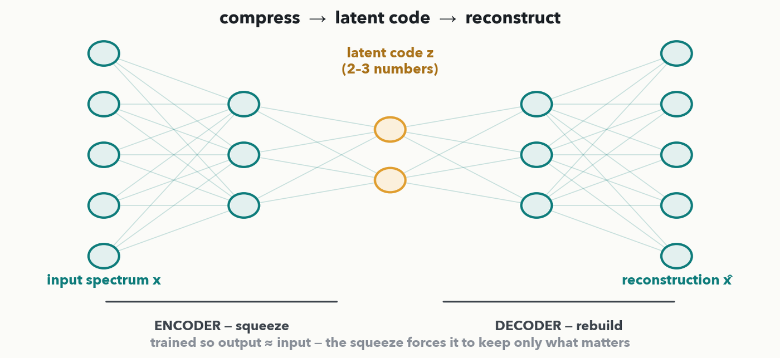
AUTOENCODERS · THE BOTTLENECK · I-DO
The bottleneck: a spectrum in, a spectrum out
MASS SPEC · MS anchor: the input is a spectrum (thousands of intensities); the latent code z is just 2–3 numbers; the decoder rebuilds the spectrum from those. Two payoffs: z is a compact MAP coordinate for each spectrum (dimensionality reduction — plot the map, cluster it), and 'how well does it rebuild?' becomes a score we can threshold.
Notes:
The same autoencoder, now drawn as an hourglass of neurons and MS-anchored. The wide input layer is a spectrum — thousands of intensity bins; the network squeezes it through a 2–3 number latent code and rebuilds it on the right. Land two payoffs the room will use. First, DIMENSIONALITY REDUCTION: the latent code is a tiny coordinate that summarizes an entire spectrum, so plotting every spectrum's code gives a 2-D MAP of your dataset — nearby points are similar spectra, and you can eyeball clusters (this is the "latent space as a map of your spectra" outcome, and it's what Lab 4 plots). Second, and the star of the next three slides: because the network only rebuilds well what it has seen before, the QUALITY of the reconstruction is itself an informative number. Train on good runs, and anything it rebuilds badly is suspicious. That is reconstruction error, coming up as an anomaly score.

Slide 5
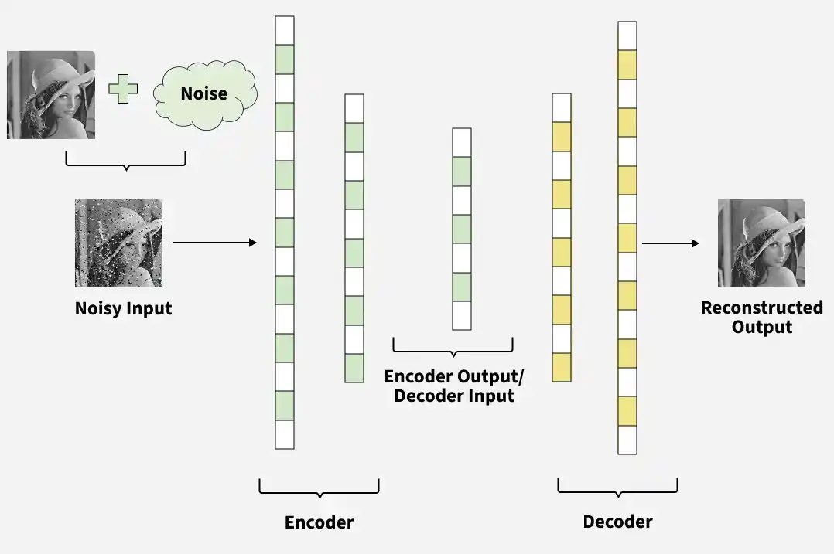
Dense Autoencoder for denoising
AUTOENCODERS · APPLICATIONS · DENOISING
source: GeeksforGeeks, “Denoising Autoencoders in Machine Learning” · © GeeksforGeeks; all rights reserved, not for redistribution

Slide 6
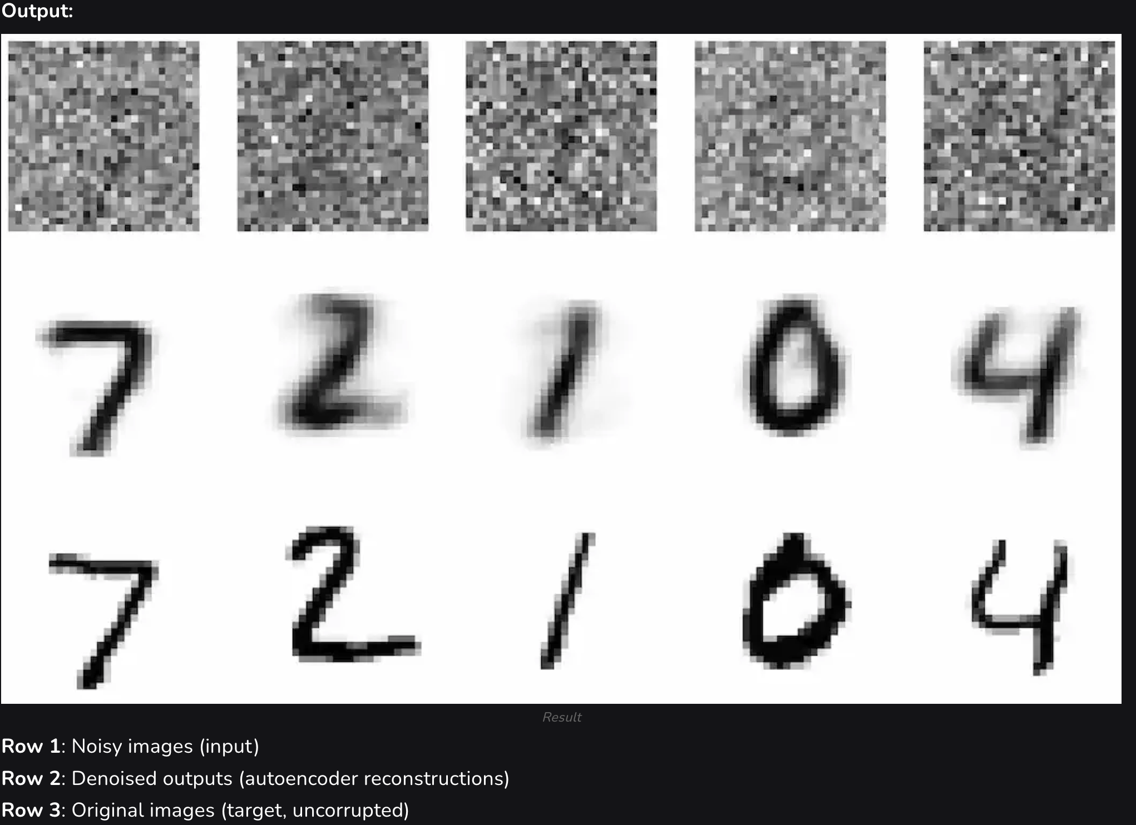
Denoising Results on MNIST
AUTOENCODERS · DENOISING RESULTS
source: GeeksforGeeks, “Denoising Autoencoders in Machine Learning” · © GeeksforGeeks; all rights reserved, not for redistribution

Slide 7
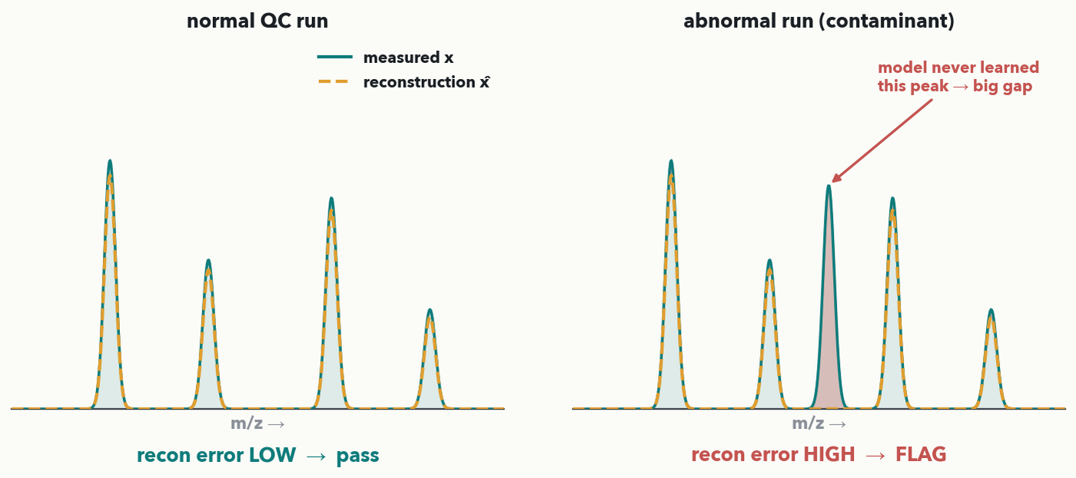
AUTOENCODERS · APPLICATIONS
Anomaly Detection
Rebuild it badly → flag it
MASS SPEC · Train the autoencoder ONLY on good QC runs. A normal run (left) reconstructs almost perfectly — small gap, LOW error → pass. An abnormal run with a contaminant peak (right) the model never learned to rebuild — big red gap, HIGH error → FLAG. Reconstruction error is an unsupervised anomaly / QC alarm.
Notes:
This is the money slide for a clinical lab (rule 2). The trick: train the autoencoder ONLY on known-good runs. Now it is an expert at rebuilding normal spectra and clueless about anything else. Feed it a normal QC run (left panel): the reconstruction (amber dashed) lands right on top of the measurement (teal) — a small gap, LOW reconstruction error, so it passes. Feed it an abnormal run (right panel) — here an extra contaminant peak the model has never seen — and it rebuilds a "normal-shaped" spectrum that misses the contaminant entirely; the red shaded gap is large, the reconstruction error is HIGH, and we FLAG the run for a human. No labels were needed: "abnormal" is simply "the model can't rebuild it." This is exactly Discussion D4 from last hour — would reconstruction error catch a bad run before a human does? Next slide we turn "how big is the gap" into a single number and a decision.

Slide 8
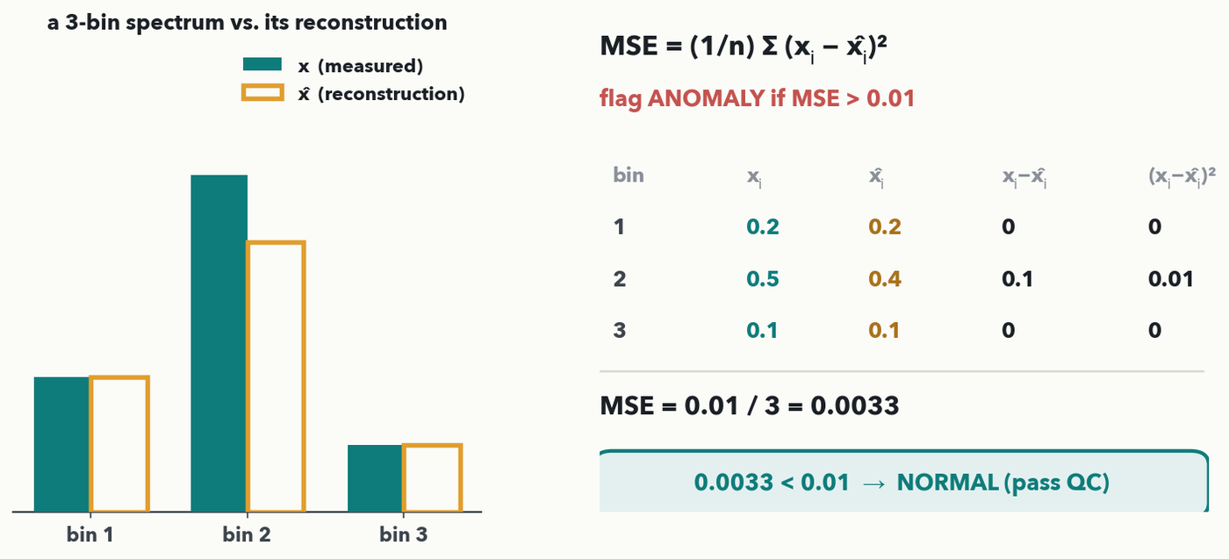
AUTOENCODERS · RECONSTRUCTION ERROR, WORKED · I-DO
Reconstruction error = MSE, by hand
MASS SPEC · One number for the whole gap: MSE = (1/n) Σ (xᵢ − x̂ᵢ)². Here x = (0.2, 0.5, 0.1), x̂ = (0.2, 0.4, 0.1). Squared errors: 0, 0.01, 0 → sum 0.01 → MSE = 0.01 / 3 = 0.0033. With a QC threshold of 0.01: 0.0033 < 0.01 → NORMAL (pass). Same threshold idea as Lecture 10's sensitivity/specificity call.
Notes:
The one numeric mechanic of the hour (rule 6), and the formula the you-do needs ON THE DECK first (rule 3). Reconstruction error collapses the whole gap between a spectrum and its rebuild into ONE number: the mean squared error, MSE = (1/n) Σ (xᵢ − x̂ᵢ)². Work the tiny 3-bin example live. Bin by bin: bin 1, 0.2 − 0.2 = 0, squared 0; bin 2, 0.5 − 0.4 = 0.1, squared 0.01; bin 3, 0.1 − 0.1 = 0, squared 0. Sum of squared errors = 0.01; divide by n = 3 → MSE = 0.01 / 3 = 0.0033 (exact, a repeating 0.00333…). Now the DECISION, which is the QC alarm: we set a threshold on normal runs — say 0.01 — and flag anything above it. 0.0033 < 0.01, so this run is NORMAL and passes. Emphasize the callback: choosing that threshold is precisely the sensitivity/specificity trade-off from Lecture 10 — lower it to catch more anomalies (higher sensitivity, more false alarms), raise it to reduce false alarms (higher specificity). Next slide the room computes a fresh one — the Quiz 11 Q3 numbers.

Slide 9
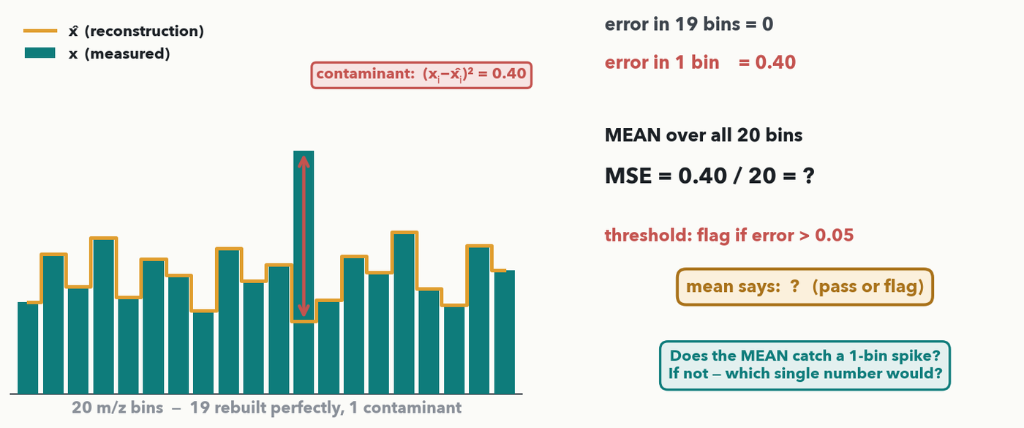
AUTOENCODERS · YOUR TURN (YOU-DO = Q3)
Your turn — does the mean catch a contaminant?
CHECKPOINT · Your turn → Quiz 11, Q3. A contaminant spikes ONE m/z bin out of 20; that bin's squared error is 0.40, the other 19 are 0. (a) Compute the MEAN MSE over all 20 bins. (b) With threshold 0.05, does mean-MSE FLAG the run? (c) It doesn't — why does averaging hide a sharp contaminant, and what single number WOULD catch it? Worked answer in the notes.
Notes:
YOU-DO = Quiz 11 Q3 (upgraded from a plug-in to a real trap that ends in a surprising answer). (a) MSE = 0.40 / 20 = 0.02. (b) 0.02 < 0.05, so the MEAN says PASS — it MISSES the contaminant. (c) The mean divides one big error across 20 bins, so a LOCALIZED spike gets diluted below threshold; the fix is to look at the MAX per-bin error (0.40 > 0.05 → flag) or the error inside the peak window. This is the anomaly-overlay slide made quantitative: a contaminant is a localized gap, and a mean over thousands of bins can wash it out. Tie it to Lecture 10 — lowering the flag threshold or switching to max-error is the sensitivity/specificity dial. Take the MSE and the (surprising) decision from the floor, then have them fill Q3.

Slide 10
Generation?
AUTOENCODERS · CAN IT GENERATE?
A random latent code
A random nice sample ?

Slide 11
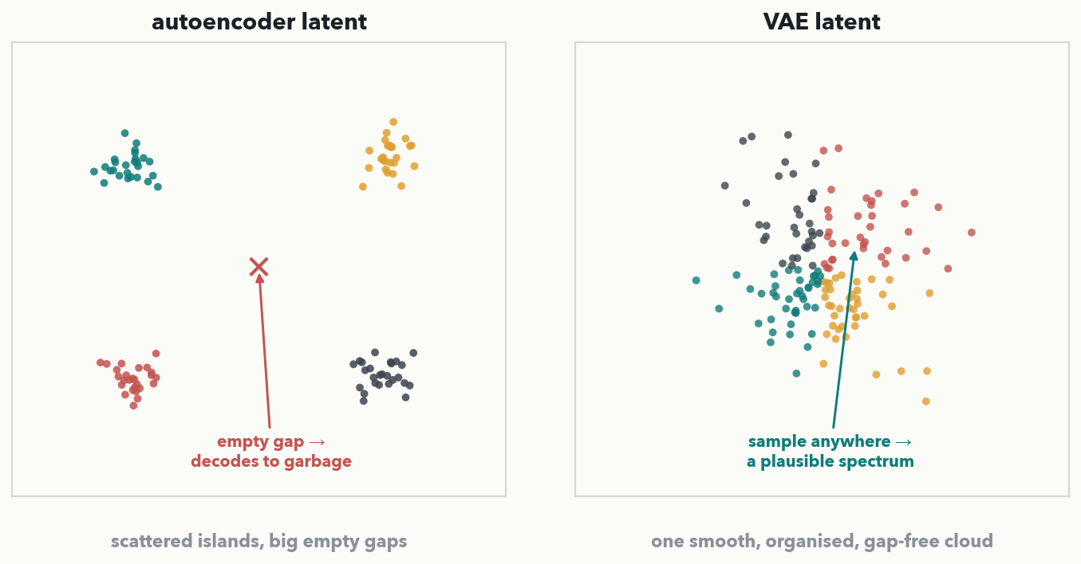
VAES · POINTS VS CLOUDS · I-DO
AE vs VAE: scattered islands vs a smooth cloud
Same spectra, two latent maps. AE (left): each spectrum is memorized as an isolated point — tight islands with big EMPTY GAPS between them; decode a point in a gap and you get garbage. VAE (right): one smooth, organised, gap-free CLOUD — every point decodes to a plausible spectrum, so you can SAMPLE new spectra and INTERPOLATE between real ones.
Notes:
The heart of the VAE, told as points vs. clouds — NO math (rule 9). Plot the same spectra in an autoencoder's latent space (left) and a VAE's (right). The plain autoencoder tends to scatter its training spectra into tight, separated ISLANDS with large empty regions between them — it has essentially memorized each example as a point and left the space between undefined; decode a latent point that falls in one of those gaps and the decoder, never trained there, emits garbage. A VAE is trained to do the same reconstruction PLUS keep its latent codes packed into one smooth, centered, gap-free CLOUD. Because the cloud has no holes, EVERY point in it decodes to a plausible spectrum — which unlocks two abilities the AE lacks: you can SAMPLE a new latent point and get a brand-new realistic spectrum, and you can walk between two real spectra and get a smooth morph (next slides). The single visual test the quiz asks: gaps and islands = AE; one smooth organized cloud = VAE. Next, the recipe that produces that tidy cloud, then the interpolation payoff, then the room makes the call.

Slide 12
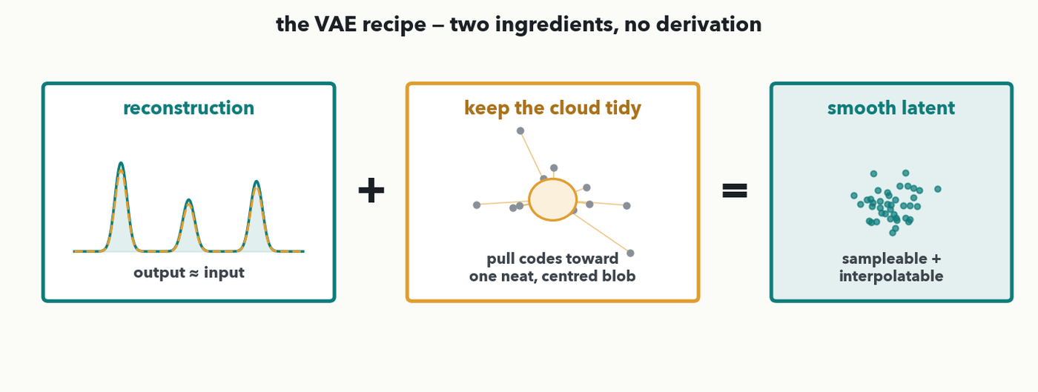
VAES · THE RECIPE · I-DO
The VAE recipe: reconstruct + keep the cloud tidy
Two ingredients, no derivation. (1) Reconstruction — output ≈ input, same as an autoencoder. (2) A 'keep the cloud tidy' penalty — pull every code toward one neat, centered blob so no gaps open up. Balance the two and you get a smooth, sampleable, interpolatable latent. (In Lab 4 that tidiness term is the KL weight you tune.)
Notes:
The VAE recipe in one picture, deliberately NO derivation (the outcome says "explain intuitively", and the audience has no calculus). A VAE's loss is just two ingredients added together. INGREDIENT ONE is reconstruction — output ≈ input — identical to a plain autoencoder, and it's what keeps the spectra faithful. INGREDIENT TWO is a "keep the cloud tidy" penalty: it gently pulls every latent code toward one neat, centered blob, so the codes pack together with no empty gaps. That second term is the ONLY difference from an autoencoder, and it's what turns scattered islands into a smooth cloud. There's a tension the room will meet in Lab 4: crank the tidiness term too high and the codes all collapse to the center and reconstructions go blurry; too low and you're back to an autoencoder with gaps. Name the term for Lab 4 — it's the "KL weight" — but do NOT write the KL formula; the equalizer intuition (reconstruct vs. tidy) is all they need. Next, the payoff of the smooth cloud: interpolation.

Slide 13
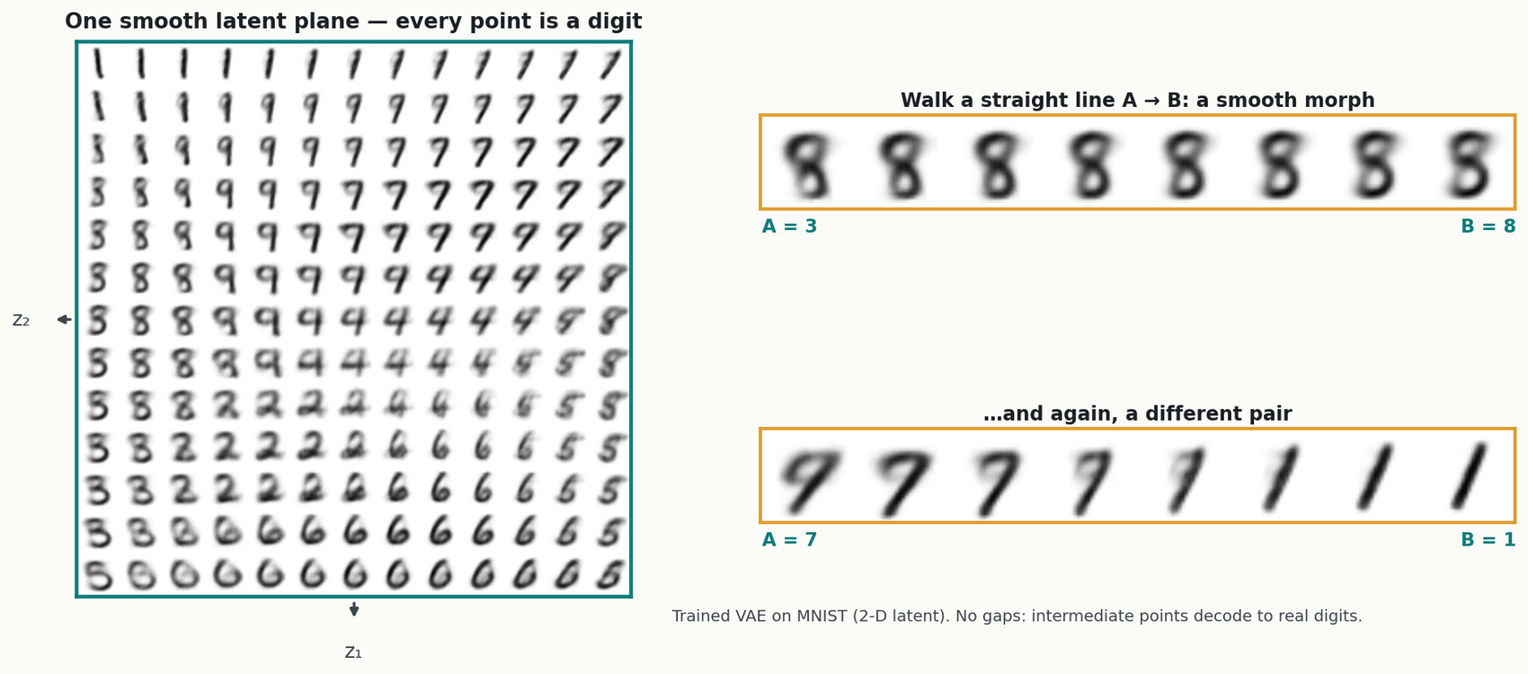
VAES · A SMOOTH LATENT (MNIST) · I-DO
A smooth latent plane: walk a line, watch it morph
2-D-latent VAE trained on MNIST (public-domain digits) — a vivid bridge; the same trick runs on spectra in Lab 4
MASS SPEC · Digits make the idea unmissable. A VAE packs all of MNIST into ONE smooth latent plane (left) — nearby points are similar digits, with NO gaps. Pick two real digits and walk the straight line between their codes (right): a 3 morphs smoothly into an 8, every stop a real digit. Same trick on SPECTRA (Lab 4): sample a latent point → a new plausible spectrum; walk A→B → a smooth spectral morph. An AE's gaps would decode to garbage partway across.
Notes:
Use MNIST as a brief, vivid bridge (rule 2) before mapping straight back to spectra. Why digits: everyone reads them instantly, so the smoothness of a VAE latent is impossible to miss. LEFT — the latent MANIFOLD: decode a grid of latent points (z1, z2) and you get a continuous sheet of digits that morph into their neighbours with no holes; that is the "one smooth, organized, gap-free cloud" from two slides ago, now literally visible. RIGHT — the INTERPOLATION: take two real digits, encode each to its latent code, walk a straight line between the codes, and decode the stops — a 3 slides smoothly into an 8, a 7 into a 1, every intermediate a valid digit. That is only possible because the cloud is gap-free; the same walk in a plain autoencoder's latent would cross an empty gap and decode to garbage. Now map it back to mass spec, which is the whole point: on a VAE trained on spectra you can SAMPLE a latent point to get a brand-new plausible spectrum, and INTERPOLATE between two real spectra to watch peaks slide and trade height — exactly the Lab 4 "fun payoff" cell. Next slide the room makes the AE-vs-VAE call itself (Quiz 11 Q1).

Slide 14
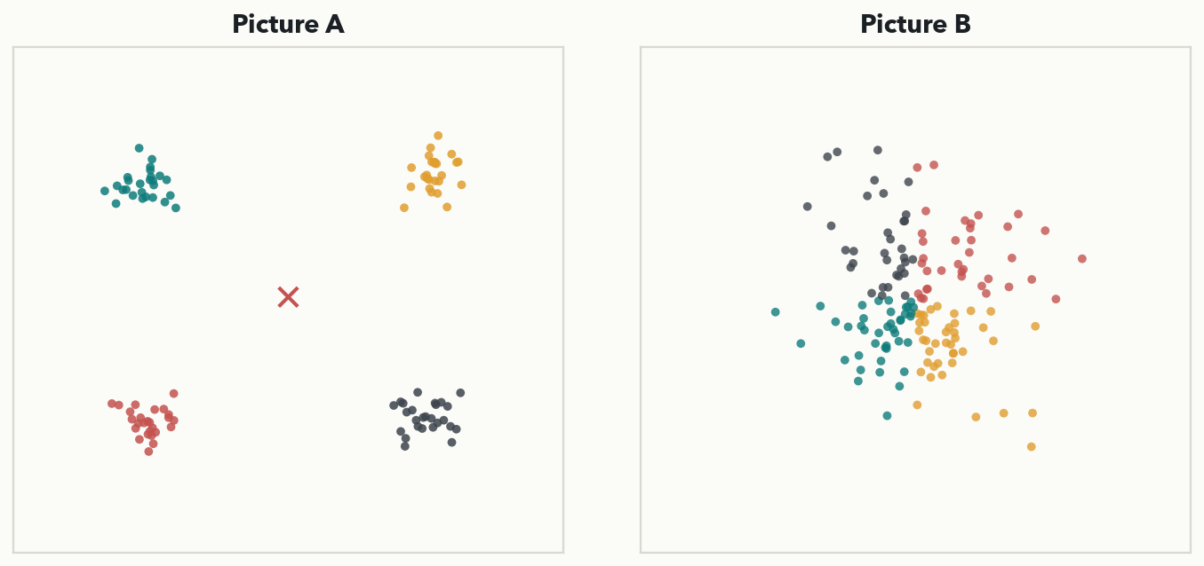
VAES · YOUR TURN (YOU-DO = Q1)
Your turn — sample each latent: what comes out?
CHECKPOINT · Your turn → Quiz 11, Q1. You want to GENERATE synthetic resistant spectra to augment training, so you sample random latent points and decode. (a) From Picture A (scattered islands with gaps), what comes out — and why? (b) From Picture B (one smooth cloud)? (c) Which is the VAE, and which latent do you use to generate? Worked answer in the notes.
Notes:
YOU-DO = Quiz 11 Q1 (upgraded from 'identify the picture' to 'predict what sampling does'). (a) Picture A is the autoencoder: scattered islands with big empty GAPS, so a random sample usually lands in a gap the decoder never trained on and decodes to GARBAGE — a non-physical spectrum. (b) Picture B is the VAE: one smooth, gap-free cloud, so every sampled point decodes to a PLAUSIBLE spectrum. (c) B is the VAE, and it is the one you use to generate (or interpolate) — only a gap-free latent is safe to sample. Good extension (the old pair prompt): B is also the map you trust to flag a NOVEL contaminant, because a genuinely new spectrum lands OUTSIDE the tidy cloud (high reconstruction error, easy to flag) while the AE's gaps make 'far from training data' ambiguous. Both pictures are on the Quiz 11 sheet, so the room answers straight off this slide. Take the sampling prediction with its reason, then have them fill Q1.

Slide 15
LECTURE 11 · PART THREE
Self-supervised learning — the data labels itself
how the big foundation models pretrain without a single human label
Notes:
Pivot to the idea behind every modern foundation model. So far, autoencoders and VAEs learned without labels by reconstructing their input. Self-supervised learning generalizes that trick: invent a "pretext" task where the ANSWER is already hidden in the data, so the data supplies its own labels for free. Train a big model on millions of unlabeled examples that way and its body learns general-purpose features — then fine-tune a small head on your few hundred labels (Lecture 8's transfer learning). This is how BERT, GPT, the protein language models, and the DINO vision models are all pretrained. Three flavors coming up: masking (the BERT callback), contrastive learning, and DINO's student–teacher self-distillation — each one anchored to spectra.

Slide 16
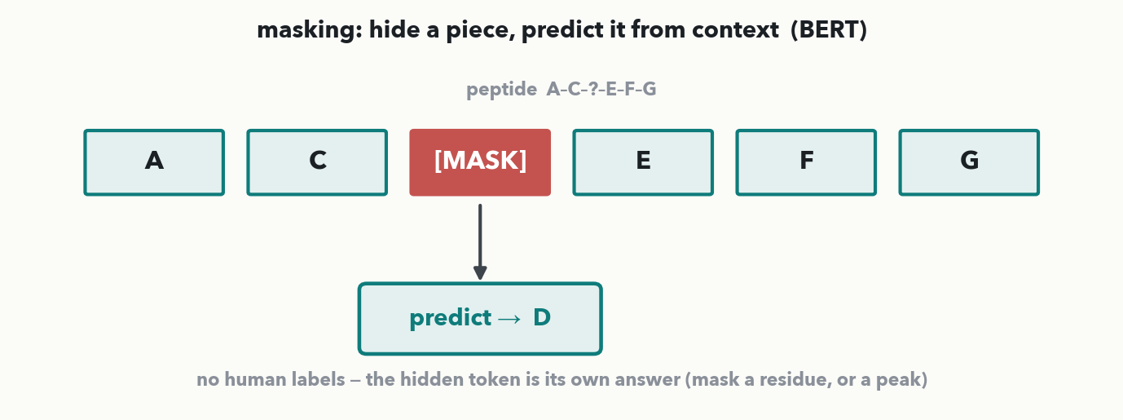
SELF-SUPERVISED · MASKING (BERT) · I-DO
Masked Language Models: hide a piece, predict it
The BERT trick (Lecture 8), now a pretext task: hide part of the input and make the model predict it from context. Mask a residue in a peptide (A–C–?–E–F–G → predict D), or a peak in a spectrum. No human labels — the hidden token IS the answer. Do this on millions of unlabeled sequences and the body learns real structure.
Notes:
The first self-supervised flavor, and a direct callback to Lecture 8's BERT. The pretext task: take an unlabeled sequence, hide a piece of it, and train the model to fill in the blank from the surrounding context. On a peptide, mask a residue — A–C–[MASK]–E–F–G — and predict the missing D; on a spectrum, mask a peak or a region and predict it back. The label was never supplied by a human — it's just the token you hid, so any pile of unlabeled data becomes training data. Run this over millions of unlabeled sequences or spectra and the model is forced to learn genuine structure (which residues co-occur, what a real peak pattern looks like) to succeed — exactly the general features you then transfer. This is precisely how BERT pretrained on text and how protein language models like ESM-2 (Lab 3's bonus) pretrained on sequences. Next, a different self-supervised idea: agreement between two views.

Slide 17
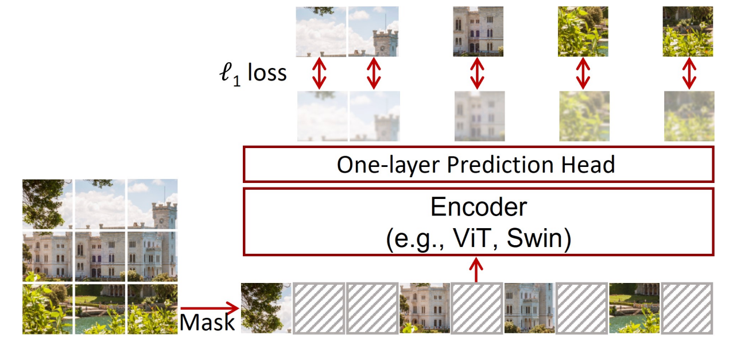
SELF-SUPERVISED · MASKING · BEYOND TEXT
Same idea also works on images (and others)
Notes:
The first self-supervised flavor, and a direct callback to Lecture 8's BERT. The pretext task: take an unlabeled sequence, hide a piece of it, and train the model to fill in the blank from the surrounding context. On a peptide, mask a residue — A–C–[MASK]–E–F–G — and predict the missing D; on a spectrum, mask a peak or a region and predict it back. The label was never supplied by a human — it's just the token you hid, so any pile of unlabeled data becomes training data. Run this over millions of unlabeled sequences or spectra and the model is forced to learn genuine structure (which residues co-occur, what a real peak pattern looks like) to succeed — exactly the general features you then transfer. This is precisely how BERT pretrained on text and how protein language models like ESM-2 (Lab 3's bonus) pretrained on sequences. Next, a different self-supervised idea: agreement between two views.

Slide 18
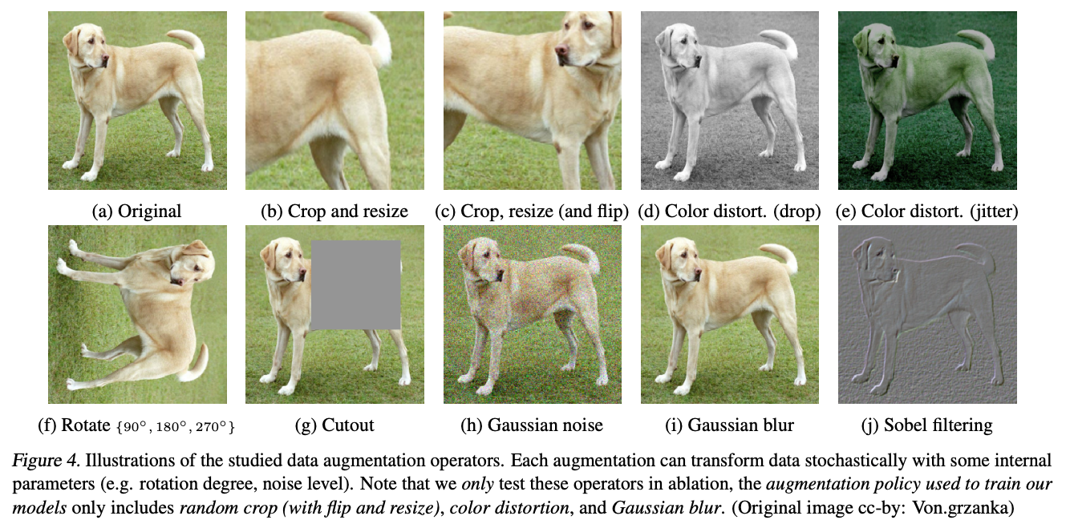
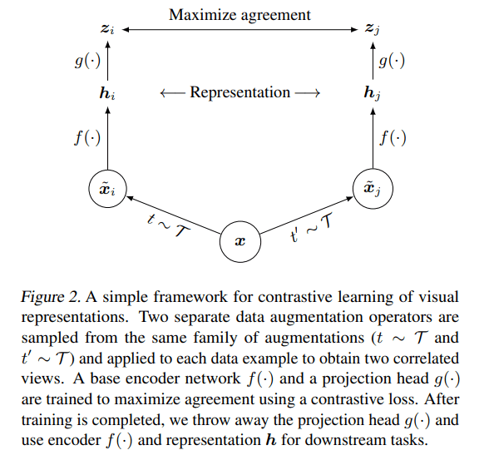
SELF-SUPERVISED · CONTRASTIVE · I-DO · 1 OF 2
Contrastive Learning: two views should land together
SimCLR: A Simple Framework for Contrastive Learning of Visual Representations
Notes:
The second self-supervised flavor: contrastive learning. Take one spectrum and make two AUGMENTED views of it — add intensity noise for one, shift the m/z axis slightly for the other (exactly the Lab 2 augmentations). Both views still come from the same physical sample, so the model should map them to NEARBY points in embedding space — "pull together" — while a view of a DIFFERENT spectrum is pushed apart. The self-supervised label is just "did these two come from the same source?", which you know for free because YOU made the augmentations. By insisting that augmented views agree, the model is forced to learn features that capture the real content and IGNORE the nuisance variation (noise, small shifts) — which is precisely the augmentation-invariance you want for robust spectra. This "views must agree" idea is the core of Quiz 11 Q4, and it sets up DINO, which takes the same agreement principle and adds a teacher.

Slide 19
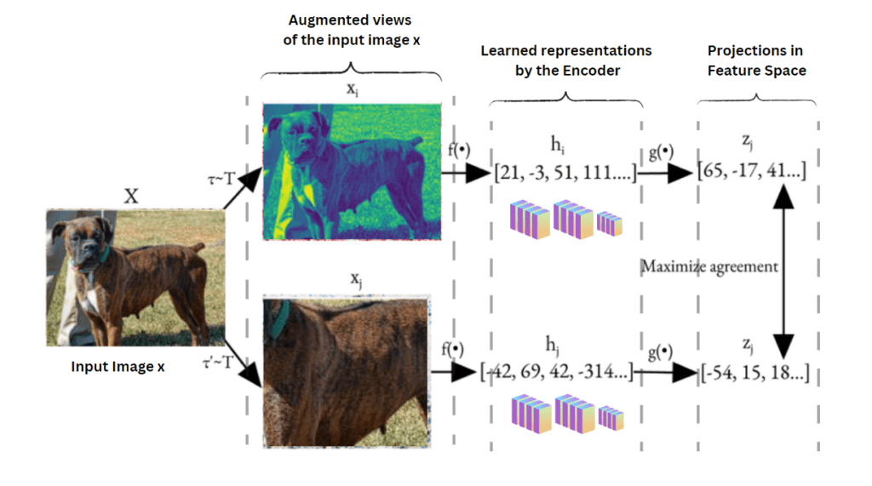
SELF-SUPERVISED · CONTRASTIVE · I-DO · 2 OF 2
Contrastive Learning: two views should land together
SimCLR: A Simple Framework for Contrastive Learning of Visual Representations
Notes:
The second self-supervised flavor: contrastive learning. Take one spectrum and make two AUGMENTED views of it — add intensity noise for one, shift the m/z axis slightly for the other (exactly the Lab 2 augmentations). Both views still come from the same physical sample, so the model should map them to NEARBY points in embedding space — "pull together" — while a view of a DIFFERENT spectrum is pushed apart. The self-supervised label is just "did these two come from the same source?", which you know for free because YOU made the augmentations. By insisting that augmented views agree, the model is forced to learn features that capture the real content and IGNORE the nuisance variation (noise, small shifts) — which is precisely the augmentation-invariance you want for robust spectra. This "views must agree" idea is the core of Quiz 11 Q4, and it sets up DINO, which takes the same agreement principle and adds a teacher.

Slide 20
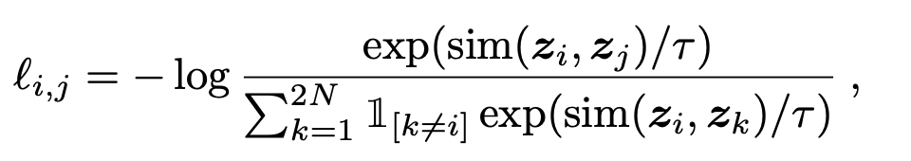
SELF-SUPERVISED · CONTRASTIVE · THE COLLAPSE PROBLEM
Contrastive Learning Problem: Collapse
Trivial solution: just making everything the same!!
Contrastive Loss (NT-Xent): You must bring negative samples to create contrast.
  - Maximizes the similarity of positive pairs z₁, and z₂​ using cosine similarity.
  - Minimizes the similarity with negative pairs (other images in the batch).
Notes:
The second self-supervised flavor: contrastive learning. Take one spectrum and make two AUGMENTED views of it — add intensity noise for one, shift the m/z axis slightly for the other (exactly the Lab 2 augmentations). Both views still come from the same physical sample, so the model should map them to NEARBY points in embedding space — "pull together" — while a view of a DIFFERENT spectrum is pushed apart. The self-supervised label is just "did these two come from the same source?", which you know for free because YOU made the augmentations. By insisting that augmented views agree, the model is forced to learn features that capture the real content and IGNORE the nuisance variation (noise, small shifts) — which is precisely the augmentation-invariance you want for robust spectra. This "views must agree" idea is the core of Quiz 11 Q4, and it sets up DINO, which takes the same agreement principle and adds a teacher.

Slide 21
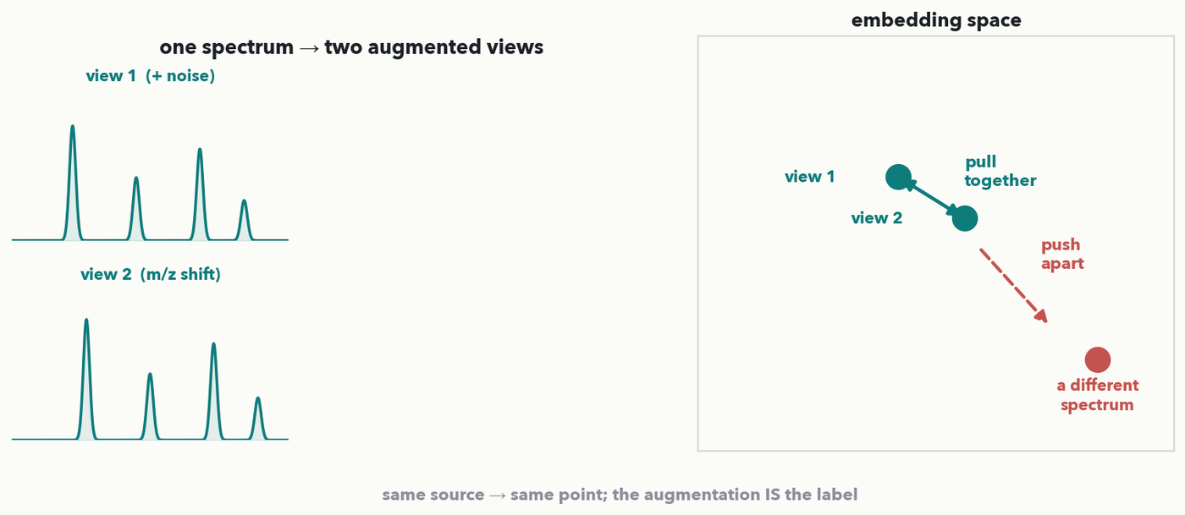
SELF-SUPERVISED · CONTRASTIVE · ON SPECTRA
Contrastive Learning on MS
MASS SPEC · Make two augmented VIEWS of the same spectrum — add noise, shift m/z. They're still the same sample, so their embeddings should land TOGETHER (pull), while a different spectrum is pushed APART. The label is simply 'same source or not' — no human needed. The model learns features that ignore nuisance augmentations.
Notes:
The second self-supervised flavor: contrastive learning. Take one spectrum and make two AUGMENTED views of it — add intensity noise for one, shift the m/z axis slightly for the other (exactly the Lab 2 augmentations). Both views still come from the same physical sample, so the model should map them to NEARBY points in embedding space — "pull together" — while a view of a DIFFERENT spectrum is pushed apart. The self-supervised label is just "did these two come from the same source?", which you know for free because YOU made the augmentations. By insisting that augmented views agree, the model is forced to learn features that capture the real content and IGNORE the nuisance variation (noise, small shifts) — which is precisely the augmentation-invariance you want for robust spectra. This "views must agree" idea is the core of Quiz 11 Q4, and it sets up DINO, which takes the same agreement principle and adds a teacher.

Slide 22
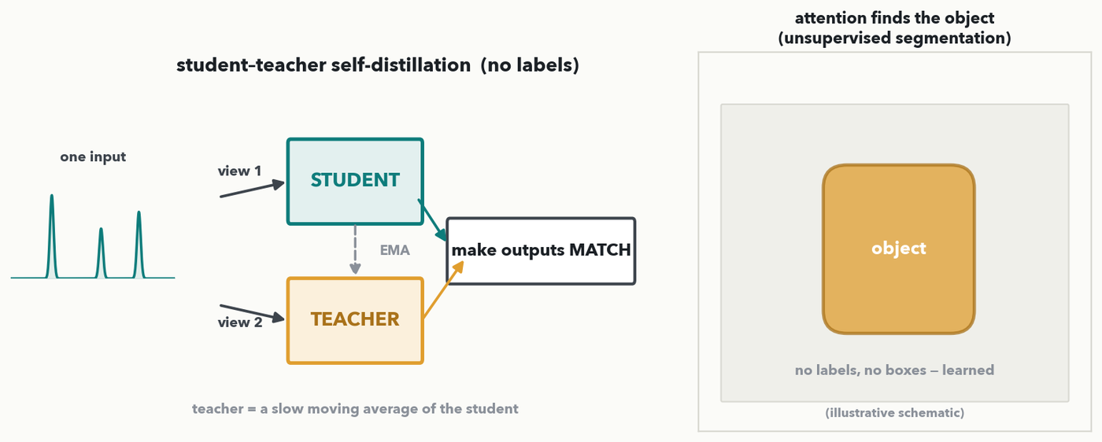
SELF-SUPERVISED · DINO · I-DO · 1 OF 3
DINO: a student learns to match a teacher
student–teacher self-distillation; the object-segmentation panel is an illustrative schematic of the DINO attention result (Caron et al. 2021, Meta AI, code Apache-2.0)
DINO = self-distillation with no labels. Two augmented views of one input go to a STUDENT and a TEACHER network; the student is trained so its output MATCHES the teacher's, and the teacher is just a slow moving average of the student. Same 'augmented views must agree' idea — and the famous payoff: attention learns to segment the object with no labels at all.
Notes:
The third self-supervised flavor and the one with the striking visual: DINO (self-DIstillation with NO labels, Caron et al. 2021). It runs on the same "two views must agree" principle as contrastive learning, packaged as a student and a teacher. Two augmented views of one input are fed to a STUDENT network and a TEACHER network; the student is trained so its output distribution MATCHES the teacher's on the same input. Where does the teacher come from with no labels? It IS the student — a slow moving average of the student's own weights — so the model teaches itself, which is why it's called self-distillation. The famous, almost eerie payoff (right panel): after this label-free pretraining, the model's ATTENTION spontaneously highlights the main object in an image — unsupervised segmentation, no masks or boxes ever provided. For us the message is the through-line of the whole self-supervised section: augmentation-invariance — make different views of the same thing agree — plus scale is enough to learn powerful, general features without labels, which is how modern foundation models pretrain (forward to Lecture 13). Next slide the room decides WHICH augmentation would corrupt this agreement — a spot-the-break DECIDE, not a definition restated (Quiz 11 Q4).

Slide 23
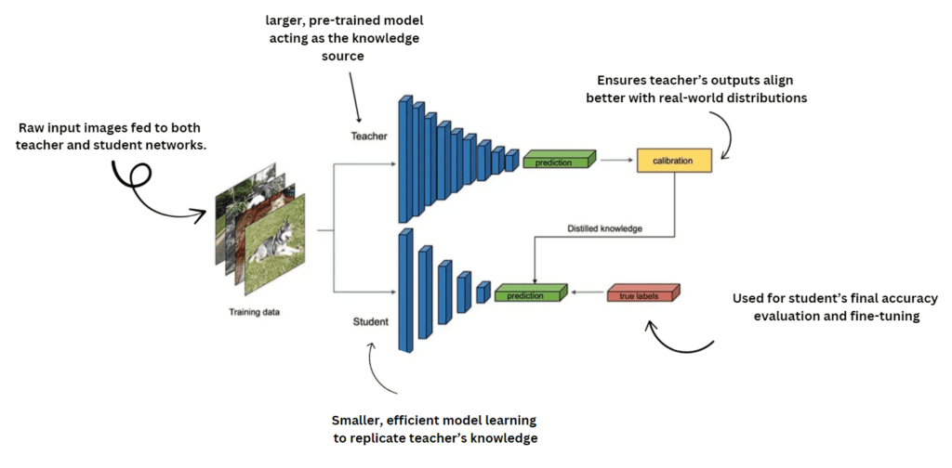
SELF-SUPERVISED · DINO · I-DO · 2 OF 3
DINO: a student learns to match a teacher
What if I don’t have enough negative examples?
student–teacher self-distillation; the object-segmentation panel is an illustrative schematic of the DINO attention result (Caron et al. 2021, Meta AI, code Apache-2.0)
DINO = self-distillation with no labels. Two augmented views of one input go to a STUDENT and a TEACHER network; the student is trained so its output MATCHES the teacher's, and the teacher is just a slow moving average of the student. Same 'augmented views must agree' idea — and the famous payoff: attention learns to segment the object with no labels at all.
Notes:
The third self-supervised flavor and the one with the striking visual: DINO (self-DIstillation with NO labels, Caron et al. 2021). It runs on the same "two views must agree" principle as contrastive learning, packaged as a student and a teacher. Two augmented views of one input are fed to a STUDENT network and a TEACHER network; the student is trained so its output distribution MATCHES the teacher's on the same input. Where does the teacher come from with no labels? It IS the student — a slow moving average of the student's own weights — so the model teaches itself, which is why it's called self-distillation. The famous, almost eerie payoff (right panel): after this label-free pretraining, the model's ATTENTION spontaneously highlights the main object in an image — unsupervised segmentation, no masks or boxes ever provided. For us the message is the through-line of the whole self-supervised section: augmentation-invariance — make different views of the same thing agree — plus scale is enough to learn powerful, general features without labels, which is how modern foundation models pretrain (forward to Lecture 13). Next slide the room decides WHICH augmentation would corrupt this agreement — a spot-the-break DECIDE, not a definition restated (Quiz 11 Q4).

Slide 24
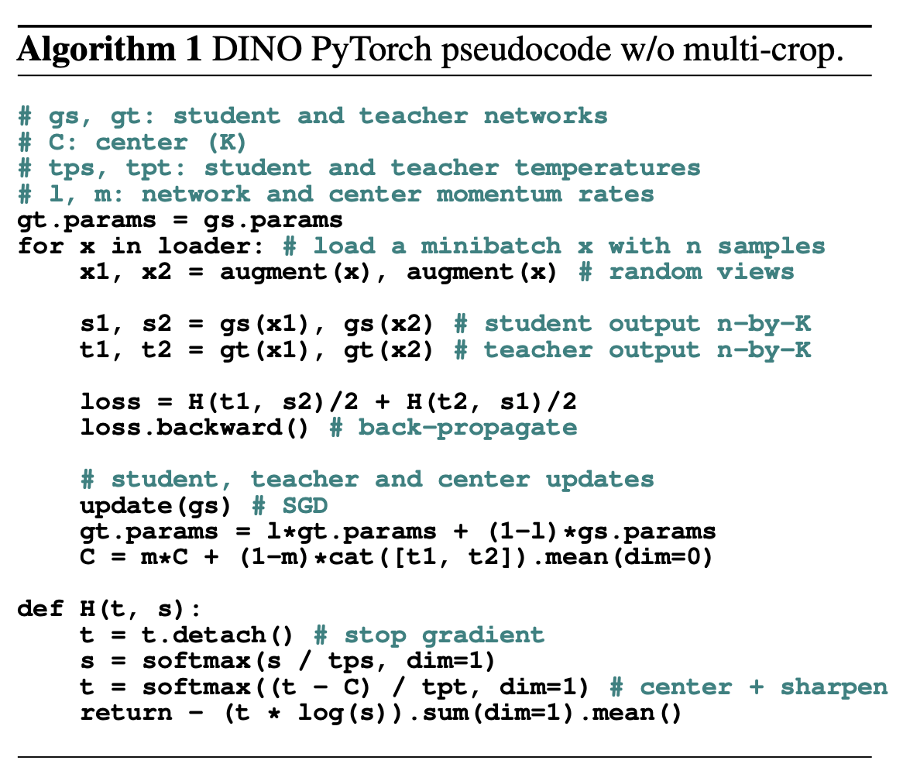
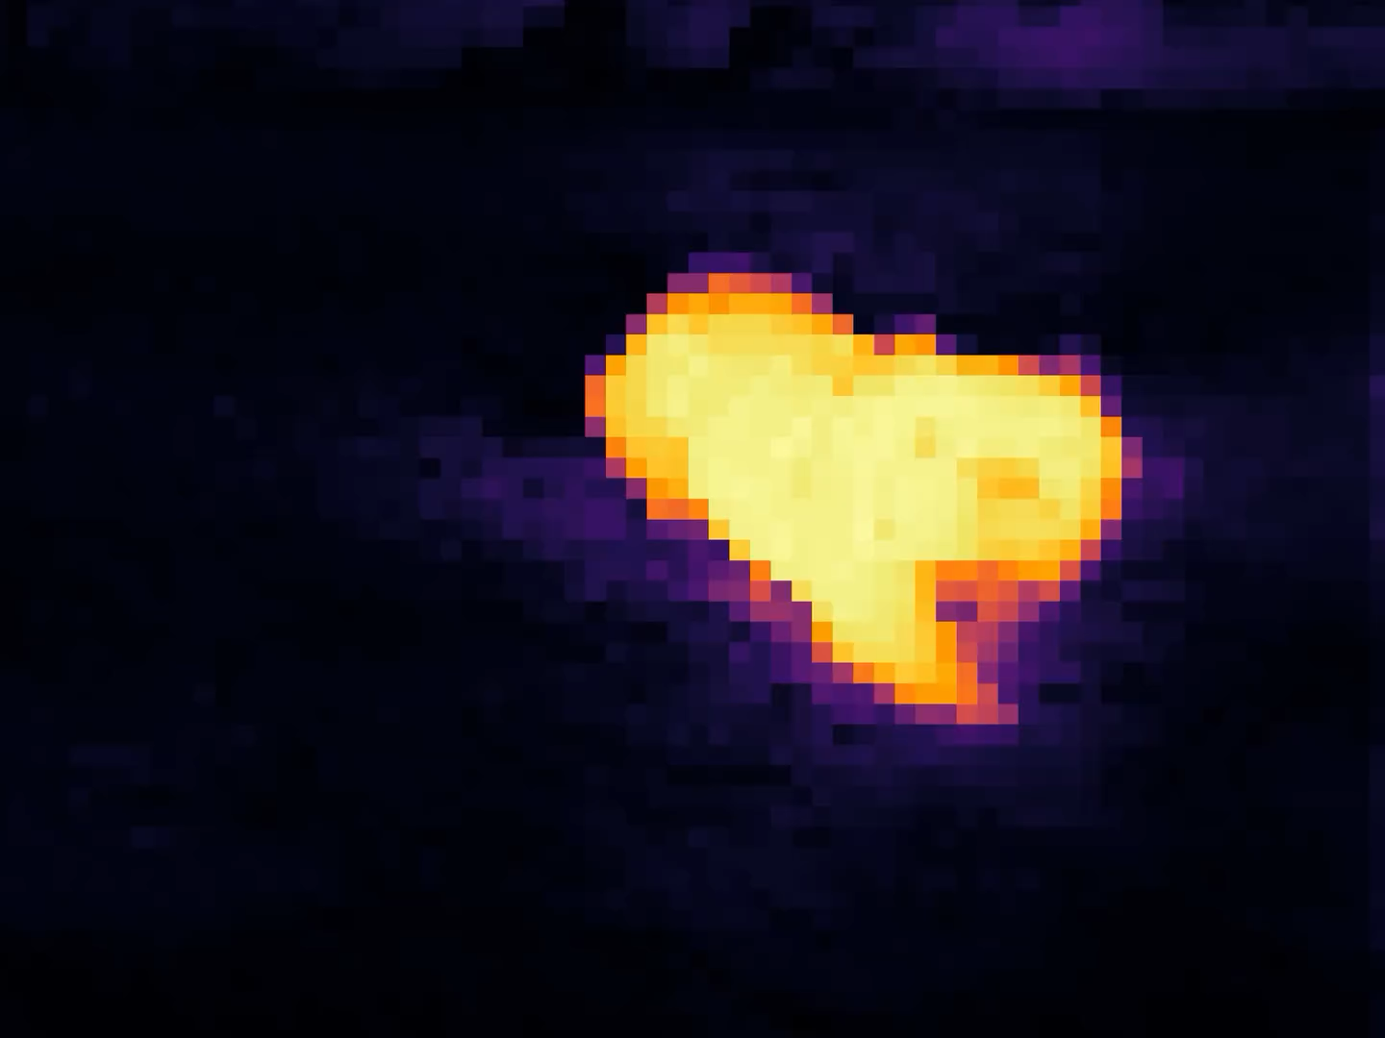
SELF-SUPERVISED · DINO · 3 OF 3
DINO: a student learns to match a teacher
source: Caron et al., “Emerging Properties in Self-Supervised Vision Transformers” (ICCV 2021, Meta AI) — Algorithm 1 pseudocode and the DINO self-attention video (github.com/facebookresearch/dino) · © the authors; all rights reserved, not for redistribution
Notes:
The third self-supervised flavor and the one with the striking visual: DINO (self-DIstillation with NO labels, Caron et al. 2021). It runs on the same "two views must agree" principle as contrastive learning, packaged as a student and a teacher. Two augmented views of one input are fed to a STUDENT network and a TEACHER network; the student is trained so its output distribution MATCHES the teacher's on the same input. Where does the teacher come from with no labels? It IS the student — a slow moving average of the student's own weights — so the model teaches itself, which is why it's called self-distillation. The famous, almost eerie payoff (right panel): after this label-free pretraining, the model's ATTENTION spontaneously highlights the main object in an image — unsupervised segmentation, no masks or boxes ever provided. For us the message is the through-line of the whole self-supervised section: augmentation-invariance — make different views of the same thing agree — plus scale is enough to learn powerful, general features without labels, which is how modern foundation models pretrain (forward to Lecture 13). Next slide the room decides WHICH augmentation would corrupt this agreement — a spot-the-break DECIDE, not a definition restated (Quiz 11 Q4).

Slide 25
SELF-SUPERVISED · YOUR TURN (YOU-DO = Q4)
Your turn — which augmentation would corrupt it?
CHECKPOINT · Your turn → Quiz 11, Q4. Contrastive pretraining forces two augmented VIEWS of the same spectrum to land together. Three augmentations are fine, ONE corrupts it — mark each SAFE or CORRUPT: (a) add intensity noise · (b) shift m/z 0.2 Da · (c) swap in a DIFFERENT patient's spectrum · (d) scale intensities ×1.05. Which is corrupt, and what would forcing agreement then teach the model? Worked answer in the notes.
Notes:
YOU-DO = Quiz 11 Q4 (a DECIDE beat, not "restate the definition": the room must spot which augmentation breaks the trick). Answer: (c) is CORRUPT; (a), (b), (d) are safe. The safe three add only the NUISANCE variation the SAME sample would show run-to-run — detector noise, a small m/z calibration drift, a global intensity rescale — so forcing those views to agree makes the model ignore the nuisance and keep the real content (augmentation-invariance, the whole point of contrastive/DINO). But (c) swaps in a GENUINELY DIFFERENT sample: forcing its embedding to match would teach the model to ignore real biological differences — it would treat two different patients as identical. The durable rule the beat lands: augmentations must preserve the underlying biology, or agreement teaches the model to throw away something real. Take one SAFE/CORRUPT call with its reason, then have them fill Q4 — that's the fourth Quiz 11 item; one more paradigm to name.

Slide 26
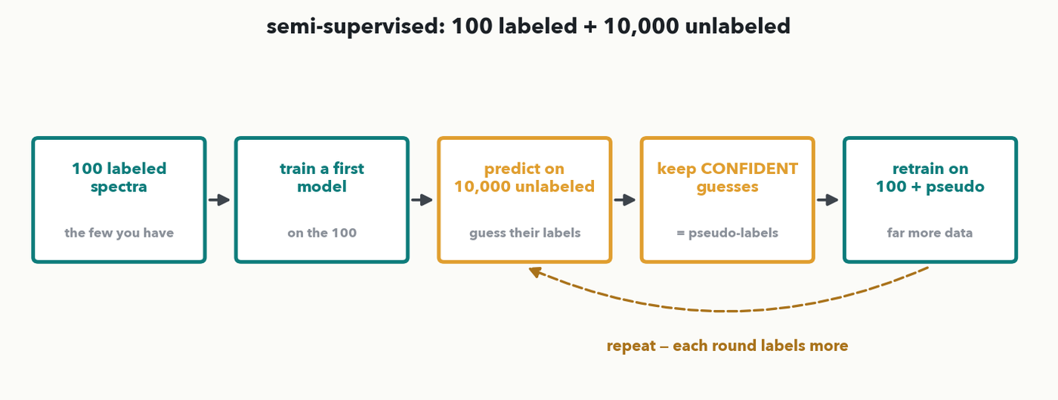
SEMI-SUPERVISED · THE MIDDLE PATH · I-DO
Semi-supervised: 10,000 unlabeled + 100 labeled
The realistic lab case: a FEW labeled examples and a MOUNTAIN of unlabeled ones. Pseudo-labeling bridges them — train on the 100, predict on the 10,000, KEEP the confident guesses as 'pseudo-labels', and retrain on the combined set. Named so you know the term (not deeper); it's the middle path between fully supervised and fully unsupervised.
Notes:
The fourth and last paradigm, deliberately one slide and named-not-derived (per the outcomes). Real labs rarely have zero labels OR plenty — they have a FEW hundred labeled examples and thousands of unlabeled ones. Semi-supervised learning uses both. The workhorse recipe is PSEUDO-LABELING: train a first model on your 100 labeled spectra; use it to predict labels for the 10,000 unlabeled ones; KEEP only the confident predictions as "pseudo-labels"; then retrain on the 100 real plus the confident pseudo-labeled examples, and optionally repeat. The unlabeled mountain, cheaply labeled by the model itself, pulls the decision boundary into better shape. The only goal here is that the room LEAVES knowing the term and where it sits — the middle path between fully supervised (Lectures 1–8) and fully unsupervised (autoencoders, today) — so when a vendor or paper says "semi-supervised," they know what it means. One honest caveat: confident-but-wrong pseudo-labels can reinforce a model's own mistakes, so the confidence filter matters. Next, put all four paradigms side by side for the match.

Slide 27
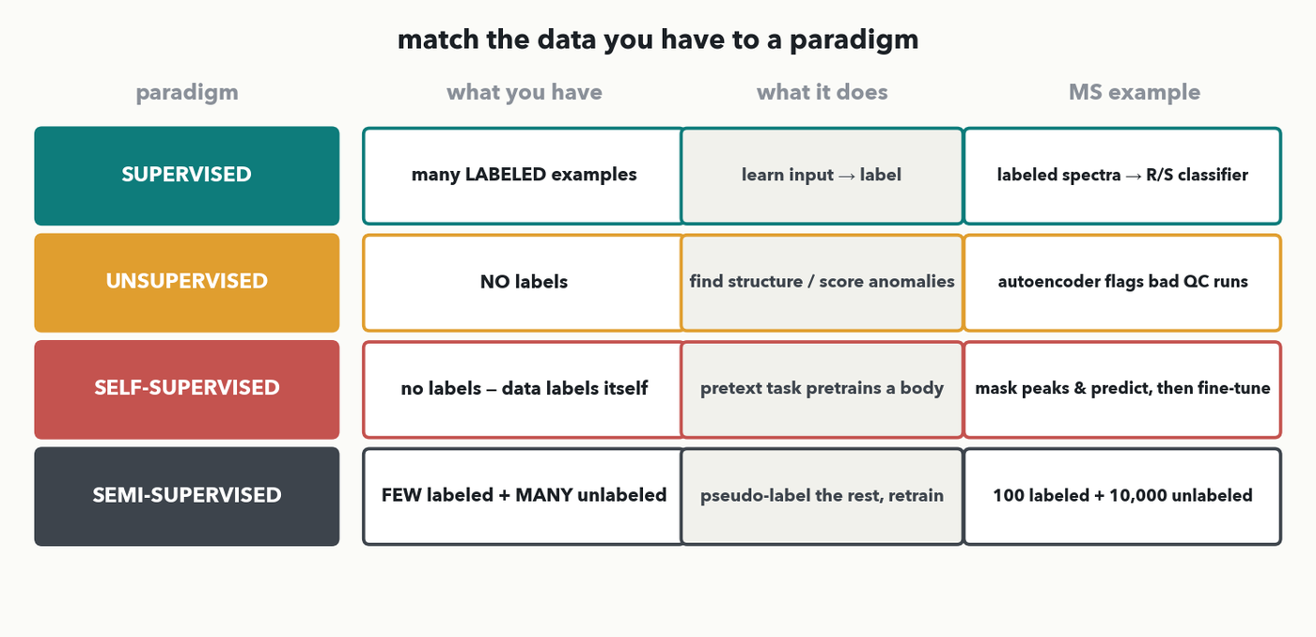
PARADIGMS · THE MATCHING CHART · I-DO
Four paradigms, side by side
One more paradigm:
Reinforcement Learning
(Coming Next)
SUMMARY· Match the DATA YOU HAVE to a paradigm. SUPERVISED: many labeled → learn input→label. UNSUPERVISED: no labels → find structure / score anomalies (autoencoder QC). SELF-SUPERVISED: no labels, the data labels itself → pretext task pretrains a body (mask & predict). SEMI-SUPERVISED: few labeled + many unlabeled → pseudo-label the rest.
Notes:
The single chart the Q2 decision is read off (rule 3). Walk the four rows by the ONE question that decides each: what data do you have? SUPERVISED — you have many LABELED examples, so learn a direct input→label map (every lecture so far; e.g. labeled spectra → resistant/susceptible). UNSUPERVISED — you have NO labels, so find structure or score anomalies (today's autoencoder flagging bad QC runs; clustering). SELF-SUPERVISED — no labels either, but the DATA LABELS ITSELF via a pretext task that pretrains a general body (mask peaks and predict, then fine-tune) — the foundation-model recipe. SEMI-SUPERVISED — you have FEW labels plus MANY unlabeled, so pseudo-label the rest and retrain. I-do one row aloud — the autoencoder QC case is unsupervised — then the room reads ONE realistic scenario off this same chart next slide (Quiz 11 Q2).

Slide 28
PARADIGMS · YOUR TURN (YOU-DO = Q2)
Your turn — use every spectrum
LABELLED
300 spectra
(S / R known)
UNLABELLED
40,000 QC runs
GOAL
a resistance classifier
Use the four-paradigm chart.
(a) Which paradigm uses ALL of your data? ________
(b) Name the specific technique. ________
(c) In one sentence: the failure mode to watch?
CHECKPOINT · Your turn → Quiz 11, Q2. 300 labelled spectra and 40,000 unlabelled QC runs; you want a resistance classifier. Which paradigm uses ALL your data, which technique, and what failure mode do you watch? Worked answer in the notes.
Notes:
YOU-DO = Quiz 11 Q2, straight after the four-paradigm chart. Worked answer: (a) Semi-supervised — a few labels plus many unlabelled examples, so use both (the middle path). (b) Pseudo-labelling: train a first model on the 300 labelled, predict on the 40,000 unlabelled, keep only the confident predictions as pseudo-labels, and retrain on the combined set (optionally repeat). (c) Confident-but-wrong pseudo-labels reinforce the model's own mistakes — a weak early model can poison the pool, so the confidence filter matters. (Pure supervised would throw away 40,000 runs; pure unsupervised would ignore the 300 labels you paid for.)

Slide 29
LECTURE 11 · OVER TO YOUR LAB
Next hour — Lab 4
• Train a VAE on NORMAL spectra, then score held-out spectra by reconstruction error and flag anomalies
• Pick the anomaly threshold — a sensitivity/specificity call, straight back to Lecture 10
• Plot the 2-D latent map, compare it to a plain AE's latent, then SAMPLE and INTERPOLATE between two spectra
• 💬 Discussion D4: what does 'abnormal' look like in YOUR instrument's output, and would reconstruction error catch it before a human does?
PAIR · 2 minutes to finish Quiz 11 solo while Colab boots → we mark it together as Lab 4 opens. The first blanks you'll fill are the latent size and the KL 'tidiness' weight from the VAE recipe — and the anomaly threshold you just learned to set.
Notes:
Hand the final minutes to finishing Quiz 11 and selling Lab 4, which makes this whole hour real. Lab 4 trains a VAE on normal spectra, scores held-out spectra by reconstruction error to flag anomalies (the Q3 mechanic on real data), and has you PICK the threshold — a sensitivity/specificity decision, the explicit callback to Lecture 10. Then it plots the 2-D latent map, compares it against a plain autoencoder's latent (the Q1 picture on real data), and lets you sample latent points and interpolate between two spectra to watch the morph (the interpolation slide, live). The fill-in blanks are the latent size, the KL "tidiness" weight from the VAE recipe, and the anomaly threshold. Run Discussion D4 as the segment close — where would reconstruction error flag a bad run before a human notices — then mark Quiz 11 together as Colab boots.

